Slide 1
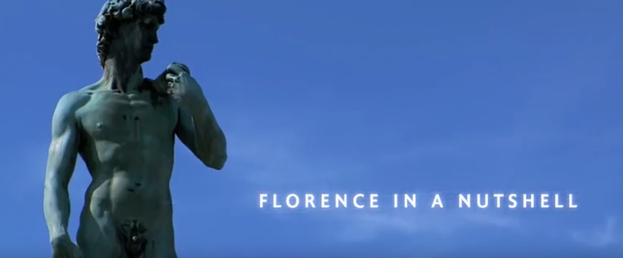
www.turismo.eu
Firenze – Guida turistica alla città
Views: 252.039 (12.10.2018)

Slide 2
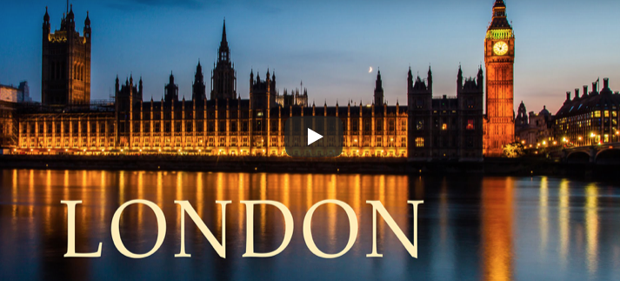
www.turismo.eu
Views: 742.257 (12.10.2018)
https://www.youtube.com/watch?time_continue=5&v=PtWeqZsuzpE

Slide 3
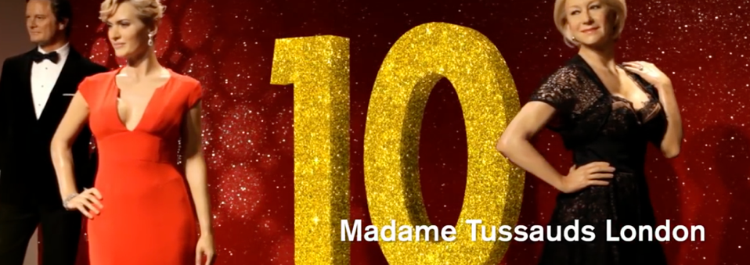
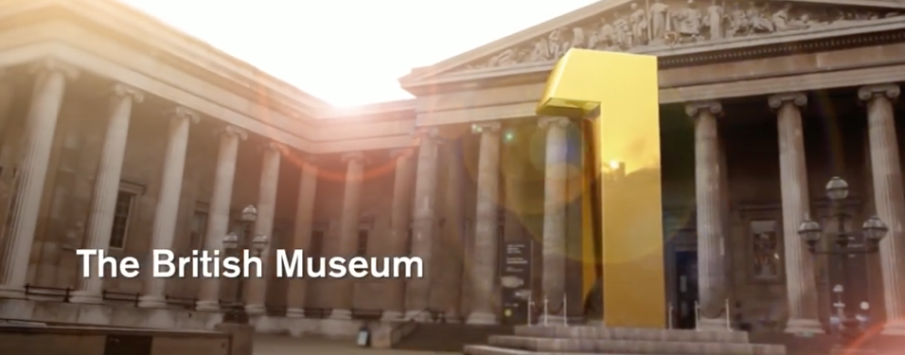
Top 10 London Attractions
Views: 825.094 (12.10.2018)
https://www.youtube.com/watch?v=L0r0VTos_wU

Slide 4
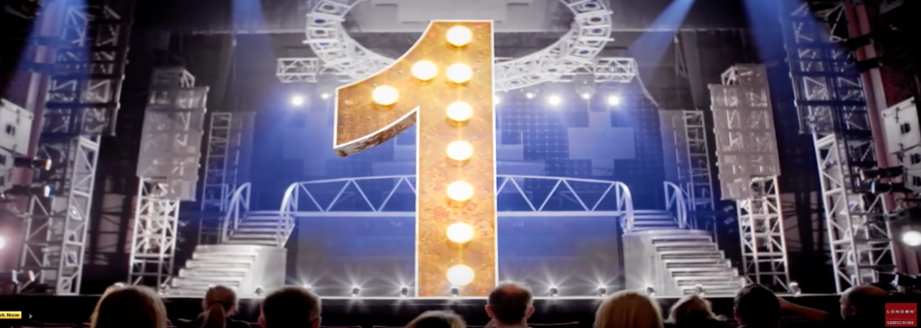
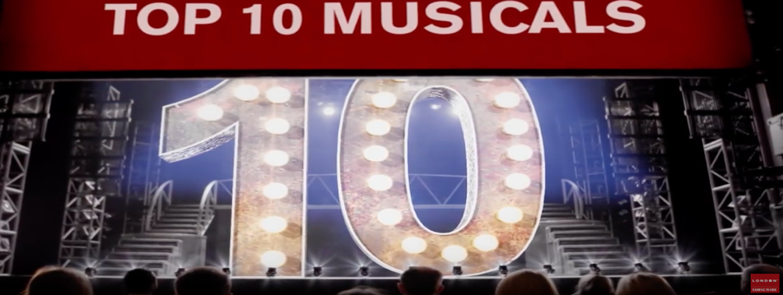
Top 10 London Musicals
Views: 663.473 (12.10.2018)
https://www.youtube.com/watch?v=QA_FSCZQCNM

Slide 5
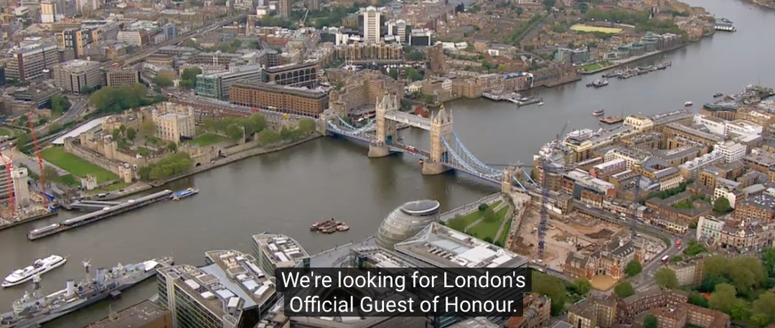
Views: 2.854.110 (12.10.2018)
https://www.youtube.com/watch?v=Ggwg0gBlBM8

Slide 6
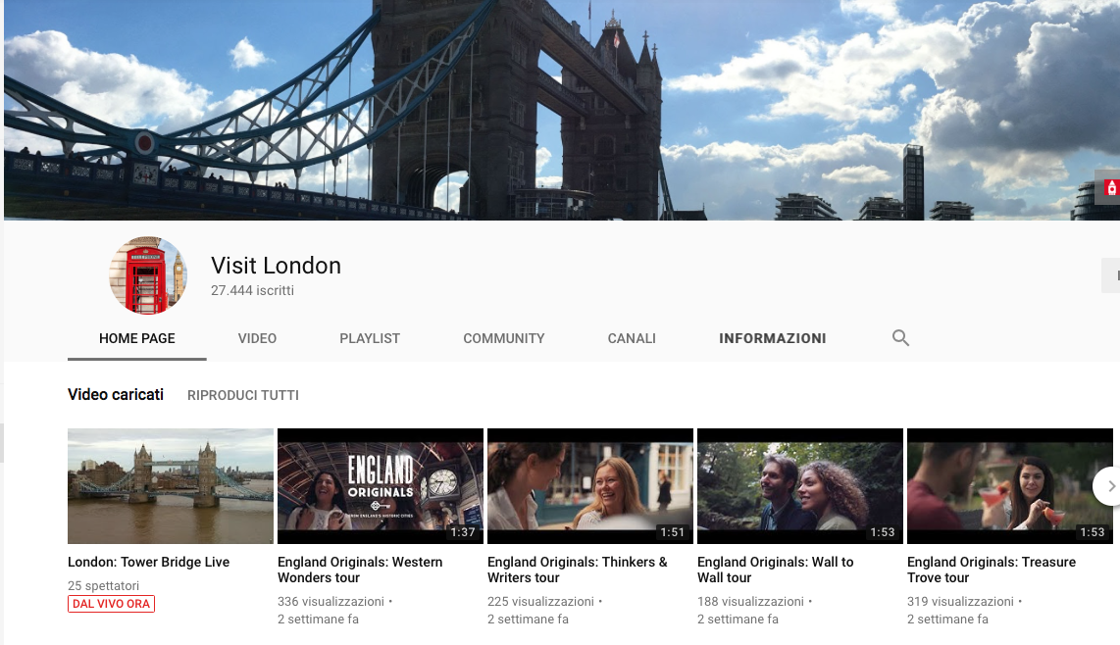

Slide 7
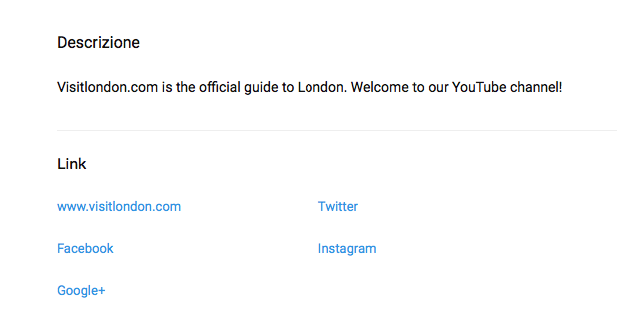

Slide 9
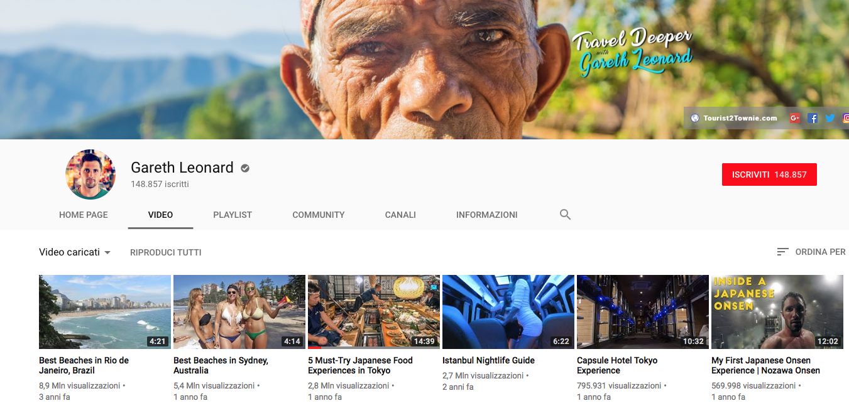

Slide 10
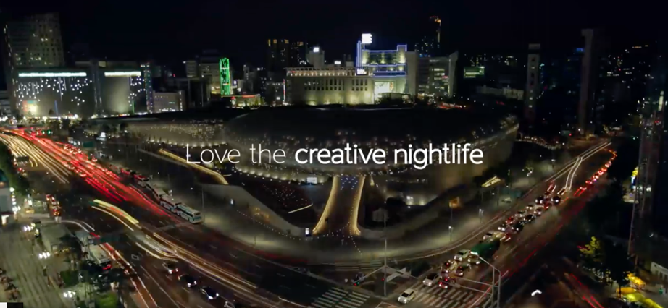
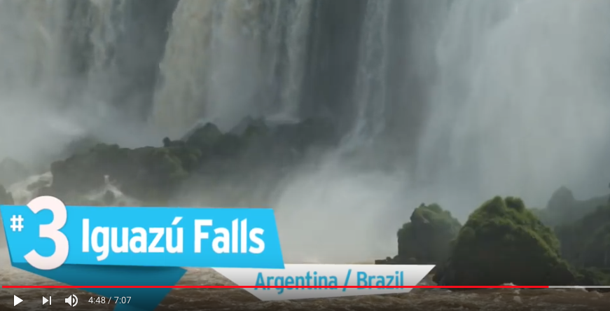
Enjoy your Creative Korea
Views: 44.398.948 (12.10.2018)
Top 10 Most Beautiful Places In The World
Views: 2.087.319 (12.10.2018)

Slide 11
Views: 1.994.181 (12.10.2018)
https://www.youtube.com/watch?time_continue=488&v=tH_rjHT1-W0

Slide 12
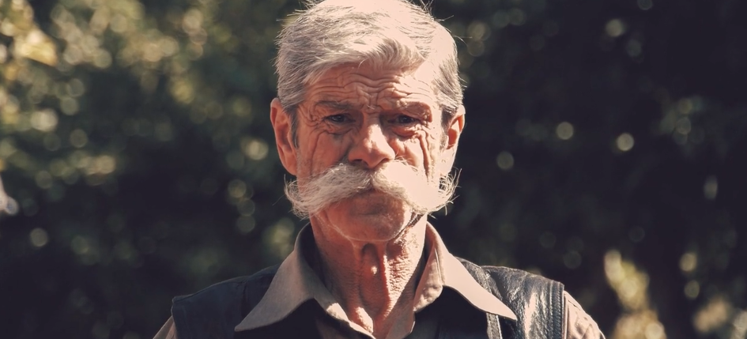
Watchtower of Turkey
Views: 4,8 milioni
https://vimeo.com/108018156

