Slide 1
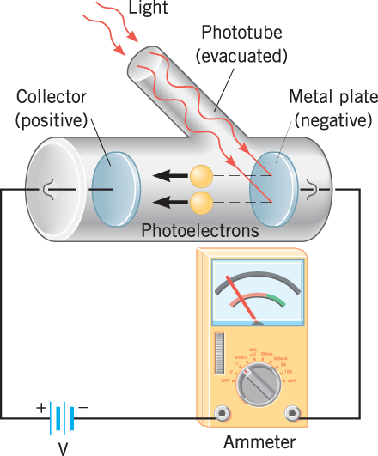
Effetto fotoelettrico

Slide 2
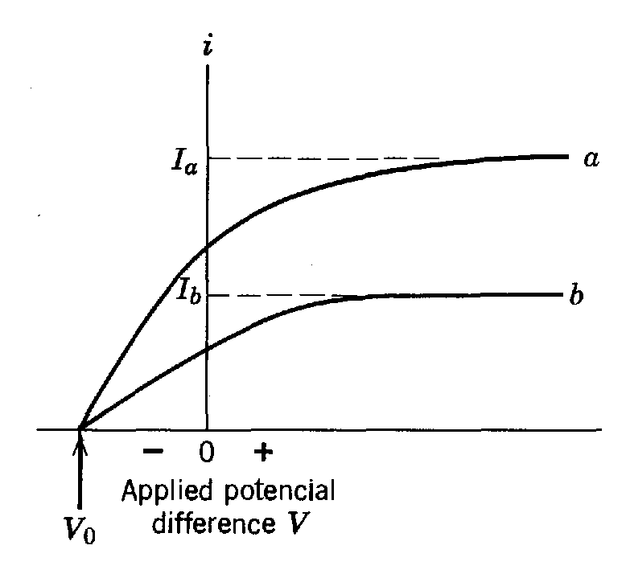

Slide 3
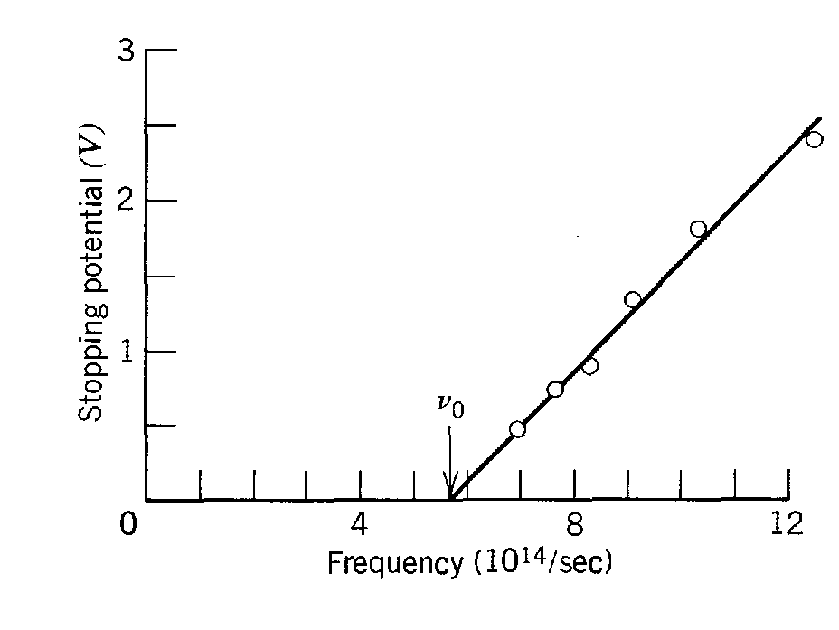

Slide 4
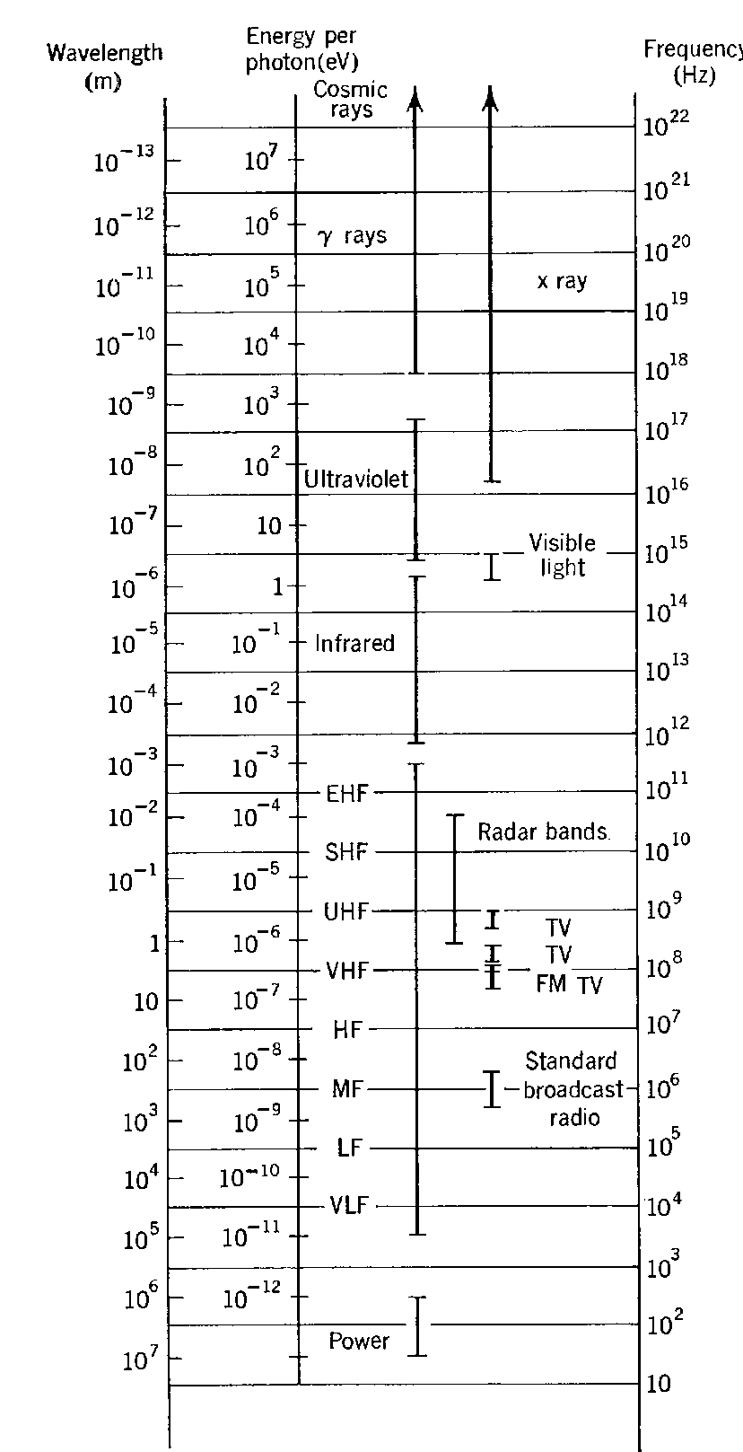
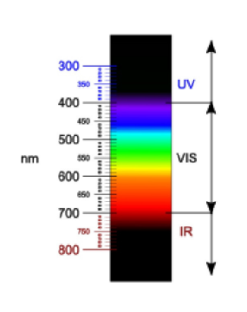
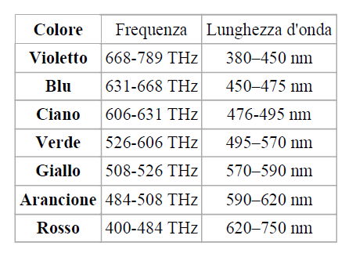

Slide 5
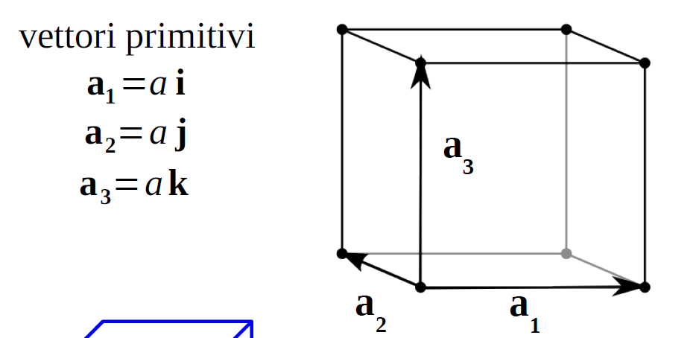
Reticolo cubico semplice

Slide 7
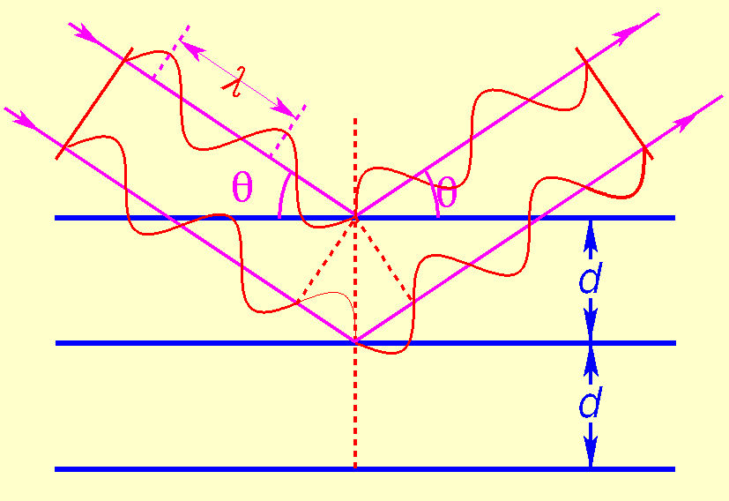
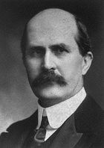
Sir William Henry Bragg:
William Henry and William Lawrence Bragg
(father and son) found a simple interpretation
of von Laue’s experiment.
They assume that each crystal plane reflects radiation as a mirror and analyze this situation for cases of constructive and destructive interference.
Bragg’s law
Noble prize 1915!
Conditions for reflection:

Slide 8
Derivation of Bragg’s law
θ
θ
d_{hkl}
θ
x
Path difference Δ= 2x => phase shift
Constructive interference if Δ=nλ
This gives the criterion for constructive interference:
Bragg’s law tells you at which angle θ_{B} to expect maximum diffracted intensity for a particular family of crystal planes.
For large crystals, all other angles give zero intensity.

Slide 9
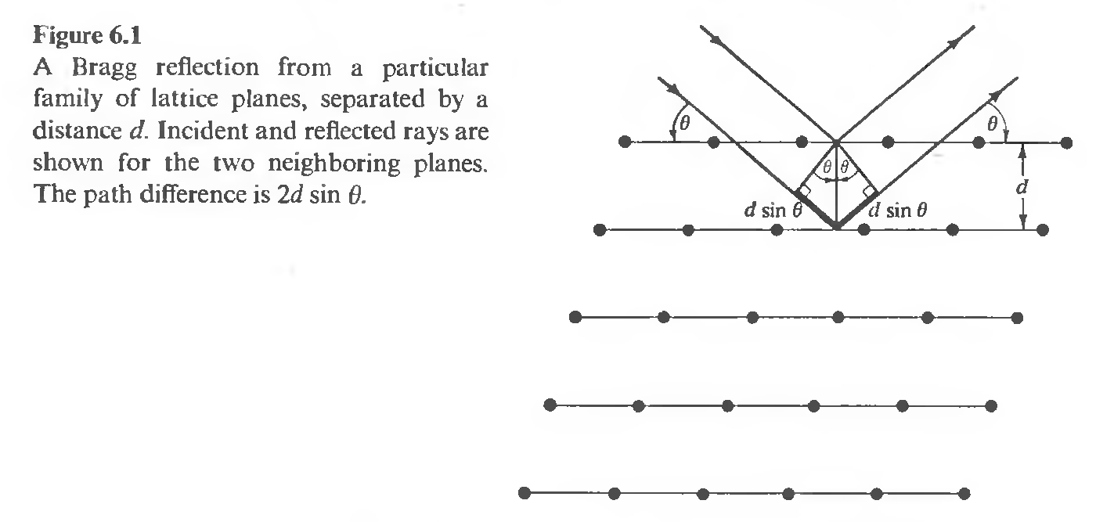
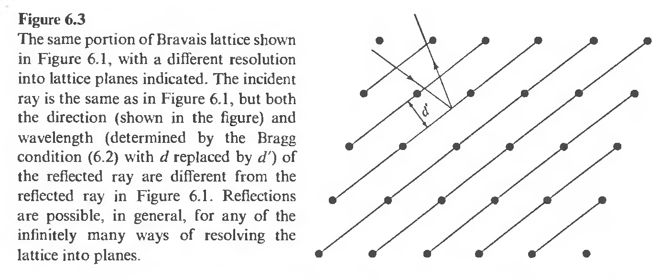

Slide 10
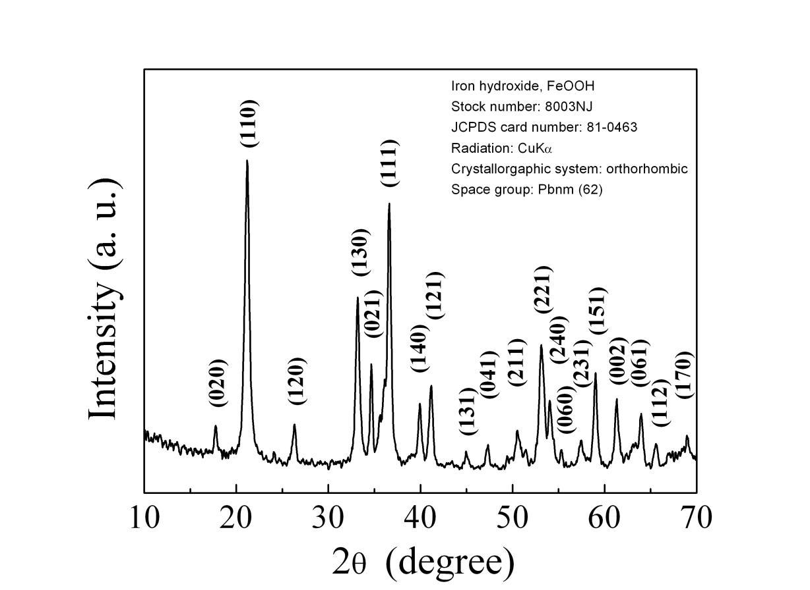
Example: Diffraction Patterns
Each peak represents the solution to Bragg’s law for known radiation wavelength (λ = 0.154nm)
The unique relationship between such patterns and crystal structures provide a powerful tool for identification of the phase composition of powders and polycrystalline materials.

Slide 11
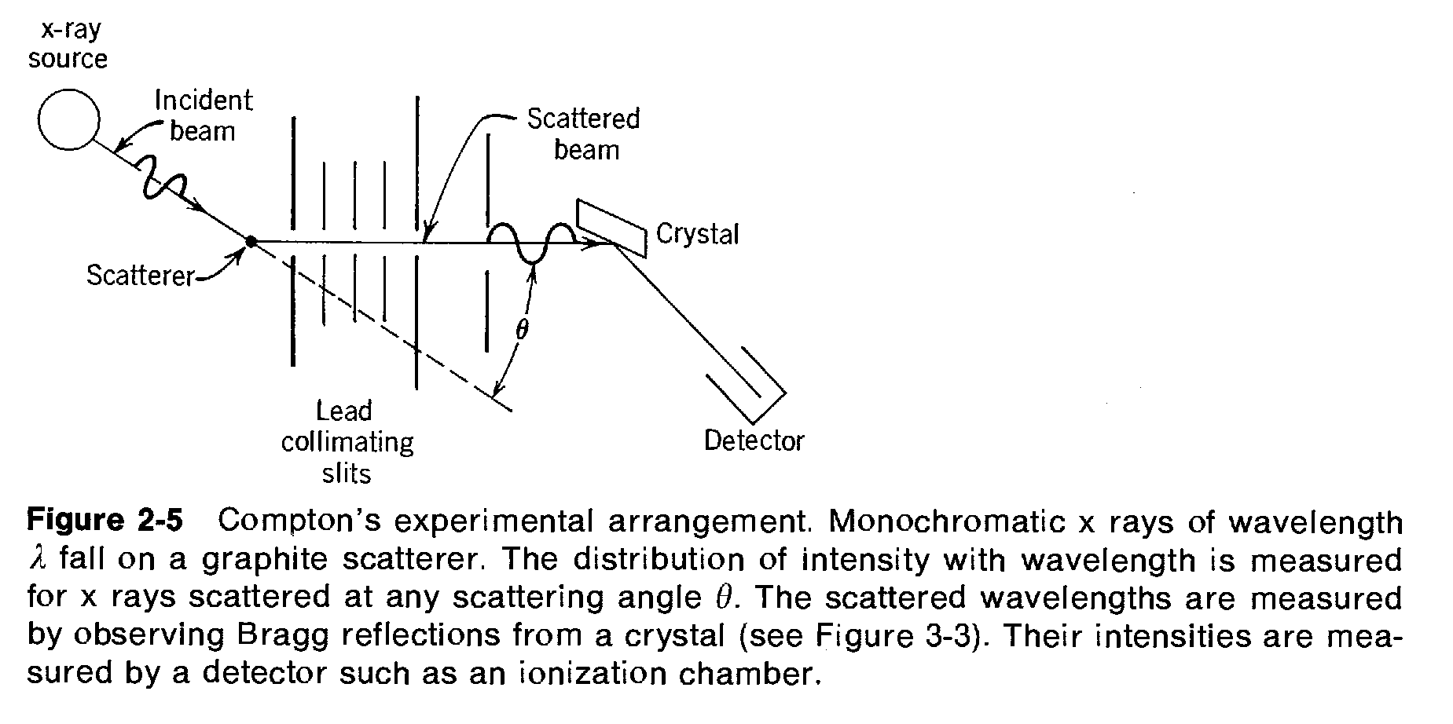
Effetto Compton

Slide 12
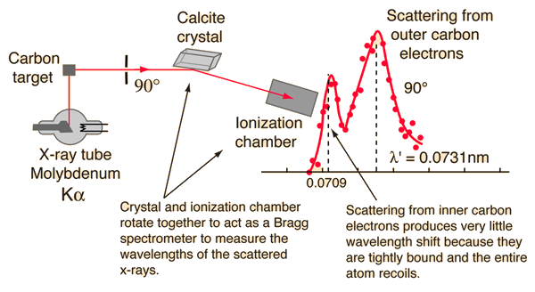
Compton's original experiment made use of molybdenum K-alpha x-rays, which have a wavelength of 0.0709 nm.
These were scattered from a block of carbon and observed at different angles with a Bragg spectrometer.
The spectrometer consists of a rotating framework with a calcite crystal to diffract the x-rays and an ionization chamber for detection of the x-rays.
Since the spacing of the crystal planes in calcite is known,
the angle of diffraction gives an accurate measure of the wavelength.

Slide 13
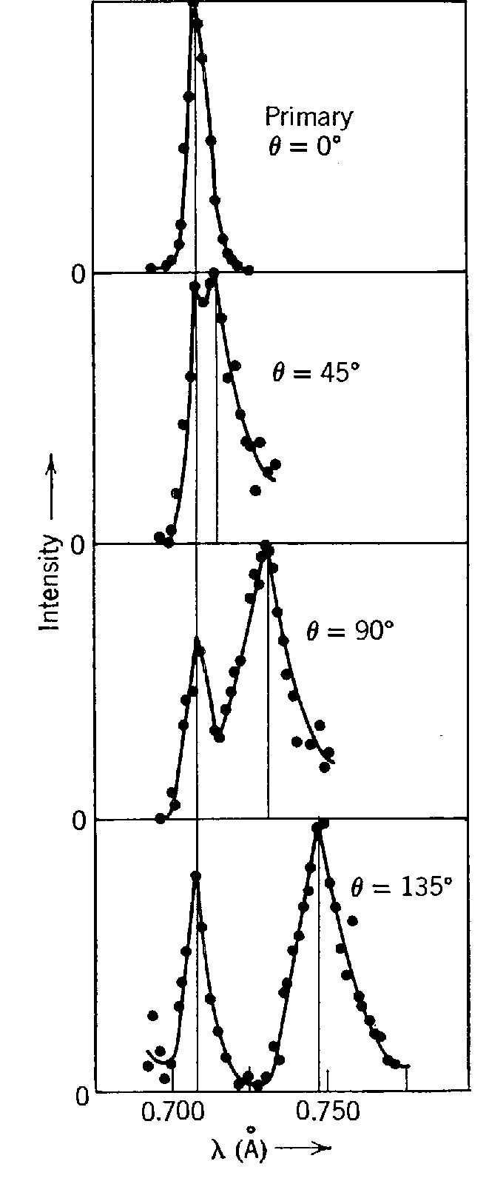

Slide 14
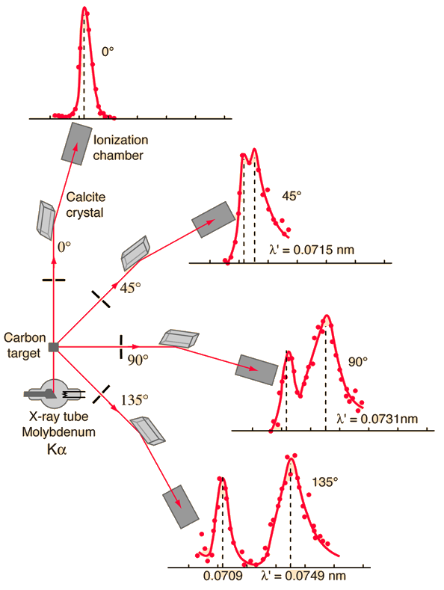

Slide 15
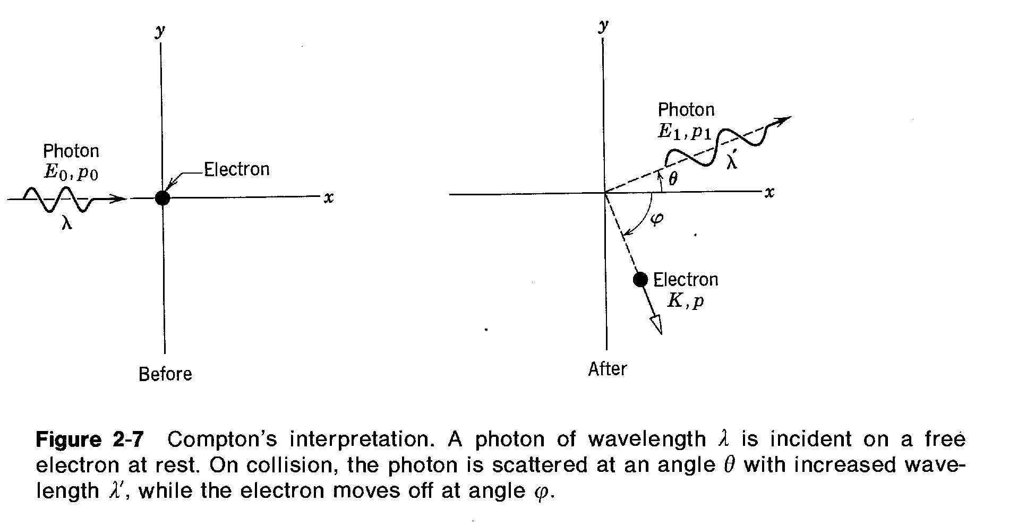

Slide 16
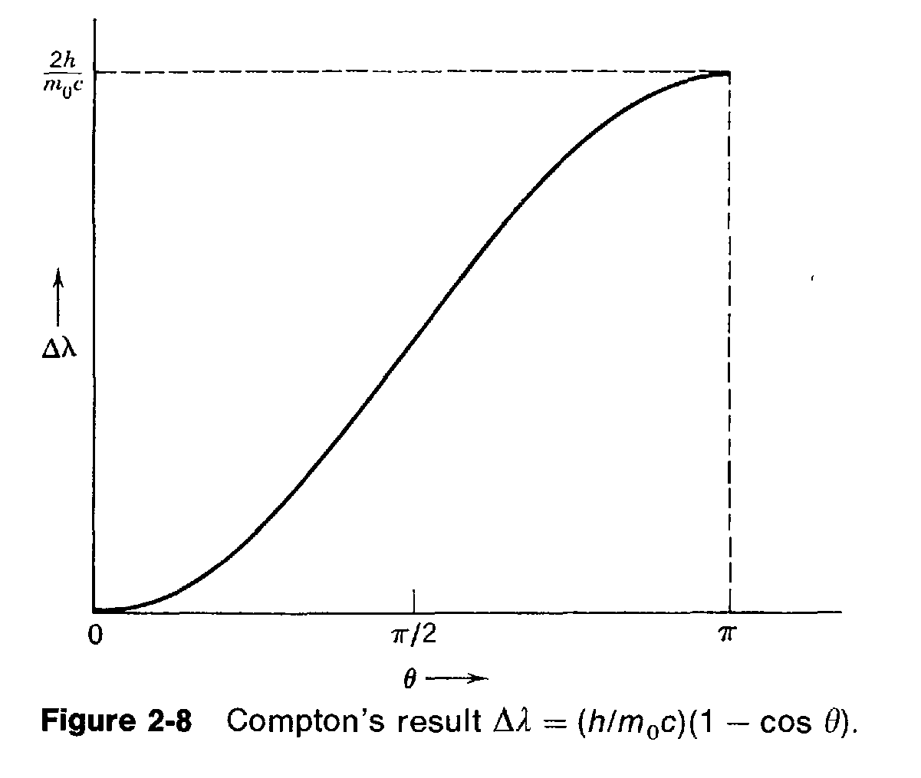

Slide 17
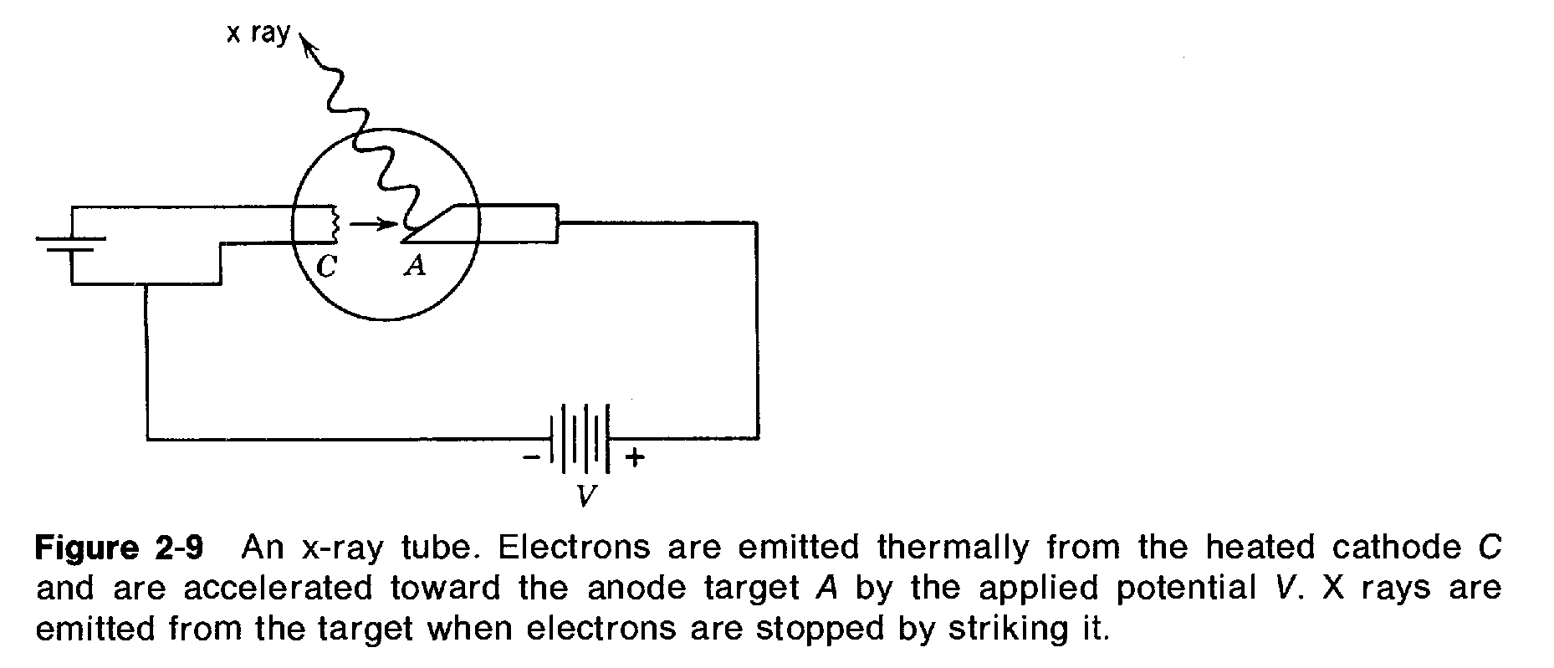

Slide 18
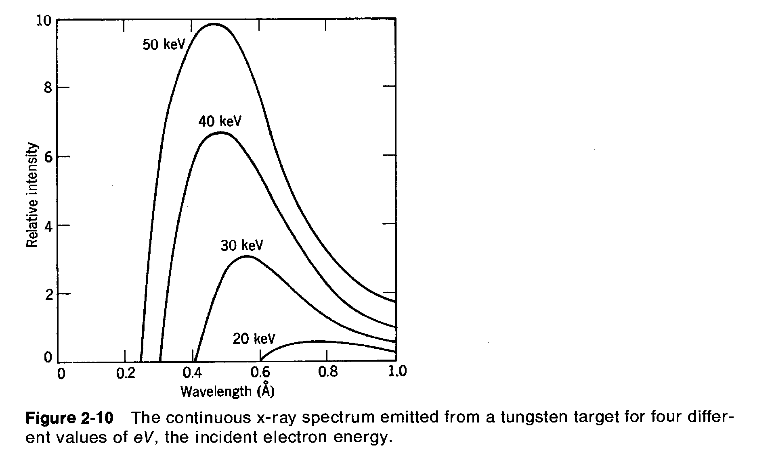

Slide 20
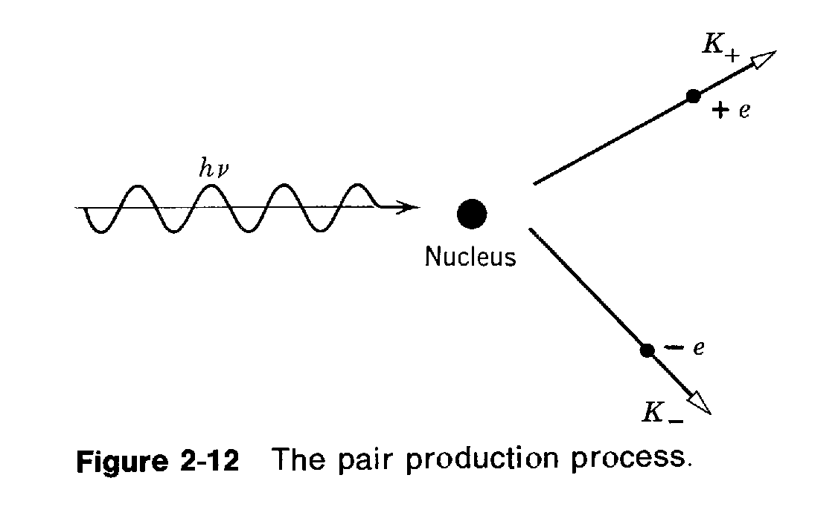

Slide 21
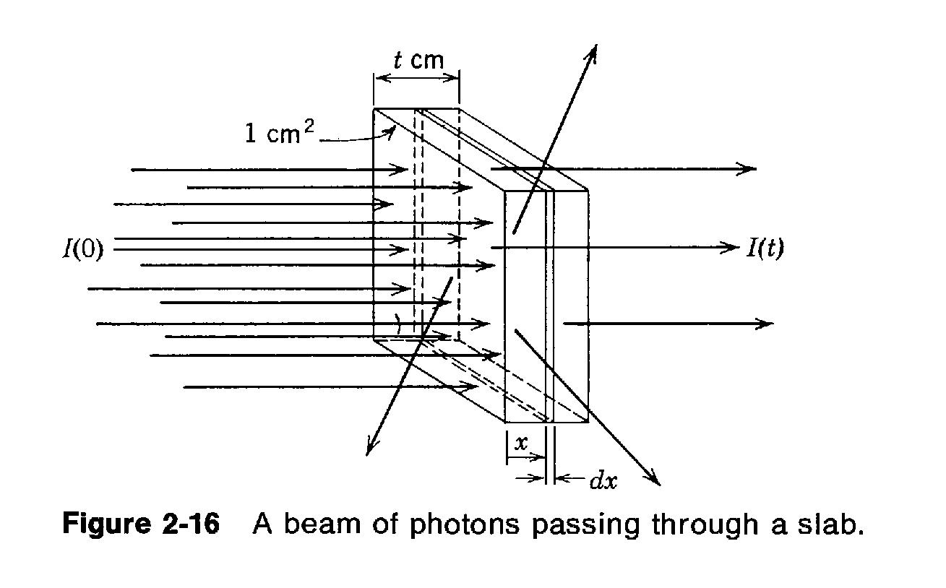

Slide 22
