Slide 1


N
1

Slide 2
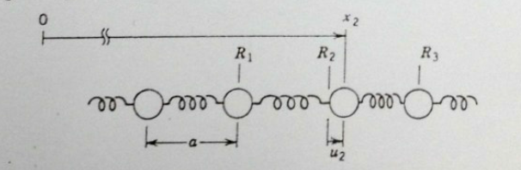

Slide 3


Slide 4
