Slide 1
Lezione scienze motorie del 5-5-2020
Considerazioni sull’obesità
Comprende tutte le fasce di età

Slide 2
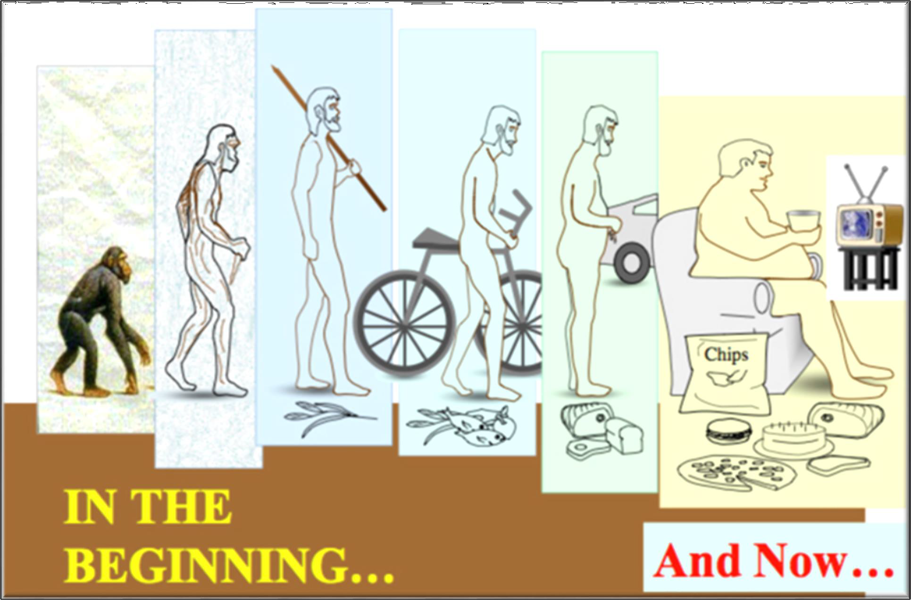
The evolution of men …

Slide 3
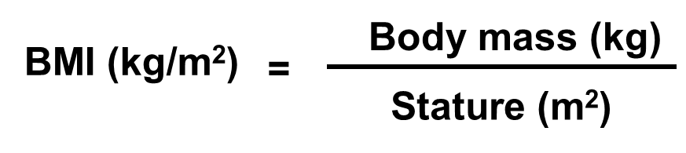
Definition of obesity from BMI
(kg/m²)
Boys
(kg/m²)
Girls
32
32
31
30
31
30
30
30
29
29
28
Obese
28
Obese
27
27
26
25
Overweight
26
Overweight
5
25
24
2
24
23
25
23
22
21
22
21
20
20
19
19
18
18
17
17
16
16
0 1 2 3 4 5 6 7 8 9 10 11 12 13 14 15 16 17 18 19
Age (years)
0 1 2 3 4 5 6 7 8 9 10 11 12 13 14 15 16 17 18 19
Age (years)
(Lazzer et al., IJO 2005)

Slide 4
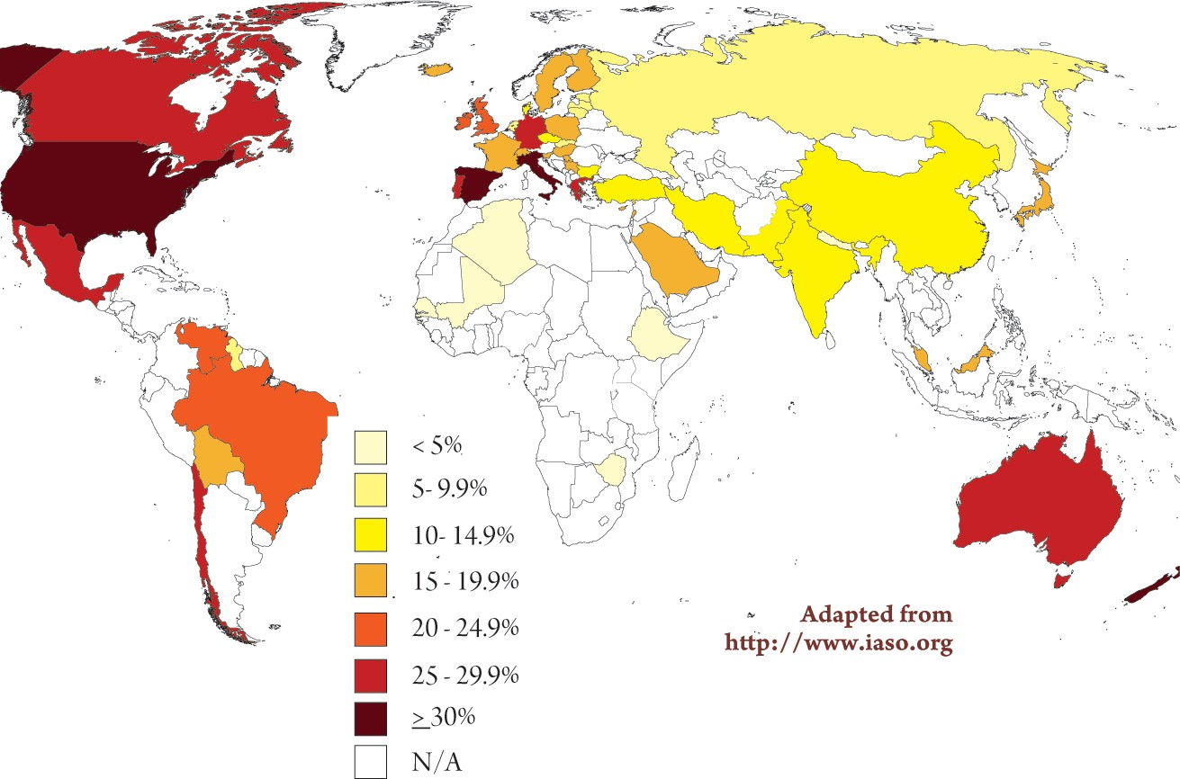
Global prevalence of overweight children (2005)
(Adapted from http://www.easo.org)

Slide 5














































Europe prevalence of overweight children (2010)
No Data
(Adapted from http://www.easo.org)
<10%
10%-14%
15-19%
>20%

Slide 6
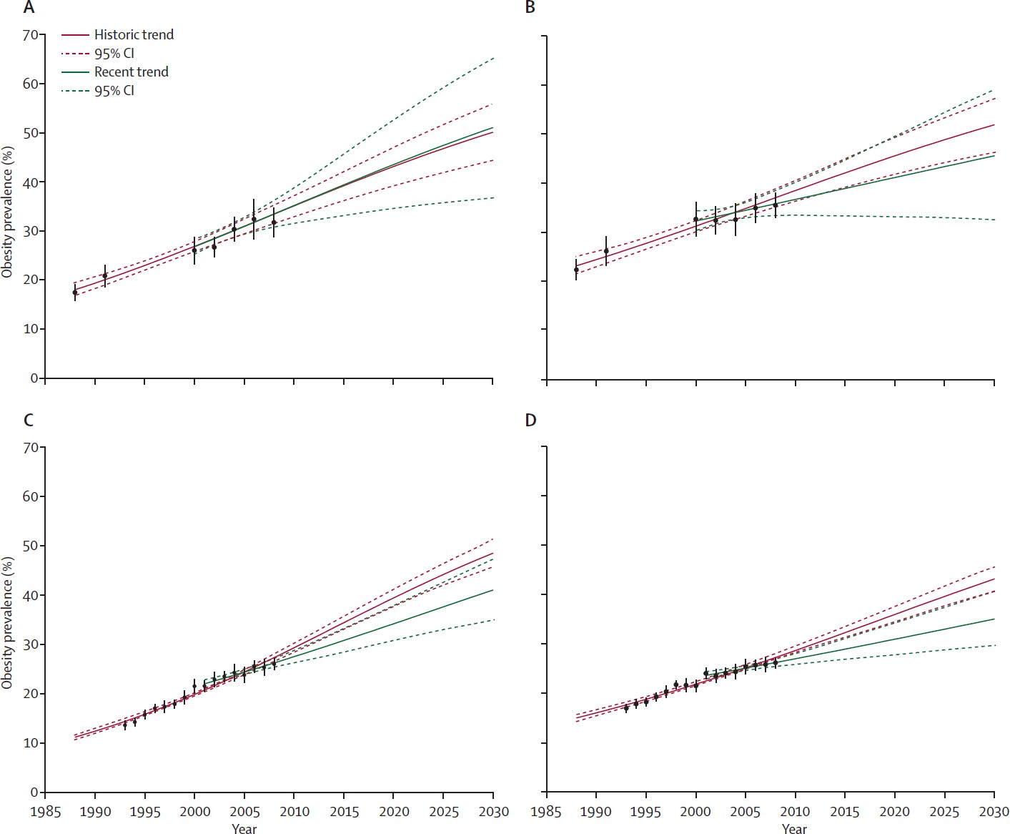
Trends in obesity prevalence in US and UK…
US Boys US Girls
UK Boys
UK Girls
(Wang CY et al., Lancet, 2011)

Slide 7
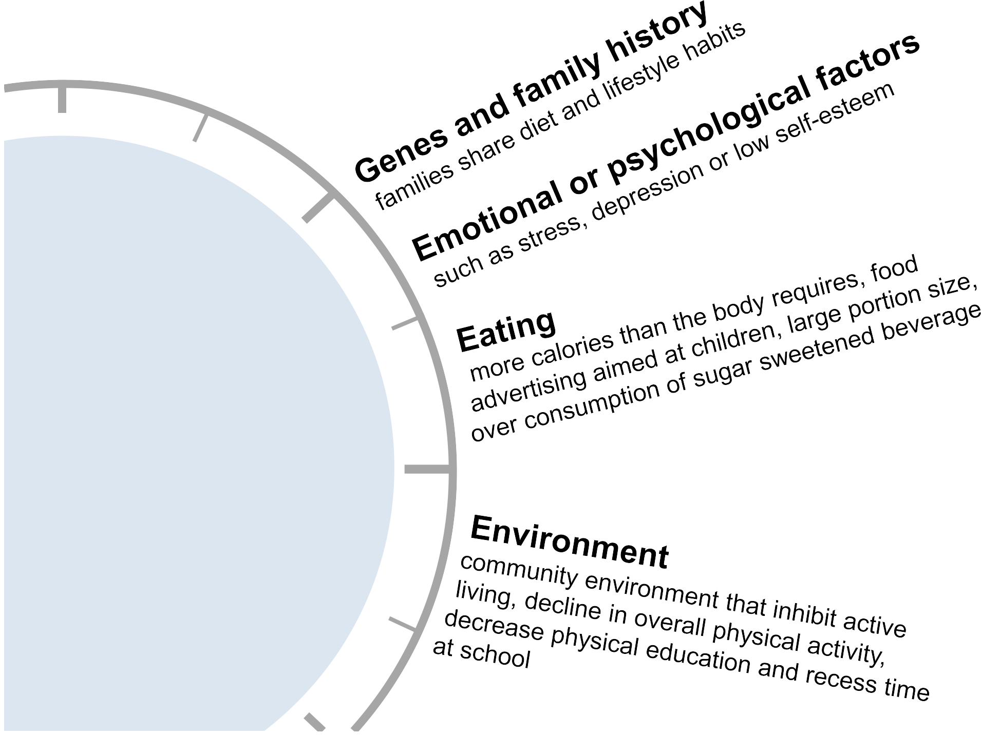
Causes of obesity
Causes of obesity
There’s usually not just one cause of obesity. Multiple factors may interact and contribution to the condition
Lack of exercise

Slide 8
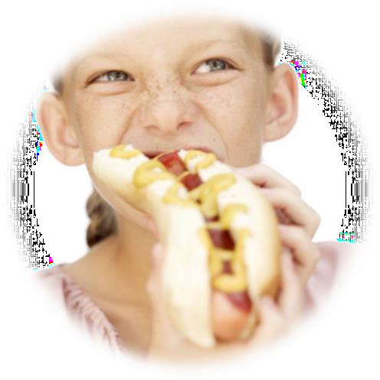
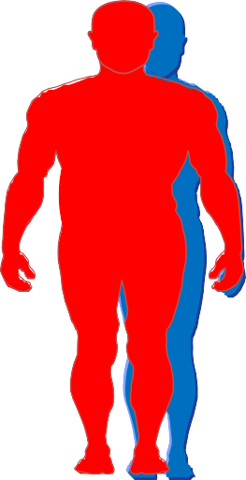

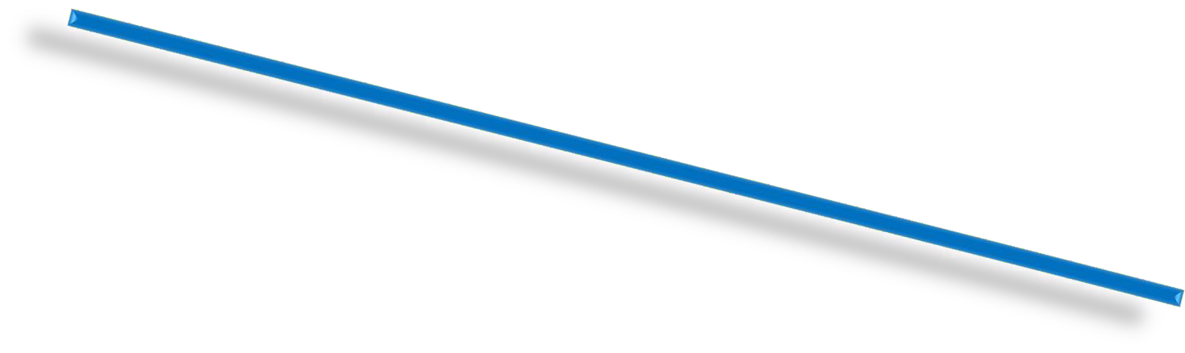

Causes of obesity
CALORIES IN
CALORIES OUT
Calories IN are 2% > Calories OUT
(2500 kcal/day → 50 kcal/day)
In one year body weight increase by 2.5 kg !

Slide 9
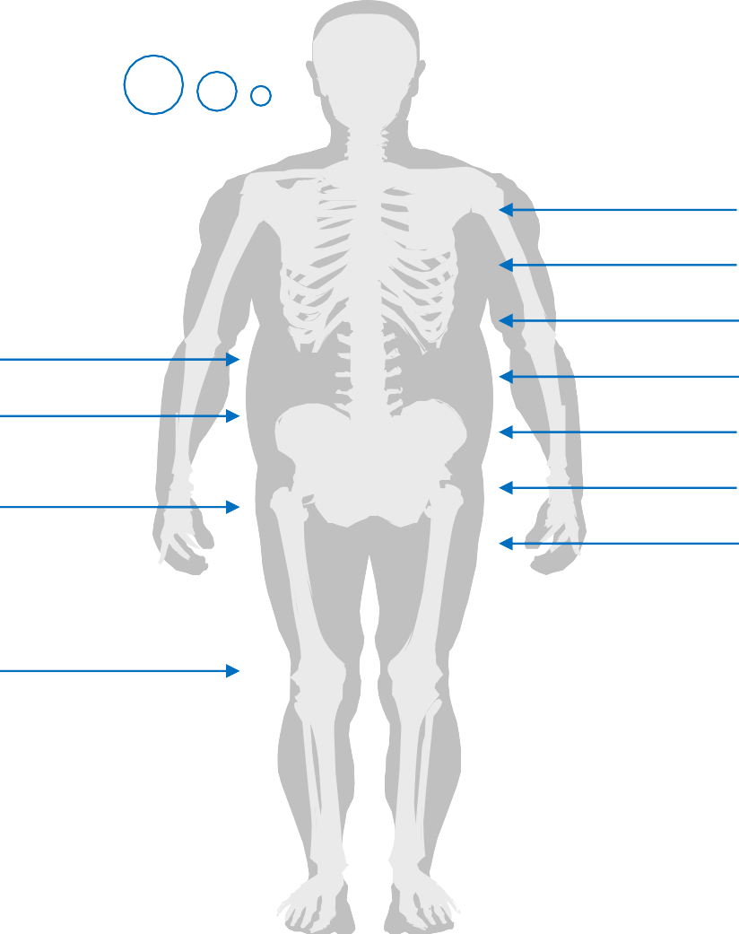
Consequences of obesity
Poor self image Social isolation Binge-eating disorder
Hypertension Sleep apnea Hypoventilation Hyper insulinemia Insulin resistance Dysmenorrhea Early puberty
Back pain
Coxa vara
Slipped capital femoral epiphyses
Genu valgum

Slide 10
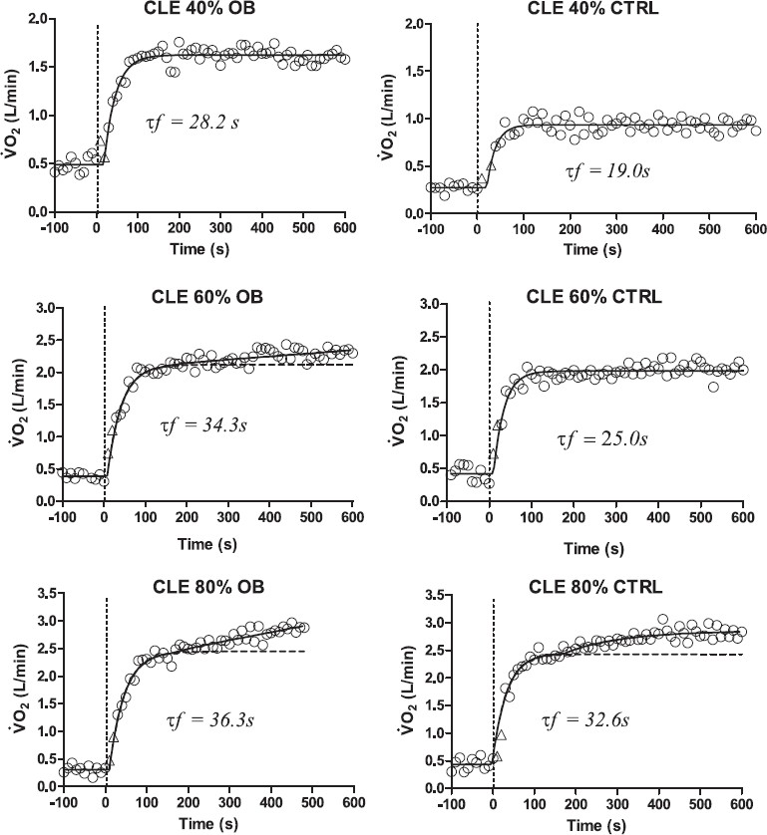
Consequences of obesity
CLE: Costant Load Exercise OB: Obese
CTRL: Controlo group
X% of V’O₂max
Higher slow component in OB adolescents should negatively affect exercise tolerance and suggest an impairment of skeletal muscle oxidative metabolism.
(Salvadego et al., JAP 2010)

Slide 11
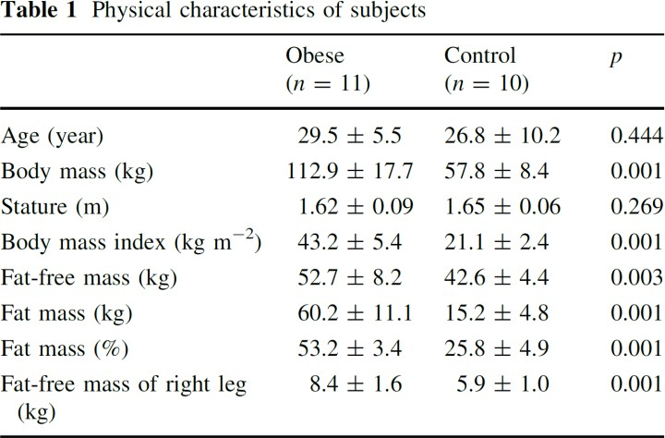
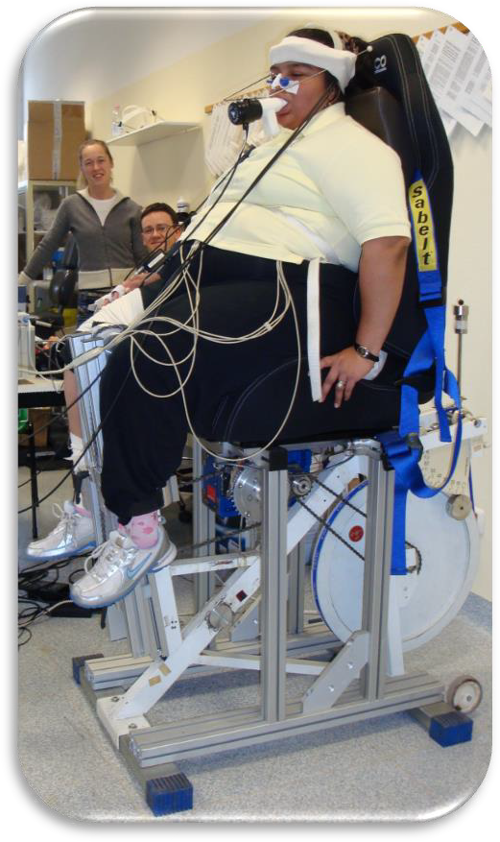
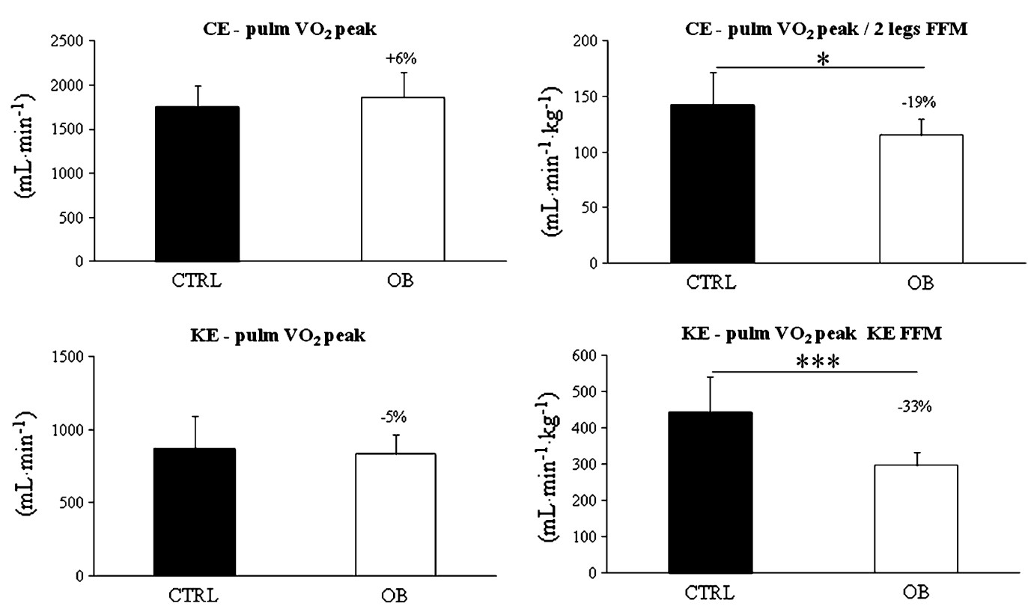
Consequences of obesity
160 W
130 W
160 W
130 W
49 W
48 W
49 W
48 W
(Lazzer et al., EJAP 2013)

Slide 12
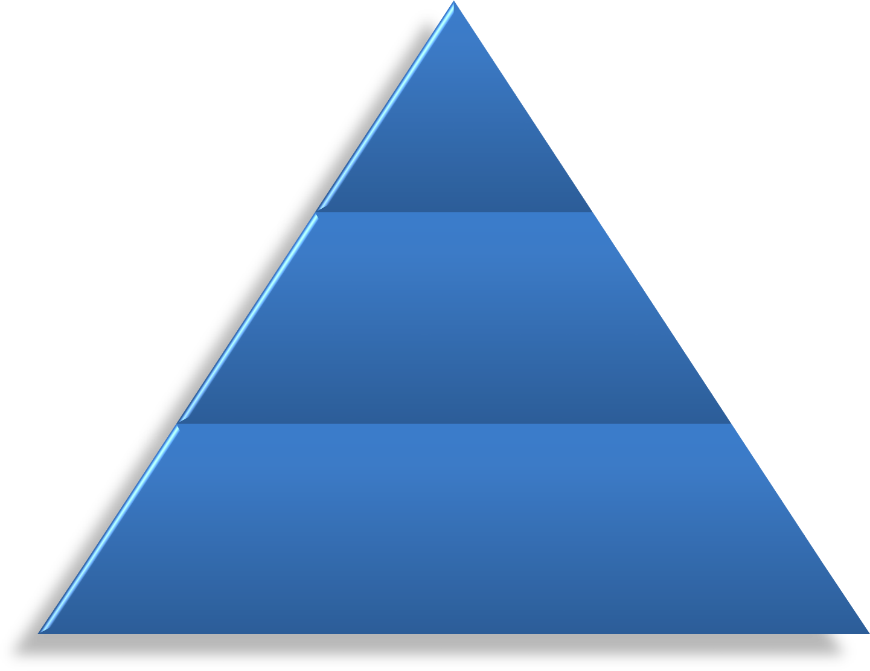
Treatments
Surgery
Pharmaceutical therapy
Lifestyle modification: Diet Physical Activity

Slide 13
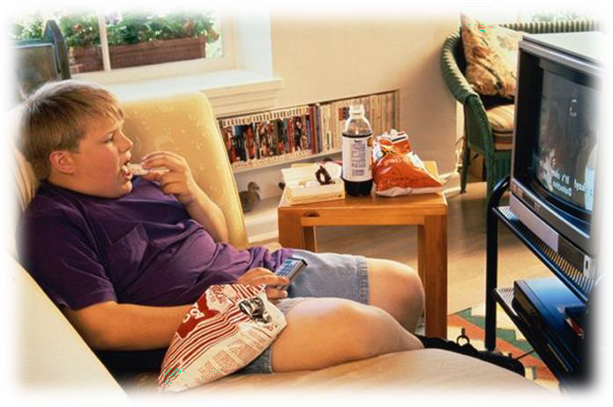


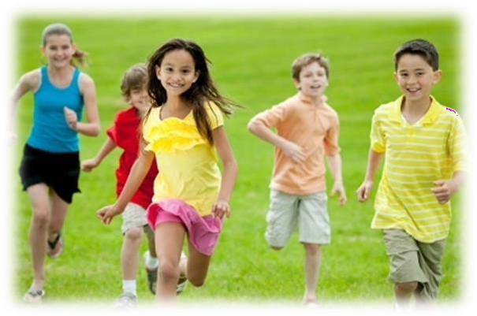
Treatments
Physical activity
…which represents 15 to 35 % of daily energy expenditure

Slide 14
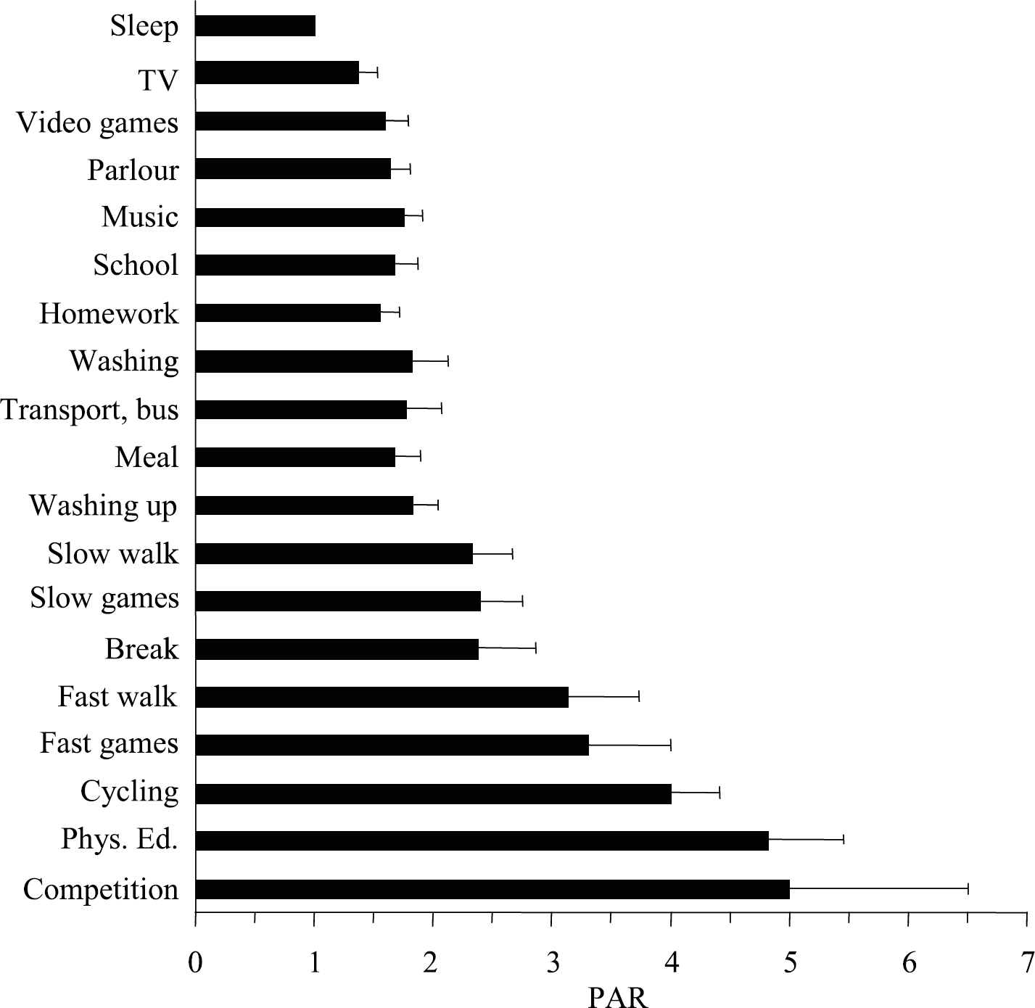
Daily energy expenditure
(mean ± sd)
MET
Energy cost (Metabolic Equivalent, MET) of activities in obese adolescents in free-living conditions.
(Lazzer et al., JEI 2009)

Slide 15
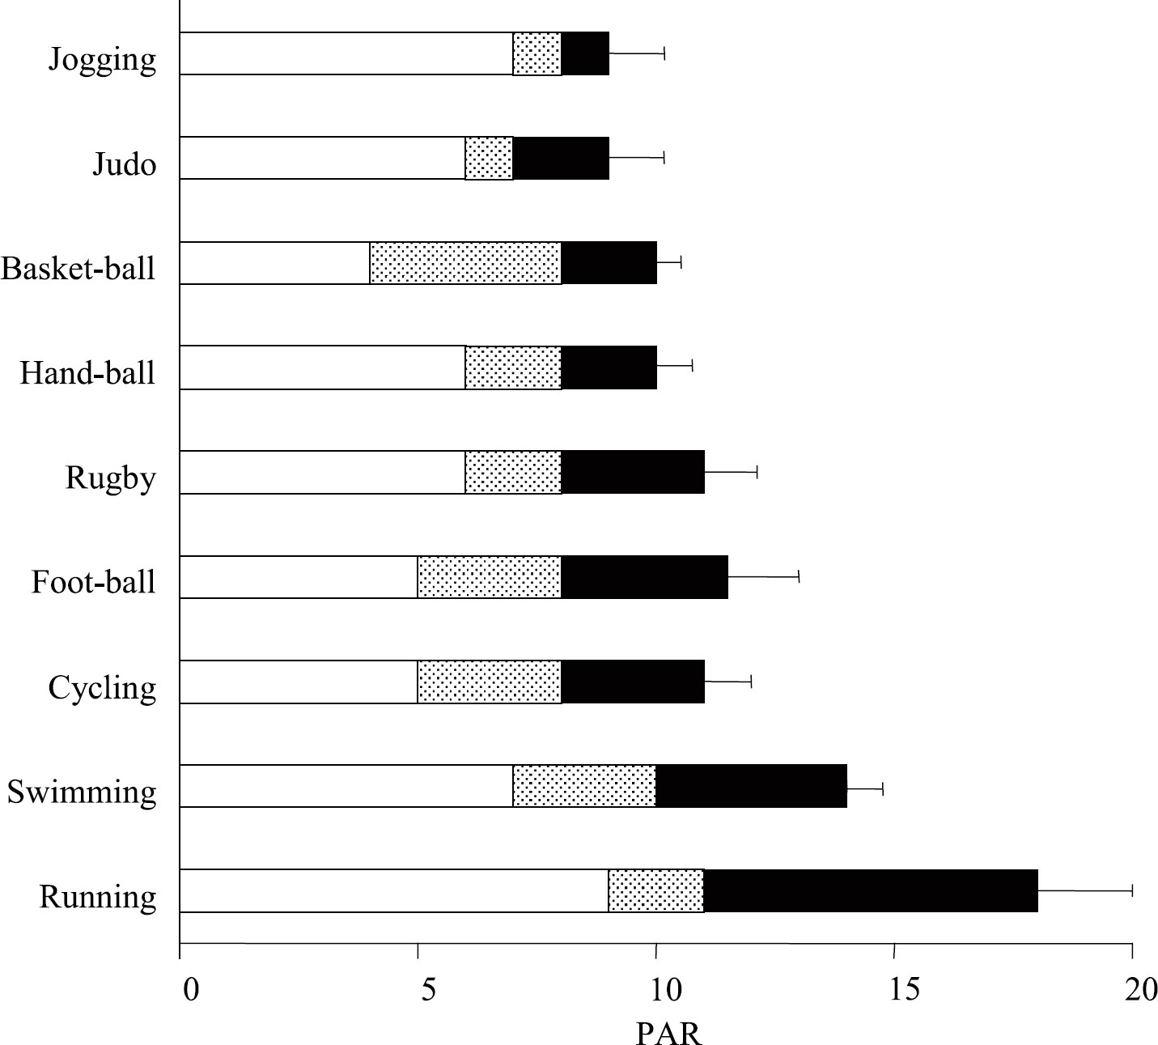
Daily energy expenditure
(mean ± sd)
MET
Energy cost (Metabolic Equivalent, MET) of sport activities at light (□), moderate (■), and high intensity (■).
(Vermorel et al., RND 2005)

Slide 16
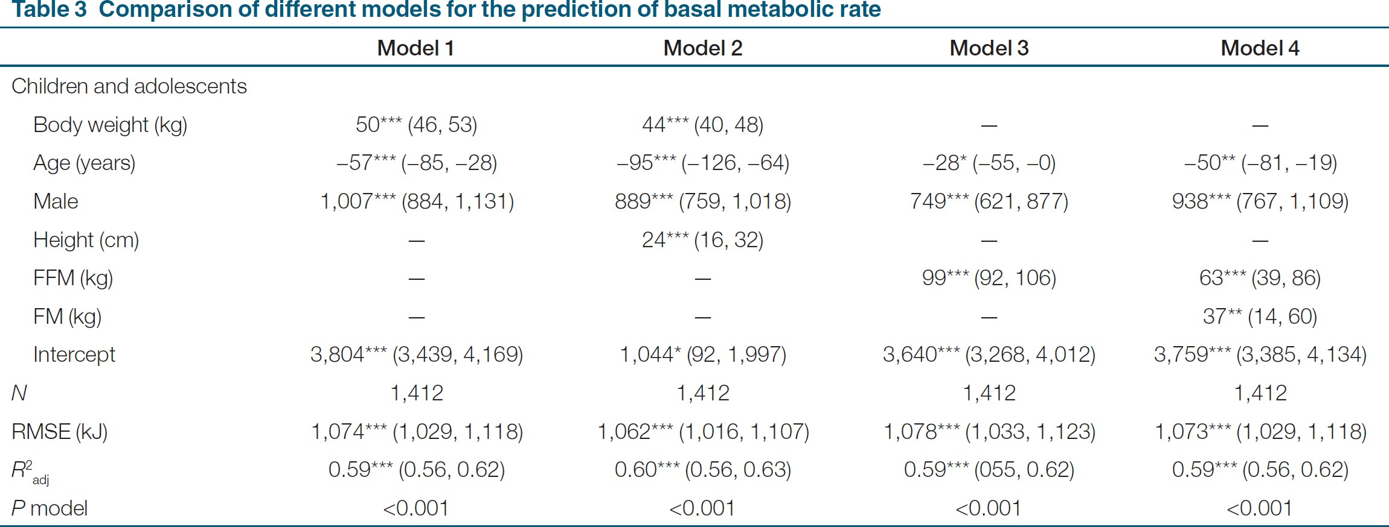
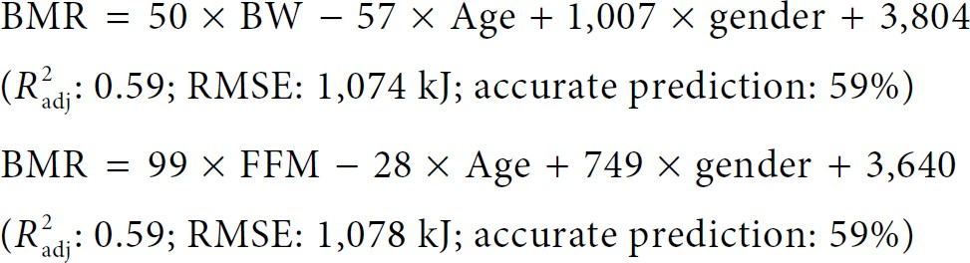
Basal metabolic rate
Predicting equation for Basal Metaboic Rate in children and adolescents
(Lazzer et al., Obesity 2009)

Slide 17
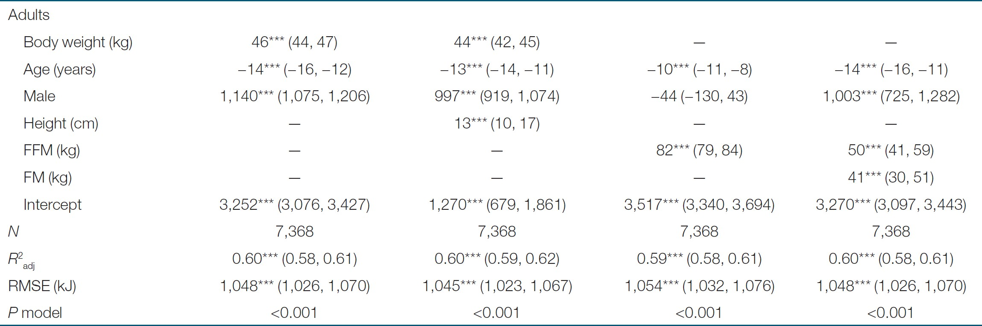
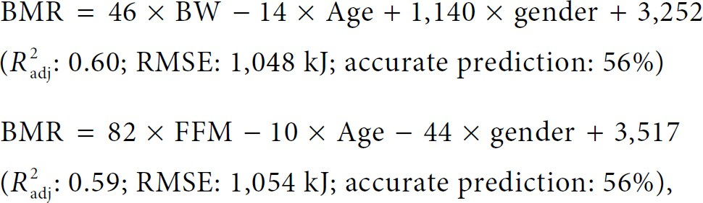
Basal metabolic rate
Predicting equation for Basal Metaboic Rate in adults
(Lazzer et al., Obesity 2009)

Slide 18
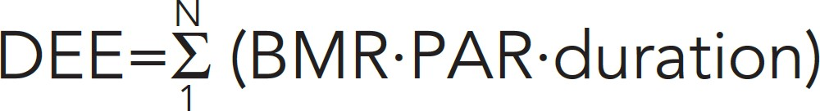
Daily energy expenditure
(BMR · MET · duration)
where N corresponds to the number of activities, DEE (kcal), BMR (basal metabolic rate, kcal/min), and duration of activity in min.
We estimate that a boy with a BMR of 1.3 (kcal/min):
sleeps for 540 min (MET: 0.93)
dresses for 60min (MET: 2.05)
eats for 120min (MET: 1.75)
stays at school for 420 min (MET: 1.65)
watches television for 180min (MET: 1.57)
walks for 60min (MET: 5.46)
cycles for 60min (MET: 3.75)
burns 3060 kcal/day
(Vermorel et al., RND 2005)

Slide 19




Frequency
FITT formula
How often you exercise
Intensity
How hard you exercise
Time
How long you exercise
Type
What kind of exercise you choose

Slide 20
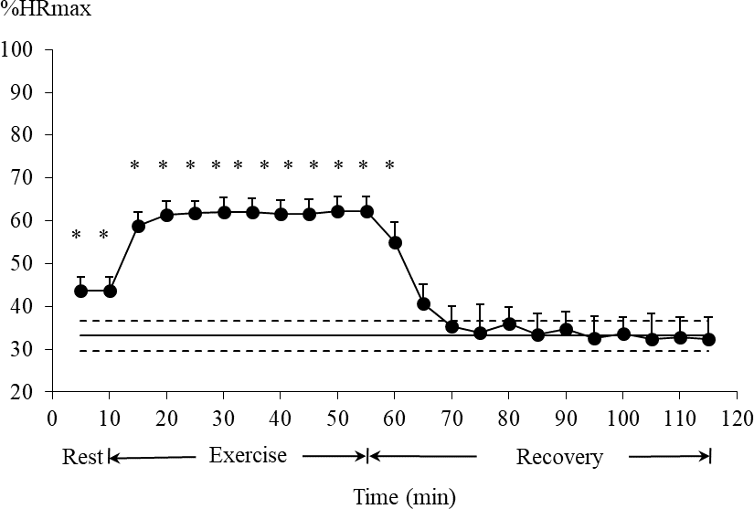
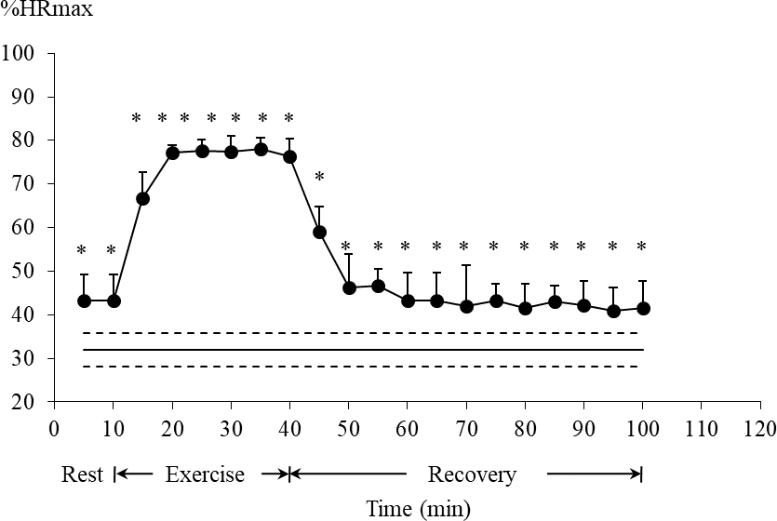


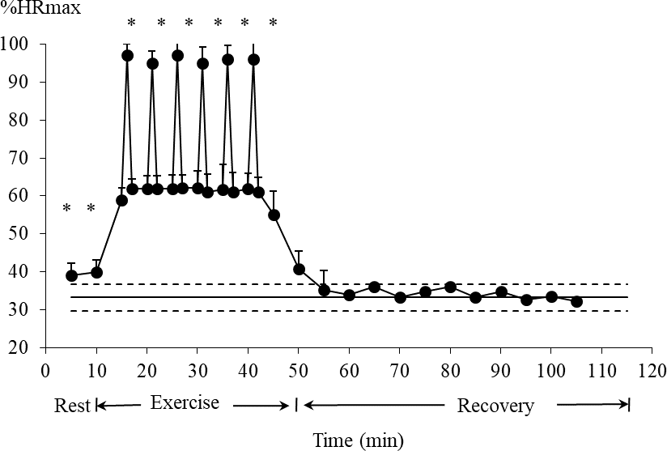

Intensity
How hard you exercise
Low-intensity Continuous Training
High-intensity Continuous Training
45 min
30 min
High-intensity Interval Training
30 min
(Lazzer et al., JEI 2017)

Slide 21
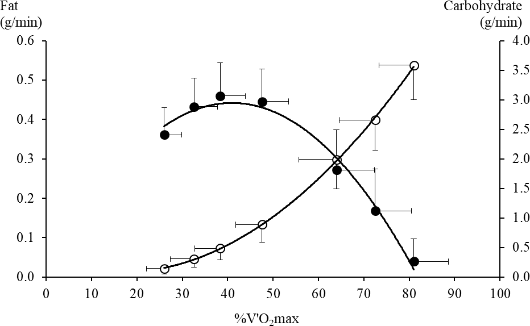
Intensity
How hard you exercise
Fat
Carbohydrate
(Lazzer et al., JEI 2010)

Slide 22
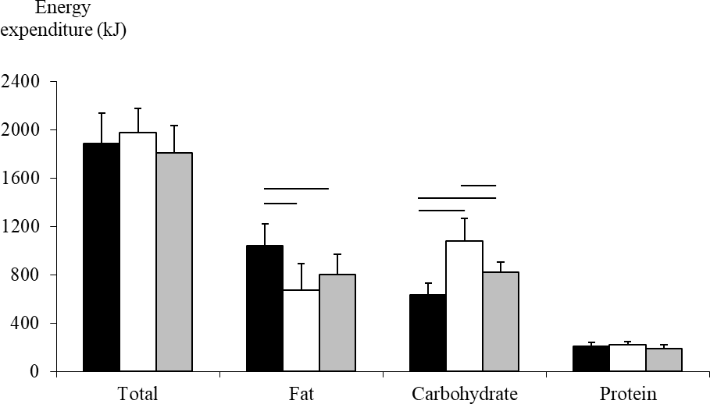
Intensity
How hard you exercise
Low-intensity Continuous Training
□ High-intensity Continuous Training
High-intensity Interval Training

Slide 23
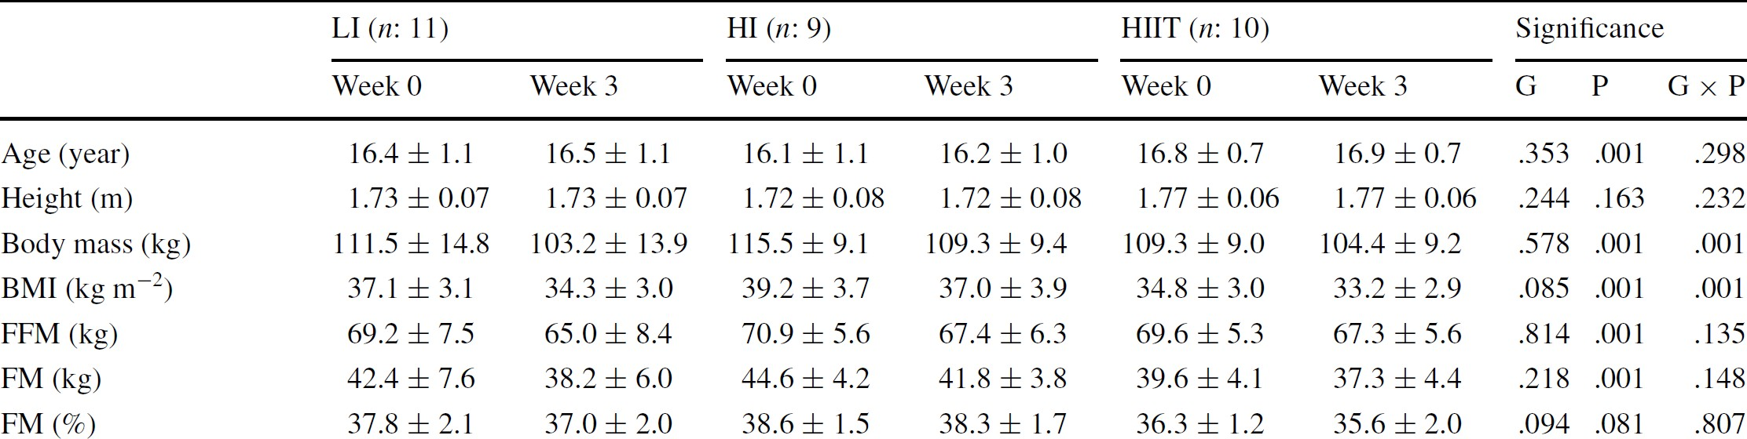
Intensity
How hard you exercise
−8.4 ± 1.5
−6.3 ± 1.9
−4.9 ± 1.3
−4.2 ± 1.9
−2.8 ± 1.2
−2.3 ± 1.4
Low-intensity Continuous Training
Higher decrease in Body mass
Higher decrease in Fat mass
(Lazzer et al., JEI 2017)

Slide 24
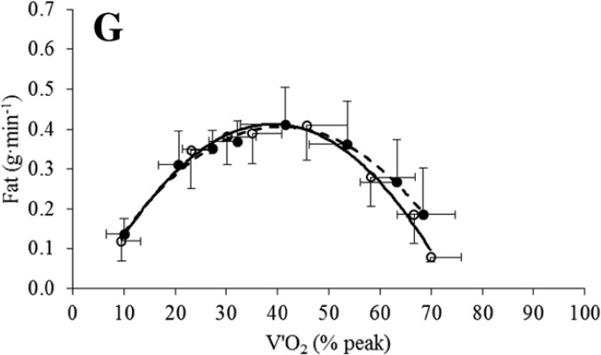
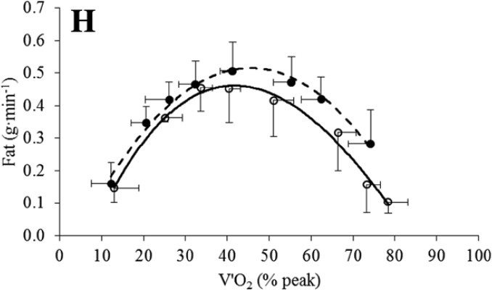
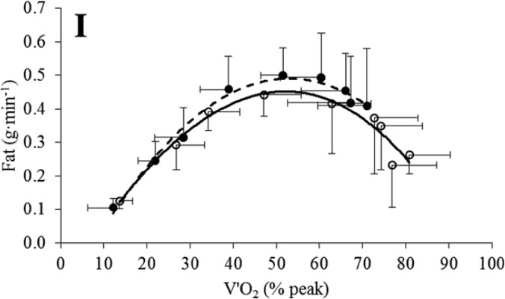
Intensity
How hard you exercise
Low-intensity Continuous training
High-intensity Continuous Training
^{F}OXY
High-intensity Interval Training
-o- Before
-●- After
^{F}OXY

Slide 25
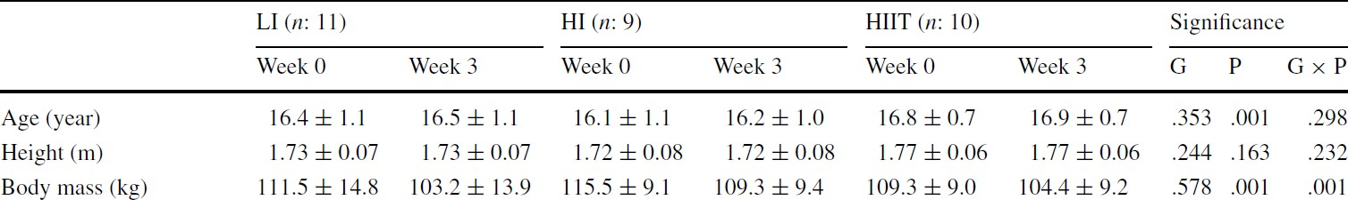
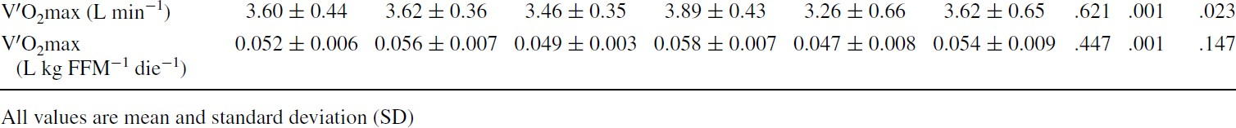
Intensity
How hard you exercise
+0.43 ± 0.39
+0.36 ± 0.21
High-intensity Continuous Training High-intensity Interval Training
Higher increase in V’O₂max
(Lazzer et al., JEI 2017)

Slide 26
Intensity
How hard you exercise
Low-intensity Continuous Training (LI) High-intensity Continuous Training (HI) High-intensity Interval Training (HIIT)
 | Body mass | Fat mass | Fat oxydation | V’O₂max
LI (60% HRmax) | ↓↓↓ | ↓↓↓ | ↑ | ↑
HI (80% HRmax) | ↓ | ↓ | ↑↑↑ | ↑↑↑
HIIT (60% HRmax + 100% HRmax) | ↓ | ↓ | ↑↑ | ↑↑
(Lazzer et al., JEI 2017)

Slide 27



Time
How long you exercise
Low-intensity Continuous Training (LI) High-intensity Continuous Training (HI) High-intensity Interval Training (HIIT)
 | Body mass | Fat mass | Fat oxydation | V’O₂max | Time efficient | Volume of activity | Fun
LI (45-60 min) | ↓↓↓ | ↓↓↓ | ↑ | ↑ | ↓↓↓ | ↑↑↑↑
HI (25-35 min) | ↓ | ↓ | ↑↑↑ | ↑↑↑ | ↑↑ | ↑↑
HIIT (10-20 min) | ↓ | ↓ | ↑↑ | ↑↑ | ↑↑↑↑ | ↓↓↓
HIIT programs seem to represent an effective alternative to LI program scheduled in a multidisciplinary body weight-management program, with the advantage of a lower volume of activity and reduced time commitment.
(Gibala et al., JP 2012)

Slide 28
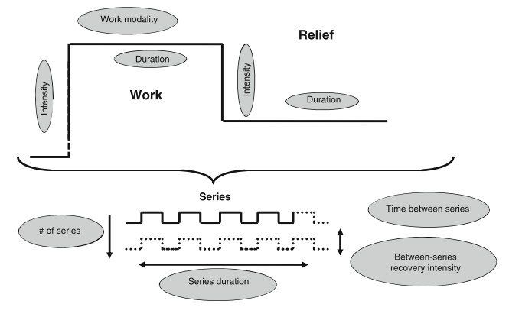
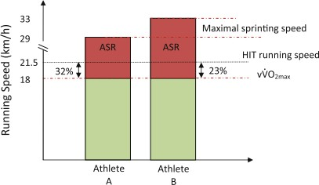
Intensity and Time
How hard and how long you exercise
High-intensity Interval Training (HIIT)
(Buchheit and Laursen, Sports Med. 2013)

Slide 29
Intensity and Time
How hard and how long you exercise
High-intensity Interval Training (HIIT)
Training studies usually assess the volume or area of mitochondria via microscopy, the activity or protein content of mitochondrial enzymes (e.g. citrate synthase and succinate dehydrogenase), or respiration in permeabilized muscle ﬁbres or isolated mitochondria (e.g. oxidative phosphorylation capacity).
HIIT induce grater increase in citrate synthase and oxidative phosphorylation
than moderate continuous exercise
(Gibala et al., JP 2017)

Slide 30
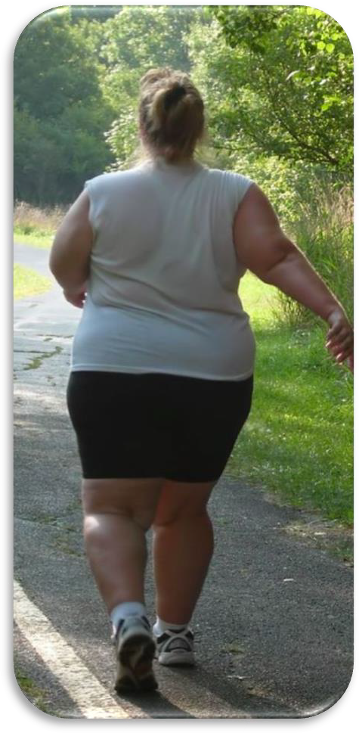
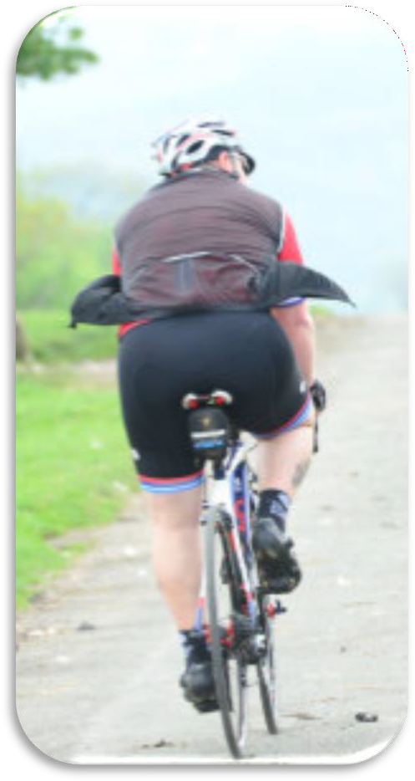
Type
What kind of exercise you choose
vs

Slide 31
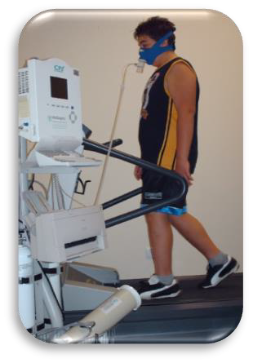
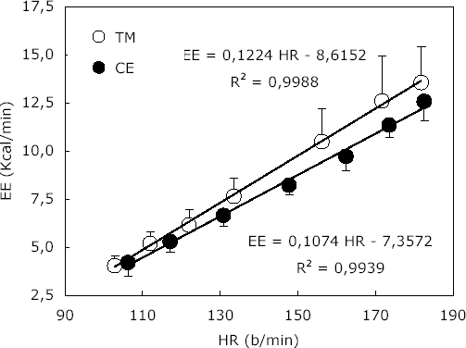
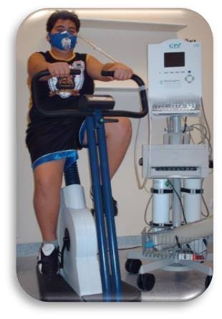
Type
What kind of exercise you choose
Energy Expenditure (kcal/min)
Heart Rate (bpm)
(Lafortuna et al., SJMSS 2010)

Slide 32
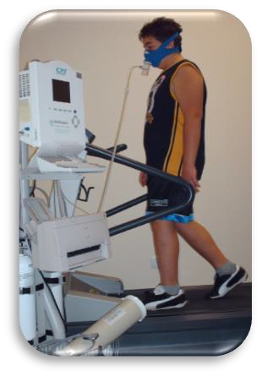
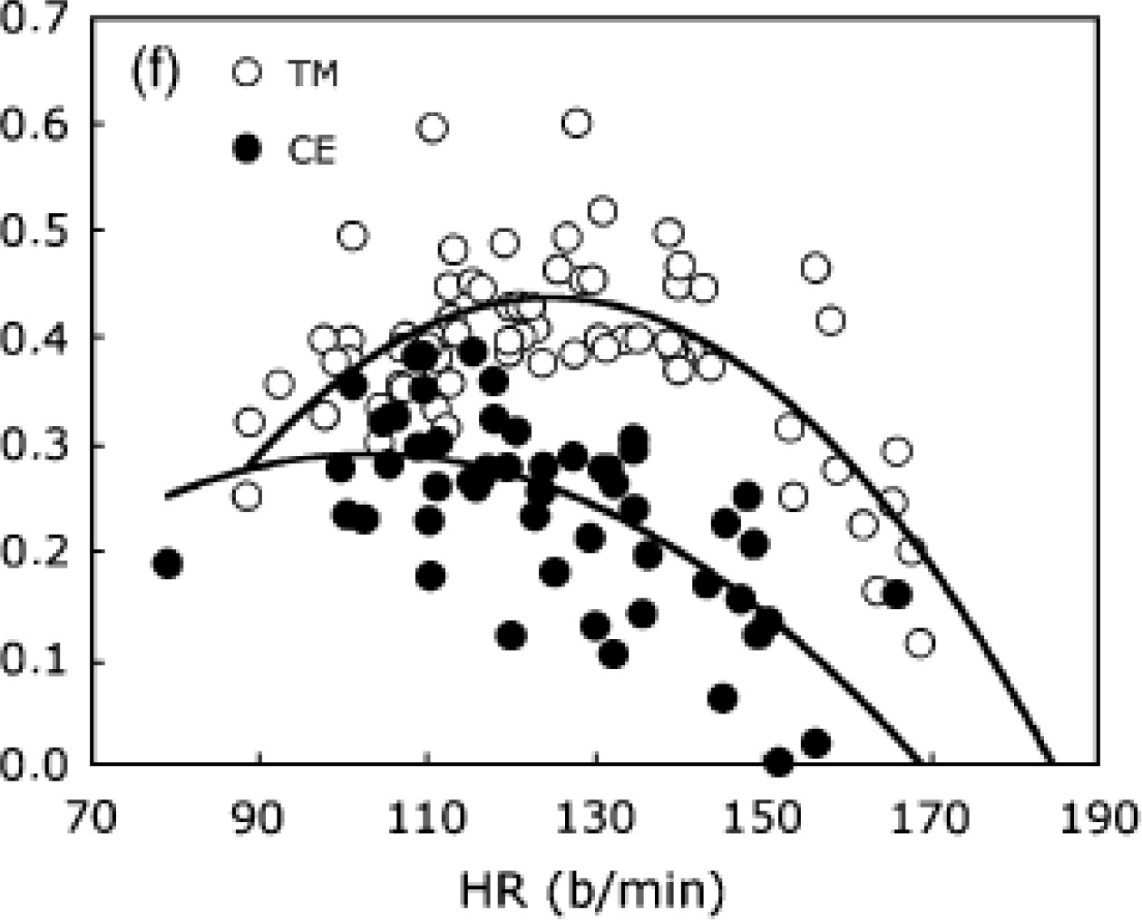
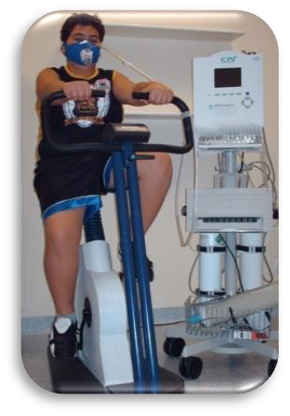
Type
What kind of exercise you choose
Fat oxydation rate (g/min)
Heart Rate (bpm)
(Lafortuna et al., SJMSS 2010)

Slide 33
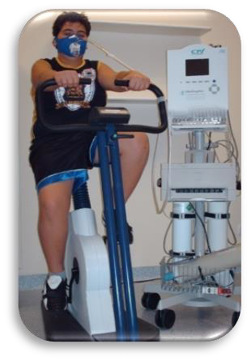
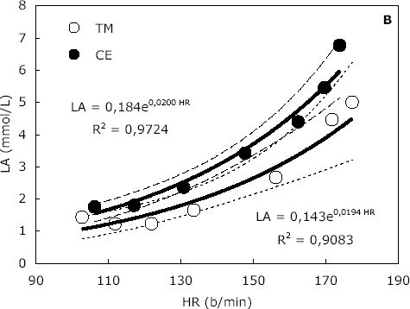
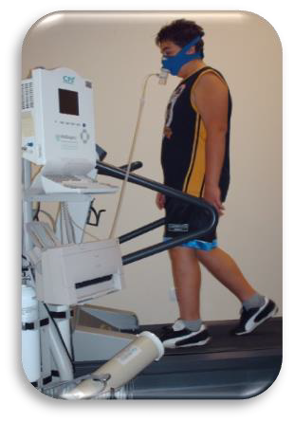
Type
What kind of exercise you choose
Blood Lactate concentration (mmol/L)
Heart Rate (bpm)
(Lafortuna et al., SJMSS 2010)

Slide 34
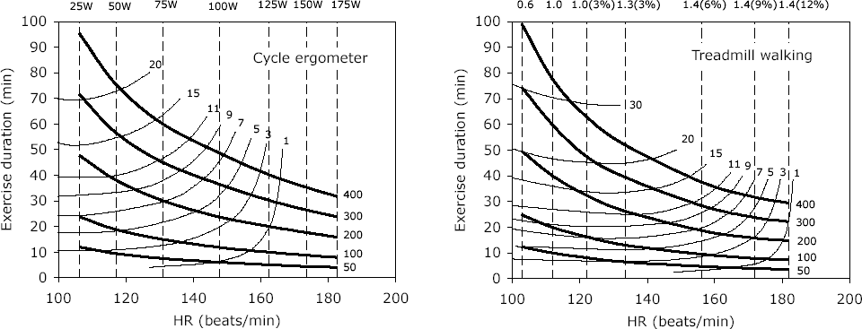
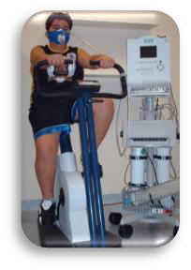
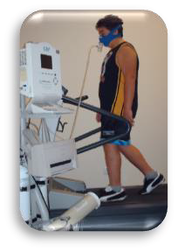


Type
What kind of exercise you choose
Fat oxidation (g)
Fat oxidation (g)
kcal
kcal
(Lafortuna et al., SJMSS 2010)

Slide 35
Type
What kind of exercise you choose
At similar Heart Rate, Energy Expenditure and Fat oxy were higher, and Blood Lactate concentration was lower, during WALKING than cycling, suggesting that cycling imposes a greater metabolic contribution at the level of the single active muscles than walking.
These
conclusions seem clinically relevant when using
exercise as a part of multidisciplinary weight reduction program for obese subjects and for the improvement of related metabolic disorders.
(Lafortuna et al., SJMSS 2010)

Slide 36



Frequency
FITT formula
How often you exercise
3 to 7 times a week
Intensity
How hard you exercise
60% HRmax to ↓ Fat mass
HIIT to ↑ V’O₂max and Fat oxydation rate
Time
How long you exercise
45-60 min to ↓ Fat mass
HIIT (10 – 20 min) to ↑ V’O₂max and Fat oxydation rate
Type
What kind of exercise you choose
Walking

Slide 37


But….
Girl, 100 kg and 1.75 m Walking at 4.5 km/h for 30 min Burns 215 kcal and 11 g of fat
Croissant, 70 g
212 kcal and 10 g of fat

