Slide 1
Dal 1983 OMS consiglia approccio non farmacologico al trattamento dell’ipertensione
Dal 1986 viene consigliato un programma strutturato di attività aerobica
In seguito siè aggiunto anche l’allenamento di resistenza

Slide 2
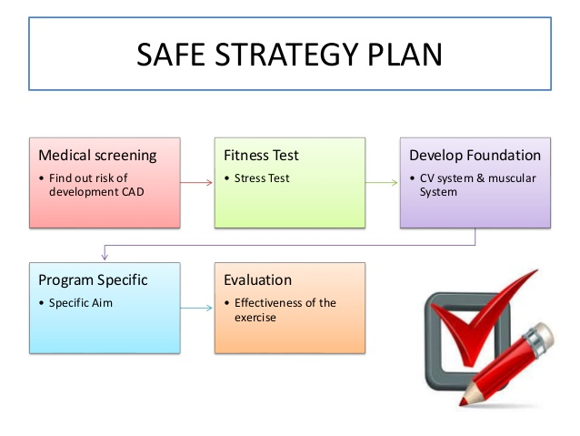
Lezione Scienze Motorie magistrale 30-4-2020

Slide 3
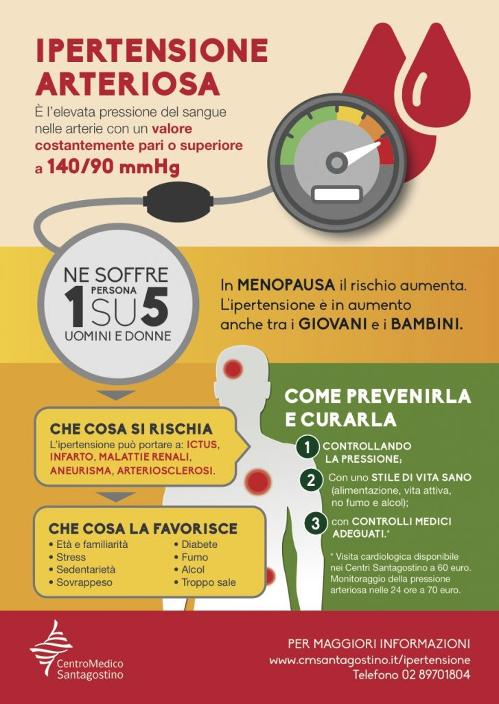

Slide 4
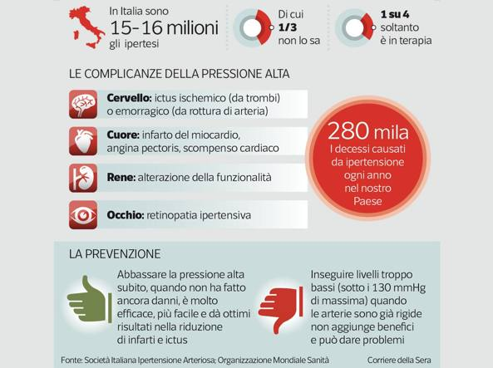

Slide 5
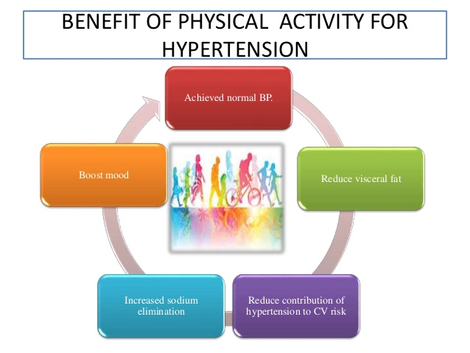

Slide 7
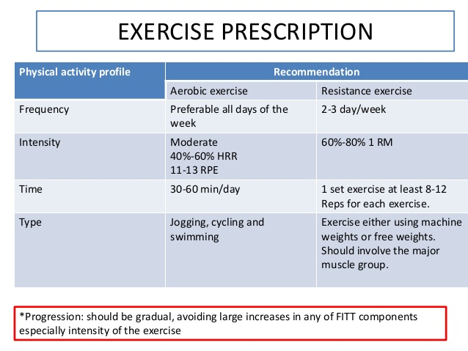

Slide 8
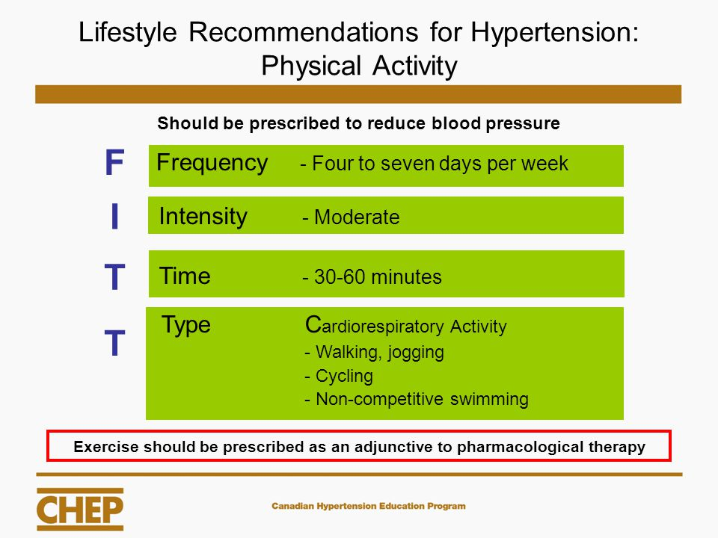

Slide 9
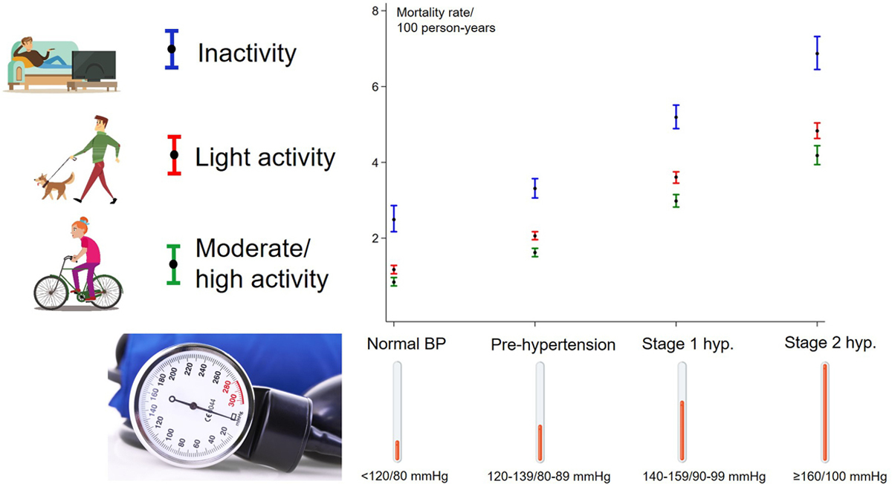
Dose-Response Association Between Level of Physical Activity and Mortality in Normal, Elevated, and High Blood Pressure
Gowsini J 2019https://doi.org/10.1161/HYPERTENSIONAHA.119.13786

Slide 10
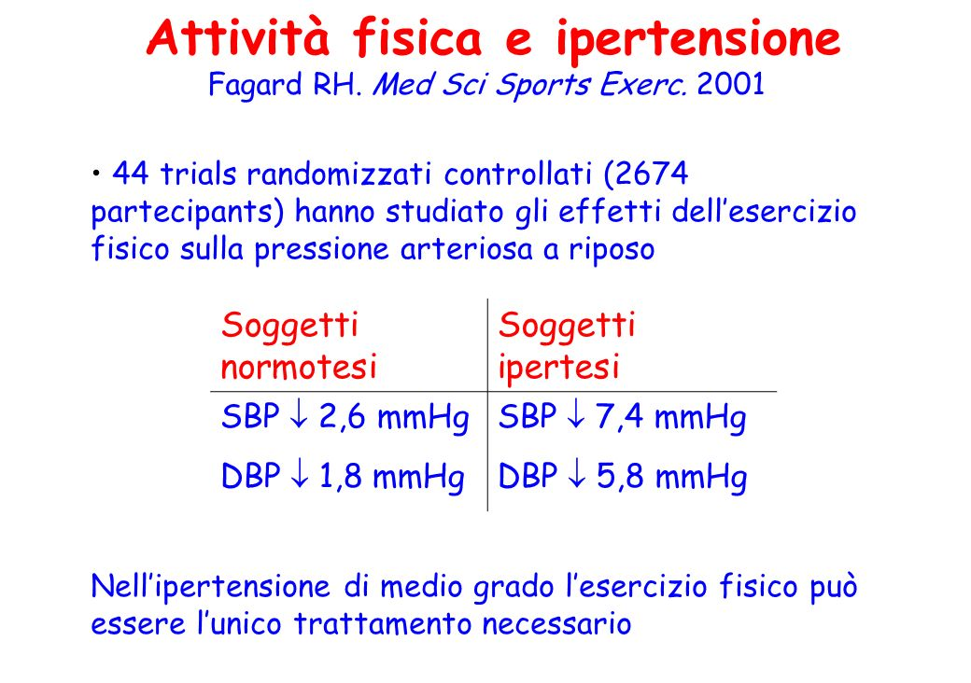

Slide 12
Risultati
Pressione arteriosa sistolica
(mmHg)
 | Pressione media pre esercizio | Pressione media post esercizio | Differenza | Calo %
Media | 129,5 | 121,7 | 7,8 | 5,4
Dev. St. | 12 | 10
Minimo | 112 | 108
Massimo | 149 | 140
P ≤ 0,05

Slide 14

WALKING: A NEW THERAPEUTIC
APPROACH IN HYPERTENSION
Mandini S, Conconi F, Mori E, Myers J, Grazzi G, Mazzoni G

Slide 15
Reduction of Systolic Blood Pressure
 | n |  | Baseline | Six months | p | Δ
Group 1 (>160) | 27 |  | 164.7±7.5 | 143.3±8.5 | *** | -21.3±9.4
Group 2 (150-159) | 35 |  | 152.1±2.9 | 140.3±6.4 | ** | -11.8±6.9
Group 3 (140-149) | 70 |  | 141.9±2.5 | 134.4±6.4 | *** | -7.5±6.2
Group 4 (130-139) | 89 |  | 131.9±2.5 | 126.6±5.0 | *** | -5.3±5.4
Group 5 (120-129) | 75 |  | 122.7±2.9 | 120.1±4.3 | *** | -2.6±4.3
*P<0.05; ** P<0.001; *** P<0.0001

Slide 16
The decrease of SBP
was more pronounced
in the subjects with
baseline stage 2 hypertension

Slide 17
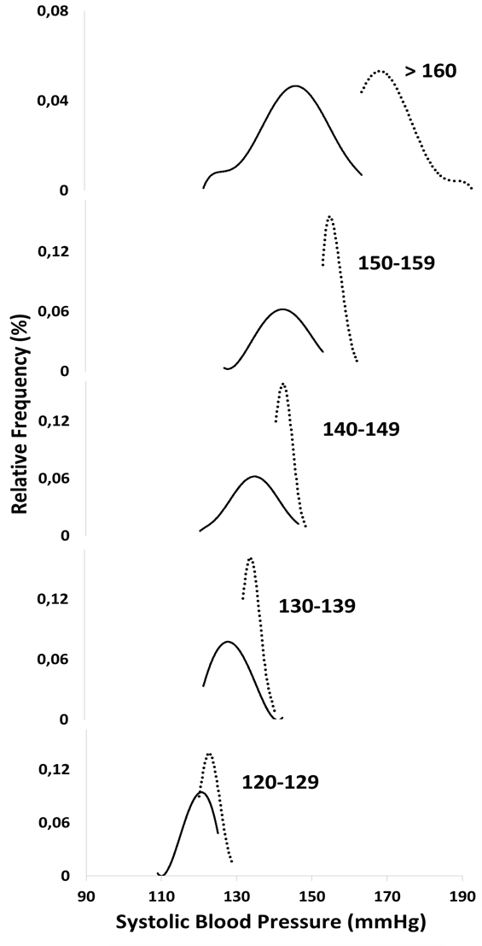
. . . Baseline
After 6-months

Slide 18
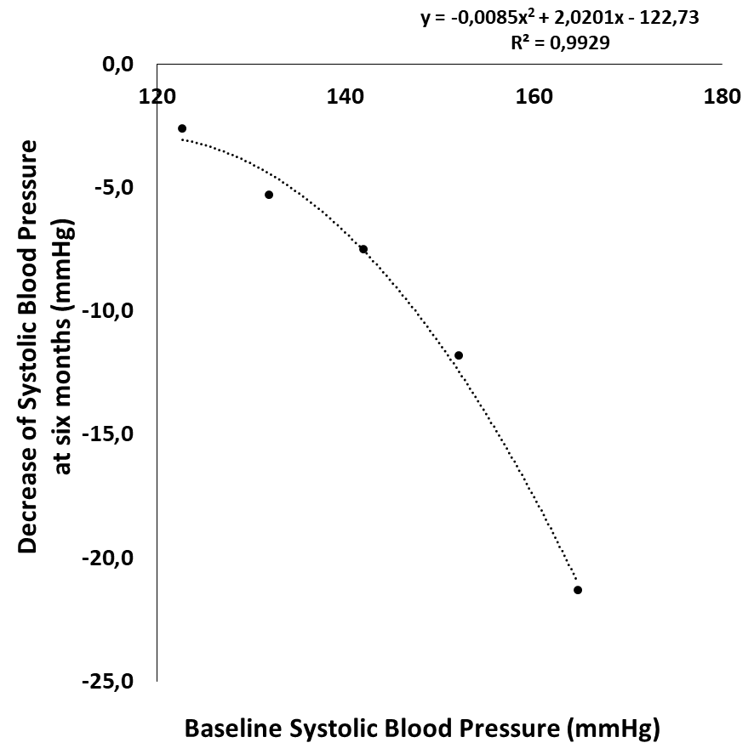

Slide 19
Reduction of Diastolic Blood Pressure
Baseline | Six months | p | Δ
88.4±9.9 | 81.1±4.9 | ** | -7.3±8.3
81.9±8.5 | 79.0±6.6 | ** | -2.9±7.3
78.5±8.8 | 76.6±5.2 | * | -1.9±7.7
76.7±7.8 | 74.5±6.4 | ** | -2.2±8.7
75.1±6.5 | 72.7±5.7 | ** | -2.4±5.8
 | n
Group 1 (>160) | 27
Group 2 (150-159) | 35
Group 3 (140-149) | 70
Group 4 (130-139) | 89
Group 5 (120-129) | 75
*P<0.05; ** P<0.001; *** P<0.0001

Slide 20
CONCLUSIONS
Main finding of the study:
6-months of supervised walking is followed by significant reductions of SBP proportional to baseline values

Slide 21
CONCLUSIONS
Habitual walking can safely and effectively contribute to the blood pressure lowering in hypertensive subjects
Guided walking programs should be included as standard adjunctive therapy for hypertension

Slide 22
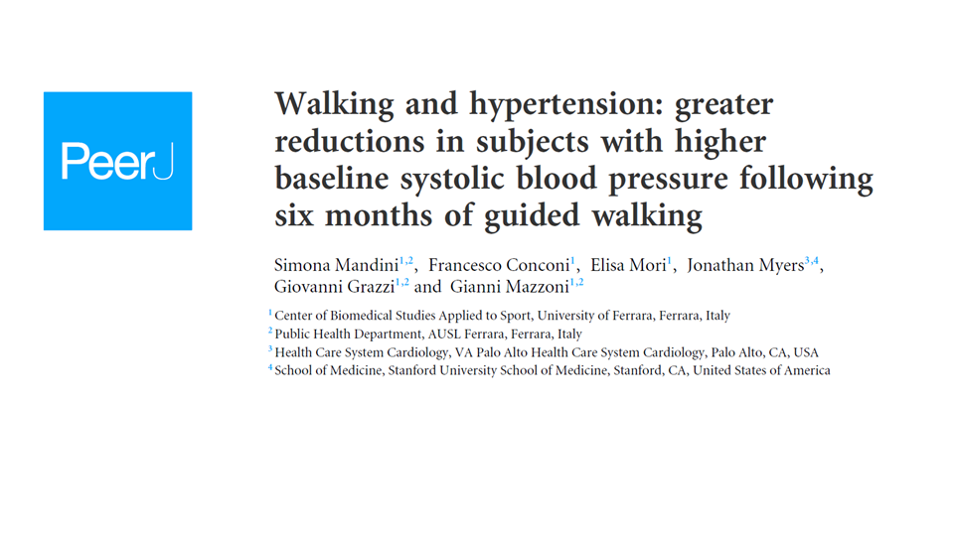
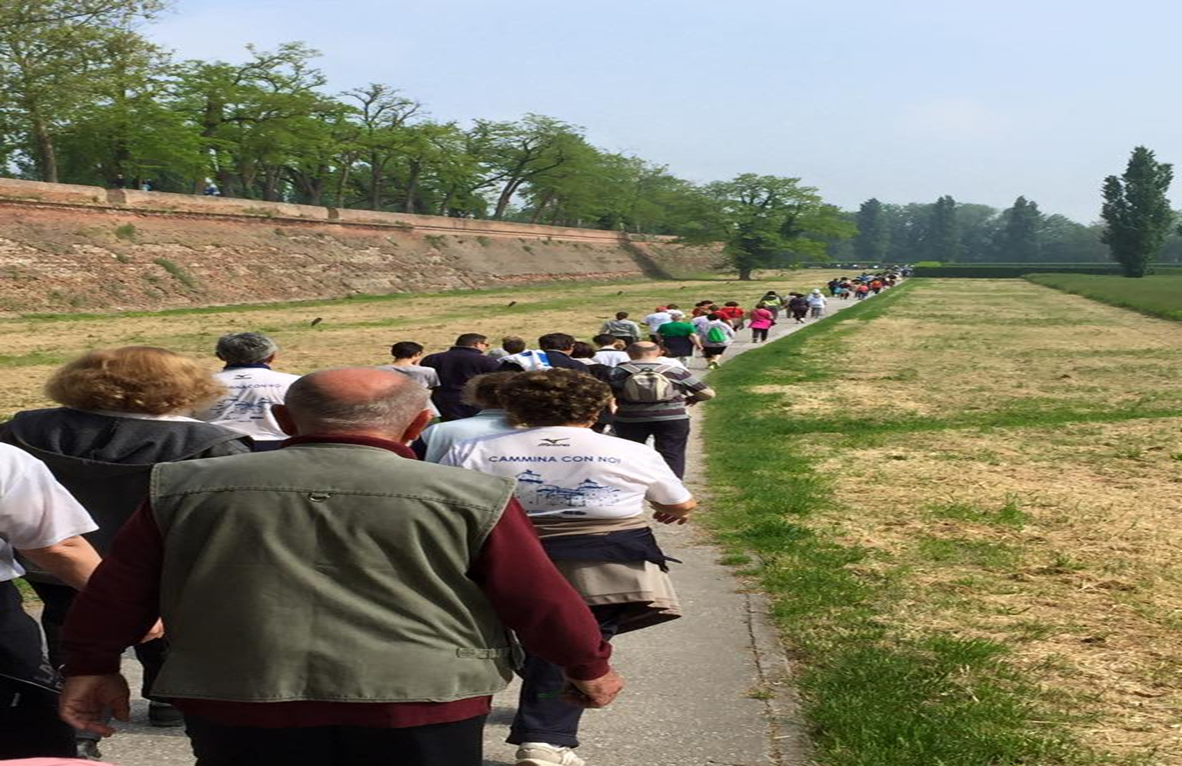
If you want go fast, go alone.
If you want go far, go together.

