Slide 1
English for Nurses, Midwives, and Health Professionals – Lesson 2
Results of Entry Test
Activities on your own
Today’s class:
  Health and illness
  Parts of the body 1
  Parts of the body 2
  Grammar (Simple past and Past continous)
  Hospital admissions (audio listening)
  Functions of the body
  Taking a history 1 and 2

Slide 2
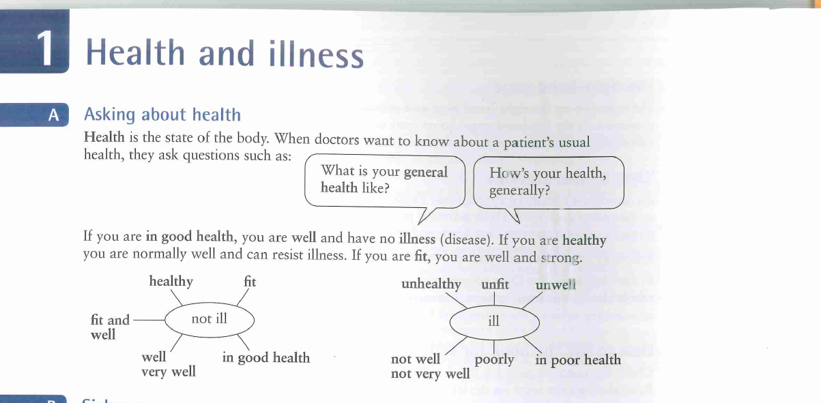
Health and illness (1)

Slide 3
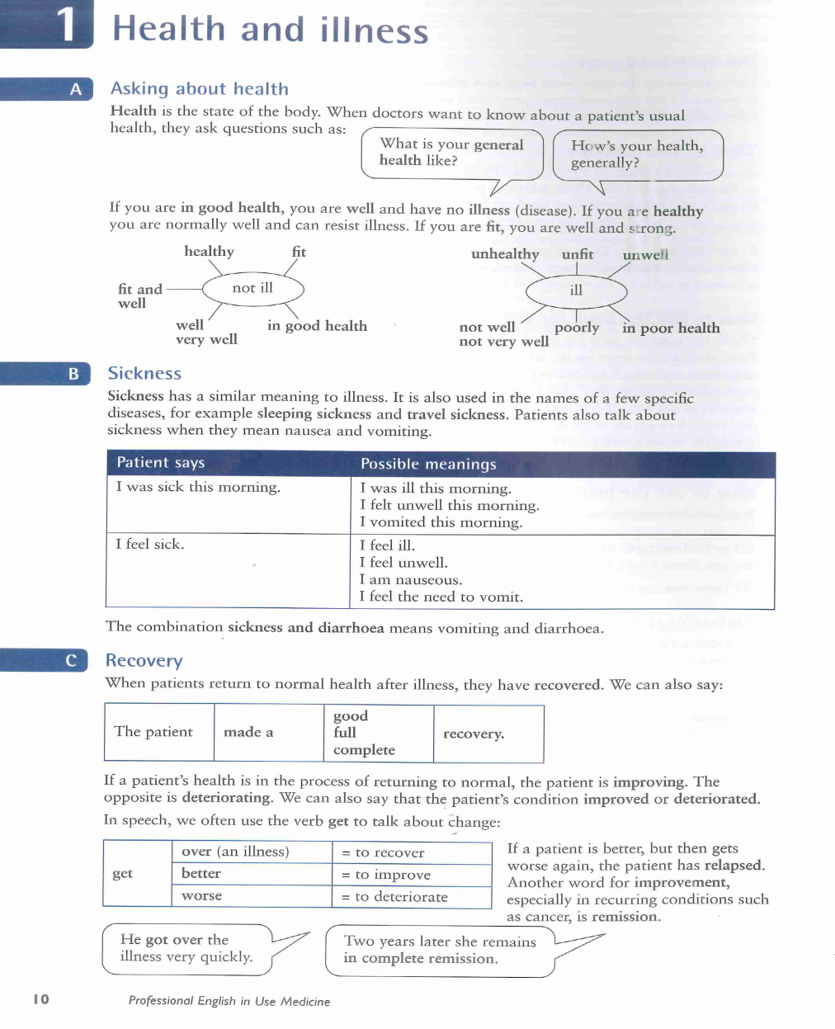
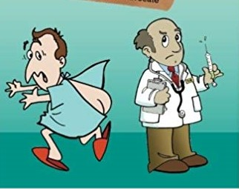
Health and illness (2)

Slide 4
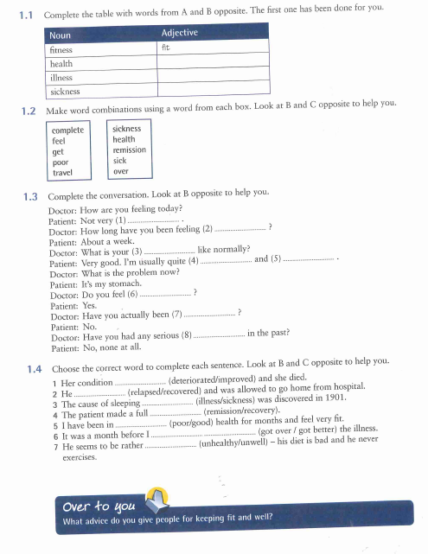
Health and illness (3)

Slide 5
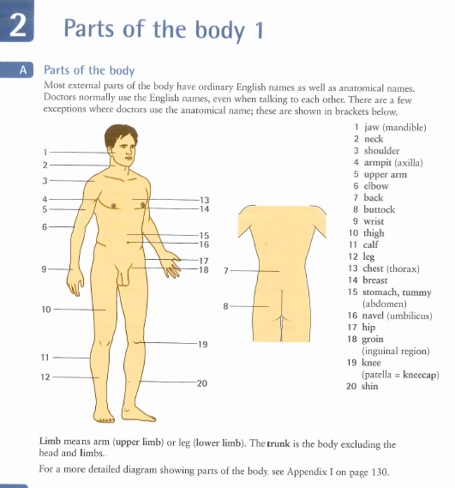
Parts of the body 1 (I)

Slide 6
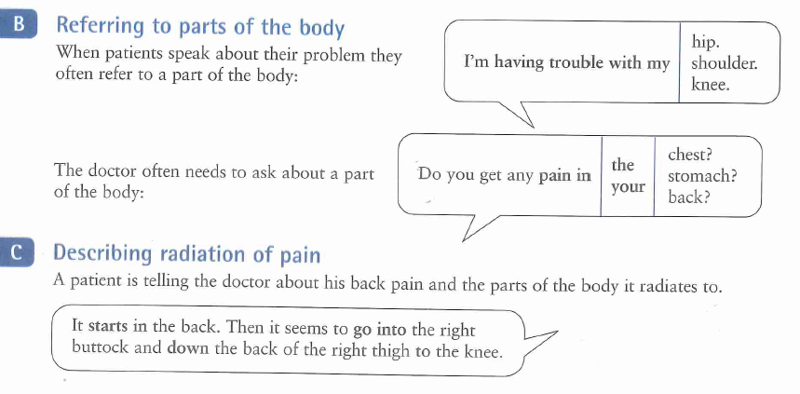
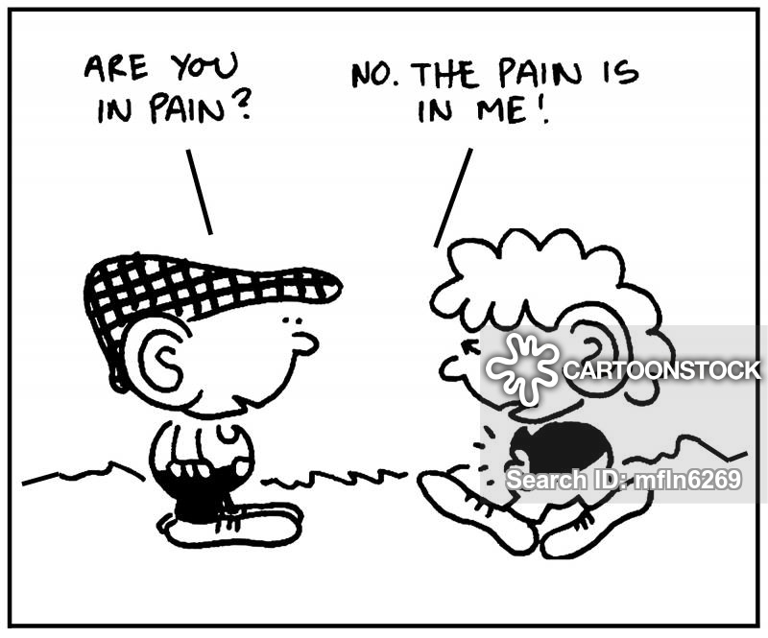
Parts of the body 1 (II)

Slide 7
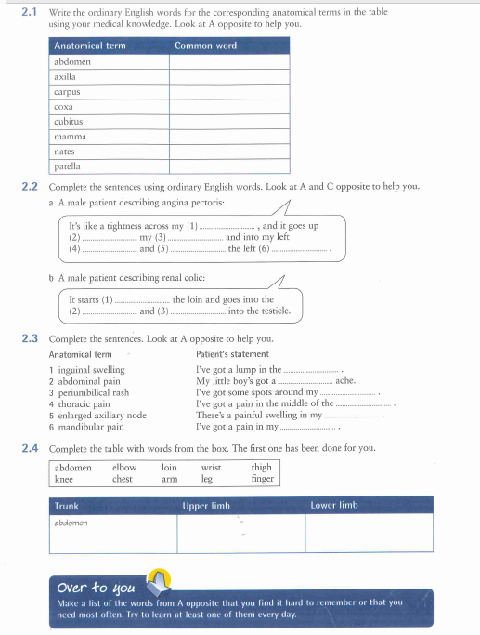
Parts of the body 1 (III) - Exercises
Over to you

Slide 8
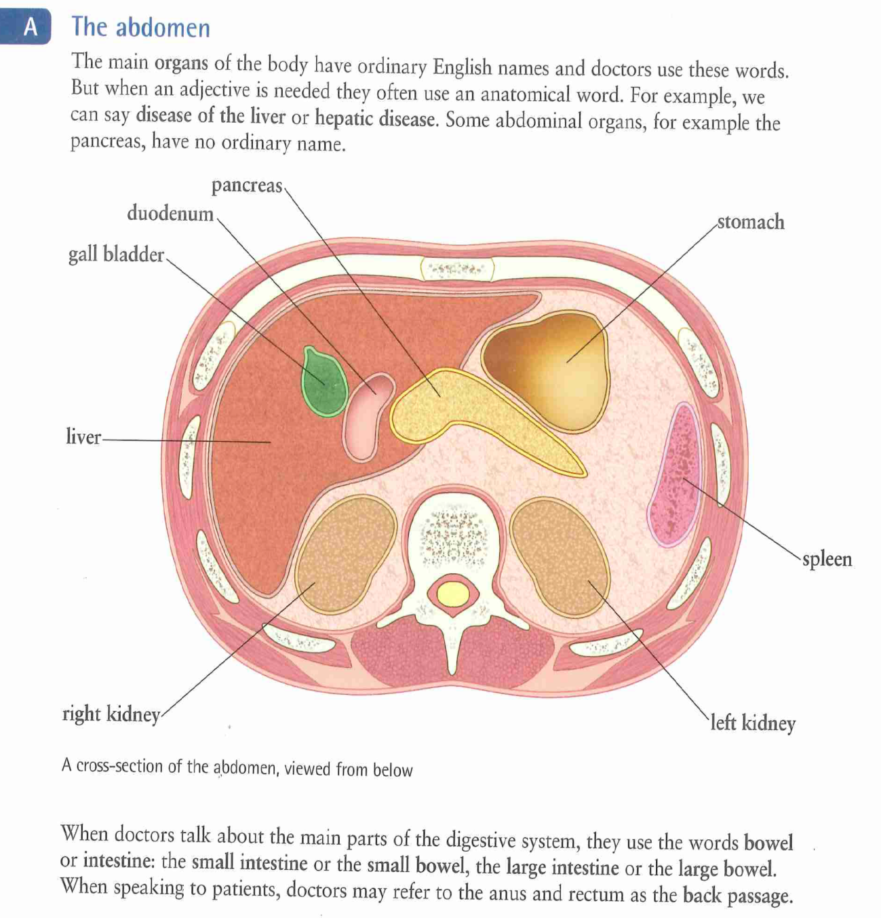
Parts of the body 2 – The abdomen

Slide 9
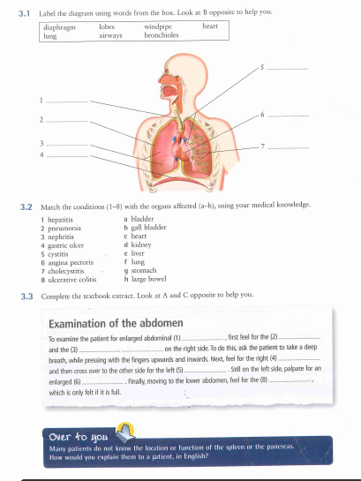
Parts of the body 2 (III) – Exercises
Over to you

Slide 10
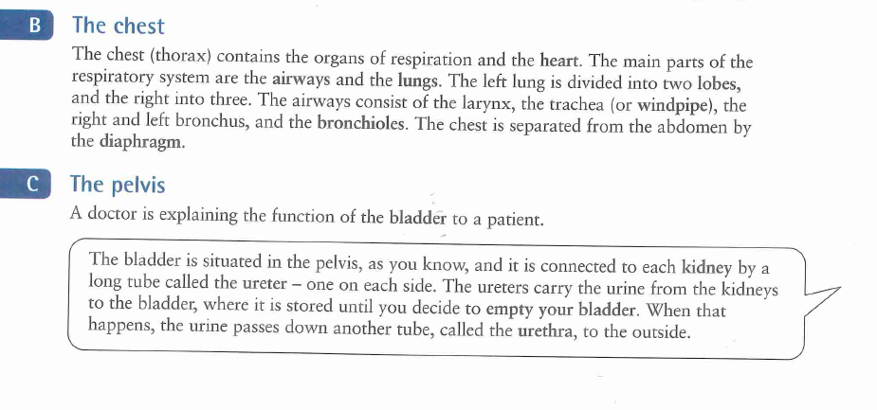
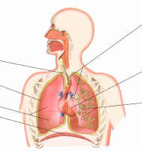
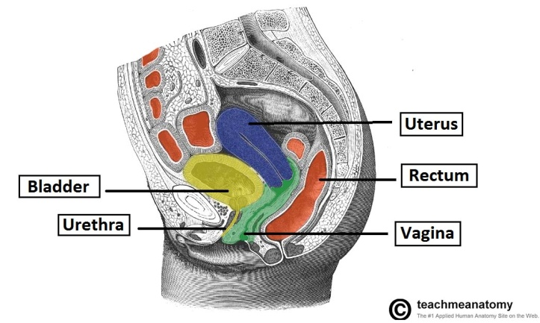
Parts of the body 2 - The chest and the pelvis

Slide 11
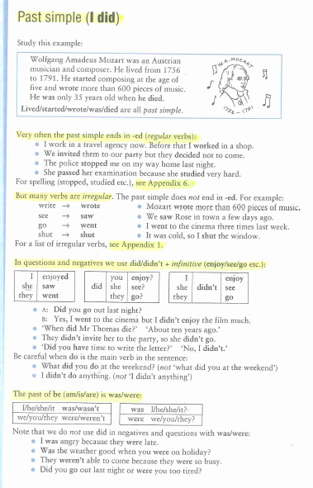
Grammar – Past simple (I did)

Slide 12
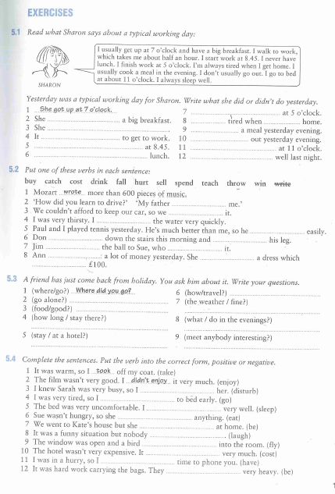
Grammar – Past simple (I did) - Exercises
Over to you

Slide 13
Grammar – Past simple (I did) - Exercises
Over to you

Slide 14
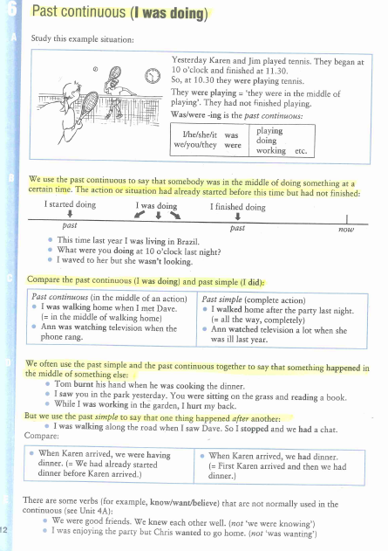
Grammar – Past continous (I was doing)
_x005F_x0001_

Slide 15
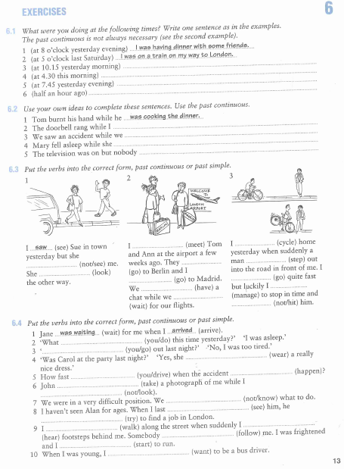
Grammar - Past continous (I was doing) - Exercises
Over to you

Slide 16
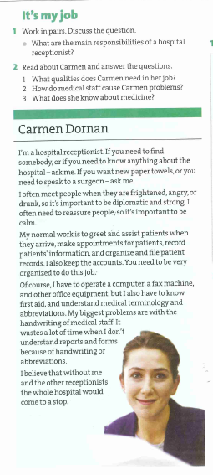
Hospital admissions - Reading
Work in pairs

Slide 17
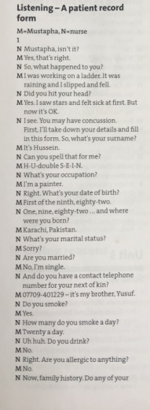
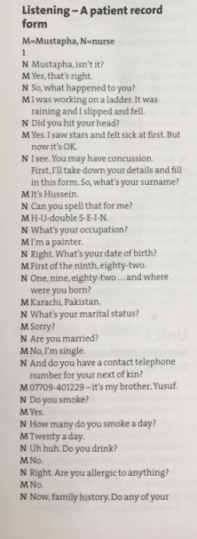
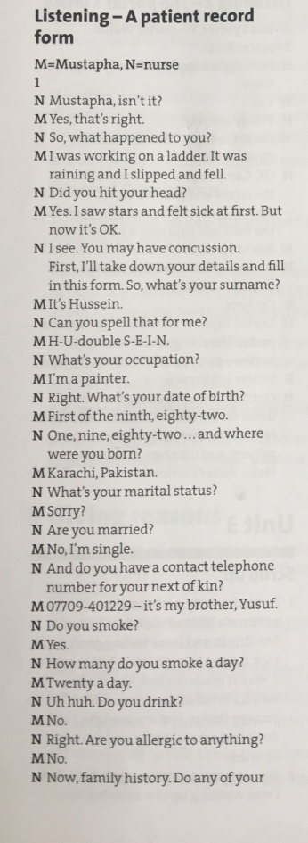
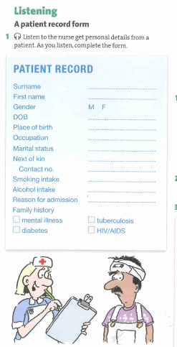
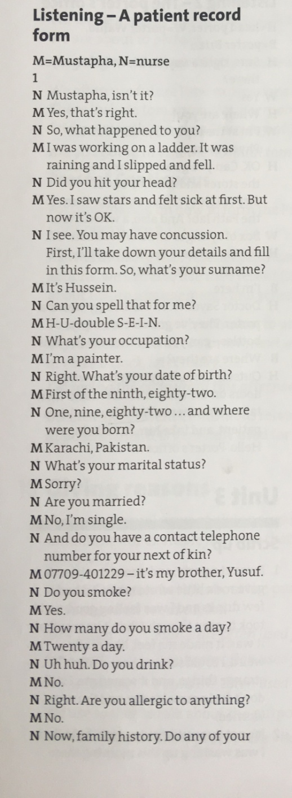
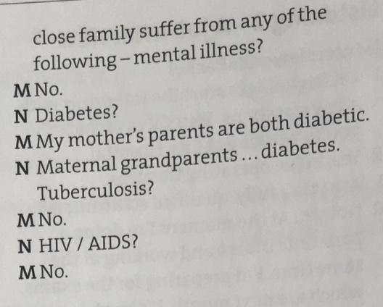
Hospital admission – Record form

Slide 18
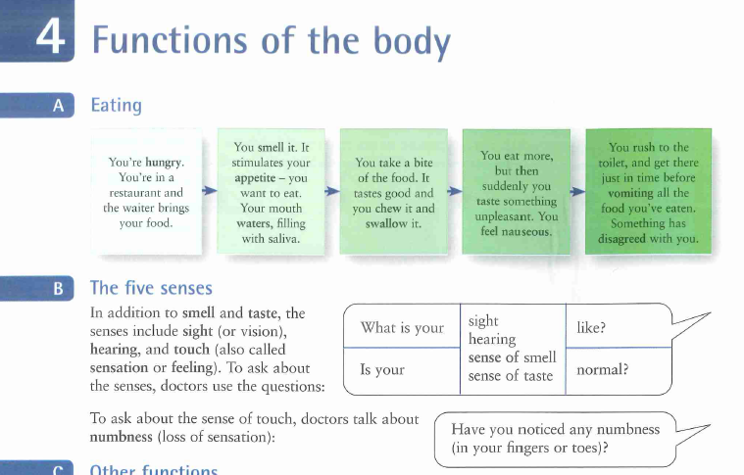
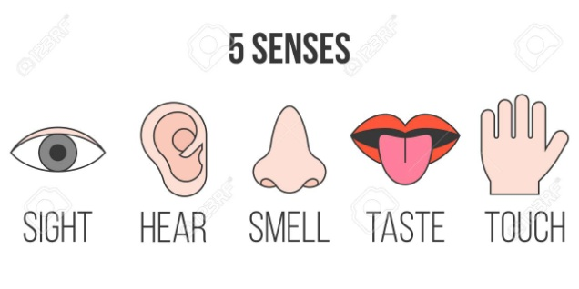
Functions of the body – Five senses

Slide 19
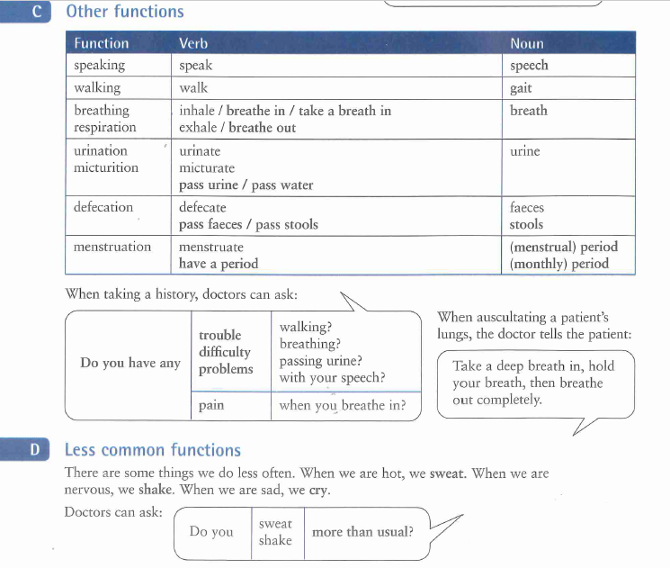
Functions of the body – Other functions

Slide 20
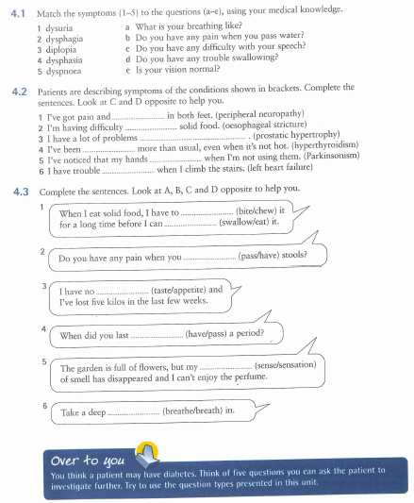
Functions of the body – Exercises
Over to you

Slide 21
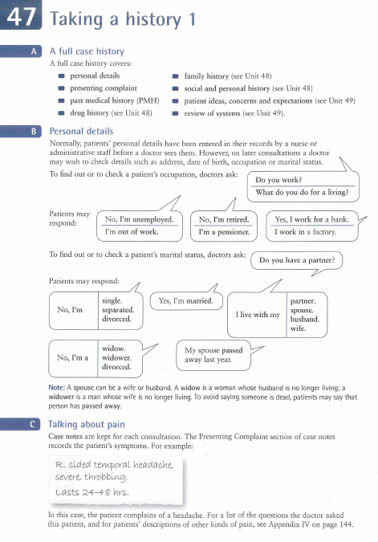
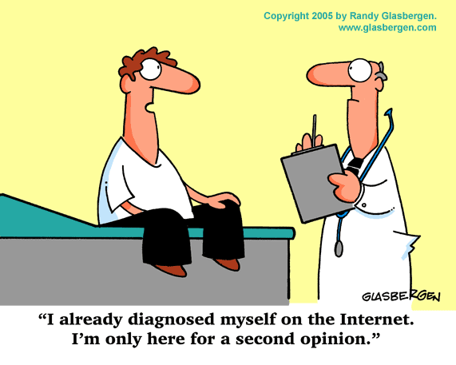
Taking a history 1

Slide 22
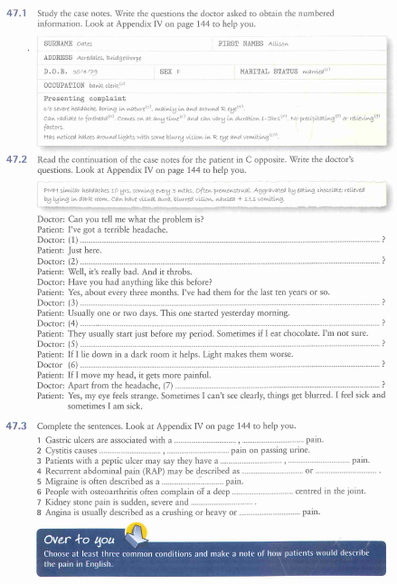
Taking a history 1 - Exercises
Over to you

Slide 23
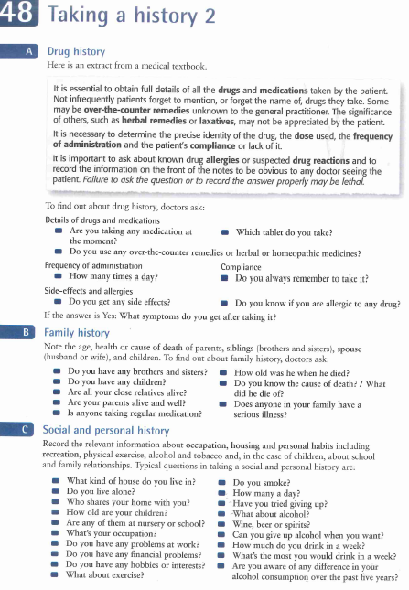
Taking a history 2

Slide 24
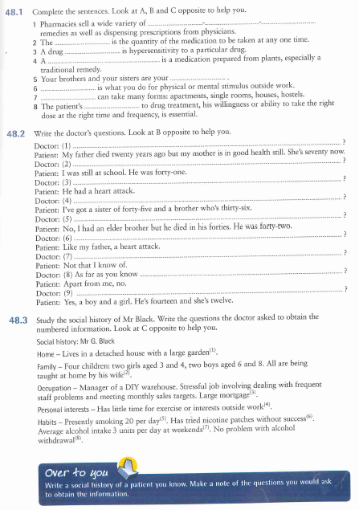
Taking a history 2 - Exercises
Over to you

