Slide 1
English for Nurses, Midwives, and Health Professionals – Lesson 3
Today’s class:
  English for Nursing
  Obstetrics
  Pregnancy and childbirth
  Gynaecology
  Grammar:
    Do you…?
    Can and could
    Must, mustn’t, don’t need to

Slide 2
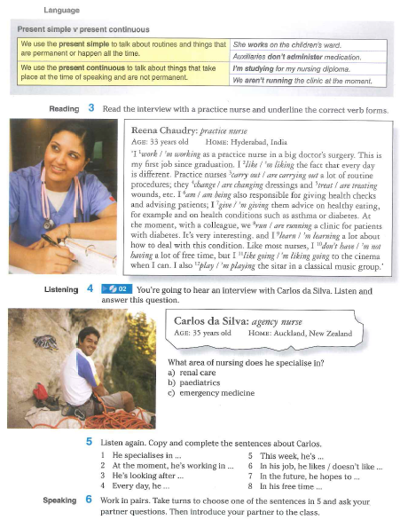
English for nursing (1)
Open USB - Listening Track 2

Slide 3
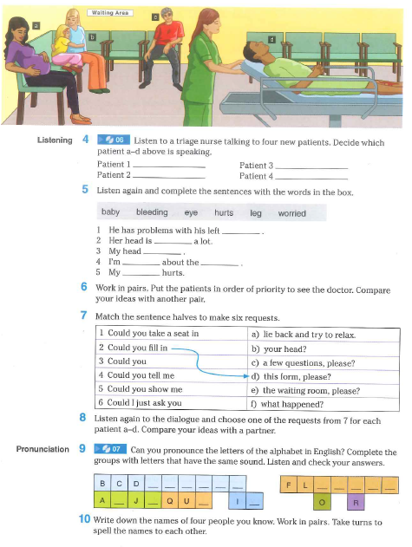
English for nursing (2)
Open USB - Listening Track 6

Slide 4
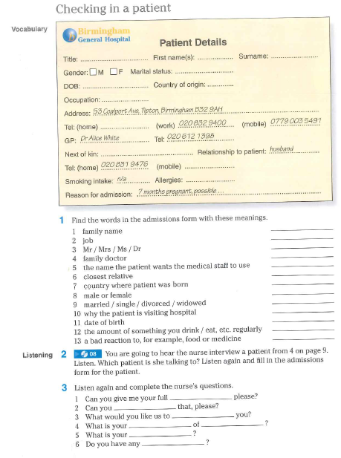
English for nursing (3)
Open USB - Listening Track 8

Slide 5
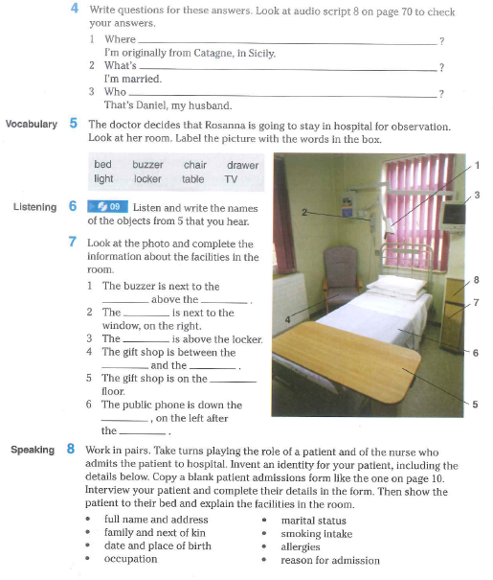
English for nursing (4)
Open USB -Listening Track 9

Slide 6
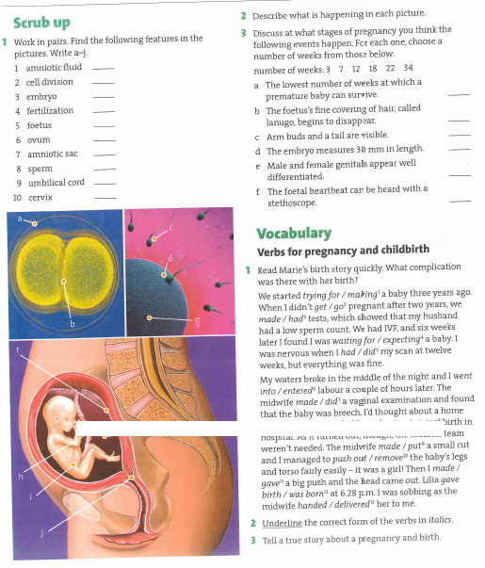
Obstetrics (1)
Notes:
<numero>

Slide 7
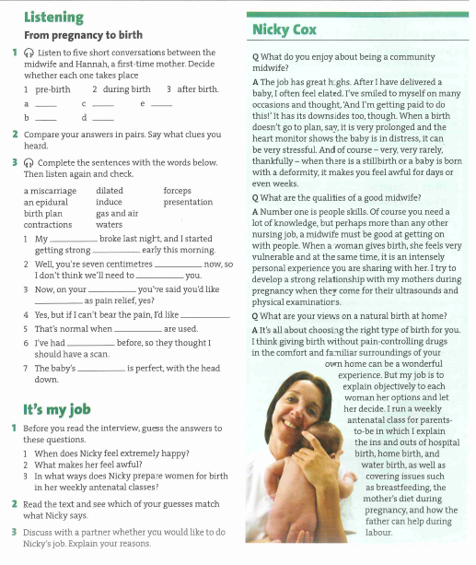
Obstetrics (2)
Listening from internet - From pregnancy to birth

Slide 8
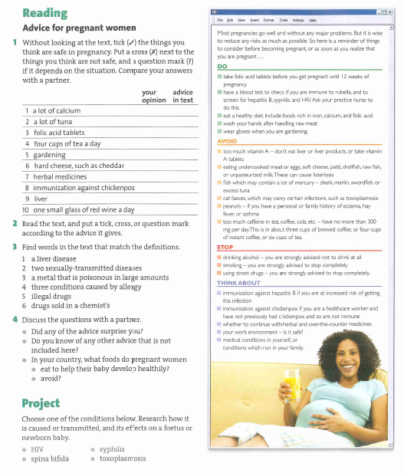
Obstetrics (3)

Slide 9
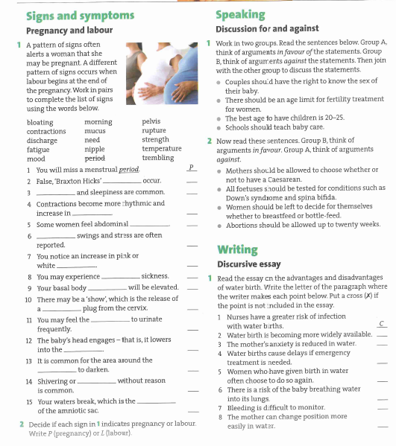
Obstetrics (4)
Notes:
<numero>

Slide 10
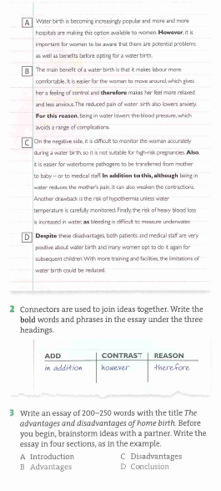
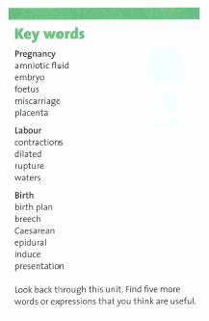
Obstetrics (5) – key words

Slide 11
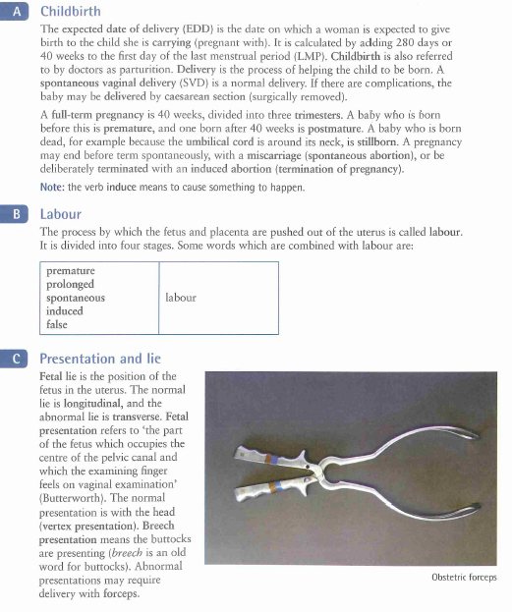
Pregnancy and childbirth

Slide 12
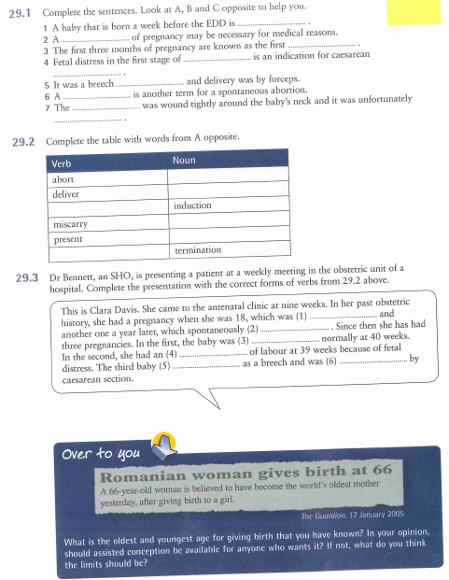
Pregnancy and childbirth - Exercises
Over to you

Slide 13
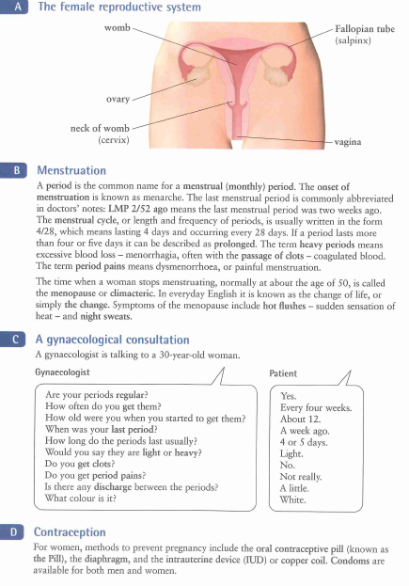
Gynaecology (1)

Slide 14
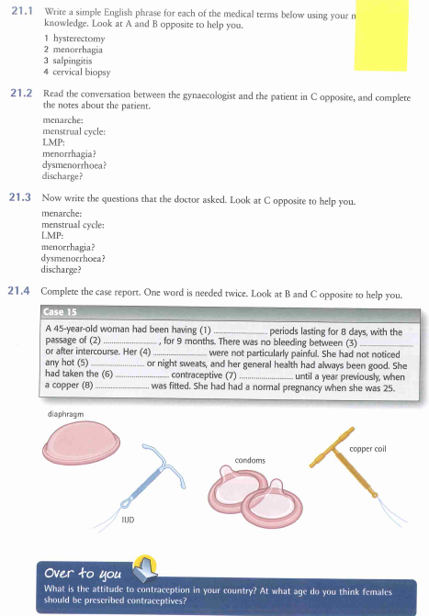
Gynaecology (2) - Exercises
Over to you

Slide 15
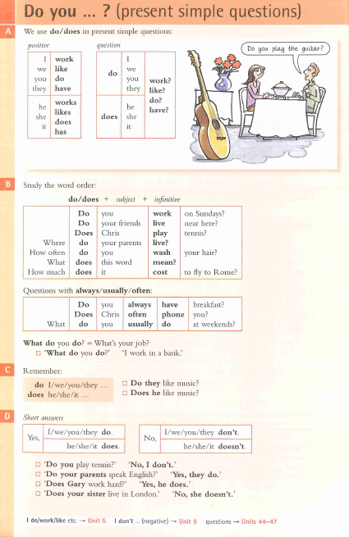
Grammar – Do you…?

Slide 16
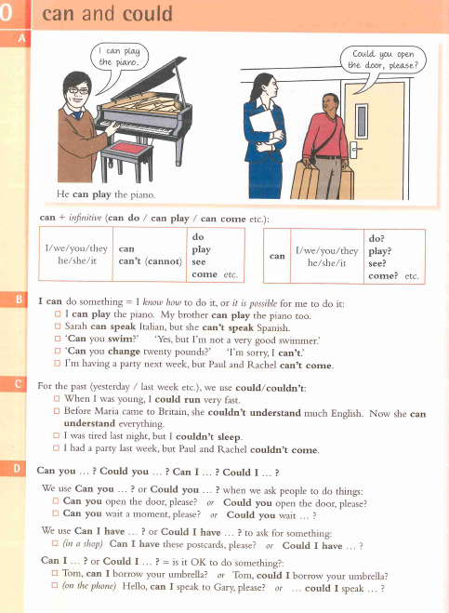
Grammar – Can and could
Listening from Youtube - Can or Could
Listening from Youtube - Can Can't Cannot

Slide 17
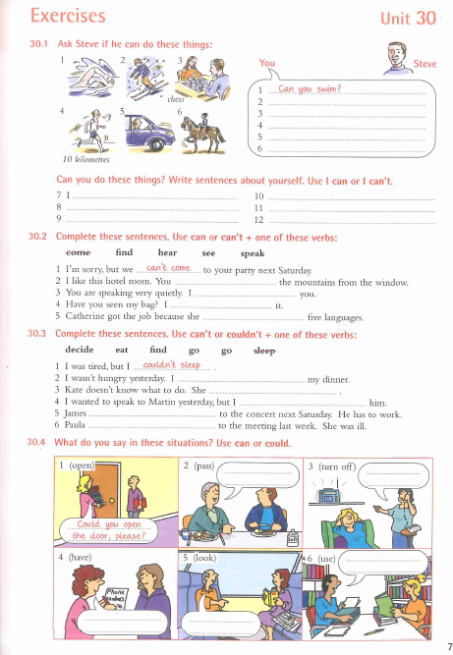
Grammar – Can and could - Exercises

Slide 18
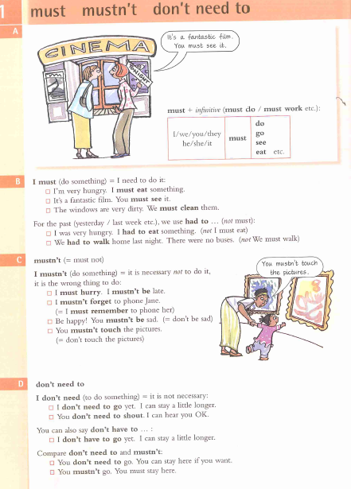
Grammar – Must, mustn’t, don’t need to
Listening from Youtube - MUST
Listening from Youtube - MUST VS HAVE TO
Listening from Youtube - MUSTN'T VS DON'T HAVE TO

Slide 19
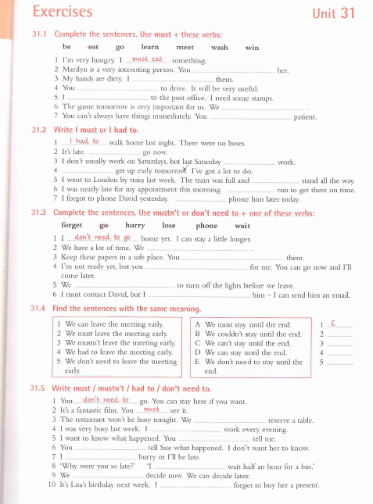
Grammar – Must, mustn’t, don’t need to – Ex.

