Slide 1
CLEIDOCRANIAL DYSPLASIA
Ilaria Balzani
Scuola di Specializzazione in Ortognatodonzia di Ferrara

Slide 2
Cleidocranial dysplasia (CCD) [OMIM 119600] is an autosomal dominant skeletal dysplasia characterized by delayed closure of the cranial sutures, hypoplastic or aplastic clavicles, and multiple dental abnormalities.

Slide 3
The molecular defect in CCD is situated at the chromosomal locus of 6p2116. The determinant gene, RUNX2 codes for a core-binding transcription factor protein (CBFA1), which is involved in the differentiation of osteoblasts and bone formation. (Cleidocranial dysplasia: a review of the dental, historical, and practical implications with an overview of the South African experience. Oral Surg Oral Med Oral Pathol Oral Radiol.2013 Jan;115(1):46-55).

Slide 4
RUNX2 plays an important role in the epithelial-mesenchymal interactions that control progressive tooth morphogenesis and histodifferentiation of the epithelial enamel organ.

Slide 5
EPIDEMIOLOGY
Whereas the worldwide prevalence of CCD is generally regarded as being about 1 per million, in the mixed ancestry community of Cape Town, South Africa, the minimum prevalence is 100 per million. (Cleidocranial dysplasia: clinical and molecular genetics, Stefan Mundlos, J Med Genet 1999; 36: 177-182)

Slide 6
CLINICAL MANIFESTATION
Height: Short stature, moderate.
Head: Delayed fontanelle closure
Parietal bossing Anterior fontanelle open in adults

Slide 7
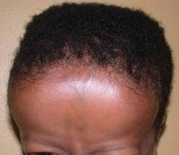
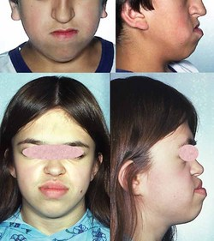
Face: Frontal bossing Metopic groove Midface hypoplasia Micrognathia Ears: Deafness

Slide 8
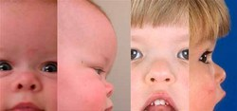
Eyes: Hypertelorism Nose: Low nasal bridge Mouth: Cleft palate Narrow, high-arched palate

Slide 9
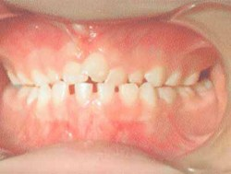
Teeth: Delayed eruption of deciduous teeth Delayed eruption of permanent teeth Supernumerary teeth Retention cysts

Slide 10
External Features: Narrow thorax Abnormal facility in opposing the shoulders Ribs, Sternum, Clavicles and Scapulae: Small scapula Hypoplastic clavicles Aplastic clavicles Short ribs Cervical ribs

Slide 11
Skull: Wormian bones Bossing of frontal bone Bossing of occipital bone Bossing of parietal bone Calvarial thickening Absent frontal sinuses Absent paranasal sinuses Hypoplastic frontal sinuses Hypoplastic paranasal sinuses Large foramen magnum

Slide 12
Spine: Spondylolysis Spondylolisthesis Scoliosis Kyphosis Pelvis: Wide pubic symphysis Coxa vara Hypoplastic iliac wing

Slide 13
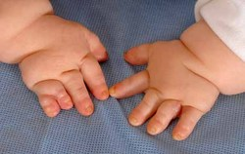
Hands: Brachydactyly Long second metacarpal Short middle phalanges of second and fifth fingers Cone-shaped phalangeal epiphyses

Slide 14
HYPERDONTIA Hyperdontia is the major dental feature of CCD. This developmental abnormality can involve either, or both the primary and secondary dentition. In CCD, hyperdontia leads to dental impaction, overcrowding, and malocclusion, while midfacial hypoplasia can exacerbate these problems. .

Slide 15
Articulation and mastication may be compromised, and the cosmetic appearance of the dentition may be unsightly. In addition to hyperdontia, other dental abnormalities include delayed eruption and retention of the primary and secondary dentition. The crowns of the teeth sometimes appear abnormal and the enamel may be hypoplastic.

Slide 16
Hyperdontia: pantamogram of an affected male showing multiple supernumerary teeth

Slide 17
DIAGNOSIS Chromosome analysis: on occasion individuals with CCD have cytogenetically visible complex chromosome rearrangements. (Purandare et al. 2008) Gene: to date, RUNX2 (CBFA1) is the only gene in which mutations are known to cause CCD.

Slide 18
Clinical testing: summary of Molecular Genetic Used in Cleidocranial Dysplasia

Slide 19
When the diagnosis of CCD is suspected, the clinician should request a skeletal survey that includes: (1) anteroposterior (AP) and lateral projections of the skull and thorax; (2) AP of the pelvis; (3) lateral of the lumbar spine; and (4) AP of the long bones, hands, and feet.

Slide 20
Sequence analysis, followed by deletion/duplication analysis, can be considered for diagnostic confirmation, particularly if the findings do not meet clinical and radiologic diagnostic criteria. CCD can be diagnosed by ultrasound examination in the offspring of an affected parent as early as 14 weeks’ gestation.

Slide 21
TREATMENT Dental: the goal of treatment is to improve appearance and to provide a functioning masticatory mechanism. The goals may be achieved with prosthetic replacements, with or without prior extractions; by removal of the supernumerary teeth followed by surgical repositioning of the permanent teeth;

Slide 22
and by a combination of surgical and orthodontic measures for actively erupting and aligning the impacted permanent teeth. (Roberts et al. 2013) Sinus and middle ear infections require aggressive and timely treatment; tympanostomy tubes should be considered when middle ear infections are recurrent (Visosky et al 2003)

Slide 23
Skeletal: if bone density is below normal on DEXA, treatment with calcium and vitamin D supplementation should be considered. Preventive treatment for osteoporosis should be initiated at a young age since peak bone mineral density is achieved in the second and third decade.

Slide 24
Craniofacial: the fontanels close with time in the majority of individuals and cranial remodeling is usually not necessary. Affected individuals may consider having correction of the depressed forehead or lengthening of the hypoplastic clavicles for cosmetic reasons. (Kang et al. 2009, Sewell et al. 2013)

