Slide 1
Gluten and Wheat Sensitivity
Roberto De Giorgio

Slide 2


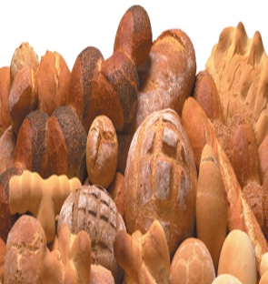
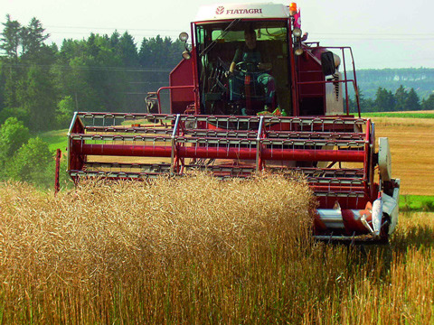



Gluten and wheat intolerance today: are the growing ingestion and modern wheat strains involved?
The worldwide growing consumption of wheat with a mean gluten ingestion of 15-30 grams/day has contributed to a significant increase in the incidence of gluten/wheat related disorders
New variants of wheat have arisen as a result of the mechanization of farming and of the growing industrial use of pesticides and fertilizers that could have a leading role in the adverse immunologic reactions to gluten and wheat
The addition of vital gluten to the dough and the shortened process of bread leavening have led to an increased concentration of toxic gluten peptides in bakery products
De Lorgeril M & Salen P, Int J Food Sci Nutr 2014

Slide 3

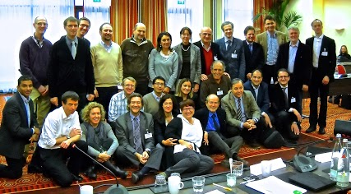
The Galaxy of wheat –related disorders
Consensus Conferences on
Gluten Related Disorders:
1st London, 2011
2nd Munich, December, 2012
3rd Salerno, 2014
4 th Merano, December 2016
Coeliac disease, dermatitis herpetiformis and gluten ataxia
Non coeliac gluten/wheat sensitivity
(NCG/WS)
IgE and non-IgE wheat allergy

Slide 4
Non-Celiac Gluten /Wheat Sensitivity (NCG/WS)
Adverse reaction to gluten and other wheat proteins (ATIs)
Negative serology / histology (not diagnostic for CD)
Negative prick test and specific IgE to gluten
Gastrointestinal (‘IBS like’) and extra-intestinal symptoms
Improvement with a gluten/wheat free diet / challenge re-evokes symptoms
4th Consensus Conference on Gluten Related Disorders, Merano 2016
4

Slide 5
Non-Celiac Gluten/Wheat Sensitivity (NCG/WS):
a mixed bag
Gluten has been confirmed as a trigger of NCG/WS by DBPCC (although only in a proportion of cases)
Several studies have demonstrated that other wheat proteins such as amylase trypsyn inhibitors (ATIs) can trigger both intestinal and extraintestinal symptoms in NCG/WS
In addition, fermentable oligo-, di-, monosaccharides and polyols (FODMAPs) could have a role in eliciting intestinal symptoms in this syndrome
Gluten, ATIs and FODMAPs (fructans) are all contained in wheat
Gluten
Other wheat proteins, i.e.ATIs
Fructans
(FODMAPs)
NCG/WS
Triggers
Volta U & De Giorgio R. Nat Rev Gastroenterol Hepatol 2012; 9:295-9
Volta U & De Giorgio R. Exp Rev Gastroenterol Hepatol 2017, 11:9-18

Slide 6
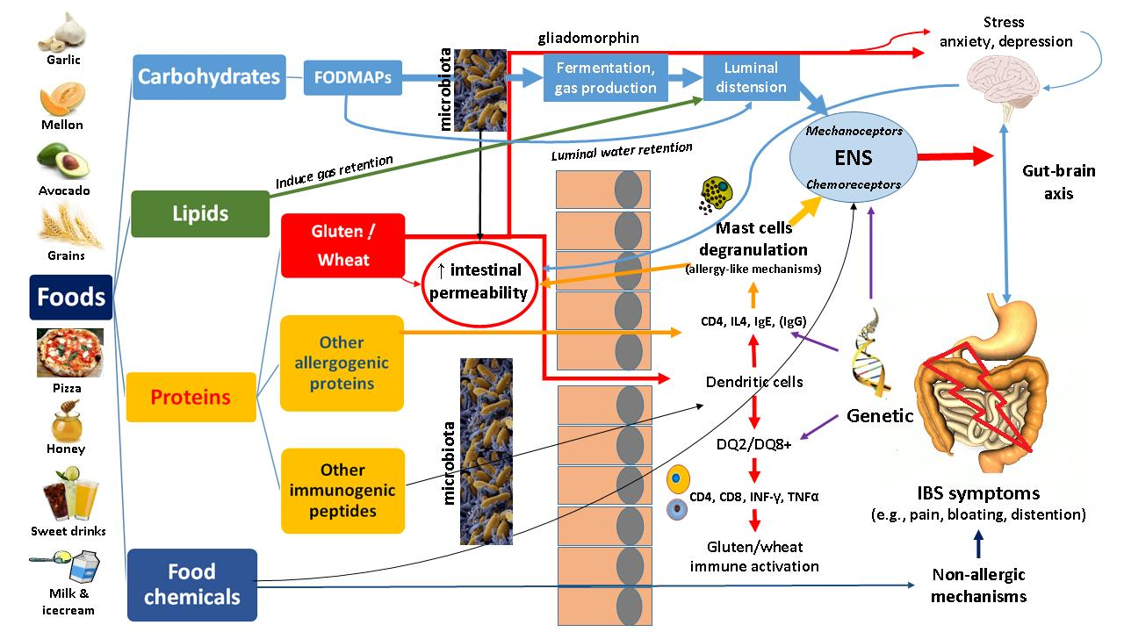
Dietary factor-driven mechanisms triggering NCG/WS
ATIs
Readapted from De Giorgio R, Volta U & Gibson P, GUT 2016; 65:169-78

Slide 7
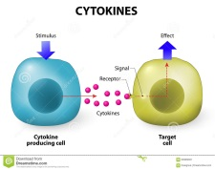

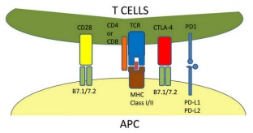
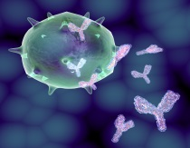
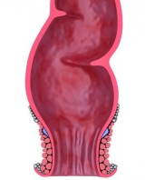
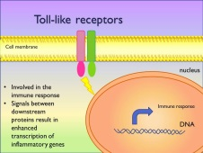
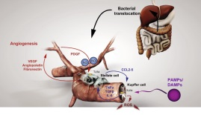

Innate more than adaptive immunity involved in NCG/WS
Innate
Adaptive
²Cytokines
⁴CD4+ T-cells
↑ gluten-stimulated cytokine
secretion from PBMC
^{5,6}B-cells
↑ IFN-γ
¹TLRs
³Innate
lymphoid cells
(ILC1)
⁶Bacterial translocation
↑ AGA IgG
↑ AGA IgM
↑intestinal
expression
↑ ILC1 with
gluten intrarectal
challenge
Abs to microbial antigens
¹Sapone A., et al., BMC Medicine, 2011; 9:23
²Vazquez-Roque M.I.et al., Gastroenterology, 2013; 144:903-11;
³Di Liberto D., et al., Clin Transl Gastroenterol, 2016; e-pub
⁴Brottveit M., et al., AJG 2013; 108:842-50
⁵Volta U., et al., J Clin Gastro 2012; 46:680-5;
⁶Uhde M., et al., Gut, 2016; e-pub

Slide 8

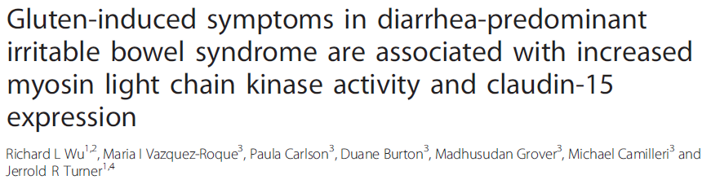
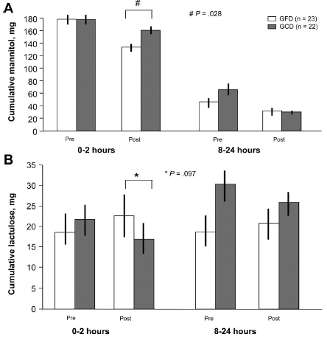
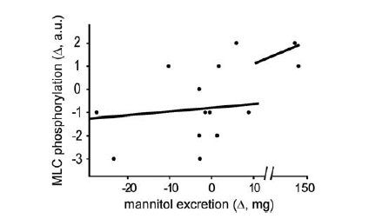
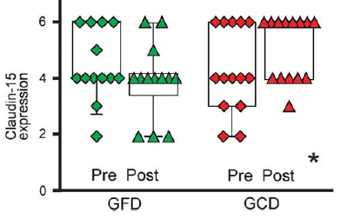
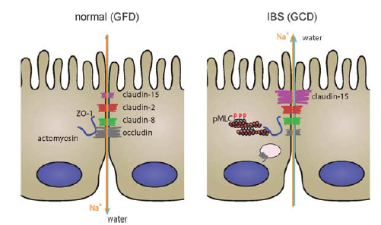
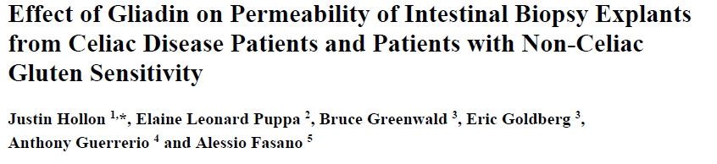
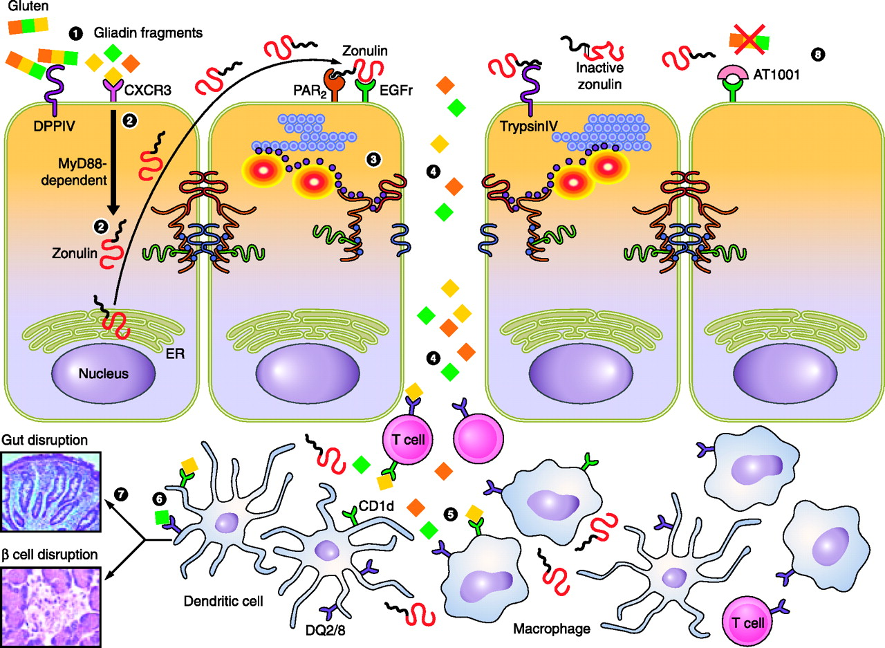
Increased small intestinal permeability in NCG/WS
Gastroenterology 2013;144:903-911
Increased small intestinal permeability by lactulose-mannitol test in DQ2/DQ8+ IBS gluten-sensitive patients
Nutrients. 2015;7:1565-76
High duodenal myosin light chain kinase activity and elevated colonocyte claudin-15 expression, both markers of increased intestinal permeability, in pts with symptomatic gluten sensitivity. Both alterations reversible after GFD together with disappearance of symptoms
Zonulin up-regulation and disassembly of intercellular tight junctions in NCG/WS intestinal biopsies exposed to gliadin

Slide 9
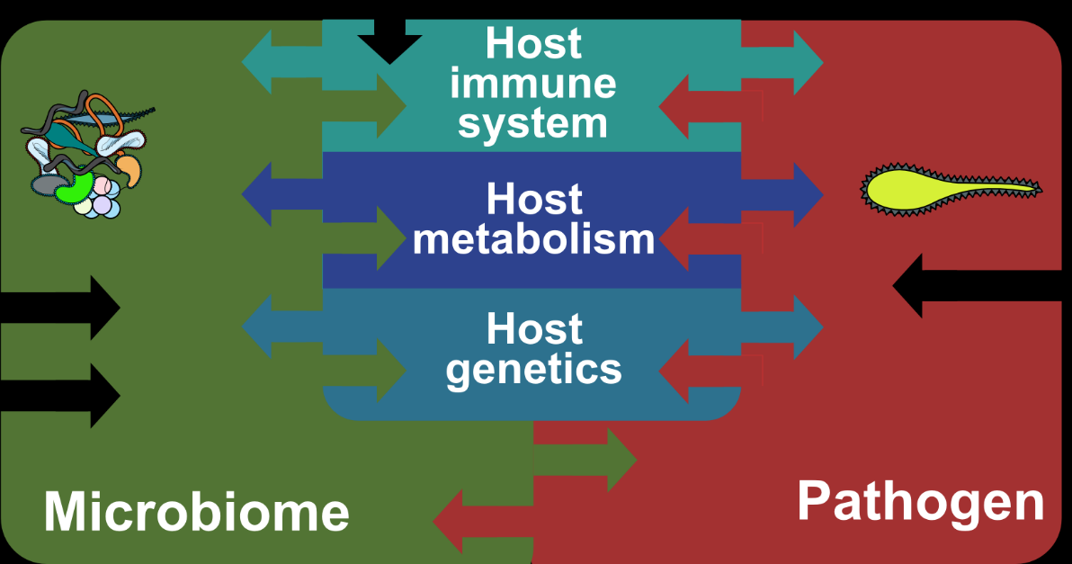
Microbiome in NCG/WS
Experimental data in HLA-DQ8 mice sensitized by gliadin showed that gut microbiome might contribute to enhance the inflammatory response to gluten
 | IBS/IBD | Celiac Disease | NCG/WS
Microbiome association | Proven in humans Saulnier DM et al Gastroenterology 2011 Manichanh C et al NRGH 2012 | Proven in humans de Palma G et al, BMC Microbiol 2010 | Tested in mice Natividad JM et al, PLoS One 2009
Dysbiosis may potentially trigger clinical manifestations in NCG/WS

Slide 10
Epidemiology of NCG/WS: still undefined and largely variable
USA Primary Care
USA Tertiary Care
Italian Tertiary Care
NHANES based on interview, biochemi-stry and physical examination 2009/10
49 NCG/WS/7762 patients (0.6%)
1 in 158 subjects
Multicenter study in tertiary care centers coordinated by Bologna University 2012/13
391 NCG/WS/12255 patients (3.2%)
1 in 31 subjects
Center for Celiac Disease University of Maryland from 2004 to 2009
347 NCG/WS/5896 patients (6.0%)
1 in 17 subjects
Di Giacomo D et al,
Scand J Gastroenterol 2013
Sapone A et al,
BMC Medicine 2012
Volta U et al,
BMC Medicine 2014

Slide 11

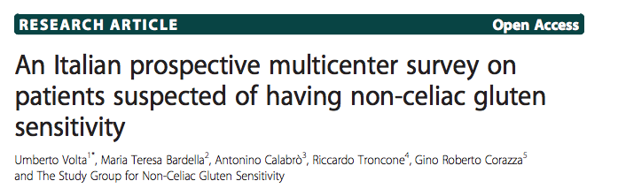
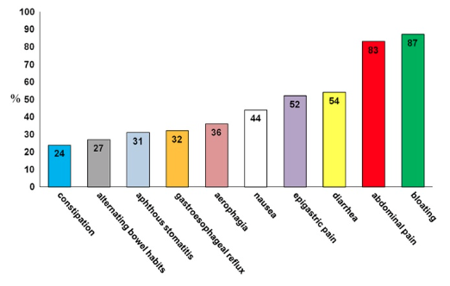
2014;12:85
Gastrointestinal symptoms in NCG/WS
F/M 5:1
Mean age
38 years
(range 3-81)

Slide 12
2014;12:85

Slide 13
Associated disorders in NCG/WS
IBS coexisted in about 50% of cases
Food intolerance (i.e, lactose and fructose
intolerance) was detected in 1/3 cases
About 20% of patients showed IgE-mediated
allergy (mites, graminaceae, parietaria, shell-
fish and other food antigens)
Nickel allergy was found in 15% of cases
Autoimmune disorders (i.e., Hashimoto
thyroiditis, autoimmune gastritis, psoriasis,
alopecia areata) were detected in 14% of cases
Volta U et al., BMC Medicine 2014;12:85

Slide 14
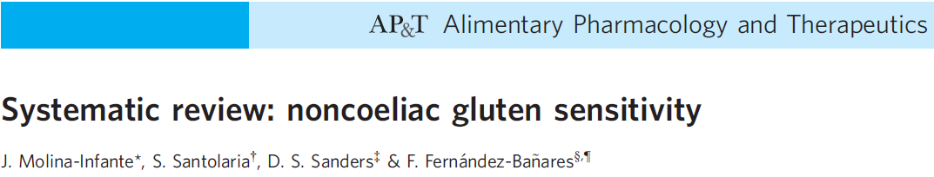
Aliment Pharmacol Ther. 2015 May;41(9):807-20
Author, Journal, Year | NCGS cases | Familiy history of CD % | Malabsorption signs (%)
Massari S, Int Arch Allergy Immunol 2011 | 77 | Not reported | Low ferritin (12%) Folate deficiency (8%)
Carroccio A, Am J Gastroenterol 2012 | 70 | 14% | Anaemia (70%)
Volta U, BMC Medicine 2014 | 486 | 18% | Low ferritin (23%) Low vitamin D (11%) Folate deficiency (11%)
Aziz I, EJGH 2014 | 186 | 10% | Low ferritin (16%) Folate deficiency (7%) Vitamin B12 def. (3%)
Kabbani A, Am J Gastroenterol 2014 | 125 | 13% | Low vitamin D (16%) Low ferritin (2.4%)

Slide 15
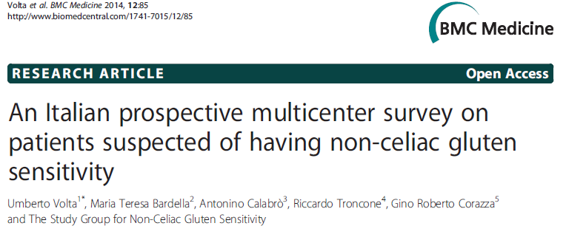
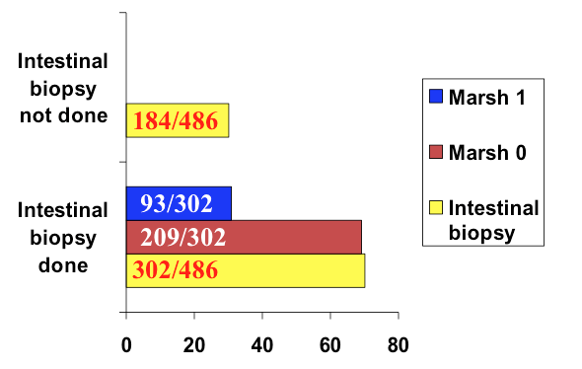
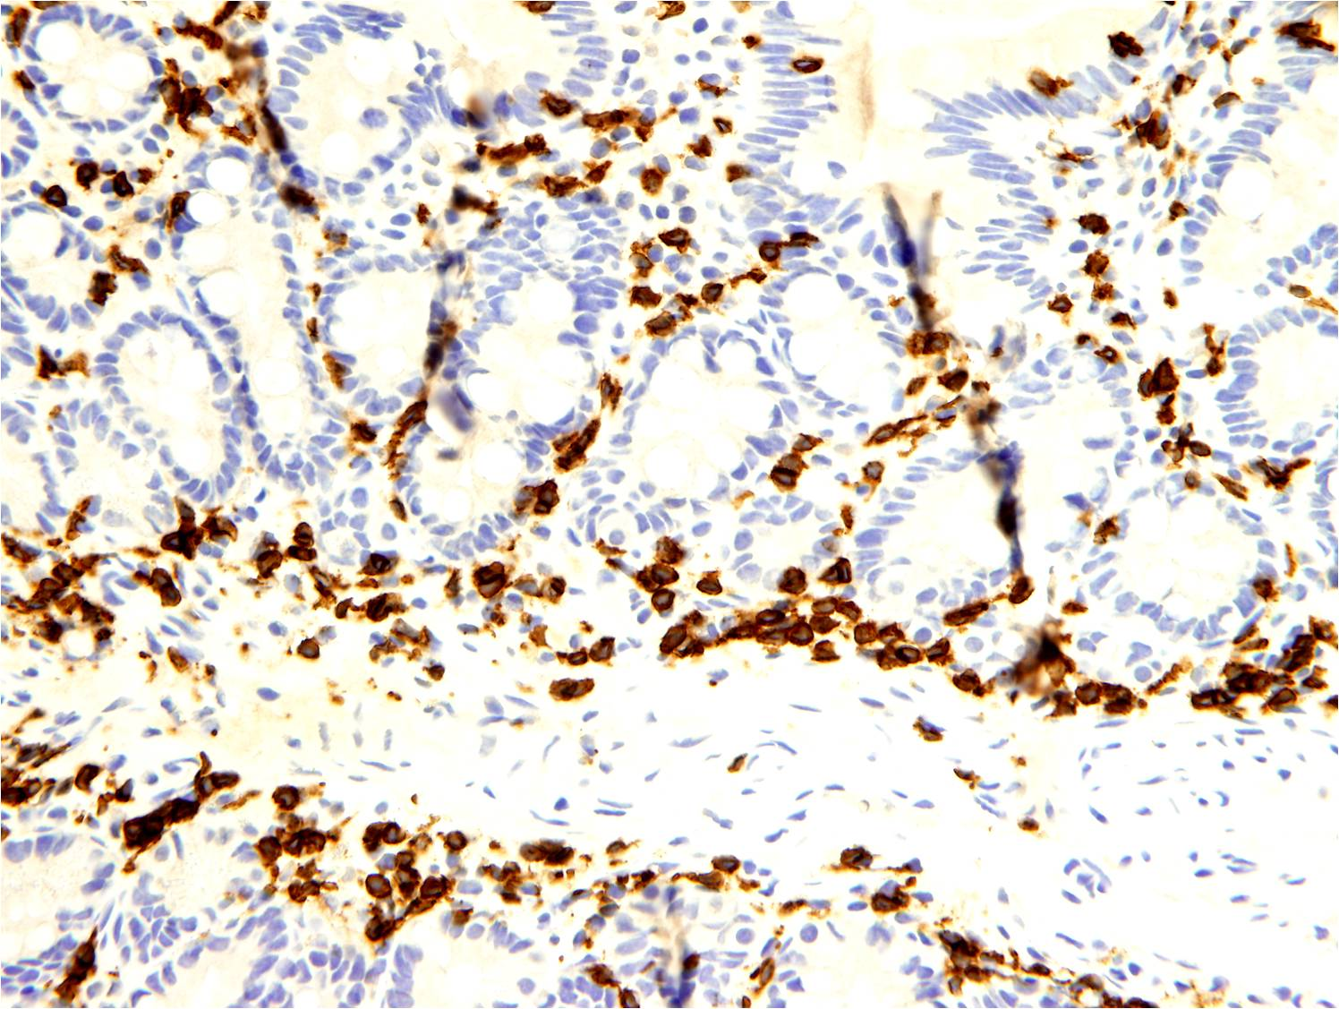
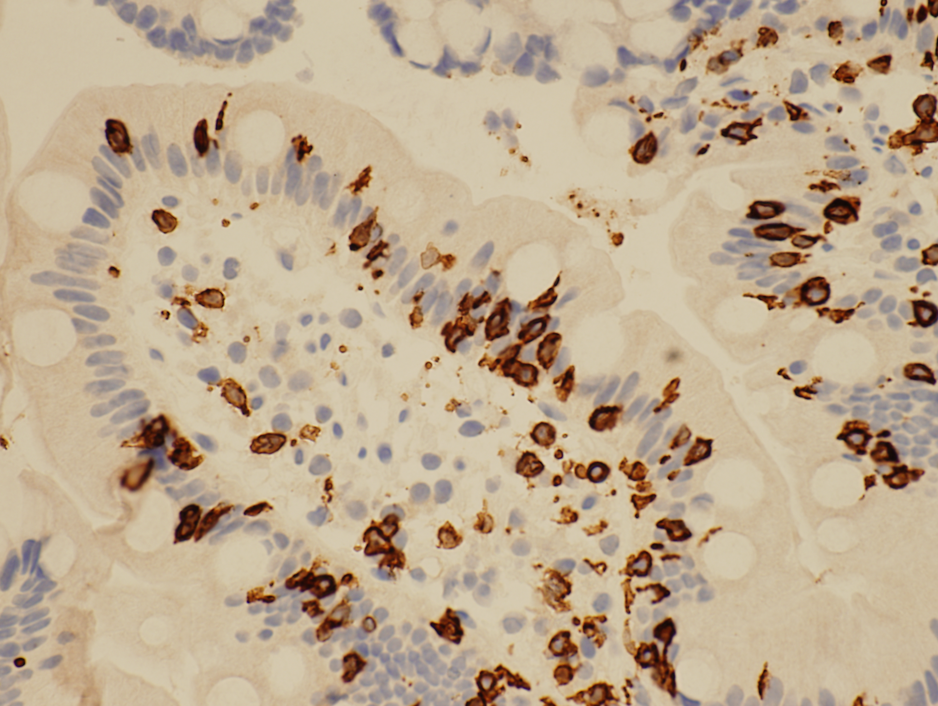
‘palisade’ pattern
‘clusterized IEL’
CD3+ T lymphocytes:
linear distribution in the deeper part
of the mucosa and clusters in the villi
Possible histological pattern of NCG/WS ?

Slide 16
No correlation between NCG/WS
and HLA-DQ2/DQ8
%
Volta U et al, J Clin Gastroenterol 2012;46:680-5

Slide 17
NCG/WS: a likely persistent condition
200 pts confirmed as NCG/WS after DBPCC with 8-year follow-up
148 (74%) still on a strict GFD
52 (26%) on a GCD
P < 0.001
145 (98%) symptom-free
30 (58%) symptom-free
Carroccio A et al. Gastroenterology. 2017 Mar 29. pii: S0016-5085(17)30343-8. Epub ahead of print

Slide 18
Towards a diagnosis of NCG/WS
based on positive criteria
Evaluation of symptom variation after GFD by a modified version of the Gastrointestinal Symptom Rating Scale (GSRS) integrated with extraintestinal manifestations
Identification of biomarkers (possibly established)
Standardization of double-blind, placebo-controlled (DBPC) trial as confirmatory diagnostic test
3th Consensus Conference on NCG/WS, Salerno 2014

Slide 19
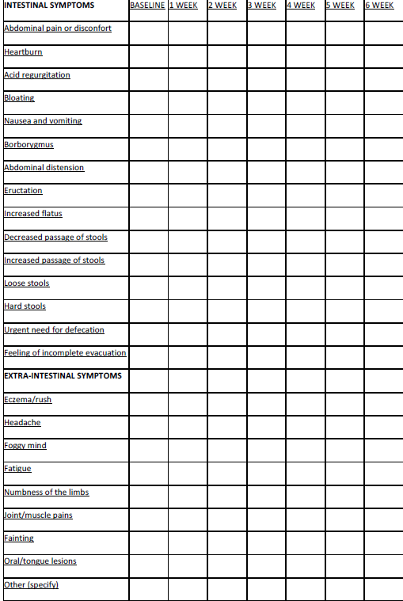
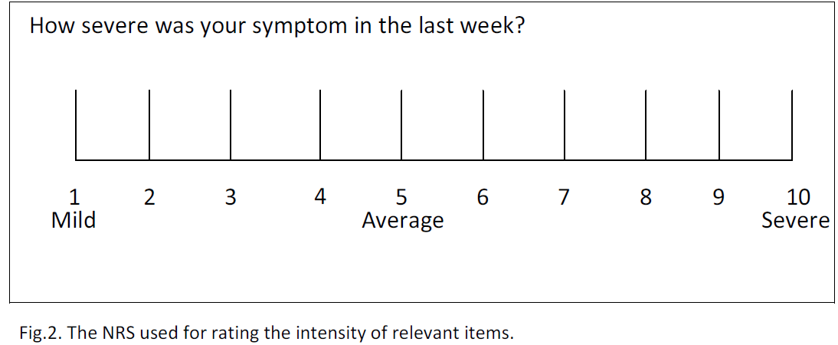
Modified version of GSRS for NCG/WS
(3rd Consensus Conference on NCGS)
Patient assessed by the questionnaire
at baseline on gluten-containing diet
Symptoms were scored from 1 (mild)
to 10 (severe)
At least 6 weeks of verified GFD
Data recording: weekly completion of
the questionnaire from week 0 to 6
Responders are those patients showing
≥ 30% reduction of three symptoms

Slide 20
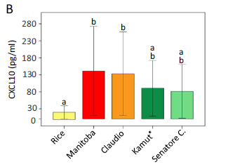
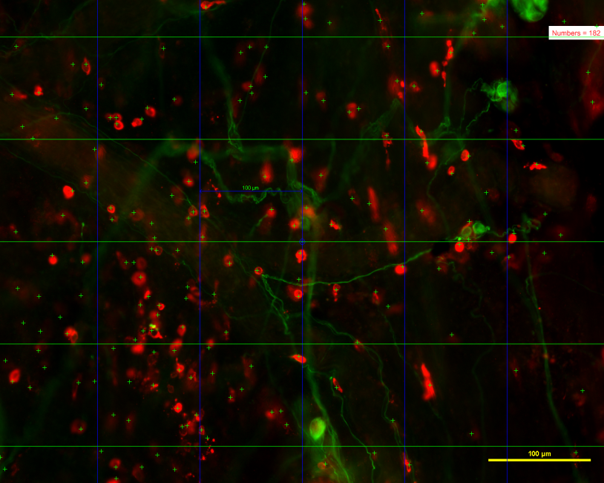
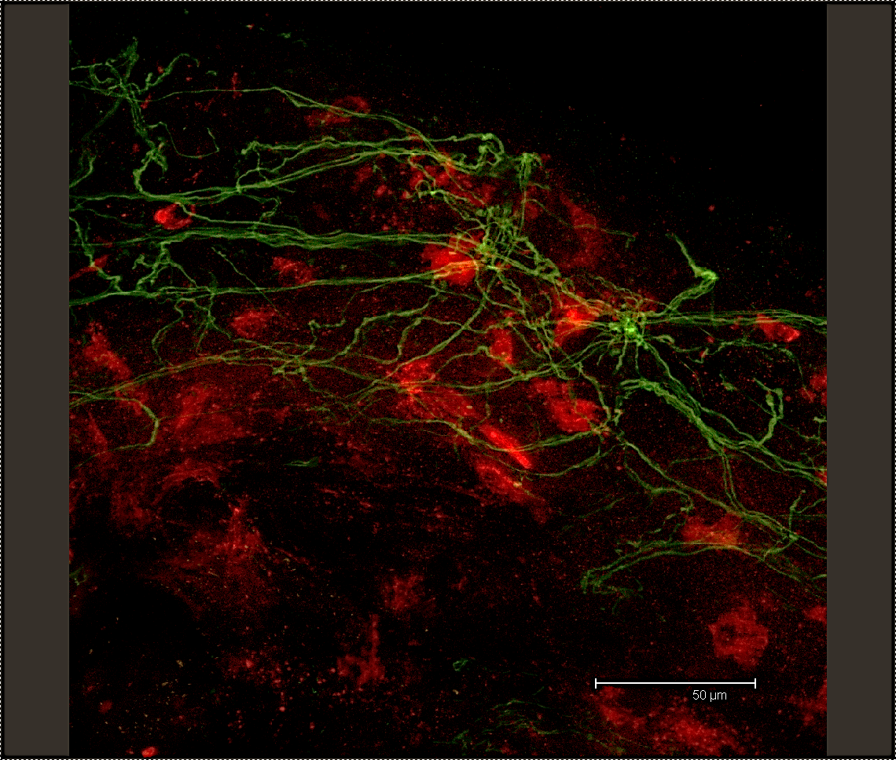
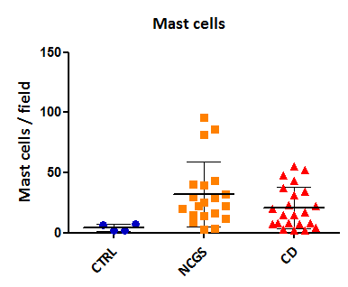
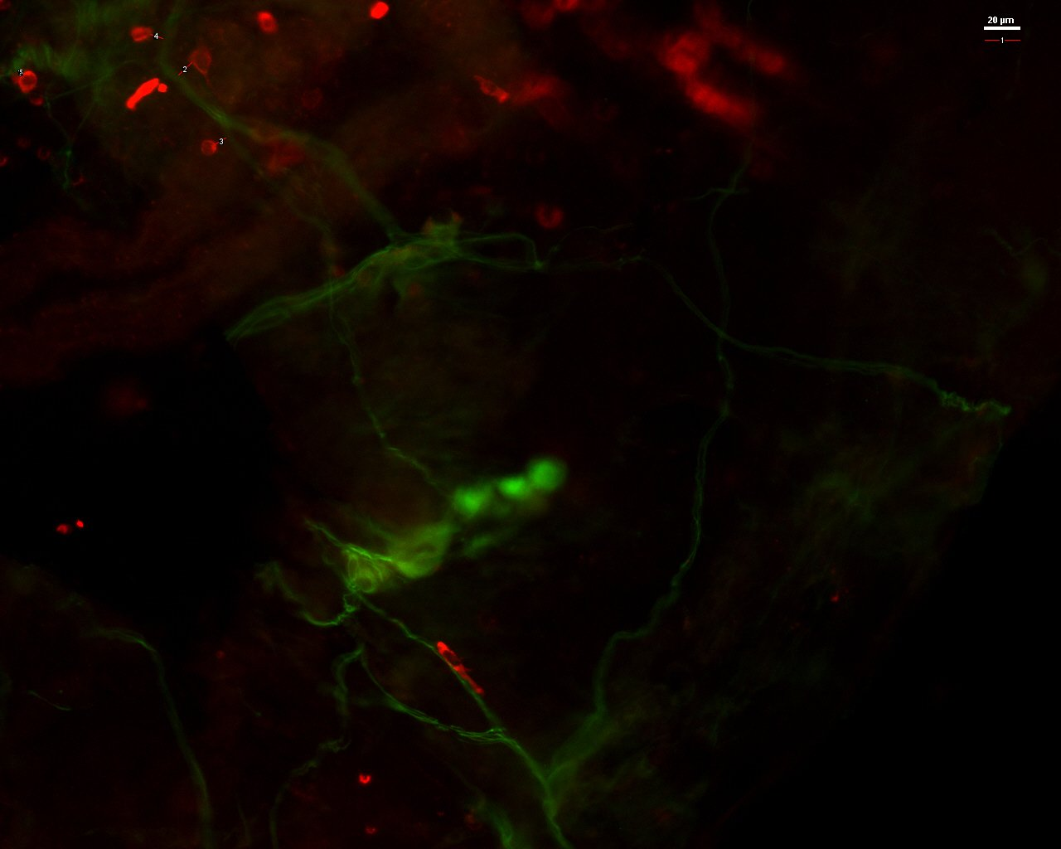
Biomarkers for NCG/WS:
Where are we? Many attempts, but no diagnostic tests
Volta et al, JCG 2012;46:680-5
Valerii et al, Food Chem 2015;176:167-74
Mast cells density
NF 200 kDa
Tryptase+
Close vicinity of mast cells to nerves
***
#
**
*
Barbaro et al, UEJG 2014; 2(suppl 1) A555
Giancola, Volta, Caio, De Giorgio unpublished

Slide 21
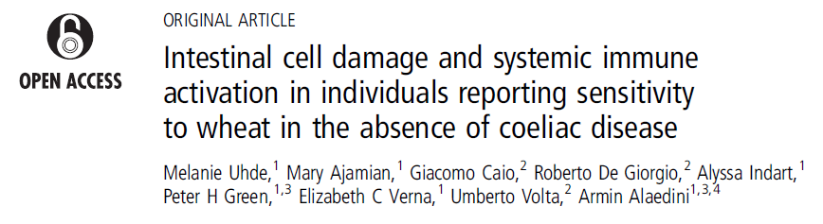
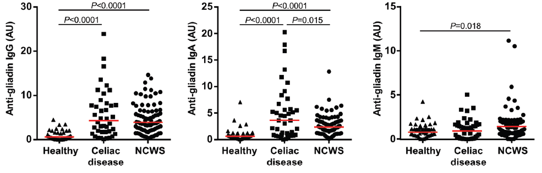
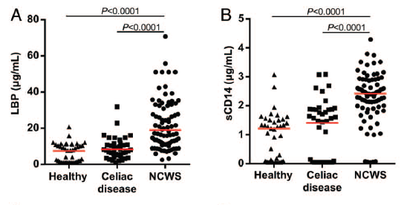
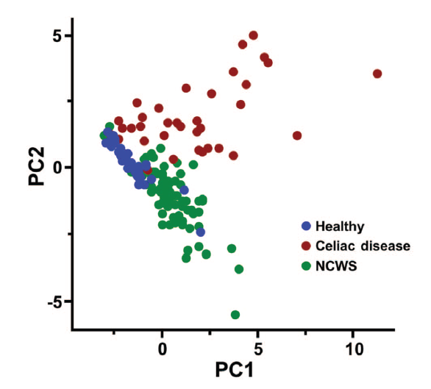
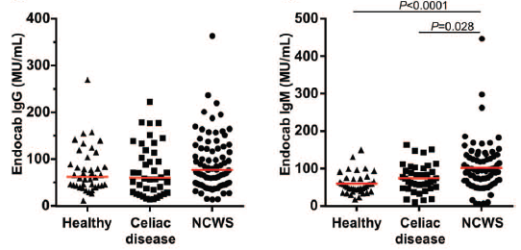
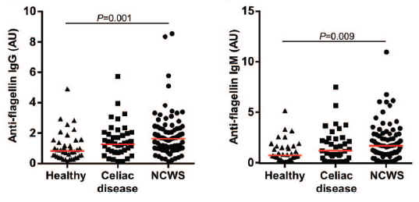
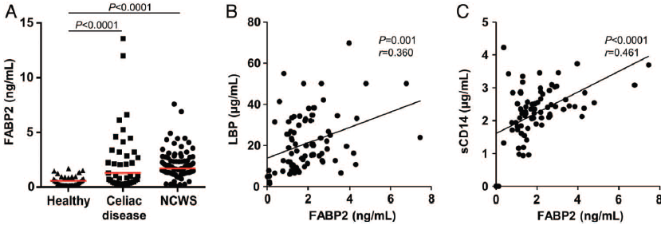
Gut 2016 July 25
IgM AGA
LBP
sCD14
Principal score analysis by means of these 6 biomarkers
IgM EndoCAB
IgM to flagellin
FABP-2

Slide 22
DBPC trials for NCG/WS
Study design | Patients | Gluten/wheat vs placebo | Results
Crossover DBPC Cooper, 1980 | 8 pts with diarrhea responding to 46-month-GFD | Tomato soup without or with gluten (20g/d) | Symptom worsening induced by gluten in 6 pts
DBPC no crossover Biesiekierski, 2011 | 34 IBS pts (Rome III) responding to 6-week-GFD | Bread/muffin without or with gluten (16g/d) | Symptom worsening indu-ced by gluten in 13/19 pts
Crossover DBPC Carroccio, 2012 | 276 IBS pts (Rome II) improved after GFD | Capsules with wheat flour (13g/d) or xylose | Symptom worsening induced by wheat in 25% pts
Crossover DBPC Biesiekierski, 2013 | 37 IBS pts (Rome III) responding to 6-week-GFD | High -(16g/d) / low-gluten diet (2g/d) vs low FODMAP diet | Symptom worsening induced by gluten in 8% pts Response to low FODMAP
Cross-over DBPC Di Sabatino, 2015 | 61 pts with NCGS/NCWS responding to 2-year GFD | Capsules with gluten 4.375g/d) / rice starch | Symptoms worsening induced by gluten in 16% pts
Cross-over DBPC Zanini et al., 2015 | 35 pts with NCGS/NCWS responding to 6-month-GFD | Gluten containing flour/ gluten free flour | Symptom worsening induced by gluten in 34% pts
Cross-over DBPC Elli L et al., 2016 | 98 IBS pts (Rome III) responding to 3-week-GFD | Capsules with gluten 5.6 g/d) /rice starch | Symptom worsening induced by gluten in 28% pts
No standardization of the challenge; different vehicle of gluten administration

Slide 23
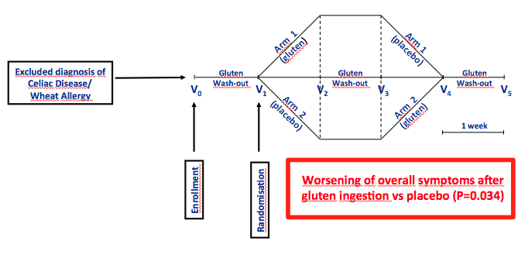
DBPC cross-over trial
Gluten-containing capsules (4.375 g/d) vs placebo (rice starch)
in 61 NCG/WS patients
(University of Pavia and Bologna, Italy)
Di Sabatino A., Volta U., et al., Clin Gastroenterol Hepatol 2015

Slide 24
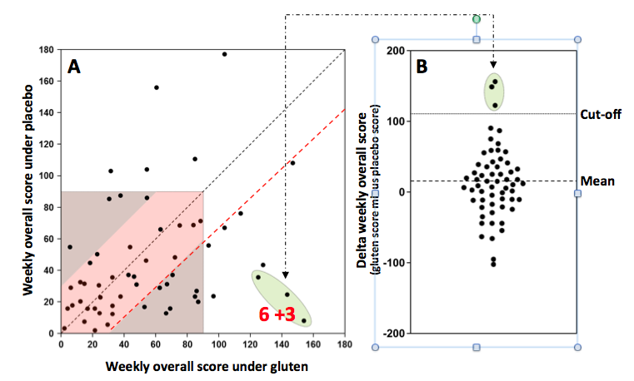
Distribution of patients according to
their weekly gluten and placebo overall scores
The analysis of the individual patients’ scores showed that only 15% of subjects (9/59)
had a significant worsening (very strong in 3 and evident in 6 pts) of symptoms when
ingesting gluten capsules.
Di Sabatino A., Volta U., et al., Clin Gastroenterol Hepatol, 2015

Slide 25
True NCG/WS confirmed by DBPC trials
Volta U et al. Exp Rev Gastroenterol Hepatol 2017; 11:9-18

Slide 26
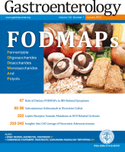
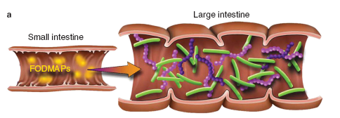
Fermentable Oligosaccharides, Disaccharides, Monosaccharides And Polyols -FODMAPs
Fructans | Wheat, onions, garlic, legumes
Galactans | Dried peas, beans, soy
Lactose | Milk, milk products
Fructose | Honey, fruits
Polyols | Fruits, sugar-free foods
Large intestine
Small intestine
Overflow
Intestinal distension

Slide 27
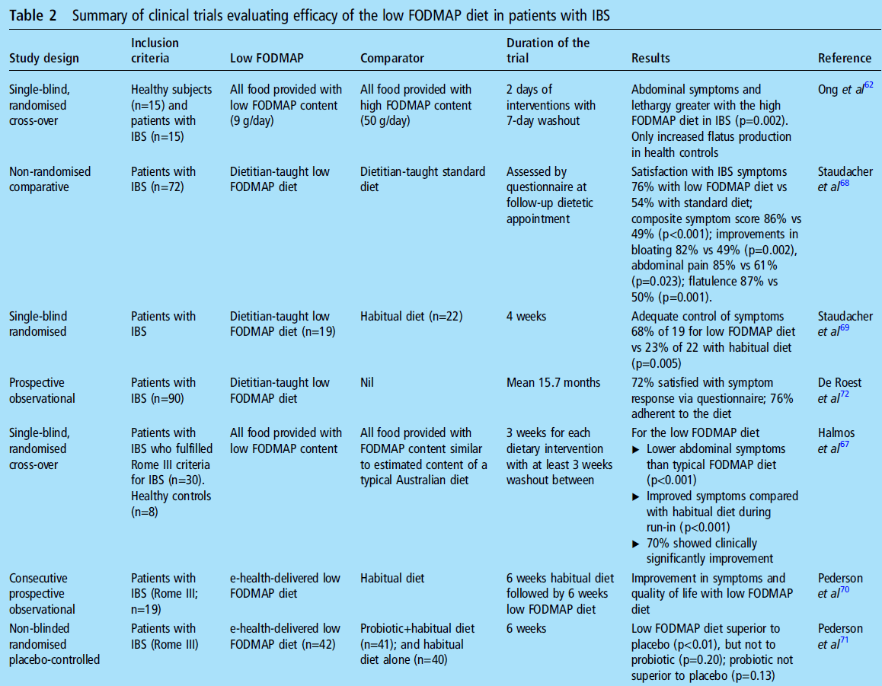

De Giorgio, et al. Gut 2016
Limitations:
lack of double blind
choice of placebo (such as habitual diet)
short term of the studies (three days to some weeks)

Slide 28
Possible risks of a low FODMAP diet
Nutritional adequacy (low calcium and fibre intake)
Psychological risk leading to eating disorders (orthorexia nervosa)
Gut microbiota changes (decrease of Bifidobacteria with increase of strongly butyrate producing Clostridal groups)
The health implications of such changes raise concerns about strict restriction of FODMAPs in the long term
Volta U et al, J Neurogastroenterol Motil 2016 ; 22:547-57
Krogsgaard LR et al, Aliment Pharmacol Ther 2017; 45:1506-13

Slide 29
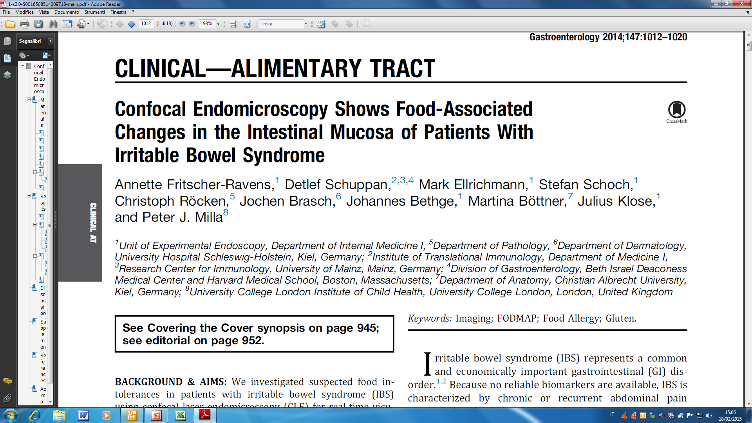
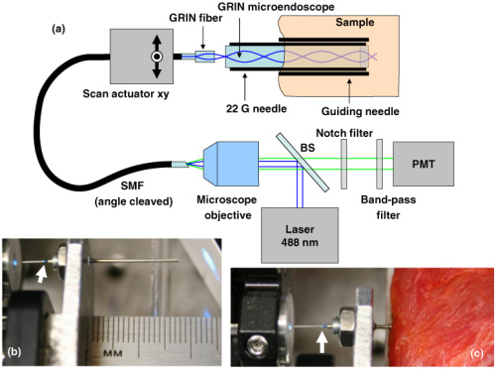
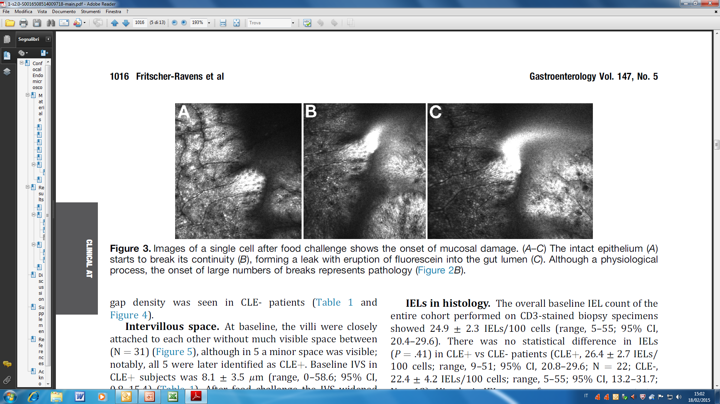
N= 36 IBS pts with suspected food intolerance;
Food antigens (WHEAT, cow’s milk, soy) administered via endoscope to duodenal mucosa
A real time response to food antigens, characterized by increased IELs, epithelial
leaks/gaps and widened intervillous spaces, in 22 out of the 36 IBS-food intolerance patients
Fritscher-Ravens A., et al., Gastroenterology 2014;147:1012–1020

Slide 30
Take home message
NCG/WS is a syndrome characterized by gastrointestinal (IBS-like) and extraintestinal symptoms elicited by gluten/wheat ingestion
Before diagnosing a patient as affected by suspected NCG/WS both celiac disease and wheat allergy must be ruled out
Although the number of patients with suspected NCG/WS has been reported as high as up to 6% in the general population, only 1/5 of them are confirmed to be true gluten/wheat sensitive by DBPCC trials.
No biomarker is available for NCG/WS diagnosis yet
Double-blind placebo-controlled with cross-over trials (DBPCC) by using 4 arms including pure gluten, ATIs, fructans and placebo is the right approach for identifying which component(s) of wheat is/are the culprits involved in symptom generation

