Slide 1
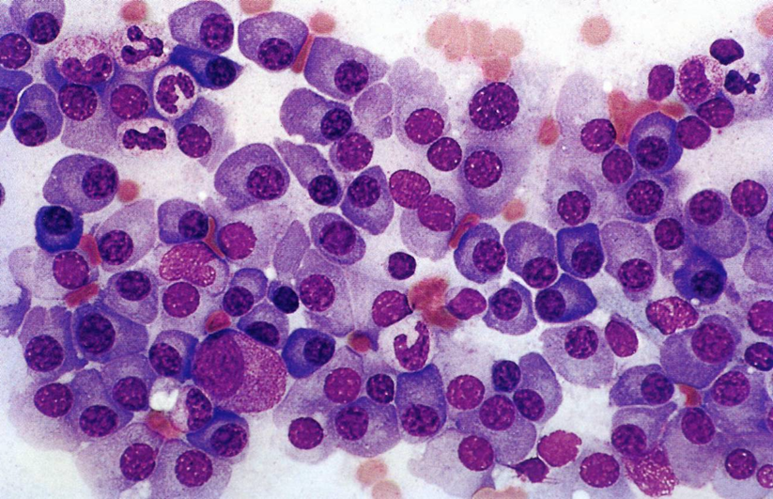
Multiple myeloma

Slide 2
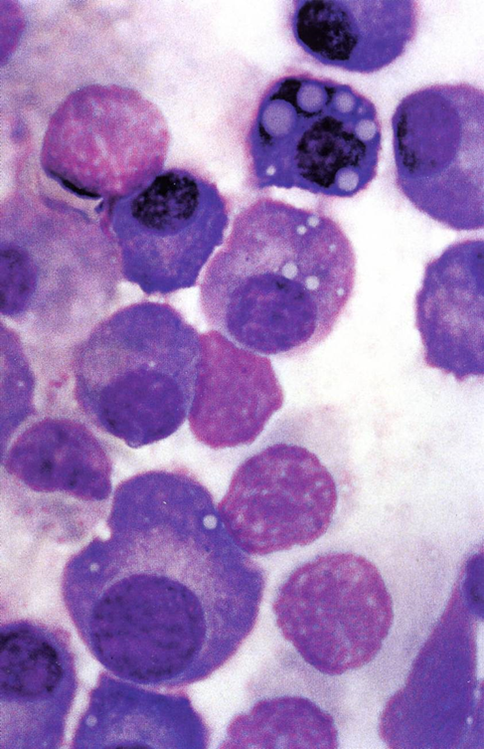
MM: definition
MM is a malignant disease characterised by proliferation of clonal plasma cells in the bone marrow and typically accompanied by the secretion of monoclonal immunoglobulins that are detectable in the serum or urine.
Rollig C et al. Lancet 2015; 385: 2197–208

Slide 3
MM and monoclonal Ig protein
In most patients, MM is characterized by the secretion of a monoclonal Ig protein (also known as M protein or monoclonal protein), which is produced by the abnormal plasma cells.
In 15–20% of patients, the MM cells secrete only monoclonal free light chains (micromolecular MM)
In <3% of patients, MM cells secrete no monoclonal protein.
●IgG – 52%
●IgA – 21 %
●K or λ light chain only (Bence Jones) – 16%
●IgD – 2%
●Biclonal – 2%
●IgM – 0.5%
●Negative – 6.5%
K is the predominant light chain isotype compared with λ, by a factor of 2 to 1 with the exception that λ light chains are more common in IgD MM and MM associated with amyloidosis
Kyle. Mayo Clin Proc. 2003;78:21.

Slide 4
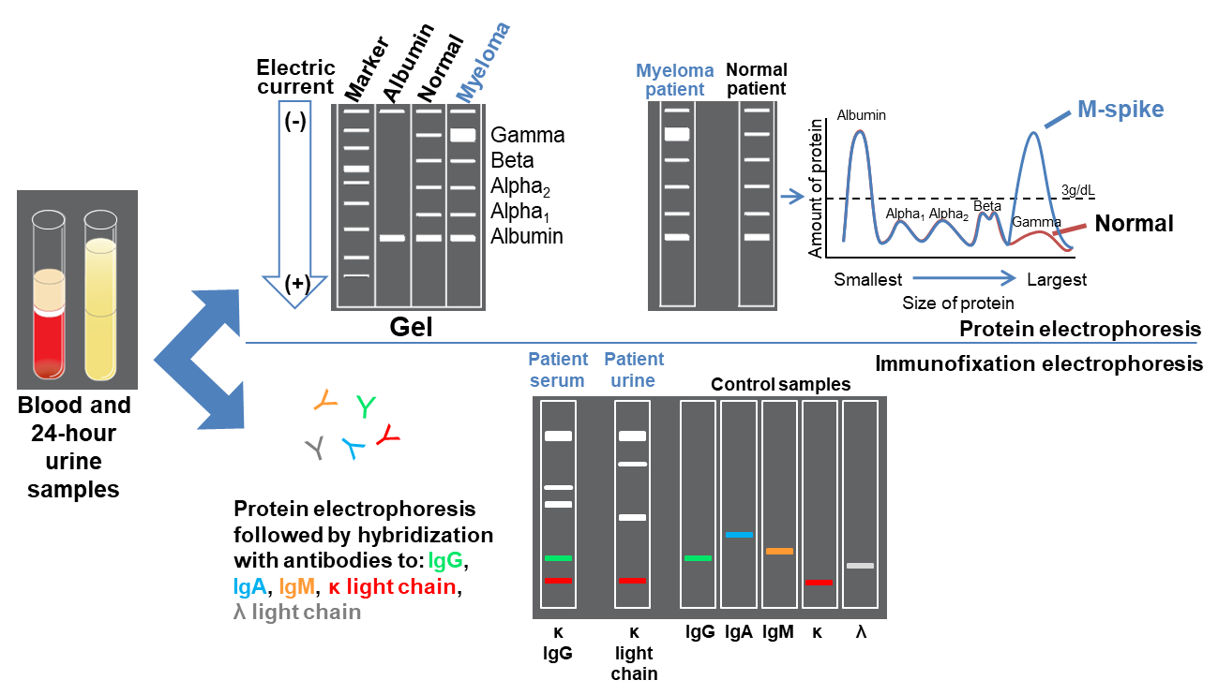
Monoclonal Gammopathies: Protein electrophoresis and immunofixation
Mayo Clinic. Test ID: PEL: Electrophoresis, Protein, Serum. Available at: www.mayomedicallaboratories.com/test-catalog/Clinical+and+Interpretive/80085. Accessed March 2016; Lab Tests Online. Protein Electrophoresis, Immunofixation Electrophoresis.
Available at: https://labtestsonline.org/understanding/analytes/electrophoresis/tab/test. Accessed March 2016.

Slide 5
Wintrobes Clinical Hematology 13th Edition

Slide 6
MM and monoclonal Gammopathies
MM is part of a range of disorders referred to as the monoclonal gammopathies.
Within these disorders, the most common is MGUS.
MGUS is asymptomatic and consistently precedes the development of MM, with or without an identified intervening stage, referred to as smouldering multiple myeloma (SMM).
Nearly 15% of patients with MGUS will progress to MM, and ~20% will progress to MM or a related condition (such as AL amyloidosis, Waldenstrom macroglobulinaemia or a lymphoproliferative disorder) over 25 years.
Wintrobes Clinical Hematology 13th Edition

Slide 7
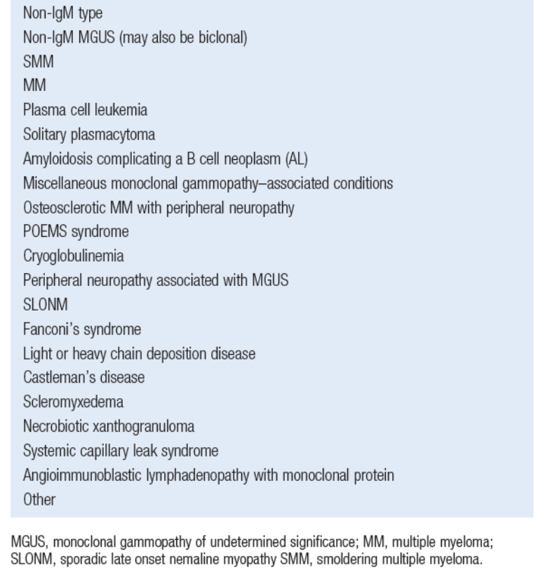
POEMS: polyneuropathy, organomegaly, endocrinopathy, M protein, skin changes.
SLONM: Sporadic late-onset nemaline myopathy.
Wintrobes Clinical Hematology 13th Edition

Slide 8
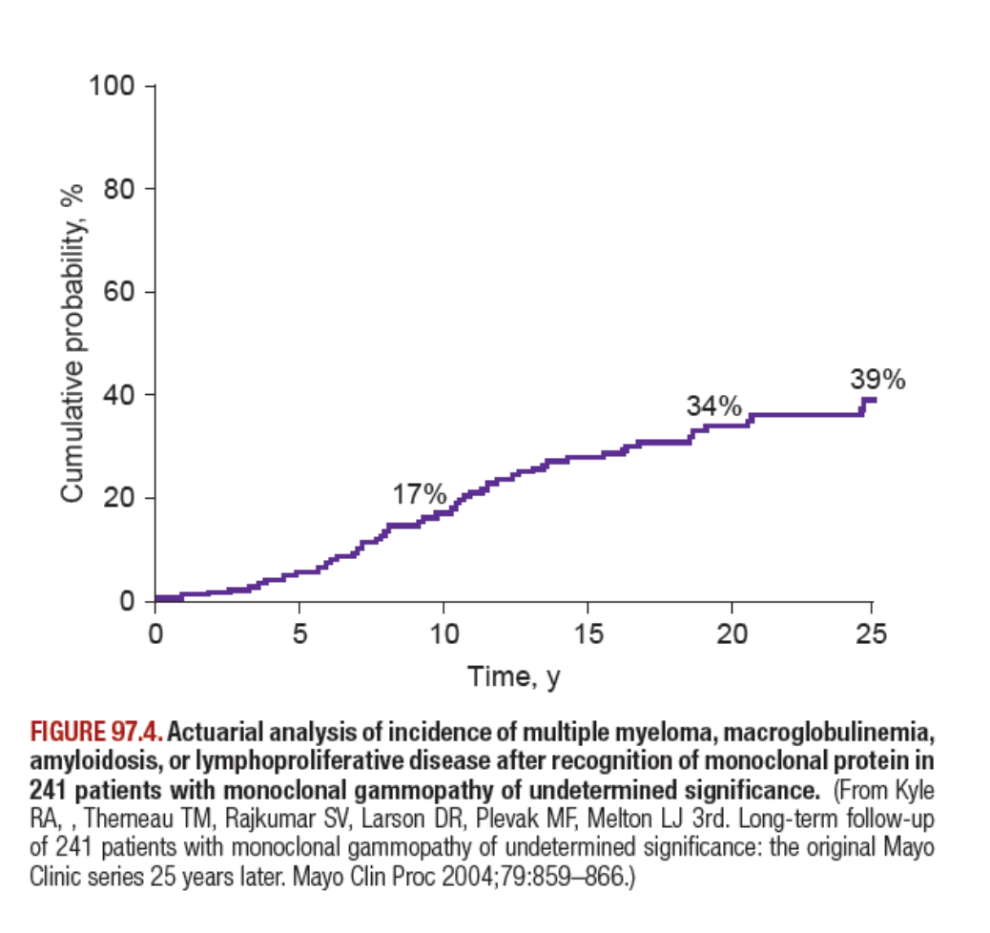
Wintrobes Clinical Hematology 13th Edition

Slide 9
Risk-stratification model to predict progression of MGUS to MM or related disorders
Serum M protein < 1.5 g/dL
IgG subtype
Normal FLC ratio (0.26-1.65)
Kyle et al. Leukemia (2010) 24, 1121–1127

Slide 10
MM: epidemiology
MM is the 2nd most frequent haematological malignancy with an age-adjusted incidence of 6 per 100 000 per year in the USA and Europe.
  The incidence is two to three times higher in African Americans, making it the most common haematological malignancy in this ethnic group.
The median age at diagnosis is 69 years, with 75% of patients being diagnosed above the age of 55 years
Two of three patients are men.
Braggio E et al. Cancer Cell. 2015;28:678
Rollig C et al. Lancet 2015; 385: 2197–208

Slide 11
Incidence of multiple myeloma in 2012.
Kumar SK et al. Nature Reviews Disease Primers. 2017;3:1

Slide 12
MM: epidemiology
Significant prevalence differences are observed between age, gender, and race, suggesting a genetic predisposition to MM
With the advent of more effective therapeutic strategies and improvements in supportive care, the median survival has increased from 3 years to 6 years in the past two decades.
The age-adjusted death rate for men and women between 2006 and 2010 in the USA was 3·4 in 100 000.
Rollig C et al. Lancet 2015; 385: 2197–208
Braggio E et al. Cancer Cell. 2015;28:678

Slide 13
MM: Aetiology
The cause of MM is unknown, although several studies have evaluated potential risk factors for this disease.
  Environmental and occupational exposures.
    Radiation (little evidence)
    Occupational exposure (farmers: debated)
    Exposure to hair dyes, benzene, petroleum products: little evidence
  Genetic factors
    Genome-wide association studies (GWAS) have identified multiple genetic loci associated with an increased risk of MM, in addition to loci associated with an increased mortality in diagnosed patients.
    Several single-nucleotide polymorphisms (SNPs) that could lead to MYC activation, inferior survival or clinical presentation were also identified.

Slide 14
MM: pathogenesis
MM cells are similar to long-lived, post-germinal centre plasma cells, and are characterised by
  strong bone marrow dependence,
  extensive somatic hypermutation of Ig genes,
  absence of IgM expression.
In most cases, MM is preceded by a pre-malignant MGUS condition, followed by an asymptomatic phase, called SMM.
The risk of progression to MM is estimated 0.5%–1% per year for the heavy chain and 0.3% for the light chain MGUS.

Slide 15
The development of monoclonal gammopathies
Kumar SK et al. Nature Reviews Disease Primers. 2017;3:1

Slide 16
Clonal composition of multiple myeloma during disease progression and therapy
Rollig C et al. Lancet 2015; 385: 2197–208

Slide 17
Tumour microenvironment
Key role of the interaction between MM cells and their bone marrow microenvironment (cell–cell and cell–matrix interactions, and growth factors and cytokines).
Cellular components of the microenvironment include bone marrow stromal cells, osteoblasts, endothelial cells, and cells of the innate and adaptive immune system, including regulatory T cells.
Crosstalk between MM and its microenvironment seems to be bidirectional.
Rollig C et al. Lancet 2015; 385: 2197–208
Kumar SK et al. Nature Reviews Disease Primers. 2017;3:1

Slide 18
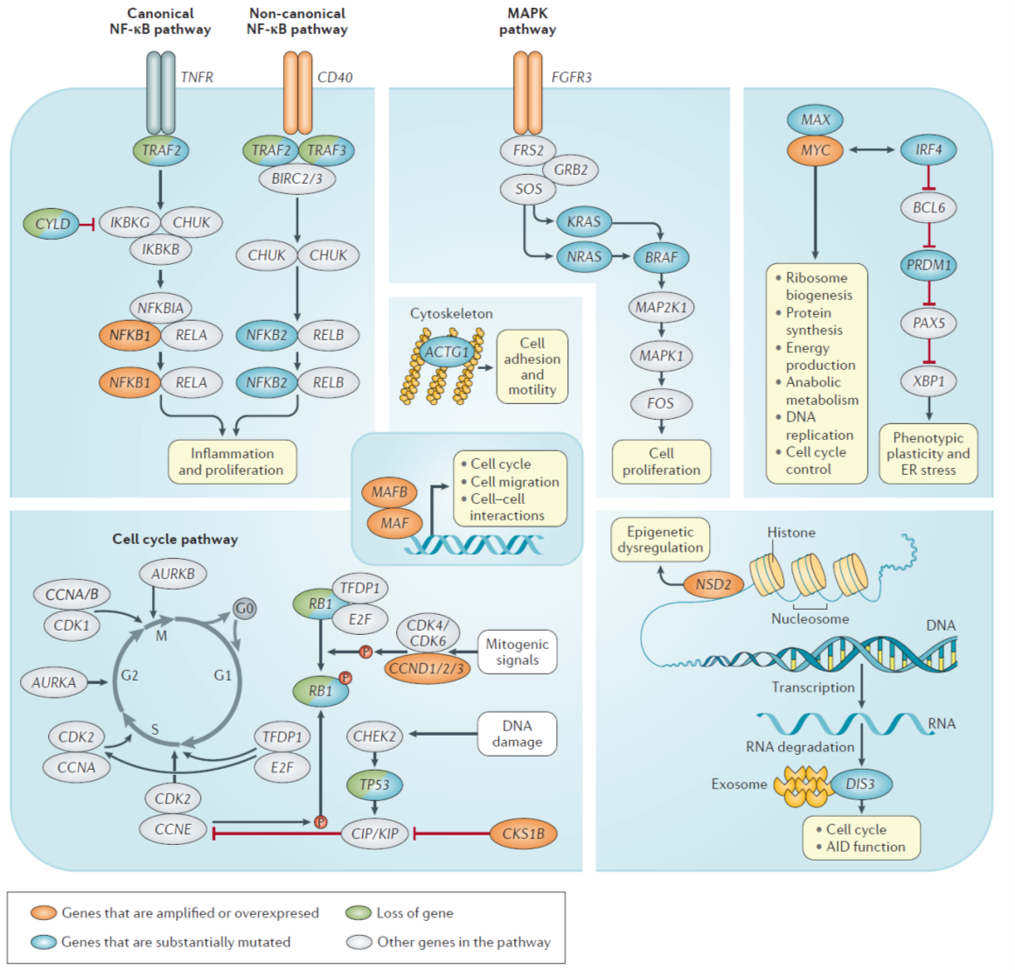
Signalling pathways affected in MM
Kumar SK et al. Nature Reviews Disease Primers. 2017;3:1

Slide 19
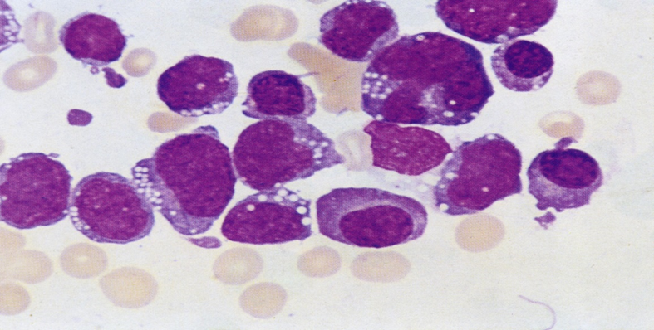
Pathobiology of end organ damage
Once the clonal plasma cell population is created and progresses to MM, patients develop symptoms (eg, hypercalcemia, lytic bone lesions, renal dysfunction, and anemia) related to
  the infiltration of plasma cells into the bone or other organs or to kidney
  damage from excess light chains or monoclonal Ig

Slide 20
Osteolytic bone lesions
Osteolytic bone lesions are the hallmark of MM.
The pathogenesis of lytic bone lesions characteristic of MM is mediated by an imbalance between the activity of osteoclasts and osteoblasts with:
  enhanced osteoclastic activity
  marked suppression of osteoblastic activity (in contrast to other malignancies).
As a result, MM bone lesions tend to be purely osteolytic and better visualized on plain radiographs compared with other bone metastases from solid tumors that tend to have an osteoblastic component and are better visualized on radionucleotide bone scans.

Slide 21
Osteolytic bone lesions
Increased osteolytic activity is mediated by
  an increase in RANKL (receptor activator of nuclear factor kappa-B ligand) expression by osteoblasts (and plasma cells)
  a reduction in the level of its decoy receptor, osteoprotegerin (OPG).
This leads to an increase in RANKL/OPG ratio, which causes osteoclast activation and bone resorption.
  Increased levels of macrophage inflammatory protein-1 alpha (MIP-1alpha, CCL3), IL-3, and IL-6 produced by marrow stromal cells also contribute to the overactivity of osteoclasts.
  Increased expression of SDF-1alpha by stromal cells and MM cells causing osteoclast activation by binding to CXCR4 on osteoclast precursors.

Slide 22
Osteolytic bone lesions
In addition to osteoclast activation, there is active suppression of osteoblasts in myeloma.
This is most likely related to
  increased levels of IL-3, IL-7, and dickkopf 1 (DKK1), which inhibit osteoblast differentiation.
  MM cells express DKK1, an inhibitor of Wnt signaling.
  An increased expression of DKK1 by these cells has been associated with presence of focal bone lesions in MM.
  Increased IL-3 and IL-7 levels may also play a role.

Slide 23
Hypercalcemia
Hypercalcemia appears to be a product of osteoclast activating factors such as
  lymphotoxin,
  interleukin-6,
  hepatocyte growth factor,
  receptor activator of nuclear factor kappa B ligand (RANK ligand).

Slide 24
Anemia
Involvement of the bone marrow in MM can result in anemia due to
  replacement of normal hematopoietic tissue by tumor (myelophthisis)
  disruption of the bone marrow microenvironment.
The common occurrence of anemia in the setting of limited BM infiltration suggests that MM-associated anemia is not entirely due to BM replacement by MM cells.
  In MM, the BM contains lower than normal numbers of hematopoietic stem and progenitor cells.
  This appears to be at least partially due to changes in the BM microenvironment.
Elimination of MM cells and restoration of the normal BM environment may result in repopulation with these precursors and reversal of the anemia.

Slide 25
Kidney disease
Kidney disease in patients with monoclonal gammopathies usually results from
  the production of monoclonal Ig or Ig fragments (ie, light or heavy chains)
  clonal proliferation of plasma cells or B cells.
Kidney injury may also result from causes unrelated to monoclonal proteins.
Mechanisms of kidney injury in plasma cell malignancies can be grouped into
  Ig-dependent
  Ig-independent

Slide 26
Kidney disease
The 3 most common forms of Ig-dependent kidney injury include:
  cast nephropathy, in which casts and crystals composed of filtered monoclonal Ig and other urinary proteins obstruct distal renal tubules, often precipitously, and typically incite an accompanying tubulointerstitial nephritis;
  AL amyloidosis, in which primarily monoclonal light chains and other proteins together form β-pleated sheets in the glomeruli;
  monoclonal Ig deposition disease (MIDD), in which intact or fragmented light chains, heavy chains, or both deposit along glomerular and/or tubular basement membranes.
Heher EC et al. Blood. 2010;116(9):1397-1404)

Slide 27
3 distinct syndromes account for most cases of Ig-mediated kidney disease but virtually all nephropathologic syndromes have been observed.
Panel A. Amyloid fibrils consisting of monoclonal Ig and serum proteins disrupting glomeruli architecture.
Panel B shows MIDD. Monoclonal light chains kappa and/or heavy chains (IgG), deposit along glomerular (iii) and tubular basement membranes (iv), altering the glomerular structure and causing dose-dependent proximal tubular toxicity.
Panel C shows cast nephropathy. Filtered monoclonal Ig, Tamm-Horsfall, and other proteins form casts, which obstruct tubules and collecting ducts. Casts can rupture and result in interstitial inflammation.
Panel D shows interstitial inflammation. Inflammation also results from the processing of filtered monoclonal light chains, which induces NF-kB and other signaling pathwaysleading to cytokine-mediated inflammatory infiltrate and subsequent matrix deposition and fibrosis.
Panel E shows glomerular crescent. Virtually every recognized nephropathologic lesion has been described in association with paraproteinemia.
Heher EC et al. Blood. 2010;116(9):1397-1404)

Slide 28
Heher EC et al. Blood. 2010;116(9):1397-1404)

Slide 29

Dispenzieri & Kyle.Best Practice & Research Clinical Haematology. 2005;18:673–688.

Slide 30
Common characteristics of peripheral neuropathies in plasma cell dyscrasias
Rosenbaum E et al. Hematological Oncology. 2017;1–12.

Slide 31
Dispenzieri & Kyle.Best Practice & Research Clinical Haematology. 2005;18:673–688.

Slide 32
MM: Symptoms.
The most common clinical manifestations of symptomatic MM are
  anaemia,
  infections,
  lytic or osteopenic bone disease,
  renal failure,
Patients with MM might be diagnosed at an asymptomatic stage by chance.
Generally, MM is diagnosed at an earlier stage today than in the past.
Back pain, particularly in older patients, or unclear anaemia should prompt screening for the presence of MM.

Slide 34
MM: Clinical presentation
Symptoms and signs present in 5 percent or less included:
  paresthesias (5 percent),
  hepatomegaly (4 percent),
  splenomegaly (1 percent),
  lymphadenopathy (1 percent), and
  fever (0.7 percent).
  Pleural effusion and diffuse pulmonary involvement due to plasma cell infiltration are rare and usually occur in advanced disease.
As the use of "routine" blood work has become more common, patients are being diagnosed earlier in the disease course.

Slide 35
MM: Clinical presentation.
Extramedullary plasmacytomas (EP) are seen in approximately 7 % of patients with MM at the time of diagnosis, and is best diagnosed by PET/CT scan;
An additional 6 percent of patients will develop EP later in the disease course.
the presence of EP at diagnosis is associated with inferior survival.

Slide 36
Clinical entities of EMM
Touzeau C. Blood. 2016;127(8):971-976

Slide 37
Extramedullary MM
MRI (T1 weighted) showing an occipital mass with leptomeningeal involvement (A, white arrow) and multiple posterior medullary lesions (B, white arrows), in a relapsed MM patient who developed progressive ataxia.
Touzeau C. Blood. 2016;127(8):971-976

Slide 38
Neurologic disease
Radiculopathy, usually in the thoracic or lumbosacral area, is the most common neurologic complication of MM.
It can result from compression of the nerve by a paravertebral plasmacytoma or rarely by the collapsed bone itself.
  Cord compression
    occurs in approximately 5% of patients;
    This set of symptoms constitutes a medical emergency; MRI or CT myelography of the entire spine must be performed immediately, with appropriate follow-up treatment by chemotherapy, radiotherapy, or neurosurgery to avoid permanent paraplegia.
Peripheral neuropathy
    uncommon at the time of initial diagnosis and, when present, is usually due to amyloidosis.
CNS involvement
    Intracranial plasmacytomas are rare.
    Leptomeningeal myelomatosis is uncommon and more frequent in advanced stages

Slide 39
Clinical presentation.
Coagulation abnormalities.
  MM can be associated with hemostatic abnormalities, either bleeding or thrombosis.
  Bleeding/thrombosis may be present in as many as one third of patients and is related to thrombocytopenia, uremia, hyperviscosity, interference with coagulation factors and treatments.
Hypercalcemia.
  Rates of hypercalcemia at presentation have been decreasing in the last few decades, suggesting earlier diagnosis (rates from 18-30% to less than 10%)
  Hypercalcemia often causes renal insufficiency.

Slide 40
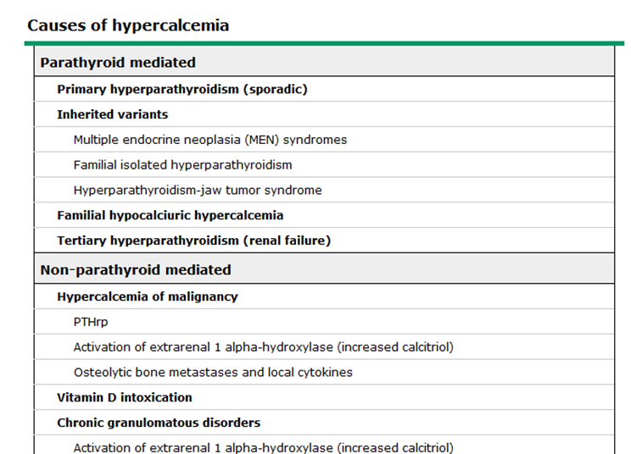
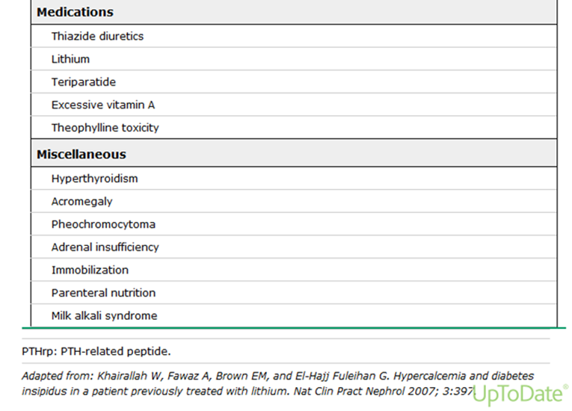

Slide 41
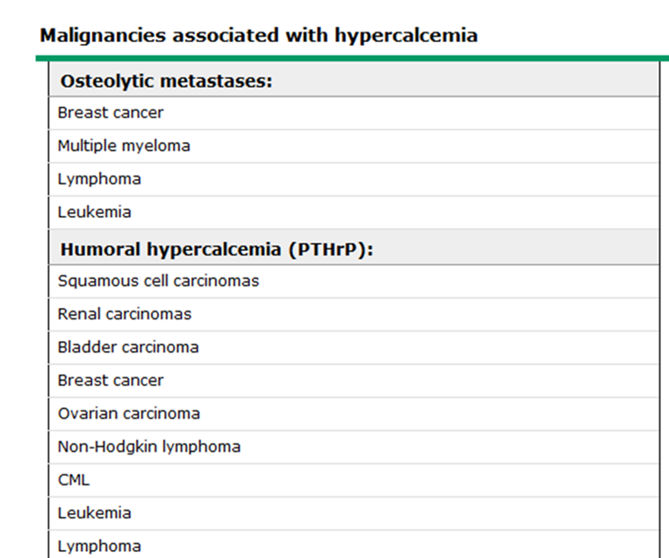


Slide 42
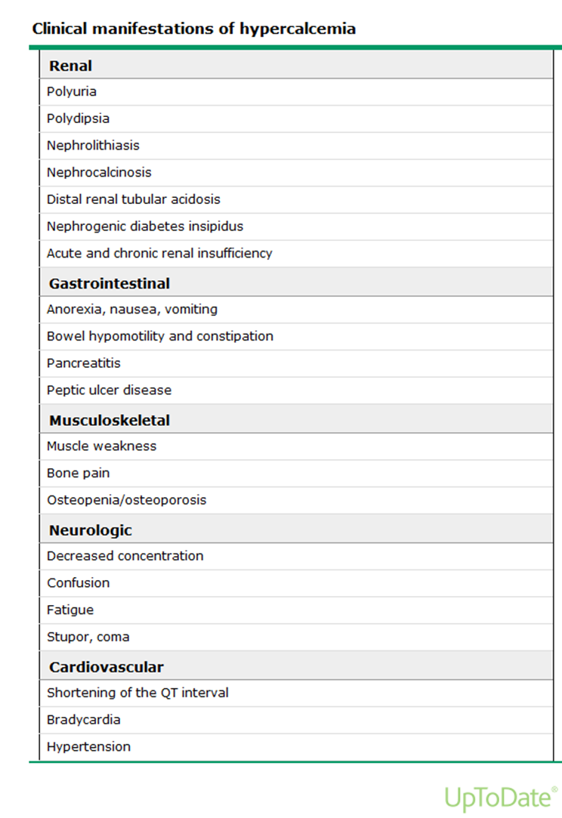

Slide 43
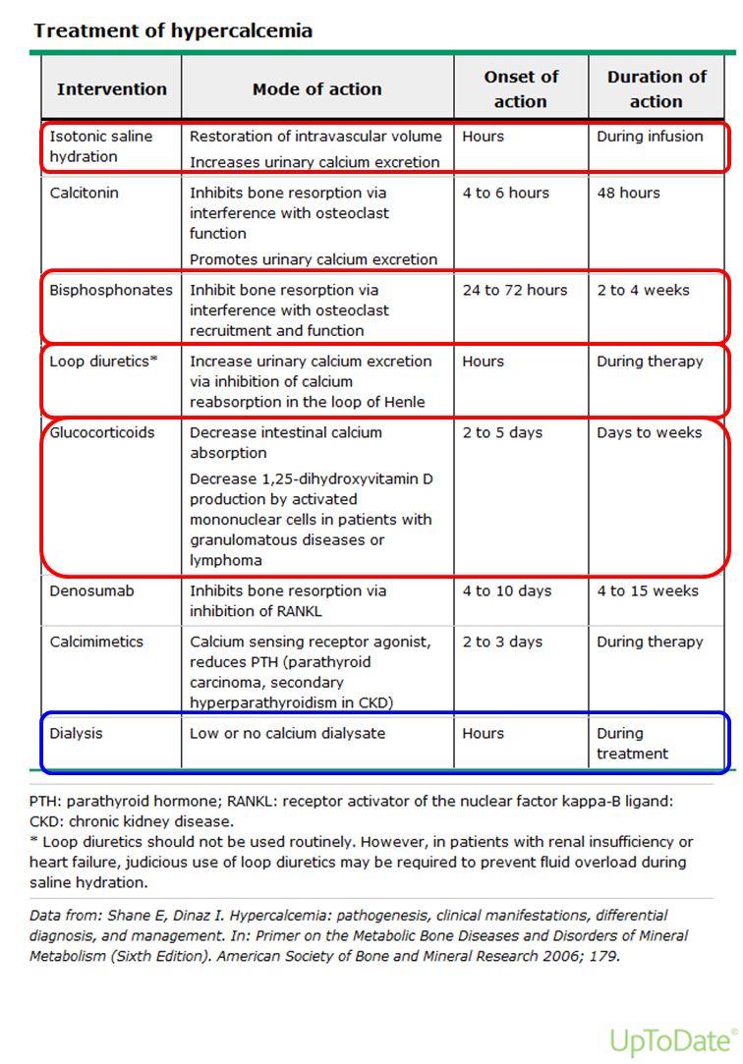

Slide 44
Rollig C et al. Lancet 2015; 385: 2197–208

Slide 45
Palumbo A et al. JCO. 2014;32:587-600.

Slide 46
Monoclonal Gammopathies: Protein electrophoresis and immunofixation
Mayo Clinic. Test ID: PEL: Electrophoresis, Protein, Serum. Available at: www.mayomedicallaboratories.com/test-catalog/Clinical+and+Interpretive/80085. Accessed March 2016; Lab Tests Online. Protein Electrophoresis, Immunofixation Electrophoresis.
Available at: https://labtestsonline.org/understanding/analytes/electrophoresis/tab/test. Accessed March 2016.

Slide 47

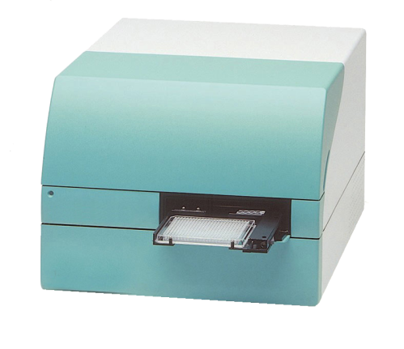
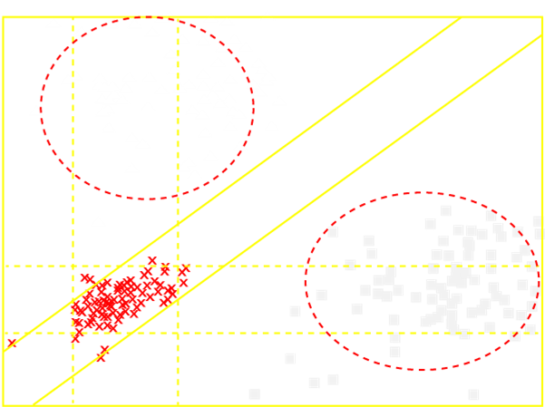
Establishing diagnosis: Free light chain assay
Serum sample
Nephelometer
High amount of λ FLC
x
Normal sera
λ light chain myeloma
κ light chain myeloma
Low amount
of FLC
High amount
of κ FLC
Bradwell. Lancet. 2003;361:489
Notes:
SFLC assay for patients with strong suspicion of MM or with negative serum protein electrophoresis
The serum sample is put into a machine that can determine the amount of specific proteins by passing light through the sample
The amounts of free light chains (κ and λ) are then plotted on a chart. Note that each dot on this chart represents a patient. If the dot falls outside of normal ranges, the patient has an excess amount of either κ or λ free light chain, which could indicate multiple myeloma
References
Images:
FLC assay in Bradwell. Lancet. 2003;361:489
Lab Tests Online: Available at: http://labtestsonline.org/understanding/analytes/free-light/tab/test. Accessed March 2016.
Serum free light chain testing provides complementary information. It can detect the low levels of free light chains that are sometimes all that is produced by a plasma cell disorder and can detect changes in the ratio of kappa and lambda production, which indicate an excess of one clone of plasma cells. Initially, the test is ordered along with a serum protein electrophoresis test to detect abnormal monoclonal protein (M-protein) production and to calculate a kappa/lambda free light chain ratio. If the protein electrophoresis test is abnormal, then an immunofixation electrophoresis test is performed to determine which immunoglobulin is present in excess. If a light chain disorder is detected, then the free light chain test may be ordered periodically to monitor the condition and to evaluate the effectiveness of treatment.
Results of a serum free light chain test will often be evaluated in conjunction with the results of a protein electrophoresis test. Free light chains will normally be present in the blood at low levels, but with a normal kappa/lambda ratio. Increased kappa free light chains and an increased kappa/lambda ratio may be seen with plasma cell disorders that produce excess monoclonal kappa light chains. Increased lambda free light chains and a decreased kappa/lambda ratio may be seen with plasma cell disorders that produce excess monoclonal lambda light chains. In general, significantly increased free light chain production and an abnormal kappa/lambda ratio indicate a poorer prognosis and an increased risk of disease progression.

Slide 48
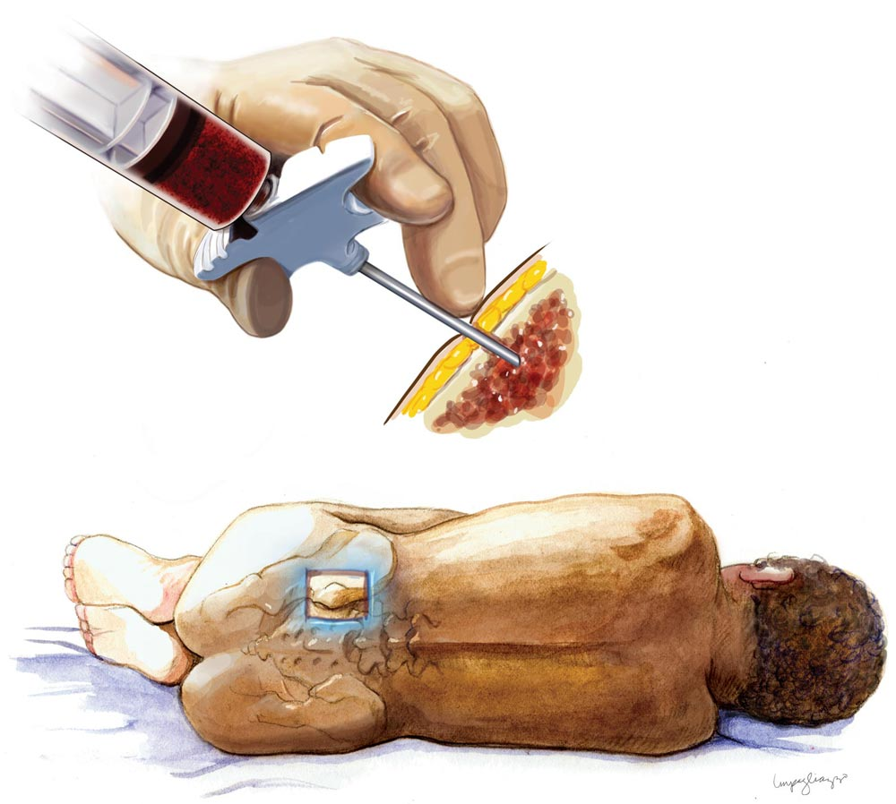
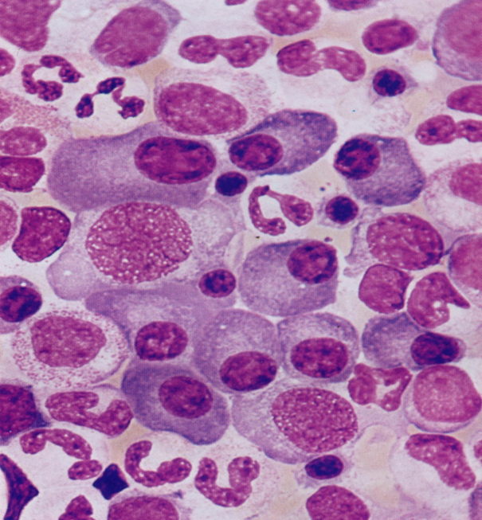
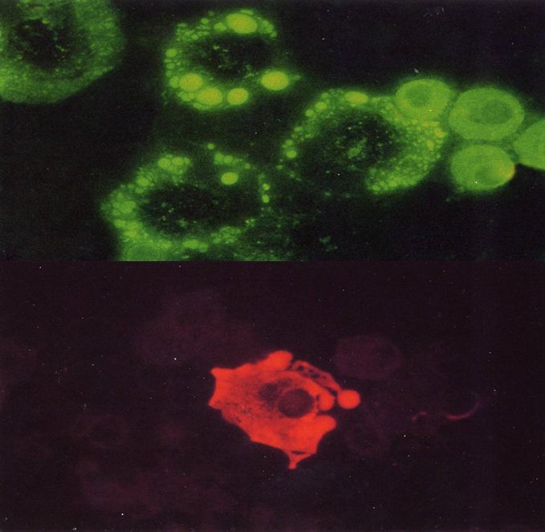
Establishing diagnosis: Bone marrow assessment
Mayo Clinic. Bone marrow biopsy and aspiration. Available at: www.mayoclinic.com/health/medical/IM01819. Accessed March 2016.
Notes:
Trephine biopsy to demonstrate aberrant plasma cell phenotype and/or monoclonality; confirm diagnosis

Slide 49
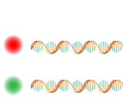

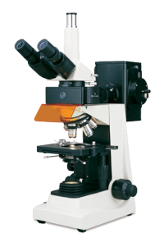


Determining prognosis: Assessment of genetic abnormalities by FISH
Example: Detection of chromosomal deletion by FISH in multiple myeloma
Chromosome 17-specific fluorescent probe
Chromosome 10-specific fluorescent probe
Hybridize
Bone
marrow
sample
Smear of
cells
Analyze by fluorescence microscopy
Del(17p) detected
Adapted from O'Connor. Nature Education. 2008;1:171.
Notes:
Favorable and unfavorable (in terms of prognosis) genetic lesions can be detected by conventional karyotyping and FISH; stratification of patients into risk groups helps in determining prognosis and in the selection and sequencing of therapy [NCCN 2015]
Target probes are fluorescently labeled and designed to bind to some specific chromosomal region of interest
If chromosomal regions targeted by probes are present in a cell, probes will bind, and fluorescent signals will be seen in the cell (one signal per chromosome carrying the target region)
In this example, chromosome 17 (commonly deleted in MM) is labeled with the red probe and chromosome 10 (not normally deleted in MM) is labeled with the green probe
Only one red signal is evident, which indicates that one copy of chromosome 17 contains the portion targeted by the probe, but the other does not (due to deletion); this provides evidence of deletion in one copy of chromosome 17
Reference
O'Connor. Nature Education. 2008;1:171. Available at: www.nature.com/scitable/topicpage/fluorescence-in-situ-hybridization-fish-327. Accessed March 2016.

Slide 50
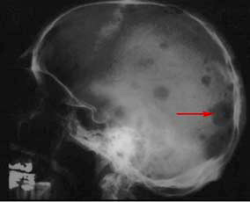
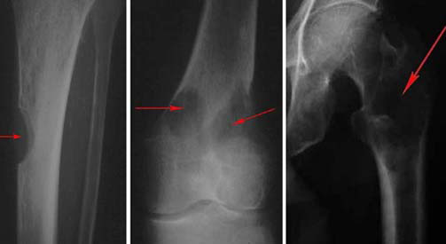
Establishing diagnosis: Skeletal survey
Reproduced with permission from OrthoInfo.
© American Academy of Orthopaedic Surgeons. http://orthoinfo.aaos.org.
Notes:
Skeletal survey for evaluating bone lesions and establishing diagnosis
MRI and PET scans are useful for determining prognosis
Skeletal survey should include post-anterior view of chest; antero-posterior and lateral views of the cervical, thoracic, and lumbar spine, humeri, and femora; lateral and antero-posterior view of skull; antero-posterior view of pelvis; and other symptomatic areas [Bird 2011]
CT or MRI should be used to clarify significance of plain radiographs, especially in parts of the skeleton where it is difficult to view lytic lesions such as ribs, sternum, and scapulae [Bird 2011]
Reference
Skeletal survey images from American Academy of Orthopaedic Surgeons. OrthoInfo. Available at: http://orthoinfo.aaos.org/topic.cfm?topic=A00086. Accessed March 2016.

Slide 51
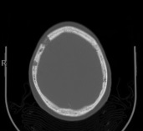
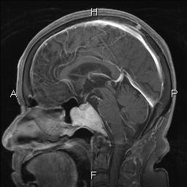
CT imaging and MRI are useful in the evaluation of lesions in suspected MM
CT¹
MRI²
Bone lesion
Plasmacytoma
1. Talamo. Bone lesions. Available at: http://www.myelomapennstate.net/Contents/04a-ClinManifest.htm. Accessed March 2016;
2. Terada. Cases J. 2009;2:9110.
Notes:
Similar to X-ray, CT imaging and MRI are useful in the evaluation of lesions when establishing a diagnosis of MM
The CT image on the left-hand side of this slide shows a characteristic osteolytic lesion in the skull of a patient with MM¹
The MRI on the right-hand side of this slide shows an intracranial plasmacytoma that evolved into MM²
MRI provides greater detail than CT and is recommended whenever spinal cord compression is suspected³
References
Talamo G. Bone lesions. Available at: http://www.myelomapennstate.net/Contents/04a-ClinManifest.htm. Accessed March 2016;
Terada T. Cases J 2009;2:9110;
Moreau P, et al. Ann Oncol 2013;24(Suppl. 6):vi133–7.

Slide 52
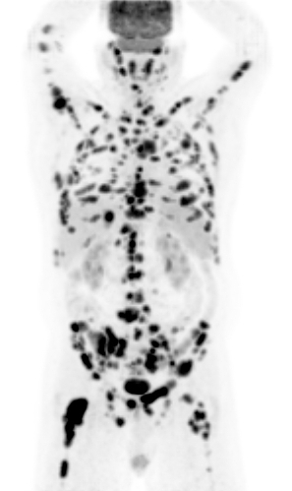
PET
PET provides a whole body image and shows only active MM lesions
PET is useful in the diagnostic work-up and in determining response to treatment
Bone lesions with active
metabolic uptake
Talamo. Evaluation of bone disease. Available at: http://www.myelomapennstate.net/Contents/10a-BoneDis-PET.htm. Accessed March 2016.
Notes:
PET provides a whole body image and shows only active MM lesions¹
PET is therefore especially useful in determining response to treatment and is superior to MRI¹
Inactive lesions on MRI can lead to a false-positive result
Fluorodeoxyglucose PET is currently under evaluation but should not be systematically used²
References
Talamo G. Evaluation of bone disease. Available at: http://www.myelomapennstate.net/Contents/10a-BoneDis-PET.htm. Accessed March 2016;
Moreau P, et al. Ann Oncol 2013;24(Suppl. 6):vi133–7.

Slide 53
MM & PET
Cavo et al. Lancet Oncol 2017; 18: e206–17

Slide 54



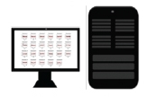
Determining prognosis: Next-generation sequencing
Patient
cancer cells
Purified genomic DNA
DNA is fragmented, tagged, and amplified
Data analysis
Sequencing
Mutated KRAS, NRAS, …
GGTACC
TCCGTAA
CTGACCT
ACGTTA
Johnsen. Blood. 2013;122:3286; Kakkar Basho. Am J Hematol Oncol. 2015;11:17;
Chapman. Nature. 2011;471:467.

Slide 55
Diagnostic criteria
The diagnosis of MGUS, SMM and MM requires
  the detection of serum monoclonal protein levels,
  assessment of the bone marrow
  Assessment of myeloma-defining events (MDEs) including
    biomarker assessment
    the presence or absence of CRAB features.

Slide 56
CRAB features
HyperCalcaemia: serum calcium >1 mg/ dl higher than the upper limit of normal levels (>11 mg/dl)
Renal insufficiency: creatinine clearance of <40 ml/min or serum creatinine >2 mg/dl
Anaemia: Hb levels of >2 g/dl below the lower limit of normal levels (<10 g/dl)
Bone lytic lesions: the presence of one or more lytic lesions detected by conventional radiology, CT imaging (or low-dose CT) or PET–CT

Slide 57
Myeloma Defining Events (MDE)*
CRAB features
A clonal bone marrow plasma cell (BMPC) percentage of ≥60%
An involved-to-uninvolved serum free light-chain ratio of ≥100
Two or more focal lesions on MRI (at least 5 mm in size)
*If there is no end-organ damage, the presence of one or more biomarker is sufficient for diagnosis

Slide 58
Diagnostic criteria for MM
Both criteria must be met
  Clonal bone marrow plasma cells ≥10% or biopsy-proven bony or extramedullary plasmacytoma
  Any one or more of the myeloma defining events (MDE)
Rajkumar SV, et al. Lancet Oncol 2014;15:e538–e548.

Slide 59
Diagnostic criteria for Smoldering MM
Both criteria must be met:
  Serum monoclonal protein (IgG or IgA) ≥3 g/dL, or urinary monoclonal protein ≥500 mg per 24 h and/or clonal bone marrow plasma cells 10%–60%
  Absence of myeloma defining events or amyloidosis
Rajkumar SV, et al. Lancet Oncol 2014;15:e538–e548.

Slide 60
Non-IgM MGUS
All 3 criteria must be met:
  Serum monoclonal protein (non-IgM type) <3 g/dL
  Clonal bone marrow plasma cells <10%
  Absence of end-organ damage (CRAB) that can be attributed to the plasma cell proliferative disorder
Rajkumar SV, et al. Lancet Oncol 2014;15:e538–e548.

Slide 61
IgM (IgM MGUS)
All 3 criteria must be met:
  Serum IgM monoclonal protein <3 g/dL
  Bone marrow lymphoplasmacytic infiltration <10%
  No evidence of anemia, constitutional symptoms, hyperviscosity, lymphadenopathy, or hepatosplenomegaly that can be attributed to the underlying lymphoproliferative disorder.
Rajkumar SV, et al. Lancet Oncol 2014;15:e538–e548.

Slide 62
Light Chain MGUS
All criteria must be met:
  Abnormal FLC ratio (<0.26 or >1.65)
  Increased level of the appropriate involved light chain (increased k FLC in patients with ratio >1.65 and increased λ FLC in patients with ratio <0.26)
  No Ig heavy chain expression on immunofixation
  Absence of end-organ damage that can be attributed to the plasma cell proliferative disorder
  Clonal bone marrow plasma cells <10%
  Urinary monoclonal protein <500 mg/24 h
Rajkumar SV, et al. Lancet Oncol 2014;15:e538–e548.

Slide 63
Solitary plasmacytoma
All 4 criteria must be met
  Biopsy proven solitary lesion of bone or soft tissue with evidence of clonal plasma cells
  Normal bone marrow with no evidence of clonal plasma cells
  Normal skeletal survey and MRI (or CT) of spine and pelvis (except for the primary solitary lesion)
  Absence of end-organ damage (CRAB) that can be attributed to a lympho-plasma cell proliferative disorder
Rajkumar SV, et al. Lancet Oncol 2014;15:e538–e548.

Slide 64
Solitary Plasmacytoma with minimal marrow involvement
All 4 criteria must be met
  Biopsy proven solitary lesion of bone or soft tissue with evidence of clonal plasma cells
  Clonal bone marrow plasma cells <10%
  Normal skeletal survey and MRI (or CT) of spine and pelvis (except for the primary solitary lesion)
  Absence of end-organ damage (CRAB) that can be attributed to a lympho-plasma cell proliferative disorder
Rajkumar SV, et al. Lancet Oncol 2014;15:e538–e548.

Slide 65
Kumar SK et al. Nature Reviews Disease Primers. 2017;3:1

Slide 66
Rajkumar SV. AJH 2016;91:720-734

Slide 67
Cytogenetic abnormalities in MM
Rajan AM. Blood Cancer Journal. 2015;5:e365.

Slide 68
Rajkumar SV. AJH 2016;91:720-734

Slide 69
Rajan AM. Blood Cancer Journal. 2015;5:e365.

Slide 70
Staging and risk stratification has evolved with improved understanding of disease biology
Hemoglobin, calcium, lytic lesions, M-protein production
β₂ microglobulin,
serum albumin
ISS plus cytogenetic abnormalities, LDH
1975
Durie–Salmon¹
2005
ISS²
2015
Revised ISS⁴
1960s
1970s
1980s
1990s
2000s
2010s
2007
mSMART³
Genetic
characteristics
1. Durie. Cancer. 1975;36:842; 2. Greipp. J Clin Oncol. 2005;23:3412;
3. Kumar. Mayo Clin Proc. 2009;84:1095; 4. Palumbo. J Clin Oncol. 2015;33:2863.
ISS, International Staging System.
Notes:
Durie and Salmon introduced an MM staging system in 1975 that predicted myeloma cell tumor burden based on commonly available clinical parameters: level and type of M-protein, hemoglobin and calcium levels, and number of bone lesions. It was widely adopted as the standard for prognostication in MM [Greipp 2005]
Subsequently, other prognostic parameters such as β2m emerged as predictors of survival duration [Greipp 2005]
The ISS was developed in 2005 and utilized serum β2m and serum albumin for patient classification and stratification [Greipp 2005]
The mSMART consensus guidelines for using genetic characteristics for risk stratification in newly diagnosed MM were published in 2007, which identified genetic factors that allow risk stratification and subsequent individualization of therapy [Kumar 2009]
The revised ISS adds cytogenetic abnormalities and LDH level to the original ISS [Palumbo 2015]

Slide 71
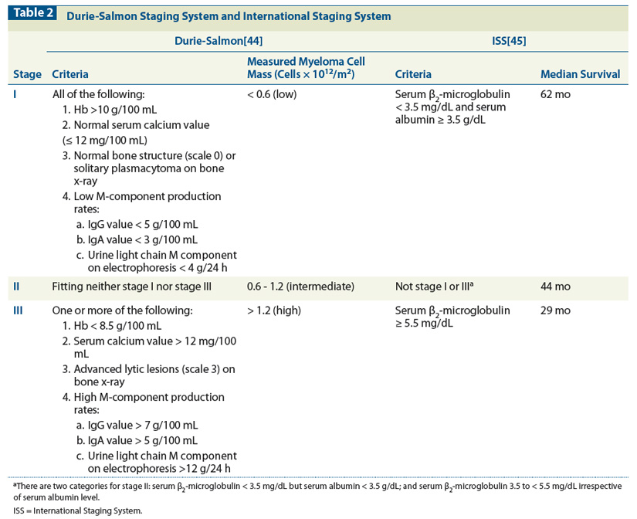

Slide 73
MM. Risk stratification
Kumar SK et al. Nature Reviews Disease Primers. 2017;3:1

Slide 74
Disease management: Indication for treatment
Patients with MGUS do not need treatment
They do need regular follow-up because of the potential for progression to multiple myeloma;
the risk of progression is only 1% per life-year.

Slide 75
Disease management: Indication for treatment
Patients with SMM have no treatment indication
  They should be monitored for disease progression because early treatment with conventional therapy has shown no benefit.
The risk of progression is highest in the first 5 years and decreases subsequently.
  The overall risk of progression is 10% per year for the first 5 years, about 3% per year for the next 5 years, and 1% per year for the next 10 years.
Patients with high-risk SMM should be enrolled onto clinical trials

Slide 76
Risk stratification for smoldering multiple myeloma
The model incorporates 3 risk factors:
  abnormal FLC ratio
  Bone marrow plasma cells >10%
  serum M protein >3 g/dl.
Patients with 1, 2 or 3 risk factors had 5-year progression rates of 25, 51 and 76%, respectively.
Corresponding median times to progression are 10, 5.1 and 1.9 years, respectively.
Kyle et al. Leukemia (2010) 24, 1121–1127

Slide 77
MM: Indication for treatment
Development of end-organ damage is the indication for treatment.
  End-organ damage is defined mainly by the CRAB criteria, which are related to a plasma cell proliferative disorder and cannot be explained by another unrelated disease or disorder.
Progressive myeloma-induced renal insufficiency should trigger initiation of treatment even before the creatinine threshold of 2 mg/dL (177 μmol/L) has been reached.
  Acute renal failure due to multiple myeloma can be reversible if treated early.
  After the confirmation of an underlying cast nephropathy, appropriate treatment should be initiated without delay.
Once patients with renal impairment have achieved a remission, their outcomes are similar to patients with no renal insufficiency.

Slide 78
Braggio E et al. Cancer Cell. 2015;28:678

Slide 79
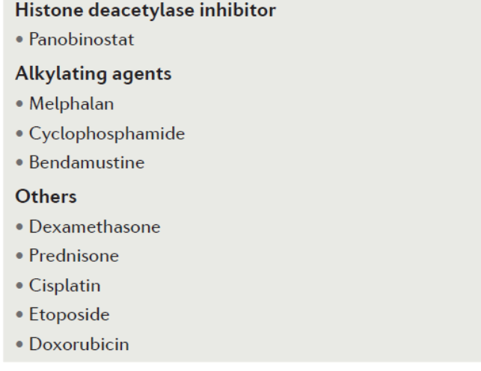
Kumar SK et al. Nature Reviews Disease Primers. 2017;3:1

Slide 80
Wildes TM et al. JCO. 2014;32:2531-2540.
Laraocca A, Palumbo A. Blood. 2015;126(19):2179-2185.

Slide 81
Clinical management of patients with newly diagnosed MM
Rollig C et al. Lancet 2015; 385: 2197–208

Slide 82
Palumbo A et al. JCO. 2014;32:587-600.

Slide 83
Clinical management of patients diagnosed with relapsed or progressive MM
Rollig C et al. Lancet 2015; 385: 2197–208

Slide 84
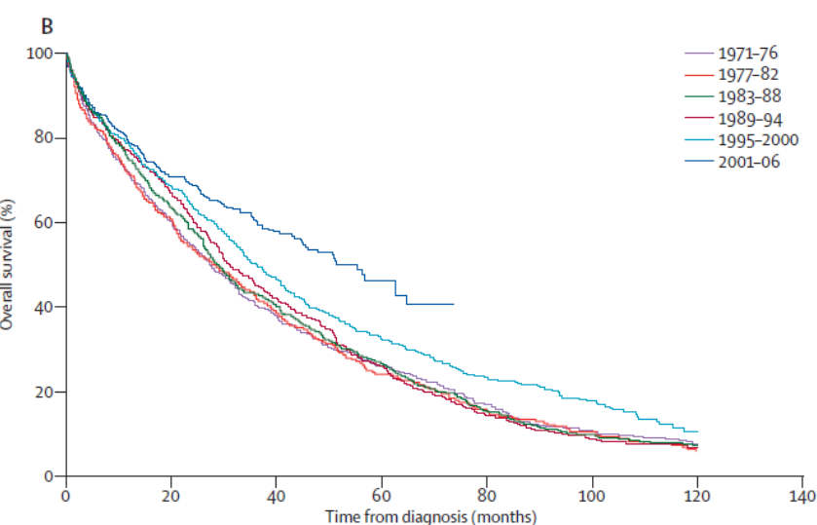
Overall survival after diagnosis in patients with MM
Rollig C et al. Lancet 2015; 385: 2197–208

Slide 85
Supportive care
Symptom burden | Prevention/treatment strategy
Anemia | Blood transfusion, ESAs, iron supplementation
Thrombosis | Aspirin, LMWH, warfarin prophylaxis and treatment
Infection | Vaccination, prophylactic antivirals
Pain | Bisphosphonates, radiotherapy, surgery, pain medication
Peripheral neuropathy | Dose reduction or discontinuation, analgesics
Osteonecrosis of the jaw | Avoid invasive dental procedures during and around bisphosphonate therapy; good oral hygiene
Compression fractures | Kyphoplasty, vertebroplasty
Snowden. Br J Haematol. 2011;154:76; Mendoza. J Pain. 2012;13:564; Terpos. J Clin Oncol. 2013;31:2347.
ESA, erythropoiesis stimulating agent;
LMWH, low molecular weight heparin.
Notes:
Since MM is incurable and survival has improved with modern treatment approaches, supportive care plays an important role in the management of MM
Supportive care covers several areas including pain management, PN, skeletal complications, infection, anemia, hemostasis and thrombosis, nausea/vomiting/diarrhea, fatigue, and bisphosphonate-induced ONJ [Snowden 2011]
Compression fractures are a major cause of bone pain and decreased quality of life and can lead to neurologic dysfunction (motor weakness, sensory loss, loss of sphincter control) [Hirsch 2011]
Pain reduction with vertebroplasty or kyphoplasty for the treatment of compression fractures is significant [Mendoza 2012]

Slide 86
Multiple myeloma is characterized by a pattern of remission and relapse
Asymptomatic
Symptomatic
Relapsing
Refractory
M-protein level
Remission duration decreases
with each line of therapy
Active
myeloma
Relapse
Remission
MGUS or indolent
myeloma
//
//
Front-line
therapy
2nd- or 3rd-line therapy
Durie. Concise Review of the Disease and Treatment Options: Multiple Myeloma. International Myeloma Foundation, 2011/2012 edition. Available at: www.myeloma.org/pdfs/CR2011-Eng_b1.pdf. Accessed March 2016; Kumar. Mayo Clin Proc. 2004;79:867.
Notes:
MM can remain asymptomatic for many years [Durie 2011/2012]
In the symptomatic phase, the most common presenting complaint is bone pain [Durie 2011/2012]
Serum and/or urine M-protein is elevated and usually rising at the time of diagnosis [Durie 2011/2012]
Pattern of disease can include multiple periods of remission and relapse. The duration of response typically decreases with each successive treatment regimen [Kumar 2004]

Slide 87
amyloidosis
Disorders such as
  nephrotic syndrome and heart failure,
  neuropathy in non-diabetic patients,
  left ventricular hypertrophy on echocardiography without consistent electro cardiographic evidence or low limb lead voltages,
  hepatomegaly with normal imaging,
  albuminuria
should be assessed carefully to not overlook light-chain amyloidosis caused by free light-chain secretion.

Slide 88
amyloidoses
a rare group of diseases that result from extracellular deposition of amyloid, a fibrillar material derived from various precursor proteins that self-assemble with highly ordered abnormal cross β-sheet conformation.
Deposition of amyloid can occur
  in the presence of an abnormal protein
    (eg, hereditary amyloidosis and acquired systemic Ig light chain [AL] amyloidosis),
  in association with prolonged excess abundance of a normal protein
    (eg, reactive systemic [AA] amyloidosis and β2-microglobulin [β2M] dialysis-related amyloidosis),
  for reasons unknown, accompanying the ageing process
    (eg, wild-type transthyretin amyloidosis [ATTRwt; or senile systemic amyloidosis] and atrial natriuretic peptide amyloidosis).
Wechalekar AD et al. Lancet 2016; 387: 2641–54

Slide 89
Wechalekar AD et al. Lancet 2016; 387: 2641–54

Slide 90
Diagnostic workup of systemic AL amyloidosis.
Paladini G, Merlini G. Blood. 2016;128(2):159-168

Slide 91
Diagnostic workup of systemic AL amyloidosis
Paladini G, Merlini G. Blood. 2016;128(2):159-168

Slide 92
Validated staging systems for AL amyloidosis
Paladini G, Merlini G. Blood. 2016;128(2):159-168

Slide 93
Wechalekar AD et al. Lancet 2016; 387: 2641–54

Slide 94
Therapeutic approach to systemic AL amyloidosis.
Paladini G, Merlini G. Blood. 2016;128(2):159-168

Slide 95
Outcome of AL amyloidosis treated with a selection of common upfront regimens, according to disease severity
Paladini G, Merlini G. Blood. 2016;128(2):159-168

Slide 96
Supportive therapy in systemic amyloidosis

Slide 97
Kaplan–Meier survival curve showing improvement over time in overall survival of patients with systemic AL amyloidosis seen at the National Amyloidosis Centre in the UK
(n=3486)
Wechalekar AD et al. Lancet 2016; 387: 2641–54

