Slide 1
Miositi
Prof. Carlo alberto scirè – carloalberto.scire@unife.it
Sezione di reumatologia ed ematologia e scuola di specializzazione di reumatologia
Dipartimento di Scienze mediche
Università degli studi di Ferrara

Slide 2
Sommario
Definizione
Patogenesi
Epidemiologia
Criteri classificativi
Diagnosi
  Clinica
  Laboratorio
  Patologia
  Imaging
Diagnosi differenziale
Follow-up e clinimetria
Prognosi
Cenni di terapia
Concetti chiave

Slide 3
Definizione
Inflammatory muscle diseases are a heterogeneous group of systemic autoimmune rheumatic disorders characterized by:
  chronic muscle weakness,
  muscle fatigue, and
  Mononuclear cell infiltration into skeletal muscle
Principali quadri clinici
DERMATOMIOSITE
POLIMIOSITE
MIOSITE DA CORPI INCLUSI

Slide 4
Patogenesi

Slide 5
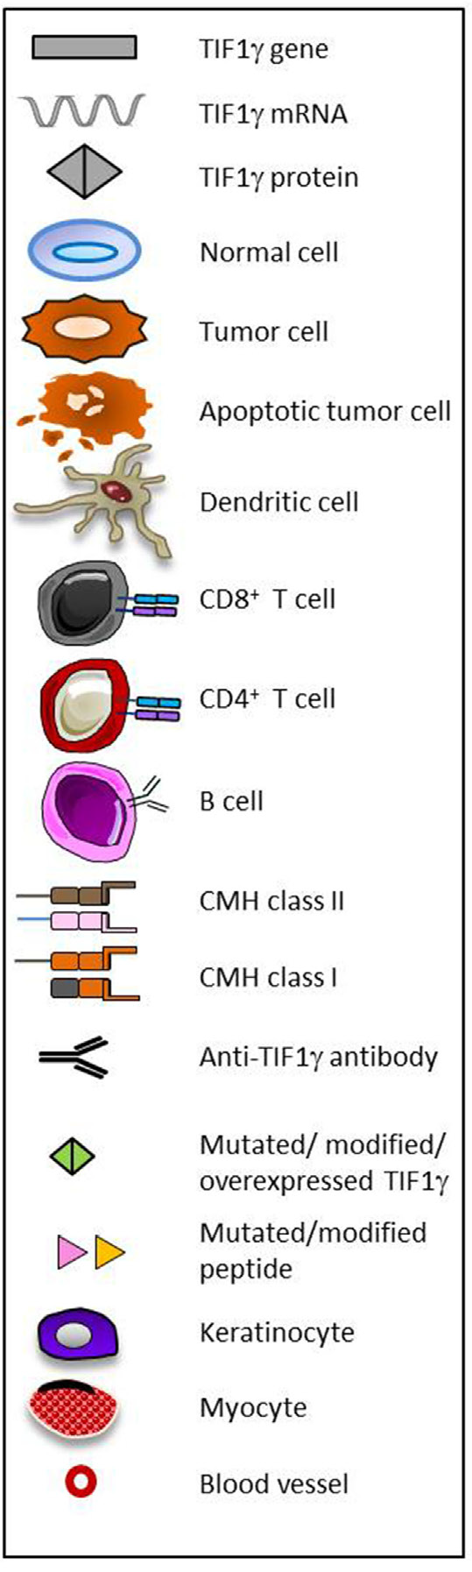
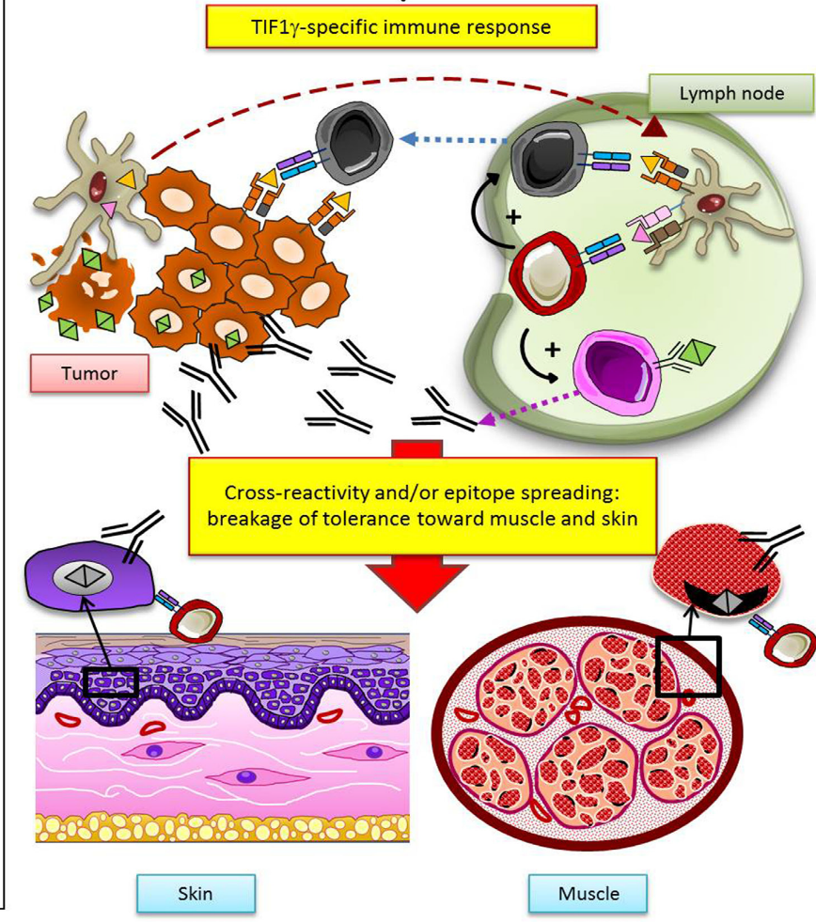
TIF1γ, NXP2, AND HMGCR: TARGETS OF AN ANTITUMORAL RESPONSE?
Aussy A, et al. Front Immunol 2017;21;8:992

Slide 6
Epidemiologia
Prevalence: 2.9 - 34 cases/100.000 inhabitants,
Incidence: 2–11 cases/1.000.000 inhabitants per year
Peak incidence: 50–60 years
Female to male ratio: ~ 2:1.
Juvenile-PM is much rarer than juvenile-DM.
PM/DM latitudinal gradient
  DM more common in latitudes closer to the equator
  PM in northern latitudes

Slide 7
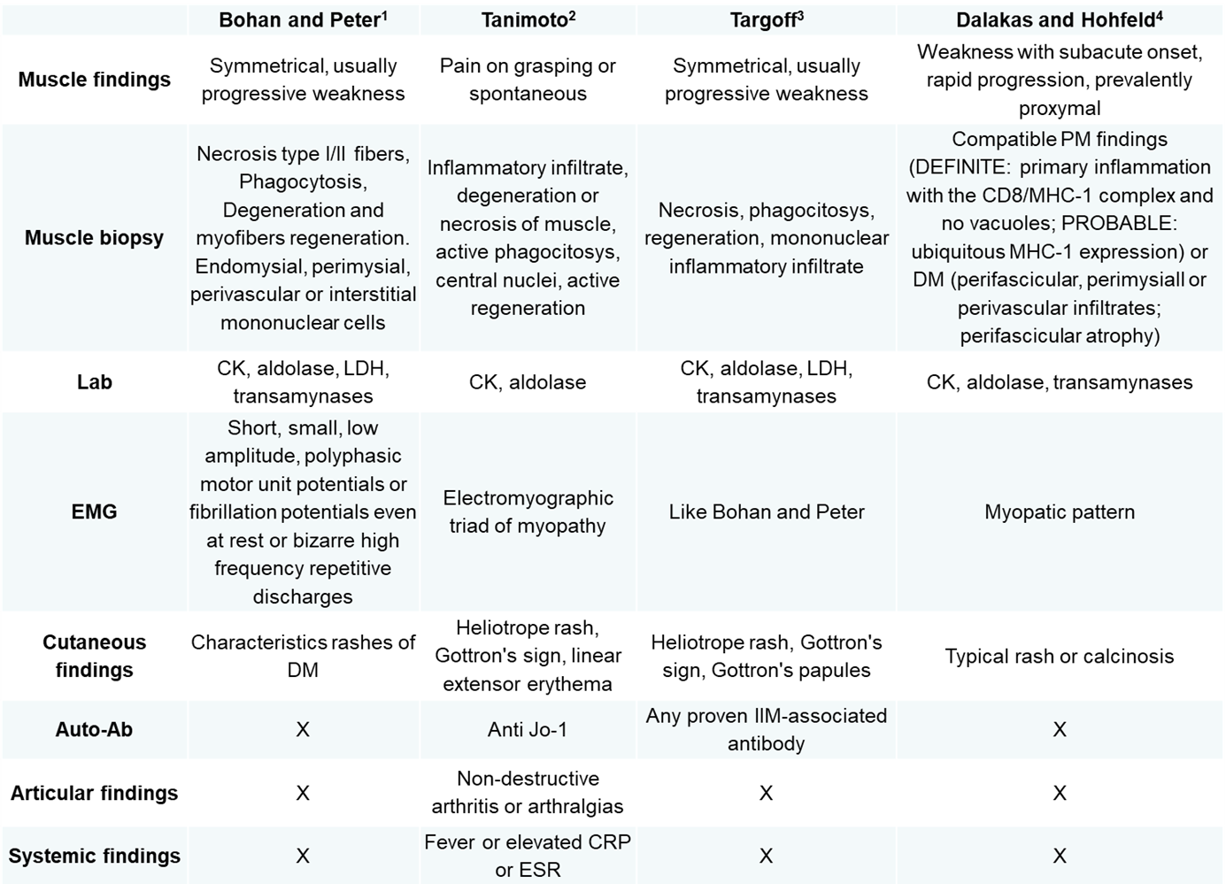
Criteri classificativi

Slide 8
Muscle involvement
Joint involvement
Lung involvement
Cutaneous Involvement
Clinical Manifestations

Slide 9
Clinica
Proximal muscle weakness
Symmetrical muscle weakness
Myalgia
Dysphagia
Fatigue
Low-grade fever
Dyspnea
Dysphonia

Slide 10
Manifestazioni cutanee

Slide 11
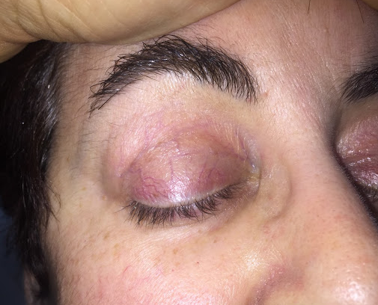
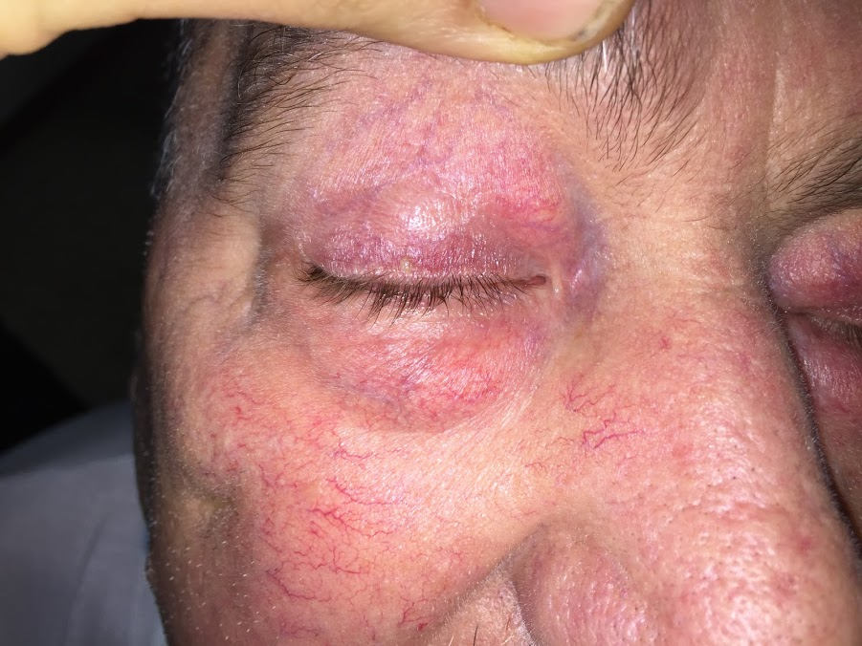
Manifestazioni cutanee – rash eliotropo

Slide 12
Manifestazioni cutanee
V
Notes:
Characteristic features of dermatomyositis skin changes. A, Linear erythema. B, Scalp rash. C, V-like sign. D, Shawl sign

Slide 13
Segno di Gottron
Notes:
Erythematous rashes on the hand in dermatomyositis and systemic lupus erythematosus. A, Note the changes on the knuckles and
dorsum of the hand in dermatomyositis (Gottron’s sign). B, Rash is absent from the knuckles but present on the phalanges in lupus. C, Capillary nailfold
changes in dermatomyositis.

Slide 14
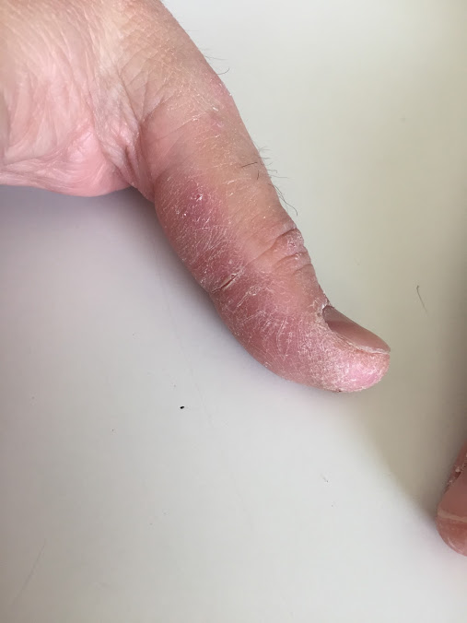
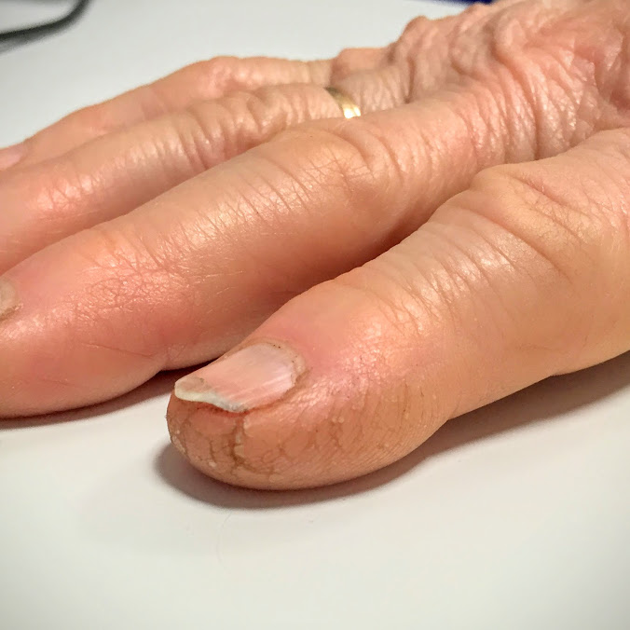
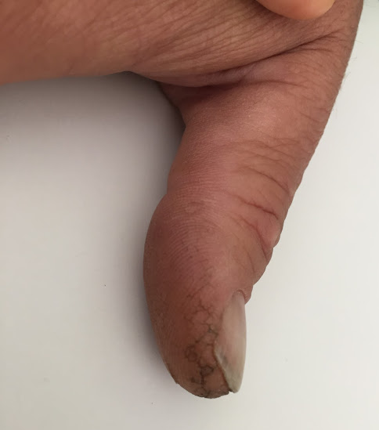
Mani da meccanico – mechanic’s hands

Slide 15
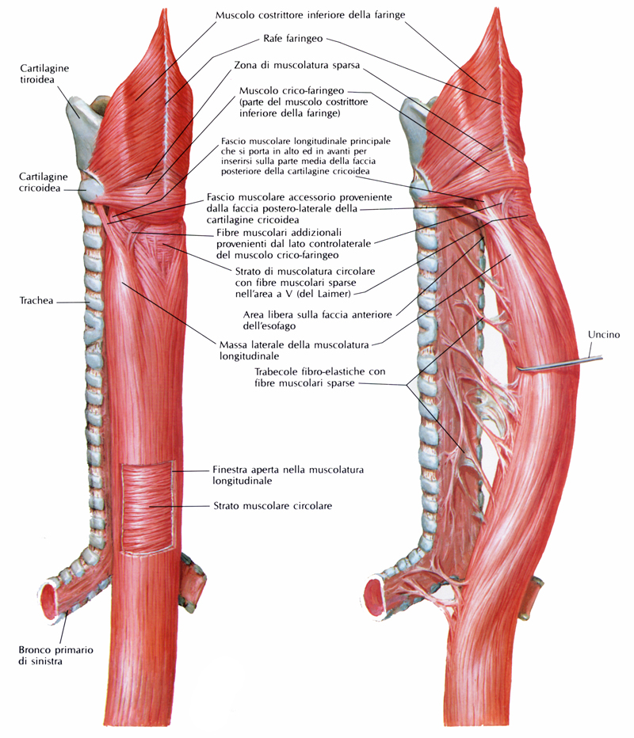
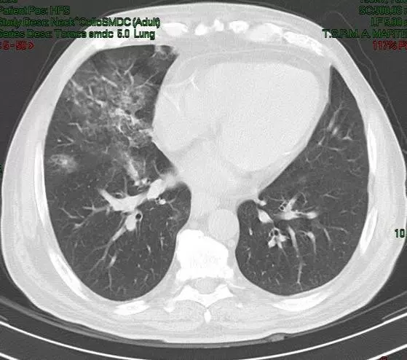
Interessamento esofageo

Slide 16
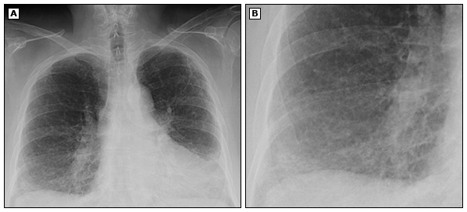
Interessamento polmonare

Slide 17
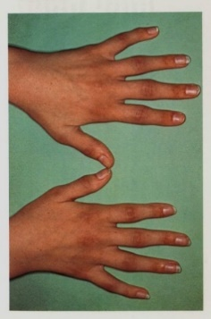
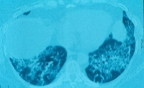
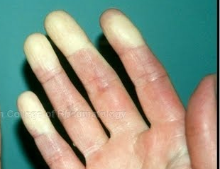
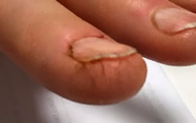
Antisynthetase syndrome
Laboratory Markers
  Antisynthetase antibodies 100% of cases
Clinical characteristics
  Arthritis: 35-85% of cases
  Interstitial lung disease: 50-95% of cases
  Myositis: 60-80% of cases
  Raynaud’s phenomenon: up to 60% of cases
  Fever: up to 40% of cases
  Mechanic’s hands: up to 40% of cases
Classic disease triad
Accompanying features (for practical purpose)

Slide 18
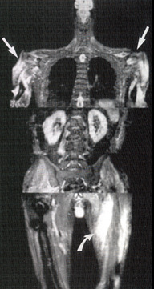
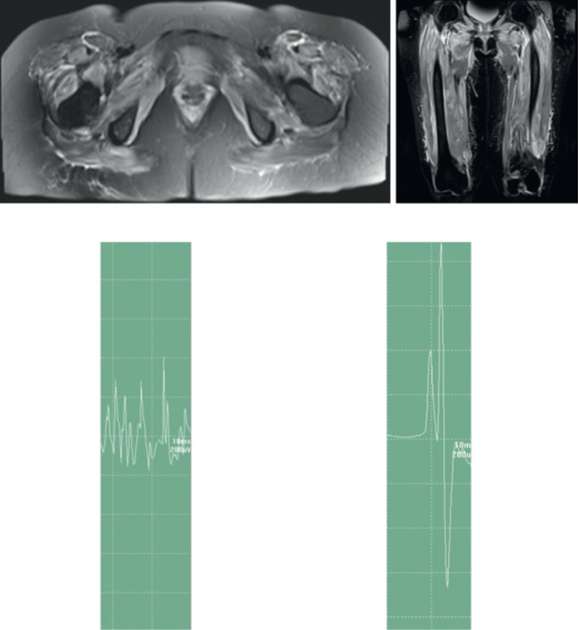
Risonanza Magnetica Nucleare

Slide 19
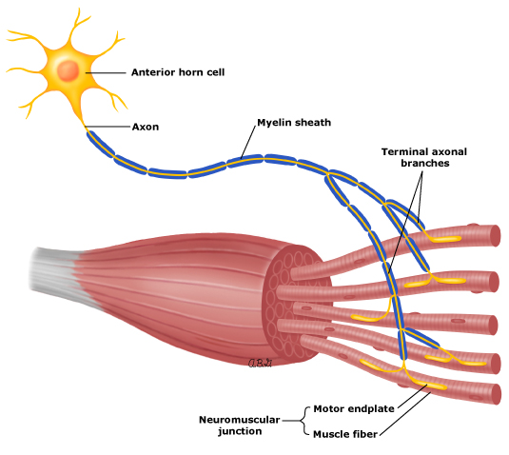
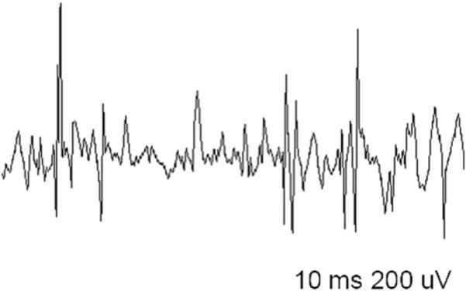
Elettromiografia
Morphology and recruitment pattern of MUAPs in myopathies.
Myopathies are characterized by the presence of polyphasic, short-duration, low-amplitude MUAPs
Because each small motor unit is able to generate only a reduced amount of force compared with normal, with little muscle contraction, many MUAPs are recruited.

Slide 20
Diagnosi - laboratorio
- Indici di miocitolisi
  Creatinfosfochinasi (CPK)
  Mioglobina
  GOT>GPT
  Aldolasi
  TNI

Slide 21
Autoantibody | Target autoantigen | Clinical associations | Frequency
 |  |  | Adults (%) | JDM (%)
Anti-ARS - Jo-1 - PL7 - PL12 - OJ - EJ - KS - Ha - Zo | Aminoacyl-tRNA synthetase Histidyl - Threonyl - Alanyl - Isoleucyl - Glycyl - Asparaginyl - Tyrosyl - Phenylalanyl - | Antisynthetase syndrome: Myositis ILD Raynaud’s phenomenon Arthritis Mechanic’s hands Fever | Overall: 30–40 Jo-1: 15–20 PL7: 2–5 PL12: 2–5 OJ: <2 EJ: 2–5 KS: <2 Ha: <1 Zo: <1 | Overall: 1–3
Anti-Mi-2 | Nucleosome remodelling deacetylase complex | DM with hallmark skin changes | 10–15 | <1
Anti-TIF-1γ | Transcriptional intermediary factor 1 gamma | JDM: DM and skin ulceration Adults: DM and malignancy | 13–21 | 23
Anti-MJ/NXP2 | Nuclear matrix protein 2 | JDM: DM and calcinosis Adults: DM and malignancy | <5 | 25
Anti-SAE | Small ubiquitin-like modifier activating enzyme (SAE) | DM | 8 | <1
Anti-MDA5 | Melanoma Differentiation Associated gene5 (MDA5) | JDM: DM and ILD Adults: CADM and ILD | <5 (50–70 in CADM) | 7–38
Anti-SRP | Signal recognition particle (SRP) | Necrotising myopathy | 4–8 | <1
Anti-HMGCR | 3-Hydroxy-3-methylglutaryl-CoA reductase (HMGCR) | Statin-induced necrotising myopathy | <10 Necrotising myopathy | Unknown

Slide 22
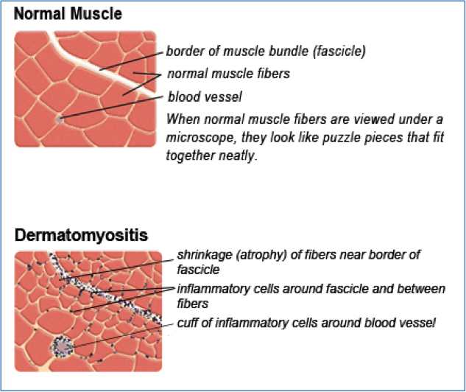
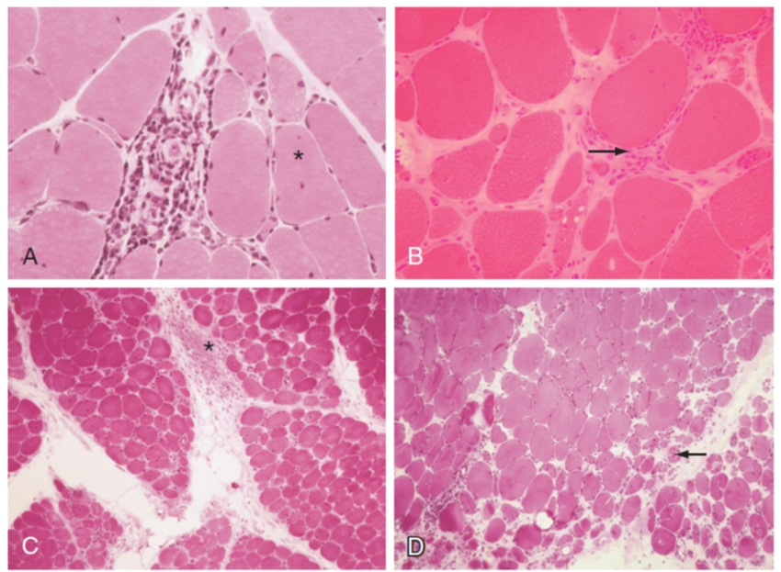
Patologia – Dermatomiosite
Notes:
Hematoxylin and eosin staining of a muscle biopsy showing perivascular inflammation. A, Variation in fiber size and central nucleation
(asterisk). B, Endomysial inflammation and increased fibrosis (arrow). C, Perimysial inflammation (asterisk). D, Perifascicular atrophy (arrow). (B, Courtesy
Dr. Inger Nemmesmo. D

Slide 23
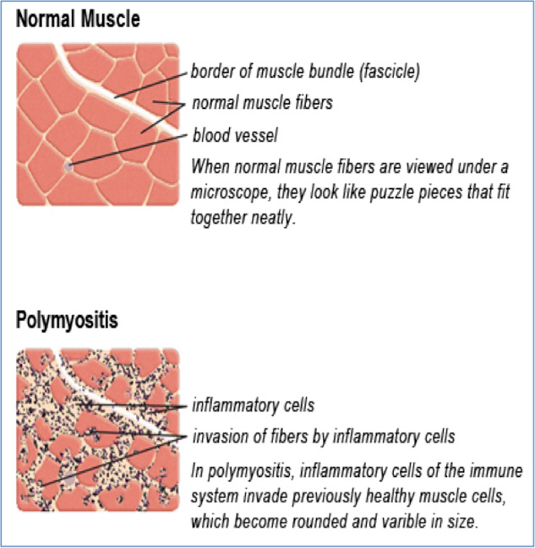
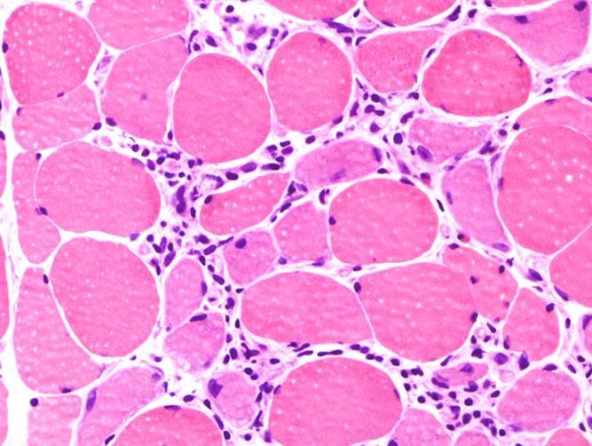
Patologia – Polimiosite
Infiltrato endomisiale
Notes:
Hematoxylin and eosin staining of a muscle biopsy showing perivascular inflammation. A, Variation in fiber size and central nucleation
(asterisk). B, Endomysial inflammation and increased fibrosis (arrow). C, Perimysial inflammation (asterisk). D, Perifascicular atrophy (arrow). (B, Courtesy
Dr. Inger Nemmesmo. D

Slide 25
Diagnosi differenziale
Miopatie infiammatorie
Miopatie infettive
  Piomiosite (batterica)
  Miositi virali, fungine, parassitarie, da spirochete
Distrifinopatie
  Duchenne
  Becker
  Facio-scapolo-omerale
  Cingolo pelvico
  Distrofia miotonica
Rabdomiolisi
  Traumatica
  Esercizio intenso
  Da calore
  Convulsioni
  Ipokaliemia, ipofosfatemia
Iatrogene
  Iniezioni intramuscolari
  Elettromiografia
  Post-intervento chirurgico
  Da farmaci e tossici
    Colchicina
    Antimalarici
    Penicillamina
    Zidovudina
    Statine
    Alcool
    Cocaina
    Steroidi
Miopatie metaboliche
Ipertermia maligna
Miopatie endocrine
  Ipotiroidismo
  Acromegalia
Paralisi periodica
  Familiare
  Tireotossica
Malattia del motoneurone
  SLA
  Atrofia spinale

Slide 26
Follow-up e clinimetria

Slide 27
Rationale - Virchow’s hypothesis 1863
If genetic damage is the “match that lights the fire” of cancer, some types of inflammation may provide the “fuel that feeds the flames”.
Fran Balkwill & Alberto Mantovani, Lancet 2001; 357: 539–45

Slide 28
Neoplasie
IIM patients have a high risk of malignancy.
  DM (30% of cases)
    Men
    Old age
    Dysphagia
Risk of neoplasm increased in the first years after disease diagnosis
  Neoplasm type:
    lung,
    ovary,
    breast,
    colon LNH
Screening for cancer is recommended in patients with DM at diagnosis, possibly yearly thereafter, in case of relapse or of refractory disease

Slide 29
Disfagia
Swallowing difficulties are often reported in PM/DM
  Palatial and pharyngeal weakness may lead to aspiration pneumonia.
  Due to weakness in the tongue, palate and pharyngeal muscles or sometimes also, in the lower oesophagus.
  Oesophageal dysfunction assessment techniques in IIMs:
    Not standardized,
      electrodiagnostic tests,
      fiberoptic endoscopic evaluation of swallowing and
      oro-pharyngo- oesophageal scintigraphy
      MRI
      Self reported
      Questionnaire

Slide 30
Prognosi
IIMs mortality is 2-3 fold higher than that of general population. Causes:
cancer,
lung and cardiac complications
infections.
Improvement: 75% of treated pts
  full recovery of muscle function: 20–40% of treated patients
Polycyclic course: 60–80% of treated patients
Poor prognostic factors: older age, male gender, non-Caucasian ethnicity, longer symptom duration, ILD, cardiac involvement, dysphagia, cancer and some specific serological patterns (anti-SRP, anti-155/140, anti-TIF1-gamma, anti-NXP2, and anti-CADM-140 antibodies).

Slide 31
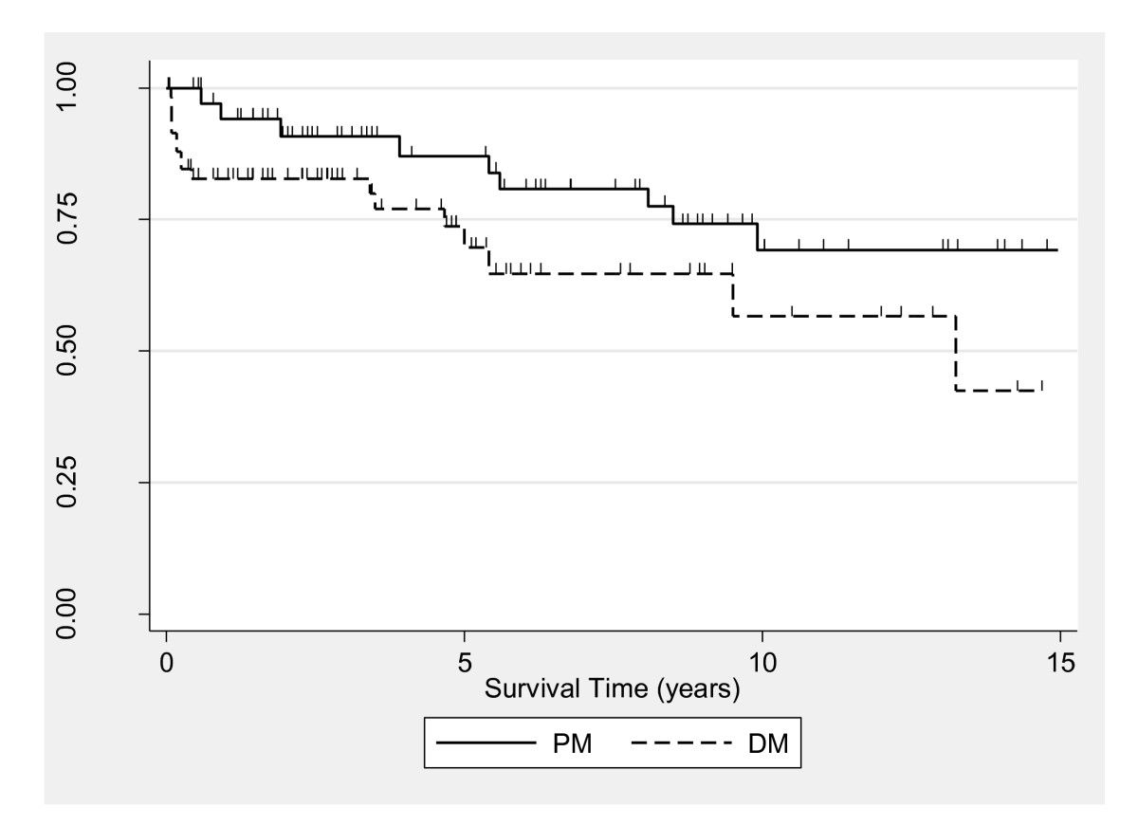
Prognosi
Arthritis Research & Therapy201214:R22 https://doi.org/10.1186/ar3704

Slide 32
Cenni di terapia

Slide 33
Concetti chiave
Myopathies are a heterogeneous group of muscle diseases characterized by symmetric proximal muscle weakness and frequent involvement of other organs.
Myopathies are often accompanied by elevated levels of serum muscle enzymes and abnormal electromyograms.
Histology shows varying degrees of inflammation and muscle fiber degeneration and regeneration.
Some patients have autoantibodies that bind to molecules involved in protein synthesis, and these antibodies are often associated with distinct clinical phenotypes.
Corticosteroids and immunosuppressants are common therapies for inflammatory muscle disease.

