Slide 1
Imaging in Reumatologia
Prof. Carlo Alberto Scirè– carloalberto.scire@unife.it
Sezione di reumatologia ed ematologia
Scuola di specializzazione in reumatologia
Dipartimento di Scienze mediche
Università degli studi di Ferrara

Slide 2
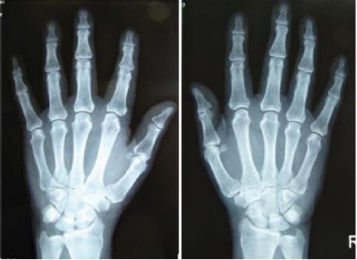
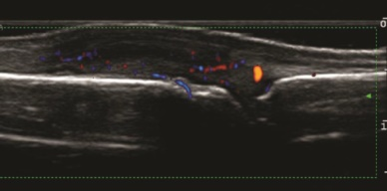
Sommario
Imaging MSK
  Radiologia convenzionale
  Risonanza magnetica nucleare
  Ecografia muscolotendinea
  Tomografia computerizzata
  Medicina Nucleare
  Tecniche assistite

Slide 3
Applicazioni dell’imaging
Diagnosi
Follow-up
Prognosi

Slide 4
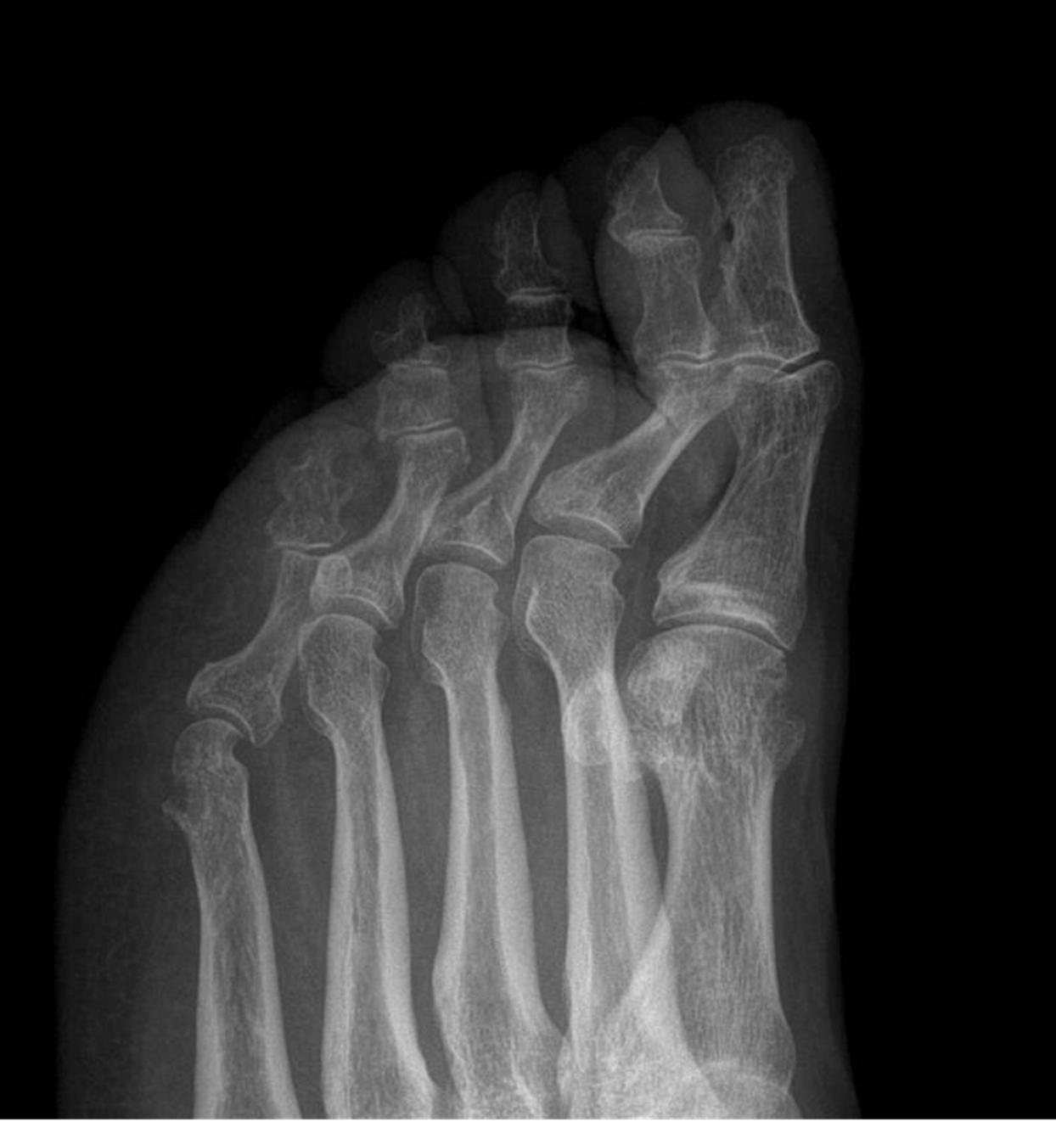
Radiologia convenzionale
Radiography is relatively inexpensive, easily available, and reliable.
Radiography provides information on bone damage and, indirectly through joint space narrowing, on cartilage damage, although radiography is neither sensitive nor specific for soft-tissue change.
Radiography findings are important parts of the classification criteria for many rheumatic disease, including RA, AS, SpA, PsA, and OA.
Radiography should most often be the first imaging investigation in arthritis because the significance of positive and negative findings is well known.
Radiography can be used to follow structural damage progression in inflammatory and degenerative joint diseases but is less sensitive to change than MRI.
The main disadvantage of radiography is its low sensitivity, particularly for soft tissue changes.

Slide 5
Lesioni elementari
osteopenia juxta-articolare
tumefazioni parti molli (Rx digitale)
pseudo-allargamento rima articolare
riduzione rima articolare
calcificazioni
osteofiti
erosioni
cisti e geodi
sclerosi ossea
proliferazione periostale
sub-lussazioni e disassamenti
anchilosi

Slide 6
Artrite reumatoide

Slide 7
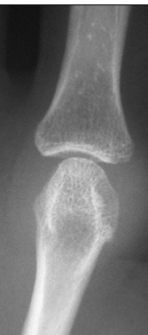
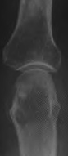
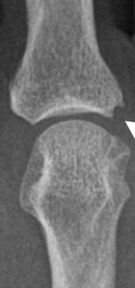
CR in RA – elementary lesions
Tumefazione tessuti periarticolari
Osteoporosi iuxta-articolare
Erosione
DX

Slide 8
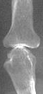
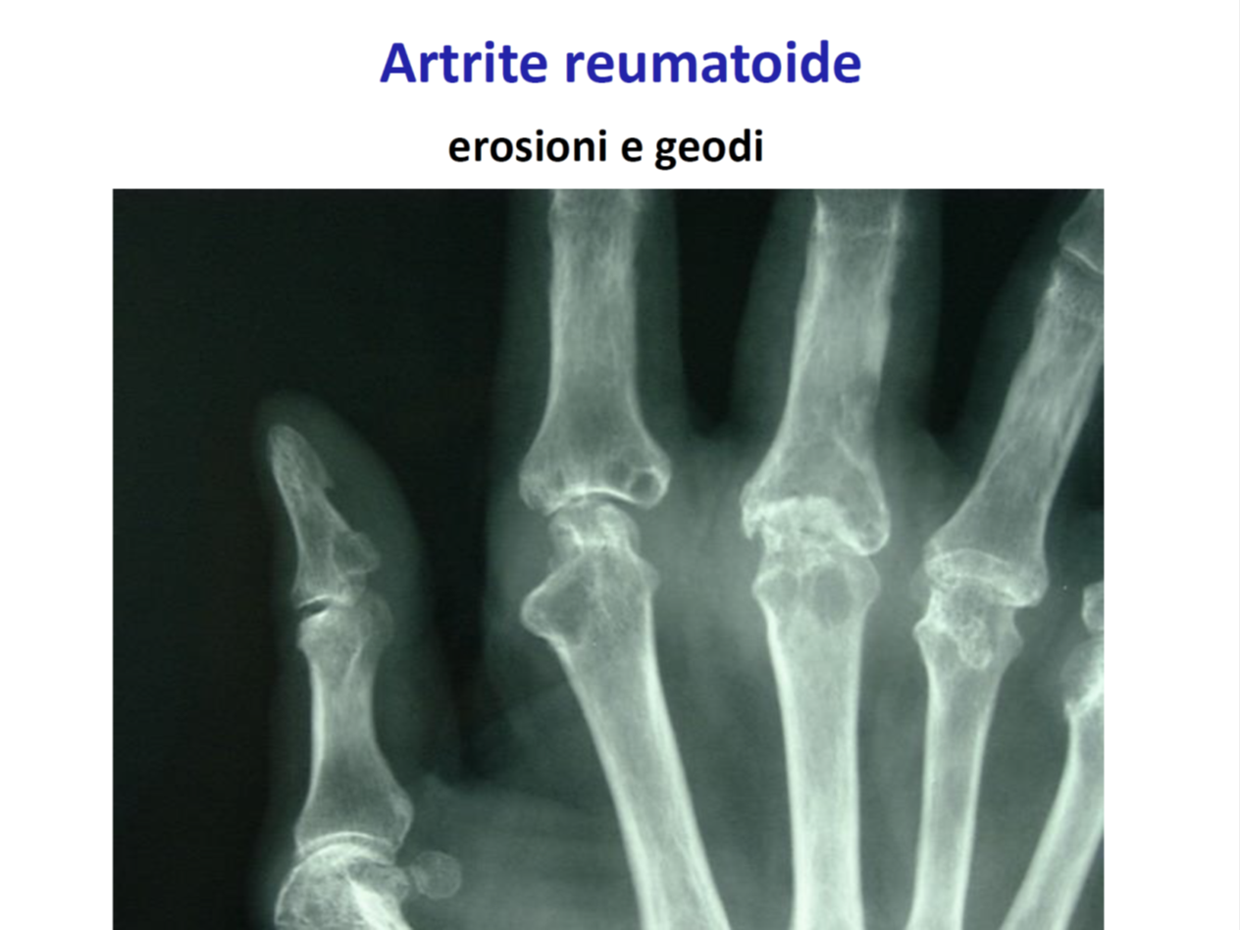
CR in RA – elementary lesions
Riduzione interlinea
geodi
anchilosi

Slide 9
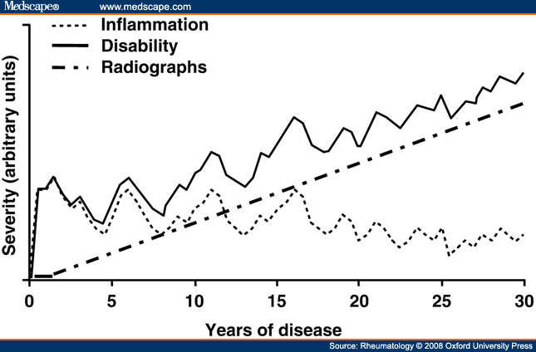
Model of X-Ray progression
Kirwan JR. J Rheumatol. 2001

Slide 10
RA outcome measure Core Set
Felson DT, et al. Arthritis Rheum 1993

Slide 11
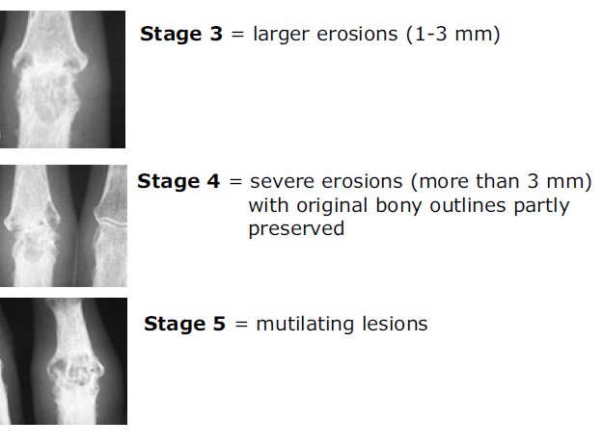
CR in RA: erosion

Slide 12
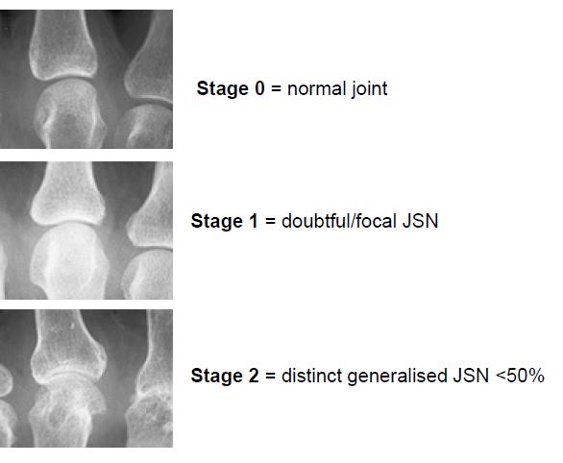
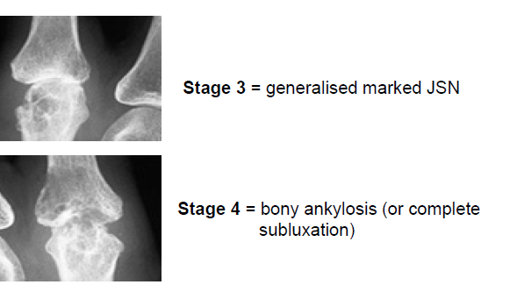
CR in RA: joint space narrowing

Slide 13
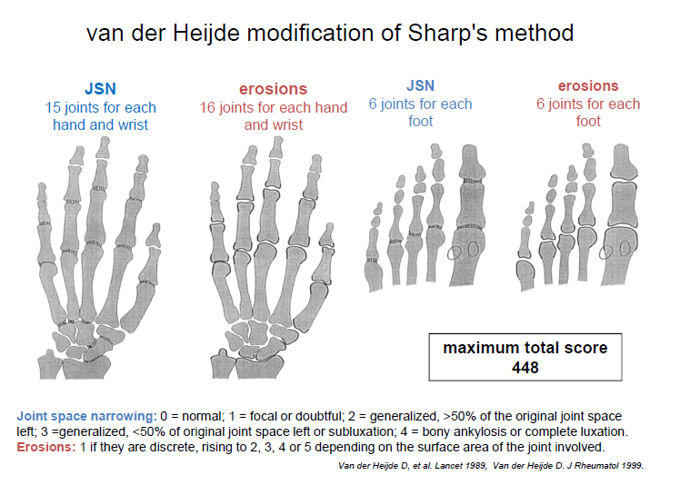
CR in RA: scoring

Slide 14
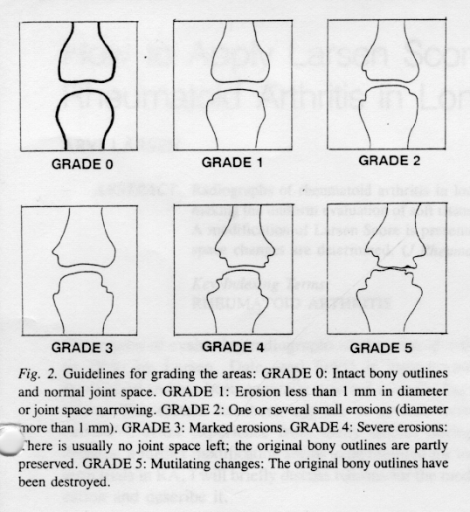
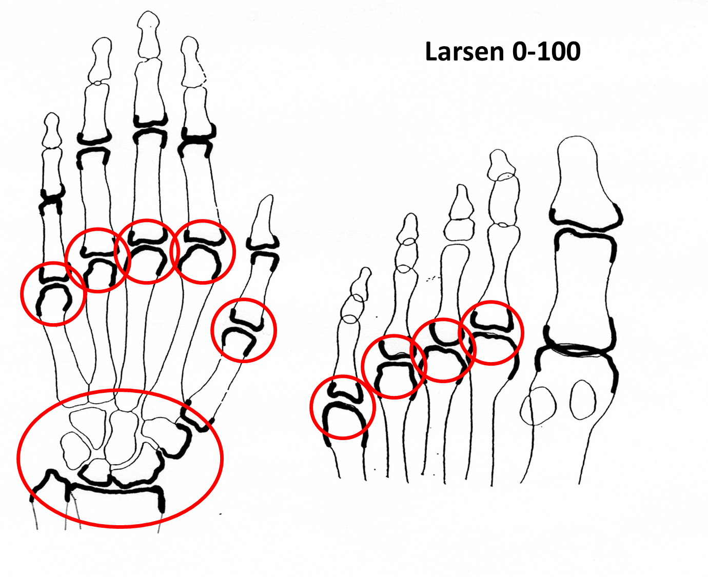
Larsen scoring

Slide 16
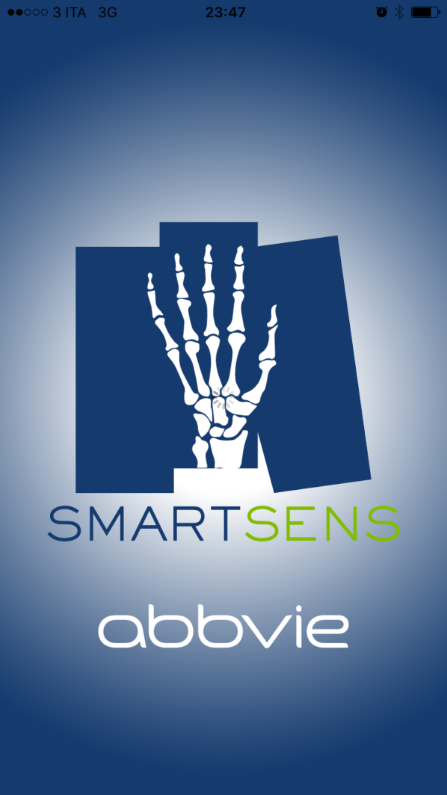
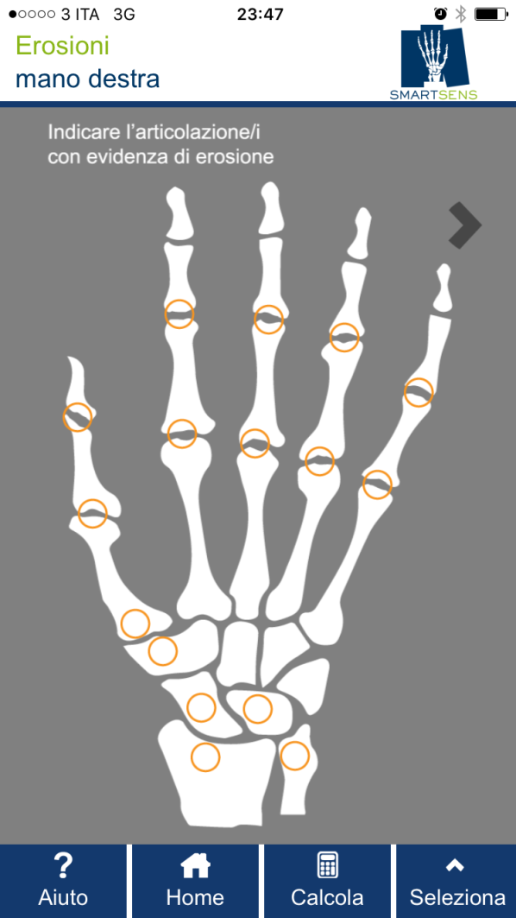
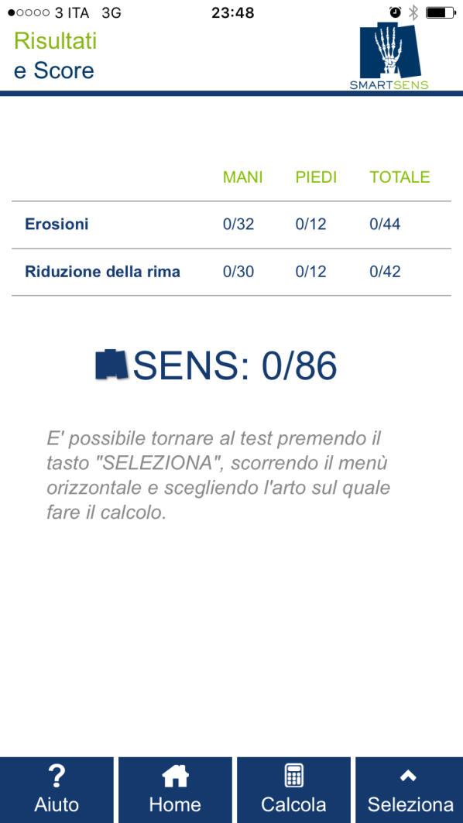

Slide 17
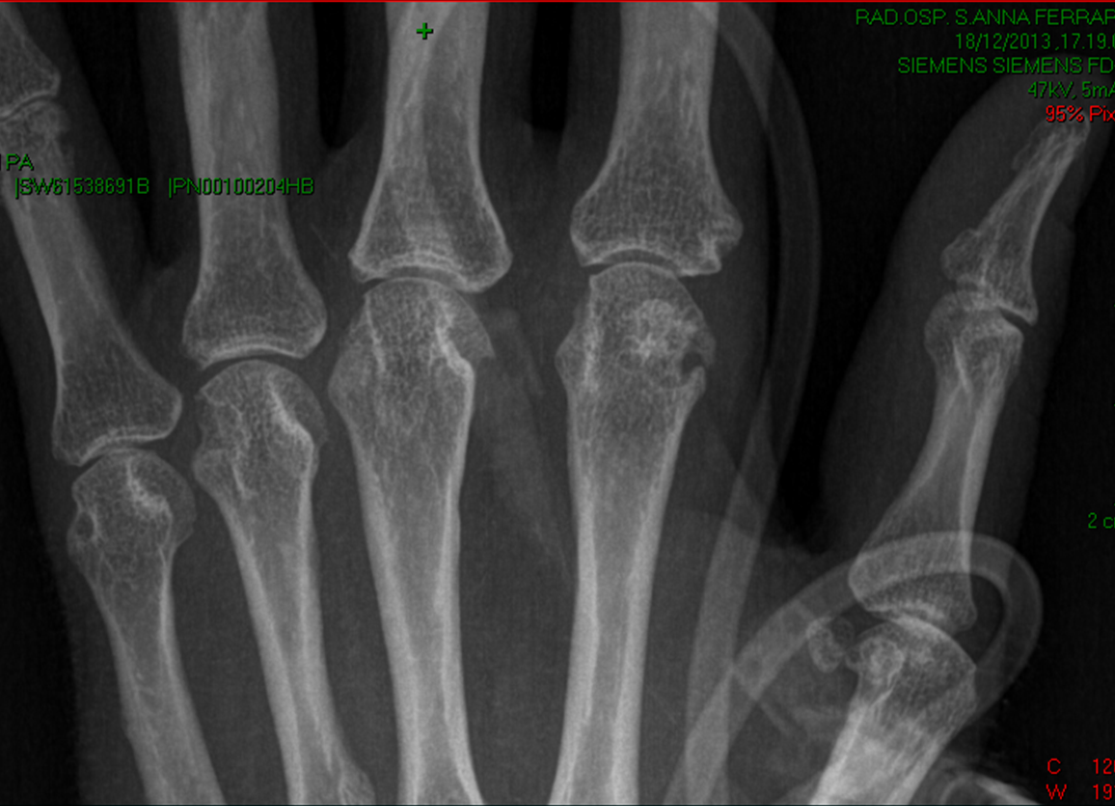
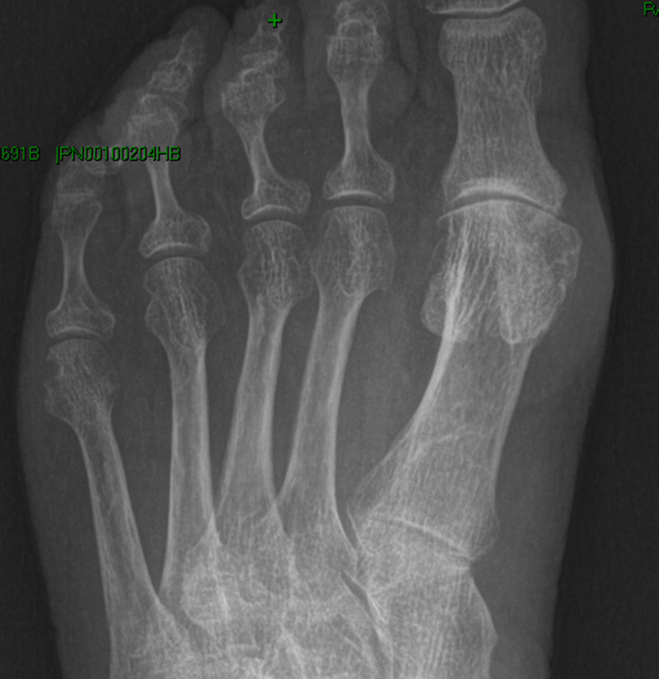

Slide 18
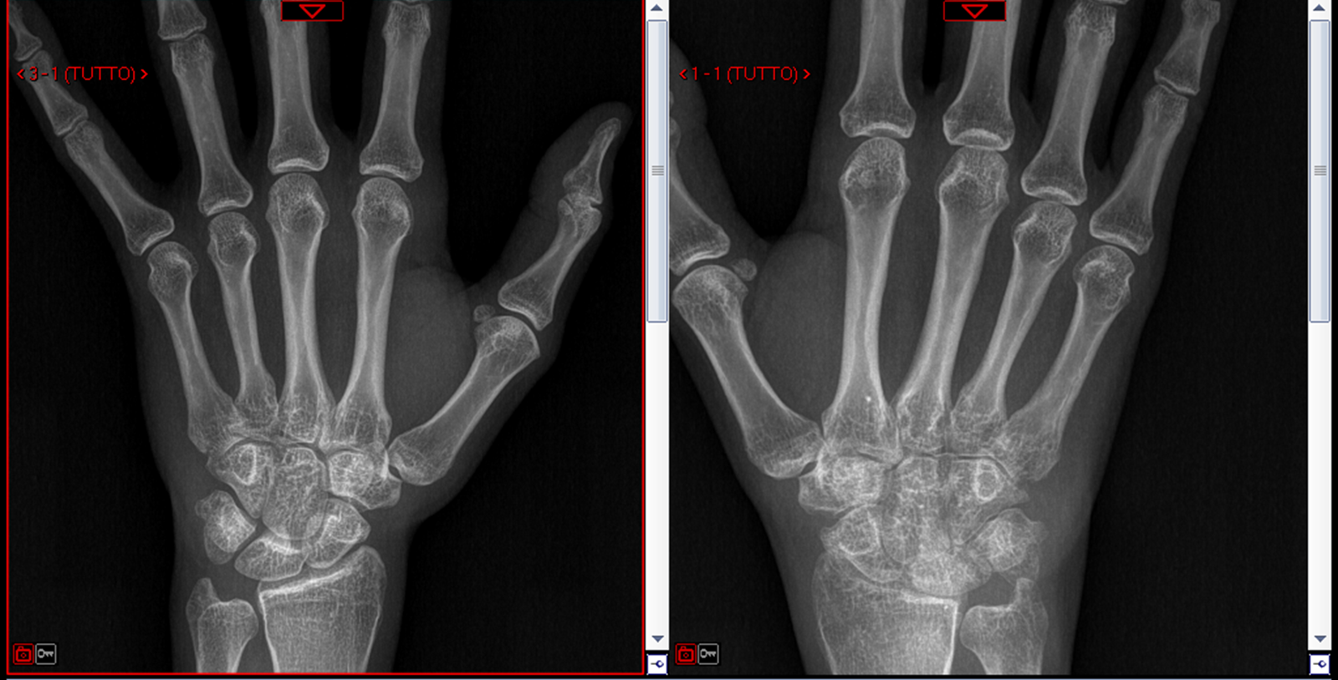

Slide 19
Spondilite anchilosante
DX

Slide 20
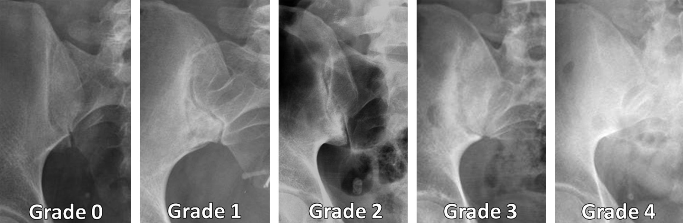
CR in AS: NY Criteria

Slide 21
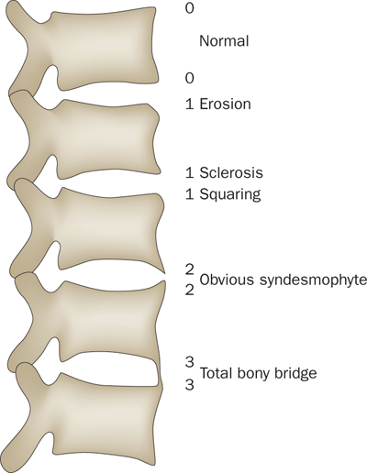
The modified Stoke Ankylosing Spondylitis Spine Score (mSASSS)
Maksymowych, W. P. (2010) Disease modification in ankylosing spondylitis
Nat. Rev. Rheumatol. doi:10.1038/nrrheum.2009.258

Slide 22
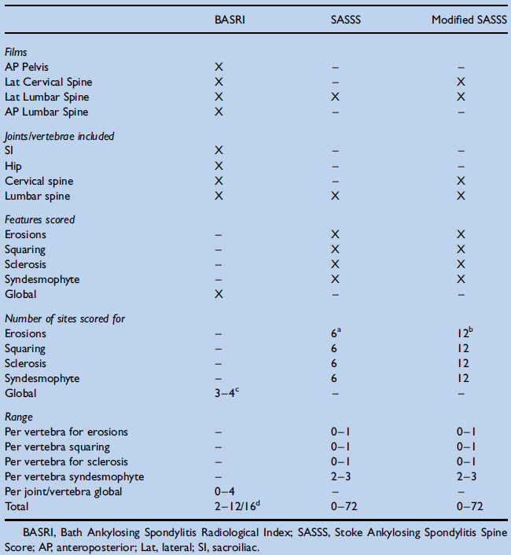
CR scoring systems in AS
Van der Heijde, D. Best Practice & Research Clinical Rheumatology, 18, no. 6 (December 2004): 847–60.

Slide 23
Artrite psoriasica
DX

Slide 24
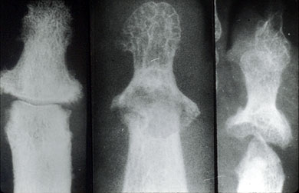
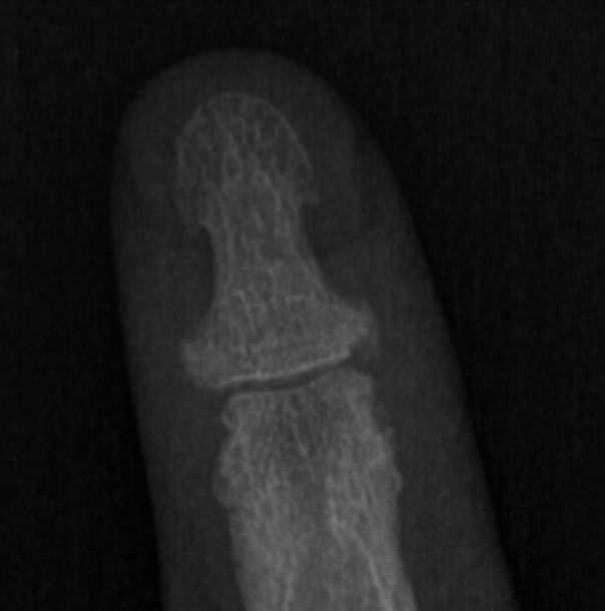
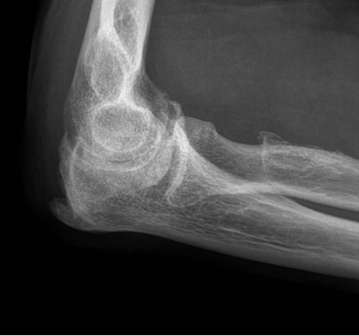
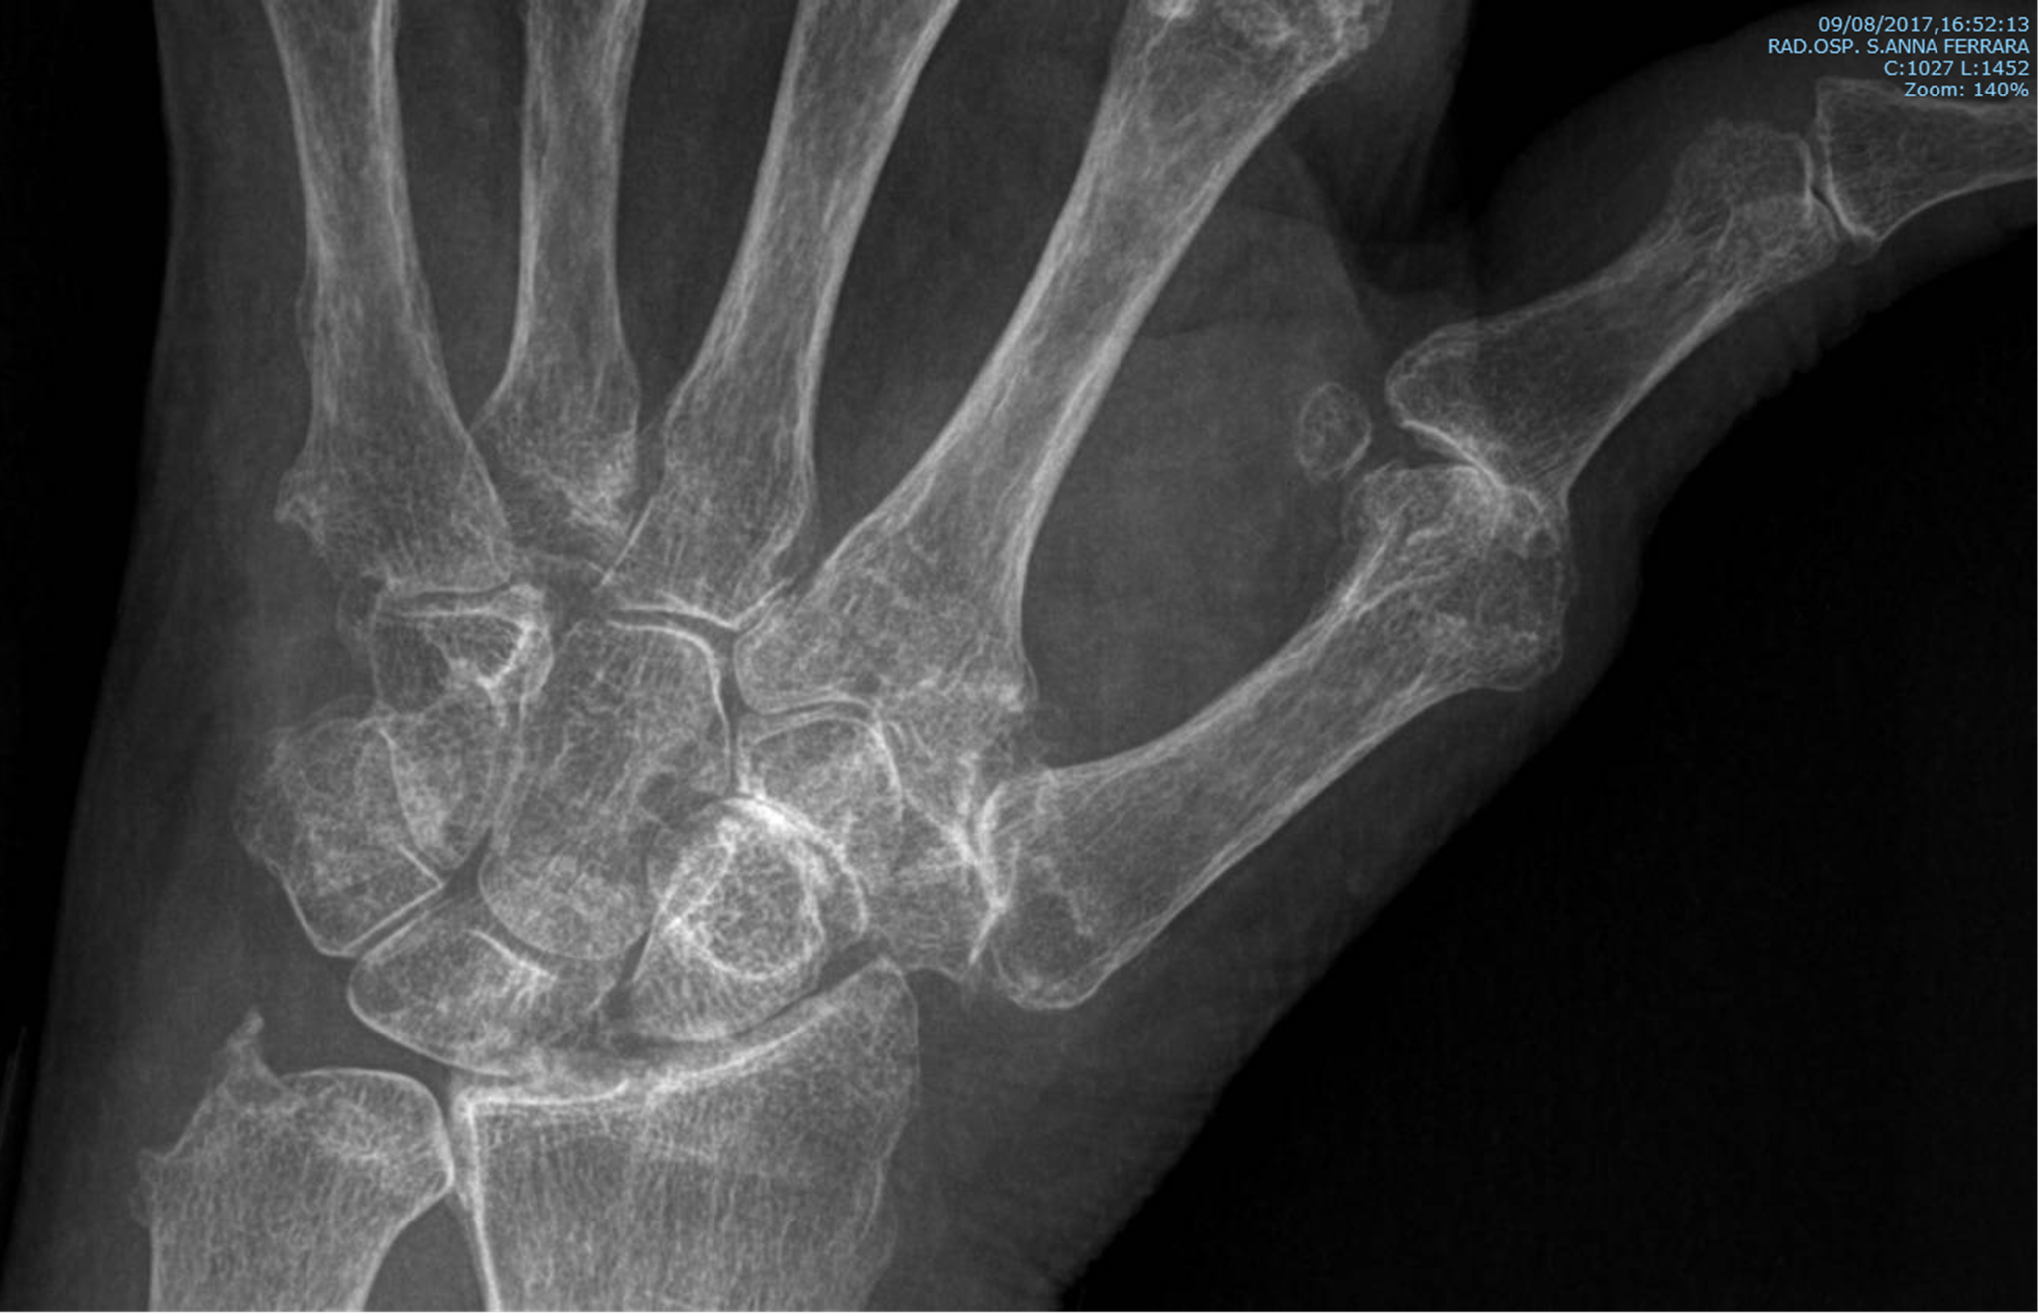
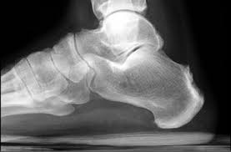
Artrite psoriasica

Slide 25
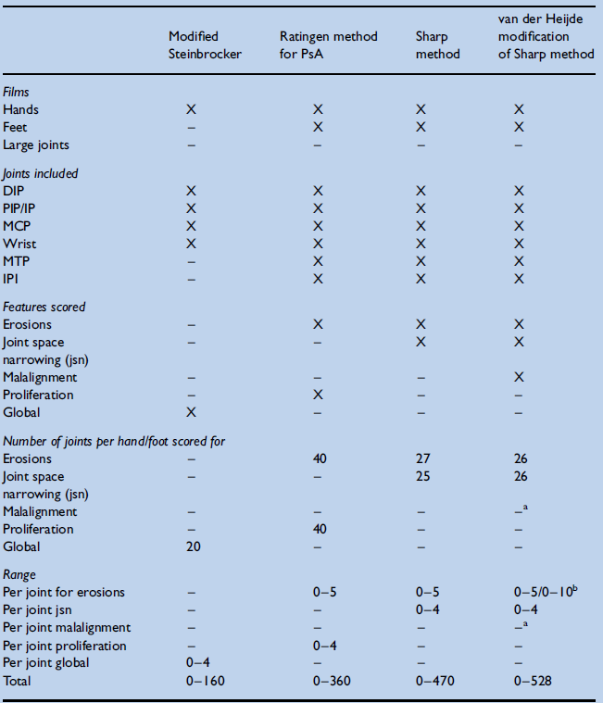
CR scoring systems in PsA
Van der Heijde, D. Best Practice & Research Clinical Rheumatology, 18, no. 6 (December 2004): 847–60.

Slide 26
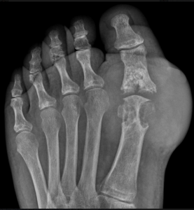
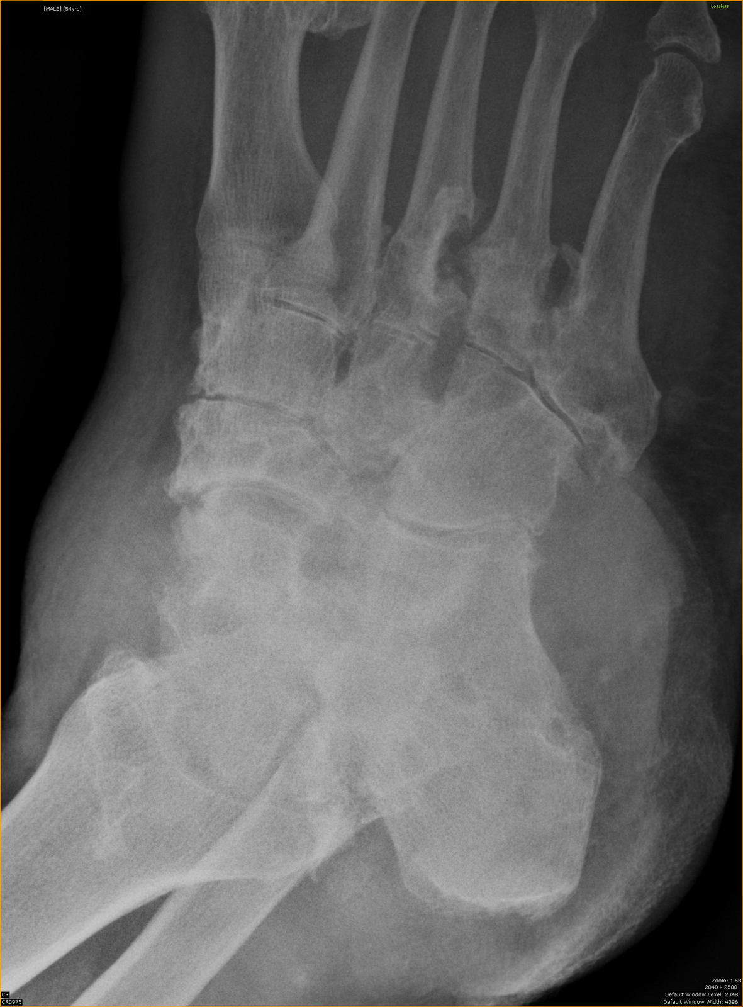
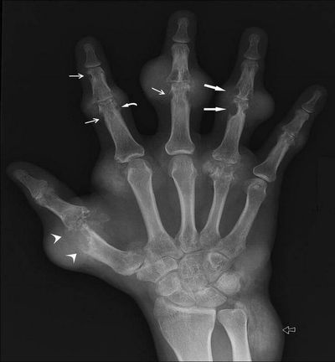
Gotta
DX

Slide 27
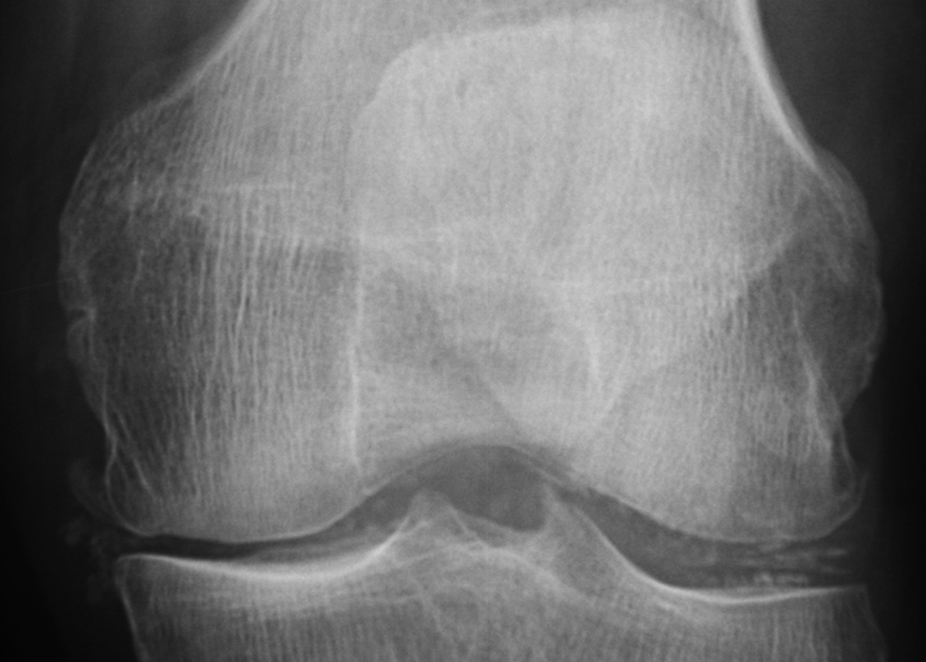
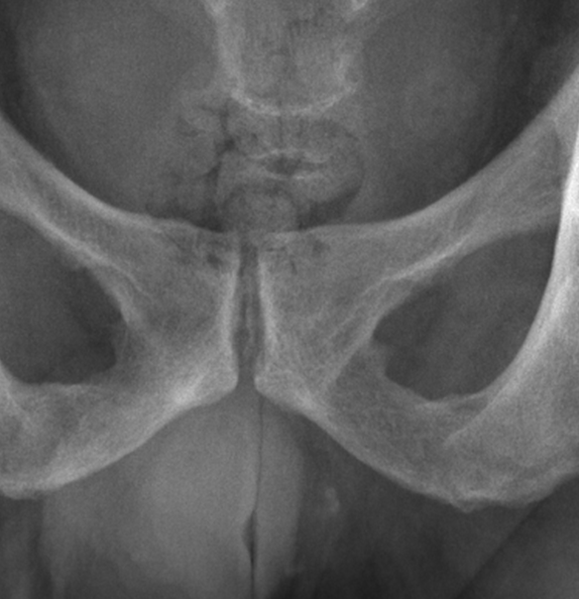
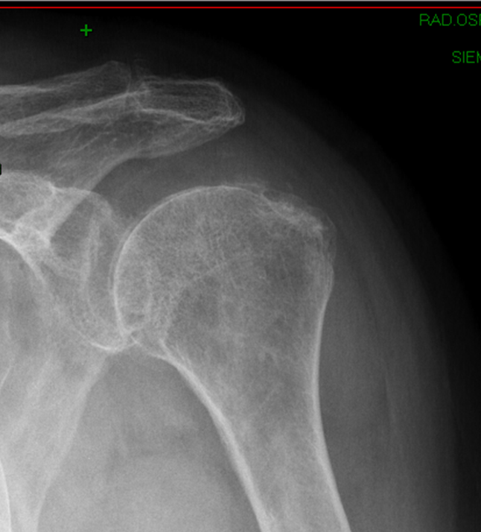
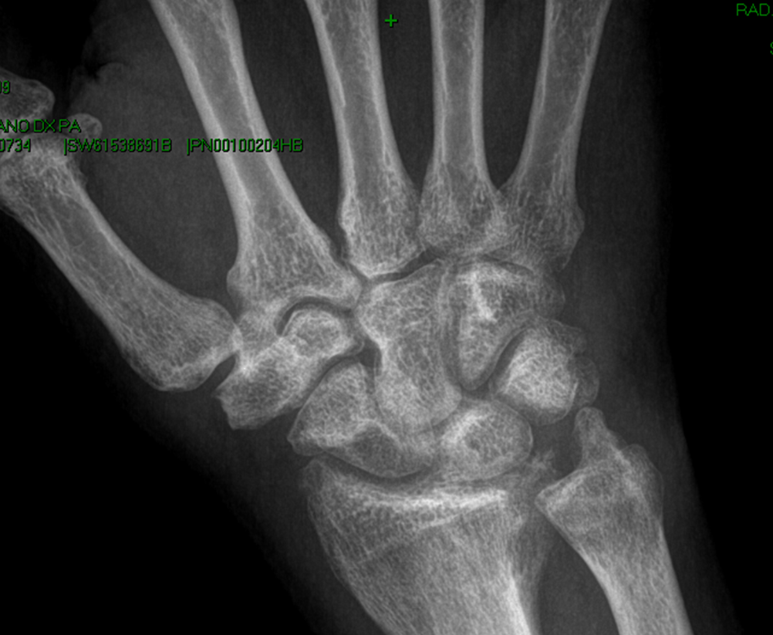
Condrocalcinosi
DX

Slide 28
Osteoartrosi
DX

Slide 29
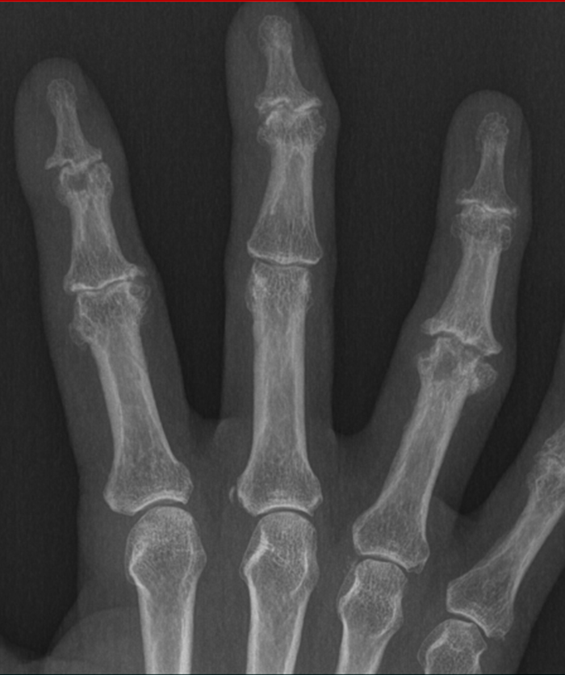
Osteoartrosi

Slide 30
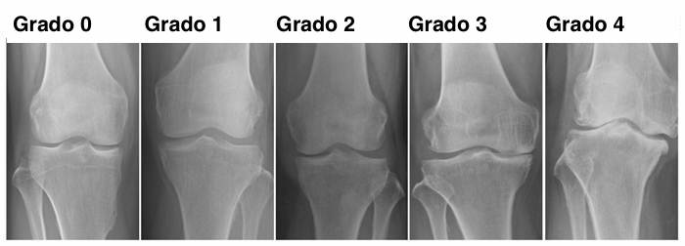
Kellgren & Lawrence

Slide 31
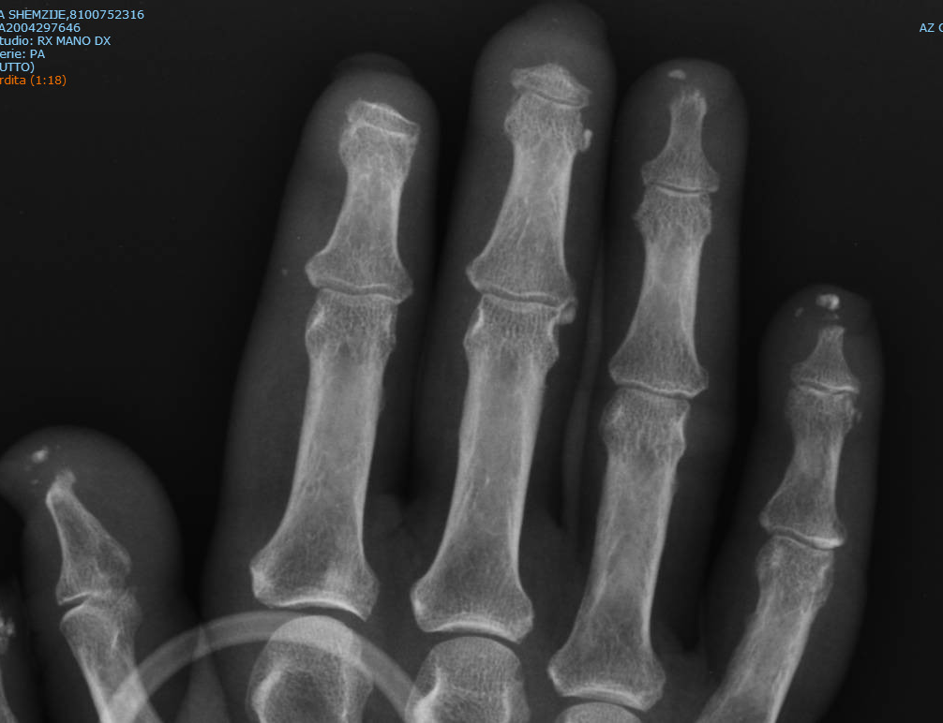
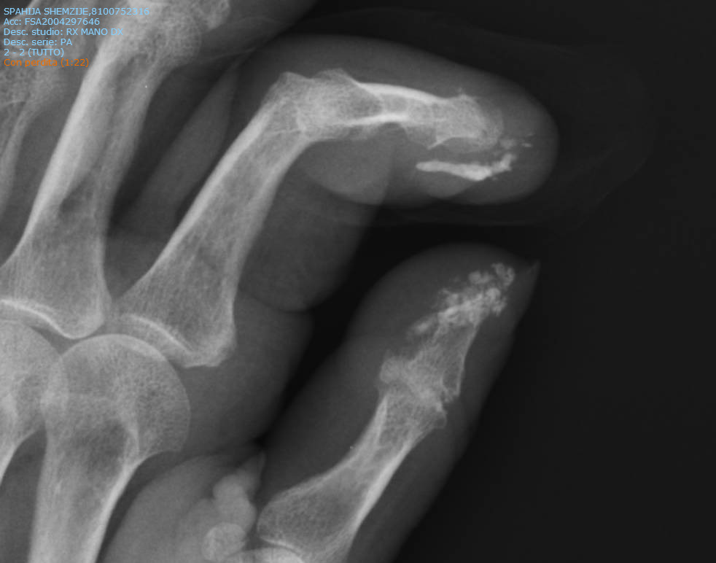
Sclerosi sistemica: calcinosi

Slide 32
Risonanza Magnetica Nucleare (MRI)
MRI allows sensitive visualization and assessment of peripheral inflammatory and destructive joint and soft tissue involvement in a variety of degenerative and inflammatory rheumatic diseases.
MRI is by far the best available method for detecting and monitoring inflammation in the spine and sacroiliac joints in AS and other spondyloarthritides.
MRI allows monitoring of inflammatory soft tissue changes (e.g., synovitis, tenosynovitis, and enthesitis) during treatment of patients with peripheral inflammatory joint diseases.
Through detection of early inflammatory changes, MRI can contribute to earlier diagnosis of RA and SpA.
MRI bone edema is uniquely visualized by MRI, and provides prognostic information in RA, SpA, OA, undifferentiated inflammatory arthritis and, possibly, other rheumatic arthritides
The main disadvantages of MRI are costs and lack of availability.

Slide 33
Lesioni elementari
Sinovite
Versamento
Edema osseo midollare
Erosioni
Alterazioni tendinee, borse, legamenti
Tenosinoviti
Cartilagine (alta risoluzione)

Slide 34
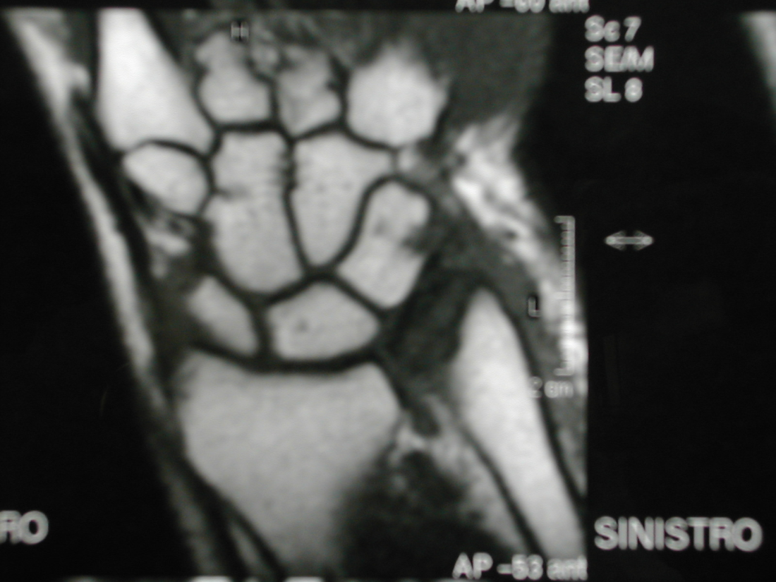
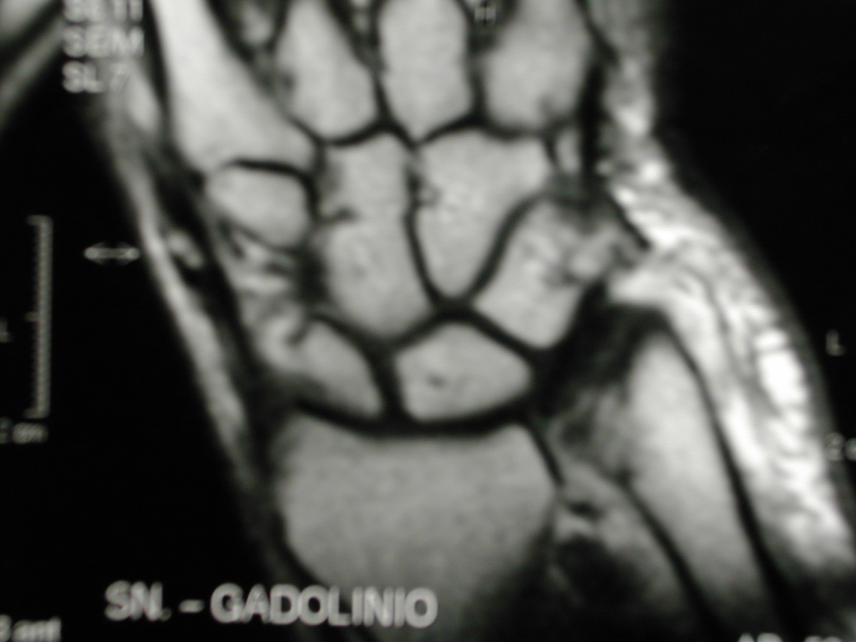
Sinovite

Slide 35
Artrite reumatoide

Slide 36
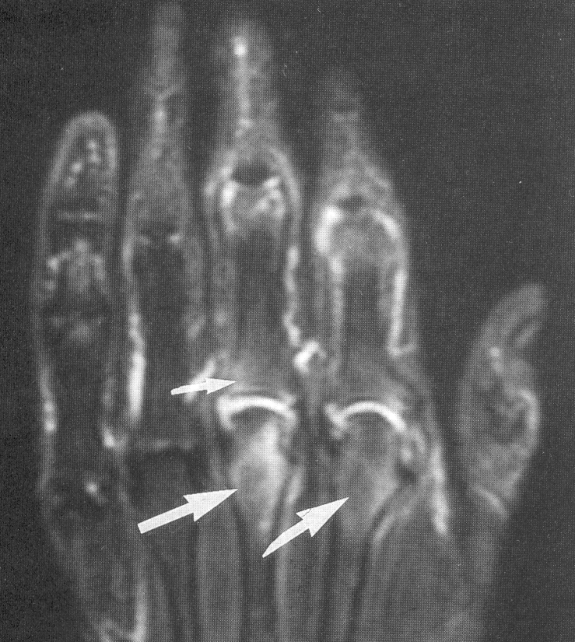
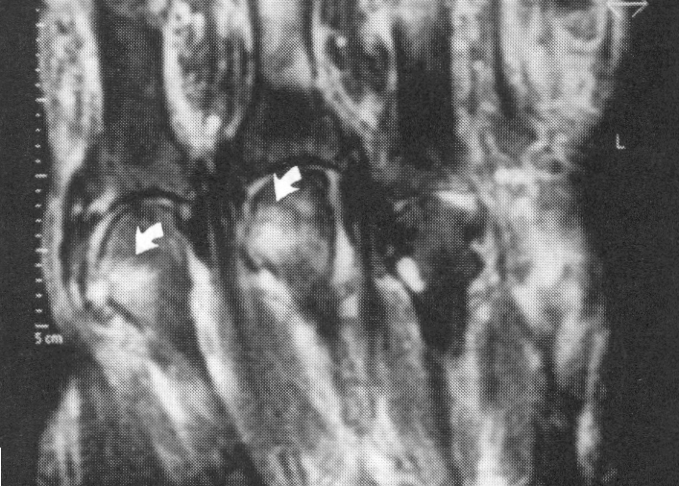
Edema Osseo Midollare
Non ha corrispondente Rx
Non è associato a osteopenia
Aumento di segnale T1 dopo FAT suppression
Dopo Gd-DTPA si ha aumento del segnale (meno intenso e più sfumato delle erosioni)
Predittivo di futura erosione (RR 6.5 dopo 1 anno)

Slide 37
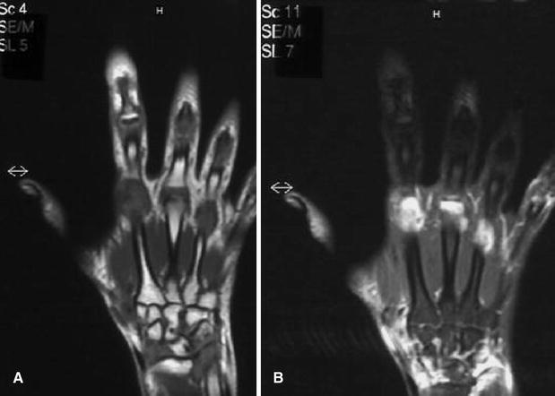
Edema osseo
SE T1 SPIR Gd

Slide 38
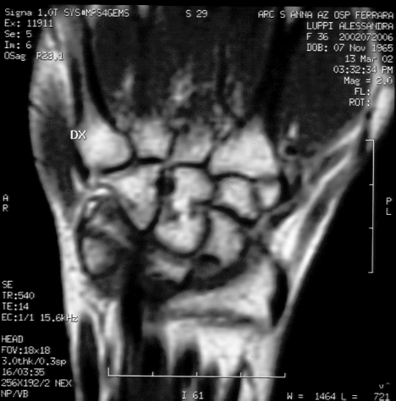
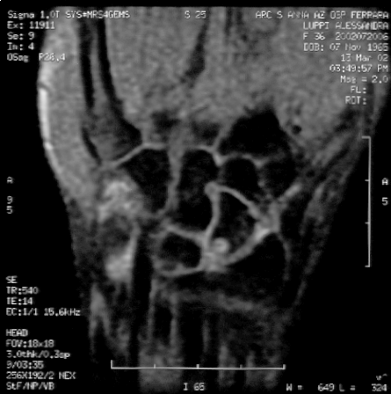
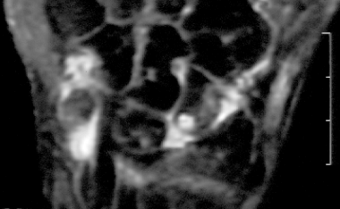
Erosioni

Slide 39
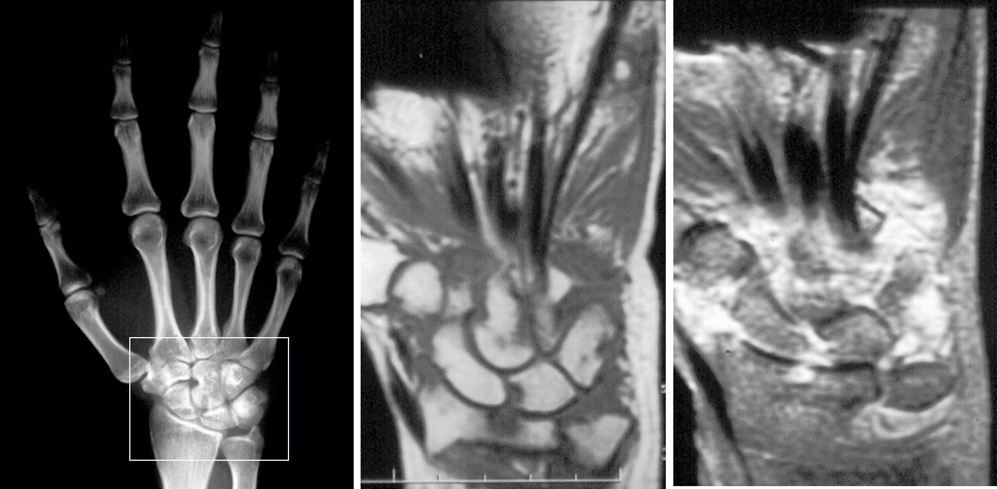
Artrite reumatoide

Slide 40
Artrite reumatoide

Slide 41
Sacroileite

Slide 42
Spondilite

Slide 43

Gotta MRI

Slide 44
Tomografia computerizzata (CT)
Computed tomography (CT) is a tomographic radiographic imaging technique that visualizes calcified tissue with high resolution. CT is a standard reference to detect bone destruction.
In rheumatology, CT is mainly useful to detect bone abnormalities in the axial skeleton (e.g., erosions, sclerosis, new bone formation, and fractures). CT is more sensitive for these purposes than radiography, and in most occasions MRI.
The role of CT of the axial skeleton is limited by the use of a relative high amount of ionizing radiation.
In practice, CT is rarely used unless radiography is unclear and MRI unavailable.
The main disadvantages of CT are the low sensitivity for soft tissue changes and the high patient exposure to ionizing radiation

Slide 45

Gotta

Slide 46

Ecografia muscoloscheltrica
Ultrasonography allows sensitive visualization and assessment of peripheral inflammatory and destructive joint and soft tissue involvement in a variety of degenerative and inflammatory rheumatic diseases.
Ultrasonography can readily be performed by trained rheumatologists in relation to the clinical examination.
Ultrasonography can, through detection of early inflammatory changes, contribute to earlier diagnosis of RA.
Grey scale and power Doppler ultrasonography allow physicians to monitor inflammatory soft tissue changes (e.g., synovitis, tenosynovitis, and enthesitis) during treatment of patients with peripheral inflammatory joint diseases.
Ultrasonography allows guidance of invasive procedures, making possible precise needle positioning for aspirations and injections (e.g., in joints, bursae, or tendon sheaths, or at entheses).
The main disadvantages of ultrasonography are the need for a skilled operator interreader and interscanner variability, and the need for an “acoustic window.”

Slide 47







Lesioni elementari
  Joint effusion
  Synovial hypertrophy
  Power Doppler
  Tenosynovitis
  Entesitis
  Bursitis
  Bone erosions
  Cartilage damage/abnormalities

Slide 48



Joint effusion
Synovial hypertrophy

Slide 49



Wakefield RJ et al. J Rheumatol 2005 on behalf of OMERACT 7 US SIG group

Slide 50




Tenosynovitis
Bursitis
Entesitis

Slide 51


Wakefield RJ et al. J Rheumatol 2005 on behalf of OMERACT 7 US SIG group

Slide 52





Articular cartilage
metacarpophalangeal joint
osteoarthritis
cppd
healthy subject
gout
rheumatoid arthritis

Slide 53

Erosione ‘calda’

Slide 54


Articular cartilage
femoral condyle
Healthy subject
CPPD disease
Gout
Filippucci E et al. Osteoarthritis Cartilage 2008

Slide 55
X-ray vs US in RA
US are 3.4-6.5 fold more sensitive in detecting the number of erosions
US are 2.7-7.5 fold more sensitive in detecting RA patients with erosions
Wakefield RJ, et al. Arthritis Rheum 2000

Slide 56



Slide 57

Notes:
57

Slide 58

US and residual disease

Slide 59

PD-US predicts clinical outcome in remission
PD positive
PD negative
Notes:
59

Slide 60
Gotta

Slide 61



CPPD

Slide 62


Slide 63




CPPD

Slide 64




Ecografia arterie temporali
Halo sign

Slide 65
Medicina nucleare
Nuclear imaging provides not only morphologic but also physiologic information regarding the metabolic state of tissues.
Nuclear medicine techniques can be fused with other imaging modalities (e.g., SPECT/CT) providing combined functional and anatomic information.
PET can be useful for diagnosis and management of vasculitides, fever of unknown origin, and malignancies.
Other imaging modalities are generally better suited than nuclear medicine to investigate inflammatory and degenerative rheumatic diseases in clinical practice

Slide 66
Artrite reumatoide

Slide 67


PET-CT: Vasculite dei grossi vasi

Slide 68

PET-CT: Vasculite dei grossi vasi

Slide 69



US guided injections
Diagnosis
  accurate aspiration of fluid
Intervention
  accurate delivery of therapeutic agent
One third of clinical examination guided injections are inaccurate
US guided injections are significantly more accurate than CE guided injections
Relative novice can achieve high accuracy rates with limited training
longitudinal
transverse

Slide 70






Ultrasound-guided synovial biopsy
Safe
Mini-invasive
Under “direct” visualization
Large and small joints
Histological validity

Slide 71
Utilità Clinica dell’imaging in reumatologia
A. Peripheral joints
• To establish a diagnosis of rheumatoid arthritis (RA): radiography, magnetic resonance imaging (MRI), ultrasonography
• To assist with the diagnostic workup in suspected, but not definite, inflammatory joint disease and early, unclassified inflammatory joint disease (by detection of the presence or absence of synovitis, enthesitis, or bone erosions, among other conditions): radiography, MRI, ultrasonography
• To monitor disease activity: MRI, ultrasonography
• To monitor structural joint damage: radiography, MRI
• To assist with the prognostic stratification of patients with early RA: radiography, MRI, (ultrasonography*), (DXR*)
• To help define the presence or absence of true remission: MRI, ultrasonography
• To guide aspirations and injections in joints, bursae, and tendon sheaths: ultrasonography
B. Axial joints
Use in clinical practice:
• To establish a diagnosis of ankylosing spondylitis (AS)/ spondyloarthropathies (SpA): radiography/radiography and MRI
• To monitor disease activity: MRI
• To monitor structural joint damage: radiography, MRI, (CT†)

Slide 72

Utilizzo integrato delle tecniche di imaging
Clinica

