Slide 1
Artriti infettive
Prof. Carlo Alberto Scire’ – carloalberto.scire@unife.it
Sezione di reumatologia ed ematologia – scuoladi specializzazione in reumatologia
Dipartimento di Scienze mediche
Università degli studi di Ferrara

Slide 2
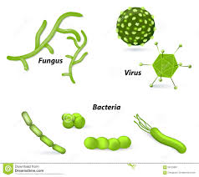
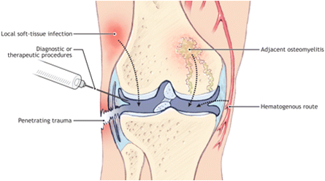
Sommario
Esame del liquido sinoviale
Artriti batteriche
Artriti virali
Febbre reumatica
Artriti reattive

Slide 3
Artriti batteriche

Slide 4
Agenti eziologici

Slide 5
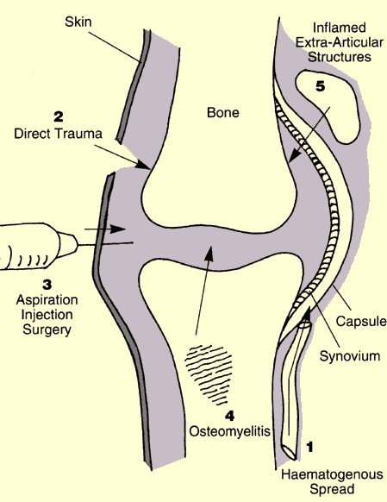
Patogenesi

Slide 6
Fattori di rischio

Slide 7
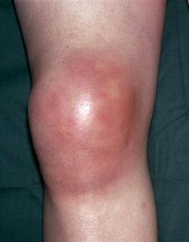
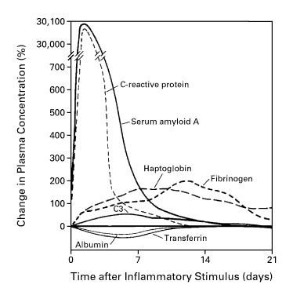
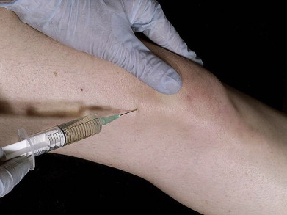
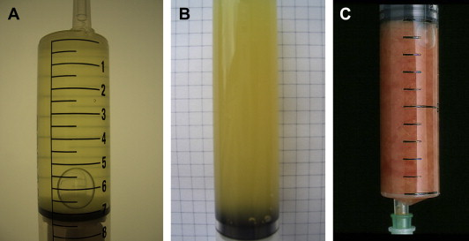
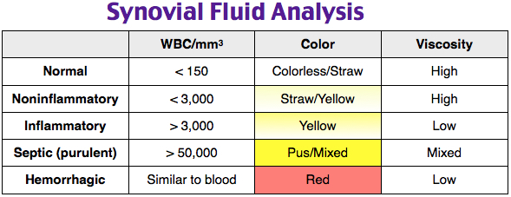
Clinica - Diagnosi
Laboratory
WBC – White Blood Count
ESR – erytrosedimentation rate
CRP – C-reactive protein
PCT – procalcitonin

Slide 8
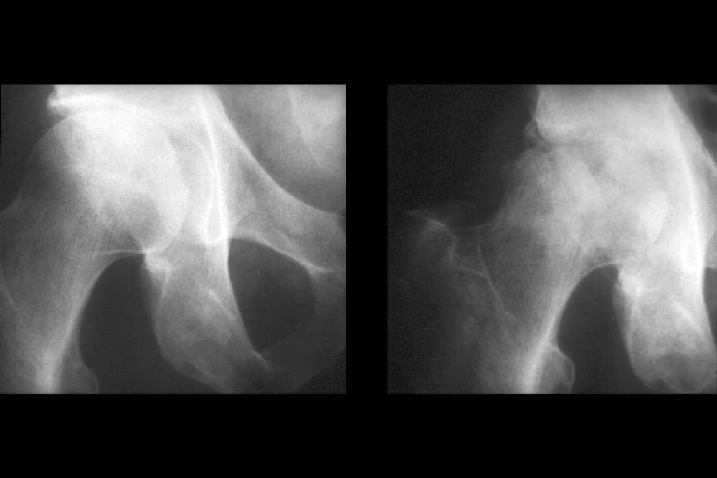
Prognosi
The mortality rates in most series have ranged from 10 to 15 percent
Polyarticular septic arthritis, particularly when it is due to S. aureus or occurs in the presence of rheumatoid arthritis, has an extremely poor prognosis, with mortality rates as high as 50 percent
Mortality due to septic pneumococcal arthritis was reported as 19 percent in one series

Slide 9
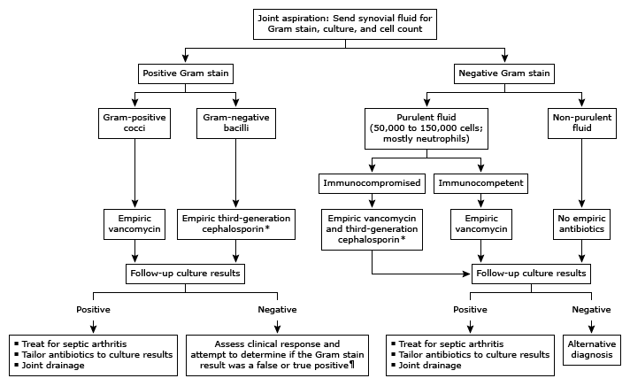
Terapia

Slide 10
Malattia di Lyme

Slide 11
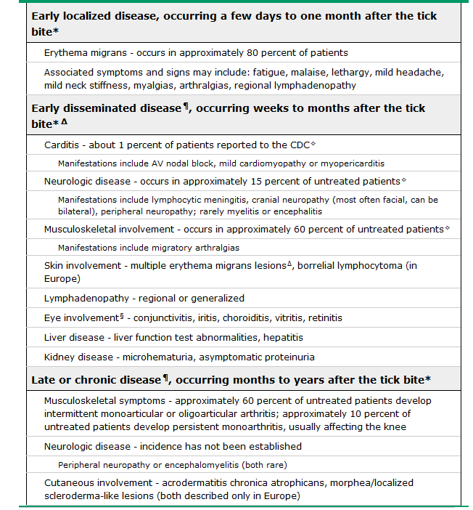
Clinica

Slide 12
Diagnosi

Slide 13
Terapia

Slide 14
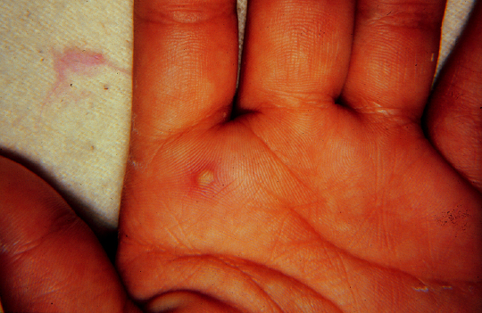
Artrite gonococcica

Slide 15
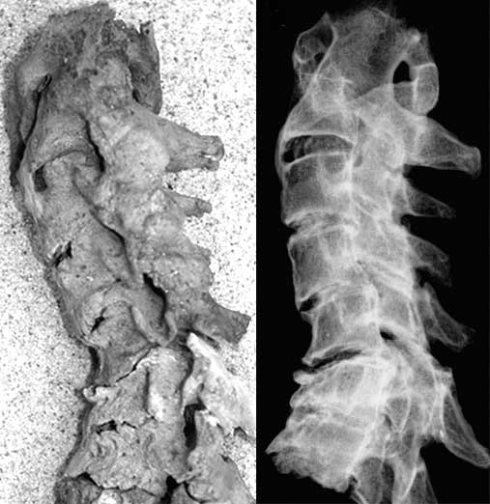
Artrite tubercolare

Slide 16
Manifestazioni rematologiche dell’HIV

Slide 17
Artriti Virali

Slide 18
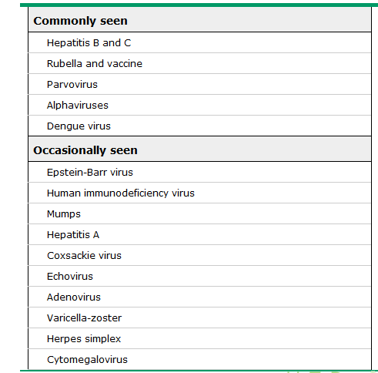
Agenti eziologici

Slide 20
Patogenesi

Slide 21
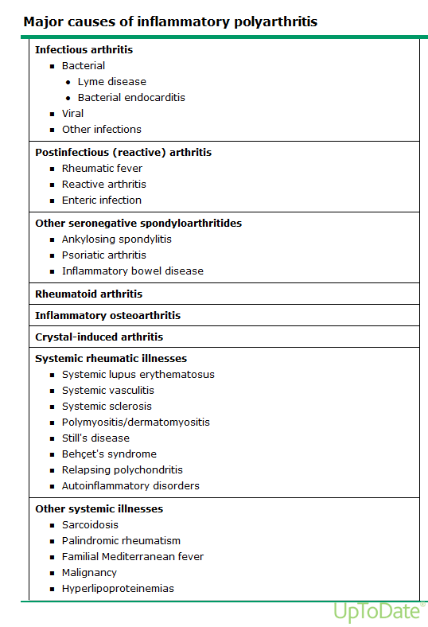
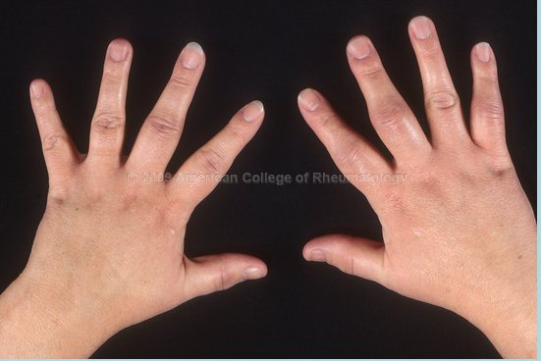
Diagnosi

Slide 22
Febbre reumatica

Slide 23
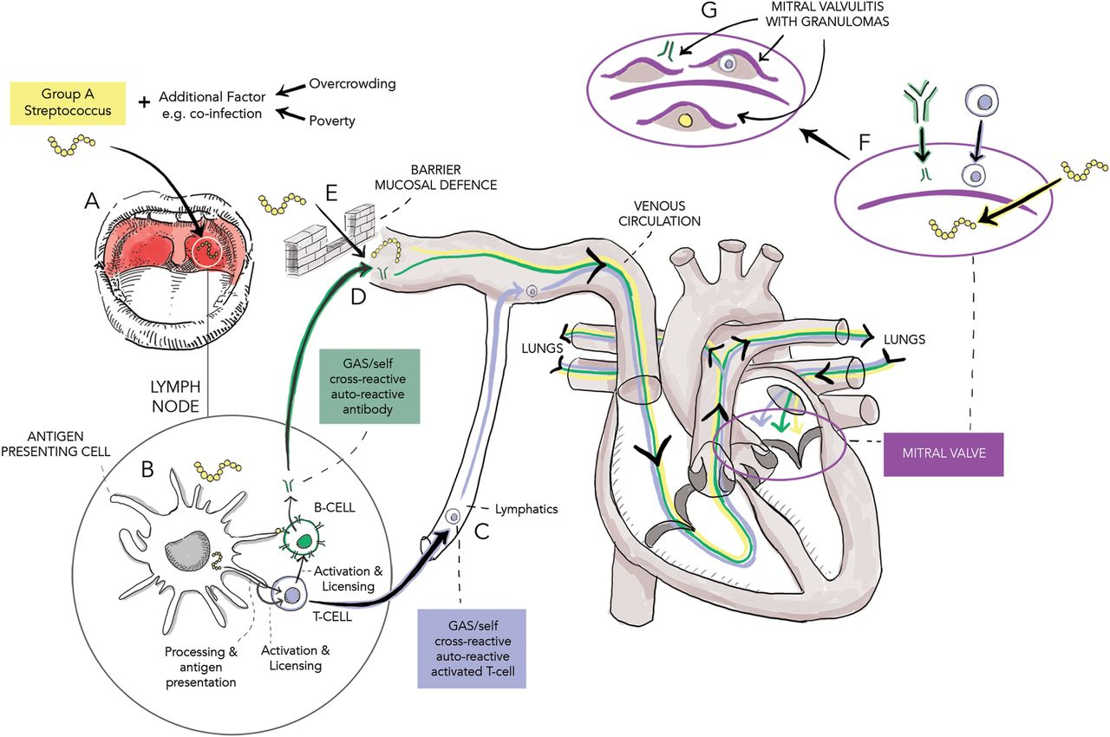
Patogenesi

Slide 24
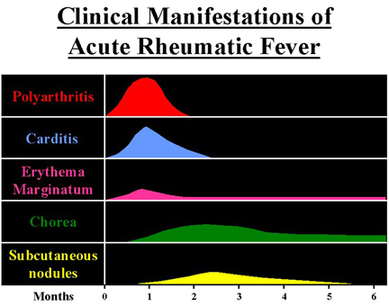
Clinica
The five major manifestations:
Carditis and valvulitis (eg, pancarditis) that is clinical or subclinical – 50 to 70 percent
Arthritis (usually migratory polyarthritis predominantly involving the large joints) – 35 to 66 percent
Central nervous system involvement (eg, Sydenham chorea) – 10 to 30 percent
Subcutaneous nodules – 0 to 10 percent
Erythema marginatum – <6 percent
The four minor manifestations:
Arthralgia
Fever
Elevated acute phase reactants (erythrocyte sedimentation rate [ESR], C-reactive protein [CRP])
Prolonged PR interval on electrocardiogram

Slide 25
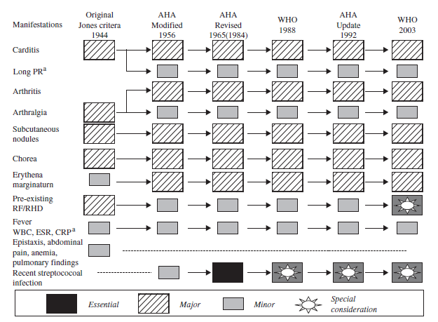
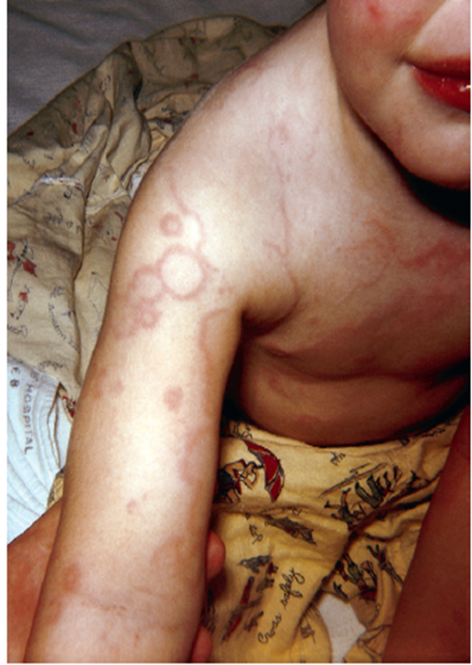
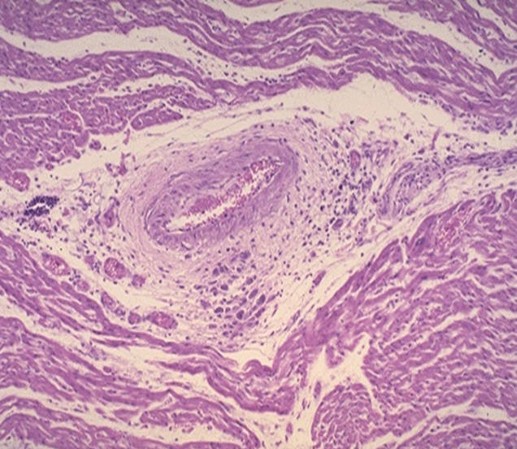
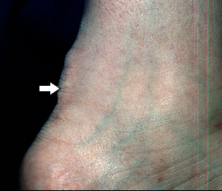
Diagnosi
Erythema marginatum

Slide 26
Prognosi

Slide 27
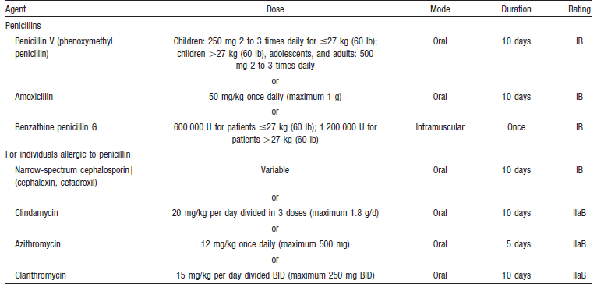
Terapia

Slide 28
Artriti reattive

Slide 29
Agenti eziologici
Infezioni gastrointestinali
  Salmonella of various serovars
  Shigella, especially Shigella flexneri, but also Shigella dysenteriae and Shigella sonnei
  Yersinia, including Yersinia enterocolitica 0:3 and 0:9 and Yersinia pseudotuberculosis
  Campylobacter, especially Campylobacter jejuni
  Clostridium difficile
Infezioni enitourinarie
  Chlamydia trachomatis
Altre
  Chlamydia pneumoniae, Escherichia coli, Ureaplasma urealyticum, and Mycoplasma genitalium.
  Intravesical Bacillus Calmette-Guerin (BCG)
  Human immunodeficiency virus (HIV) infection

Slide 30
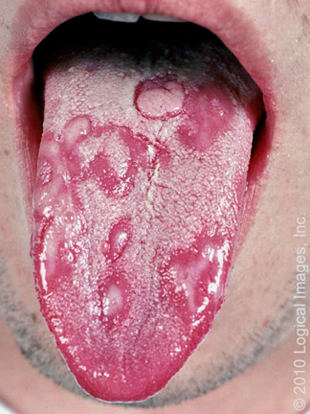
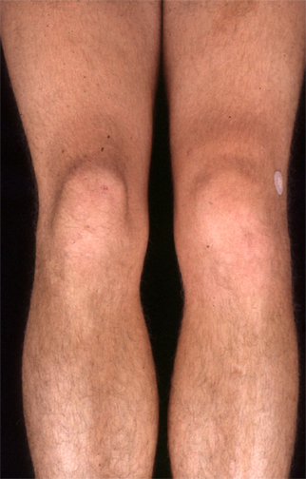
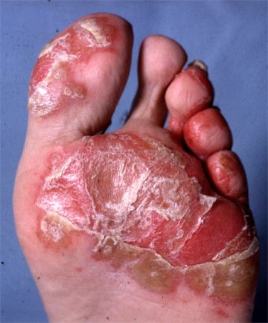
Clinica
MSK symptoms
  Arthritis
  Enthesitisi
  Dactylitis
  Low back pain
Extraarticular manifestations
  Conjunctivitis
  Genitourinary tract symptoms
  Oral lesions, including mucosal ulcers
  Cutaneous eruptions and other skin changes, such as keratoderma blennorrhagica (hyperkeratotic skin lesions on soles and palms) and erythema nodosum
  Onychopathy
  Genital lesions such as circinate balanitis

