Slide 1
APACHE III SCORING SYSTEM
Temperatura
Pressione arteriosa media
Frequenza cardiaca
Frequenza respiratoria
PaO2
pH arterioso
Sodio e potassio sierico
Glicemia
Creatininemia
BUN
Leucociti
ematocrito
albumina
Bilirubina
Fattori addizionali:
Età, pregressa insufficienza d’organo, Immunosoppressione, pregressi
interventi chirurgici

Slide 2
Ranson’S Criteria

Slide 3
Predittori di gravità comprendono:
Punteggio all’indice di Ranson >3
Punteggio All’Apache II >8
BISAP score (Bedside Index of Severity in AP):
Azotemia > 25 mg/dl
Alterazione stato di coscienza
Età > 60
Evidenza radiografica di versamento pleurico
Va valutato nelle prime 24 h di ospedalizzazione
3 o + criteri = ↑ mortalità intraospedaliera

Slide 4
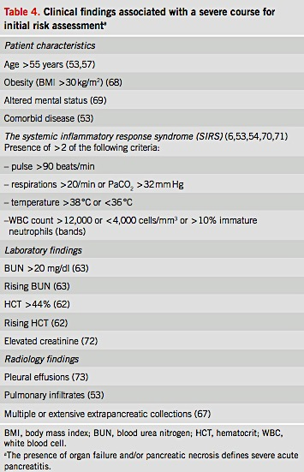

Slide 5
INITIAL MANAGEMENT
Recommendations
Aggressive hydration, defined as 250–500 ml per hour of isotonic crystalloid solution should be provided to all patients, unless cardiovascular, renal, or other related comorbid factors exist. Early aggressive intravenous hydration is most beneficial during the first 12–24 h, and may have little benefit beyond this time period (strong recommendation, moderate quality of evidence).
In a patient with severe volume depletion, manifest as hypotension and tachycardia, more rapid repletion (bolus) may be needed (conditional recommendation, moderate quality of evidence).
Lactated Ringer’s solution may be the preferred isotonic crystalloid replacement fluid (conditional recommendation, moderate quality of evidence).
Fluid requirements should be reassessed at frequent intervals within 6 h of admission and for the next 24–48 h. The goal of aggressive hydration should be to decrease the BUN (strong recommendation, moderate quality of evidence).

Slide 6
MANAGEMENT
Nella maggior parte dei pazienti (85-90%) la malattia si risolve spontaneamente entro 3-7 giorni dall’inizio del trattamento
Le misure terapeutiche comprendono:
Misure d’emergenza!!!
Somministrazione di analgesici
Reintegro idroelettrolitico
Sospensione alimentazione orale
Considerare nutrizione enterale
Considerare colecistectomia

Slide 7
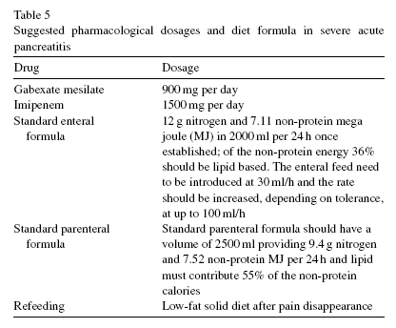

Slide 8
ROLE OF ERCP
Recommendations
Patients with AP and concurrent acute cholangitis should undergo ERCP within 24 h of admission (strong recommendation, moderate quality of evidence).
ERCP is not needed early in most patients with gallstone pancreatitis who lack laboratory or clinical evidence of ongoing biliary obstruction (strong recommendation, moderate quality of evidence).
In the absence of cholangitis and / or jaundice, MRCP or EUS rather than diagnostic ERCP should be used to screen for choledocholithiasis if highly suspected (conditional recommendation, moderate quality of evidence).
Pancreatic duct stents and/or post-procedure rectal nonsteroidal anti-inflammatory drug (NSAID) suppositories should be utilized to lower the risk of severe post-ERCP pancreatitis in high-risk patients (conditional recommendation, moderate quality of evidence).

Slide 9
Pancreatite acuta biliare severa
ERCP + ES
entro 48/72 ore
SEMPRE
(Neoptolemos)
ITTERO
COLANGITE ACUTA
VB DILATATA (Folsch)
TERAPIA MEDICA INTENSIVA
In severe gallstone-associated acute pancreatitis,
cholecystectomy should be delayed
until there is sufficient resolution of the inflammatory
response and clinical recovery
Recommendation grade B
No early surgery
(entro 48 ore)
Si delayed surgery
(dopo 48 ore)

Slide 10
ATB Treatment
Recommendations
Antibiotics should be given for an extrapancreatic infection, such as cholangitis, catheter-acquired infections, bacteremia, urinary tract infections, pneumonia (strong recommendation, moderate quality of evidence).
Routine use of prophylactic antibiotics in patients with severe AP is not recommended (strong recommendation, moderate quality of evidence).
The use of antibiotics in patients with sterile necrosis to prevent the development of infected necrosis is not recommended (strong recommendation, moderate quality of evidence).
Infected necrosis should be considered in patients with pancreatic necrosis who deteriorate or fail to improve after 7–10 days of hospitalization. In these patients, either (i) initial CT-guided fine-needle aspiration (FNA) for Gram stain and culture or (ii) empiric use of antibiotics after obtaining necessary cultures, without CT FNA, should be given (strong recommendation, moderate evidence).
In patients with infected necrosis, antibiotics known to penetrate pancreatic necrosis, such as carbapenems, quinolones, and metronidazole, may be useful in delaying or sometimes totally avoiding intervention, thus decreasing morbidity and mortality (conditional recommendation, moderate quality of evidence).
Routine administration of antifungal agents along with prophylactic or therapeutic antibiotics is not recommended (conditional recommendation, low quality of evidence).

Slide 11
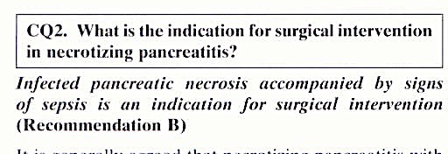
TERAPIA CHIRURGICA
ProInf AISP 2001
…indicazioni
all’intervento chirurgico…
Necrosi infetta 57.8%
Peritonite 44.6%
Necrosi sterile 20.5%
MOF 19.3%
Pseudocisti 8.4%
JPN guidelines
Tadahiro 2006

Slide 12
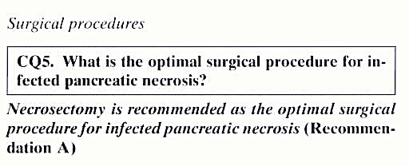
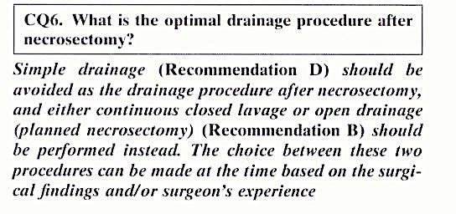
Pancreatite acuta severa
Quale chirurgia ?
JPN guidelines
2006

Slide 13
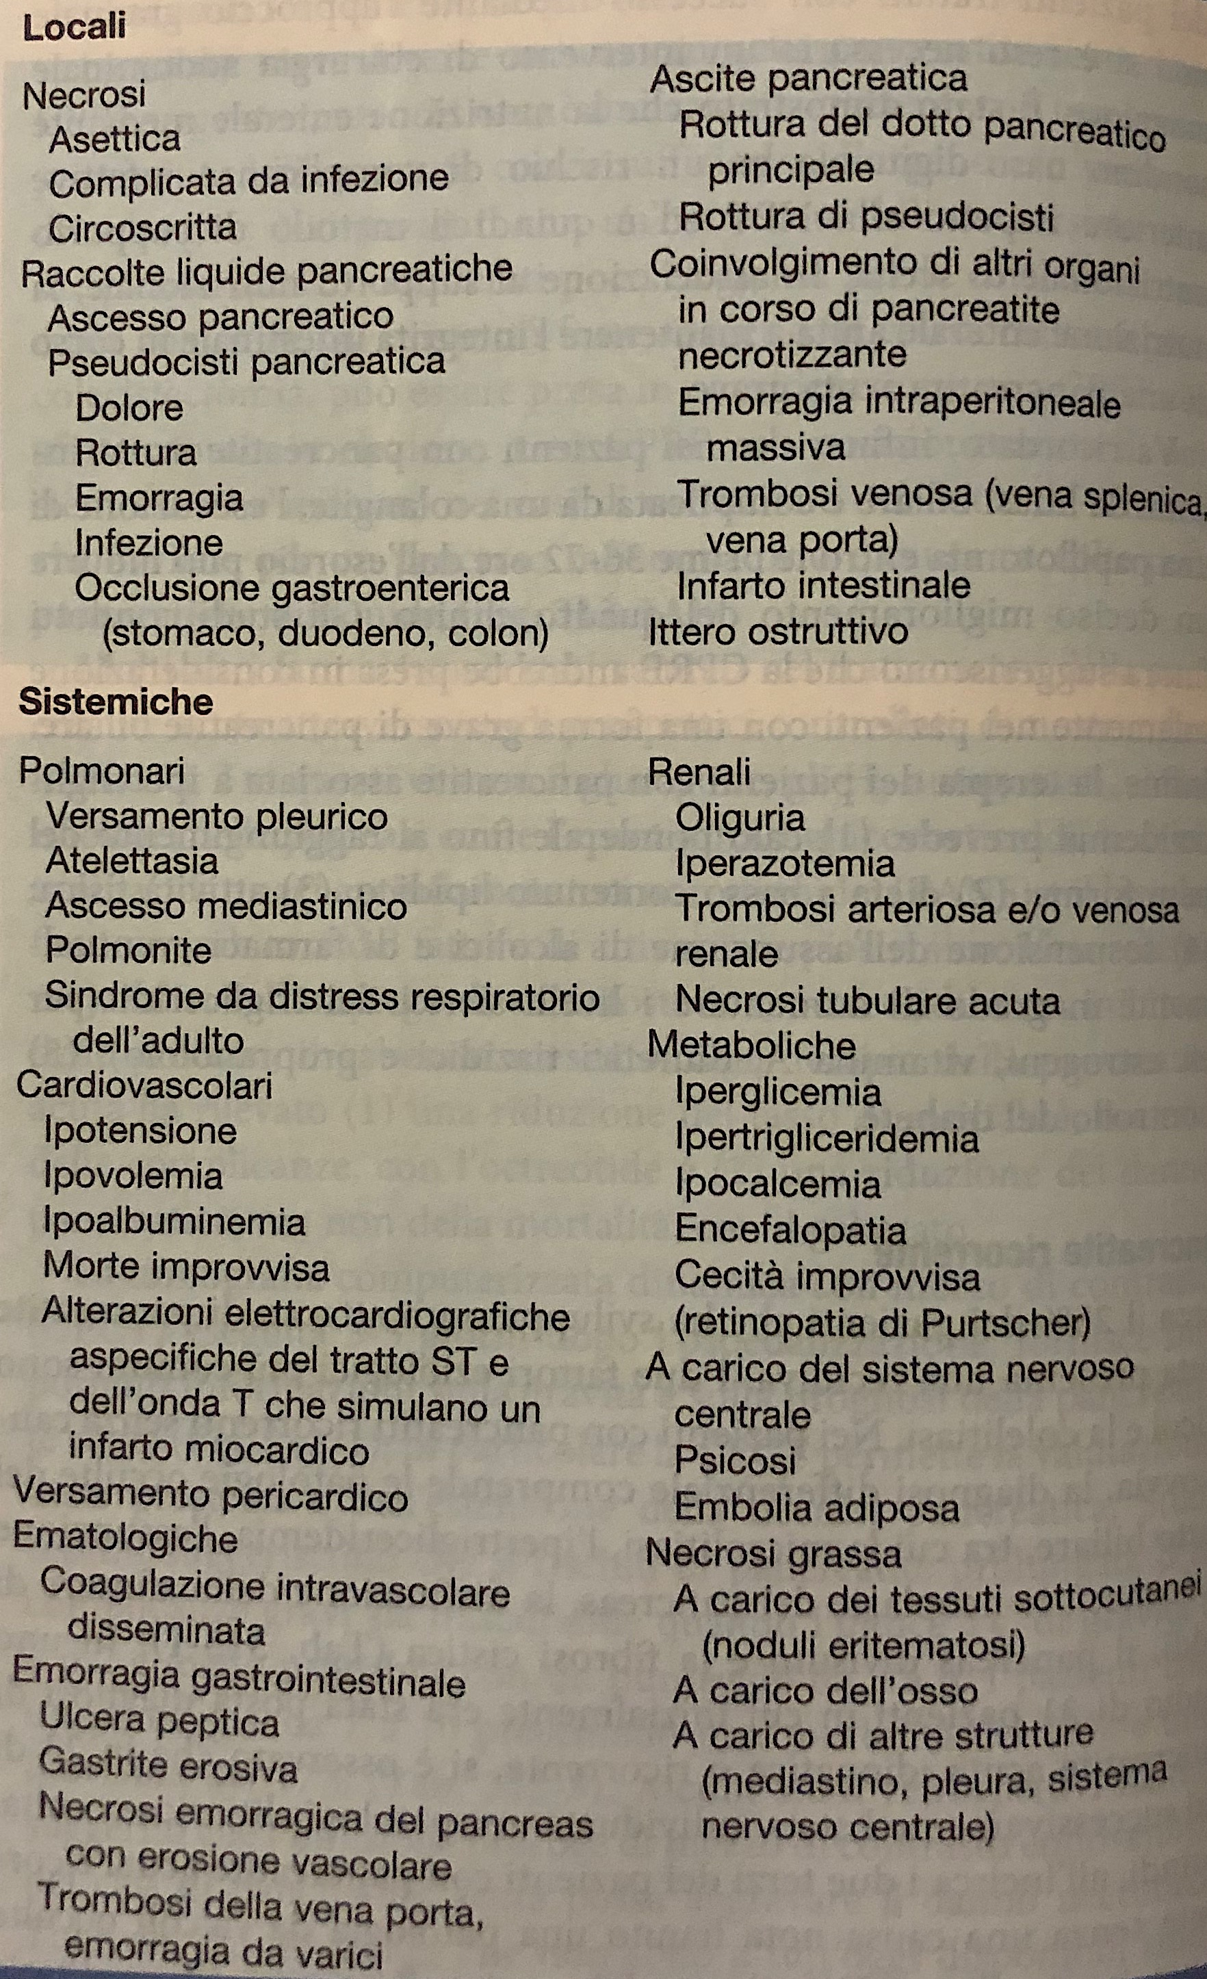
COMPLICANZE

Slide 14
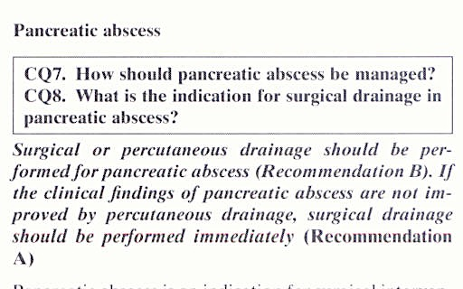
TRATTAMENTO DELLE COMPLICANZE
JPN guidelines 2006

Slide 15
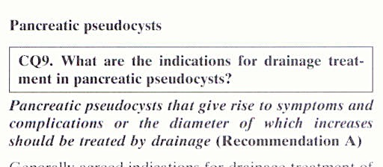
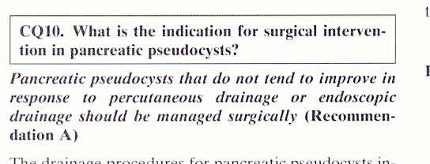
JPN guidelines 2006

Slide 16
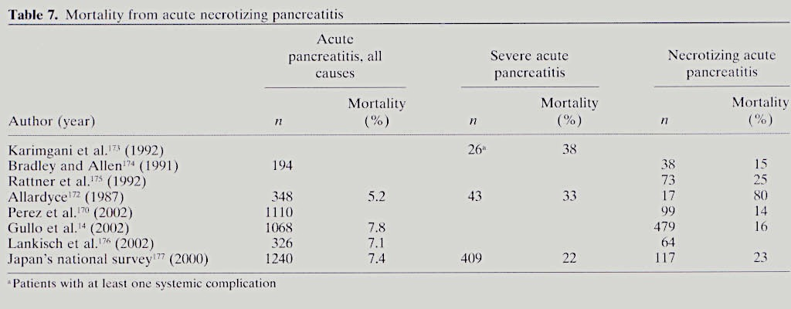
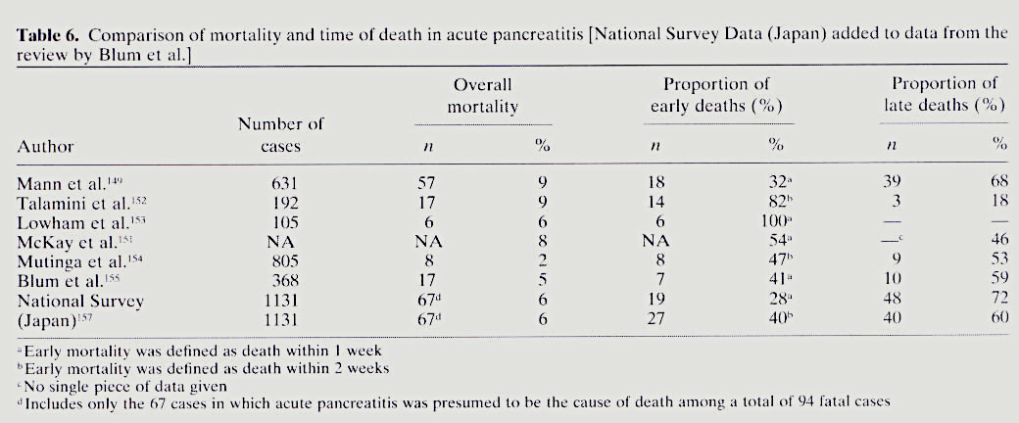
…la mortalità in corso di pancreatite acuta…
5.2-7.8%
22-38%
14-80%
Sekimoto 2006

