Slide 1
Corso di Laurea in Medicina e Chirurgia A.A. 2018/2019
PANCREATITE ACUTA
…Tutto quello che avreste voluto sapere e non avete mai osato chiedere sulla pancreatite acuta…
Matteo Guarino e Roberto De Giorgio

Slide 2
“ Acute Pancreatitis is the most terrible of all the calamities that occur in connection with the abdominal viscera.”
Sir Berkeley Moynihan, Ann Surg 1925

Slide 3
CASO CLINICO

Slide 4
Dati Clinici
♀, 60 anni
Recente colectomia sx per adenocarcinoma non infiltrante; non altre patologie in APR
In PS per: dolore epigastrico, intenso (NRS: 9), irradiato posteriormente in regione lombare; diversi episodi di vomito biliare;
Viene posto un accesso venoso e vengono somministrati analgesici

Slide 5
Esame Clinico
Addome teso e dolente; segno di Blumberg positivo
Nulla di patologico all’obiettività toracica e cardiaca
P.A.: 100 / 60 mmHg

Slide 6
Esami Richiesti
ECG
RX torace
RX addome diretto
Esami ematochimici

Slide 7
Referto Esami
ECG: alterazioni della ripolarizzazione ventricolare
RX addome: presenza di alcuni livelli idroaerei
RX del torace: piccolo versamento pleurico dx

Slide 8
Esami Ematochimici
Leucociti: 15.300 / mm³
PaO₂: 80 mmHg

Slide 9
Risultati

Slide 10
Risultati-2

Slide 11
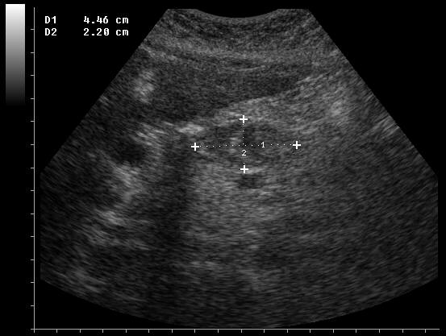
Ecografia Addominale

Slide 12
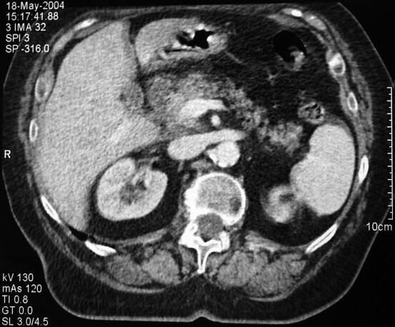
Tomografia Computerizzata

Slide 13
Follow-up
La paziente eseguì una ERCP + sfinterotomia con estrazione di calcoli dalla VBP
In seguito fu colecistectomizzata per litiasi
Attualmente le condizioni cliniche della paziente sono buone

Slide 14
Definizione
La pancreatite acuta è un processo infiammatorio acuto a carico del pancreas con variabile coinvolgimento dei tessuti peripancreatici e degli organi a distanza

Slide 16
EpidemIOLOGIA
5-35/100,000
Increasing incidence (detection? meds? iatrog?)
Increases with increasing age
Onset before 14-15 yrs unusual (hereditary, traumatic, anatomic anomalies)
250,000 admissions per year in U.S. (2nd GI)
$2 billion in direct costs per year
6th costliest GI disease behind ESLD, cancers, IBD
NIDDK funding is 11 out of 17 GI illnesses

Slide 17
EZIOLOGIA
In Italia la AP ha incidenza crescente.
I dati ISTAT parlano di 20.000 nuovi casi ogni anno

Slide 18
EZIOLOGIA ED ETÀ

Slide 19
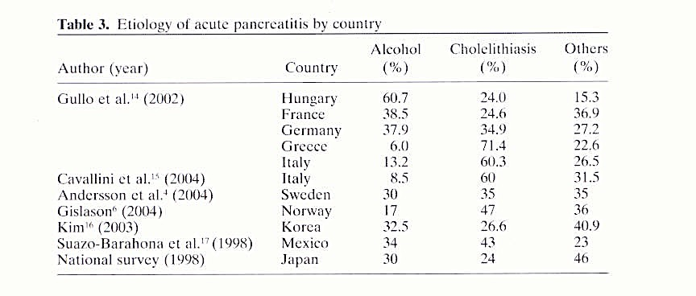
pancreatite acuta
..eziologia…
Sekimoto et al. 2006

Slide 20
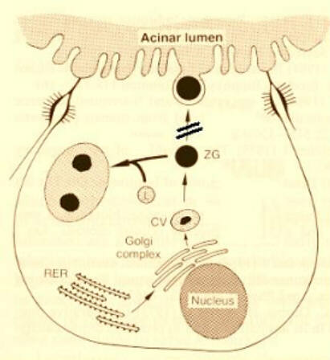
Patogenesi

Slide 21
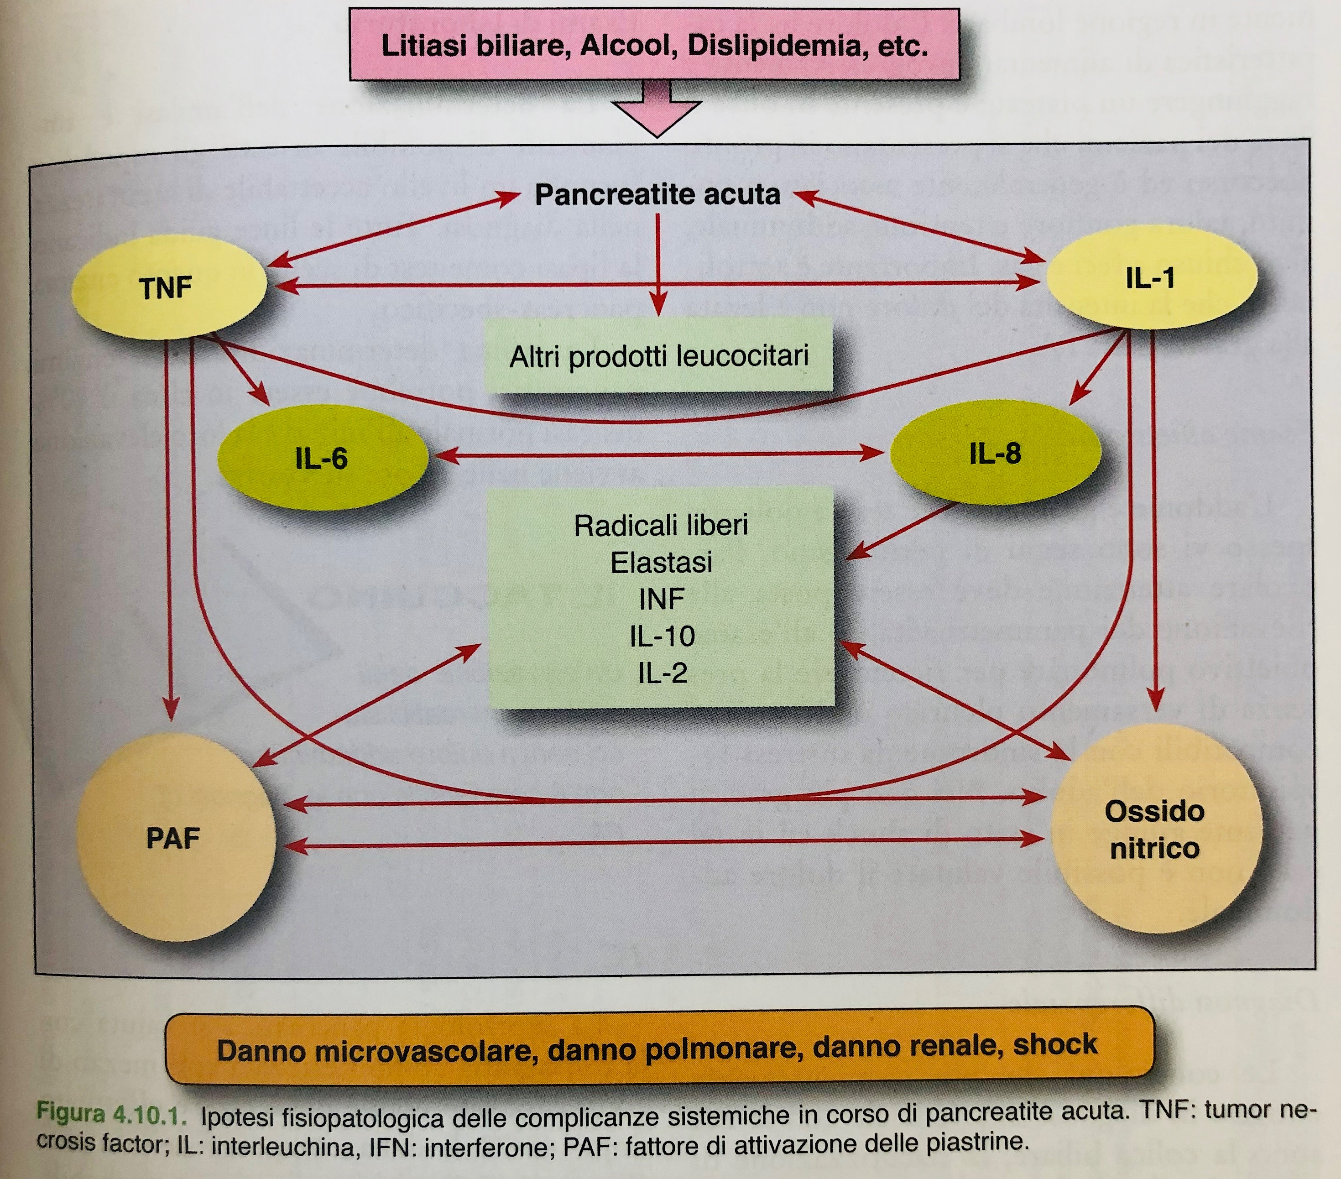

Slide 22
FISIOPATOLOGIA
Trypsinogen
Trypsin
Systemic circulation
PSTI
No pancreatitis or
Edematous Pancreatitis
PSTI + Trypsin
Alfa2-M
Alfa1-AT
Alfa2 + Trypsin
Alfa1-AT + Trypsin
Trypsin
Mesotrypsin
RES
Liver
Spleen
Bone marrow
Nodes
Enzyme Y
Procolipase
Proelastase
Chymotrypsinogen
Prophospholipase A2
Xanthynedehydrogenase
Prokallycrein
C3
C5
Plasminogen
XII Factor
Clearance
Necrotizing
Pancreatitis
Kininogens
Colipase
Elastase
Chymotrypsin
Phospholipase A2
Xanthynedehydrogenase
Kallycrein
C3a
C5a
Plasminogen
XIIa Factor
Kinins

Slide 23
Physiopathological and Clinical Phases of Acute Pancreatitis
PHASE
INITIAL
EARLY MIDDLE
LATE
TIMING
Hours
1st week 2nd week
3rd-4th weeks
MAJOR
EVENTS
Altered intra-acinar protein traffic
Inappropriate
activation of
proteases
Gut and biliary
bacteria
Microcirculatory
disorders
Accumulation of trypsinogen in the interstitial space
Progression of
necrosis
Infection
of necrosis
Necrosis
Macrophage
activation
DEATHS
?
32%
12%
19% 37%
Causes
?
?
26%
0%
0%
5%
0% 0%
12% 28%
M.O.F.
Infection

Slide 24
DIAGNOSI
The diagnosis is established by the presence of 2 of the 3 following criteria: (1) abdominal pain consistent with the disease, (2) serum amylase and/or lipase greater than three times the upper limit of normal, and/or (3) characteristic findings from abdominal imaging.
Contrast-enhanced computed tomography (CECT) and/or magnetic resonance imaging (MRI) of the pancreas should be reserved for patients in whom the diagnosis is unclear or who fail to improve clinically within the first 48–72 h after hospital admission or to evaluate complications.

Slide 25
SINTOMATOLOGIA
Dolore addominale
Malessere generale
Nausea/Vomito
Ittero
Febbre (spesso non elevata)
Difesa addominale
Segni e sintomi di shock (ipotensione, tachicardia…)
Manifestazioni extra-addominali
Segno di Cullen
Segno di Turner

Slide 26
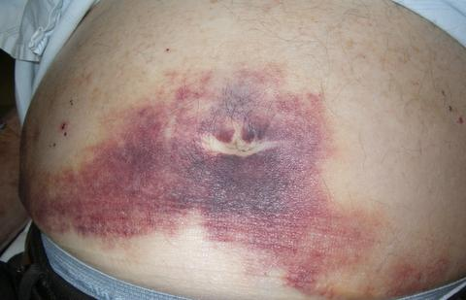
SEGNO DI CULLEN

Slide 27
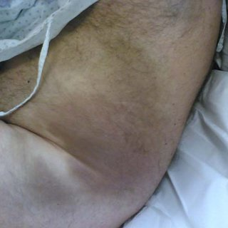
SEGNO DI TURNER

Slide 28
SINTOMATOLOGIA
Abdominal pain
Nausea / vomiting
Tachycardia
Low grade fever
Abdominal guarding
Loss of bowel sounds
Jaundice
0
20
40
60
80
100
% patients
Notes:
Slide 184
Presenting features of acute pancreatitis
The cardinal symptom of acute pancreatitis is abdominal pain, which is present in 95% of patients. The pain is usually steady and severe, radiates from the upper abdomen to the back, and may improve with lying on the left side or leaning forward. Absence of pain may be associated with delayed diagnosis or severe disease, and is probably the reason why many cases of fatal pancreatitis are not diagnosed until postmortem exam. Nausea and/or vomiting are also extremely common in acute pancreatitis. Physical signs in acute pancreatitis include tachycardia, which may be due to intravascular hypovolemia and should prompt aggressive intravenous fluid and electrolyte replacement. Low grade fever is common, as are peritoneal signs such as guarding and rebound tenderness. The presence of guarding and/or ileus on exam has been identified as useful prognostic features in acute pancreatitis.
Lankisch PG, Schirren CA, Kunze E. Am.J.Gastroenterol. 1991; 86:322-26
Rabeneck L, Feinstein AR, Horwitz RI, Wells CK. Am J Med. 1993; 95:61-70

Slide 29
Pain in acute pancreatitis
“Worse than childbirth” “Worse than being shot”
Inizio rapido e dopo 10-15min raggiunge il picco di intensità
3° per rapidità dopo perforazione ed occlusione vascolare mesenterica
Dolore costante (non colico)
Può durare giorni (o più, se cronicizza)
Si irradia al dorso nel 50% dei casi
A volte viene a mancare (painless pancreatitis)
È il sintomo principale di accesso in PS per pancreatite acuta

Slide 30
MANIFESTAZIONI EXTRAINTESTINALI
Artriti
Sierositi (pericarditi, pleuriti)
Pannicoliti, Necrosi grassa sottocutanea, può ricordare l’eritema nodoso (1% of di tutti i casi, 10% all’esame autoptico)
Retinopatia di Purtscher (rara)
Cecità improvvisa da occlusione dell’arteria retinica

Slide 31
Laboratorio
↑ Amilasi
↑ Isoamilasi pancreatiche
↑ Lipasi (Più specifiche e rimangono in circolo più a lungo)
↑ Leucociti
↑ BUN (se emoconcentrazione)
Ipocalcemia (25% dei casi)
IPERGLICEMIA
↑ ALP
↑ AST
↑ LDH
↑ PCR
Iperbilirubinemia (10% dei casi)
Ipossemia
AP SU BASE LITIASICA

Slide 32
SERUM PANCREATIC ENZYMES (Amylase and/or Lipase)
Fase 1
%

Slide 33
SERUM PANCREATIC ENZYMES
Ventrucci M, Pezzilli R, Naldoni P, Plate L, Baldoni F, Gullo L, Barbara L. Serum pancreatic enzyme behavior during the course of acute pancreatitis. Pancreas 1987;2(5):506-9.

Slide 34
Acute Pancreatitis: Time course of enzyme elevations
12
10
8
Fold increase over normal
Lipase
6
4
2
Amylase
0
0
6
12
24
48
72
96
Hours after onset
Notes:
Slide 187
Serum levels of pancreatic enzymes in acute pancreatitis
Some pancreatic enzymes normally enter the blood stream by unknown mechanisms. In acute pancreatitis the levels increase. This slide shows the time course of serum pancreatic enzyme levels in acute pancreatitis. Amylase levels typically fall more rapidly than lipase levels. Thus patients with a delayed presentation may have an elevated serum lipase with a normal serum amylase. An initial lipase determination is also useful since lipase is more specific than amylase for diagnosis, and hyperamylasemia may be absent in hyperlipidemic pancreatitis.

Slide 35
CAUSES OF ELEVATED AMYLASE & LIPASE
AMYLASE
LIPASE
Renal insuff
Salivary inflammation
i.e. parotiditis
Macroamylasemia
Hereditary
Intestinal infarction / peritonitis
Through transperitoneal absorption
Cholecistitis, Salpingitis, ectopic pregnancy
Ovarian cysts, lung inflammation
Acidosis
Intestinal radiation, obstruction
Colon, ovar, panc, brst, prst, lung, esoph CA
Pheo
Appendicitis, gastroenteritis
Burns, normal pregnancy
Renal insuff
Small Intestinal ischemia/obstr
Ovarian abscess
Macrolipasemia (LNH, cirrhosis)
Hypotension / sepsis
HIV
Pancreatic ca.
Gullo’s syndrome
Cholecystitis
Notes:
British surgeon. Major gen in WWI in medical corps. Was knighted in 1909. From U of Leeds. Father was a victoria’s cross recipient.

Slide 36
IMAGING
ECOGRAFIA ADDOMINALE

Slide 37
IMAGING
DOPO >48H
TC ADDOMINALE

Slide 38
IMAGING
RMN ADDOMINALE

Slide 39
…diagnosi di
pancreatite acuta biliare…

Slide 40
DIAGNOSI DIFFERENZIALE
Perforazione viscere addominale
Colecistite acuta o Colica biliare
Occlusione intestinale acuta
Occlusione vascolare mesenterica
Colica renale
Infarto miocardico acuto
Dissezione dell’aorta addominale/Rottura di aneurisma
Collagenopatia con vasculite
Polmonite
Chetoacidosi diabetica

Slide 41
RISK ASSESTMENT
Recommendations
Hemodynamic status should be assessed immediately upon presentation and resuscitative measures begun as needed (strong recommendation, moderate quality of evidence).
Risk assessment should be performed to stratify patients into higher- and lower-risk categories to assist triage, such as admission to an intensive care setting (conditional recommendation, low to moderate quality of evidence).
Patients with organ failure should be admitted to an intensive care unit or intermediary care setting whenever possible (strong recommendation, low quality of evidence).

Slide 42
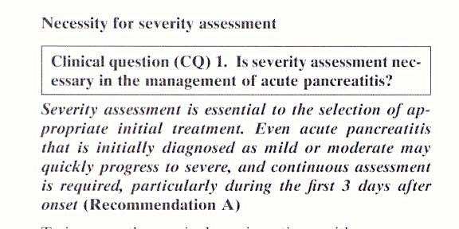
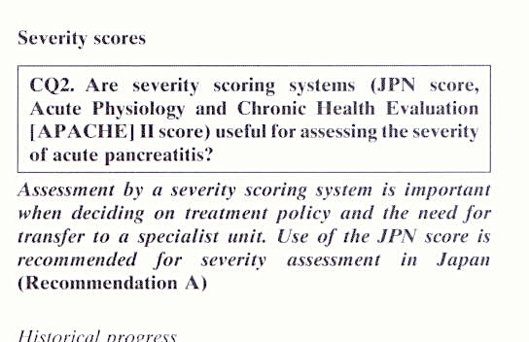
STRATIFICAZIONE
JPN guidelines for the management
of acute pancreatitis:
severity assessment
of acute pancreatitis
Hirota e Coll
J Hepatobiliary Pancreat Surg
2006

Slide 43
Bradley et al. “A clinically based classification system for acute pancreatitis. summary of the international symposium on acute pancreatitis”, Atlanta, GA, September 11-13, 1992. Arch Surg 1993;128:586-90
La pancreatite acuta lieve, generalmente ma non necessariamente edematosa, è caratterizzata da un decorso clinico favorevole che non presenta o ha minime disfunzioni d’organo
La pancreatite acuta severa è un quadro clinico che si associa ad insufficienza d’organo e/o complicanze locali quali necrosi, ascessi o pseudocisti

Slide 45
Severità
%

Slide 46
APACHE-II Score

