Slide 1
Women and Heart Disease
Shannon J. Winakur, M.D.
Maryland Cardiovascular Specialists
Maryland ACP Meeting 2/1/14

Slide 2
Overview
The scope of the problem
Symptoms
Risk factors
Prevention, diagnosis, and treatment
Pearls from the 2014 ACC Heart of Women’s Health course

Slide 3
The Scope of the Problem
Coronary Artery Disease (a.k.a. Coronary Heart Disease)
Cardiovascular Disease
  CHD: MI, angina, heart failure, coronary death
  Cerebrovascular dz – CVA, TIA
  PAD – claudication
  Aortic disease: atherosclerosis, TAA, AAA

Slide 4
The Scope of the Problem
Heart disease is the biggest killer of women
Cardiovascular disease is BY FAR the biggest killer of women
  Roughly 401,000 deaths/year from CVD (vs. 386,000 men)
  176,255 deaths/year from CAD
  Vs 39,520 deaths from breast cancer

Slide 5
The Scope of the Problem
One woman dies every minute from cardiovascular disease in the U.S.!

Slide 6
The Scope of the Problem
CVD accounts for a third of all female deaths
Maryland ranks 33rd in death rate due to CVD, 40th in death rate due to CAD
CVD and CAD disproportionately affect African-American and Latina women

Slide 7
The Scope of the Problem
Women are roughly 10 yrs older than men when they present, and have more co-morbidities
Young women also develop CAD and have a worse prognosis than men
Women are more likely to wait before presenting to medical attention

Slide 8
The Scope of the Problem
Women are referred less often for appropriate testing or treatment
Women with MI are more likely to have complications and increased mortality
Fewer women have been included in studies, so there’s less data

Slide 9
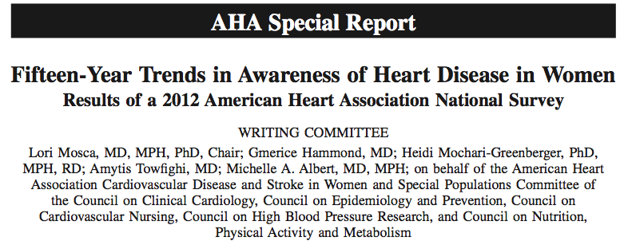
Awareness is lacking!

Slide 10
Awareness is lacking!
~2500 women > 25 y.o. surveyed
Between 1997-2012, awareness among whole study population nearly doubled: 30%→56%
Still low in minorities:
  Blacks: 36%
  Hispanics: 34%

Slide 11
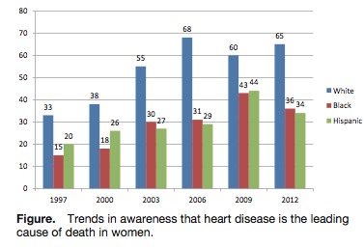
Awareness

Slide 12
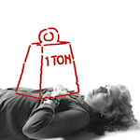
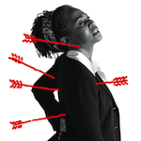
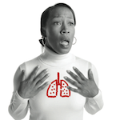
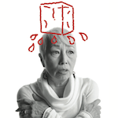
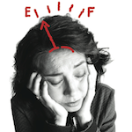
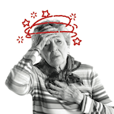
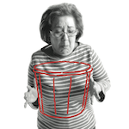
What are the symptoms?
Chest pain or discomfort
Unusual upper body discomfort
Shortness of breath
Breaking out in a cold sweat
Unusual or unexplained fatigue (tiredness)
Light-headedness or sudden dizziness
Nausea (feeling sick to the stomach)

Slide 13
Symptoms in women with MI
Study of 515 women with MI
  Chest pain absent in 43%
  Most common symptom:
    Dyspnea in 58%
    Weakness in 55%
    Fatigue in 43%
  Prodrome:
    Fatigue in 71%
    Sleep disturbance (48%), dyspnea (42%)

Slide 14
Symptoms in women with MI
Over 1,000,000 men and women in NRMI registry, 1994-2006 (481,581 women)
  42% of women presented without CP (vs. 31% of men)
  Higher in-hospital mortality in women (14.6%) than in men (10.3%)
  Younger women without chest pain were at the highest risk

Slide 15
Symptoms in women with MI
These women who presented without CP were sicker and fared worse:
  More had DM
  Later presentation
  More Killip III/IV
  More NSTEMI
  Less timely therapies
  Less antiplatelet meds, heparin, BB

Slide 16
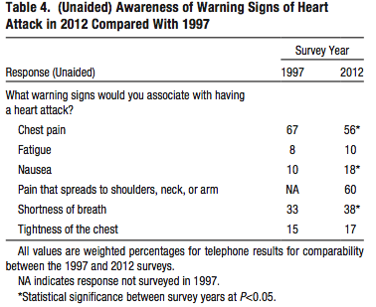
Awareness

Slide 17
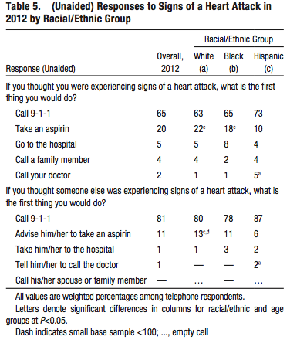
Awareness

Slide 18
Symptoms in women with MI
Sudden cardiac death
  Higher rates in men
  However, a significantly higher percentage of women who have SCD had no prior symptoms! (63% vs. 44%)

Slide 19
Risk Factors
Age over 55
Dyslipidemia: high LDL and/or low HDL
Family hx of premature CAD
  First degree male < 55, female <65
Diabetes
Smoking
Hypertension
Peripheral arterial disease

Slide 20
Risk factors
Menopause
Obesity
High triglycerides
Metabolic syndrome
Sedentary lifestyle
Collagen vascular disease/autoimmune disease
CKD

Slide 21
Risk factors
Pregnancy-related
  Pre-eclampsia, eclampsia
  Gestational diabetes
  Stillbirth
  Miscarriages, esp. multiple
Hx of cancer treatments (XRT)
Depression and stress
Hx of trauma or abuse

Slide 22
Which risk factors are more predictive in women?
Low HDL is more predictive than high LDL
Lp (a) can be more predictive in younger women
TG can be more predictive in older women, especially if >400 mg/dL

Slide 23
Which risk factors are more predictive in women?
Diabetes: almost double the risk of fatal CAD
Smoking:
  associated with 50% of all coronary events in women
  Risk elevated even with minimal use

Slide 24
Effect of smoking
Women who smoke have a six-fold increased risk of MI (vs. 3x in men)
Risk was higher for women smokers than men regardless of age

Slide 25
Reproductive
Pregnancy-related
  “failed stress test:
  Pre-eclampsia – 3.8x more likely to develop DM, 11.6x more likely to develop HTN requiring rx
  Gestational DM: up to 70% develop DM within 5 years
Menopause

Slide 26
Diagnosis
Treadmill stress testing
Nuclear stress testing
Stress echo
CT calcium score
Coronary CTA
Cardiac catheterization with coronary angiography

Slide 27
Stress Testing
ETT only (lower than in men)
  61% and 70%
Stress Nuclear (similar in men)
  78% and 64%
Stress Echo (similar in men)
  86% and 79%

Slide 28
Coronary CTA
ROMICAT trial
  Women had greater reduction in LOS, lower admission rates, lower radiation doses
  More normal studies, less obstructive dz

Slide 29
Diagnosis
Women less likely to be referred for further evaluation if they have a positive stress test
  Higher incidence of MI or death in these patients

Slide 30
Risk Factors/Prevention
The Multiplier Effect
  1 risk factor doubles your risk
  2 risk factors quadruple your risk
  3 or more risk factors can increase your risk more
  than tenfold
By doing just 4 things – eating right, being physically active, not smoking, and keeping a healthy weight – you can lower your risk of heart disease by as much as 82 percent

Slide 31
Treatment/Prevention
All women
  Exercise
  Quit smoking
  Healthy diet
  BMI <25, waist circumference <35 in.
  Treat risk factors: HTN, DM, dyslipidemia
  ASA – look at risk/benefit ratio
  Treat depression

Slide 32
Treatment/Prevention
Increasing awareness
Screening

Slide 33
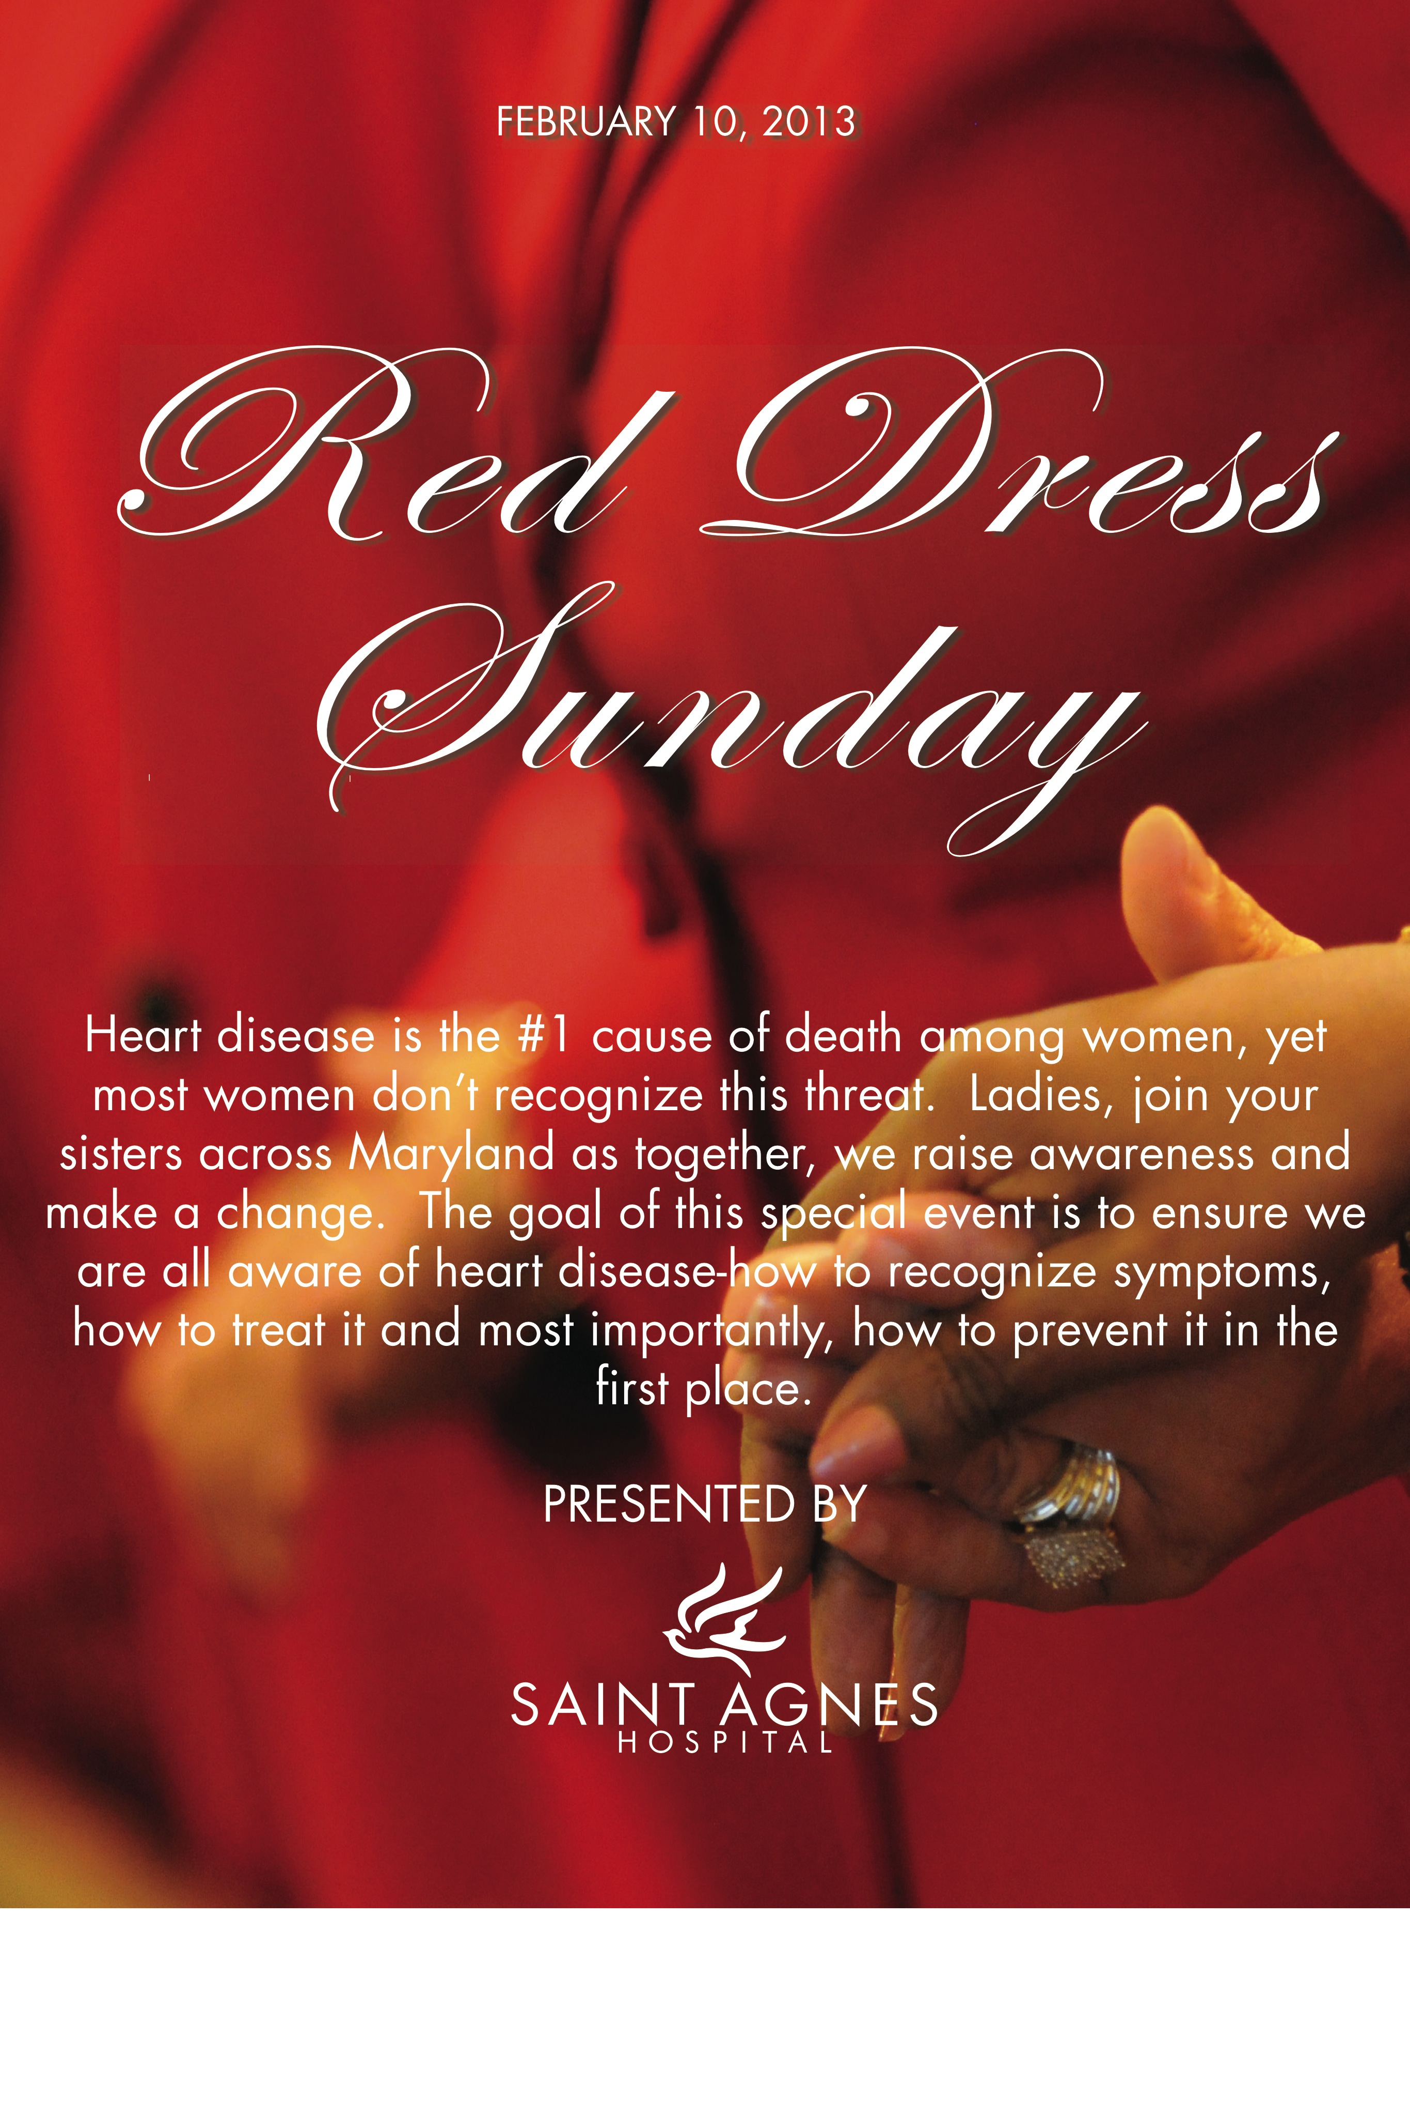
How are we getting the word out?

Slide 34
How are we getting the word out?

Slide 35
Saint Agnes Women’s Heart Center
“60 minutes for $60”
60 minutes of screening and education
Personal risk assessment
EKG
Blood work: lipid profile, hemoglobin A1c

Slide 36
Treatment/Prevention
Lipids: New guidelines
  Different approach: moderate or high intensity statin rather for different risk categories rather than treatment to targets
  Overall risk
  Patient centered care
  Limited role for non-statin rx

Slide 37
Treatment/Prevention
Lipids: New guidelines
  4 categories:
    Clinical ASCVD, no HF or ESRD on HD
    Ages 40-75 with DM and LDL 70-189
    LDL >190
    Ages 40-75, LDL 70-189, estimated 10-year risk of 7.5% or greater
  New risk calculator: Pooled Cohort Equations for ASCVD risk predictionshttp://www.cardiosource.org/en/Science-And-Quality/Practice-Guidelines-and-Quality-Standards/2013-Prevention-Guideline-Tools.aspx?w_nav=Search&WT.oss=new risk calculator&WT.oss_r=3056&

Slide 38
Lipid therapy
New risk calculator
  Heavily driven by age, also includes ethnicity/race, BP, cholesterol, current tobacco use and DM
  65 yo M or 71 yo F with optimal RF has >7.5% 10 year risk of ASCVD
  If uncertain, can take into consideration other factors:
    Family hx
    CRP>2
    Calcium score >300 or >75%
    Abnormal ABI (<0.9)

Slide 39
Lipid therapy
New guidelines
  No clear role for CKD, apoB, albuminuria, cardiorespiratory fitness, CIMT
  Lifestyle modifications
    Diet high in fruits and vegetables
    Keep sat fat <5-6%, minimize trans fat
    Exercise: 3-4 sessions/week, 40 minutes per session to lower LDL

Slide 40
Treatment/Prevention
High risk women
  Dyslipidemia (better secondary prevention data: 4S, CARE, HPS, PROVE-IT)
  Aspirin
  HTN
  No role for vitamins or HRT

Slide 41
Treatment in ACS or acute MI
Medical therapy
  Aspirin, beta blockers, ACE-inhibitors
  Statins

Slide 42
Interventional treatment in women
Less likely to be referred
Higher complication rate than in men
  Smaller arteries, more bleeding
But these pts do better than if no intervention
Higher peri-procedural rate of complication but better long-term survival than men

Slide 43
Treatment of ACS, NSTEMI, STEMI
Early invasive strategy for high-risk patients
PCI for STEMI
  Better than fibrinolysis or POBA

Slide 44
Bleeding
Women have more bleeding than men
  Technical factors, medication issues
  RISK-PCI
    Same efficacy as in men
    Higher bleeding
    Higher mortality

Slide 45
Bleeding
Bleeding avoidance strategies
  Transradial approach, closure devices, bivalrudin
  Lower bleeding rates in both sexes
  Higher absolute bleeding rate

Slide 46
Other cardiac causes of chest pain
Women’s ischemic heart disease (syndrome X, microvascular disease)
Myocarditis
  Stress-induced cardiomyopathy
Coronary dissection

Slide 47
Cancer and CV disease
Chemotherapy toxicity: anthracyclines and Herceptin
  Communication and monitoring
  Treatment of baseline risk factors: HTN, DM, CAD and LV dysfxn pts at higher risk
  Older patients
  Combination chemo and higher dose chemo
  Combination with XRT

Slide 48
Cancer and CV disease
Radiation toxicity
  Effects on all parts of the heart
  Most common sign: pericardial effusion
  Increases by 7.4% per gray of xrt dose
  Starts within first 5 yrs after rx, continues for at least 20 years
  Women with baseline cardiac RF at higher risk of events

Slide 49
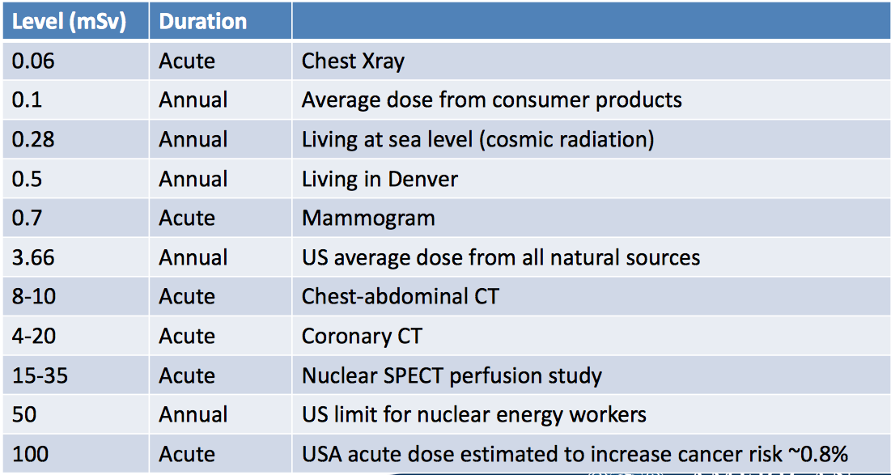
Women and radiation exposure

Slide 50
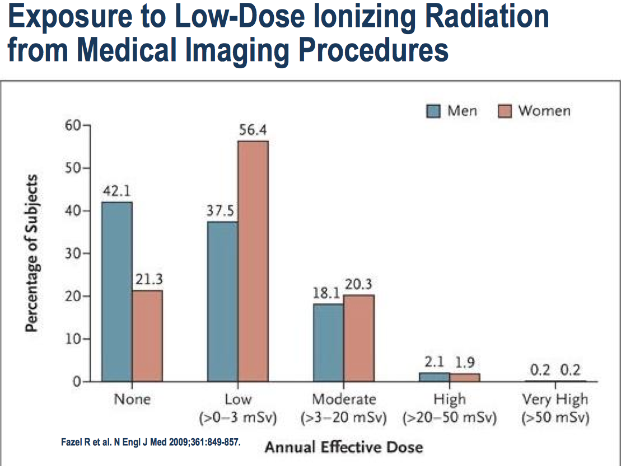
Women and radiation exposure

Slide 51
Take-home points
CAD and CVD are by far the biggest health risks for women
Awareness is still less than it needs to be
Prevention CAN reduce risk
Screening programs are available

Slide 52
Take-home points
Women can present differently, and do worse when they do
Women are referred less often for appropriate testing and treatment
Women can have more complications from treatment, but still fare better than without rx
Special considerations: pregnancy, menopause, comorbidities

Slide 53
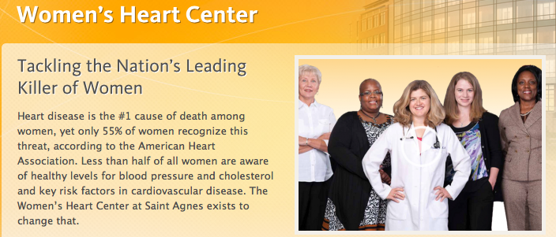
THANK YOU!

