Slide 1

L’interessamento
del sistema nervoso centrale nelle malattie reumatiche sistemiche
Corso opzionale
AA 2017-2018
Marcello Govoni
gvl@unife.it
Rheumatology Unit
Department of Medical Sciences
ITALY

Slide 2

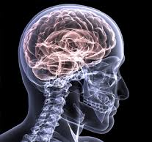
Why rheumatologist should be aware of CNS involvement ?
The nervous system
is a major target organ in most rheumatological diseases

Slide 3
Rheumatic diseases with potential CNS involvement
Connective tissue diseases
Systemic vasculitis
Antiphospholipid syndrome
Systemic lupus erythematosus
Sjogren’s syndrome
Mixed connective tissue disease
Scleroderma
Dermatomyositis/polymyositis
Rheumatoid arthritis
Takayasu’s arteritis
Giant cell arteritis
Wegener’s granulomatosis
Polyarteritis Nodosa
Systemic lupus erythematosus
Sjogren’s syndrome
Infectious diseases
Miscellanea
Behçet’s disease
Sarcoidosis
Lyme disease
Whipple’s disease
Behçet’s disease
PACNSV : Primary Central Nervous System Vasculitis

Slide 4
Don’t forget drug induced neuro-psychiatric syndrome/symtoms
Antimalarials Psychosis
Corticosteroids Psychosis, euphoria, depression
Cyclosporin/Tacrolimus Leukoencephalopathy, Headache, insomnia, paraesthesia, confusion, depression, dizziness, convulsions, incoordination, psychosis,
Cytokine inhibitors Demyelinating disorders, seizures, drowsiness, dizziness, paraesthesia, PML
Leflunomide Headache, dizziness, paraesthesia
Methotrexate Dizziness, drowsiness, malaise, headache, mood changes
Mycophenolate Insomnia, headache, tremor
NSAIDs Headache, dizziness, depression, aseptic meningitis
Sulfasalazine Ataxia, aseptic meningitis, vertigo, insomnia, depression, hallucinations

Slide 5
2 scenarios in every day clinical practice
New neuropsychiatric sign or symptoms during the course of an already diagnosed rheumatic disease
  Proceed with attribution : related or unrelated
Neurolpsychiatric signs or symptoms in the absence of known rheumatological diseases
  Start work-up for DD
  Don’t forget rheumatic diseases ! (*)
  (in about 11 % - Olsen ML et al. Am J Med 1991)
(*) NP symptoms may represent the heralding manifestation of a rheumatic disease.

Slide 6
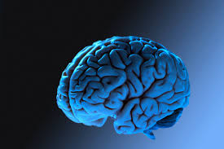
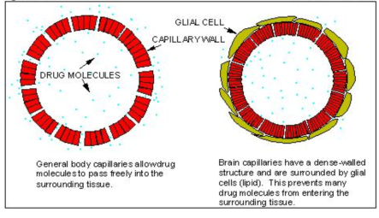
Main pathogenetic pathways for CNS damage
Ischemia, thrombosis
Microangiopathy/vasculopathy
Vessel inflammation (vasculitis)
Brain tissue or meningeal inflammation
Neurotoxicity
Autoantibodies
Cytokines
Different clinical pictures & pathogenetic pathways may coexist
BBB dysfunction or damage
Conditions which can open or damage BBB :
Acute stress
Infections
Disease activity
Drugs …

Slide 7
L’interessamento del sistema nervoso centrale nel LES

Slide 8
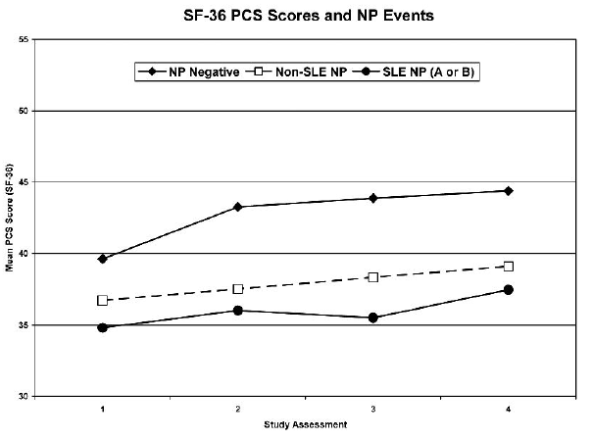
Neuropsychiatric lupus
CNS involvement affects patient’s quality of life and is associated with poor prognosis
Hanly JG et al. J Rheumatol 2009
NP involvement represents one of the main causes of morbidity and mortality in SLE
NPSLE
Predictors of mortality in SLE (meta-regression)
Neuropsychiatric damage
Renal damage
Mak A, et al. Semin Arthritis Rheum. 2012

Slide 9
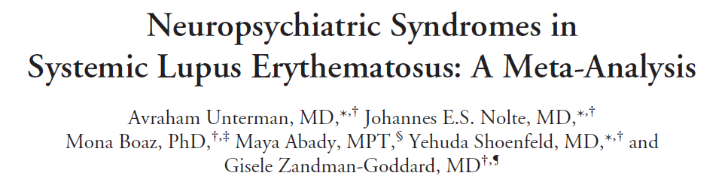

The burden of NPSLE
Range of reported prevalence : 14 - 95 %
Sem Arthritis Rheum 2011
According to 10 high-quality prospective studies, which included 2,049 SLE patients
The overall prevalence of NP syndromes in SLE
patients was estimated to be 56.3 %
93.1 % CNS vs 6.9 % PNS
i.e. one out of two !

Slide 10

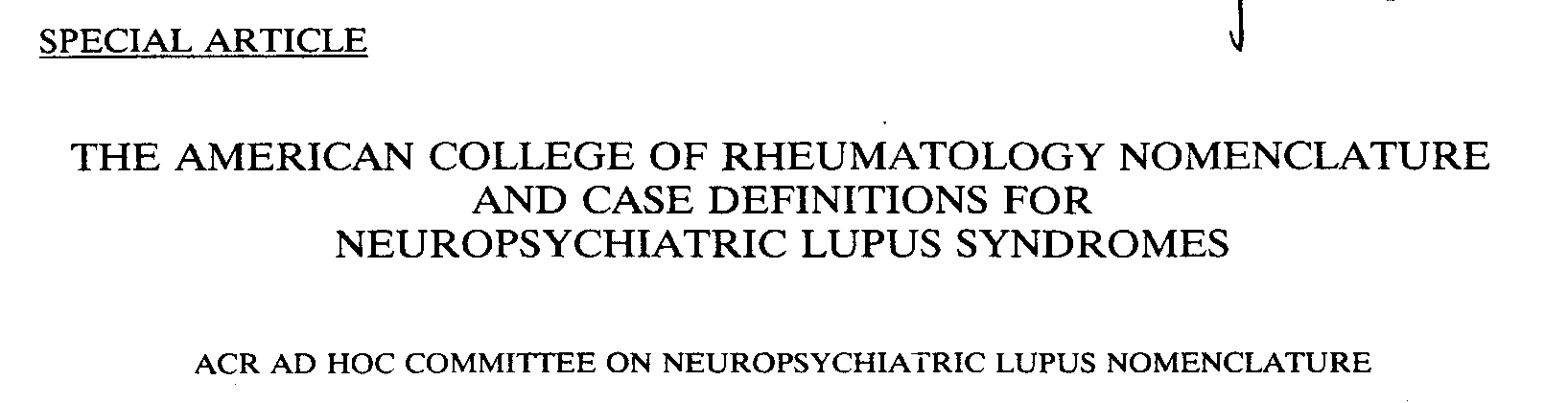
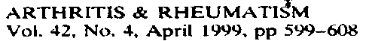
A milestone in the NPSLE research
www.rheumatology.org/at/1999/aprilappendix.html

Slide 11
CNS | PNS
Aseptic meningitis | Guillain Barré syndrome
CVD | Autonomic neuropathy
Demyelinating sd. | Mononeuropathy
Headache | Myasthenia gravis
Movement disorder | Cranial neuropathy
Myelopathy | Plexopathy
Seizure disorders | Polyneuropathy
Acute confusional state
Anxiety disorder
Cognitive dysfunction
Mood disorder
Psychosis
CNS | PNS
Aseptic meningitis | Guillain Barré syndrome
CVD | Autonomic neuropathy
Demyelinating sd. | Mononeuropathy
Headache | Myasthenia gravis
Movement disorder | Cranial neuropathy
Myelopathy | Plexopathy
Seizure disorders | Polyneuropathy (no ENG)
Acute confusional state
Anxiety disorder
Cognitive dysfunction
Mood disorder
Psychosis
Focal
CNS | PNS
Aseptic meningitis | Guillain Barré syndrome
CVD | Autonomic neuropathy
Demyelinating sd. | Mononeuropathy
Headache | Myasthenia gravis
Movement disorder | Cranial neuropathy
Myelopathy | Plexopathy
Seizure disorders | Polyneuropathy (no ENG)
Acute confusional state
Anxiety disorder
Cognitive dysfunction
Mood disorder
Psychosis
Major
CNS
Diffuse
Minor
PNS
According to Ainiala et al. 2001
According to EULAR Rec. 2010
According to ACR 1999
case definition

Slide 12
NP syndromes as disease classification criteria
ARA 1982 & ACR 1997 criteria
New
SLICC criteria 2012
Psychosis
Seizures
Myelopathy
Seizure disorders
Acute confusional state
Psychosis
Mononeuropathy
Cranial neuropathy
Polyneuropathy

Slide 13
SLEDAI-2K
(da 0 a 105) ≥ 2 clinicamente attivo
ORGANI COINVOLTI | MANIFESTAZIONI | SCORE
SNC (LES correlato) | Fenomeni epilettici | 8
 | Psicosi | 8
 | Demenza | 8
 | Disturbi visivi | 8
 | Neuropatia nervi cronici | 8
 | Cefalea lupica | 8
 | Vasculite cerebrale | 8
VASCOLARE | Vasculiti | 8
RENE | Alterazione sedimento (cilindri) | 4
 | Ematuria (GR > 5 per campo) | 4
 | Leucocituria (GB > 5 per campo) | 4
 | Proteinuria (0.5 g/24 ore) | 4
MUSCOLO-SCHELETRICO | Artrite (> 2 articolazioni) | 4
 | Miosite | 4
SIEROSE | Pleurite | 2
 | Pericardite | 2
ALTERAZIONI IMMUNOLOGICHE | Riduzione C3 o C4 | 2
 | Anticorpi anti-DNA | 2
CUTE | Rash recenti | 2
 | Alopecia | 2
 | Ulcere mucose | 2
SINTOMI GENERALI | Febbre | 1
ALTERAZIONI EMATOLOGICHE | Piastrinopenia (< 100000/mmc) / Leucopenia (< 3000/mmc) | 1

Slide 14
SLICC - Disease Index (SDI) 0 - 42 , dove 0 = assenza di danno
ORGANI COINVOLTI | MANIFESTAZIONI (parte 1) | SCORE
SNC | Disturbi cognitivi | 1
 | Psicosi | 1
 | Epilessia (che richieda terapia per almeno 6 mesi) | 1
 | Accidenti vascolari cerebrali (score 2 se > 1) | 1 (2)
 | Neuropatia cranica o periferica (esclusa neuropatia ottica) | 1
 | Mielite trasversa | 1
OCCHIO | Cataratta | 1
 | Alterazioni retiniche o atrofia ottica | 1
RENE | Filtrato glomerulare renale > 50 % | 1
 | Proteinuria > 3.5 g/24 ore | 1
 | IR terminale | 3
POLMONE | Ipertensione polmonare | 1
 | Fibrosi polmonare | 1
 | Shrinking lung | 1
 | Fibrosi pleurica | 1
 | Infarto polmonare o resezione per patologia non neoplastica | 1
CUORE | Angina o by-pass coronarico | 1 (2)
 | IMA (score 2 > 1) | 1
 | Cardiomiopatia | 1
 | Pericardite per 6 mesi o pericardiotomia | 1
SIST. VASCOLARE | Claudicatio per 6 mesi | 1
 | Perdita minima di tessuto | 1

Slide 15
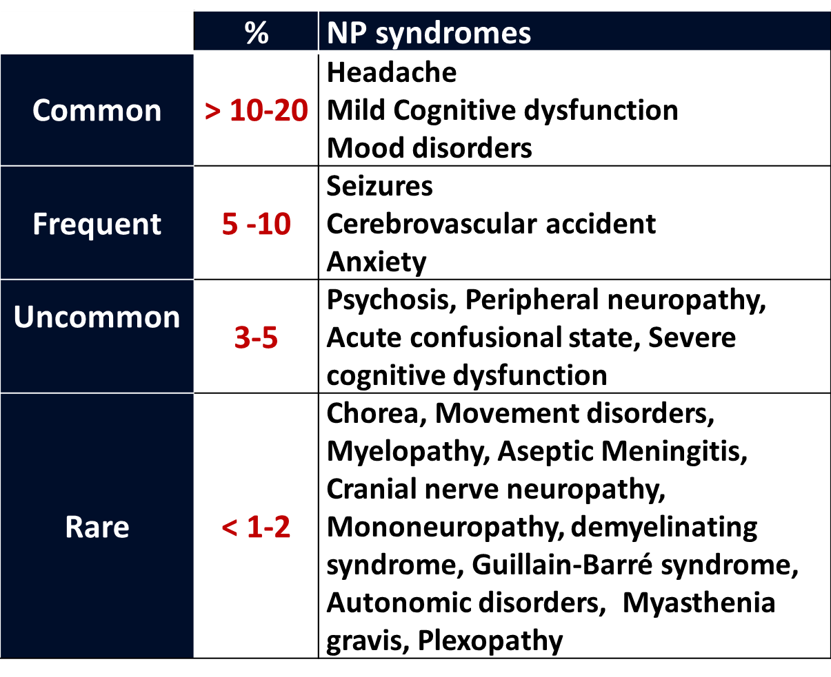
Frequency of neuropsychiatric syndromes as reported in cohort studies using the ACR nomenclature and case definitions for NPSLE
FREQUENCY
SPECIFICITY

Slide 16
One of the major challenges in diagnosing NP involvement, is that in NPSLE nothing is specific !
No specific clinical pictures
No specific patterns on neuroimaging
No specific lab or serologic biomarkers
No specific changes in CSF
High prevalence of some NP pictures in GP

Slide 17
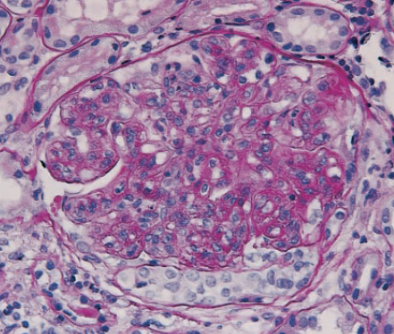
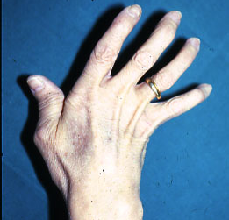
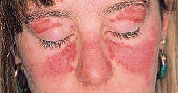
ACR 1999 Definition of NPSLE
“Neuropsychiatric lupus erythematosus includes the neurologic syndromes of the central, peripheral and autonomic nervous system and the psychiatric syndromes observed in patients with SLE in which other causes have been excluded”
In clinical practice, NPSLE is a diagnosis
«per exclusionem»
ATTRIBUTION of NP events in SLE patients, remains one of the most challenging issue
LUPUS-RELATED MANIFESTATIONS
HEADACHE
DEPRESSION
STROKE
SEIZURE
Lupus
?
Lupus
?
Lupus
?
Lupus
?
… and so on

Slide 18
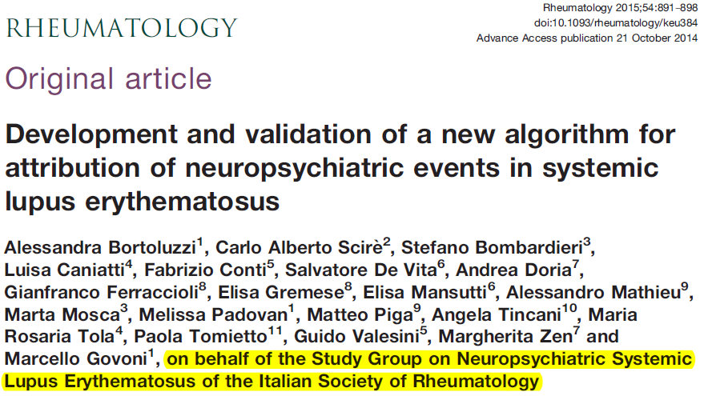
How to approach attribution in NPSLE ? The Italian Study Group for NP-Lupus
(Research project : on behalf of Italian Society of Reumatology)
Items | Result | Score
TIME onset of NP event | Before | 0
 | After | 2
 | Concomitant | 3
Items | Result | Score
CONFOUNDING FACTORS | YES > 1 | 0
 | YES at least 1 | 1
 | None or NA | 2
FAVOURING FACTORS | None or NA | 0
 | YES at least 1 | 1
 | YES > 1 | 2
Tipology of NP event | Major | 3
 | Minor | 0
Normalized score from 0 to 10
A score ≥ 7 is highly suggestive for NPSLE

Slide 19
WHAT ABOUT NEUROIMAGING ?
Functional
SPECT, PET, fMRI, PWI
Morphology
MRI
Anatomy
Macro-architecture
Metabolism
Perfusion
Quantitative
MRS, MTI, DTI, DWI
Micro-architecture
Metabolism
No single imaging technique covers all brain NPSLE pathology
Notes:
In diagnosing and managing NPSLE neuroimaging could be extremely useful especially to exclude other ethiologies. Conventional MRI is fundamental to depict anatomy and macro-architecture of CNS, functional neuroimaging enbles to explore neuronal metabolism and perfusion, while new quantitative techniques yield information about micro-architecture and metabolic status. The appropriate utilizatin of neuroimaging has been clearly described by the EULAR recommendations and Bertsias will illustrate it in more detail.
What is to be stressed is that no single neuroimaging technique cover all the physiopathologic aspect of NP manifestations occuring in SLE and a multimodality approach is needed.

Slide 20
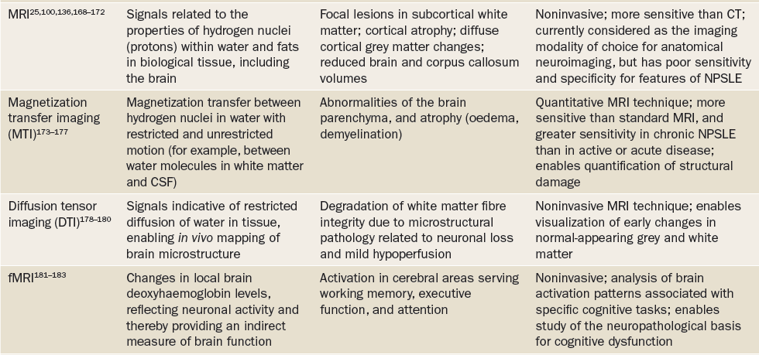
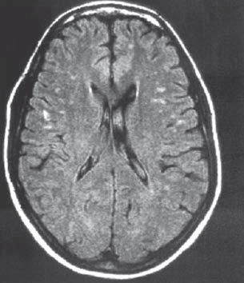
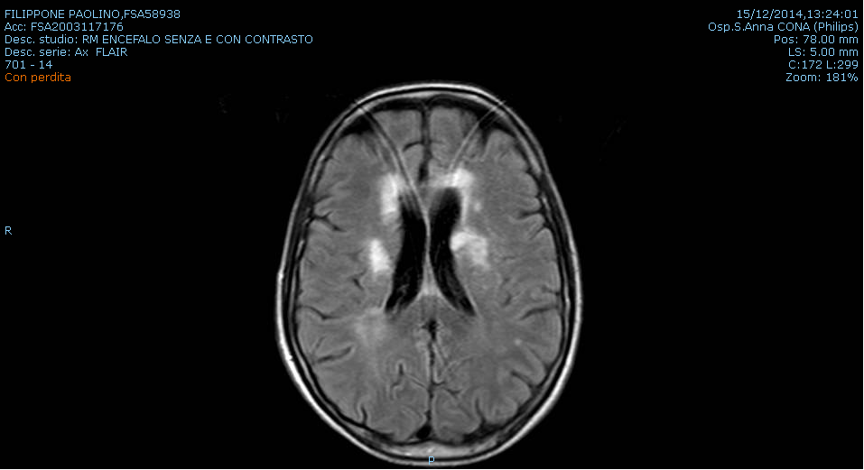
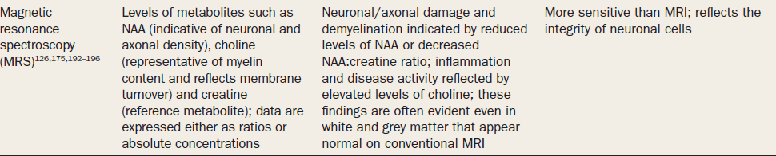
Magnetic Resonance Imaging (EULAR 2010)
MRI
The recommended MRI protocol
(brain and spinal cord) includes :
conventional MRI sequences (T1/T2, FLAIR)
Diffusion weighted imaging (DWI)
gadolinium-enhanced T1 sequences (T1-gd)
In FOCAL presentation cMRI provides useful information
In DIFFUSE presentation cMRI can be
frequently negative

Slide 21
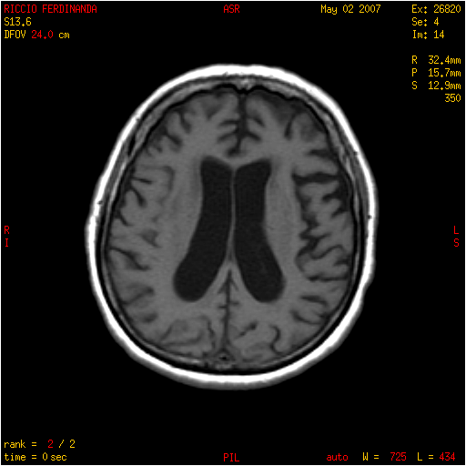
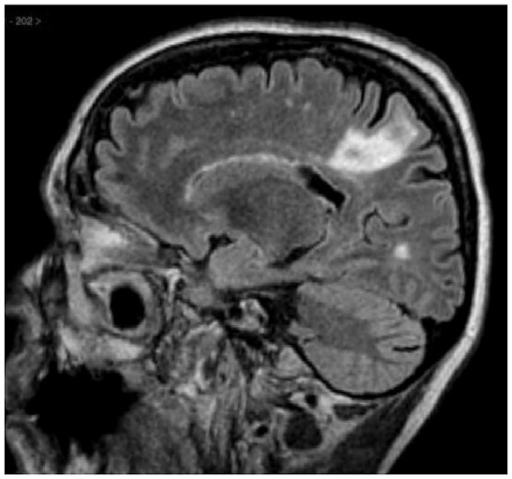
The pattern of MRI abnormalities in NP-SLE
Cortical atrophy
Brain infarcts
8
Notes:
Other possible findings detectable by MRI are : ventricular dilation, cortical atrophy and diffuse WM changes

Slide 22
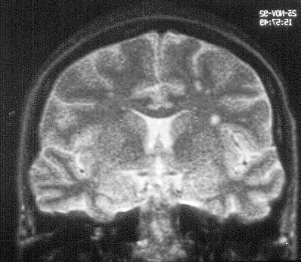
The most frequent
Small punctate hyperintense T2-weighted focal lesions in subcortical and periventricular WM
microinfarcts, demyelination, gliosis
9
Notes:
The most frquently observed abnormalities are the so-called UBO corresponding to Small punctate hyperintense T2-weighted focal lesions in subcortical and periventricular WM related to microinfarcts, demyelination or gliosis

Slide 23
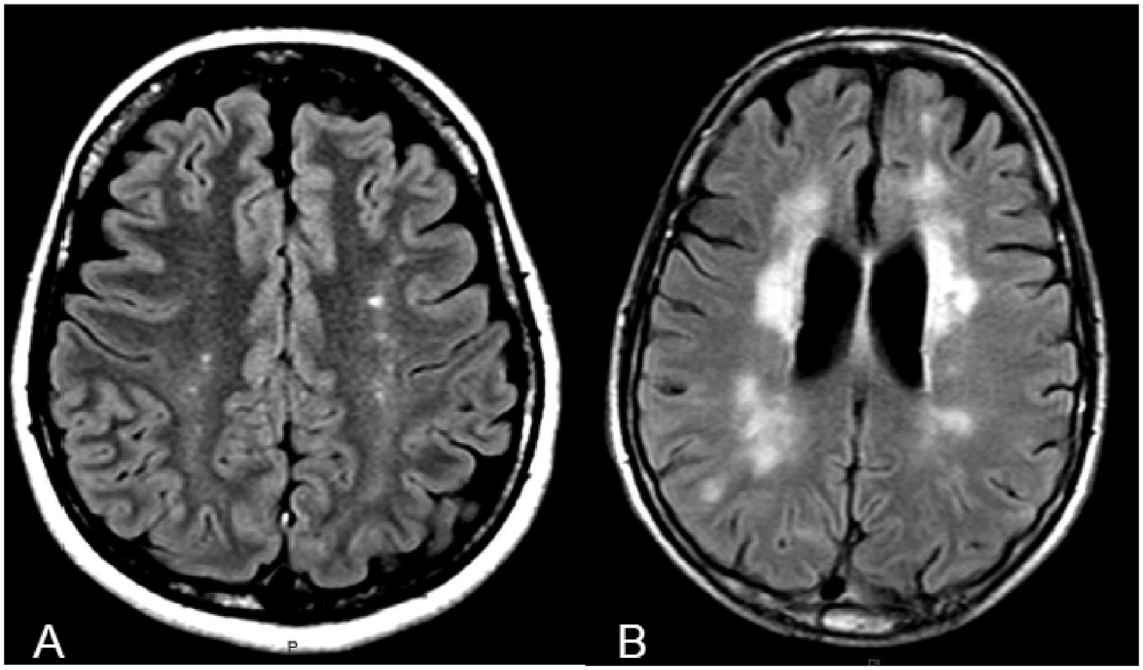
axial-FLAIR scan highlights multiple punctate WMHIs in semioval centres; B: multiple confluent lesions in periventricular WM

Slide 24
Small punctate hyperintense T2-weighted focal lesions
in subcortical and periventricular WM
Clinical correlations
Common in chronic NP-SLE (25-60 %) correlate with :
- clinical severity
- past history of CNS involvement
- cognitive dysfunction
- APLA
They are NOT SPECIFIC
Can be seen in SLE without NP symptoms, in patients without SLE Increase with aging, heart valvular disease & hypertension
De Leeuw et al, Brain 2002
De Leeuw et al, Stroke 2004
Roldan et al, Am J Cardiol 2005
Roldan et al, Cardiology 2007
Sibbitt et al, Arthritis Rheum 1999
Sanna et al, J Rheumatol 2003
Sibbitt et al, J Rheumatol 2003
Ainiala et al, Scand J Rheumatol 2005
Ovbiagele & Saver, Cerebrovasc Dis 2006
Notes:
These kind of lesions are commonly found in NPSLE and correlate with clinical severity, past history of CNS involvement, cognitive dysfunction, APLA. They are ASPECIFIC since they can be observed also in SLE without NP symptoms, in patients without SLE Increase with aging, heart valvular disease & hypertension.

Slide 25
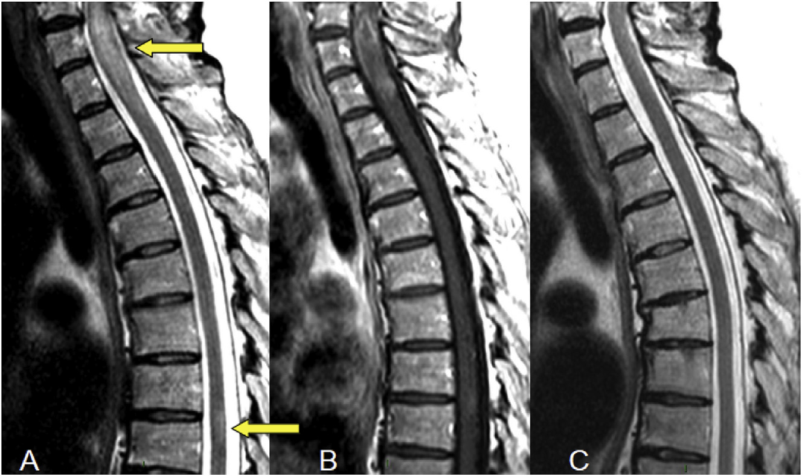
T2-scan shows 2 hyperintense focuses of myelitis (at C6-T1 and D7-D8 levels; arrows) in a 45 year old SLE female, with associated cord swelling; B: after administration of IV gadolinium, an inhomogeneous pattern of contrast enhancement is remarked; C: after 3 months of immunosuppressive therapy, a reduction in cord swelling, a complete regression of D7-D8 lesion and a subtotal regression of C6-T1 lesion were demonstrated.

Slide 26
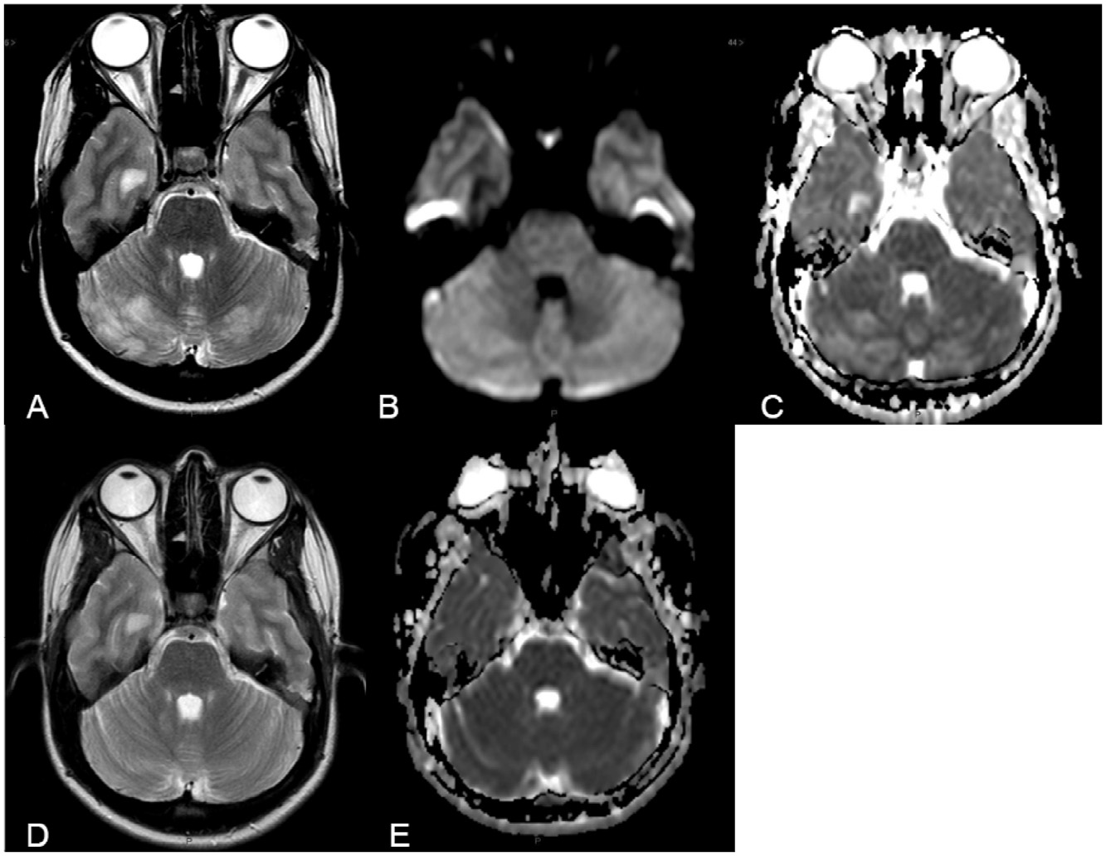
T2-scan highlights a bilateral and symmetrical mild hyperintensity in cerebellar hemispheres; B: low hyperintensity on DWI; C: increase in ADC; D:
complete reversibility of lesions on axial T2-scan after 2 months; E: normalization of ADC.

Slide 27
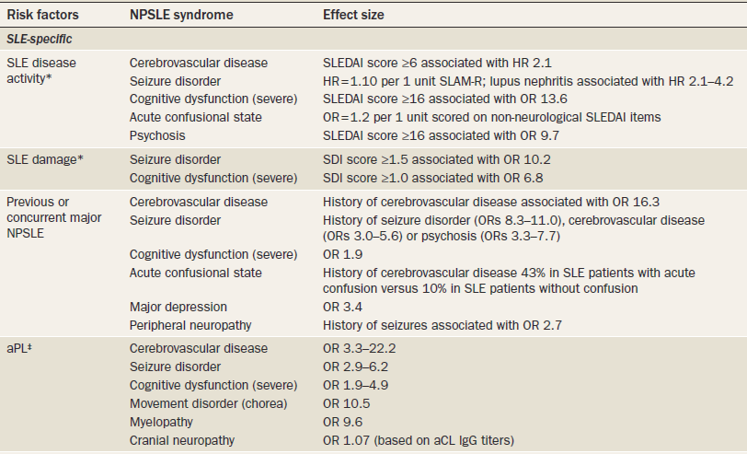
EULAR Recommendations for the Management of NPSLE SLE (ARD 2010)
DISEASE RELATED RISK FACTORS
Who is at risk for (primary) NPSLE?
SLE disease activity
SLE
damage
Previous or concurrent NPSLE
aPL abs
(Evidence: 2/B)
Nat Rev Rheumatol. 2010;6:358-67

Slide 28
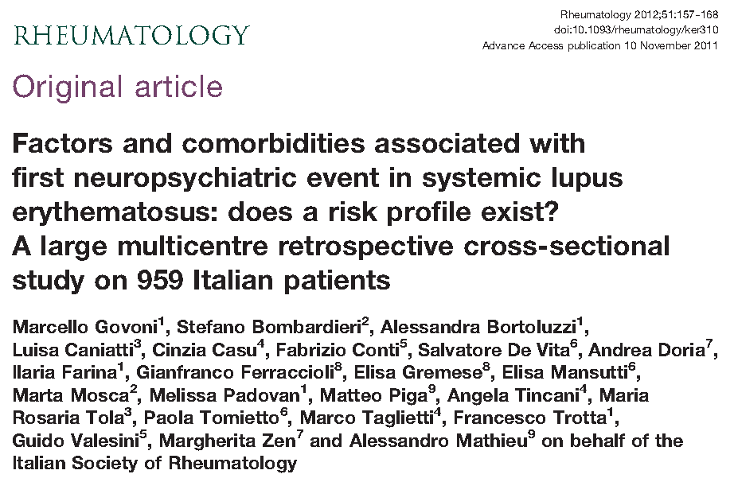
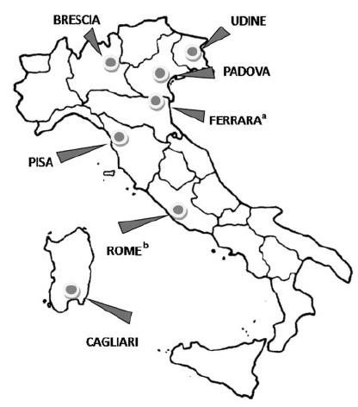
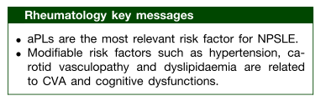
326 patients with NP involvement
469 NP events

Slide 29
Ischemic-thrombotic-vascular phenotype
Usually focal presentation
Frequent MRI abnormalities
Usually acute in onset
High prevalence of aPL antibodies
Brain vasculopathy (or vasculitis)
Usually anatomical-structural damage
No clear relationships with underlying SLE disease activity
Refractory to therapy
Cerebrovascular disease
Seizures
Movement disorder
Myelopathy
Cranial neuropathy PNS involvement
Main clinical phenotypes
Inflammatory-neurotoxic phenotype
Usually diffuse presentation
Frequent normal MRI
Usually insidious, develop slowly over time
anti-NR2, anti-P-Rib antibodies & cytokines
Usually no structural pathology is detectable
Associated mostly with cognitive dysfunctions
SLE high disease activity may be relevant
Usually reversible with therapy
Aseptic meningitis
Demyelinating syndrome
Headache
Acute confusional state
Anxiety disorder
Cognitive dysfunction
Mood disorder
Psychosis

Slide 30
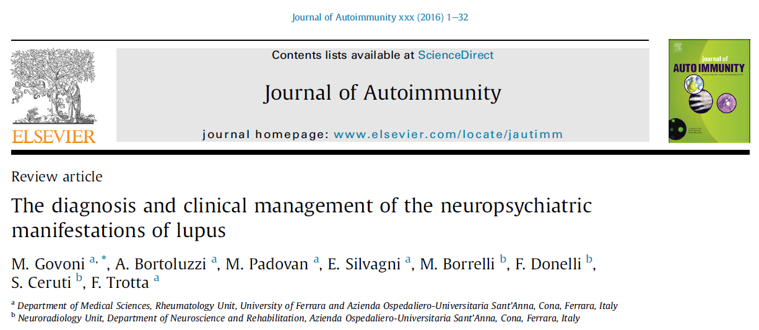
If you want to know more …

Slide 31
L’interessamento del sistema nervoso centrale nel m. di Behçet

Slide 32

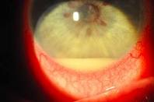
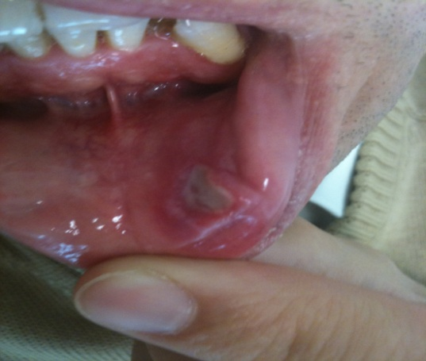
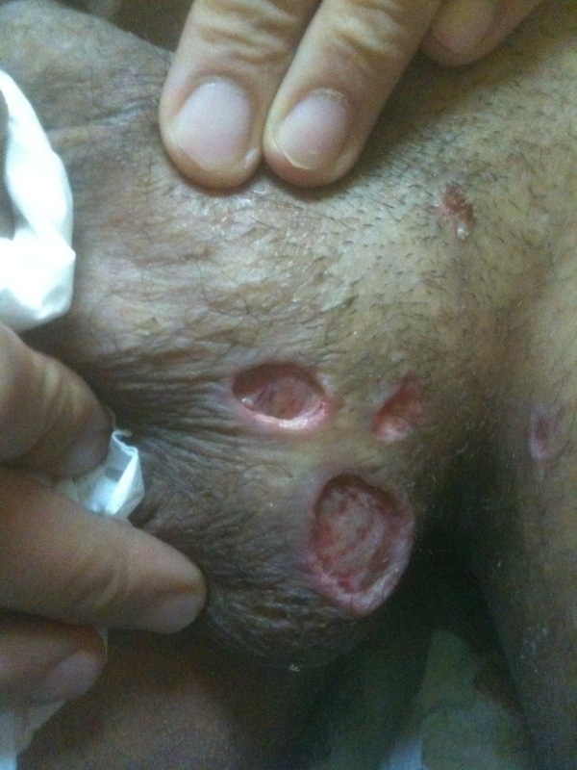
Ocular
Oral aphtae
Genital ulcers

Slide 33
Epidemiology
BD is rare among children
No case among 450,000 in one survey in Turkey Ozen S, et al. J Rheumatol 1998;25:2445
More common in men in the Mediterranean populations
The sex ratio is reversed in Asian populations
Familial disease is uncommon in Caucasians
Positive family history in 12% of non-caucasoid patients

Slide 34
World Prevalence
Country (reference) | Prevalence Per 100,000 population
UK : Scotland / Yorkshire | 0.27 / 0.64
USA : Olmsted County, MN | 0.33
Sweden | 1.18
Portugal | 1.53
Germany | 2.26
Italy : RE / PZ | 3.8 / 15.9
Spain | 7.5
Japan | 13.5
Iran | 16.7
Saudi Arabia | 20.0
Turkey North-Eastern Ankara region Istanbul | 370 110 420

Slide 35
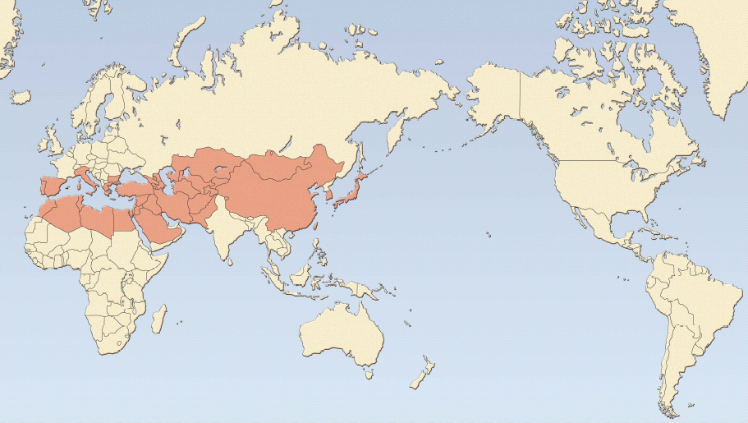
The geografical distribution of BD is distinctive:
it is most prevalent along the Silk Route
45º N
Kazakhstan
Mongolia
Portugal
Italy
Bulgaria
Azerbaijan
Uzbekistan
Spain
Greece
Turkey
Turkmenistan
Japan
Tunisia
Syria
Iran
Afghanistan
China
Korea
Morocco
Israel
Jordan
Algeria
Libya
Egypt
Pakistan
30º N
Saudi Arabia

Slide 36
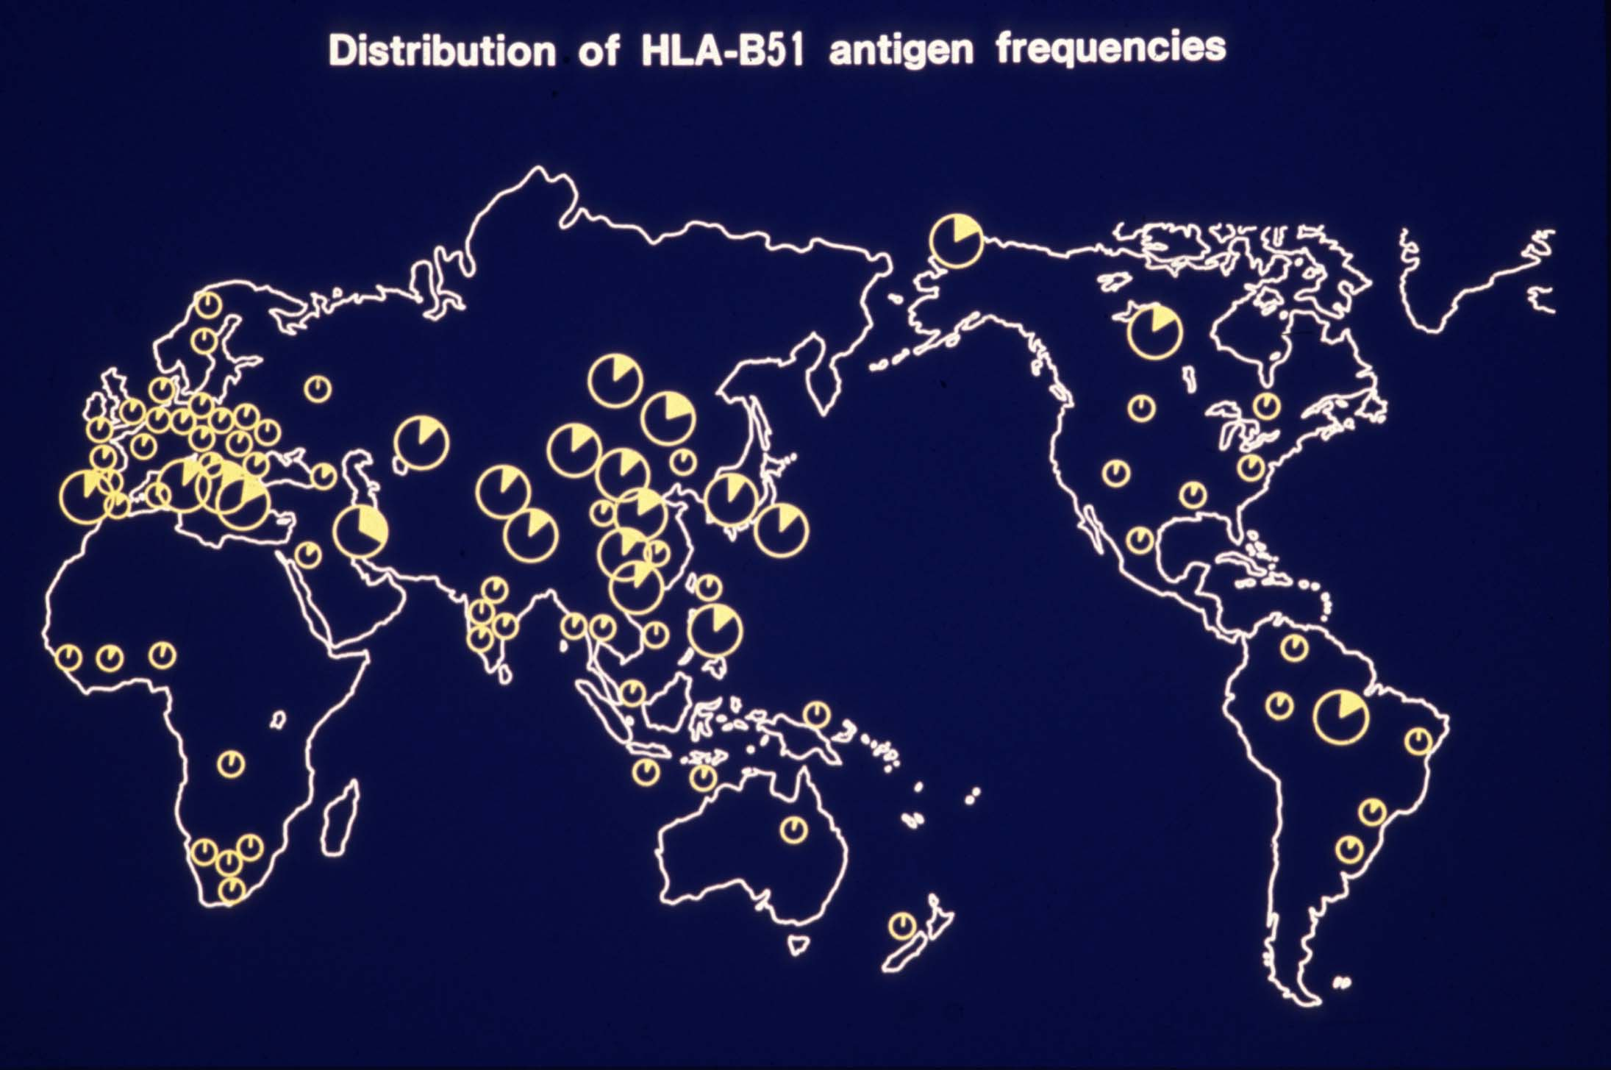
Distribution of HLA-B51 in the world

Slide 37
Although BD is a well-defined disease with well-established criteria for its diagnosis ^{(1,2)}, the same is not true for NBD
Criteri ISG¹
Criteri ICBD²
International Study Group for Behcet’s Disease (1990) Lancet
International Team for the Revision of the International Criteria for Behcet’s Disease (ITR-ICBD) (2014) JEADV.
Aftosi orale ricorrente (major or minor : almeno 3 episodi in 12 mesi)
+ 2 delle seguenti
Ulcere genitali ricorrenti
Manifestazioni oculari (UA, UP, vitreite, vasculite retinica)
Lesioni cutanee (EN, pseudofollicolite, noduli acneiformi)
Patergy test +
Manifestazioni | Punti
Oculari | 2
Aftosi orale | 2
Ulcere genitali | 2
Cutanee | 1
Neurogiche | 1
Vascolari | 1
Patergia | 1
Per la diagnosi:
≥ 4 punti
Sens | Spec | Accur
82.4 | 96.0 | 86.7
Sens | Spec | Accur
94.8 | 90.5 | 93.9

Slide 38
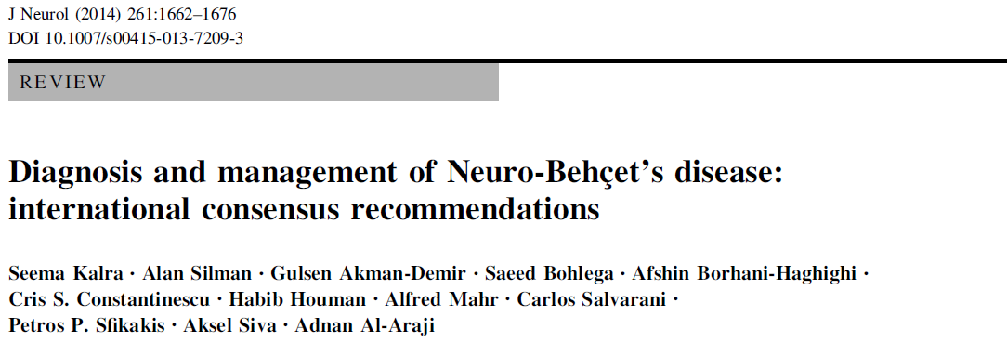

Slide 39
International Consensus Recommendation (ICR) criteria for Neuro Behçet Disease (NBD) diagnosis (2014)
DEFINITE NBD (all of the following)
1. BD satisfying International Study Group (ISG) criteria
2. Neurological syndrome (with objective neurological signs) recognised to be caused by BD (attribution) and supported by Neuroimaging and/or CSF
3. No better explanation for the neurological findings
PROBABLE NBD (1 of the following)
1. Neurological syndrome as in definite NBD, with systemic BD features
but not satisfying the ISG criteria
2. A non-characteristic neurological syndrome occurring in the context of ISG criteria-supported BD
in the absence of a better explanation for the neurological findings

Slide 40
Epidemiologia del coinvolgimento neurologico nel m. di Behçet
Frequenza: 5.3 - 38 % dei pazienti
4.8 - 5.3 % studi clinici
Akman-Demir G et al. Brain 1999
Siva A et al. J Neurol 2001
20 % studi autoptici
Lakhanpal S et al. Hum Pathol 1985
Sex ratio : M / F = 3 : 1
Esordio: in genere 4 - 6 aa dopo l’esordio della malattia;
nel 10% circa prima o all’esordio della malattia
Età media all’esordio: terza decade
31.5 ± 8.9 (Akman-Demir G et al. Brain 1999)
32.0 ± 8.7 (Siva A et al. J Neurol 2001)
30.2 ± 8.5 (Koçer n et al. AJNR 1999)

Slide 41
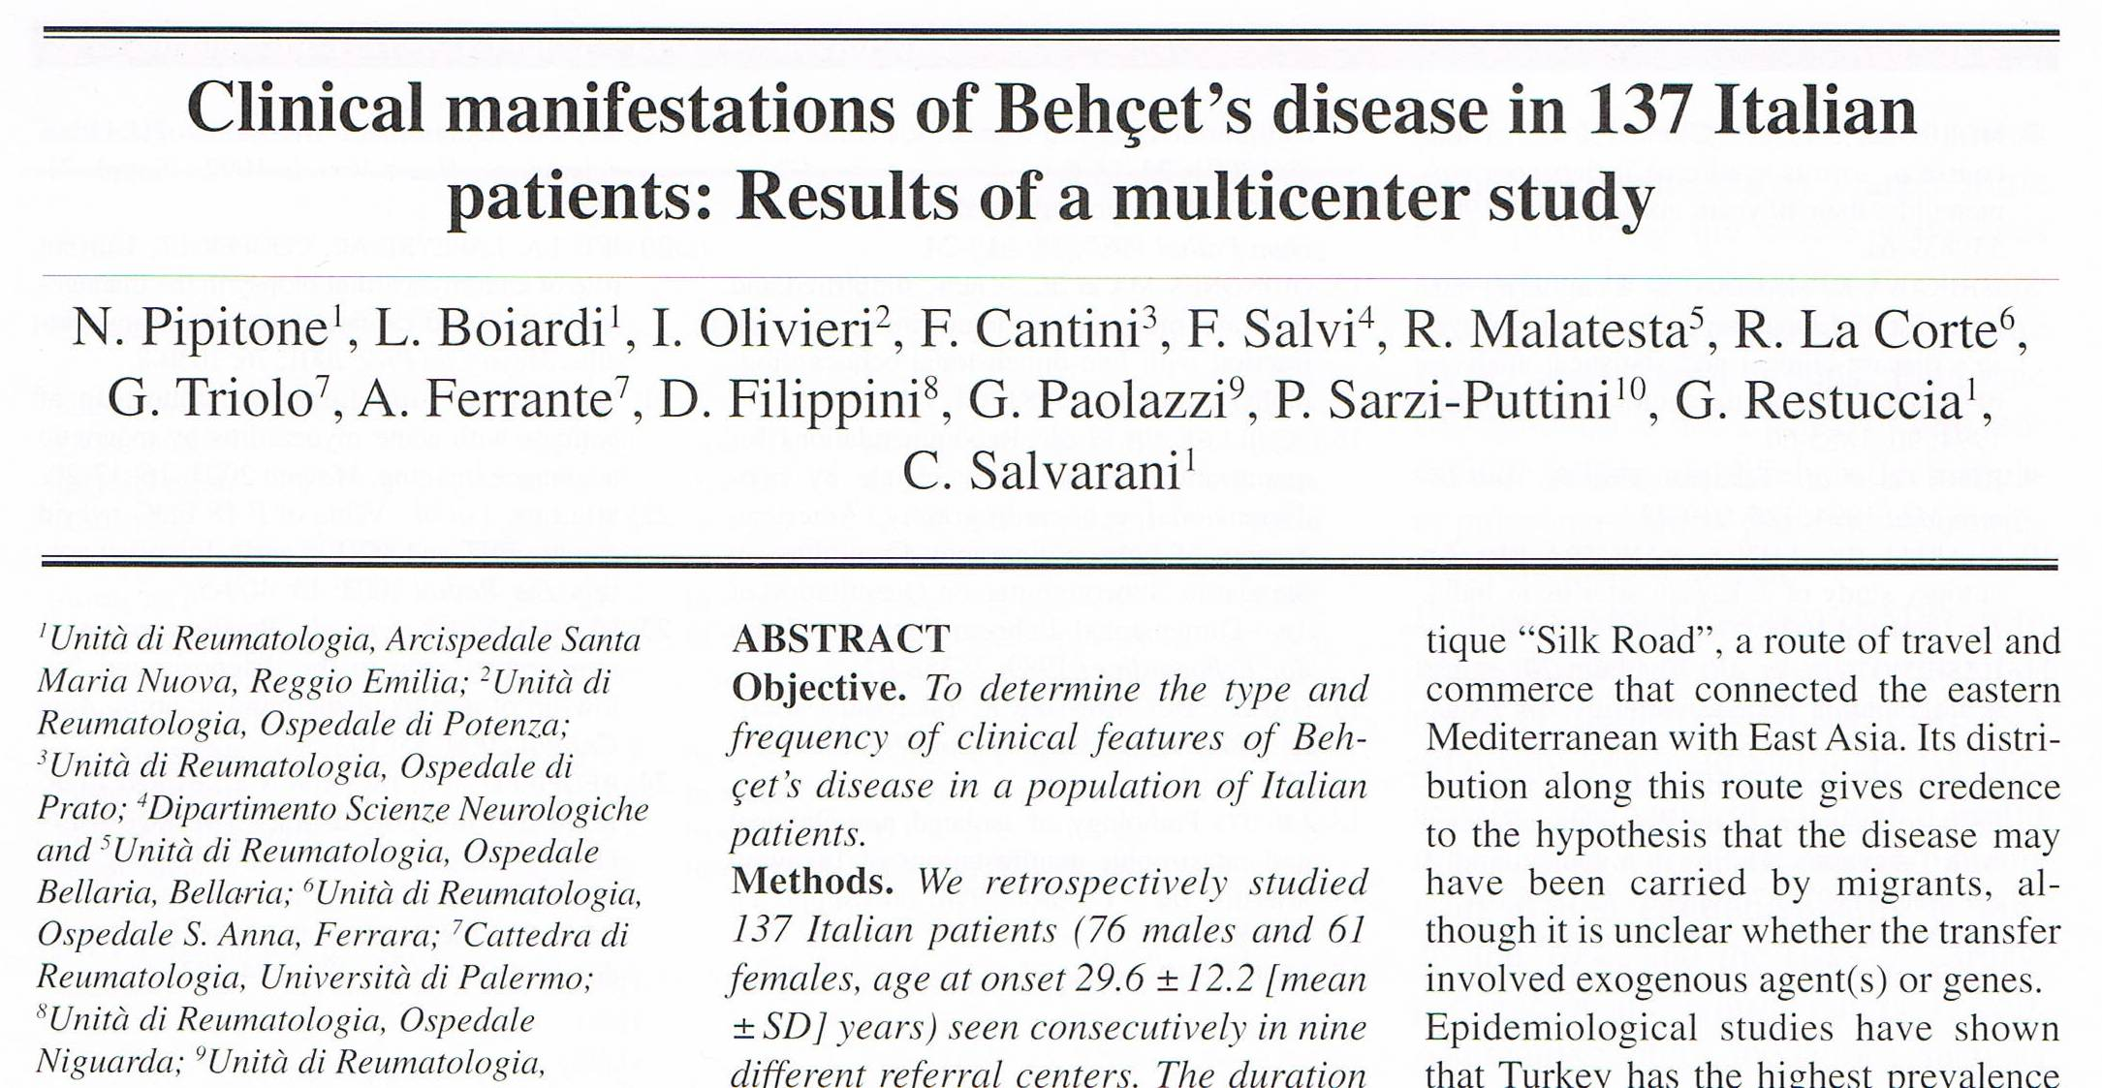
CNS involvement : 5 %
Clin Experiment Rheu 2009

Slide 42
Classificazione Neuro-Behcet
Subtypes which differ by clinical, neuro-radiological, pathological, and prognostic characteristics
Sistema Nervoso Centrale
Parenchimale
(Intra-assiale)
Troncoencefalico
Midollo spinale
Cerebrale
Asintomatico
Neurite ottica
Non-Parenchimale
(Extra-assiale)
Trombosi venosa cerebrale
Aneurismi intracranici/dissecazione
Aneurismi extracranici/dissecazione
SMALL VESSEL
LARGE VESSEL
~ 80 %
~ 20 %
Sistema Nervoso Periferico
uncommon
Neuropatie periferiche e mononeurite multipla
Miopatie e miositi
Altre sindromi
uncommon
Tumor like neuro-BD
Sintomi psichiatrici
Akmar-Demir et al. Brain 1999
Siva A. et al. J Neurol 2001
Siva A Saip S, J Neurol 2009
Kalra S et al. J Neurol 2014

Slide 43
Clinical phenotypes
Parenchymal NBD
usually presents with :
  a sub-acute onset of brainstem syndrome (with/without other features)
  cerebral hemispheric or spinal cord syndrome (multifocal)
  features : pyramidal weakness, behavioural changes, headaches, ophthalmoplegia, optic neuropathy and sphincter changes.
usually follows a relapsing-remitting pattern or a primary/secondary progressive course
Non-parenchymal NBD (vasculo-NBD)
commonly presents with headache and visual features secondary to intracranial hypertension, usually due to cerebral venous thrombosis.
It can present as an acute stroke related to arterial thrombosis, dissection, or aneurysm (uncommon), acute meningeal syndrome
can be monophasic, but recurrences may occur
A mixed parenchymal and non-parenchymal disease presentation can occur

Slide 44
Principali segni neurologici
Molto frequenti
(> 50%)
Segni piramidali
Emiparesi
Disturbi comportamento
Disturbi sfinterici/impotenza
Cefalea
Comuni
(10 - 40%)
S. troncoencefaliche
S. piramido-cerebellari
Disturbi sensitivi
Paraparesi
Febbre
Disturbi movimento
Meningismo
Ipersonnia/iperfagia
Rari
(< 5%)
Crisi comiziali
Disturbi psichiatrici
S. cerebellari pure
Ipo-anacusia
Neuropatia ottica
Emianopsia
Afasia
Akmar-Demir G et al. Brain 1999

Slide 45
Pricipali sintomi neurologici all’esordio
CEFALEA 61.6%
S. motori 53.7%
S. cerebellari 29.9%
S. tronco-encefaliche 29.3%
Disartria 22.6%
S. sensitivi 11%
Alterazioni coscienza 7.3%
S. cognitivi 2.4%
altri 9.4%
Esordio
polisintomatico: 72.7%
Siva A et al. J Neurol 2001

Slide 46
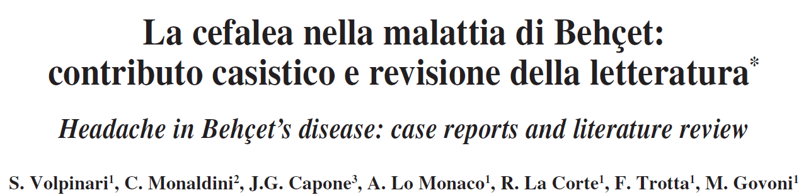
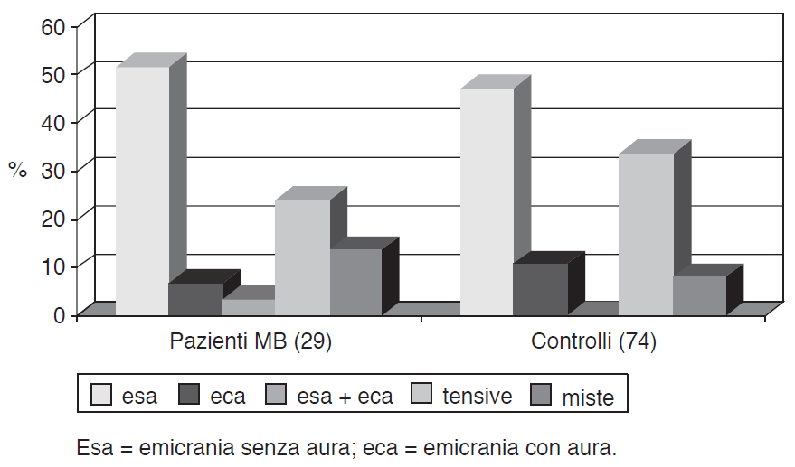
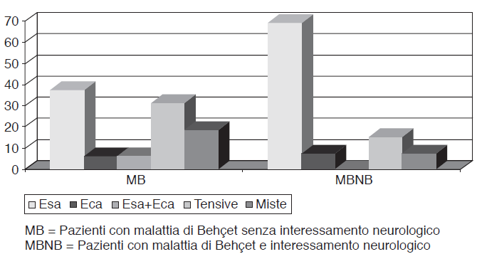
41 patients were enrolled into the study
No differences in the frequency of the different pattern of headache between BD patients and controls.
Headache occurred in 70,7 % of BD patients & in 92,8 % of Neuro-BD patients.
Migraine without aura did prove the most frequent type of headache

Slide 47
Modalità di coinvolgimento neurologico
Attacco acuto:
esordio acuto o subacuto di sintomi o segni neurologici
Decorso progressivo primario:
lenta e progressiva evoluzione di sintomi o segni neurologici nell’arco di mesi o anni senza attacchi
Decorso progressivo secondario:
lenta e progressiva evoluzione di sintomi o segni neurologici dopo almeno 1 attacco o progressione a tappe successive segnate da attacchi
Coinvolgimento neurologico silente:
presenza di anormalità all’esame neurologico in assenza di sintomi specifici al di fuori della cefalea

Slide 48
Differential diagnosis
multiple sclerosis
stroke affecting the young
intracranial hypertension
meningo-encephalitis
myelitis

Slide 49
Neuroimaging & Neuro-Behçet
Distribuzione delle lesioni RM
Giunzione meso-diencefalica 46%
Ponte/bulbo 40%
Ipotalamo/talamo 23%
Gangli della base/ cap. interna 18%
Midollo cervicale 5%
Cervelletto 5%
Telencefalo 8%
65 paz. con neuro-Behçet e RMN cerebrale anormale
Koçer N et al. AJNR 1999

Slide 50
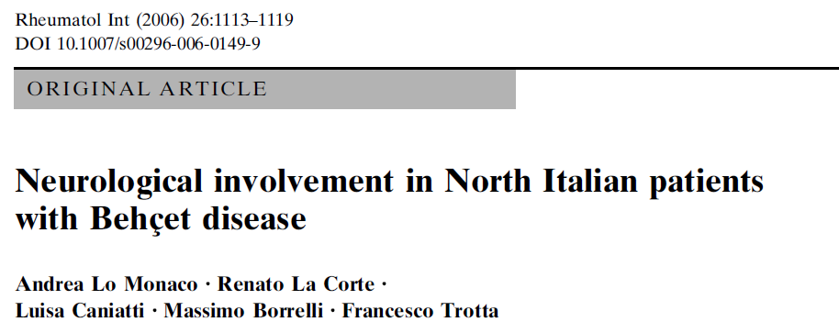
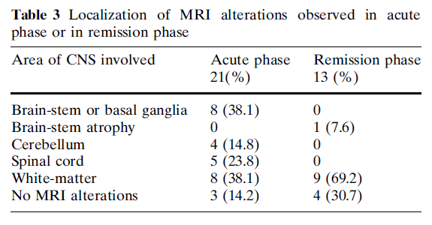

Slide 51
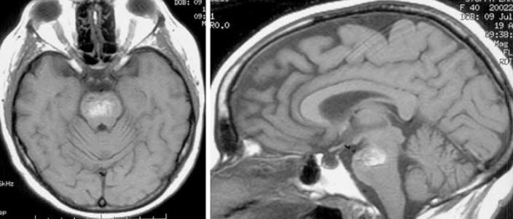
Predominat brainstem involvement
The brainstem-thalamic-basal ganglia lesions, in the proper clinical context, can strongly support the diagnosis of acute/subacute parenchymal NBD, and on occasions can raise this possibility even when the systemic features of BD are scarce
large pontomesencephalic lesion in a 41-year-old woman with a locked-in syndrome 1 week after the acute onset
(personal observation)

Slide 52
Region predominantly involved in ANBD, CNBD, NPSLE, MS
MRI | ANBD | CNBD | MS | NPSLE
Basal ganglia and/or brain stem | 100 | 36 | 0 | 14
Sc. hemisphere white matter | 0 | 36 | 100 | 29
Cerebral cortex | 0 | 0 | 0 | 29
No parenchimal lesions | 0 | 27 | 0 | 29
ANBD = acute neuro BD
CNBD = chronic neuro BD
NPSLE = NP Systemic Lupus Erythematosus
MS = multiple sclerosis
Coban et al. Neuroradiology 1999

Slide 53
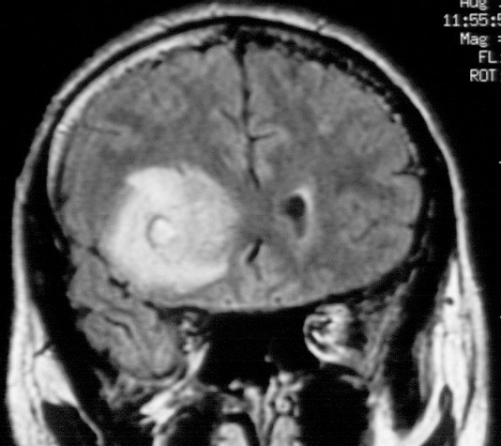
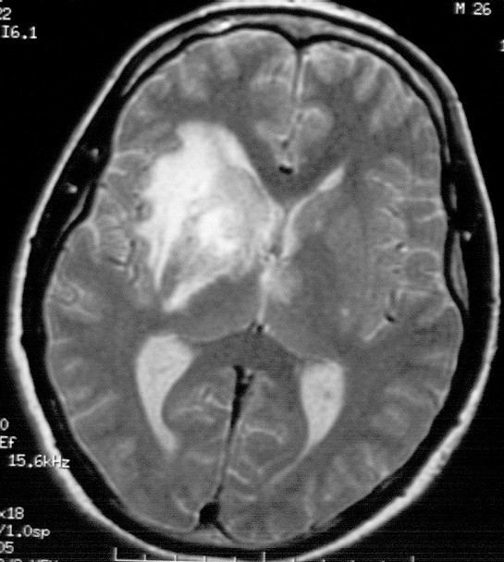
Acute Neuro-Behçet
Agosto:
cefalea intensa, emiparesi sin.
Settembre:
ampie lacune mnesiche.
Novembre:
ipersonnia diurnia, iperfagia, apatia.
RM: vasta lesione fronto-temporale dx sottocorticale interessante anche la regione dei nuclei della base con compressione del corno temporale e frontale del III ventricolo.
(osservazione personale)

Slide 54
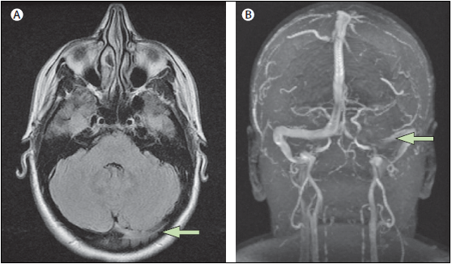
Non-parenchymal neuro-Behçet’s disease
Right-sided transverse venous sinus thrombosis in a patient with MR venogram
Notes:
.

Slide 55
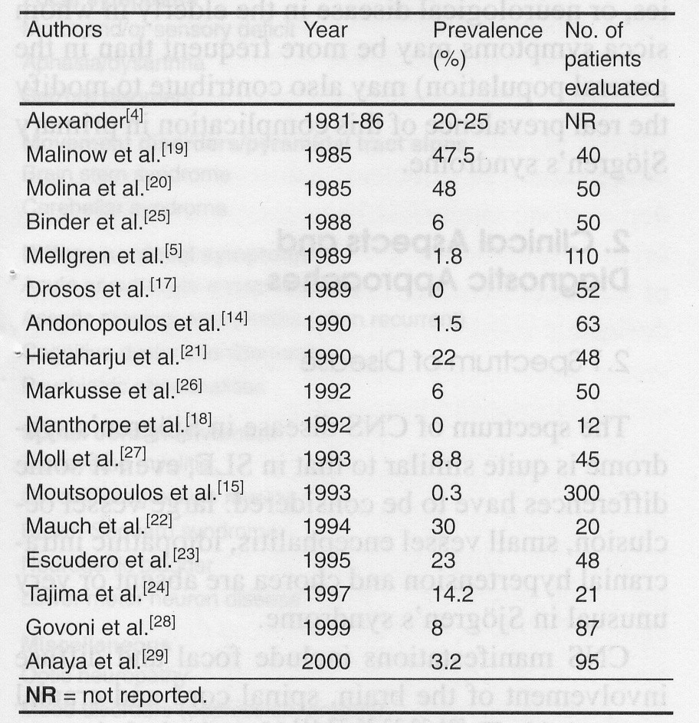
Neuro-Sjogren
The real burden of CNS involvement still represents a controversial issue
Range = 0 - 68 % ???
Govoni M et al. CNS Drugs 2001
More recent data :
year % n.pz
Anaya et al 2002 2.5 120
Garcia-Carrasco 2002 1 400
Delalande et al. 2004 68 82
Jamilloux et al 2003 9.7 420
Ramos-Casals 2010 2 1010
Morreale et al 2014 67.5 120
Moreira et al 2015 15 93
Carvajal-Alegria et al 2016 3.6 392
In Sjogren’s syndrome the PNS is predominantly involved
Range = 7 - 35 %

Slide 56
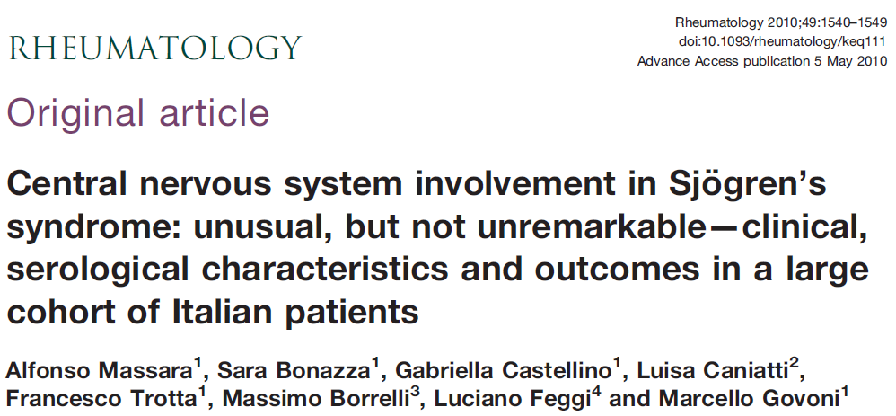
25/424 patients - 5.8 %
NP involvement | No. pts. | % | Outcome
 |  |  | S | I | W
Diffuse manifestations | 10* | 40 | 4 | 3 | -
Focal or multifocal pictures | 9 | 36 | 1 | 7 | 1
MS-like disorders | 5 | 20 | - | 2 | 3
Isolated optic neuritis | 1 | 4 | 1
* FUP not available in 3 pts. S = stable; I = improved; W = worsened
Age at first CNS-NP event, mean (yrs) 46.7 (13.6)
Disease duration at first CNS-NP event, mean (yrs) 3.4 (4.6)

Slide 57
Aspetti clinici
Quadri NP polimorfi
Tutto il nevrasse può essere colpito
Esordio spesso insidioso (4ª - 5ª decade)
Modalità di decorso variabile (intermittente/remittente o lentamente progressivo)
Possibile manifestazione di esordio (*)
(*) nel 52 % dei casi della casistica di Ferrara 2010
  nel 62 % casistica di Lafitte 2001

Slide 58
Clinical spectrum of CNS involvement
Focali
  Deficit focali (mono/multipli)
  Afasia/disartria
  Convulsioni parziali (rare)
  S. tronco cerebrale
  S. cerebellare
  Sindromi extrapiramidali
Mielopatia
  Mielite trasversa acuta
  Mielite cronica progressiva
  S. Brown-Sequard
  Vescica neurogena
  M. del motoneurone
Diffuse
  encefalopatia
  Meningite asettica
  Meningoencefalite
  Disfunzioni cognitive
  Ansia, Depressione
  Cefalea
Altri
  Neuropatia ottica
  Quadri SM-like

Slide 59
Aspetti particolari
Quadri psichiatrici di tipo prev. neurotico
  aumentati livelli di ostilità, ideazione paranoide, disforia, ansia, somatizzazione e compulsività, aspetti isteroidi, depressione
Frequenti disturbi del sonno (SFM), talora narcolessia
Disturbi cognitivi subdoli, raramente gravi (demenza)
Rari epilessia, psicosi e disturbi del movimento
      Malinow et al Ann Int Med 1985
      Drosos et al Clin Exp Rheumatol 1989
      Tishler et al Clin Exp Rheumatol 1997
      Valtysdottir et al J Rheumatol 2000
      Mitsuo et al, Mod Rheumatol 2001

Slide 60
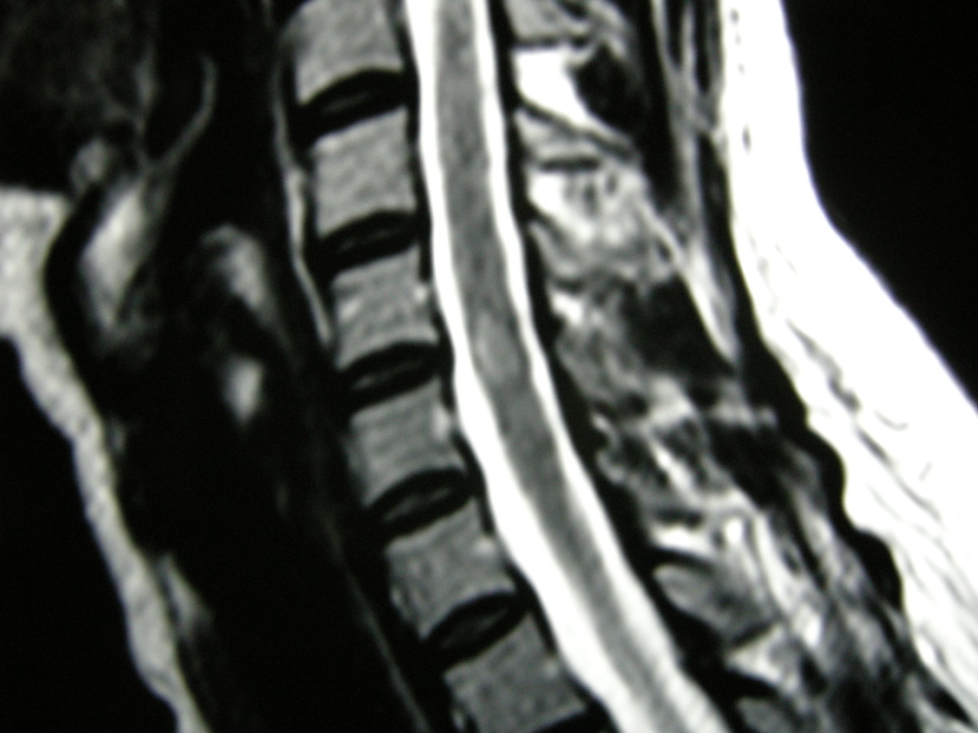
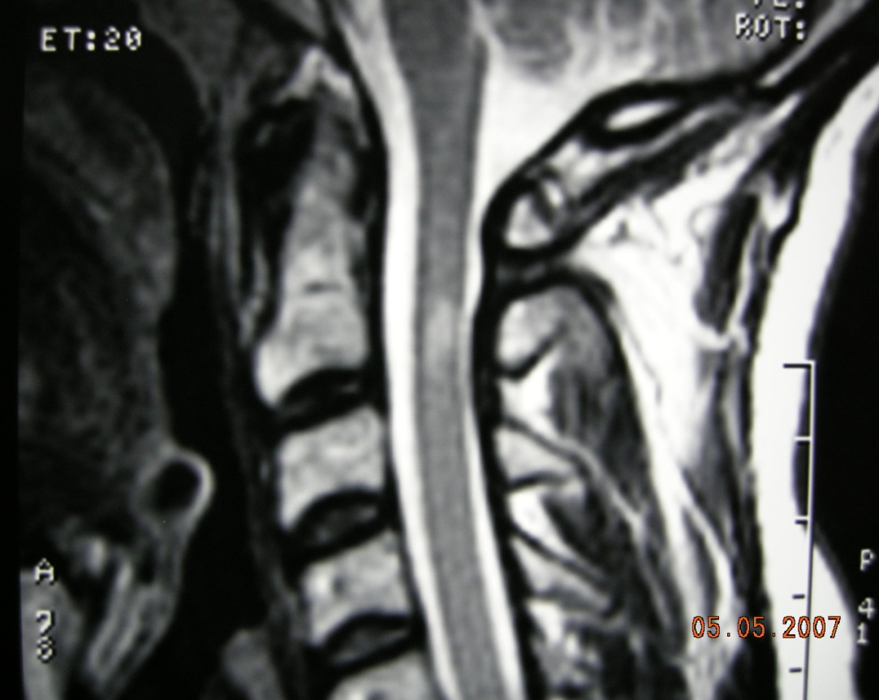
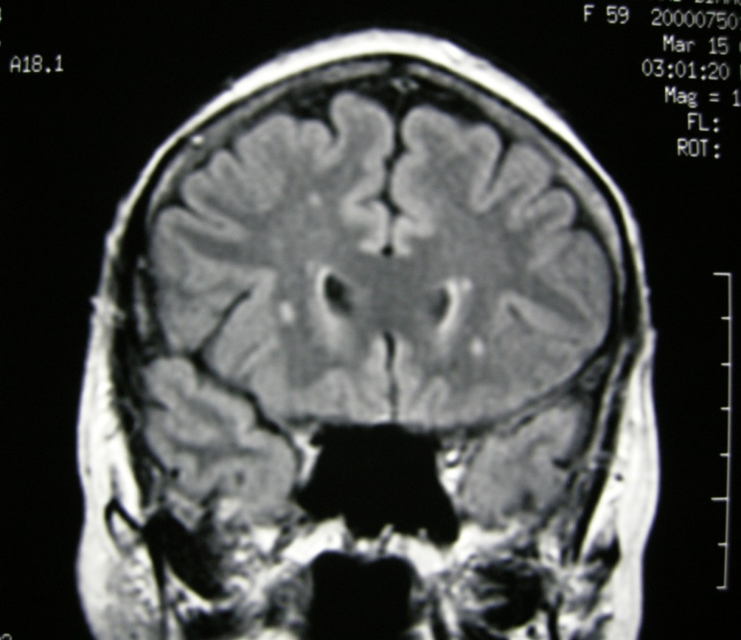
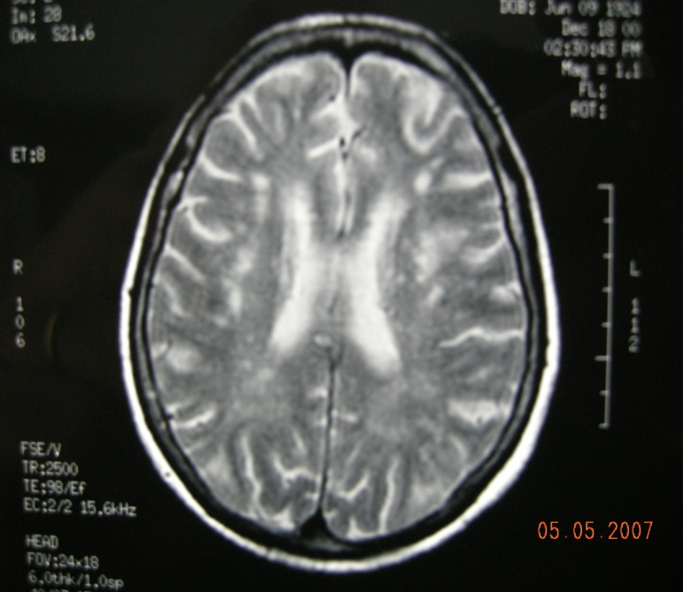
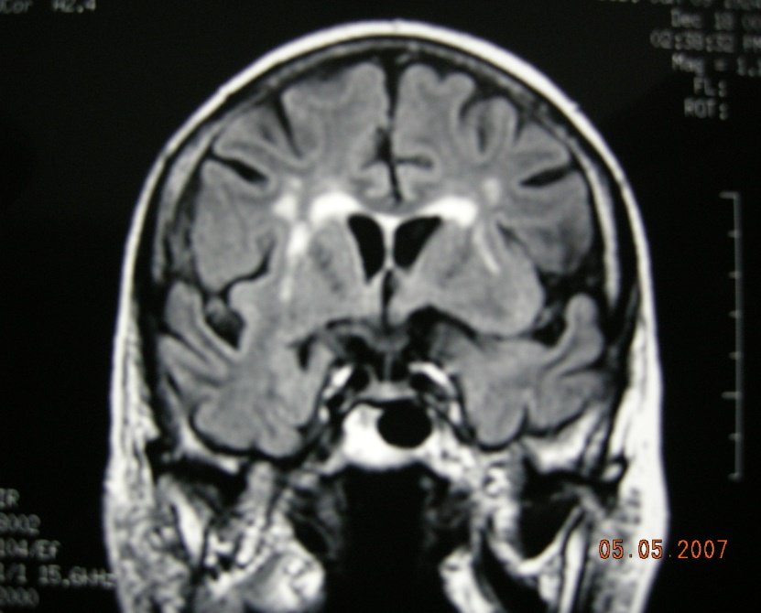
Risonanza Magnetica
Overlap Sjogren & SM
Atrofia cerebrale, dilatazione ventricoli; frequente riscontro (60-80 %) di WMH sottocorticali e peri-ventricolari nei pz. con S. Sjogren (con o senza int. NP)
Quadri mielitici
Prevalenza del Sjogren nella SM
2.3 - 3.3 %
Prevalenza della SM nel Sjogren
up to 30 %
casistica di Ferrara
20 %
dei quadri neurologici
Ferrara
alterazioni RM nel 91 % dei pz. con int. SNC

Slide 61




DD tra S. di Sjögren e SM
Sjogren
Quadri multifocali con decorso remittente e ricorrente
Quadri di neuropatia ottica e mielopatia acuta
Rilievo di BOC nel LCR
Aspetti RM simili alla SM
  Alexander et al, Ann Int Med 1986
  Barnet et al, Neurology 1995
  Collard et al, Neurology 1997
F : 24 yr
SM
S. sicca (soggettiva) in 1/3 dei casi
F. Raynaud, piastrinopenia
ANA nel 3 - 27 % dei casi
Ac Ro/SSA nel 2 -15 % dei casi
ACL nel 6-8 % dei casi
  Tourbah et al, Arch Neurol 1998
  Ijdo et al, Lupus 1999
  De Andres et al, Acta N Scand 2001
2001
2003
2005
2007

Slide 62
Neuro-Sjögren vs SM
Neuropatia periferica
Vasculite cutanea
Presenza di Ac. anti-Ro/SSA e anti-La/SSB
Tumefazione delle gh. parotidi
Sialoadenite focale (FS ≥ 1)
HLA-B8, DR3, DRw52 vs DR2
Minore quantità di BOC nel LCS

Slide 63
Summary
CNS is a potential and not rare target for damage in rheumatic diseases
Different pathogenetic pathways working in systemic rheumatic diseases can lead to NP involvement
Thinking of an underlying rheumatic disease when approaching a new onset NP picture - especially in young patients – is warmly advised

