Slide 1
Part VI: “Goodbye magic bullet”
Cancer Therapy in the Age of Precision Medicine

Slide 2
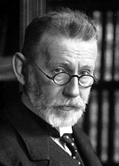
The “Magic Bullet” idea
Paul Ehrlich coined the term “Magische Kugel” (magic bullet) to indicate a highly specific agent that would only kill one organism
The original magic bullet was Salvarsan, a syphilis therapeutic
Paul Ehrlich
(1854-1915)

Slide 3
The “Magic Bullet” idea
Although this concept is useful to describe drugs with high specificity (e.g. a monoclonal antibody-drug conjugate, or a targeted kinase inhibitor), it has had unintended consequences
By analogy with infectious diseases, the public (and many physicians and scientists) developed the concept that someday, a “magic bullet” could be found that cures all cancers, exploiting a common weakness of all cancer cells
This erroneous concept is still widespread and internet memes propagate it
http://www.cancertreatmentwatch.org/q/conspiracy.shtml

Slide 4
The “Magic Bullet” idea
Unfortunately, given what we know today about cancer, the likelihood that a magic cure will ever be found is…
0
Cancer are so diverse, heterogeneous and mutable that the approach based on looking for a magic bullet is conceptually absurd. Modern cancer therapeutic research is going in the opposite direction, namely, towards individualized, multimodality treatment strategies based on an analysis of individual tumors. The future in cancer therapeutics is Precision Medicine.

Slide 5
Precision Medicine
An emerging approach for disease treatment and prevention that takes into account individual variability in genes, environment, and lifestyle for each person.
Significant advances have been made, but precision medicine is still not standard practice for many diseases.

Slide 6
Precision vs. Personalized Medicine
Truly “Personalized” medicine would individualize treatment for each patient, changing not only types of agents but doses and regimens based on purely individual characteristics
Precision Medicine is a step towards Personalized medicine, in that it uses more variables to stratify patients, but is not completely individualized

Slide 7
The progress of medical research
has been slow for millennia
Medicine began 45 centuries ago with the Egyptians and the Babylonians. Yet, until the 20th century, physicians could only use their unaided senses to examine patients
The Greeks and Romans perfected ancient medicine, beginning early anatomical dissections
However, from the 2nd century AD dissecting human bodies was forbidden. All we thought we understood about the inner workings of our bodies derived from the dissection of dead animals
Hedwin Smith Papyrus describing brain surgery
Hippocrates examining a young patient

Slide 8
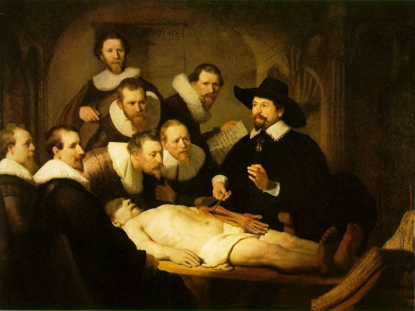
The first revolution: human anatomy
Leonardo da Vinci (1452-1519) jump-started medical science after a long slumber by re-introducing the study of human anatomy through cadaver dissection. For the first time since Roman times, we began learning about the inside of a human body, but remained limited to the resolution of unaided senses

Slide 9
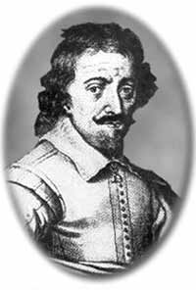
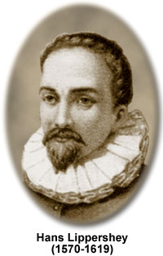
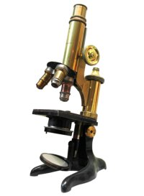
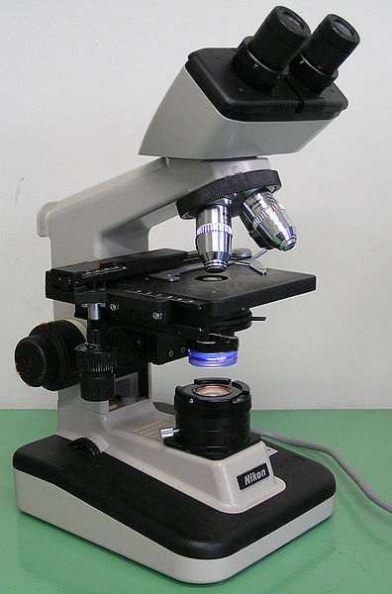
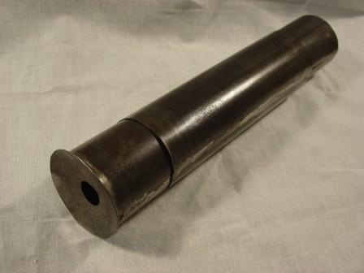
The second revolution: microscopy
A century after Leonardo, the microscope enabled us to observe normal and diseased tissues at the cellular level for the first time in history
Zacharias Janssen (1585-1632)
Hans Lippershey
(1570-1619)

Slide 10
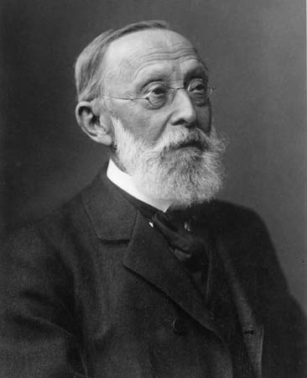
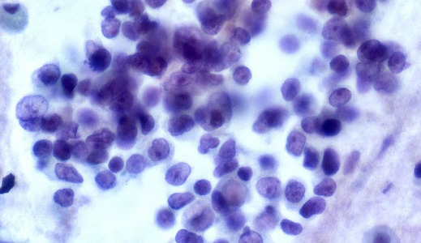
Microscopy brought us pathology
Using the microscope, Rudolf Virchow built his revolutionary theory of the cell as the unit of life and disease:
All living organisms are made of cells
Cells only derive from other cells
Cells are subject to external stresses which damage them, causing disease
Developing this theory took nearly 200 years of microscopy
To this day, most pathology is done by microscopic examination of diseased tissue
Rudolf Virchow
(1821-1902)

Slide 11
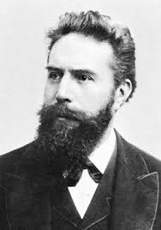
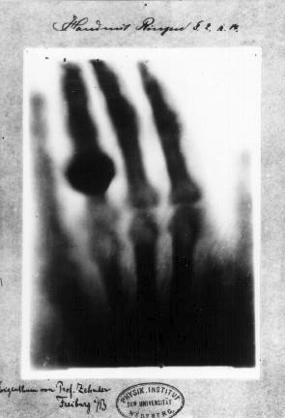
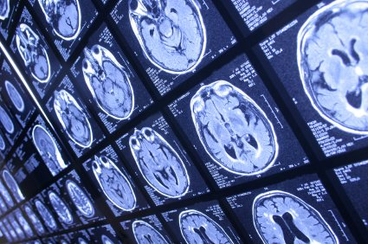
The third revolution: radiology
While pathology improved our ability to look at the cellular pictures of disease, radiology enabled us to look inside living patients
To date, radiology and related imaging techniques (CT, PET, MRI) are essential to diagnosis
Wilhelm Conrad Roentgen (1845-1923)

Slide 12
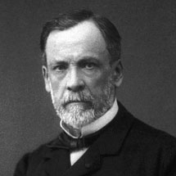
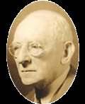
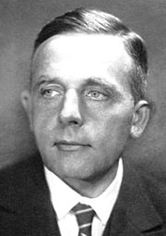
Beyond observation, the fourth revolution: biochemistry
For all the observing we could do, organs and cells weren’t small enough to reveal the molecular mechanisms of disease
Medical science needed to go deeper: to the level of molecules
The application of chemistry to living cells produced biochemistry and elucidated metabolism
Today’s clinical chemistry panels and targeted drugs are the product of a century of biochemistry
Louis Pasteur
(1822-1895)
Paul Ehrlich
(1854-1915)
Carl Neuberg
(1877-1956)
Otto Warburg
(1883-1970)

Slide 13
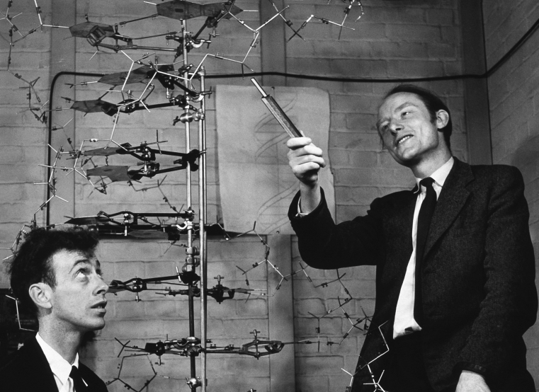
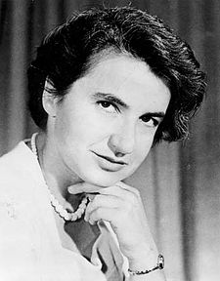
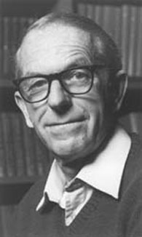
The chemistry of genes:
molecular genetics
James Watson (1928-), Francis Crick (1916-2004)
Rosalind Franklin (1920-1958)
Fred Sanger (1918-2013)
Structure of DNA: the double helix
Routine sequencing of DNA
made possible!

Slide 14
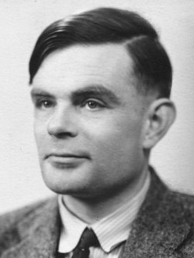
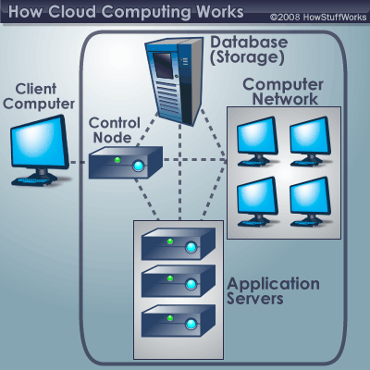
Informatics unlocks the ability to analyze massive datasets: the game changes
Alan Turing
(1912-1954)
Steve Jobs
(1955-2011)
Bill Gates
(1955-)
Mainframe
digital computers
1940s-50s
Personal computers
1980s
Cloud computing
2010s
INTERNET

Slide 15
Molecular genetics + bioinformatics = genomics
Francis Collins
(1950-)
Craig Venter
(1946-)
Sequence of the human genome

Slide 16
Genomics is bringing about a revolution in the diagnosis and prognosis of disease similar to the introduction of pathology, radiology or biochemistry
History
Physical
Imaging
Pathology
Clinical Chemistry
Genomics
“Personalized” (Precision) medicine:
diagnosis, prognosis, prevention, treatment

Slide 17
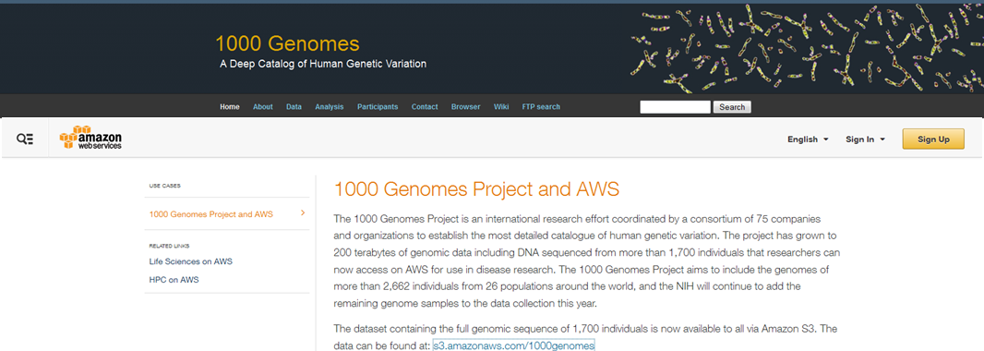
Thousands of genomes and counting:
human genetic variation meets medicine

Slide 18
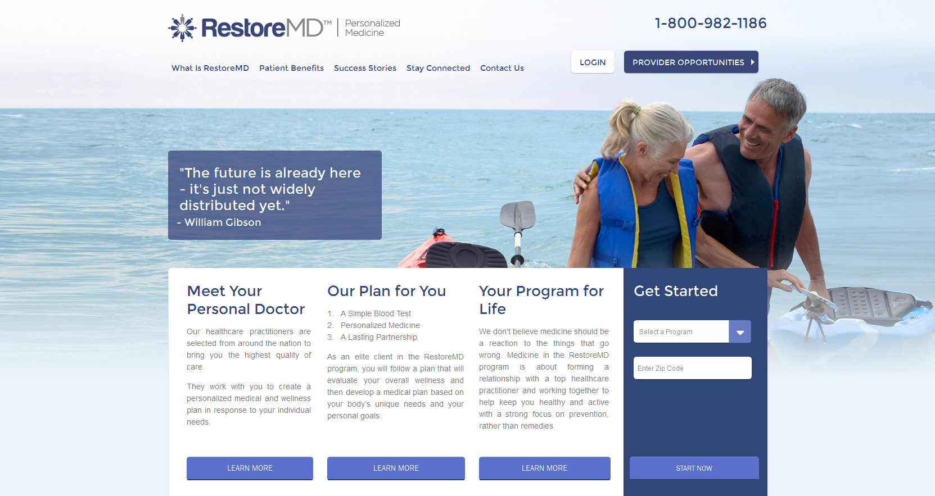
…And commercial products
are following suit

Slide 19
Not all “personalized medicine” products are validated to produce clinically actionable information. Regulation must keep pace

Slide 20
Types of Genomic Tests
mRNA and ncRNA expression tests
Measure relative abundance of specific transcripts
Can use different quantification platforms
Microarray (chip-based hybridization)
Nanostring (solution hybridization with bar-coded probes)
Digital PCR
RNASeq
Useful in identifying and validating candidate biomarkers for diagnosis and prognosis
RNASeq-based tests provide sequence information in addition to relative abundance. They can identify the presence of mutations in transcribed genes

Slide 21
Types of Genomic Tests
Genomic DNA Next-generation sequencing tests (NGS)
Exome sequencing (sequence of exons, i.e., coding regions of specific genes)
Targeted exome panels (selected groups of genes)
Whole exome sequencing (all coding exons)
Familial mutations/diagnosis of rare genetic disorders
Commercial multigene panels
Exome sequencing
Exome sequencing for oncology
SNP tests: examine single nucleotide polymorphisms in specific genes
Chip hybridization, PCR or NGS-based
CYP2C19, CYP2C9, CYP3A4, CYP3A5, CYP2D6
These genes and a few others control the metabolism of many commonly used medications, including opiates, antibiotics, metformin, antiplatelet agents (clopidogrel), anticancer agents (tamoxifen, 5-FU)

Slide 22
Questions Addressed by Medical Genomics
Individual risk of disease
Familial mutations
SNPs identified by GWAS (Genome-Wide Association Studies)
Diagnosis of rare genetic disorders
Exome sequencing (“Medical Exome” or Whole Exome)
Individual pharmacokinetics of numerous drugs
SNPs in Cyps and other drug metabolizing genes
Individual response to treatment/prognosis
Exome sequencing
WGS
miRNAs
lncRNAs

Slide 23
Genomic tests in clinical use
Established tests
Familial mutations (gene panels, e.g. MyRisk 25-gene panel)
SNPs in genes involved in drug metabolism (pharmacogenomics)
Multiplex PCR or nanostring gene expression panels (Oncotype DX for breast cancer, colon cancer, melanoma)
Exome sequencing (pediatric disorders, cancer)
Investigational tests
Whole genome sequencing (WGS)
RNAseq
miRNA
lncRNA
Methylome

Slide 24
The data barrier
1 single human genome sequence = approx. 3.7 billion bp = 4 TB
Each needs to be read multiple times (30-500X) in short overlapping stretches which are then aligned to compile “the sequence”
Now this needs to be compared to a “reference” human genome to distinguish “normal” from “variant”
Then the possible consequences of each variation need to be predicted
Multiply all this by the number of patients you wish to study
Then correlate this data with clinical, environmental, epidemiological variables…. before you can draw any meaningful conclusions

Slide 25
“Big Data” analytics are the hidden backbone of precision medicine
Class discovery: e.g., identification of patient populations with similar characteristics
Reclassification of patients based on molecular variables correlated with clinical measures
Multicenter clinical trial design, “basket” trials
Class comparison: comparing clinical outcomes or disease prevalence based on multiple variables with large N
Molecular and classical epidemiology
Class prediction: predicting clinical outcomes from genomics, non-genomic datasets
Identification of actionable trends in health care
Adverse events in specific patient groups
Resource usage

Slide 26
Challenges for Precision Medicine- 1
Data ontology must be homogeneous and carefully thought out. Need “flexible standardization” for cooperative studies
EHR mining, natural language search algorithms needed
For genomic datasets (WES, WGS) we DON’T know the phenotypic effect of most genetic variants we discover
Variants of Unknown Significance (VUS), silent mutations. Different mutations in the same gene can and do have different biological consequences
Genes work in networks, not in isolation: pathway discovery and pathway annotation are improving but remain somewhat imprecise
We still need basic science to improve our models to make accurate predictions
Heterogeneous cell populations require deconvolution or single cell omics

Slide 27
Challenges for Precision Medicine- 2
Computationally intensive
Data storage capacity, cloud computing
Data transfer speeds
Privacy concerns
Data security is essential (separate servers for outside-facing apps and databases)
Need for encryption - GPID
Consent needed for use of PHI. Standard consents

Slide 28
Challenges for Precision Medicine- 3
Patient selection
Who needs what tests?
Role of specialists in medical genetics
Result interpretation and explanation
“What do these results mean?” Need to communicate results in an accurate, understandable way that takes into account patient and family concerns
Role of genetics counselors

Slide 29
How can we use genomic information in treatment?
We are rapidly accumulating data on the mutational and gene expression landscapes of individual tumors
Some mutations are “actionable”, meaning they are correlated with response to specific therapeutic agents
However, others are neomorphs. They affect important genes, but we don’t know how they affect sensitivity to therapeutic agents
Neomorphs often evolve during treatment
Need for methods to predict the effect of mutations
Several algorithms have been developed, but none is perfect

Slide 30
From MAGIC BULLETS TO RATIONAL COMBINATIONs
THE EVOLUTION OF CANCER DRUG DEVELOPMENT

Slide 31
The traditional “Clinical Trial and Error” drug development is highly inefficient
This traditional “trial and error” process has a 95% failure rate, in large part because it is based on incomplete and often partially incorrect scientific knowledge
Clinical and basic investigators operate in parallel silos with significant language barriers
Neither industry nor academia can bridge this gap alone
The development of a novel medical intervention (new drug, device, test) that is reasonably SAFE and EFFECTIVE is extremely difficult and expensive: on average, it requires 14 years and $2 billion, not including the basic research that generates the initial concept

Slide 32
Medical Research Workflow: Traditional Vs. Translational
Basic
Science
In vitro/animal models. Study design not always informed by knowledge of disease process in humans
Incremental improvement in biological knowledge
Applied
Science
Mining of biological knowledge, “brute force” drug screening (chemical libraries)
Identification of lead drug candidate, often with partial mechanistic information and clinically uninformative models
Clinical Science
Phase 1-3 clinical trials
Endpoints not always appropriate for target biology
Combinations not always based on sufficient mechanistic data
Unexpected toxicities
Lack of efficacy
Efficacy limited to a subset of patients
Safety
Efficacy

Slide 33
Medical Research Workflow: Traditional Vs. Translational
Basic
Science
In vitro/animal models. Study design informed by knowledge of disease process in humans and applicability considerations
Incremental improvement in clinically relevant biological knowledge
Applied
Science
Mechanism-based screening and potency assays
Identification of lead drug candidate based on best available biological and clinical information, clinically relevant models
Clinical Science
Phase 1-3 clinical trials
Endpoints based on target biology, biologically informative studies
Mechanism-based combinations
Delivery to patients/communities
Real world clinical use of new intervention
Post-marketing studies (rare side effects, genetic variability in safety/efficacy)
Safety
Efficacy

Slide 34
The translational process is based on cyclical, recursive information transfer
Research
Team
Lab
Data
Bed
side
Data

Slide 35
Example 1
Breast Cancer: From One Disease To Many

Slide 36
Breast Cancer
Second largest cause of cancer death for women in the industrialized world
Classified histologically. Each type includes multiple subtypes:
Ductal carcinoma
Lobular carcinoma
Nipple carcinoma (Paget’s disease)
Other (Metaplastic, undifferentiated)

Slide 37
Breast Cancer Classification
When I was in training, the Estrogen Receptor Alpha (ERα) was isolated biochemically
Tamoxifen was the first “targeted drug”, a selective estrogen receptor modulator
It significantly improved survival in cancers that express ERα
Breast cancer began to be classified on the basis of ERα immunohistochemistry
Subsequently, another subgroup of breast cancers that contain genomic amplification of the HER2 gene and express the ErbB2 protein at very high levels were identified
Trastuzumab, a monoclonal antibody that blocks HER2, was approved in 1998 and revolutionized the treatment of HER2+ breast cancer
This antibody was originally developed in an academic lab and is currently standard of care, along with its newer counterpart Pertuzumab

Slide 38
Breast Cancer Classification
Until the genomic era, and to this day in common practice, breast cancer is classified into 3 broad groups for therapeutic purposes based on immunohistochemistry (IHC)
ER+ (treated with endocrine therapy with or without chemotherapy)
HER2+ (treated with trastuzumab or other HER2 inhibitors
“Triple Negative” (ER-, PR- HER2 non-amplified, treated with chemotherapy)

Slide 39
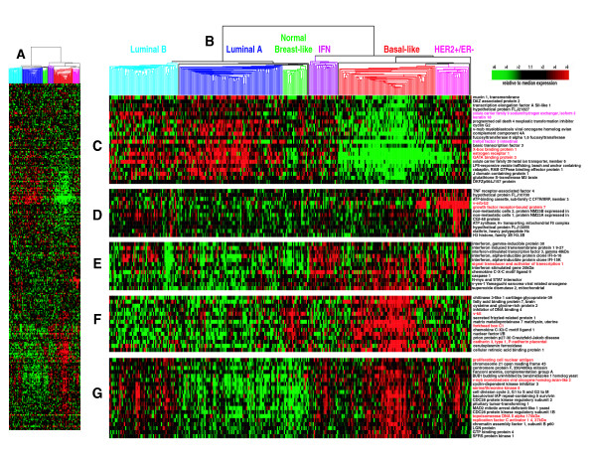
Gene expression profiling reveals multiple intrinsic groups of breast cancer
Hu et al., BMC Genomics. 2006; 7: 96

Slide 40
These have Different Prognoses
Hu et al., BMC Genomics. 2006; 7: 96

Slide 41
Genomics identifies up to 7 sub-subtypes within triple-negative breast cancer
Chen et al., Cancer Informatics 2012:11 147-156

Slide 42
FDA-approved genomic tests are now routine for breast cancer
Oncotype-DX examines the expression of 21 genes (including 5 controls) to determine the risk of recurrence in node-negative luminal breast cancer
September 2015: the TAILORx study proves that patients falling within the low recurrence score group do NOT need chemotherapy.

Slide 43
FDA-approved genomic tests are now routine for breast cancer
PAM50 examines the expression levels of 50 genes and determines the risk of recurrence even more accurately
It identifies intrinsic subgroups better than IHC and it computes a Risk of Recurrence (ROR) score
Clinical decisions (whether to use chemotherapy, how aggressively to use radiotherapy) are made on the basis of these tests TODAY

Slide 44
April-June 2016: The MINDACT Trial results unveiled at AACR and ASCO
Microarray In Node Negative Diseases may Avoid ChemoTherapy study started in 2007
Prospective design using the MammaPrint 70-gene test (plus the BluePrint 80-gene test)
These are still done by microarray, will switch to RNASeq
http://www.aacr.org/Newsroom/Pages/News-Release-Detail.aspx?ItemID=867#.V0LALo-cEcQ
MINDACT shows for the first time that gene expression profile is a better predictor of the need for chemotherapy than histology or clinical variables, in an ER subtype-independent manner

Slide 45
QUICK REMINDER ON CLINICAL TRIALS
The only scientific way to determine whether a treatment is safe and effective
Best possible attempt to quantify patient responses using statistics
Phase 1: to determine safety and tolerability, generally using dose escalation up to Maximum Tolerated Dose (MTD). NO intra-patient dose escalation. Pharmacokinetics typically studied
Phase 2: to begin determining effective dose ranges. Can compare two or more doses to each other and to standard of care
Phase 3: Statistically powered to determine efficacy. Use doses optimized in Phase 2

Slide 46
QUICK REMINDER ON CLINICAL TRIALS -2
Phase 3: classically 2-arm design, with efficacy endpoints (standard of care versus investigational drug, standard of care versus standard of care PLUS investigational drug). Placebo arms typically unethical in cancer trials (cannot deny standard of care). Traditionally, these were kept as simple as possible, to include as many patients as possible and complete the trial earlier. Typical results were often a statistically significant but clinically meaningless improvement, largely due to the fact that only a few patients responded well. WHY?
Phase 4: Post-marketing studies: investigate rare side effects not captured by Phase 3 studies under real-life conditions. Still very useful, but the goal is to PREDICT rare aderse effects

Slide 47
Clinical Trial Endpoints
Traditionally, efficacy endpoints in cancer clinical trials are defined radiologically, especially for solid tumors and lymphomas (leukemias can use molecular endpoints such as minimal residual disease)
RECIST (Response Evaluation Criteria in Solid Tumors) criteria measure the effect of experimental treatments of tumor volume
However, reductions in tumor volume do not always translate into clinical benefit
Prolonged survival
Improved quality of life

Slide 48
Clinical Trial Endpoints
Also, traditionally the efficacy of a new cancer treatment is evaluated in the context of monotherapy (single agent) or combination with standard of care (e.g., Herceptin plus chemotherapy)
Some of the new agents, especially the ones that target cancer stem cells, do not necessarily shrink tumors on their own: monotherapy is pointless
However, they can dramatically improve survival in combinations based on mechanism: need for RATIONAL COMBINATIONS

Slide 49
Clinical Trial Endpoints
There is a need for more valid endpoints
Overall survival
Progression or Recurrence-free survival
However, these endpoints may require very long trials (e.g., 10 years!)
Hence, the need to develop surrogate endpoints that predict survival based on the most modern molecular and cellular techniques
CTC
ctDNA
Circulating CSC (tumorspheres)

Slide 50
Genomics is changing cancer clinical trials
Traditional clinical trials stratify patients based on:
Anatomical location of tumors (e.g., pancreatic cancer)
A combination of anatomical and histological parameters (e.g., lung adenocarcinoma)
Anatomy, histology and clinical stage (e.g., metastatic lung squamous carcinoma)
Immunohistochemical biomarkers (e.g., metastatic, ER+ breast cancer)
However, these criteria do not capture molecular heterogeneity of cancers, nor do not take clonality into account
As a result, very large studies with broad inclusion criteria led to miniscule results

Slide 51
Genomics is changing cancer clinical trials -2
The ability to stratify patients based on genomics is changing how we design our cancer trials for the better, because new inclusion criteria are based on more accurate biology
However, this means that many hospitals need to collaborate to have a study where the many sub-subtypes of cancer are represented adequately and to preserve statistical power

Slide 52
“Basket” and “Umbrella” Trials
“Basket” trials stratify patients with COMMON MOLECULAR FEATURES, irrespective of anatomical location of their tumors (e.g., all tumors with CDK4 mutations or overexpression receive a CD4 inhibitor)
“Umbrella trials” look at patients with one particular anatomical tumor type (e.g., lung cancers) but adaptively assign them to different treatment arms depending on mutations (e.g., among lung cancer patients, the ones with ALK rearrangements get ALK inhibitors, the ones with EGFR mutations get an EGFR mutation, etc. etc.)

Slide 53
“Basket” and “Umbrella” Trials

Slide 54
Example 2
Umbrellas and Baskets to Fight Cancer

Slide 55
Non-Small Cell Lung Cancer (NSCLC)
The largest cause of cancer death in the industrialized world
Classified histologically. Each type includes multiple subtypes.
Adenocarcinoma
Squamous carcinoma
Adenosquamous carcinoma
Large cell carcinoma
Neuroendocrine tumors
Carcinomas with pleomorphic, sarcomatoid or sarcomatous elements

Slide 56
Non-Small Cell Lung Cancer (NSCLC)
However, until recently, non-surgical treatment was limited to radiotherapy and chemotherapy (platinum agents, taxanes, topoisomerase inhibitors, gemcitabine, pemetrexed), with marginal benefit
Two major translational developments are changing this:
Mutation-driven therapy
Immunotherapy

Slide 57
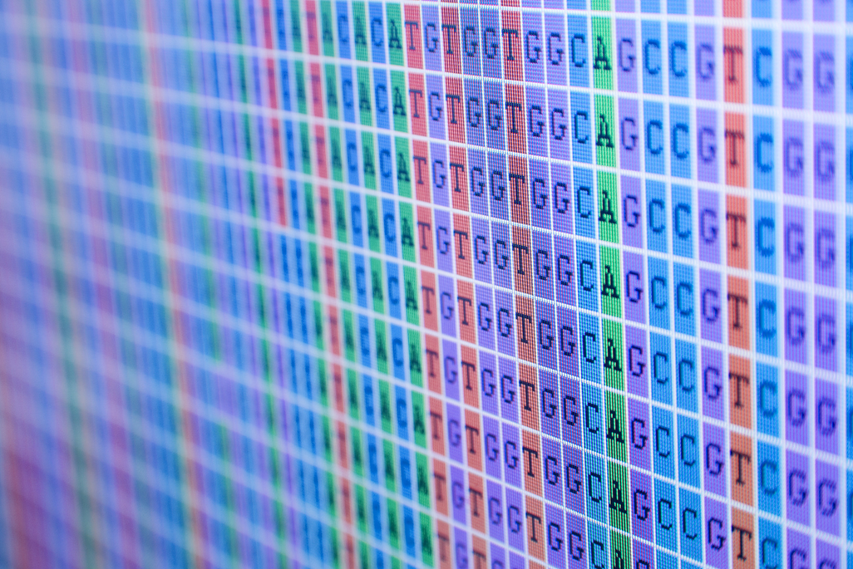
Mutation-driven therapy
An offshoot of the Human Genome project
In oncology, it identifies specific mutations in potential drug targets
In lung cancer, at least 2 such targets are used routinely, and others are under study
Mutations in EGFR, the receptor for Epidermal Growth Factor
More common in women and never smokers
ALK rearrangements, which juxtapose the 5’ of the EML4 gene with the 3’ of ALK (Anaplastic Lymphoma Kinase) creating a fusion oncogene
5-6.7% of NSCLC patients

Slide 58
Targeted drugs
EGFR mutations
Erlotinib
Afatinib
These drugs inhibit EGFR kinase activity and can be used as FIRST LINE agents in patients carrying EGFR mutations and SECOND LINE after chemo
Some EGFR mutations confer resistance
ALK rearrangements
Crizotinib
Ceritinib
These drugs inhibit the chimeric EML4-ALK kinase and can be used as FIRST LINE in patients carrying ALK rearrangements

Slide 59
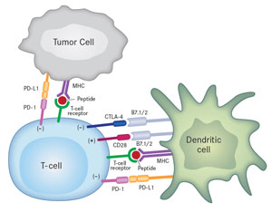
Cancer Immunotherapy
After decades of pre-clinical successes followed by clinical failures, we have learned enough basic immunology to produce clinically active products
Recombinant Monoclonal Antibodies (mAbs) that block “immune checkpoint” molecules (receptors and ligands that limit T-cell proliferation and activation)
Nivolumab (anti PD-1)
Ipilimumab (anti CTLA-4)
Tremelimumab (anti CTLA-4)
Aterolizumab (Anti-PDL1) and others
Nivolumab has produced durable clinical responses in squamous NSCLC that were previously resistant to all other therapies
Just approved by FDA

Slide 60
The MAP: Umbrella trial for NSCLC

Slide 61
Lung-MAP study schema: An UMBRELLA Trial
Roy S. Herbst et al. Clin Cancer Res 2015;21:1514-1524
©2015 by American Association for Cancer Research
Notes:
Lung-MAP study schema. Fresh tumor biopsy or archival FFPE tumor from eligible patients with stage IIIB or IV lung SCC whose disease has progressed on first-line therapy is evaluated using NGS (FoundationOne) and, in some cases molecular assays (e.g., IHC-based), carried out in a CLIA-certified laboratory for the presence of drug-specific biomarkers relevant to lung SCC that may serve as targets for drugs currently under study in Lung-MAP. Results are returned within 10–14 days of tissue submission. Patients are then assigned to substudies based on their biomarkers or to a nonmatch therapy substudy; within the substudies the patients are randomized to biomarker-driven targeted or standard-of care (SOC) therapy. Patients with more than one relevant biomarker are assigned to substudies based on an algorithm designed to best balance accrual among the substudies. Accrual and treatment in phase II continues within each substudy until a sufficient number of progression events have been observed to estimate whether or not a drug will likely be successful in the phase III component. Drugs meeting PFS criteria will continue on in phase III until a sufficient number of progression events has occurred to determine whether or not the targeted drug regimen shows statistically and clinically significant improvement in PFS over SOC. Patients will be followed for up to three years to determine effects on OS.

Slide 62
Schema for Lung-MAP substudies, June 2014. *, Archival FFPE tumor, fresh core needle biopsy (CNB) if needed; TT, targeted therapy; CT, chemotherapy (docetaxel or gemcitabine); TKI, tyrosine kinase inhibitor (erlotinib).
Roy S. Herbst et al. Clin Cancer Res 2015;21:1514-1524
©2015 by American Association for Cancer Research
Notes:
Schema for Lung-MAP substudies, June 2014. *, Archival FFPE tumor, fresh core needle biopsy (CNB) if needed; TT, targeted therapy; CT, chemotherapy (docetaxel or gemcitabine); TKI, tyrosine kinase inhibitor (erlotinib). See Table 2 for description of initial substudies in Lung-MAP.

Slide 63
Drugs Tested in Lung MAP Arms
Mutation | Drug
PIK3CA (PI3 Kinase alpha) | Taselisib (PI3K inhibitor)
CDK4/6, CCND1, 2, 3 or CDK4 amplification | Palbociclib (CD4/6 inhibitor)
FGFR amplification, mutation or fusion | AZD4547 (FGFR inhibitor)
MET mutation or expression | AMG102 (HGF mAb) or other MET inhibitor
No match | MEDI4736: immunotherapy with anti-PDL1 mAb

Slide 64
The NCI MATCH trial, a BASKET trial
Molecular Analysis for Therapy Choice
Advanced solid tumors and lymphomas
24 arms!
5000 patients, 143 genes, 4000 variants included so far
Arms can be dropped and replaced adaptively
Overall Response Rate (ORR, radiologic) and PFS (Progression-Free Survival) endpoints (16% minimum)
Patients with MMR (Mismatch Repair) deficits assigned to nivolumab (more intrinsic mutations, more neoantigens)

Slide 65
Example 3
Targeting CSC Pathways

Slide 66
CSC Pathways
Notch, Hedgehog, Wnt, TGF-β, EMT transcription factors such as Twist, SOX2 etc.
These are embryonic development and stem cell fate determination pathways highjacked by cancer stem cells
Often, CSC respond to chemotherapy by activating one or more of these pathways
They work together and cross-talk with many survival and differentiation pathways

Slide 67
CSC Pathways
Typically, targeting these pathways does not result in massive tumor death
However, it can eradicate CSC by eliminating their survival support WHEN USED IN RATIONAL COMBINATIONS WITH OTHER DRUGS
Gene expression profiling of tumors and CSC can guide treatment

Slide 68
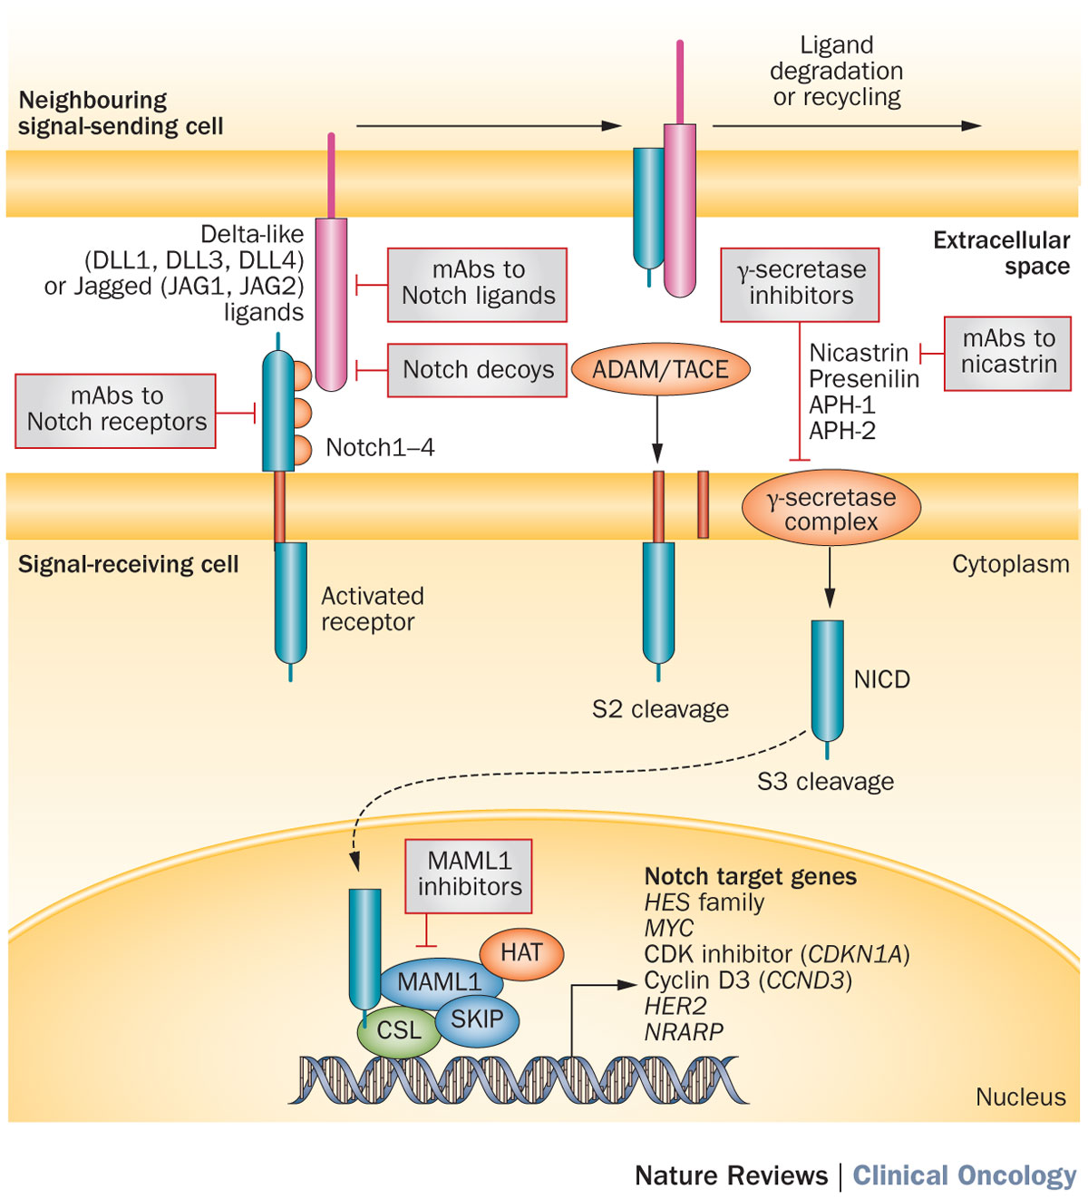
Figure 1 The canonical Notch signalling pathway and relevant pharmacological inhibitors under development in cancer
Takebe, N. et al. (2015) Targeting Notch, Hedgehog, and Wnt pathways in cancer stem cells: clinical update
Nat. Rev. Clin. Oncol. doi:10.1038/nrclinonc.2015.61

Slide 69
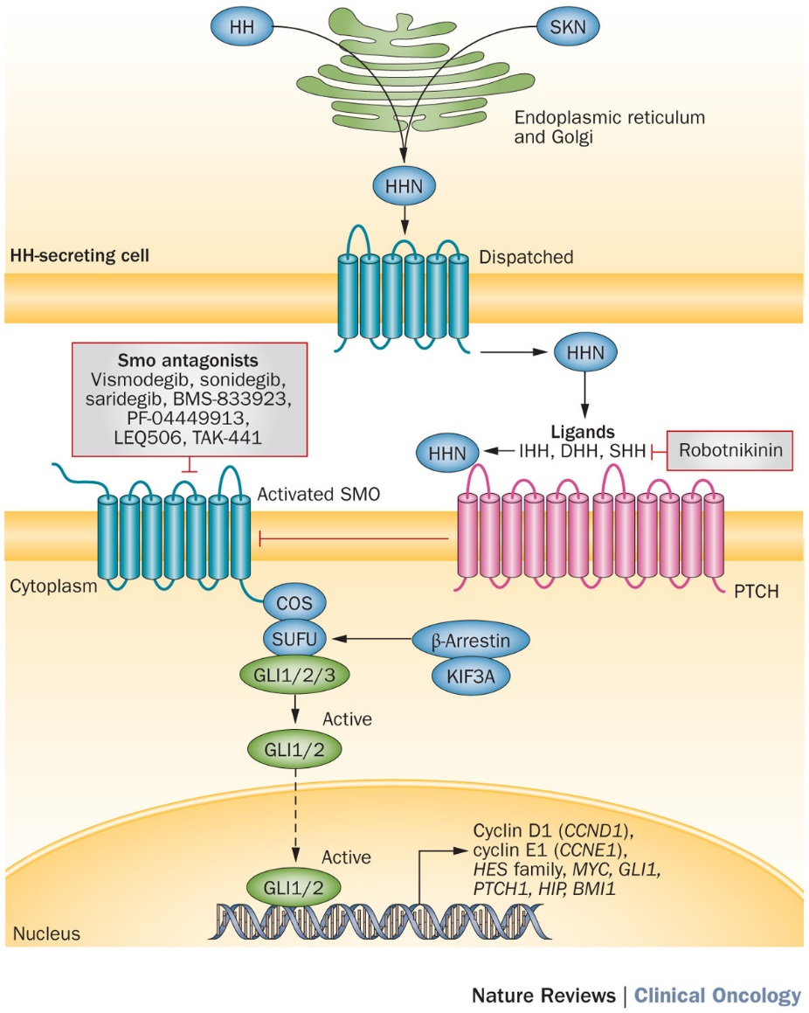
Figure 2 The canonical HH-signalling pathway and pharmacological inhibitors targeting this pathway that are under ongoing development as anticancer therapies
Takebe, N. et al. (2015) Targeting Notch, Hedgehog, and Wnt pathways in cancer stem cells: clinical update
Nat. Rev. Clin. Oncol. doi:10.1038/nrclinonc.2015.61

Slide 70
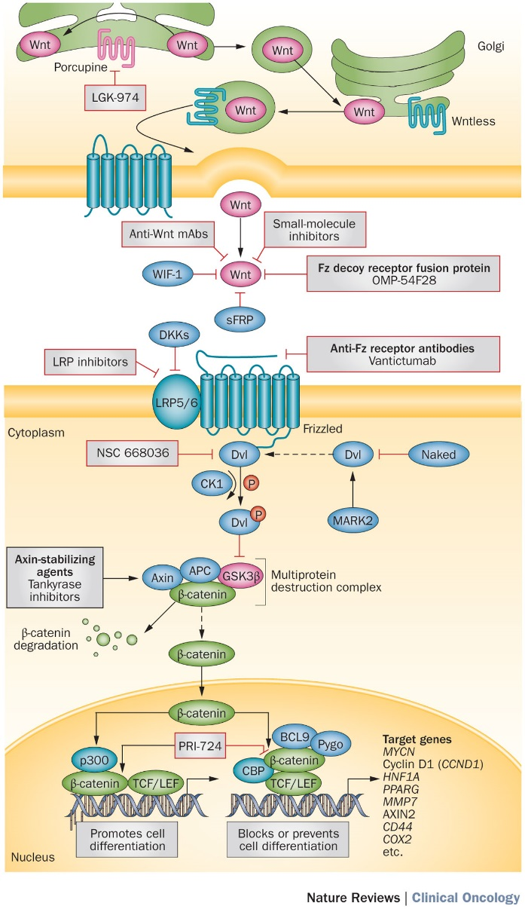
Figure 3 The canonical Wnt signalling pathway and pharmacological inhibitors under investigation in cancer
Takebe, N. et al. (2015) Targeting Notch, Hedgehog, and Wnt pathways in cancer stem cells: clinical update
Nat. Rev. Clin. Oncol. doi:10.1038/nrclinonc.2015.61

Slide 71
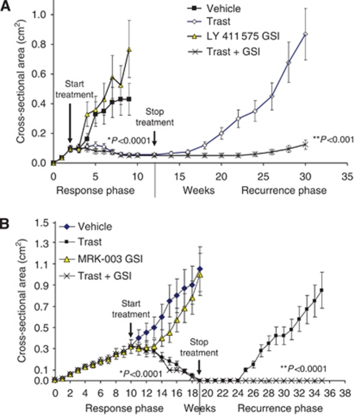
Herceptin plus Notch inhibitors in mice
Pandya et al., Br. J. Cancer 2011, 105:796-806

Slide 72
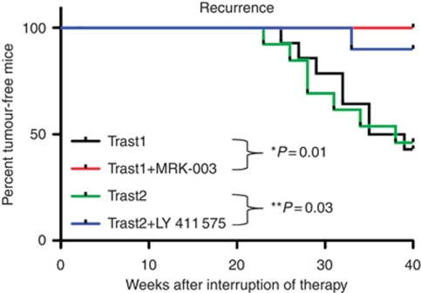
Herceptin plus Notch inhibitors in mice
Pandya et al., Br. J. Cancer 2011, 105:796-806

Slide 73
A phase Ib trial of R04929097 GSI with exemestane in ERα-positive metastatic breast cancer
DIAGNOSTIC
BIOPSY
BIOPSY 2
(if possible)
EXEMESTANE plus GSI
PFS, SAFETY
ARRAY
Q-RTPCR
IHC
ARRAY
Q-RTPCR
IHC
CANDIDATE
BIOMARKERS

Slide 74
ACCRUAL, SAFETY, BIOMARKERS
15 patients were accrued
Toxicity was minimal:
1 DLT (rash)
Non-DLT included :
1 hyperglycemia,
1 hypophosphatemia,
1 fatigue.
Notch1 and Notch4 expression, PKCalpha expression (protein and mRNA) were evaluated in 10/15 participants from whom sufficient tissue was available
PKCalpha and Notch4 correlated strongly with each other (both are correlated with endocrine resistance)

Slide 75
EARLY EFFICACY SIGNAL
Complete Response (CR) = 0
Partial Response (PR) = 1
Stable Disease (SD) = 7
Progression of Disease (PD) = 6
Non-evaluable (N/E) = 1
Clinical Benefit Rate (CR+PR+SD ≥ 6 months) = 20%
Progression Free Survival (PFS) = 3.2 mo
Estimated Overall Survival (OS) at 6 months = 79% (60-100%)
LIMITATIONS: small sample size, dose not optimized, lack of post-treatment tissue for PD biomarker evaluation

Slide 76
Figure 1
Joining forces: Genomics and
Immunotherapy
Genomically targeted agents can release relevant neoantigens
ctDNA sequencing can reveal neoantigen genes
Immunotherapy can exploit the neoantigen, delivering the coup de grace
Cell 2015 161, 205-214DOI: (10.1016/j.cell.2015.03.030)
Copyright © 2015 Elsevier Inc. Terms and Conditions
Notes:
Combination Therapy May Improve Anti-tumor Responses
Depiction of tumor cells dying as a result of genomically targeted therapies with release of tumor antigens; tumor antigens are taken up by APCs and are presented in the context of B7 costimulatory molecules to T cells; T cells recognize antigens on APCs to become activated; activated T cells also upregulate inhibitory checkpoints such as CTLA-4 and PD-1; immune checkpoint therapy prevents attenuation of T cell responses, thereby allowing T cells to kill tumor cells; and T cells may differentiate into memory T cells that can reactivate in the presence of recurrent tumor.

Slide 77
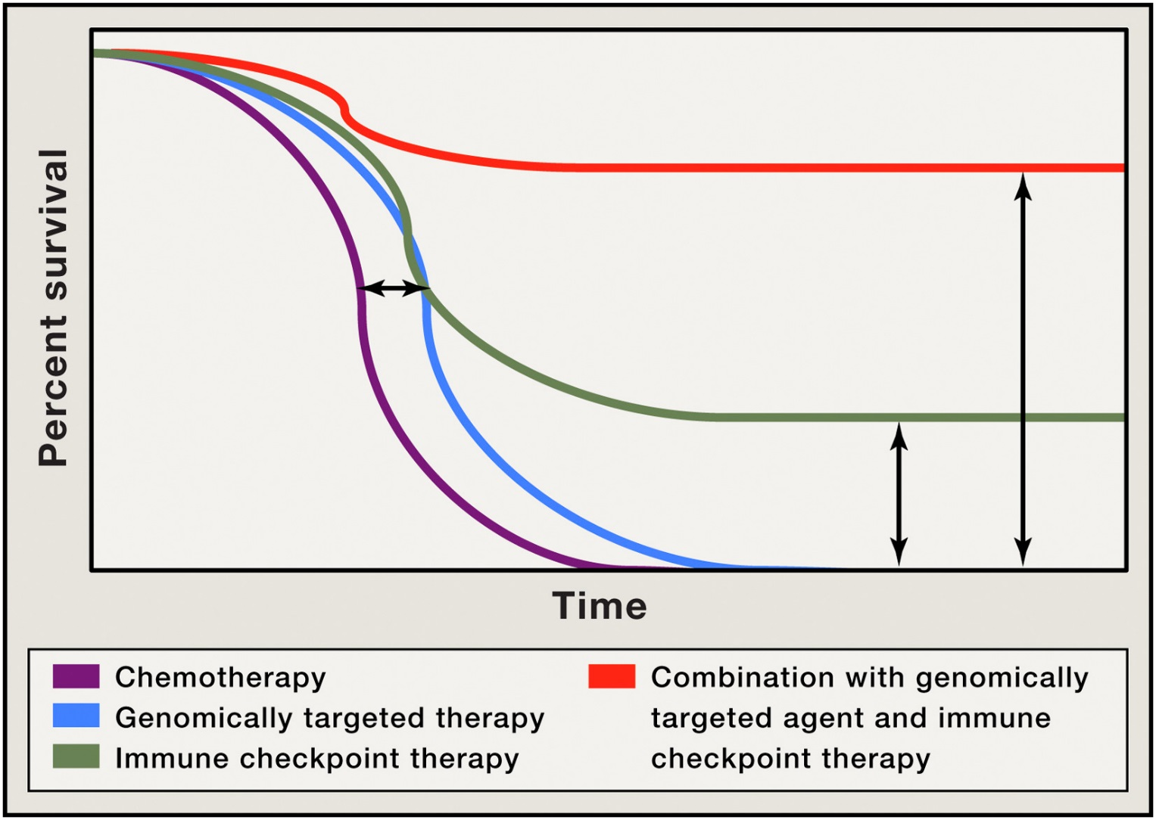
Rational, Adaptive Combinations are more likely to deliver curative results
Figure 2
Cell 2015 161, 205-214DOI: (10.1016/j.cell.2015.03.030)
Copyright © 2015 Elsevier Inc. Terms and Conditions
Notes:
Improved Overall Survival as a Result of Combination Therapy
Depiction of Kaplan-Meier survival curve with genomically targeted agents (blue line) as compared to standard therapies (purple line), indicating an improvement in median overall survival but lack of durable responses; improved median overall survival and durable responses in a fraction of patients treated with immune checkpoint therapy (green line); possibility for improved median overall survival with durable responses for the majority of patients in the setting of combination treatment with genomically targeted agents and immune checkpoint therapy (red line).

Slide 78
CONCLUSIONS
Genomics and Bio-informatics are the driving forces of a revolution in diagnostic and prognostic testing
This revolution is still in its infancy
Translating genomic discoveries into clinical tools requires a comprehensive process of hypothesis generation and hypothesis validation (e.g., TAILORx, MINDACT)
There is a need for flexible regulation that establishes scientific standards to determine which tests are clinically useful, based on evidence

Slide 79
CONCLUSIONS
We need to continue gathering information with the “21st century microscope” of “omics” in order to develop a new generation of diagnostic and prognostic tests that will enable precision medicine, i.e., an individualized approach to medicine that considers biological variation among individuals in designing treatment strategies
It’s still early, but we are seeing the “beginning of the end” for cancer. How quickly we get there will depend on resources devoted to research

