Slide 1

The Basics of Cancer Biology
Lucio Miele, M.D., Ph.D.

Slide 2
Part III: “The Godfather and the Untouchables”
How cancer cells avoid and corrupt the police – and what to do about it

Slide 3
A Primer on Cancer Immunology
http://bcove.me/1xr0xjty
http://www.nature.com/nrd/collections/cancerimmuno/index.html

Slide 4
A Primer on Cancer Immunology
Cancer immunology is beginning to show clinical results after 30 years of promising basic research without successful clinical translation
This is a perfect example for the need to understand biology well enough before designing treatments
This is also an example of the limitations of animal models: unlike laboratory mice, humans are genetically outbred, and their tumors grow over long periods of time. They have much longer to adapt to evade the immune system. Hence, immunotherapy is much easier to implement in mice

Slide 5
A Primer on Cancer Immunology -2
In general, the immune response to cancer cells utilizes
  Innate immunity (independent on the presence of neoantigens)
  Adaptive immunity (dependent on the presence of neoantigens)
    Cell-mediated immunity (most effective)
    Antibody response (not as effective except under special circumstances)

Slide 6
A Primer on Cancer Immunology -3
In reality, the various component of the immune response cross-talk with each other, with tumor cells and with other stromal cells (fibroblasts, endothelial cells, mast cells, eosinophils) that can be found in tumor stromas
This intricate intercellular cross-talk determines whether or not anti-tumor immunity is effective

Slide 7
A Primer on Cancer Immunology -4
The notion of cancer immunology originated after the first experiences with organ transplantation
It became quickly apparent that an unrestrained immune response against non-self cells could completely destroy an organ (acute rejection). In fact, no transplant would be effective without immune suppressive therapy
Hence, the idea that IF we could trigger a “rejection” of tumor cells, the body’s own immune system could eradicate tumors.
Sounds simple, but…as we have learned….
The Devil is in the Details

Slide 8
A Primer on Cancer Immunology -5
Despite spectacular successes in mouse tumor models, clinically effective immunotherapy was not available until very recently. It turns out that…
Tumors can evade immune destruction and even reprogram the body’s hematopoietic system
Not all forms of immune response harm tumors. Some forms of immune response actually protect and promote tumors, by turning into a chronic inflammatory process that induces angiogenesis and dampens T-cell mediated cytotoxic responses
The immune system has VERY effective safeguards against unintended self-damage, and a normal immune response is self-limited

Slide 9
A Primer on Cancer Immunology -6
For decades, two results were most commonly obtained in clinical cancer immunotherapy
  A measurable immune response was triggered, but no effect on tumor growth or patient survival was observed
  Rare patients experienced spectacular responses, especially in melanoma, but these were not reproducible, and it was unclear what distinguished “exceptional responders” from all other patients
So, what initially appeared to be an easy winner (just vaccinate patients against tumors and wait for the immune system to eliminate it) is actually very difficult to accomplish in practice
This underscores the importance of deeper understanding of the underlying biology before expecting clinical success

Slide 10
The Cast of Characters (simplified): The Untouchables: Uncorrupted, Sworn Enemies of Cancer
Innate immunity: iLCs (innate lymphoid cells)
  NK cells (kill non-self cells that fail to activate KIR, (Killer Inhibitory Receptors), produce cytokines that attract T-cells)
  NK-T cells (do the same but express T-cell markers)
Adaptive immunity: T-cells, APCs
  CD4 T-cells of the Th1 variety (produce cytokines that promote a CD8 cytolytic response, such as gamma interferon)
  CD8 T-cells, particularly cytotoxic T-cells (activated by Th1 cytokines, kill tumors cells expressing neoantigens in the context of MHC-I receptors)
  Antigen-presenting cells (APCs): Dendritic cells (several varieties of them). Activated by Th1 cytokines, present antigen and in turn activate Th1 CD4 T-cells and CD8 cells
  Other APCs: Macrophages (“type I”), B-cells

Slide 11
The cast of characters (simplified): Corrupt Police, Cancer accomplices
Adaptive immunity
  CD4 T-cells of the Treg variety (FOXP3 positive, produce cytokines that suppress CD8 and CD4 Th1 cells)
  CD4 T-cells of the Th2 variety (produce cytokines that stimulate B-cells and drive an antibody response rather than a cytotoxic response)
  CD4 T-cells of the Th17 variety (produce IL-17 and are stimulated by IL-23). These cells drive chronic inflammation which actually PROMOTES tumor growth. Several mouse tumor models cannot form in IL-23 or IL-17 KO mice
  Eosinophils, neutrophils, basophils (promote chronic inflammation)

Slide 12
The cast of characters (simplified): Corrupt Police, Cancer accomplices - 2
Adaptive AND innate immunity
  Aberrantly matured myeloid cells: MDSC (myeloid-derived suppressor cells). These cells are produced by the bone marrow in large numbers and arrest at the promyelocyte stage of maturation. They migrate into tumor stromas and actively suppress anti-tumor responses. They also stimulate Tregs
  Tumor-associated macrophages (TAMs), type II. These cells promote chronic inflammation, suppress cytotoxic responses
  CAF (Cancer Associated Fibroblasts). These cells produce cytokines that promote angiogenesis, attract MDSC, suppress cytotoxic CD8 T-cell responses

Slide 13
The Godfather: How Cancer Cells Avoid or Corrupt the Police
Cancers avoid immune destruction by several mechanisms
  Downregulation of MHC, so antigen presentation is reduced
  Production of chemokines, cytokines (VEGF) and metabolic mediators (adenosine, kynurenine) that attract MDSC or inhibit T cells
  Stimulation of Tregs
  Stimulation of CAFs
In general, cancers act both systemically and locally to promote chronic inflammation, Th17 and Th2 responses and inhibit Th1 responses. The tissue hypoxia that accompanies chronic inflammation also promotes CSCs!
Systemic conditions that promote chronic inflammation (e.g., obesity) favor immune avoidance by cancers

Slide 14
The Godfather: How Cancer Cells Avoid or Corrupt the Police - 2
Weak antigens tend to induce tolerance rather than a destructive immune response
Anergy can be induced in T-cells when an antigen is presented to them in the absence of co-stimulatory signals or in the presence of checkpoint-inhibitory signals
Metabolites present in the tumor microenvironment (e.g., adenosine, tryptophan catabolites) and/or the absence of nutrients necessary to T-cell proliferation (arginine, tryptophan, glutamine) can lead to anergy)
A dense extracellular matrix can hinder penetration of immune cells in tumor stroma

Slide 15
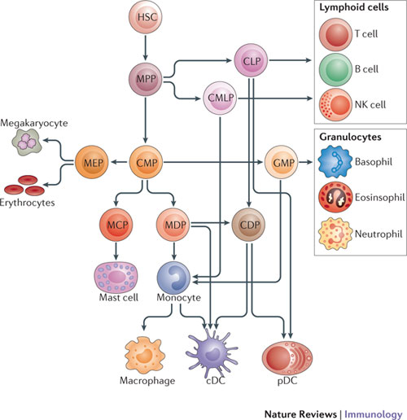
Reminder: Hematopoiesis
Gabrilovich et al. Nature Immunology (2012)

Slide 16
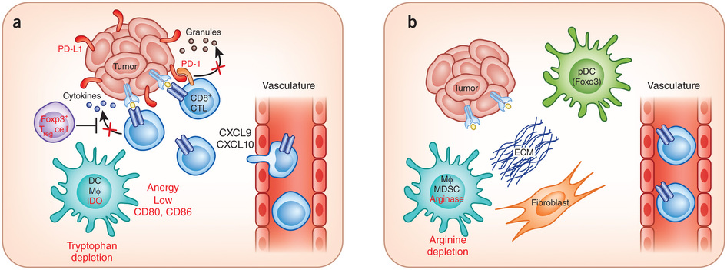
Immune Escape Mechanisms
Figure 1
Gajewski et al. Nature Immunology 14, 1014–1022 (2013)
Notes:
Complex Interactions between the CTLA-4/CD28 and PD-1 Families of Receptors and Ligands
Shown are the defined interactions between the co-inhibitory (checkpoint) receptors CTLA-4 and PD-1 and their ligands and related receptors. The two known ligands for CTLA-4 are CD80 (B7.1) and CD86 (B7.2). CD86 can “backward-signal” into APCs when engaged by CTLA-4, inducing the immune inhibitory enzyme IDO. CD80 and CD86 also bind the co-stimulatory receptor CD28 on T cells. Recently, another B7 family member, inducible costimulator ligand (ICOS-L), which was discovered as the ligand for the co-stimulatory receptor ICOS (not shown), has been reported to bind to CD28, leading to co-stimulation independent of CD80 or CD86. The two defined ligands for PD-1, PD-L1 (B7-H1) and PD-L2 (B7-DC), bind to additional molecules. PD-L1 binds CD80 molecules expressed on activated T cells, mediating inhibition. Additionally, PD-L1 on APCs appears to provide inhibitory signals (backward signaling) when it is engaged by PD-1. PD-L2 binds another molecule, RGMb, which is expressed on macrophages and some epithelial cell types and appears to deliver an inhibitory immune signal through an as yet undefined mechanism. Although not identified, genetic evidence from PD-1 knockout T cells and knockout mice suggests the existence of another receptor for PD-L2 that is co-stimulatory.

Slide 17
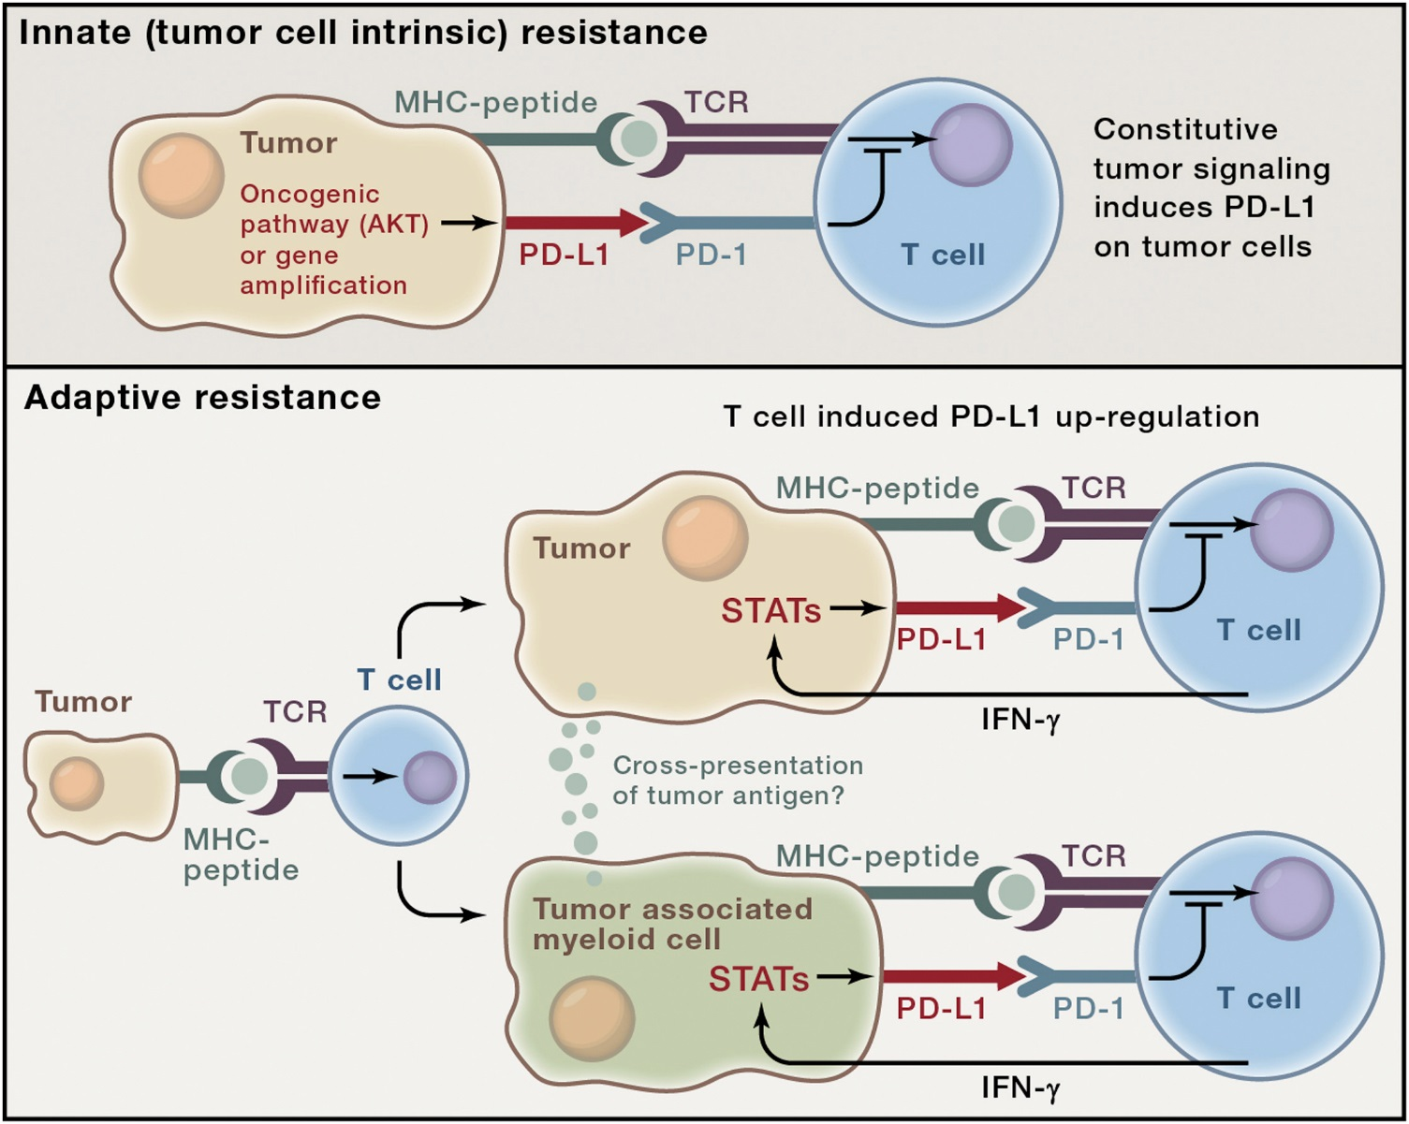

Figure 2
Immune Escape Mechanisms
Cancer Cell 2015 27, 450-461DOI: (10.1016/j.ccell.2015.03.001)
Copyright © 2015 Elsevier Inc. Terms and Conditions
Notes:
Two General Mechanisms for Expression of Checkpoint Ligands in the TME
The examples in this figure use the PD-1 ligand PD-L1 for illustrative purposes, although the concept likely applies to multiple checkpoint ligands. Top: innate immune resistance. In some tumors, constitutive oncogenic signaling, such as through activation of the AKT pathway or gene amplification, can upregulate PD-L1 expression on tumor cells independently of inflammatory signals in the TME. Bottom: adaptive immune resistance refers to PD-L1 induction in tumors as an adaptation to the sensing of an immune attack. In adaptive resistance, PD-L1 is not constitutively expressed but, rather, is induced by inflammatory signals, such as IFN-γ produced by T cells attempting to execute an active anti-tumor response. Expression of PD-L1 in a non-uniform distribution associated with lymphocyte infiltrates suggests adaptive induction in response to immune reactivity within the TME. Adaptive resistance can be generated by cytokine-induced PD-L1 expression on either tumor cells themselves or on leukocytes (macrophages, myeloid suppressor cells, dendritic cells, or even lymphocytes) in the TME. Inhibition of tumor-specific T cells by PD-L1- or PD-L2-expressing leukocytes may involve cross-presentation of tumor antigens so that PD-1-dependent inhibition is in cis. Adaptive resistance may be a common mechanism for the intratumoral expression of multiple immune checkpoint molecules.

Slide 18
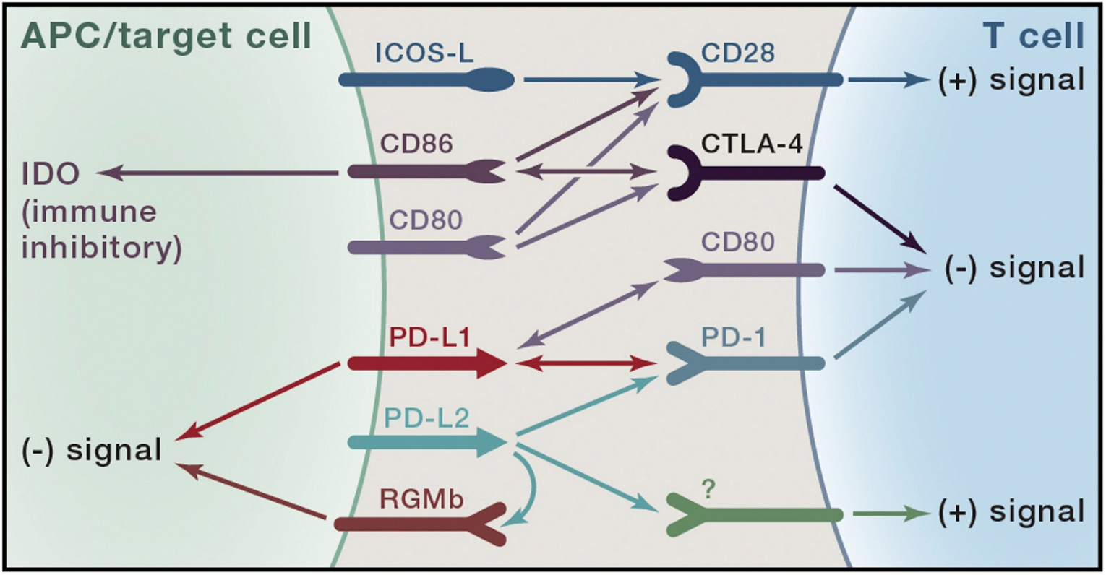
Figure 1
Immune Escape Mechanisms
Cancer Cell 2015 27, 450-461DOI: (10.1016/j.ccell.2015.03.001)
Copyright © 2015 Elsevier Inc. Terms and Conditions
Notes:
Complex Interactions between the CTLA-4/CD28 and PD-1 Families of Receptors and Ligands
Shown are the defined interactions between the co-inhibitory (checkpoint) receptors CTLA-4 and PD-1 and their ligands and related receptors. The two known ligands for CTLA-4 are CD80 (B7.1) and CD86 (B7.2). CD86 can “backward-signal” into APCs when engaged by CTLA-4, inducing the immune inhibitory enzyme IDO. CD80 and CD86 also bind the co-stimulatory receptor CD28 on T cells. Recently, another B7 family member, inducible costimulator ligand (ICOS-L), which was discovered as the ligand for the co-stimulatory receptor ICOS (not shown), has been reported to bind to CD28, leading to co-stimulation independent of CD80 or CD86. The two defined ligands for PD-1, PD-L1 (B7-H1) and PD-L2 (B7-DC), bind to additional molecules. PD-L1 binds CD80 molecules expressed on activated T cells, mediating inhibition. Additionally, PD-L1 on APCs appears to provide inhibitory signals (backward signaling) when it is engaged by PD-1. PD-L2 binds another molecule, RGMb, which is expressed on macrophages and some epithelial cell types and appears to deliver an inhibitory immune signal through an as yet undefined mechanism. Although not identified, genetic evidence from PD-1 knockout T cells and knockout mice suggests the existence of another receptor for PD-L2 that is co-stimulatory.

Slide 19
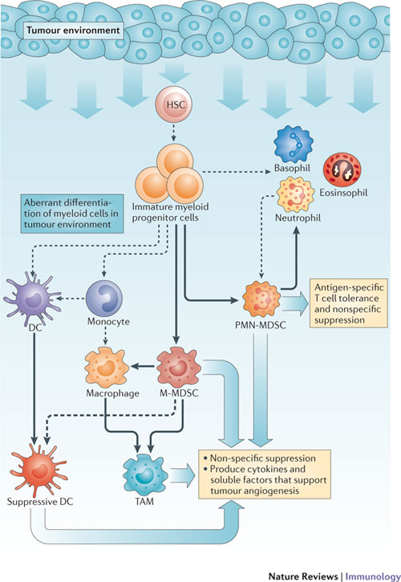
Aberrant differentiation of myeloid cells in tumor stroma

Slide 20
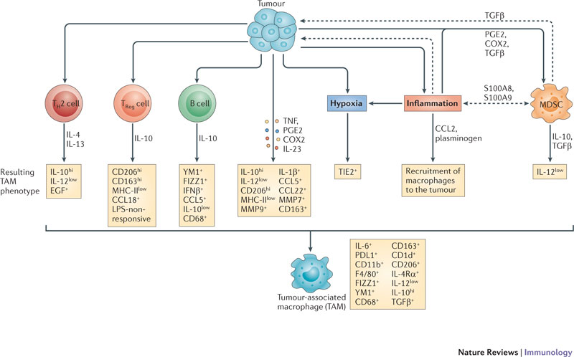
How cancers modulate macrophage phenotype to generate TAMs

Slide 21
Cancer immunotherapy is a growing field of clinical research
Strategy | Mechanism, Advantage | Disadvantage
High-dose IL-2 | Stimulates host immune responses | Low response rates Systemic toxicity
Interferon alpha | Stimulates host immune responses – long lasting | Low response rates Systemic toxicity
DC-based vaccines | Stimulate antigen-dependent immunity Low toxicity Outpatient administration | Difficult to standardize, requires extensive ex-vivo manipulations, hence low responses
Adoptive T-cell therapy (TIL or genetically engineered T-cells, CARs) | Does not require tolerance breaking High affinity Lymphodepletion conditioning increases efficacy | Expensive, extensive ex vivo manipulations of cells, requires time, risk of toxicity

Slide 22
Cancer immunotherapy is a growing field of clinical research -2
Strategy | Mechanism, Advantage | Disadvantage
CTLA-4 mAb | Stimulates pre-existing immune responses, may initiate new ones Has shown survival benefit in clinic Relatively easy to manufacture mAbs | Inconsistent response rates, significant toxicity in a large fraction of patients
PD1, PDL-1 mAb | Stimulates host immune responses – long lasting Has shown benefit in different cancer types, long lasting effects, less toxic than CTLA-4 mAb | Only a fraction of patients respond
Combination immunotherapy (immune checkpoint blockade plus other) | Possibility of increased efficacy | Possibility of increased toxicity

Slide 23
Cancer immunotherapy is a growing field of clinical research -3
Strategy | Mechanism, Advantage | Disadvantage
IDO inhibitors | Decrease immune suppression by tryptophan metabolites and lack of tryptophan | Most likely not sufficient as single agent
Adenosine receptor inhibitors | A2A receptors on T-cells A2B receptors on MDSC, other stromal cells Can decrease immune suppression | Still in early experimental stages
FAO inhibitors | Suppress fatty acid beta oxidation, required for MDSC action in stroma | Still in early experimental stages

Slide 24
Cancer immunotherapy is a growing field of clinical research -4
Strategy | Mechanism, Advantage | Disadvantage
KIR blocking mAb | Can enhance NK functions | Still in early experimental stages
Allogeneic NK cells | Can kill “non-self” tumor cells more effectively | Can cause GVHD, can kill host APCs too
Allogeneic, genetically engineered NK cells | Can include “suicide” gene for safety purposes, enhanced efficacy | Still in early experimental stages
Oncolytic Viruses | Can be genetically engineered in vitro, immunogenicity can be exploited. One product FDA-approved | Complex manufacturing, repeat administration can be a problem due to neutralizing Abs

Slide 25
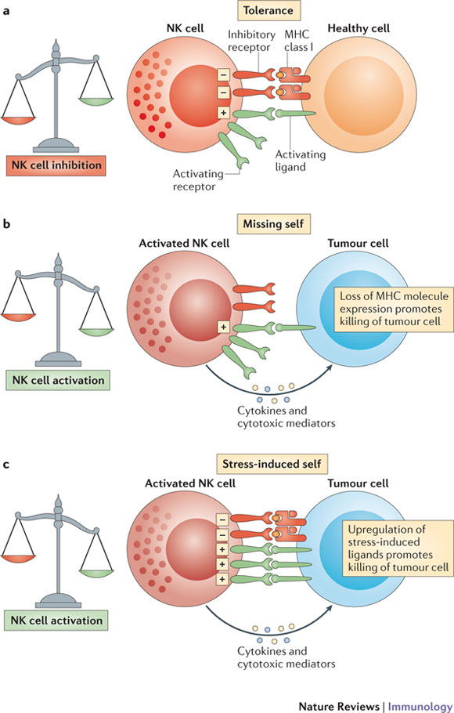
Exploiting iLCs for cancer therapy
Vivier al. Nature Immunology (2012)

Slide 26
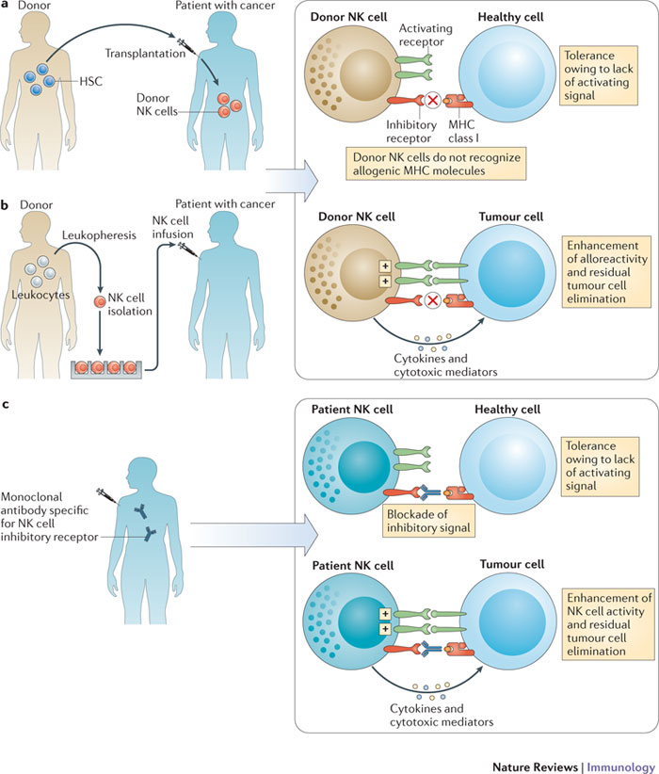
Vivier al. Nature Immunology (2012)

Slide 27
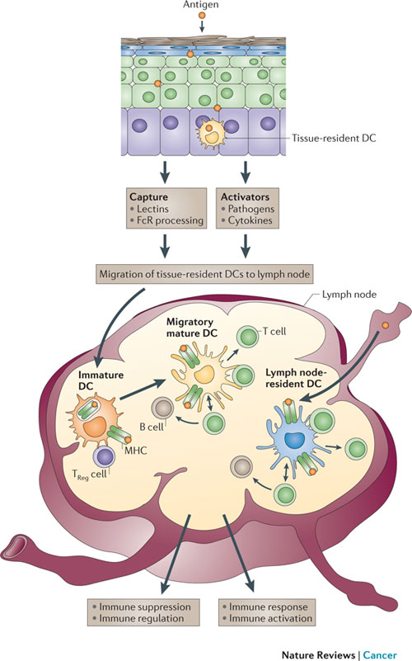
Palucka and Banchereau, Nature Reviews Cancer 12, 265-277 (April 2012)

Slide 28
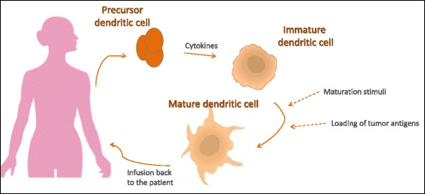
DC vaccines (e.g., Provenge)
Farkona et al. BMC Med. 2016; 14: 73.

Slide 29
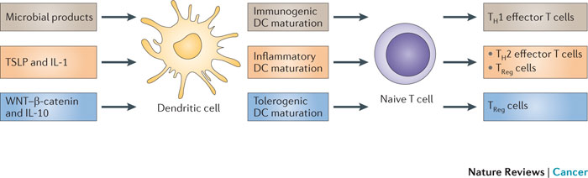
Palucka and Banchereau, Nature Reviews Cancer 12, 265-277 (April 2012)

Slide 30
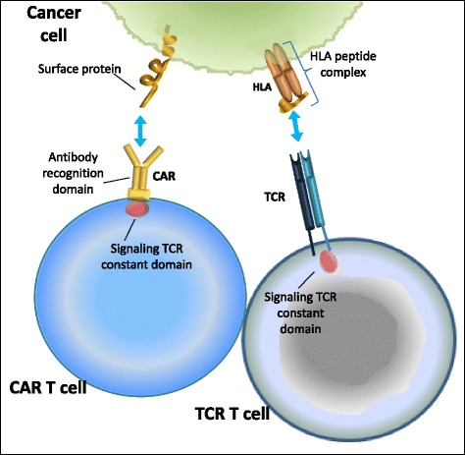
TIL and CAR-T (Chimeric Antigen Receptor) cells
Farkona et al. BMC Med. 2016; 14: 73.

Slide 31
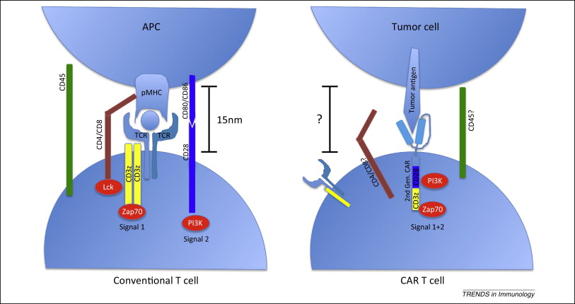
TIL and CAR-T (Chimeric Antigen Receptor) cells
Figure 1
Trends in Immunology 2015 36, 494-502DOI: (10.1016/j.it.2015.06.004)
Copyright © 2015 Elsevier Ltd Terms and Conditions
Notes:
Signaling of conventional and chimeric antigen receptor (CAR)-T cells. Left: Delivery of signals 1 and 2 to conventional T cells is initiated by the T cell receptor (TCR) interacting with foreign-peptide MHC (pMHC) on an antigen-presenting cell (APC). The spatial distance between the T cell and the APC is ∼15nm, which physically excludes from the synapse the inhibitory receptor CD45 because of its large ectodomain. Interaction of CD4/CD8 coreceptors with MHC recruits Lck to the TCR complex, where it phosphorylates and activates Zap70, which provides signal 1. Ligation of the costimulatory receptor CD28 by CD80/CD86 results in PI3K activation and delivers signal 2 for full T cell activation. Right: Single-receptor design showing a second-generation CAR containing CD3ζ and CD28 endodomains in cis. Activation of these CARs by a single tumor antigen is sufficient to deliver both signals 1 and 2 in cis, resulting in T cell activation. The spatial distance between CAR-T cells and target tumor cells is not known, nor is it known whether this distance is small enough to physically exclude the phosphatase CD45 from the synapse. It is also unknown whether CARs interact with endogenous TCR/CD3ζ or CD4/CD8 coreceptors.

Slide 32
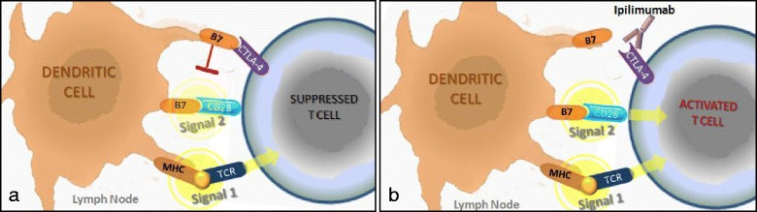
CTLA-4 mAb (ipilimumab, tremelimumab)
Farkona et al. BMC Med. 2016; 14: 73.

Slide 33
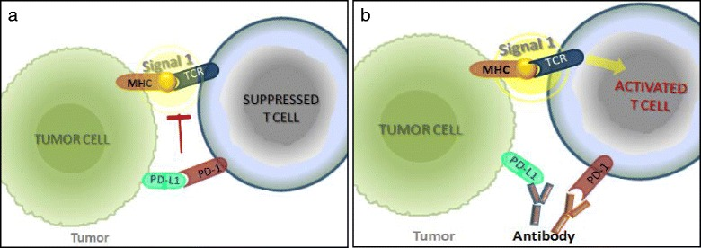
PD-1 or PDL-1 mAb (nivolumab, pembrolizumab aterolizumab)
Vivier al. Nature Immunology (2012)

Slide 34
Oncolytic Viruses
Viruses were originally proposed as vectors for gene therapy
  They are extremely good at transducing human cells
  They can deliver engineered genes
BUT, they are also highly immunogenic. The first attempts to use adenoviruses to correct genetic defects caused serious toxicity due to immune destruction of infected cells by CD8 T-cells (e.g., cystic fibrosis, OTC deficiency). Also, they induce the production of neutralizing antibodies, and thus repeated systemic administration is a problem
In the case of cancer, immunogenicity can be an advantage! If infected cells are destroyed by the immune system, this can potentiate the effects of immunotherapy
Thus, viruses are hot again, this time as cancer therapeutics

Slide 35
T-VEC
Oncolytic HSV-1 products had been in development for nearly 20 years (e.g., in GBM)
Advances in gene editing have made it possible to engineer viral genomes for better safety/efficacy ratios
T-VEC (“Talimogene Laherparevec”) is an engineered, attenuated strain of HSV-1 in which:
  Neurovirulence has been eliminated by deletion of the ICP34.5 genomic region. Hence, the virus replicates selectively in cells near the injection area
  The ICP34.5 gene is replaced with a GM-CSF minigene. Thus, infected cells produce GM-CSF, which stimulates the maturation of dendritic cells (and thus, tumor immunity)
  Antigen presentation and oncolysis are enhanced by deletion of the ICP47 region
  Like all human HSV, it is sensitive to ganciclovir (safety)
It is FDA- and EU-approved for the intralesional treatment of inoperable melanoma

Slide 36
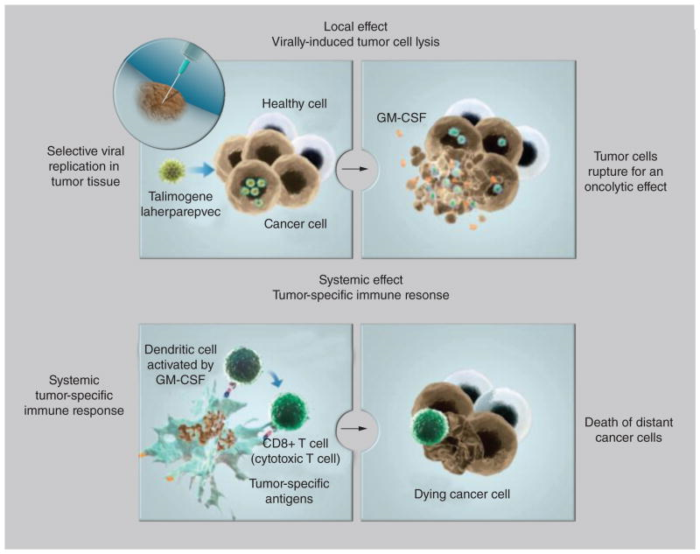
T-VEC, the first FDA-approved oncolytic virus
Johnson et al., Immunotherapy. 2015 Jul; 7(6): 611–619.

Slide 37
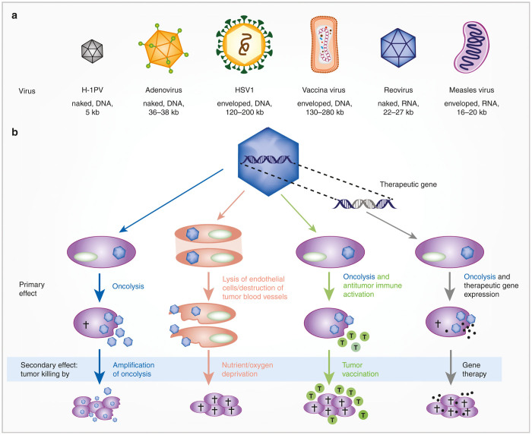
Oncolytic Viruses
Ungerechts et al., Mol Ther Methods Clin Dev. 2016; 3: 16018.

Slide 38
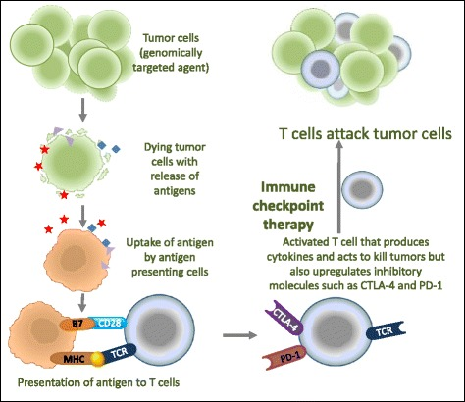
Combination Immunotherapy
Farkona et al. BMC Med. 2016; 14: 73.

Slide 39
How important is activation of the immune system in tumors?
Your life may depend on it!

Slide 40
The GeparSixto Clinical Trial
Triple-negative breast cancers (TNBC) were stratified by expression of transcripts indicative of immunological responses (or histologically, by enumeration of tumor-infiltrating T-cells)
Two different neo-adjuvant (pre-surgical) chemotherapy regimens were compared
The primary endpoint was Pathological Complete Remission (absence of tumor cells by histology) which predicts survival
Tumors with higher content of T-cells (or T-cell derived transcripts) responded much better in terms of pCR
These results suggest that the most important variable, at least in TNBC, is presence of absence of a tumor-associated immune response

Slide 41
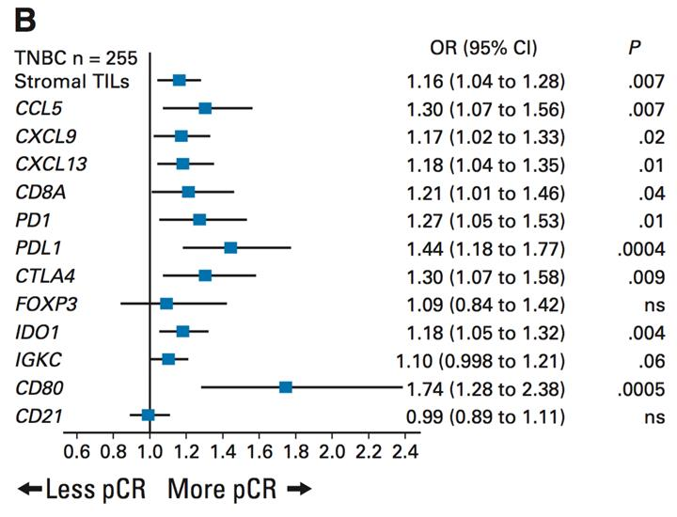
Tumor-infiltrating lymphocytes and response to neoadjuvant chemotherapy with or without carboplatin in triple-negative primary breast cancers.
(B) All mRNA markers, including immunosuppressive markers IDO1, PD-1, PD-L1, CTLA4, and FOXP3, were correlated positively to response to neoadjuvant therapy. For stromal TILs, odds ratio (OR) is shown per 10% change. For mRNA markers, OR is shown per one cycle threshold value, which approximately corresponds to doubling of mRNA levels. pCR, pathologic complete response.
Denkert C. et Al. J Clin Oncol. 2015 Mar 20;33(9):983-91

Slide 42
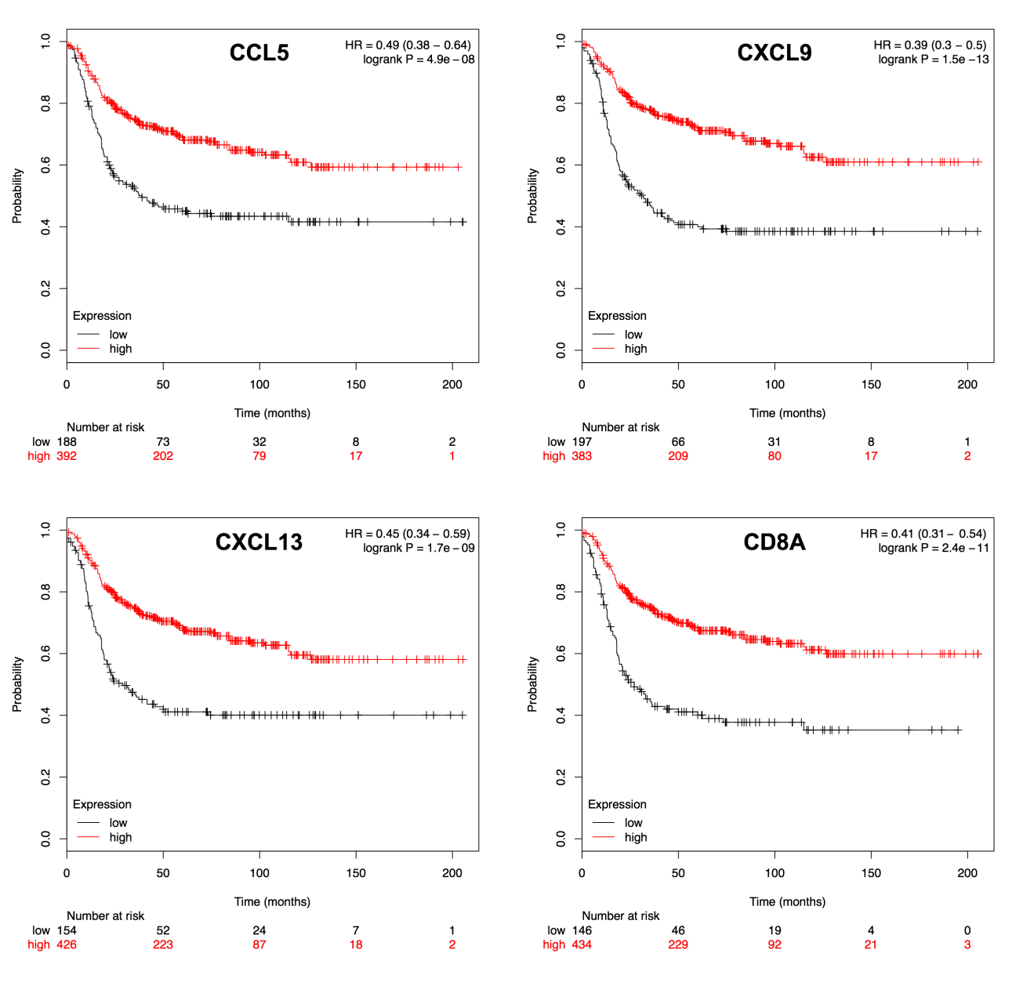
Correlation of several immuno-markers to outcome in basal-like TNBC
Relapse free survival (RFS) Kaplan Meier plots
Each transcript cutoff used to split patients was determined computing all percentiles between the lower and upper quartiles, and taking the best performing threshold
NOTE: The reported P values are uncorrected for multiple testing.

Slide 43
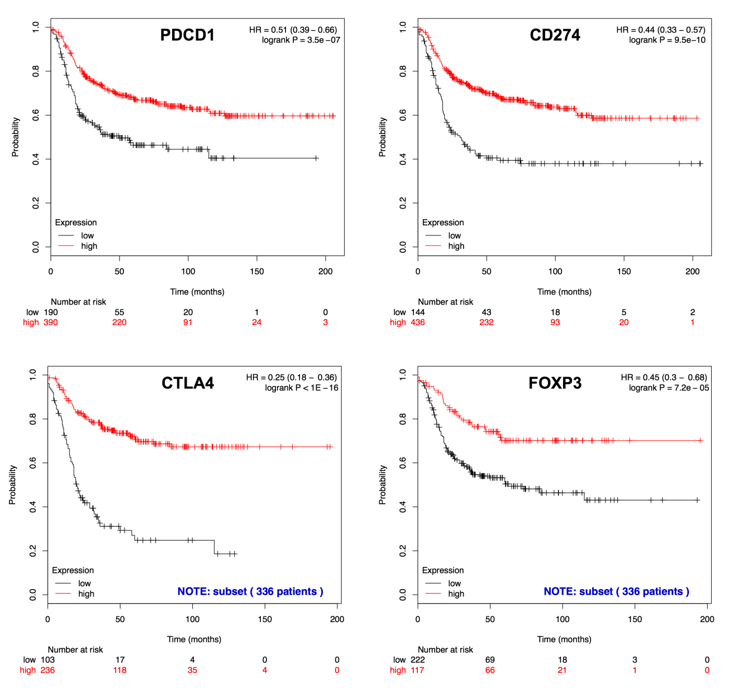
Correlation of several immuno-markers to outcome in basal-like TNBC
Relapse free survival (RFS) Kaplan Meier plots

Slide 44
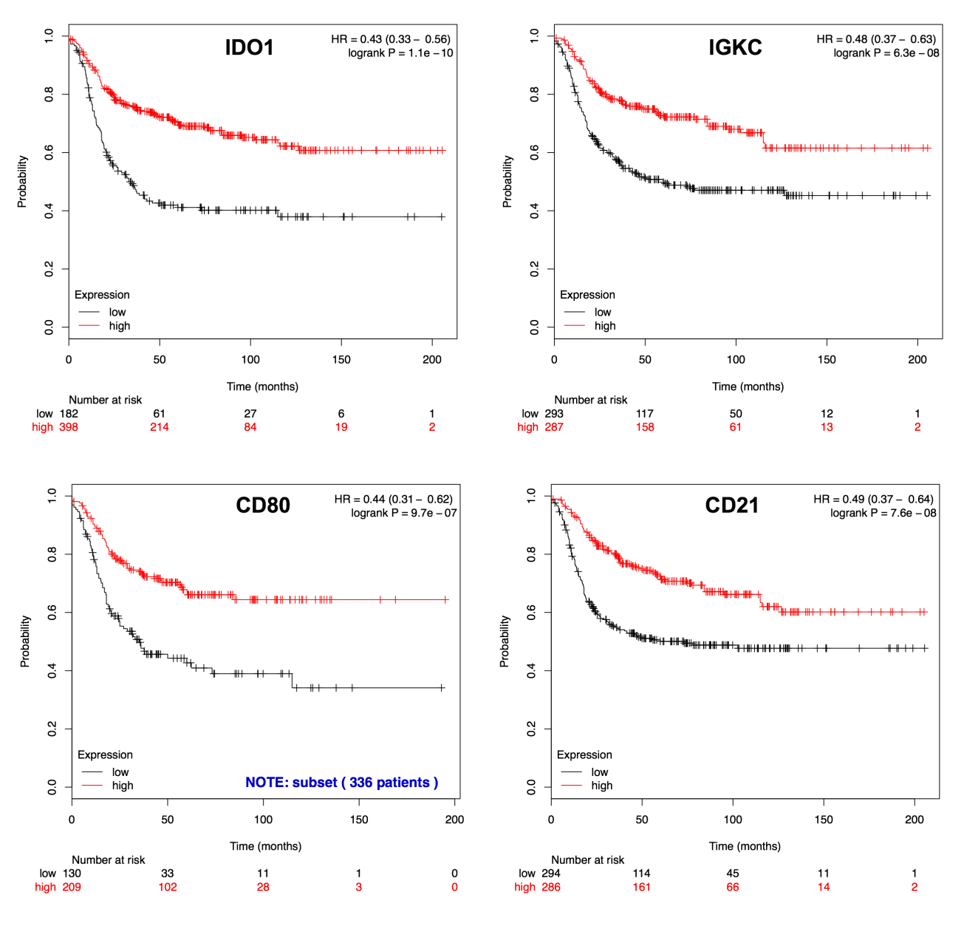
Correlation of several immuno-markers to outcome in basal-like TNBC
Relapse free survival (RFS) Kaplan Meier plots

Slide 45
Conclusions
Various forms of immunotherapy have been developed. Some (immune checkpoint inhibitors) are relatively easy to manufacture (mAbs) and have shown clinical efficacy in previously incurable diseases
The effectiveness of immune surveillance appears to be strongly correlated with tumor prognosis AND response to chemotherapy
Yet, tumors use multiple mechanisms to evade or reprogram the immune response, and countermeasures to these mechanisms are necessary to assure immunotherapy efficacy
Systemic toxicity from uncontrolled activation of an immune response is a risk
Immunological biomarkers are strongly associated with survival in some human tumors

