Slide 1

The Basics of Cancer Biology
Lucio Miele, M.D., Ph.D.

Slide 2
Part II: “Partners in Crime -2”
Tumor Suppressors, Oncogenes, Enablers and Turncoats

Slide 3
Oncogenes
Oncogenes are mutated forms of genes that cause normal cells to grow out of control, promoting neoplastic transformation.
They are generally gain-of-function mutations of certain normal genes called proto-oncogenes.
Proto-oncogenes are mostly genes that normally control cell division and differentiation, or promote survival (e.g., anti-apoptotic genes such as Bcl-2).
When a proto-oncogene mutates (changes) into an oncogene, it becomes permanently "turned on" or “constitutively activated” when it is not supposed to be.
When this occurs, the cell divides without control (not necessarily too rapidly). Uncontrolled proliferation makes it more likely that additional mutations will be acquired, leading to cancer.
More than 100 oncogenes are recognized such as Myc and Ras.

Slide 4
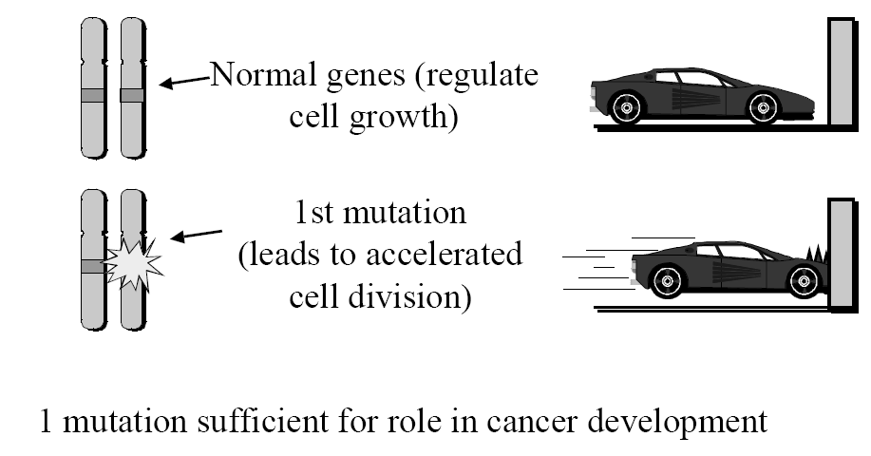
Oncogene
A proto-oncogene normally functions in a way that is much like a gas pedal.
It helps the cell grow and divide at a normal pace. An oncogene could be
compared with a gas pedal that is stuck down, which causes the cell to divide
out of control.

Slide 5
Examples
Ras (K, N, H-Ras)
  Active or mutant in many cancers (colorectal, NSCLC)
Myc (c-Myc, N-Myc)
  Overexpressed in colorectal and breast cancers, rearranged in lymphomas, amplified in breast cancers and neuroblastomas (N-Myc)
Met
  Hereditary renal cancer, others
Ret
  Multiple endocrine neoplasia type II

Slide 6
Examples
CDK4
  Mutant in familial melanoma, sporadic mutations in other tumors
BCR/ABL
  Chimeric gene produced by a t(9;22) translocation (the “Philadelphia Chromosome”). Cause of most Chronic Myelogenous Leukemias (CML)
BCL-2
  Overexpressed due to a t(14;18) translocation in follicular lymphoma

Slide 7
Oncogenes in various types of cancers
Oncogene | Related Cancers
Bcr-abl | Chronic myelogenous leukemia (CML)
Bcl-2 | B-cell lymphoma
HER2/neu (erbB-2) | Breast cancer, Ovarian cancer, others
N-myc | Neuroblastoma
EWS | Ewing tumor
C-myc | Burkitt lymphoma, others

Slide 8
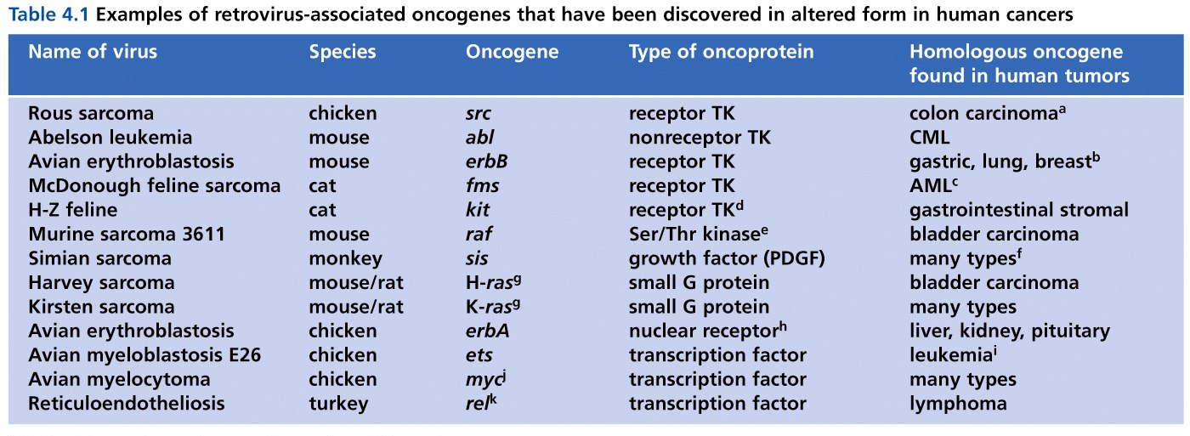
Oncogenes
History:
1960’s - it was discovered that some animal cancers were caused by viruses
1980s - The transforming nature of these viruses derived from the presence of a single gene
These “extra genes” were actually versions of normal cellular genes that had accidentally been incorporated into the viral particles and the viral genome.
These viral copies of normal cellular genes were then activated as a result of being present in the viral genome resulting in the transformation of the cell.

Slide 9
Oncogenes
Researchers were excited thinking they have found the “magic bullet” for a cancer cure.
However, it was found that very few human cancers derive from viral infection (cervical and head and neck squamous carcinomas from HPV and hepatocellular carcinomas from hepatitis viruses HCV and HBV are a few of the best known)
Instead, the discovery that these viral oncogenes had normal cellular counterparts led to the understanding that normal cellular genes can be “activated” to become transforming through the acquisition of mutations.

Slide 10
Activation of Oncogenes
Proto-oncogene - the non-mutant version of a gene (the wild type gene)
Mutations in the these genes convert a proto-oncogene to an oncogene – these mutations are dominant.
Simply put - a gain of function mutation of a normal (wild-type) gene (i.e., the proto-oncogene) creates an oncogene that evades, disrupts, or alters the normal regulatory functions of the cell

Slide 11
Activation of Oncogenes
These mutations consist in the following:
  Acquisition of a point mutation that results in a “constitutively active” form of the protein.
  Increase in the number of the copies of the gene present (amplification).
  Increase in the amount of protein that is present (activation by insertion into a transcriptionally active region of the genome or a highly active promoter).
  A translocation that creates a fusion protein between two unrelated proteins.

Slide 12
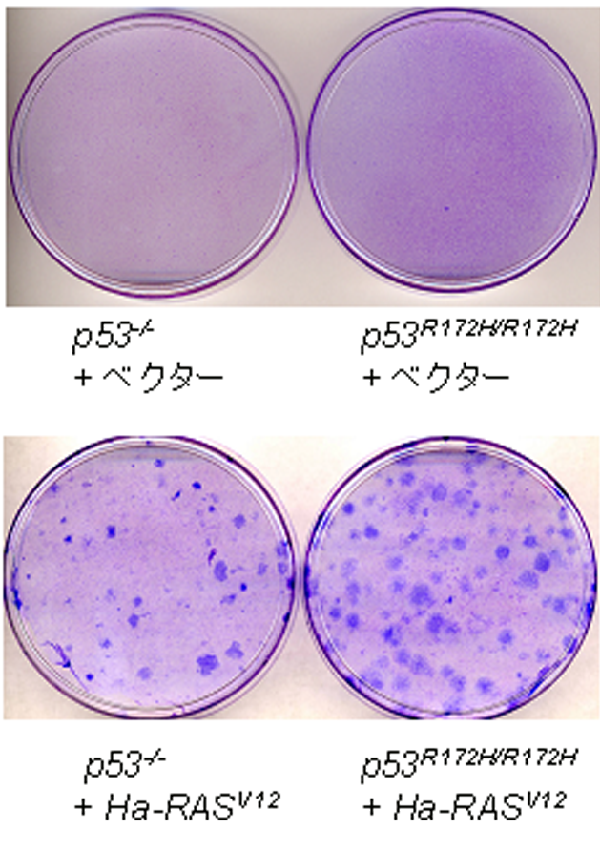
Quantitative or qualitative changes can explain oncogenicity
Oncogene sequence is different from proto-oncogene (mutation).
Oncogene is sometimes expressed at higher levels than the proto-oncogene.
Mos, Sis, Myc…Small number of amino acid substitutions do not change their enzymatic activities, but their overexpresssion causes oncogenicity…quantitative
Ras and src….Point mutations, changes of some sequences, or phosphorylations of proteins activate these oncogenes….qualitative
Assays to test oncogenicity of the gene of interest
Foci formation assays: When cells are transformed (eg. by mutated ras oncogene), their descendants pile up into foci.
p53 ^{-/-}
+ vector
p53 ^{R172H/R172H}
+ vector
Foci formation assays by an oncogenic ras transduction.
Soft agar assays: testing anchorage-independent growth of normal or immortalized mouse fibroblasts.
p53 ^{-/-}
+ H-Ras^{V12}
p53 ^{R172H/R172H}
+ H-Ras^{V12}
Generate generically engineered mice: mice with overexpression (transgenic) or deletion (knockout)

Slide 13
Activation of Oncogenes: Point Mutation (Ras)
Ras – family of G-protein coupled receptors.
Binding of extracellular signal promotes recruitment of Ras to receptor complex.
Recruitment promotes Ras to exchange GDP (inactive Ras) with GTP (active Ras).
Activated Ras than initiates the remainder of the signaling cascade to promote expression of genes important for growth and survival.

Slide 14
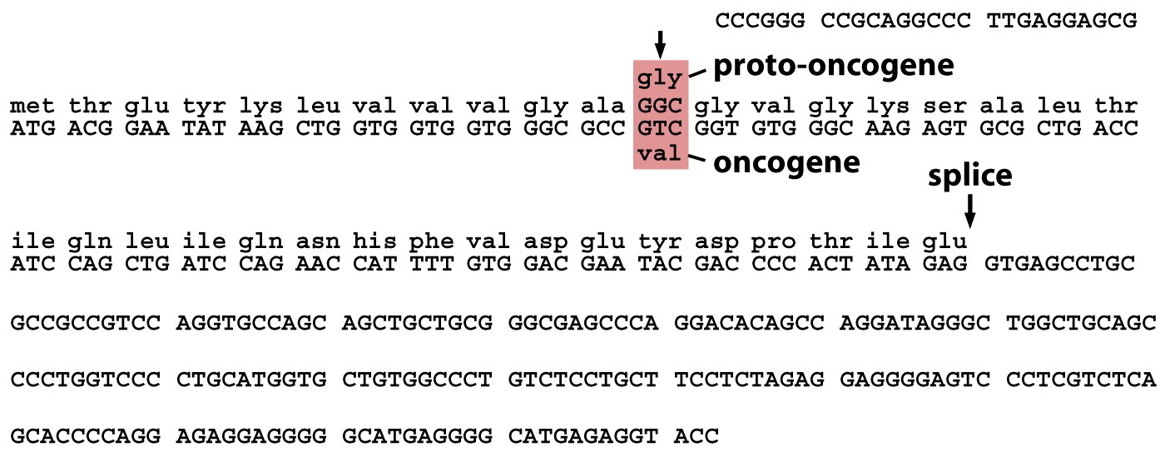
Activation of Oncogenes: Point mutation (Ras)
A single point mutation of Ras was found in many tumors (colon, lung, breast, and bladder).
The apparently conservative mutation (Gly to Val) results in a protein that hydrolyzes GTP to GDP very inefficiently.
This mutation therefore results in a Ras protein that is excessively active, evading normal regulation by extracellular signals, and providing an oncogenic effect on the cells.

Slide 15
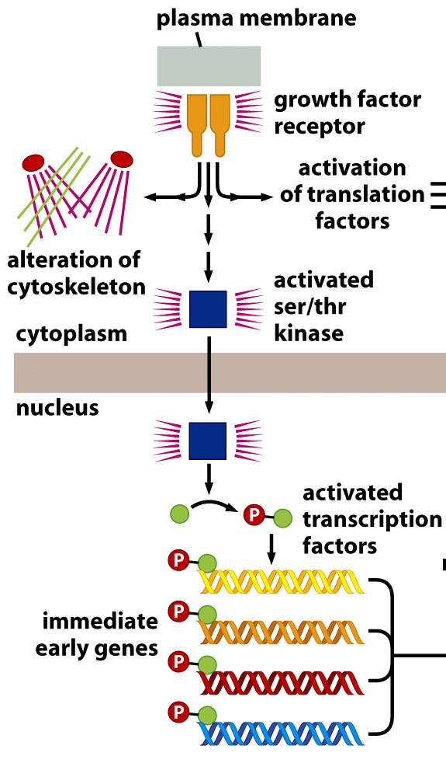
Activation of Oncogenes: Point mutation and Altered Signaling
Point mutations can also occur in membrane bound receptors or in components of signaling molecules.
These mutations or alterations result in the aberrant activity (usually constitutively turned on or off) of the affected proteins.
The aberrant activity results in the increased or decreased signaling of extracellular signals to the nucleus to alter the expression of transcription factors.
Some examples - PTEN mutation (ovarian cancer), Src (many cancers)

Slide 16
Activation of Oncogenes: Amplification and Myc
The c-Myc gene encodes a transcription factor that forms a hetero-dimeric complex with Max.
Regulates the expression and activity of cell cycle regulatory proteins Cyclins, CDKs, CDK inhibitors, and E2F
Induction of c-Myc is necessary and sufficient to drive quiescent cells into the S phase.
c-Myc
DNA
Max
G1
S
R point
Notes:
1

Slide 17
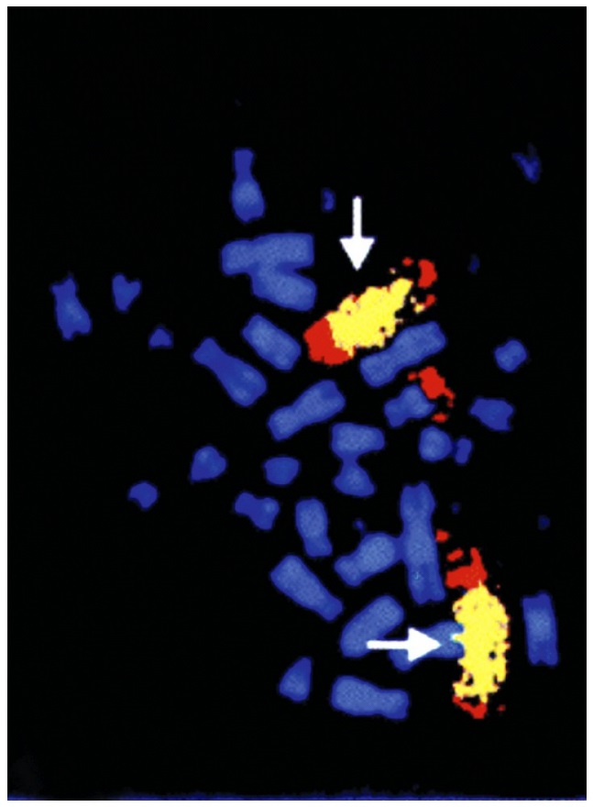
Activation of Oncogenes: Amplification and Myc
Cancer cells can contain hundreds of extra copies of proto-oncogenes.
These extra copies exist as extrachromosomal bodies (known as double minutes) or as extensive tandem repeat insertions within the chromosome (homogenously staining region).
The ultimate result is the overexpression of the normal gene providing “too much of a good thing”.
Mutation is not within the gene itself but instead results from too many copies of the gene being present.
Breast cancers often amplify ERBB2 (Her2) and late stage neuroblastoma often amplify N-myc
FISH analysis of the N-myc gene showing a homogeneously staining region (yellow) demonstrating tandem repeat amplification of the gene in a neuroblastoma patient.

Slide 18
Activation of Oncogenes:
Chromosomal Translocations
Chromosomal Translocation: a chromosomal rearrangement in which part of one chromosome is detached by double strand DNA breaks and subsequently joined to a second non-homologous chromosome.
Balanced Rearrangement: a chromosomal translocation that has no substantial net gain or loss of DNA, also referred to as a reciprocal translocation.
[Cytogenetic chromosome stain of patient with Chronic Myelogenous Leukemia (CML), which contains the t(9;22)(p34;p11)translocation.]

Slide 19
Activation of Oncogenes:
Translocation of Proto-oncogene to Highly Active Promoter
Translocation results in the tightly regulated promoter or regulatory elements for one gene being replaced by the regulatory DNA sequence elements a highly active promoter.
This genetic event results the in the uncontrolled or altered expression of the normal gene.
As with amplification, conversion from the proto-oncogene to the oncogene does not result from mutation of the gene itself, but from the unregulated expression of the oncogene.
Burkitt’s Lymphoma (a non-Hodgkin’s B-cell lymphoma - t(8;14) translocation)
Translocates the immunoglobuulin heavy chain regulatory elements next to the proto-oncogene c-Myc.

Slide 20
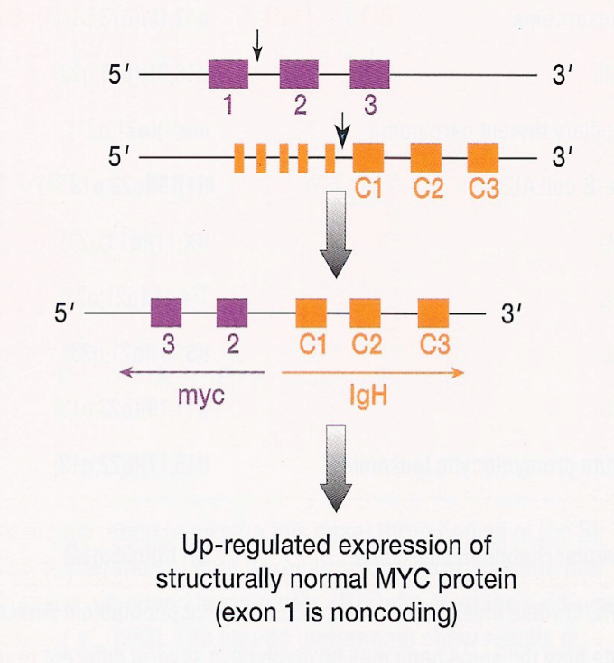
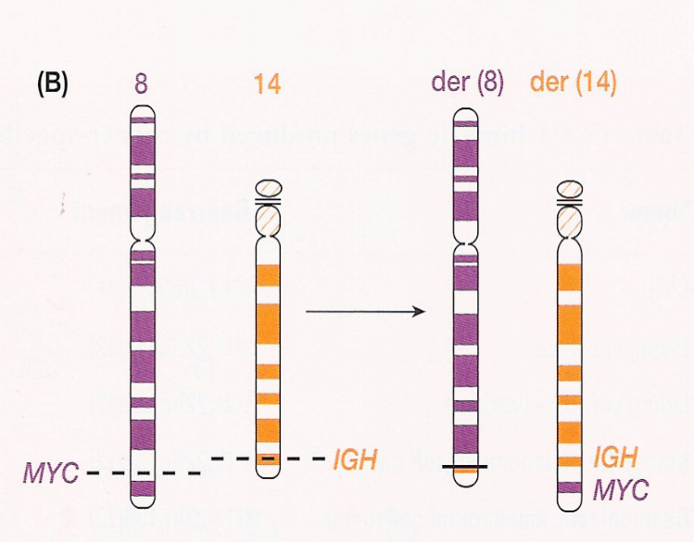
Activation of Oncogenes:
Translocation of Proto-oncogene to Highly Active Promoter
Normal genomic locus of Myc (purple) and normal IgH locus (orange) on separate chromosomes (8 and 14, respectively).
Balanced translocation replaces the normal regulatory elements (promoter, enhancer, etc.) with the regulatory elements for the IgH locus.
In B cells the IgH locus is highly active, thereby allowing the unregulated overexpression of Myc.

Slide 21
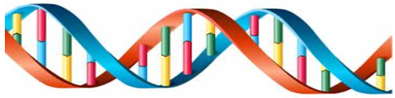
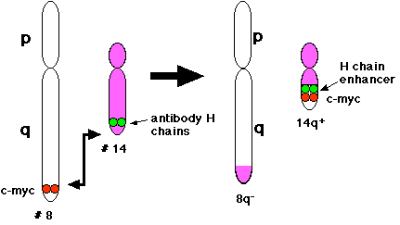
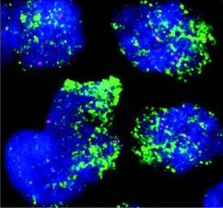
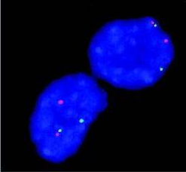
Mechanisms of Myc activation
Stabilize
Myc
R
U5
gag
v-myc
U3
R
Myc^{Thr58}
Retroviral transduction
Missense mutation
Amplification
Myc
LTR
LTR
Other
Mechanisms
1
2
3
C-myc locus
Translocation
Meyer N & Penn L, 2008
Proviral Insertion

Slide 22
Activation of Oncogenes:
Translocation to Generate Fusion Protein
  Chronic myelogenous leukemia (CML):
  Results from the t(9;22)(p34;p11) translocation (also known as the Philadelphia chromosome)
  The first identified translocation associated with a cancer.
  Fuses the Breakpoint Cluster Region (BCR) to the cellular homolog of the Abelson murine leukemia virus transforming gene (c-Abl) to generate the BCR-Abl gene product
    BCR - multi-functional protein implicated in two signaling pathways
    Abl - a non-receptor tyrosine kinase. It interacts with activated receptors - the wild-type form is ONLY activated in response to extracellular signals acting on a receptor.)
  CML is very effectively treated with the drug Gleevec, formerly known as STI571 or imatinib.

Slide 23
Activation of Oncogenes:
Normal Function of Proto-oncogene Abl
Phosphorylation, and subsequent activation of Abl only occurs when it interacts with a receptor that was activated by binding of the ligand.
Cellular responses of the proto-oncogene Abl occur in a controlled manner only in response to extracellular stimuli binding to receptors.
Ligand
Ligand
Ligand
Receptor
Receptor
Receptor
Receptor
Abl
p
Abl
Abl
p
Abl
Actin Reorginization
Proliferation
Adhesion
Migration
Survival

Slide 24
Activation of Oncogenes:
Aberrant action of the BCR-Abl Translocation Product
The BCR-Abl product aberrantly interacts with itself.
This allows the unregulated phosphorylation and activation of Abl
Results in a constitutively active molecule that activates genes in an uncontrolled manner
Ligand
Ligand
Ligand
Receptor
Receptor
Receptor
Receptor
X
BCR
BCR
BCR
BCR
BCR
p
p
Abl
Abl
Abl
Abl
Abl
BCR
p
Abl
Actin Reorginization
Proliferation
Adhesion
Migration
Survival

Slide 25
Oncogenes inhibit tumor suppressors
or directly promote cell proliferation or survival
Cell proliferation
Tumor suppressors
Cell Death
E1a, b, E6, 7, SV40 Tag
(DNA virus derived-oncogenes)
Oncogene
Cancer
Myc, Ras
(RNA virus derived oncogenes)
Mutated
Up-regulated
Cell proliferation

Slide 26
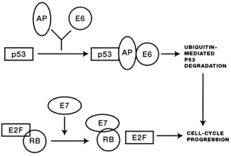
HPV Oncogenes inhibit Rb and p53 tumor suppressors
Ubiquitin
mediated
P53
degradation
Cell proliferation
and cancer
Cell-cycle
progression
Human papillomavirus serotypes 16, 18, 31 and others cause virtually all uterine cervical cancers and a significant fraction of oropharyngeal carcinomas using only 2 oncogenes: E6 and E7

Slide 27
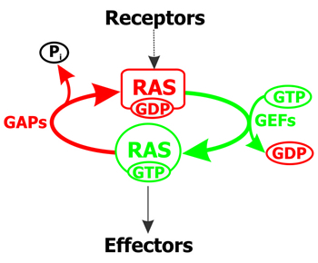
RAS, the most frequently mutated or activated oncogene in human cancer
Three Ras isoforms: H-ras, K-ras, and N-ras
Mutated in 20-25% of tumors (G12D) but over 90% in pancreatic cancer
Mutations also common in colorectal and NSCLC
Ras switches between active and inactive conformations.
Ras mutations inhibit Ras GTPase activity thus locking it permanently
in the active state.
inactive
Quiescence
Cell Death
Active
MAPK
Proliferation
Survival

Slide 28
How many mutations does it take to cause cancer?
Original work performed in mouse cells by the Weinberg group indicated that 2 oncogenes are sufficient to confer a fully transformed phenotype to rodent fibroblasts: Myc and Ras
  Land et al., Nature 304, 596–602 (1983)
However:
  These tumors were not metastatic, indicating that further mutations may be necessary to achieve a metastatic phenotype
  Fibroblasts would be a model for sarcomas, not for the most common epithelial carcinomas
  Rodent cells are far easier to transform than human cells (lifespan of a mouse or rat is 1-2 years). Rodent cells have long telomeres and express telomerase, hence they are more resistant to replicative senescence
Much later, the same group determined that human fibroblasts require 4-6 mutations to be transformed. These include the introduction of Telomerase (hTERT), SV40 large T (the construct also encoded small T) and mutant H-Ras. SV40 LT inactivates both RB and p53, while small T inhibits PP2A, thereby changing the phosphorylation status of multiple proteins
  Hahn et al., Nature 400, 464–468 (1999)

Slide 29
“Enablers”
Some oncogenes require other genes downstream of them for their oncogenic activity. These downstream genes may not be mutated or even overexpressed, but they are functionally necessary for the oncogenes to transform. Comparing oncogenes to criminals, these genes are “accomplices”, or “enablers”
The importance of these genes is that they may indicate therapeutic strategies
Genes do NOT work in isolation, but as a pathways. Therapeutic targeting of pathways rather than specific gene products is a feasible strategy
In 2002, using the Hahn-Weinberg model, the Miele group determined that the transformation in this model requires Notch1, a stem-cell/developmental gene. Inactivation of Notch1 causes death of Ras-transformed cells. This group went on to demonstrate that Ras causes Notch1 activation
  Weijzen et al., Nat Med. 2002 Sep;8(9):979-86.
  These findings have been confirmed by multiple groups in other Ras-dependent tumors (e.g. pancreatic cancer)
  There are now 8 Notch inhibitors in clinical development

Slide 30
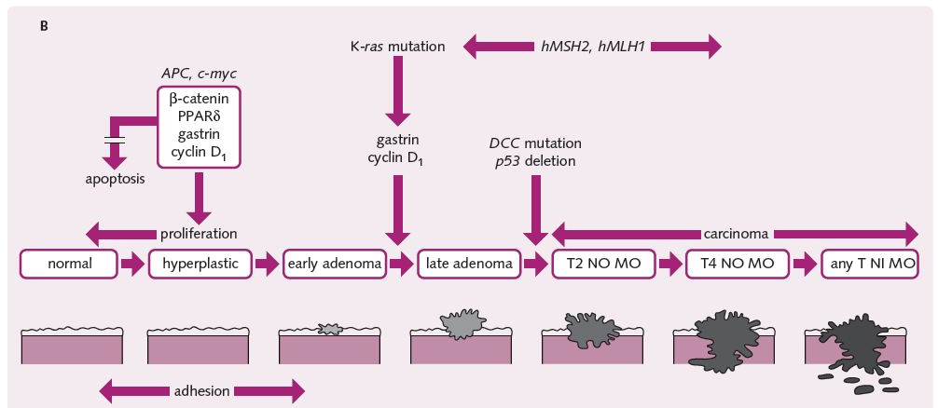
Multistep model of carcinogenesis in colorectal cancer

Slide 31
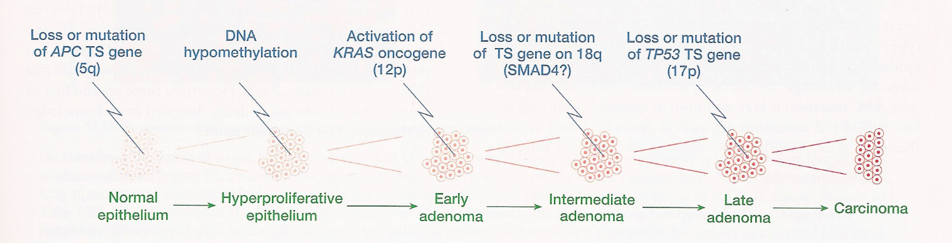
The Multistage Evolution of Cancer:
Colon Cancer as Example
The development of colon cancer progresses through discrete steps:
  Loss or mutation of the APC gene [about 60%] (usually resulting in a dominant negative mutant or loss of the gene altogether).
  DNA hypomethylation followed by point mutation of the KRAS gene (50% of tumors) resulting in its activiation.
  LOH at chromosome 18q (about 50% of tumors) with a supposed loss of SMAD4.
  Late in the game is the final loss or mutation of p53.
NOTE: Even with this “well described” model of progression, only 50 - 60% actually demonstrate the described mutations. This further supports the extreme heterogeneity and uniqueness of cancer.

Slide 32
Thinking in Pathways and/or Genetic Networks vs. Individual Mutations
Because cancers arise (usually) from a series of somatic mutations - EVERY TUMOR IS INDIVIDUAL! - many different genes can be mutated or altered to give rise to the same effect (increased proliferation rate, escape from apoptosis, aberrant signaling processes).
Many mutated genes can affect multiple pathways or biological functions.
Many mutated genes can alter the expression of downstream genes and/or microRNA. (Remember the use of Next Gen sequencing techniques…..)
However – all cancerous cells share phenotypic characteristics (Part I) that result from the pathological activation or inactivation of certain pathways (e.g., the intrinsic apoptosis pathway, the cell cycle progression pathway etc.).
Therefore, you can think of cancer in terms of pathways leading to a final effect vs. a series of isolated mutations. You can “attack” the pathway at a different point to fight the effect of an upstream mutation.

Slide 33
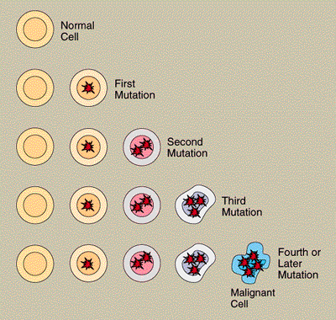
Cancer usually arises in a single cell. The cell's progress from normal to malignant to metastatic appears to follow a series of distinct steps, each controlled by a different gene or set of genes. Persons with hereditary cancer already have the first mutation.

Slide 34
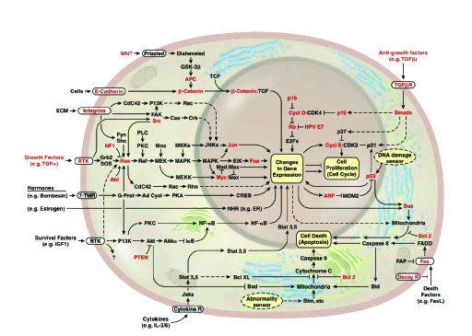
The Complexity in the Development of Cancer
Just a brief snapshot of many of the potential signaling pathways involved in cancer development: DO NOT MEMORIZE FOR EXAM!!!!!!

Slide 35
“Turncoat” genes can function as either oncogenes or TSG
In the case of p53, the wt gene is a TSG, but some mutants act as oncogenes
Other genes can act either as TSG or oncogene depending on the context: the stage of tumor progression or the cell type in which they are expressed
TGF-β functions as tumor suppressor early during carcinogenesis but turns into an oncogene that promotes metastasis in advanced disease
TGF-β inhibits proliferation and promotes apoptosis in many epithelial cells
Loss of function mutations in TGF-β pathway components are common in cancers, which led to its classification as a TSG
HOWEVER, most advanced human tumors secrete TGF-β, which promotes EMT and self-replication of CSC, promotes the secretion of mitogenic growth factors, acts on tumor stroma by promoting fibrosis and suppresses tumor immunity. The overall effect is metastasis promotion

Slide 36
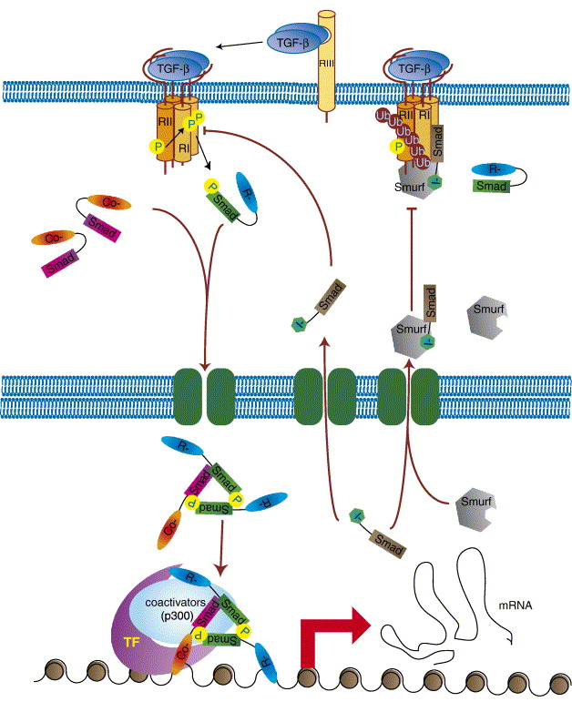
Katerina Pardali, Aristidis Moustakas
Actions of TGF-β as tumor suppressor and pro-metastatic factor in human cancer
Biochimica et Biophysica Acta (BBA) - Reviews on Cancer, Volume 1775, Issue 1, 2007, 21–62
http://dx.doi.org/10.1016/j.bbcan.2006.06.004

Slide 37
Individual genes can have different functions in specific cancer types and in specific individuals
The last 30 years of tumor biology have shown that although most tumors have genetic lesions in some key pathways controlling cell cycle, cell death and differentiation, EACH TUMOR IS UNIQUE in terms of mutational profile, gene expression profile, the function of specific genes and often, clonal composition
This indicates the need for individual molecular characterization of tumors, including repeated sampling
We will study this in detail when we discuss Precision Medicine
For example, Notch1 can be an classic oncogene (activating mutations in T-cell lymphoblastic leukemia and some breast cancers), a TSG (inactivating mutations in squamous carcinomas of the skin and oropharynx and SCLC) AND an enabler (required for Ras-mediated transformation)! So, depending on what tumor and what individual patient we are considering, the function and classification of a gene, and therefore the potential usefulness of targeting it therapeutically, must be examined individually!

Slide 38
How DiD WE GET TO TARGETING PATHWAYS?
A LITTLE HISTORY

Slide 39
Definitions
Signal Transduction is a series of molecular mechanisms whereby cells and tissues in the body communicate with each other
The basic mechanisms are evolutionarily ancient (which is why target discovery in animal models as simple as Drosophila can be informative)

Slide 40
Definitions - 2
There are a limited number of signal transduction mechanisms
  Small molecule ligands activating membrane receptors linked to downstream kinases or nucleotide cyclases (e.g., adrenergic, cholinergic, adenosine, sphingosine receptors)
  Protein ligands activating membrane receptors linked to downstream kinases (e.g. EGF-EGFR, VEGF-VEGFR

Slide 41
Definitions - 3
There are a limited number of signal transduction mechanisms
  Protein ligands activating receptors linked to proteolytic activities. (Notch, Wnt, Hedgehog)
  Protein ligands activating transcription factors (TGF-β family)
  Cell-permeable small molecule ligands directly activating ligand-dependent transcription factors (e.g., steroid hormones, Vitamin D)

Slide 42
Characteristics of signaling pathways in humans and mammals
Highly redundant: multiple pathways can activate the same downstream targets (e.g. Growth factors, insulin, steroids and T-cell receptors all activate the AKT pathway)
Highly interconnected: there is NO such thing as a linear signal transduction pathway. These are abstractions we create for ease of understanding. Actual intracellular signals function more like the internet than like snail mail

Slide 43
Characteristics of signaling pathways in humans and mammals - 2
Highly modulated through multiple mechanisms: (e.g., multiple isoforms of the same kinase or receptor, feedback mechanisms with other pathways)
  There are actually 3 AKTs
  There are 3 VEGFRs
  There are 4 Notches
  There are 19 Wnts….

Slide 44
Characteristics of signaling pathways in humans and mammals - 3
Highly context-dependent: the phenotype of a cell at any given time is the integrated output of multiple pathways, each operating for specific lengths of time and signal intensity and each talking to each other (the symphony analogy). Therefore, a relatively small number of pathways can produce a vast variety of physiological effects
This can result in unexpected toxicities: VEGF inhibitors causing hypertension, HER2 inhibitors targeted to epithelial cells cause cardiac toxicity

Slide 45
If this is so complicated, why bother targeting pathways?
Every drug targets cellular pathways, whether we know which ones or not. It is our responsibility to learn the language of cells and target the right nodes in the signaling networks with the right drug combinations to obtain efficacious therapeutics with acceptable toxicity

Slide 46
Designing targeted therapeutic regimens is highly data intensive
The human mind cannot easily visualize the complex functional networks of cells.
  Multi-platform data (clinical data from EHR, genomic data, proteomic data, metabolomics data, epidemiology data)
  Very large datasets (e.g. 1 human genome ≈ 4TB)
  Multivariate analysis
  Requires specialized bio-informatics and biostatistics techniques and expertise

Slide 47
Example 1
An apparently logical process leads to clinical failure

Slide 48
Ras, Cancer and Farnesyltransferase Inhibitors
Over the last 30 years, molecular biology has shown that Ras GTPases are activated by mutation or upstream pathways in numerous solid tumors, including among others
  Colorectal cancer
  Pancreatic cancer
  Lung cancer
As of today, 28,432 published papers on Ras and cancer
Biochemical studies determined that Ras proteins need to be farnesylated to traffic to the membrane, where they function

Slide 49
Ras, Cancer and Farnesyltransferase Inhibitors
FTase, the enzyme that catalyzes the farnesylation of Ras was thought to be a prime drug target candidate, and a class of farnesyltransferase inhibitors (FTIs) were developed by industry
To date, 2,746 papers on FTase and 1,577 on FTIs
FTIs were effective in preclinical models and were brought to the clinic
However, in the clinic they had little to no efficacy
WHAT WENT WRONG?

Slide 50
Ras, Cancer and Farnesyltransferase Inhibitors
There are several Ras isoforms (K-Ras4A and 4B, N-Ras, H-Ras)
Of these, H-Ras is most sensitive to FTase inhibition, but the other isoforms have alternate paths to the plasma membrane:
  Geranyl-geranyltransferase (GGTase)
  Palmitoyl transferase
  A polybasic region that mediates electrostatic attraction with the inner leaflet of the membrane

Slide 51
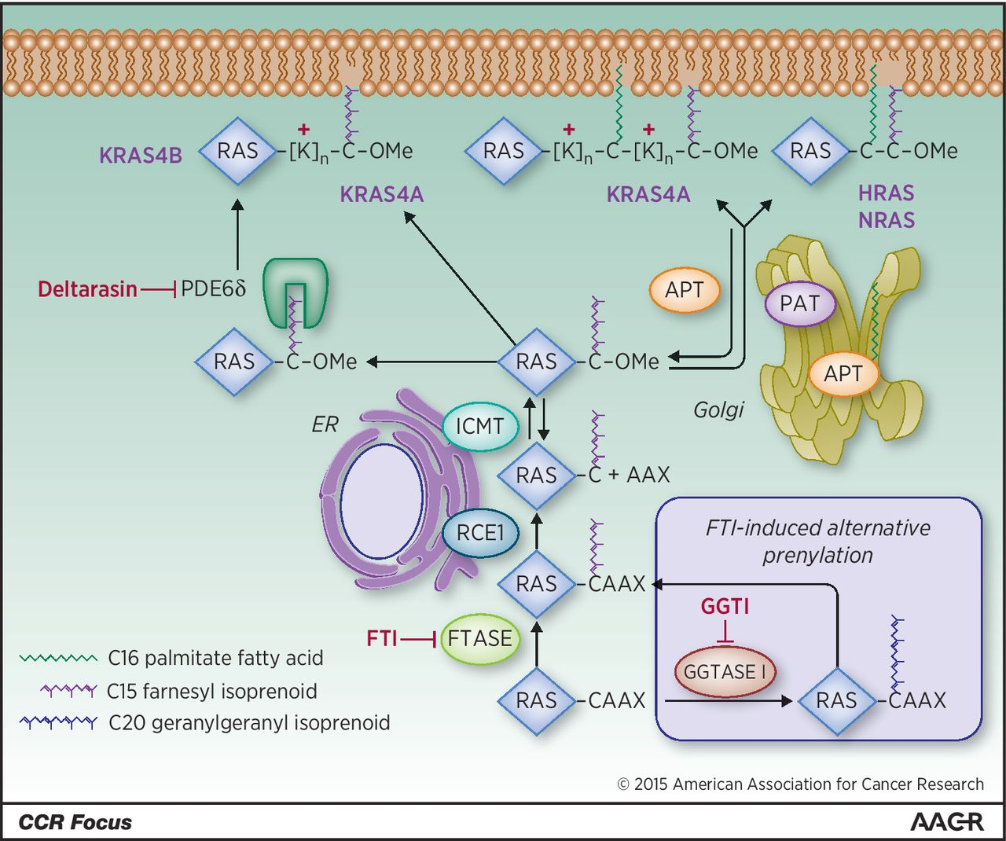

RAS trafficking pathway.
Adrienne D. Cox et al. Clin Cancer Res 2015;21:1819-1827
©2015 by American Association for Cancer Research
Notes:
RAS trafficking pathway. Nascent RAS proteins leaving the polysome are rapidly modified by farnesyltransferase (FTase), which attaches a C15 farnesyl isoprenoid lipid to the cysteine of the CAAX motif. This provides them sufficient affinity for the endoplasmic reticulum (ER), where they are further modified by RAS-converting CAAX endopeptidase 1 (RCE1)-catalyzed proteolytic removal of the AAX residues, and by reversible isoprenylcysteine carboxylmethyltransferase (ICMT)-catalyzed carboxylmethylation of the now terminal farnesylated cysteine residue. By preventing the first and obligate step, FTIs prevent all three of these modifications. In the presence of FTIs, KRAS and NRAS are alternatively prenylated by geranylgeranyltransferase I (GGTase I), which attaches a C20 geranylgeranyl isoprenoid that allows the same subsequent processing steps. RAS trafficking to the inner leaflet of the plasma membrane (PM) requires a second membrane-targeting element that dictates the pathway it will take to the plasma membrane. NRAS and HRAS have one or two cysteine residues, respectively, that undergo reversible acylation by a Golgi-resident protein acyltransferase (PAT) to promote their trafficking to the plasma membrane. Rapid deacylation by an acyl protein thioesterase (APT1/2) frees them up to be re-acylated and trafficked back to the plasma membrane. The nonpalmitoylated pool of APT in the cytosol is the active form, and is in dynamic equilibrium with a palmitoylated pool on the Golgi. KRAS4B, which has no palmitoylatable cysteine but a stretch of 6 lysines (polybasic region) does not go to the Golgi but trafficks the more directly to the plasma membrane, where it binds by virtue of its electrostatic charge. KRAS4A, which has a hybrid motif of a palmitoylated cysteine and a bifurcated polybasic region, undergoes an intermediate form of trafficking. PDE6δ recognizes the farnesyl isoprenoid and solubilizes nonpalmitoylated RAS proteins from any compartment, thereby promoting their availability for restoration to the plasma membrane; deltarasin blocks this interaction. Not pictured: other chaperone proteins that guide the lipidated RAS proteins between and within membrane regions. Each enzyme depicted has been a target for drug discovery.

Slide 52
Plenty of blame to go around
Basic cancer biologists preferred to work with H-Ras, for which cDNA constructs and cell lines were widely available and reagents (e.g., antibodies) were of better quality
However, K-Ras and N-Ras are much more frequently involved in human tumors
Drug developers started a major effort based on limited scientific information, assuming they knew everything they needed to know
Clinicians and drug developers underestimated the complexity and redundancy in Ras biochemistry, and thought they had a “magic bullet”

Slide 53
What would have helped?
Basic cancer biologists should choose their models based on translational relevance than experimental treatability
  What human disease is this gene actually involved in?
  Is this isoform/drug/model relevant to the disease I claim to be studying?
Pharmaceutical companies should not begin a major drug development effort based on superficial scientific knowledge
  Haste makes waste – billions of dollars worth of it
Clinical investigators should not underestimate the complexity of biology
  A little knowledge is a dangerous thing
These groups of people SHOULD BE WORKING TOGETHER (hence the concept of Translational Science)

