Slide 1
The Basics of Cancer Biology
Lucio Miele, M.D., Ph.D.

Slide 2
The Basics of Cancer Biology
With special thanks to
Andrew Hollenbach, PhD
Wanguo Liu, PhD
Antonio Pannuti, PhD
For providing original materials

Slide 3
Course outline
The Selfish Cell: Darwin and Cancer
Partners in Crime 1: Tumor Suppressors
Partners in Crime 2: Oncogenes, Enablers and Turncoats
The Piano and the Pianist: genes, environment and bad luck
The Godfather: how cancers escape the immune police and what to do about it
Goodbye magic bullet: cancer therapeutics in the era of precision medicine

Slide 4
Part I: “The Selfish Cell”
Darwin and cancer

Slide 5
Learning objectives
1. list biological features that distinguish “benign” from “malignant” tumor cells
2. list biological adaptations required for a benign tumor to metastasize
3. explain the importance of cell-to-cell and cell-to-matrix adhesions in the processes of metastasis and angiogenesis
4. identify some therapeutic agents that affect the process of metastasis

Slide 6
“Cancer” is an abstraction
Imperial Family

Slide 7
“Cancer” is an abstraction
We’ve heard it so many times: Why can’t they just find a Cure for Cancer? The reason why we haven’t is that “Cancer” does not exist as a single disease entity, such as TB, cholera or HIV.
Cancer is a collection of hundreds of diseases with distinct biological behaviors
These have in common the accumulation of unwanted cells that originate from the organism itself. These can damage the organism in a variety of ways and lead to death
There is NO SUCH THING as a single “cure for cancer”, any more than there can be “the cure for infectious diseases”. This is a popular myth that should not be encouraged.

Slide 8
Quick Reminders: Traditional Definitions
Carcinomas: malignancies derived from epithelia (of ectodermal or endodermal origin).
Tumors of neuroectodermal origins (gliomas, neuroblastomas, NETs) are a special category that aren’t called ALWAYS called carcinomas (e.g., glioblastoma, astrocytoma, carcinoid BUT Small Cell Lung Carcinoma…)
Sarcomas: malignancies derived from mesodermal tissues
Leukemias: malignancies derived from the hematopoietic system that do not form solid masses but infiltrate the bone marrow and other organs
Lymphomas: malignancies derived from the lymphoid compartment of the hematopoietic system that DO form solid masses in lymphoid organs (lymph nodes, spleen)
Benign tumors: cells proliferate and form masses, but do not infiltrate or metastasize. Generally though not always resectable
Malignant tumors: cells do infiltrate and metastasize. Only resectable when localized or invading regional lymph nodes, or isolated metastases. Disseminated mestastatic disease inoperable

Slide 9
Traditional Definitions Have Limitations
As we will see, the biological behavior of neoplastic cells is not dictated by their anatomical or histological origin
“Epithelial” carcinoma cells can develop “mesenchymal” characteristics and vice versa
Some tumors have mixed histology (“metaplastic breast cancer”, “endometrial carcinosarcoma”)
In reality, the phenotype of malignant cells is highly plastic, and dictated by their molecular landscapes as well as the microenvironment

Slide 10
Epithelial cancers are the most common

Slide 11
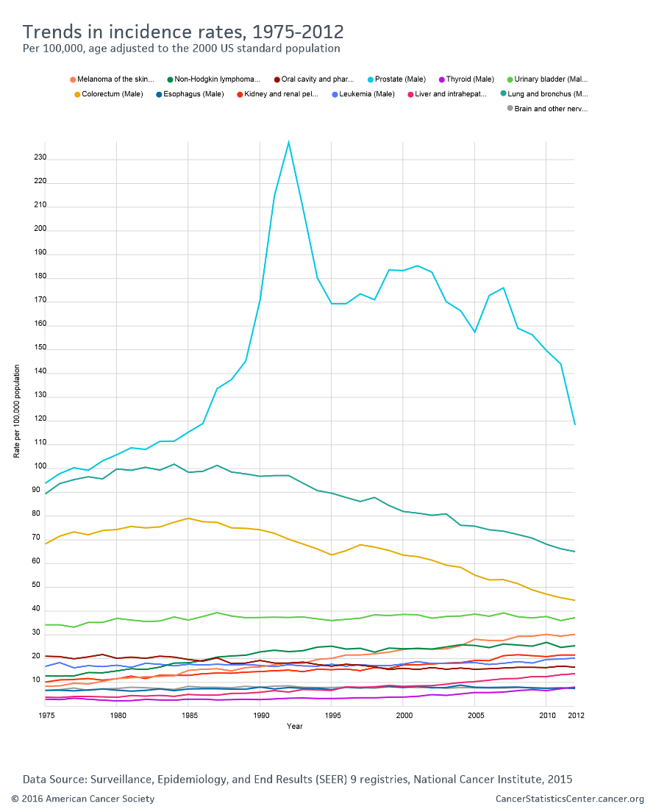
Incidence is decreasing for some cancers but not others

Slide 12
Death rates for most cancers are decreasing

Slide 13
Death rates for most cancers are decreasing

Slide 14
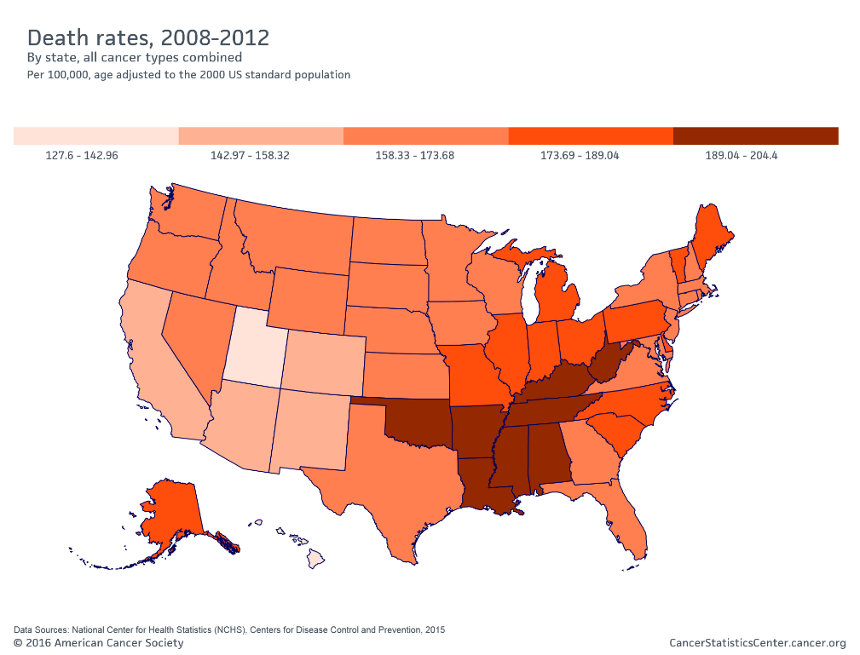
Socioeconomic factors affect cancer mortality

Slide 15
How do cancers kill?
The primary cause of death (90%) is metastatic spread: tumor cells spread from the main tumor site to lymph nodes, bone, bone marrow, other organs, brain etc, eventually overcoming the body’s ability to function
Ultimate cause of death varies, but often is sepsis, liver failure, kidney failure, brain compression etc

Slide 16
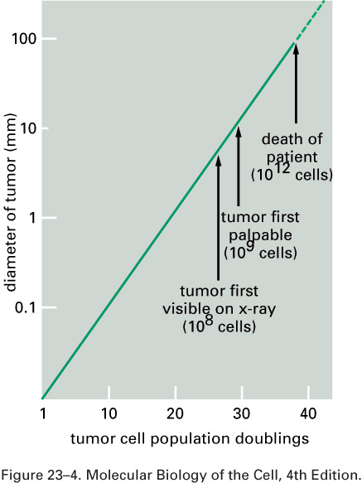
Cancer development in humans is a multi-year process
More modern imaging (MRI, PET-CT, PET-MRI)

Slide 17
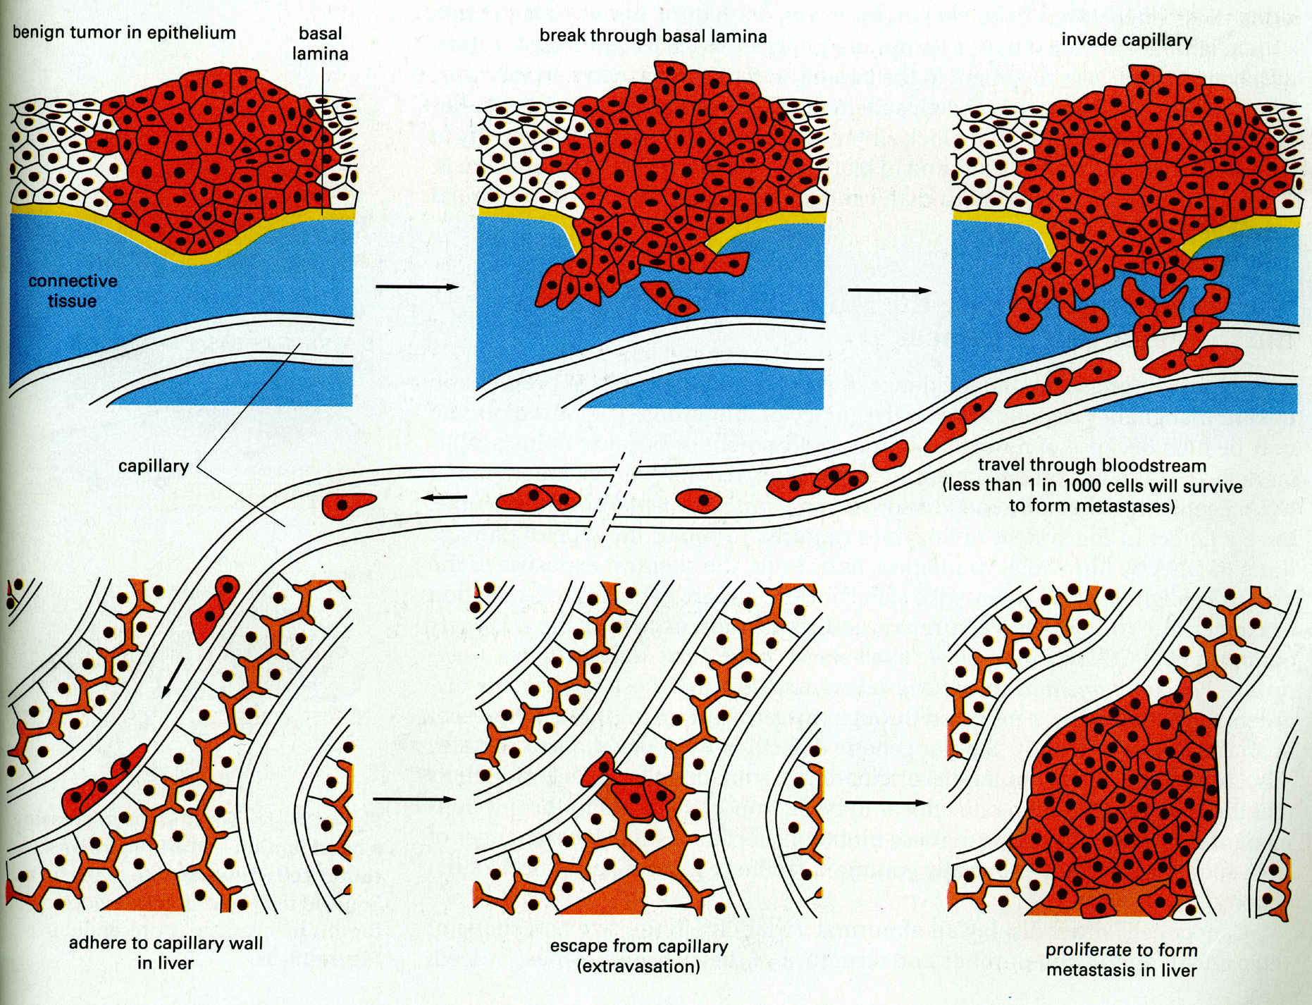
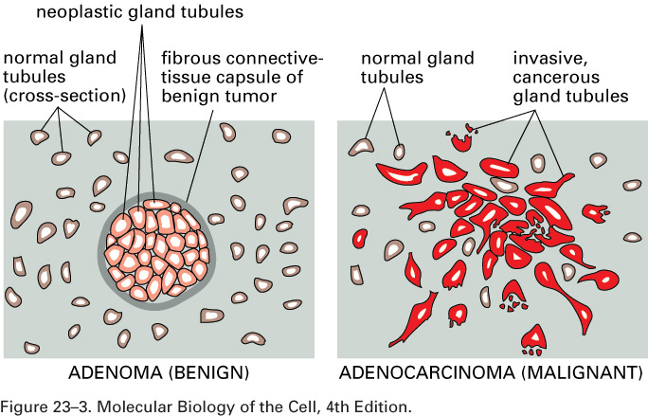
A malignant tumor is invasive

Slide 18
Do we know “the cause of cancer”?
Anything that can damage DNA, rearrange DNA sequences or epigenetically modify gene expression can potentially cause cancer
Mutagens
Radiation
Oxidizing ROS (Reactive Oxygen Species) from chronic inflammation
Viruses (either through viral oncogenes or indirectly through inflammation – e.g., HPV, HCV)
Bacteria (H. Pylori)
Random errors in DNA repair/replication

Slide 19
Do we know “the cause of cancer”?
Broadly speaking, the cause of cancer is structural or functional damage to a group of genes that control cell fate (proliferation, differentiation or death).
Sounds simple, but….
The devil is the details

Slide 20
The devil is in the details
There are many genes that control crucial cell fate decisions.
Their functions are often overlapping or redundant
If gene 1 works by activating gene 2, damage to either gene can have the same effect
It only takes a handful of damaged genes to start a cancer (3-6 in humans), and there are MANY combinations of gene damages that can have this effect

Slide 21
The devil is in the details-2
Therefore, CANCERS ARE GENETICALLY HETEROGENEOUS
Cancers of the same tissue can have different combinations of gene damages
Importance of genomics to classify cancers based on genetic profiles
Exome sequencing – Whole genome sequencing
Gene expression profiling (including ncRNAs)
Methylation profiling

Slide 22
Tumor subtypes are identified by multiplatform discovery
Comprehensive molecular portraits of human breast tumours
The Cancer Genome Atlas Network
Nature (2012) doi:10.1038/nature11412 Received 22 March 2012 Accepted 11 July 2012 Published online 23 September 2012

Slide 23
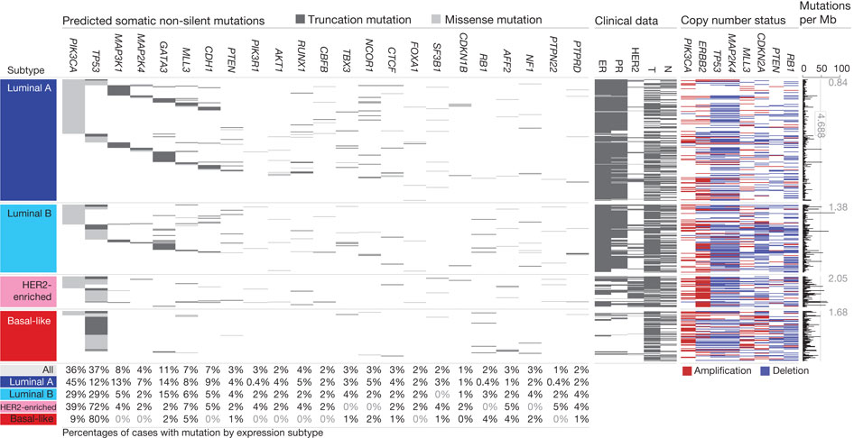
Significantly mutated genes and
correlations with genomic and clinical features.
DC Koboldt et al. Nature 000, 1-10 (2012) doi:10.1038/nature11412

Slide 24
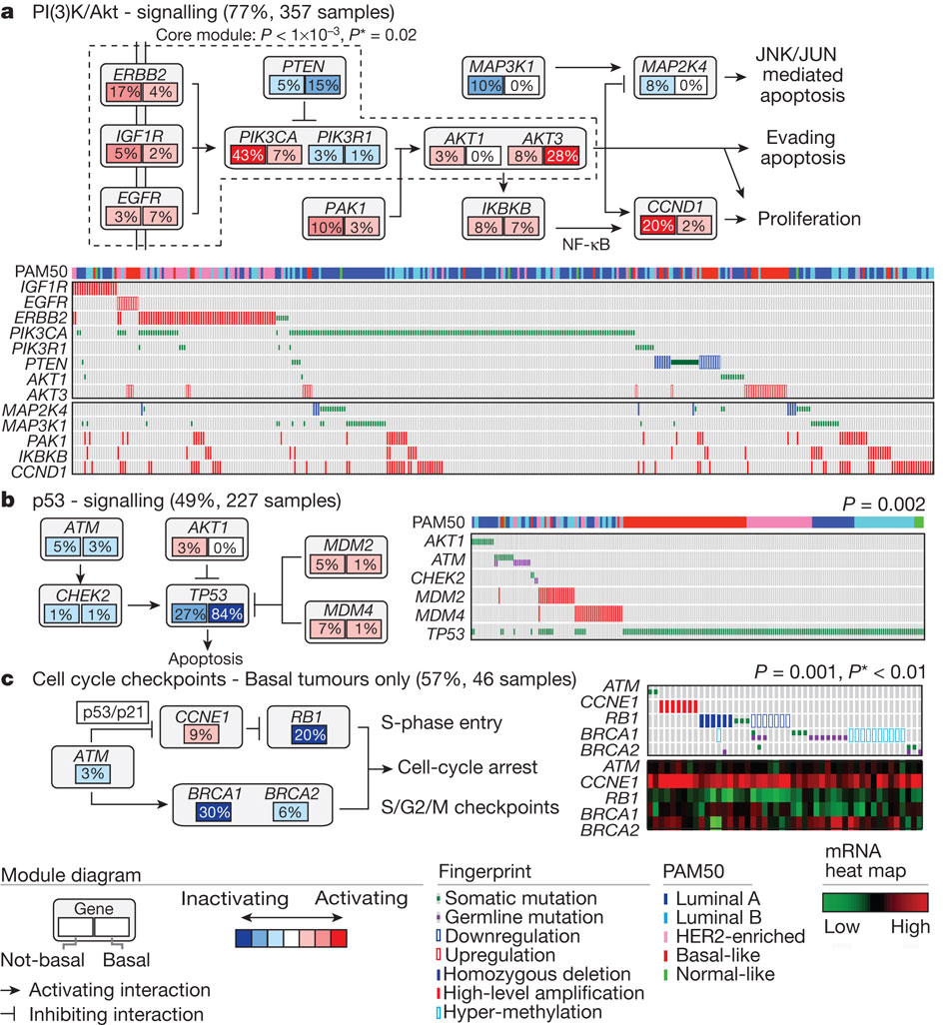
Mutual exclusivity modules in cancer (MEMo) analysis
DC Koboldt et al. Nature 000, 1-10 (2012) doi:10.1038/nature11412

Slide 25
The devil is in the details-3
IT GETS WORSE. Some key genes that are damaged in cancer cells CONTROL the REPAIR of DNA DAMAGE ITSELF. Once these genes are inactivated, the cell can KEEP ACCUMULATING MUTATIONS. Also, chromosomes rearrange through non-homologous end-joining, so that genes change places, are lost or increase in number.
Therefore, the genetic profile of cancers CHANGES WITH TIME and WITHIN the same advanced cancer there are cells with different genetic profiles. Concept of GENOMIC INSTABILITY
Cancers accumulate a large number of “passenger” mutations that may be phenotypically silent, as well as new “driver” mutations that change their phenotype (e.g., response to drugs)

Slide 26
Mapping Cancer Genomes
COSMIC circos legend
Circos plots visualize cancer genomes
Coding Mutations - links to the Mutations tab
Non-Coding Mutations - links to the Non-Coding Mutations tab
Aberrant Gene Expression - Over and Under Expression plot; over=red, under=green (links to the CNV ChromoView page which displays CNV and Expression data for the chromosome)
Copy Number Variants - Gain and Loss Plot; gain=red,loss=blue (links to the CNV ChromoView page which displays CNV and Expression data for the chromosome)
Chromosomal Rearrangements - intra-chromosomal (green) and inter-chromosomal (purple)
(links to the Breakpoints tab)
http://cancer.sanger.ac.uk/cosmic/landscape
https://tcga-data.nci.nih.gov/tcga/tcgaHome2.jsp

Slide 27
Cancers evolve
Evolution by natural selection at the organism level - speciation
Evolution by natural selection at the cellular level inside a multicellular body - cancer
“It is not the strongest species that survives, nor the most intelligent, but the one most responsive to change” (Charles Darwin)
“It is not the fastest growing cell clone that survives, nor the most useful to the organism, but the one most adaptable to change (i.e., changing in the body’s environment or therapeutic agents)

Slide 28
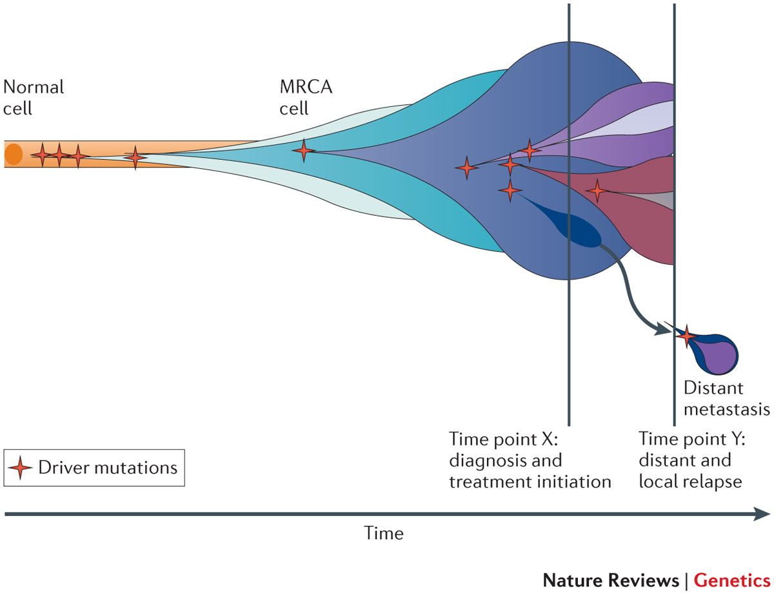
Evolution requires mutation
http://www.nature.com/nrg/journal/v13/n11/full/nrg3317.html
Yates and Campbell, Nature Reviews Genetics 2012

Slide 29
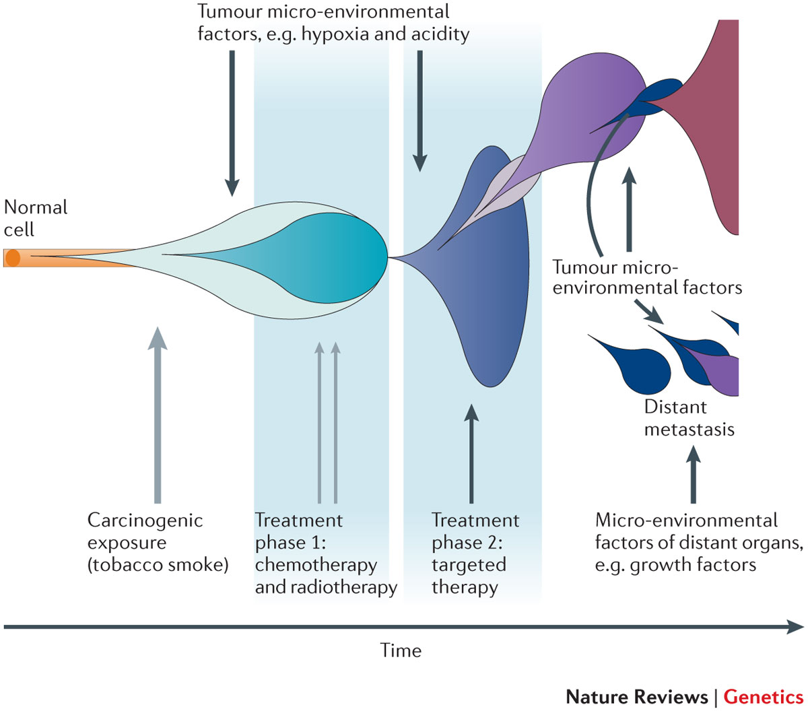
And Natural Selection
http://www.nature.com/nrg/journal/v13/n11/full/nrg3317.html
Yates and Campbell, Nature Reviews Genetics 2012

Slide 30
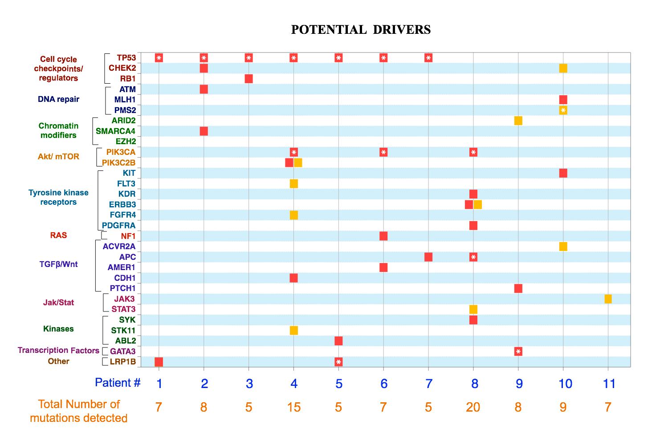
New potential driver mutations arise in recurrent tumors
Figure 1: High-confidence (red) and low-confidence (orange) potential drivers identified as described in the Results section. Mutations present in the COSMIC database are labeled with asterisks. Primary pathways associated with genes are color-coded on the Y axis. Pathway assignment was based on Gene Ontology supplemented by individual PathCards searches (http://pathcards.genecards.org/) for each gene. Pannuti et al, in preparation, 2016

Slide 31
A moving target
So, when we describe a cancer, what we are really dealing with is a population of rogue cells that keep changing and evolving in time, and can select cell clones that are resistant to treatment, very much like an infectious agent.
This is why a single cure is a utopia. The best way to attack a cancer is from multiple sides at the same time, just like we do with antibiotic therapy, and/or adapting treatment to the evolution of disease.

Slide 32
Coalitions of clones!
Advanced tumors are heterogeneous. They can contain multiple clonal populations.
Different cell clones within a cancer can work together to promote tumor growth
A complete cure would require identifying individual clones and targeting clones necessary for tumor growth
To test different clones, it is possible to isolate them ex vivo and implant them in nude mice OR produce ex vivo spheroids that maintain clonality (for some time)

Slide 33
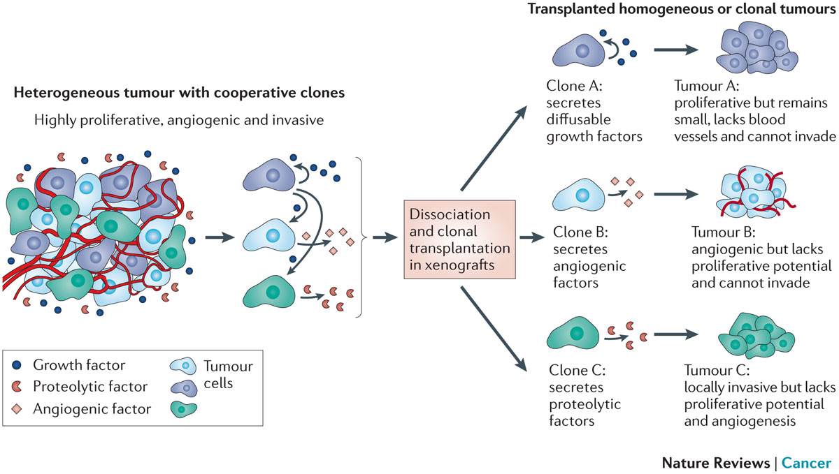
Divide and conquer
Tabassum and Polyak, 2015
http://www.nature.com/nrc/journal/v15/n8/full/nrc3971.html

Slide 34
Know thy enemy
To properly capture the genomic map of tumors, it is necessary to sample tumors at different times and in different places (to capture information about multiple clones)
In most cases, we still treat cancers based on what we see at diagnosis or in the surgical specimen. We do not routinely capture the molecular evolution of cancers
That is changing through “liquid biopsy”, either of circulating tumor cells (CTC) or circulating tumor DNA” (ctDNA) followed by NGS, or single cell genomics

Slide 35
Detecting cancer cells in patients’ blood
Circulating Tumor Cells
http://www.veridex.com/media/CellsearchMOA.aspx

Slide 36
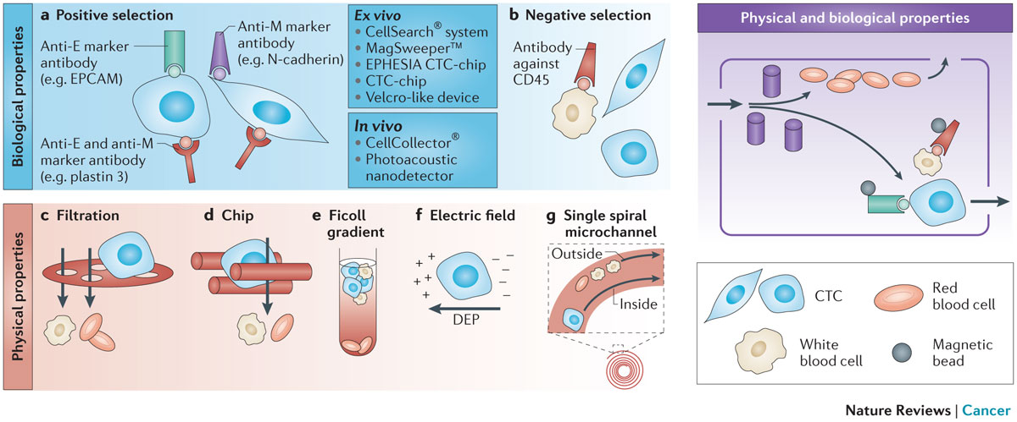
CTC: Finding the needle in a haystack…and sequencing it
Alix-Panabieres and Pantel, 2014
http://www.nature.com/nrc/journal/v14/n9/full/nrc3820.html

Slide 37
ctDNA
PROS:
Less invasive than repeat biopsy (which may or may not be possible depending on accessibility)
Does not require intact cells
Can be used to identify new mutations in recurrent disease
Can be used to identify neoantigens for immunotherapy
Potentially useful to monitor response to therapy
CONS:
Sensitivity can be a problem: in a mixture of DNA from different clones, the most abundant ones will be over-represented
Needs very deep sequencing to confirm variants
Abundance depends on tumor burden, access to circulation etc.

Slide 38
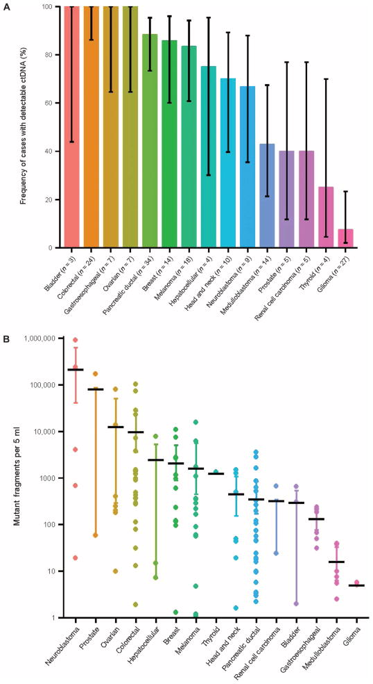
Some tumors shed more DNA than others
Bettegowda et al., 2014
http://www.ncbi.nlm.nih.gov/pmc/articles/PMC4017867/

Slide 39
What DO malignant cancers have in common?
NOT rapid proliferation. Some slowly growing tumors are highly lethal
Cancer cells are inherently “selfish”
An organism functions as a society of cells. There are rules dictating cell fate (when cells grow or die, what shape they take and what functions they perform)
Cancer cells no longer follow rules of and simply propagate and spread without contributing to “society”

Slide 40
What does “selfish” mean in molecular terms?
Cancer cells are ANCHORAGE-INDEPENDENT, i.e., capable of surviving when detached from a basement membrane
Normal epithelial cells attach to basement membrane through adhesion molecules, particularly INTEGRINS. These transmit signals that allow survival
When normal epithelial cells detach from the basement membrane, they are programmed to die. This is called “anoikis” (without a home) and it is a specialized form of programmed cell death (apoptosis, or “dropping off”).
One of the key components of neoplastic transformation is resistance to anoikis

Slide 41
What does “selfish” mean in molecular terms? – 2
Cancer cells lose CONTACT INHIBITION. Normal epithelial cells proliferate until they come into contact with each other. When they do, they signal to each other to stop proliferation. Cancer cells are insensitive to contact inhibition
In addition to anchorage independence and loss of contact inhibition, several other biological properties are needed for a cancer cell to exhibit malignant (invasive) behavior:

Slide 42
What does “selfish” mean in molecular terms? – 3
Angiogenesis: the ability to stimulate the growth of blood vessels to supply the tumor. This is caused by a variety of secreted factors from tumor cells (e.g., VEGF, bFGF)
Motility: cancer cells must be able to migrate without dying (hence the importance of anchorage-independence). Sometimes cancer cells become sensitive to chemotaxis (“chemical call”) by protein factors called chemokines that are normally produced by immune cells
Invasion: cancer cells must able to break through basement membranes. This requires the production of proteolytic enzymes (e.g., matrix metalloproteases or MMP). Once cells break into a blood or lymph vessel, they circulate and some of them stop in distant tissues and lymph nodes

Slide 43
What does “selfish” mean in molecular terms? – 4-
Once cancer cells stop in distant tissues, they must extravasate (exit vessels), and home by binding to basement membranes or extracellular matrix in these tissues. Then they start proliferating and attract new blood vessels through angiogenesis. This eventually forms a metastatic mass
Also, cancer cells must learn to evade immune recognition and even enlist the help of the immune system. They do so by producing chemokines and cytokines, as well as metabolites (e.g., adenosine) which cause the immune system to overlook cancer cells or even to develop a chronic inflammatory status that actually helps tumor growth!

Slide 44
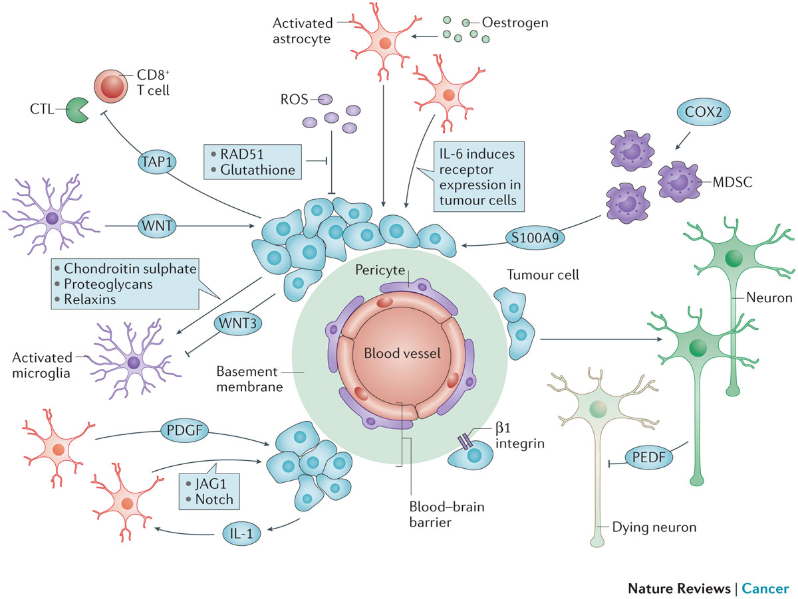
The tumor microenvironment affects metastatic cells: metastatic niche
Steeg, 2016 http://www.nature.com/nrc/journal/v16/n4/full/nrc.2016.25.html

Slide 45
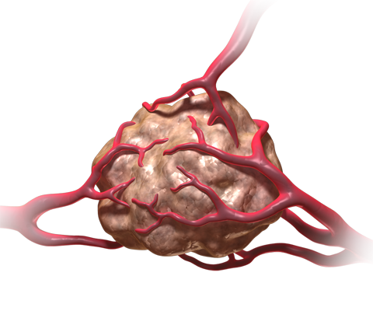
Angiogenesis
Angiogenesis: the physiological process by which new blood vessels form from pre-existing vessels. This is distinct from vasculogenesis, which is the de novo formation of vessels from mesoderm precursors
In order for a tumor to grow beyond a certain size (1-2 mm), a network of blood vessels is required to provide nutrients and oxygen and to remove waste products
Solid tumors are dependent on angiogenesis to grow beyond this limiting size
Angiogenesis is highly regulated during development. Therefore, neoplastic tissues must acquire the ability to develop a blood supply to allow continued growth
This ability is acquired through mutations or dysregulation of genes that control the process

Slide 46
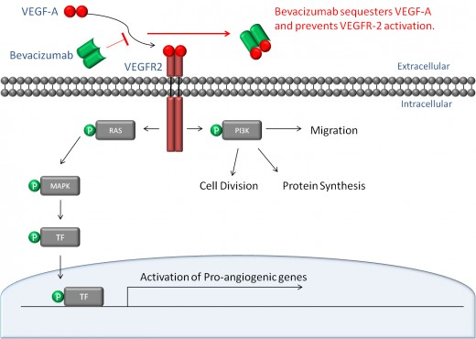
Angiogenesis

Slide 47
Basic Mechanisms of Angiogenesis
Tumor cells and sometimes inflammatory cells in tumor stroma produce the pro-angiogenic soluble growth factor, vascular endothelial growth factor (VEGF).
VEGF binds to its receptor (VEGF-R), promotes homodimerization, and the initiation of the signal cascade.
This cascade results in the expression of genes required for promoting angiogenesis.
FGF-beta, IL17 and IL-8 can also promote angiogenesis
VEGF induces expression of Notch ligand DLL4, which activates Notch1. This causes branching of capillaries
VEGF promotes proliferation of new capillary “tip” cells, while Notch promotes branching. Without VEGF activity, proliferation stops. Without DLL4-Notch activity, branching stops and dysfunctional capillaries form

Slide 48
Angiogenesis as a Target for Therapy
In the general theme of “know thy enemy”, the knowledge of how VEGF works to promote angiogenesis makes it a viable target for therapies.
If you can inhibit any step of the pathway, for which the most specific would be the ligand (VEGF) or the receptor (VEGF-R), you could potentially inhibit angiogenesis and further tumor development.
The following drugs are being used to do just that:
Bevacizumab (Avastin™) – a monoclonal antibody that binds VEGF and blocks it from binding to VEGF receptors on the surface of vascular endothelial cells.
Sunitinib (Sutent™) – inhibits the kinase activity of VEGF-R and several other kinases
Sorafenib (Nexavar™) – inhibits the kinase activity of VEGF-R and other kinases
Cediranib (Recentin™ - AZD- 2171) – inhibits the kinase activity of VEGF-R
Demcizumab (Oncomed) inhibits DLL4-Notch1 signaling
NOTE: Drugs ending in “-mab”, such as bevacizumab, indicate they are monoclonal antibodies.

Slide 49
Metastasis
90% of cancer related death is due to metastasis since once a tumor cell has traveled from the site of origin to a distant target tissue, it is difficult, if not impossible to remove the metastatic cancer by localized surgery or irradiation.
Cancer cells capable of metastasis are more resistant to a special type of cell death called “anoikis”.
Anoikis – a form of programmed cell death that is induced when anchorage dependent cells detach from the extracellular matrix (ECM). This can also be interpreted as anchorage-independent growth.
Normal cells undergo cell death when they are detached from the matrix, whereas cancer cells are resistant to “anoikis” when migrating through the bloodstream.

Slide 50
Metastasis and the Epithelial – Mesenchymal Transition (EMT)
Epithelial to Mesenchymal Transition (EMT) – a process by which epithelial cells lose their polarity and cell-cell adhesion and gain migratory and invasive properties to become mesenchymal stem cells (multipotent stromal cells that can differentiate into a variety of cell types).
EMT initiates metastasis and allows tumor cells to invade and migrate into the extracellular matrix (ECM)
EMT can trigger a de-differentiation of cancer cells towards a stem-like phenotype (CSC)
This process requires several enzymes:
Matrix metalloproteinases (MMPs) – degrade the ECM and allow invasion and migration.
Tissue inhibitors of matrix metalloproteinases (TIMPs) – inhibit the action of MMPs.
Therefore, in order for metastasis to happen, you must have dysregulation of MMPs or TIMPs to contribute to the initiation of metastatic cancer

Slide 51
The Seven Basic Steps for Metastasis
There are seven basic steps that are involved in the establishment of a metastatic tumor:
Localized invasion – this involves the EMT, which initiates invasion and migration through the ECM.
Intravasation – entry of the tumor cells into the blood stream or lymphatic vessels.
Transport through circulation - Recent data indicate that some but not all circulating tumor cells can form metastases. CTC “clumps” that contain CSC appear to be capable of forming metastasis
Arrest of the tumor cells in the microvessels of the target organ (or lymph node).
Extravasation – exit of the tumor cells from the microvessels to the target tissue.
Formation of micro-metastasis (an initial colonization of tumor cells within the target tissue).
Angiogenesis and formation of macrometastasis (a metastatic tumor)

Slide 52
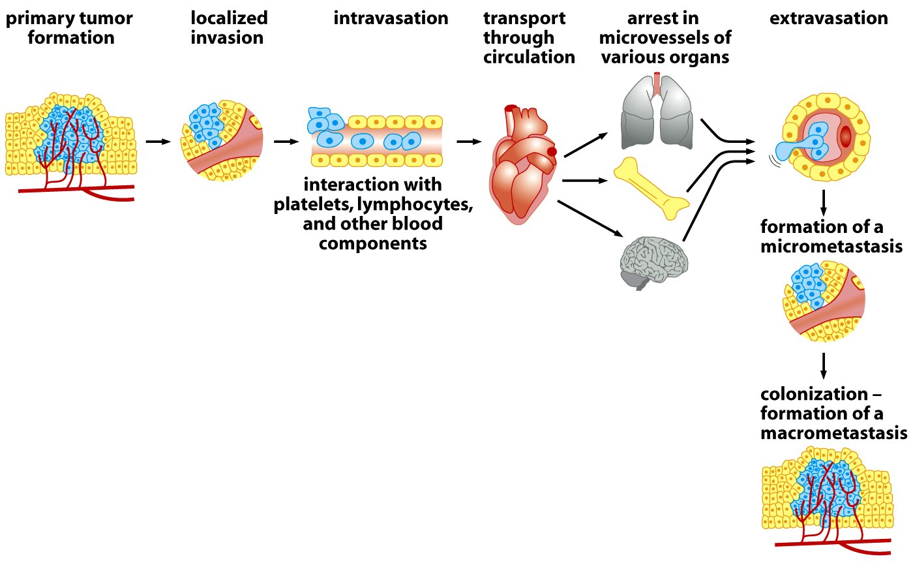
Cancer Metastasis
INVASION
EMT
MMPs
TIMPs
Angiogenesis
Adapted from : The biology of cancer – Robert A. Weinberg

Slide 53
Conclusions
Cancers are the product of a multistep evolutionary process that selects somatic clones of “selfish cells”, capable of evading the multicellular body’s cell fate determination mechanisms as well as the body’s immune defenses
These clones can cooperate with each other
The cancer we treat is not necessarily the same cell clone(s) identified at diagnosis or in the surgical specimen
Need for much more detailed molecular tracking of cancers over time

