Slide 1
Moto circolare uniforme

Slide 2
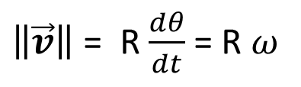
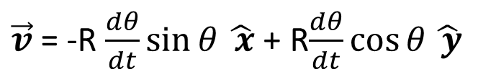
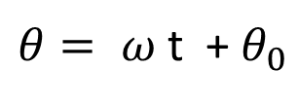
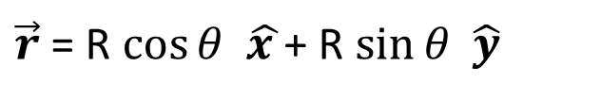
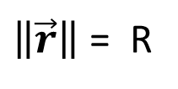
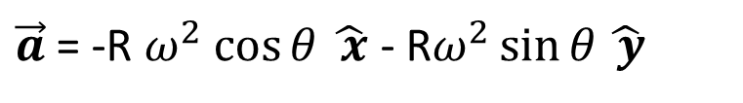
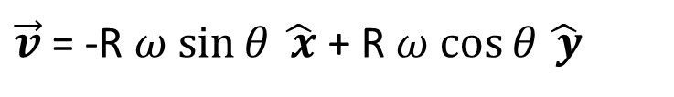
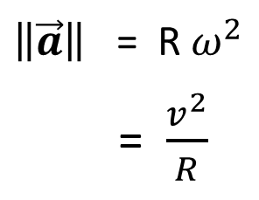
costante
$\vec{r}$ = R $\cos{θ}$ $\hat{x }$+ R $\sin{θ}$ $\hat{y}$
$\left\|\vec{r}\right\|$ = R
$θ= ω$ t + $θ_{0}$
$\vec{v}$ = -R $\frac{dθ}{dt}\sin{θ}$ $\hat{ x}$ + R$\frac{dθ}{dt}cos{θ}\hat{ y}$
velocità angolare, costante
$\vec{v}$ = -R $ω$ $\sin{θ}$ $\hat{ x}$ + R $ω$ $\cos{θ}\hat{ y}$
$\left\|\vec{v}\right\|$ = R $\frac{dθ}{dt}$ = R $ω$
$\vec{a}$ = -R $ω^{2}$ $\cos{θ}$ $\hat{ x}$ - R$ω^{2}\sin{θ}\hat{ y}$
$\left\|\vec{a}\right\|$ = R $ω^{2}$
= $\frac{v^{2}}{R}$

