Slide 1
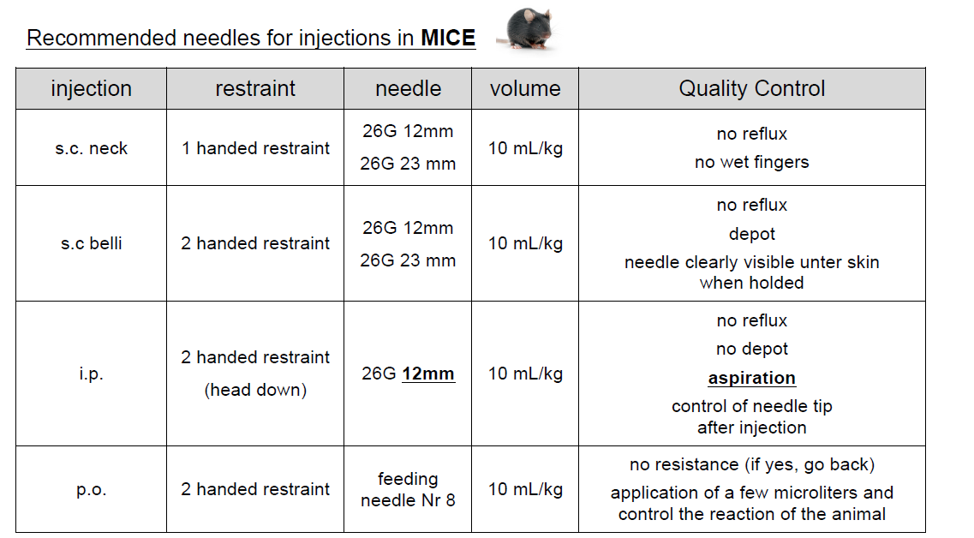

Slide 3
Blood collection methods in rodents
Tail vain (bleeding or syringe)
Submandibular puncture
Saphenous veine puncture
Retroorbital sampling
Sublingual samplin (rat)
Heart puncture

Slide 4
CHOISE OF METHODS ACCORDING TO…
AMOUNT
QUALITY
Tail vein
Saphenous vein
Facialis vein
Sublingual vein
Heart puncture
Sterile only from heart puncture or tail vain (with syringe)
ANAESTHESIA
Tail vein NO
Saphenous vein NO
Submandibular vein NO
Retroorbital YES
Sublingual vein YES
Heart puncture YES (deep and followed by death)
FREQUENCY
http://www.nc3rs.org.uk/bloodsamplingmicrosite/page.asp?id=313

Slide 5
VOLUME AND RECOVERY
10 % body weight and 2 weeks of recovery
Dihel et al. 2001, J. Appl. Toxicol. 21, 15–23

Slide 6
