Slide 1



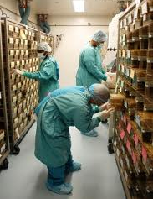
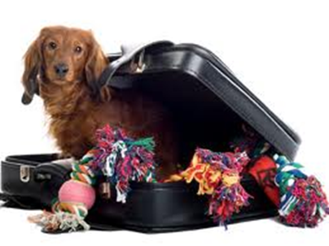
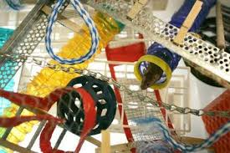
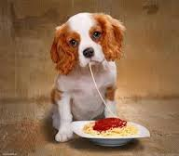
STANDARDIZATION
husbandry, environment, nutrition,
transportation, health status
2010/63/UE

Slide 2
STANDARDIZATION
to reduce the variability of my research results (not only behaviour!) – reduce the number of animal used
factors affecting the laboratoty animals
ENVIRONMENTAL FACTORS
SOCIAL RELATIONS
NUTRITION
HEALTH STATUS
GENETIC FACTORS
MEN

Slide 3
HUSBANDRY AND ENVIRONMENT
Lighting
Noise
Air
Cage - enrichment
MACROENVIRONMENT
MICROENVIRONMENT

Slide 4

HUSBANDRY AND ENVIRONMENT - LIGHT
Light at the cage levels shoul be between 130 and 325 Lux
325 Lux are sufficient for animal care
more than 400 Lux are phototoxic (retinal damage), expecially in albino animals
light in the animal room must be uniform
problem for standardization: different rack leavels – different illumination:
  rotate cages position
  provide animals with ways to control their own light (i.e. tunneling material)
  never put cages to close to the light source, never use the upper side of the rack

Slide 5
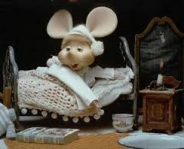
HUSBANDRY AND ENVIRONMENT – circadian rhythm
Light – darkness cycle
12 – 12 hours
14 – 10 hours
Rodents active during the darkness
Effects on physiological parameters
Standardization: experiments at same time of the day
Eventually a room with reversed light/darkness cycle can be useful for behavior experiments

Slide 6
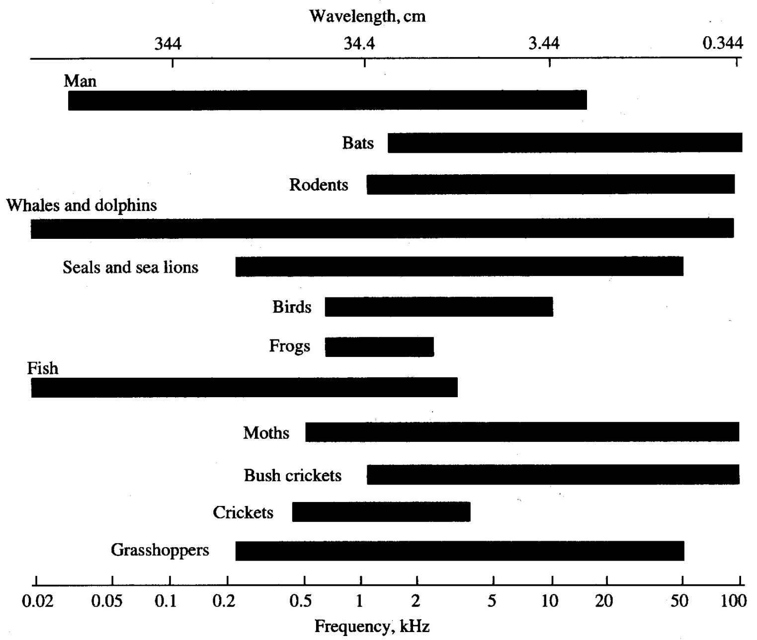
HUSBANDRY AND ENVIRONMENT – noise and vibrations

Slide 7
HUSBANDRY AND ENVIRONMENT – noise and vibrations
NOISE PRODUCED BY HUMANS OR ANIMALS
Separation of human and animal activity
Noisy animals (dogs, monkeys, birds) separated from quiet animals (rodents, rabbit)
Personnal should avoid the production od unnecesary noise
Training people to minimize noise, special equipment to avoid noise, adeguate maintenace of equipments
Avoide the use of sound generators (music, alarm, cell phone)

Slide 8
HUSBANDRY AND ENVIRONMENT – noise and vibrations
NOISE PRODUCED BY EQUIPMENT
Cage washer
Video display terminals - computer
Running tap water
Heating, ventilating and air conditioning system
Becouse it is not possible to avoide noises, we can use a background noise 24h to decrease the effects of suden noise. For instance radio

Slide 9
HUSBANDRY AND ENVIRONMENT – air
TEMPERATURE
 | Temperature °C
Mouse, rat, hamster, gerbil, guinea pig | 21 - 24
Rabbit | 15 - 21
Cat, dog, nonhuman primate | 18 - 29
Animals should be provided with adequate resurces for thermoregulation (nesting material)

Slide 10
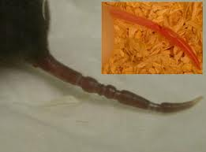
HUSBANDRY AND ENVIRONMENT – air
HUMIDITY
30 – 60%
High humidity | Low humidity
Reduced food consumption | Ring tail
Impaired body temperature regulation
Decreased activity
Enanched desease transmission
Increased NH₃ production

Slide 11
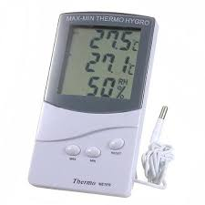
HUSBANDRY AND ENVIRONMENT – air
MAX-MIN THERMO HYGRO
2010/63/UE - temperature must be checked and register every day

Slide 12
HUSBANDRY AND ENVIRONMENT – air
VENTILATION
Provide appropriate air quality and a stable environment
Provides an adequate oxygen supply
Removes thermal loads caused by the animals, personnel, lights, and equipment
Dilutes gaseous and particulate contaminants (allergens and airborne pathogens)
Adjusts the moisture content and temperature of room air
Creates air pressure differentials
Ventilating the room does not necessarily ensure adequate ventilation of an animal’s primary enclosure, that is the air to which the animal is actually exposed

Slide 13
HUSBANDRY AND ENVIRONMENT – air
VENTILATION
10 – 15 fresh air changes/h
Avoid high moving air
Consider:
  room volume
  number of mice/room and mice/cage,
  frequency of cage changing
  efficiency of air distribution both in the room and in the cage

Slide 14


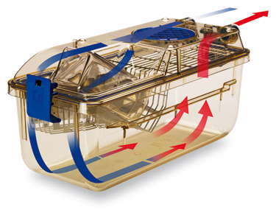
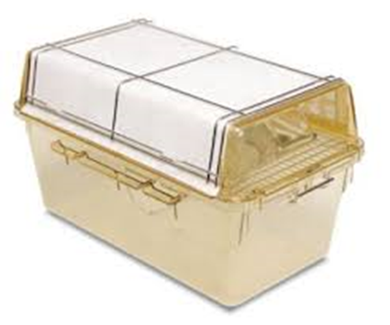
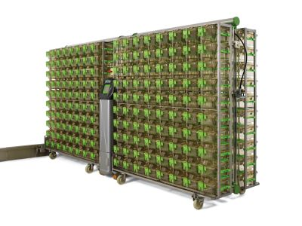
HUSBANDRY AND ENVIRONMENT – air
VENTILATION
INDIVIDUALLY VENTILATED CAGE
TOP FILTER CAGE
  ↑ cage change frequency (2/week)
  ↓number of mice/cage
  ↓ humidity
  ↓ cage change frequency (2/month)

Slide 15
HUSBANDRY AND ENVIRONMENT – cage and environment
SPACE
Rodents are social animals but they need adequate space!
Mouse
Peso corporeo (g) | Dimensione minima alloggiamento (cm²) | Spazio al suolo per animale (cm²) | Altezza minima alloggiamento (cm²)
Fino 20 | 330 | 60 | 12
20 - 25 | 330 | 70 | 12
25 - 30 | 330 | 80 | 12
˃ 30 | 330 | 100 | 12
Coppia monogama o trio | 330 | Aggiungere 180 per ogni femmina in piu | 12
2010/63/UE

Slide 16
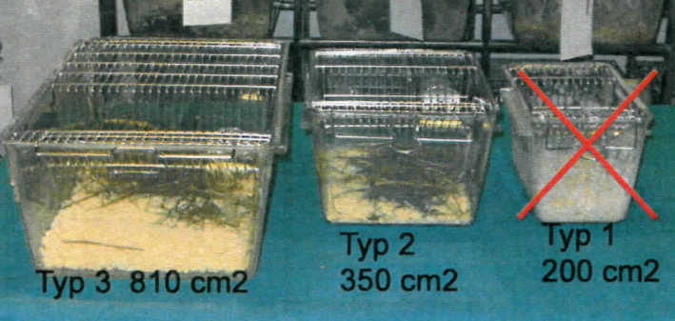
HUSBANDRY AND ENVIRONMENT – cage and environment
SPACE
Mouse
13 ˂ 20 g
8 > 20 g
5 ˂ 20 g
3 > 20 g

Slide 17
HUSBANDRY AND ENVIRONMENT – cage and environment
SPACE
Rat
Peso corporeo (g) | Dimensione minima alloggiamento (cm²) | Spazio al suolo per animale (cm²) | Altezza minima alloggiamento (cm²)
Fino 200 | 800 | 200 | 18
200 - 300 | 800 | 250 | 18
300 - 400 | 800 | 350 | 18
400 - 600 | 800 | 450 | 18
˃ 600 | 1500 | 600
Coppia | 800 | Aggiungere 400 per ogni femmina in piu | 18
2010/63/UE

Slide 18
HUSBANDRY AND ENVIRONMENT – cage and environment
SPACE
Not all members of a social species are necessarily socially compatible
Social housing of incompatible animals can induce chronic stress and injury
Subordinate male mice often present depressed phenotype
Grouped mice from a young age
Enrichment
Female increase male aggressiveness
Incompatible individuals need to be separated
Single housing of social species should be the exception and justified

Slide 19
HUSBANDRY AND ENVIRONMENT – cage and environment
ENVIRONMENTAL ENRICHEMENT
2010/63/UE – the enrichment of the cage is essential
“Environmental enrichment is any modification in the environment of the captive animals that seeks to enhance its physical and psychological well-being by providing stimuli meeting the animals’ species-specific needs”
Cage with no enrichment lead to:
  abnormal brain development
  physiologic dysfunction
  behavioral disorders (mood, anxiety and cognition)

Slide 20
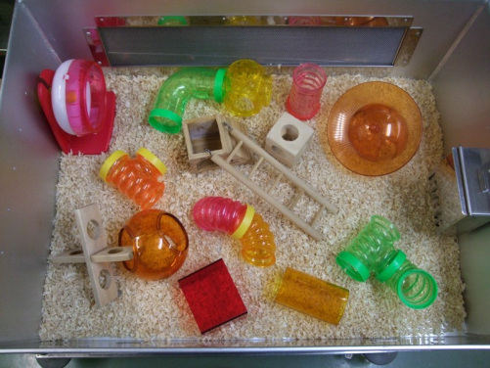

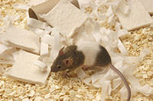
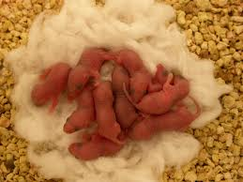
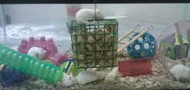
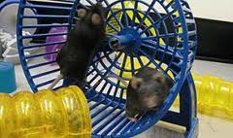
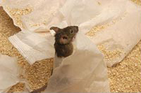
HUSBANDRY AND ENVIRONMENT – cage and environment
ENVIRONMENTAL ENRICHEMENT
NO STANDARDIZATION
STANDARDIZATION
SHELTERS
NESTING MATHERIAL
OCCUPATION
KLEENEX ON THE COVER GRID

Slide 21
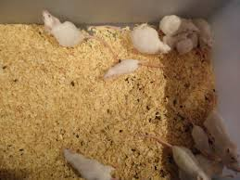
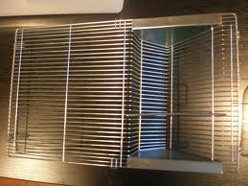

HUSBANDRY AND ENVIRONMENT – cage and environment
CLEANING
2/week – 2/month
(number, and size; type and size of the enclosure; macro- and micro-environmental temperature, humidity, ventilation; urinary and fecal output; appearance and wetness)
2/month
1/week
Hot waters, chemicals, pay attention to details!
Disinfection program

Slide 22
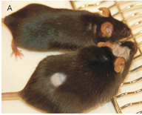
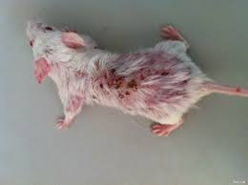
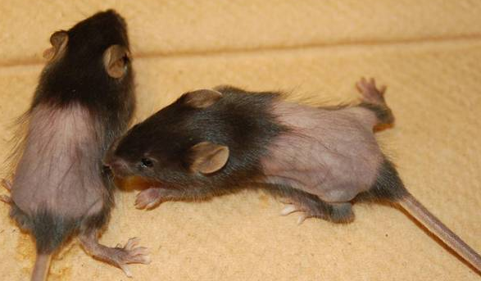
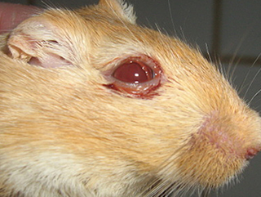
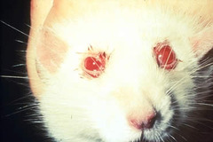
HUSBANDRY AND ENVIRONMENT
fight
porphyrine deposit

Slide 23
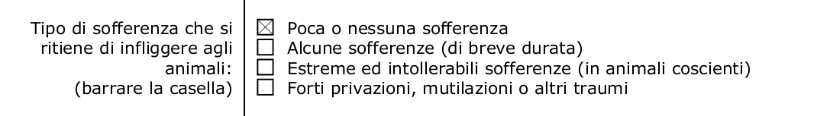
HUSBANDRY AND ENVIRONMENT
SURE???
The condition during the breeding are often a higher charge for animal than the experimentation itself

Slide 24
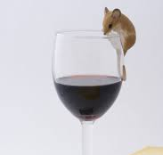
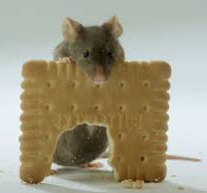
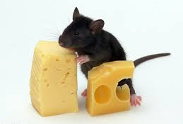
NUTRITION
STANDARDIZATION
Natural ingredient diet is not enough standardized for my research
Standardize in my lab but also across differnt labs
Diet must be adapted to:
Species
Age
Gender
Transgenic
Desease and organs failure

Slide 25
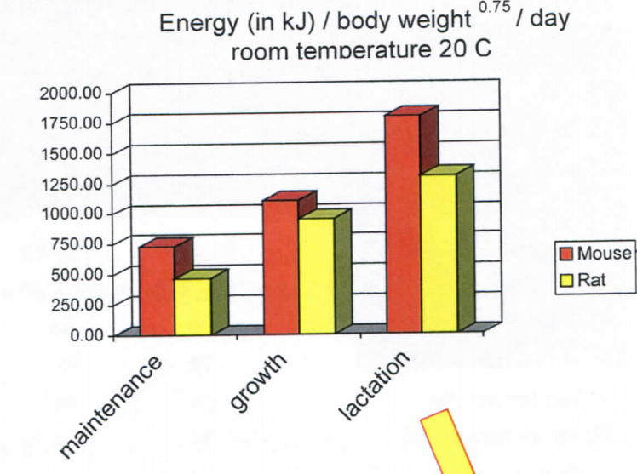
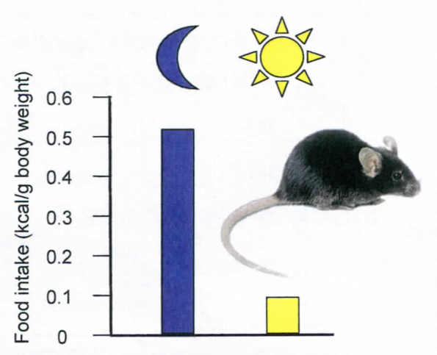
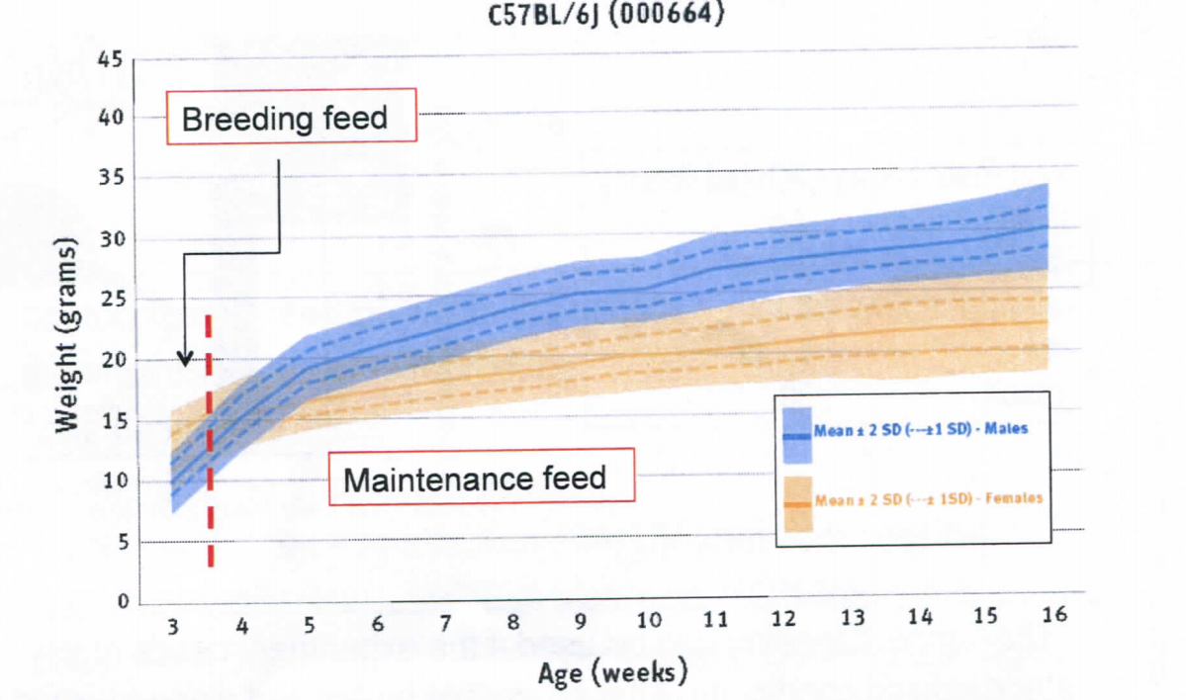
NUTRITION
Breeding feed from mating to weaning age
Maintenance feed after weaning age

Slide 26

NUTRITION
GLOBAL STANDARDIZED DIET
(American Institute of Nutrition)
AIN-93G
AIN-93M
To have a standardize diet:
  Store in appropriate conditions
  Not use after the expiration date
  Change food once a week

Slide 27

NUTRITION – hygiene treatment
FOOD
WATER
autoclaving (special food)
irradiation
UV light
reverse osmosis
autoclaving
acidification (pH 2.5 – 3.0)
chlorinization

Slide 28
NUTRITION
Food and water can be used to provide animals with drugs…
effect of the carrier
effect of the drug on the carrier (taste)
substance sensitive to light or temperature
amount of substance injested by one animals (hierarchy effects)

Slide 29
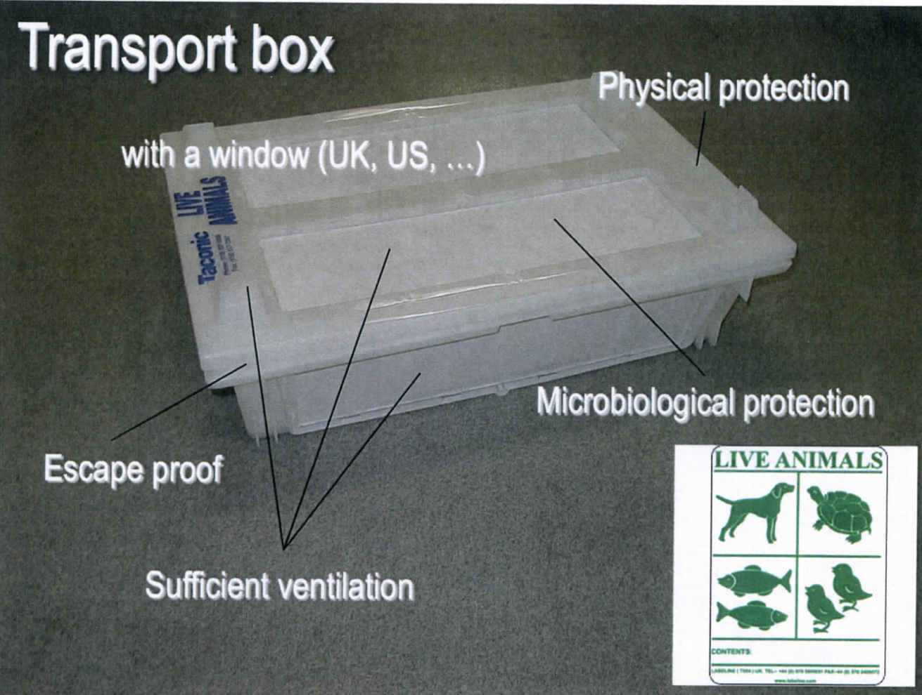
TRANSPORTATION

Slide 30
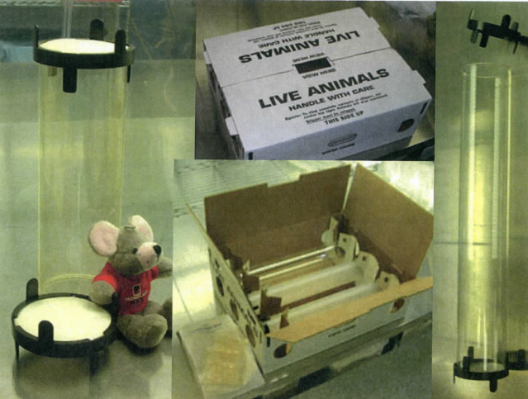
TRANSPORTATION

Slide 31
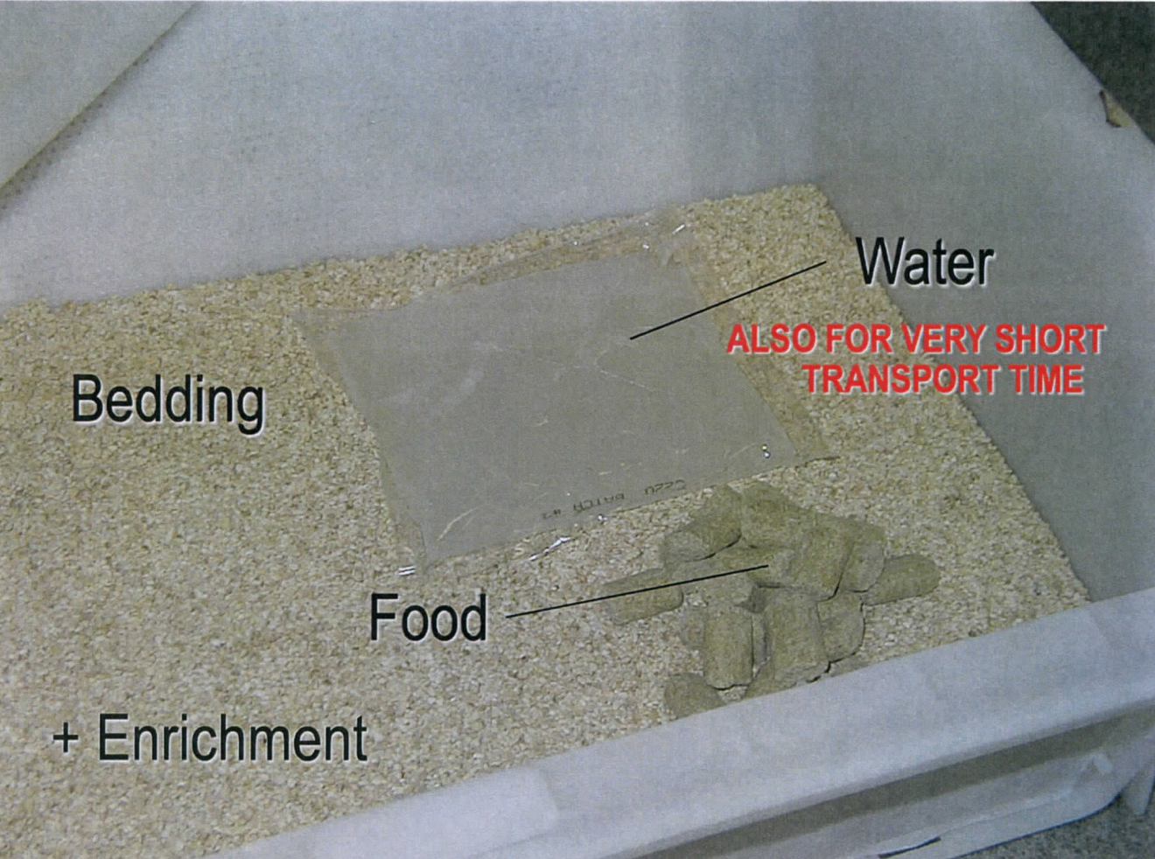
TRANSPORTATION
Check the documents!!!

Slide 32
TRANSPORTATION
STRESSOR:
Transportation
Temperature, humidity
Vibration, noise
Light cycle
Change in the new facility
Cages, bedding, feed, people
Regrouping
Environmental conditions
Microbiological state
Acclimatisation period is one of the most important component for the preparation of experiments with lab animals

Slide 33
TRANSPORTATION
SPECIES | ADAPTATION TIME (DAYS)
mouse | 5 -15
rat | 5 - 15
guinea pig | 5 - 15
hamster | 5 - 15
pig, sheep, chicken | 7
rabbit | 20 - 30
cat | 20 - 30
dog | 20 - 30
primate | 40 . 60

Slide 34
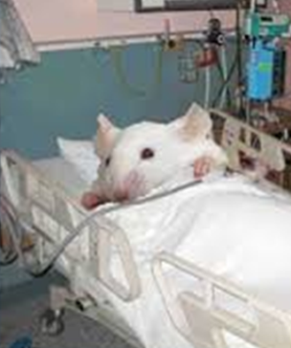
HEALTH STATUS/HYGEN LEVELS
GERMFREE/AXENIC | Free of associated form of life
GNOTOBIOTIC | Axenic animals that have been intentional inoculated with a well-defined mixture of microorganisms
SPF (specific pathogen free) | All pathogens excluded (FELASA list)
OHC (optimal hygene conditions) | Almost all pathogens excluded
CONVENTIONAL

Slide 35
HEALTH STATUS/HYGEN LEVELS
Animal welfare
Occupational health and safety
Failure to experiments
(also cell culures and isolated organs)
Alteration of experimental data
(both clinical and sublinical infections)
A conventional animal will never enter
in a SPF animal facility – keep in mind for collaboration

Slide 36
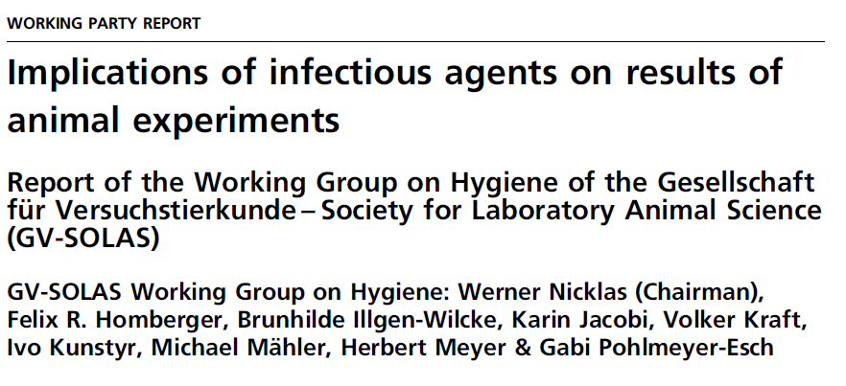
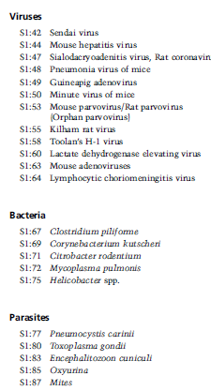
HEALTH STATUS/HYGEN LEVELS
Many agents don’t produce evident clinical signs
Anyway they alter the animal phisioloy and results of animal exp.
Infections increase inter-indvidual variability
Infections cal lead to false conclusions and misinterpretations of the results
Infections are responsable of lack of riproducibility

Slide 37
HEALTH STATUS/HYGEN LEVELS
TEST
RULES
FACILITY

Slide 38
HEALTH STATUS/HYGEN LEVELS
TEST
RULES
FACILITY

Slide 39
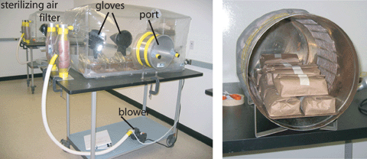
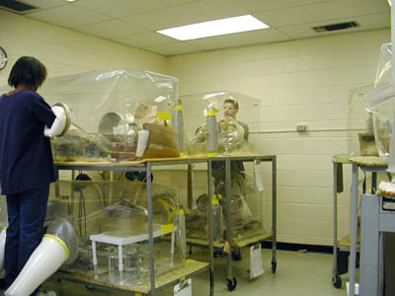
CAGE I – ISOLATOR
GERMFREE, GNOTOBIOTIC,
SPF ANIMALS

Slide 40
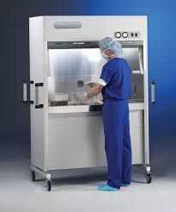
CAGE II – INDIVIDUALLY VENTILATED CAGES
Work under laminal flow system!
OHC,
SPF ANIMALS

Slide 41

CAGE III – TOP FILTER CAGES
Work under laminal flow system!
OHC,
SPF ANIMALS
NO GOOD VENTILATION

Slide 42
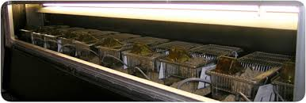
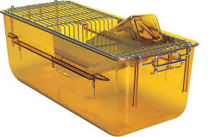
CAGE IV – CONVENTIONAL CAGES
CONVENTIONAL ANIMALS
CONTAMINATION!

Slide 43
HEALTH STATUS/HYGEN LEVELS
TEST
RULES
FACILITY

Slide 44

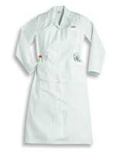
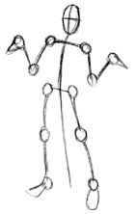
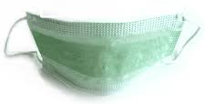

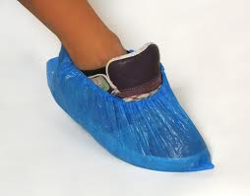
RULES

Slide 45
HEALTH STATUS/HYGEN LEVELS
TEST
RULES
FACILITY

Slide 46
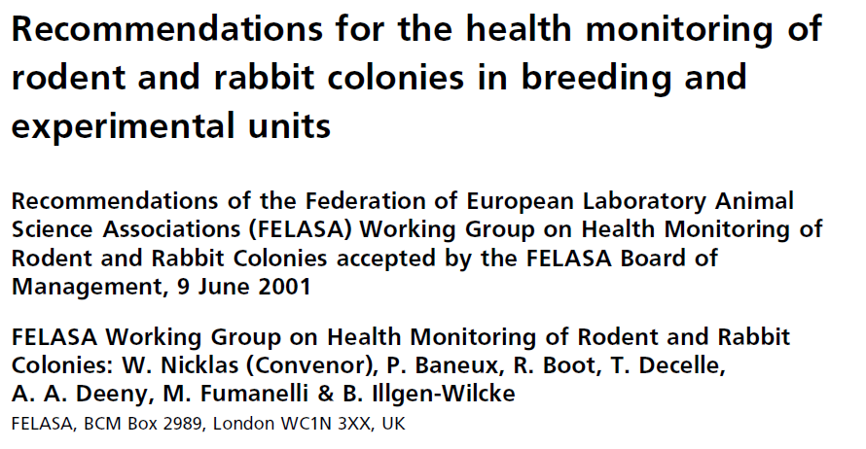
HEALTH STATUS/HYGEN LEVELS

Slide 47


QUALITY CONTROL - how to check the health status of my animals?
WHEN?
Detection of abnormal situation by the stuff
Routine
Every 3 months
(FELASA raccomandation)
Import of animals

Slide 48

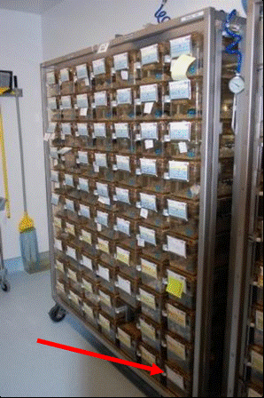
QUALITY CONTROL - how to check the health status of my animals?
WHICH ANIMALS?
SENTINEL ANIMAL
dirty bedding, water bottle and food from all the cages of the same rack
at least 8 weeks before testing
Mouse: CD-1
Rat: Sprague Dawley

Slide 49
QUALITY CONTROL - how to check the health status of my animals?
WHICH TEST?

Slide 50
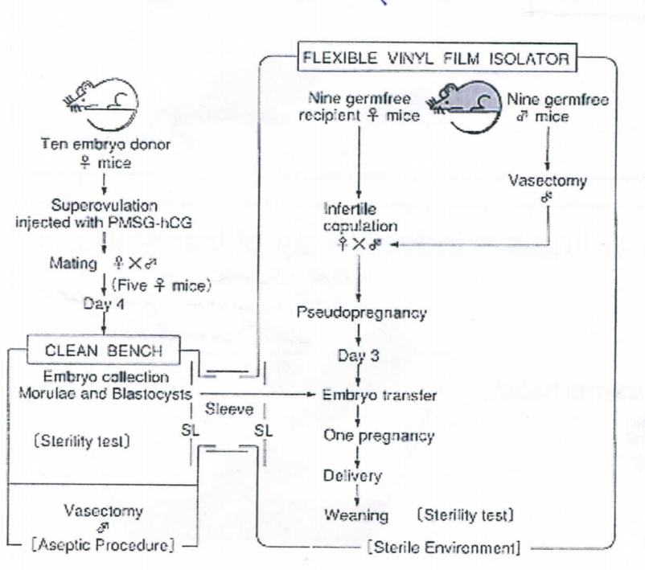
QUALITY CONTROL - how to check the health status of my animals?
WHEN A CONTAMINATION OCCURS?
VIRUS – no treatment
BACTERIA – antibiotics
PARASITES – antiparasistics
EMBRYO TRANSFER

Slide 51
HUMANE ENDPOINTS
Minimize pain and distress by choosing the earliest possible endpoint that is still predictive, practical and compatible with the scientific research in a given project – death is not a good endpoint
No list with specific endpoint criteria – specific for each research
When an animal is no longer going to provide scientifically useful information because it is physically or psychologically disturbed
When the suffering caused to the animal id higher than predicted and there is no cost-benefit proportionality
When the animal is experiencing «severe pain and distress»
When an higher suffering is not necessary for the scientific outcome of the study
Establish a specific score sheet for each experiment/species/strain
Perform a pilot study with few animals to determine it
Share it and re-evaluate constantly

Slide 52
SCORING SYSTEMS - example

Slide 53
SCORING SYSTEMS - example

Slide 54

SCORING SYSTEMS - example

