Slide 1
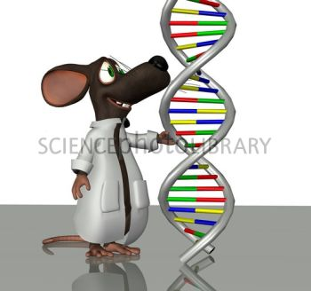
Genetic modified mice
Standardization of the genetic background
Identification and genotyping

Slide 2
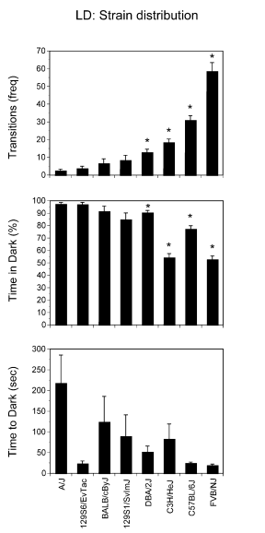
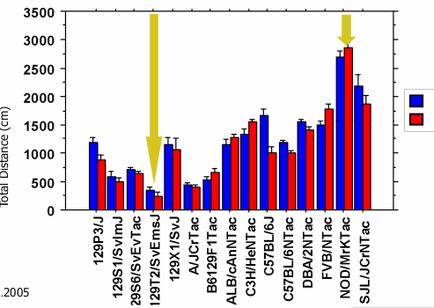
STANDARDIZATION OF THE GENETIC BACKGOUND
GENETIC BACKGROUND MAKES A DIFFERENCE

Slide 3
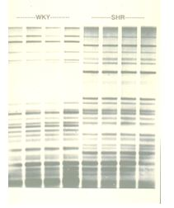
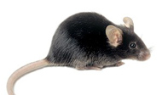
STANDARDIZATION OF THE GENETIC BACKGOUND
INBRED STRAIN
Is the result of at least 20 generation of brother x sister mating
All individuals are genetically identical
Homozygosity
Long-term stability
Is a unique and constant representation of the genotype of the parents
Must be maintained by continuous inbreeding
Huge strain specific characteristics
Phenotypic uniformity
Less intra-individual variability – reduced number of animals required
Reduced vitality (less robust animals) and reduced reproductive performance
“Inbred strains should be used in all experiments using mice or rats unless the use of an outbred stock is specifically justified for a particular project”
C57BL/6 Inbred Mice

Slide 4
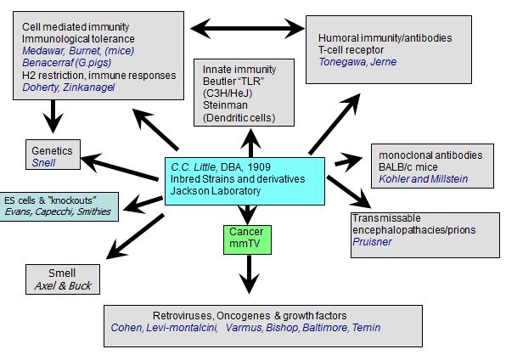
STANDARDIZATION OF THE GENETIC BACKGROUND
Twenty-four Nobel prizes which depended on the use of inbred strains

Slide 5
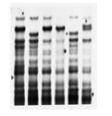
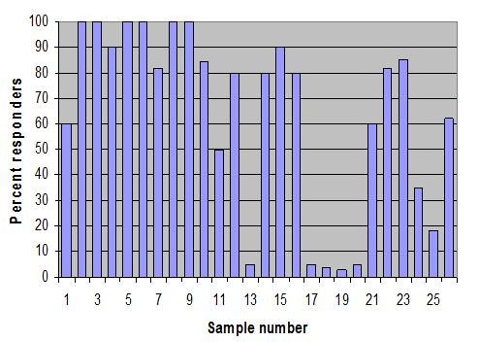
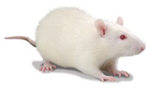
STANDARDIZATION OF THE GENETIC BACKGROUND
OUTBRED STOCKS
Random mating to minimized inbreeding and maintains genetic variability
Each animal is genetically different
Undefined genotype
High intra-individual variability – higher number of animals required
Not stable
Robust animals and high reproductive performance
Cheap
Used in toxicology but now this point is controversial
percent responders to a synthetic polypeptide
sequential samples of Sprague-Dawley rats from the same breeder over a period of about 18 months (30 rat/group)
ICR (CD-1®) Outbred Mice
Sprague Dawley® Outbred Rat

Slide 6
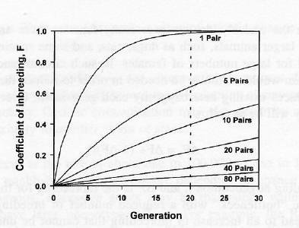
STANDARDIZATION OF THE GENETIC BACKGROUND

Slide 7
STANDARDIZATION OF THE GENETIC BACKGROUND
HYBRIDS
F1 hybrid mice are produced by crossing mice of two different inbred strains
Genetically defined
Phenotypically uniform
As long as the parental strains exist F1 hybrids can be generated
Robust animals
F2 hybrid mice are the offspring of F1 hybrid parents
Genetically not defined
Unique random mixture of alleles from both parental strains

Slide 8
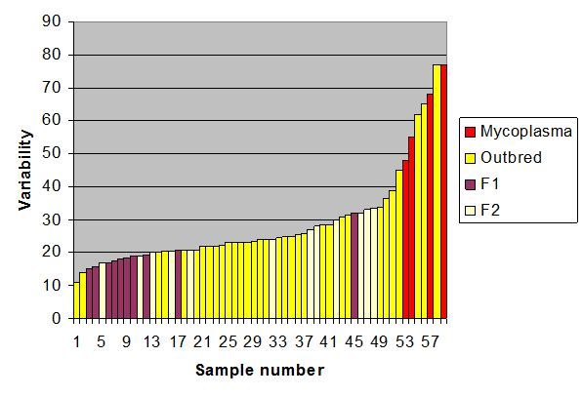
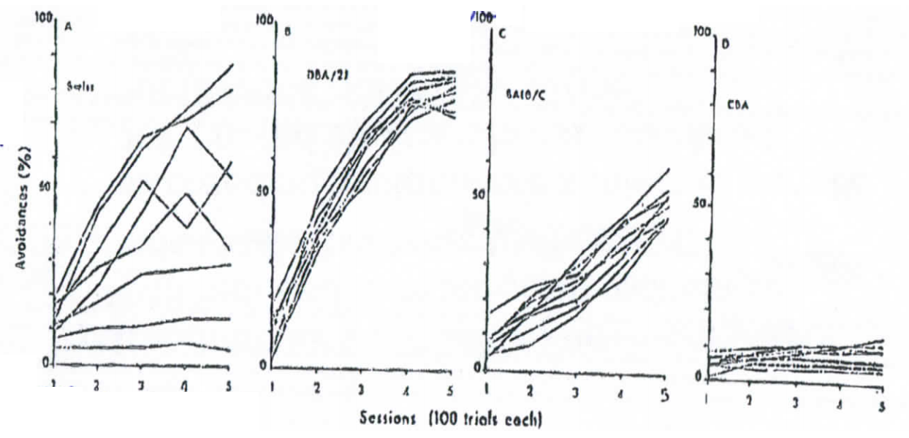
STANDARDIZATION OF THE GENETIC BACKGROUND
Sleeping time under barbiturate anesthetic
kidney weight in 58 groups of rats (N=approx 30 in each group)
Learning avoidance

Slide 9
STANDARDIZATION OF THE GENETIC BACKGROUND
Problems with transgenic mice:
Undefined mixed genetic background due to:
generation of transgenic animals using ES cells from an hybrid 129-derived cells
combination of different transgenic lines from different origin with different genetic background
Solutions:
backcross
compare littermates born from heterozygous
generation of transgenic animal using inbred strain derived ES – less efficient system

Slide 10
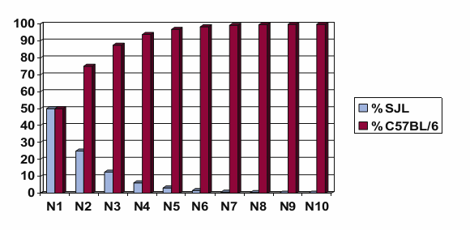
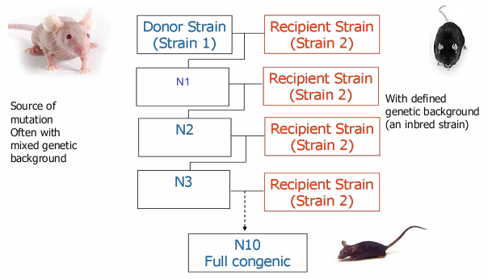
STANDARDIZATION OF THE GENETIC BACKGROUND
BACKCROSS
Transfer of a defined allele or mutation from a given genetic background (donor) into a different genetic background (recipient) by repeated crosses of mutation carriers with recipient type animals
Result: congenic animals
2.5 years

Slide 11
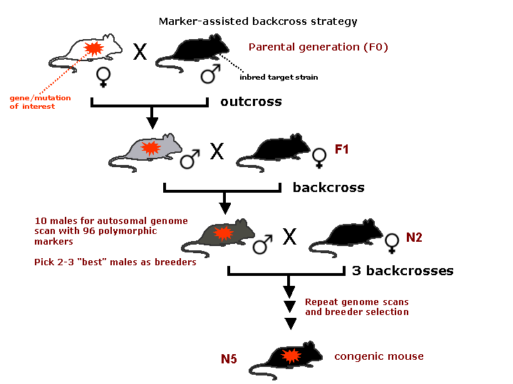
STANDARDIZATION OF THE GENETIC BACKGROUND
SPEED CONGENICS

Slide 12
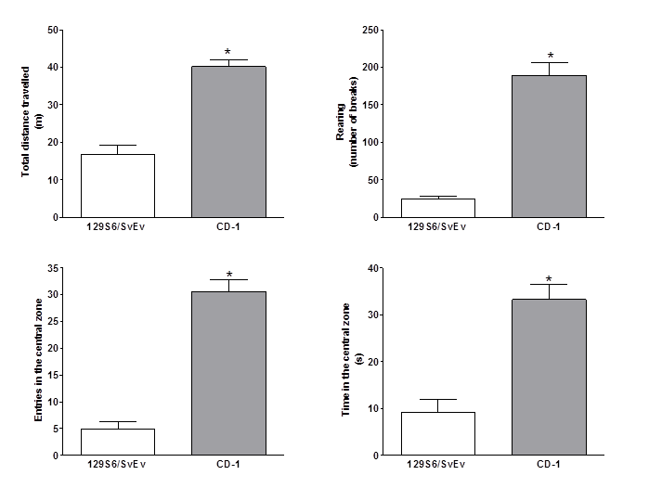
STANDARDIZATION OF THE GENETIC BACKGROUND
BACKCROSS

Slide 13
BREEDING STRATEGIES
Sexual maturity: 6-8 weeks
Reproductive life span: 7-8 months
Fertility strongly depends from the strain
Gestation: 18 – 21 days
Litter size: 3 -12
Weaning age: 18 – 28 days
OPTIMIZING BREEDING PERFORMANCE
Mate mice 8 weeks old
Use experienced male
Replace non productive breeders
Mate numerous female simultaneously
Remember that reproductive performance are strongly determined by temperature, humidity, noise, vibrations, odors, handling, nutrition and health
If necessary litter fostering
Jackson Laboratory

Slide 14
BREEDING STRATEGIES
HOMOZYGOUS MUTANT (-/-) X HOMOZYGOUS MUTANT (-/-)
Verify breeding genotype at least every 2 generations
To maintain the inbred background backcross on the parental strain at least every 10 generations
HETEROUZYGOUS MUTANT (-/+) X HETEROUZYGOUS MUTANT (-/+)
Genotype every individual
To maintain the inbred background backcross on the parental strain at least every 10 generations
OUTBRED STOCKS
Mate unrelated mice randomly
At least 25 breeding pairs
Outcrossed every 5 years
Jackson Laboratory

Slide 15
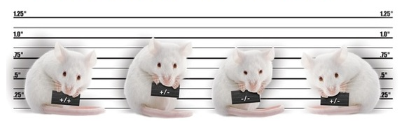
IDENTIFICATION AND GENOTYPING
Permanent or temporari identification
Invasive or non-invasive methods
Generating tissues sample for genotyping or not
In breeding
Invasive methods accepted
The identification for genotyping must be combine with collection of sample
In experimentation
Invasive methods should be avoided

Slide 16
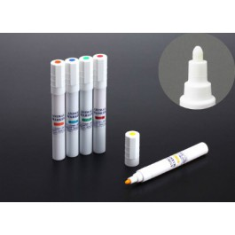
IDENTIFICATION AND GENOTYPING
NON INVASIVE TEMPORARY METHODS
Skin or tail marking

Slide 17
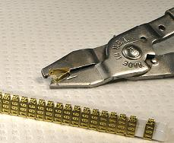
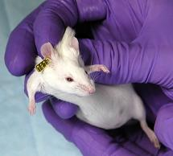
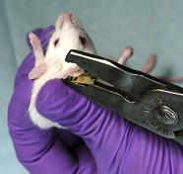
IDENTIFICATION AND GENOTYPING
INVASIVE TEMPORARY METHODS NOT GENERATING DNA SAMPLES
Ear tag
At the weaning age or later
0.18 g tag for a mouse = more than 500 g for a human

Slide 18
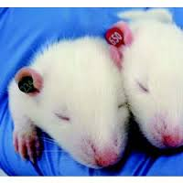
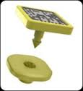
IDENTIFICATION AND GENOTYPING
INVASIVE TEMPORARY METHODS NOT GENERATING DNA SAMPLES
New plastic ear tag
rapID tags

Slide 19
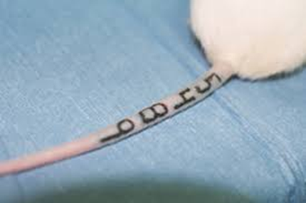
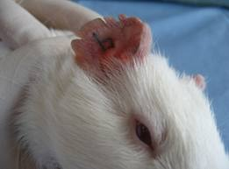
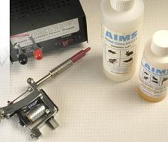
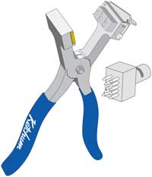
IDENTIFICATION AND GENOTYPING
INVASIVE PERMANENT METHODS NOT GENERATING DNA SAMPLES
tattoo
tail
ear
At the weaning age or later

Slide 20
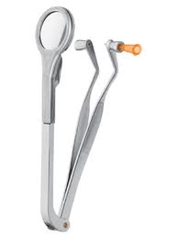
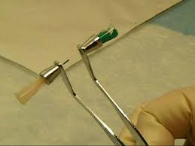
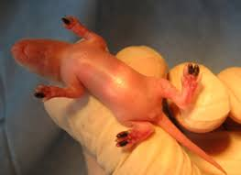
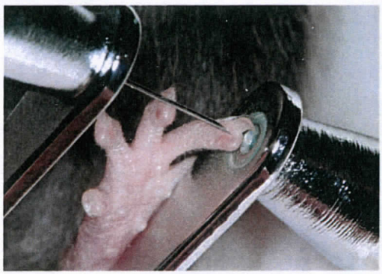
IDENTIFICATION AND GENOTYPING
INVASIVE PERMANENT METHODS NOT GENERATING DNA SAMPLES
Micro-tattoo
At the weaning age or later

Slide 21
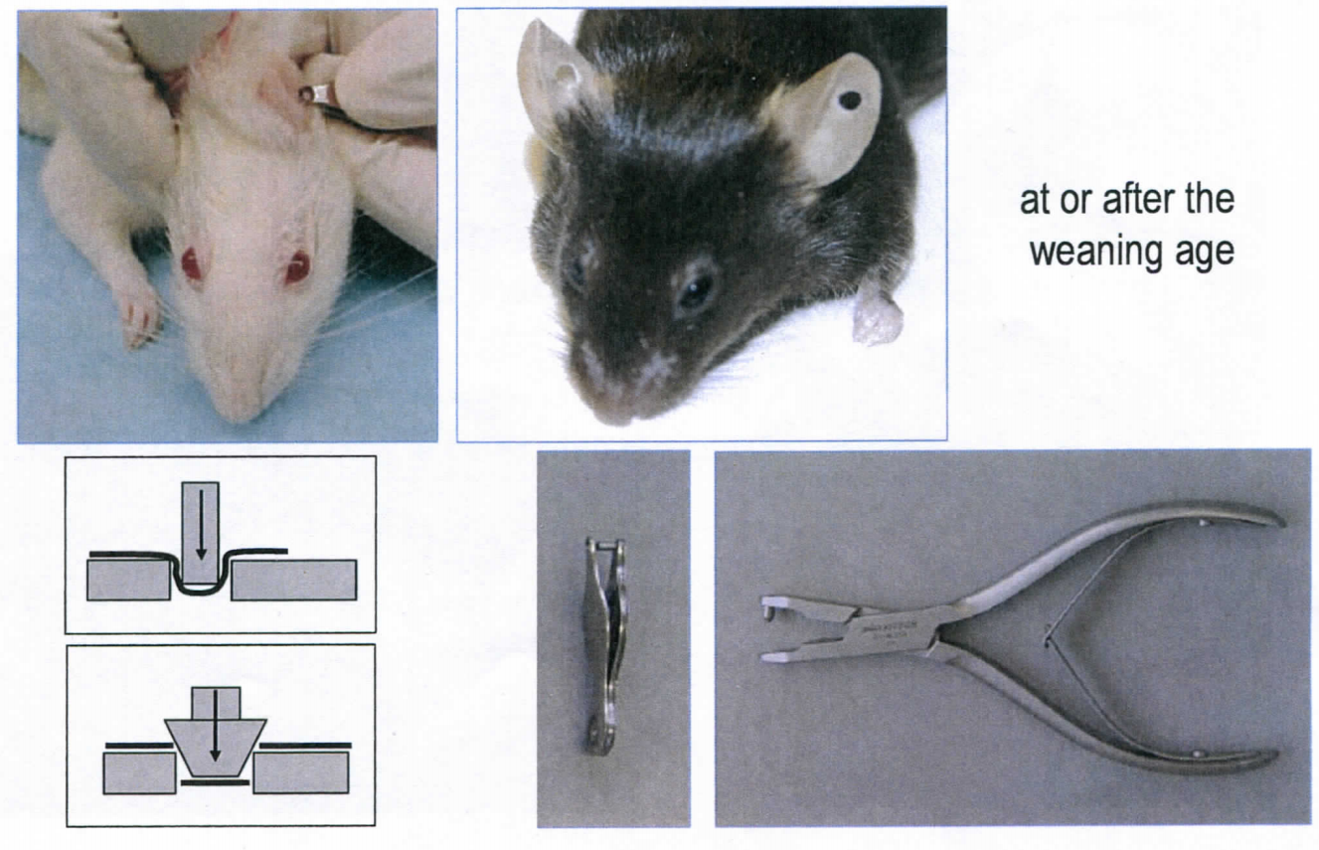
IDENTIFICATION AND GENOTYPING
INVASIVE PERMANENT METHODS GENERATING DNA SAMPLES
Ear clipping

Slide 22
IDENTIFICATION AND GENOTYPING
INVASIVE PERMANENT METHODS GENERATING DNA SAMPLES
Distal phalanx cutting

Slide 23
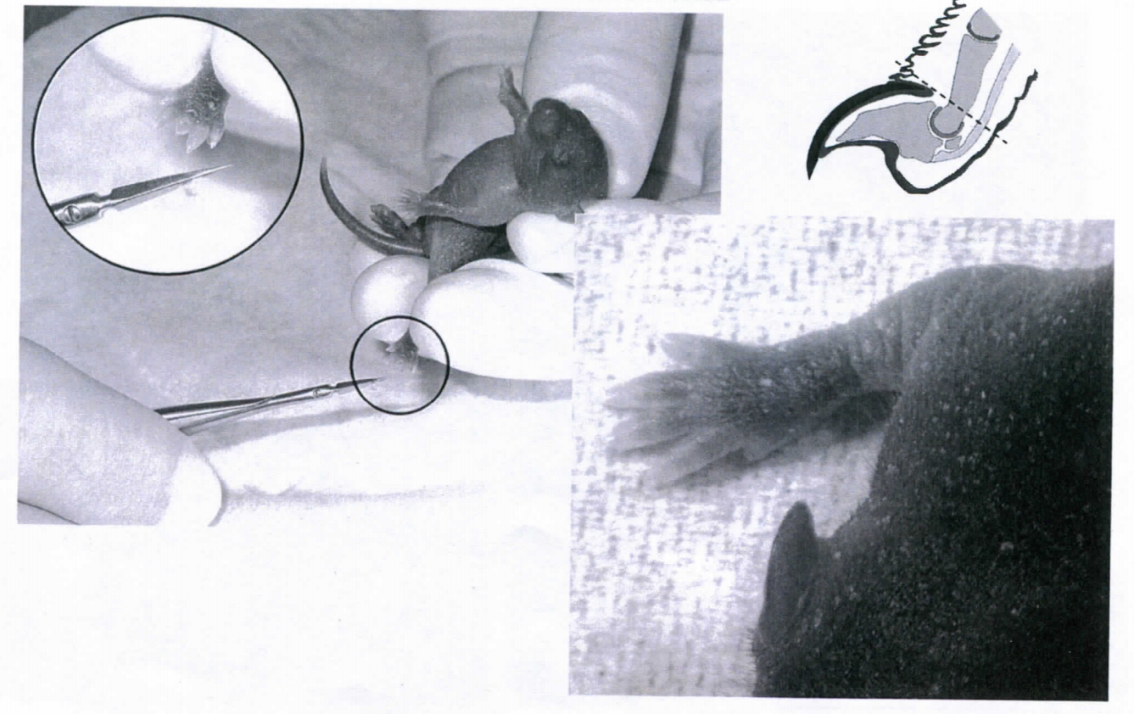
IDENTIFICATION AND GENOTYPING
INVASIVE PERMANENT METHODS GENERATING DNA SAMPLES
Distal phalanx cutting

Slide 25
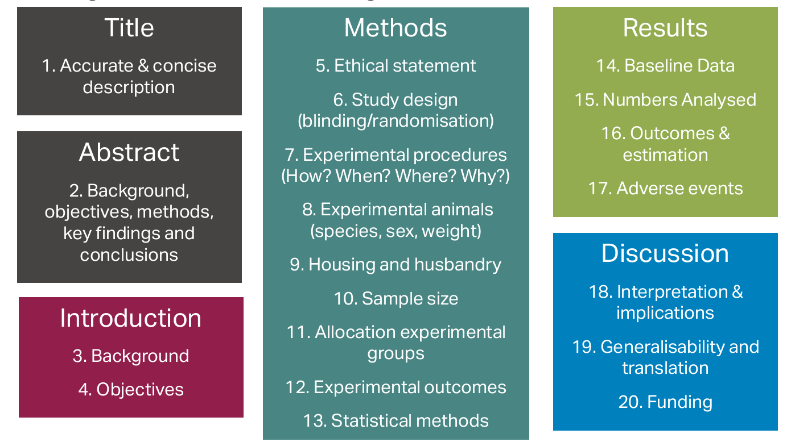
The ARRIVE guidelines: Animal Research: Reporting of In Vivo Experiments

Slide 26
http://www.nc3rs.org.uk/
http://www.basel-declaration.org/
http://www.felasa.eu/
www.mmrrc.org
http://www.humane-endpoints.info/
http://www.informatics.jax.org/

