Slide 1
Nelson Mandela
One of the most courageous and best-loved men of all time

Slide 2
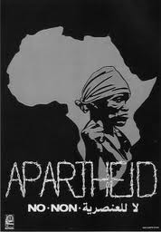

Slide 3

ANC – the African National Congress logo

Slide 4
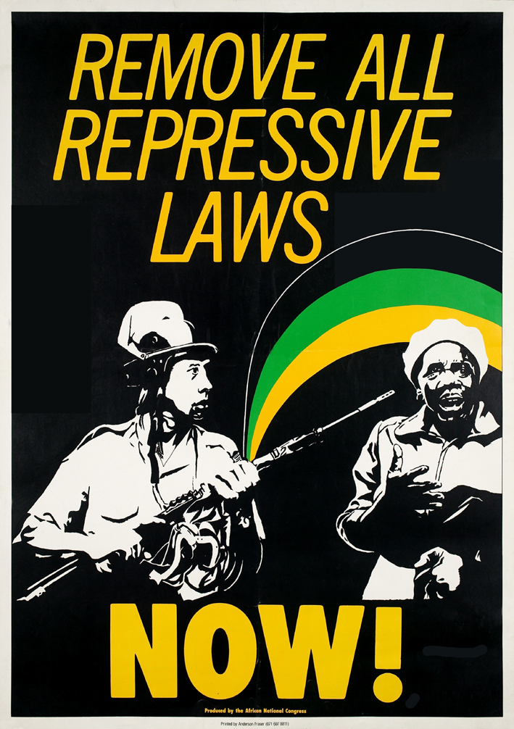

Slide 5
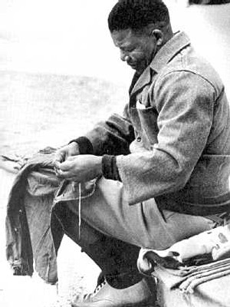
Sentenced to imprisonment

Slide 6
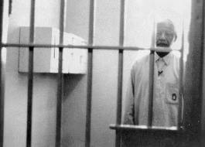
Many years later …

Slide 7
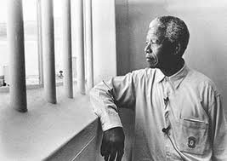
Long walk to freedom …

Slide 8
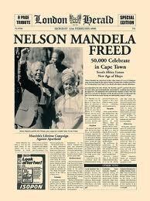

Slide 9
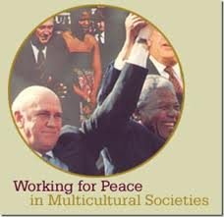
Mandela and De Klerk together

Slide 10
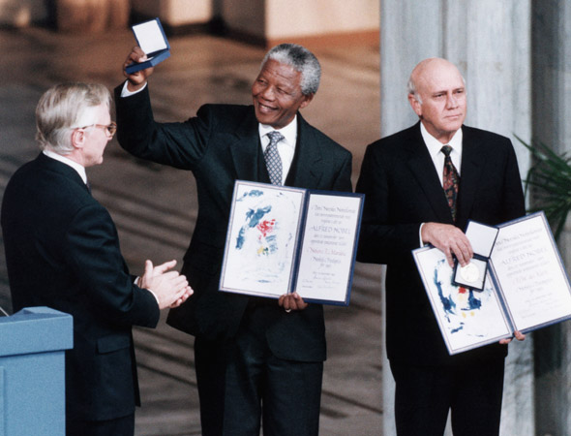
1993 – winners of the Nobel Peace Prize

Slide 11
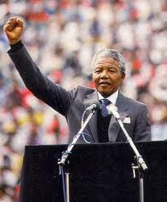
Mandela becomes President

Slide 12
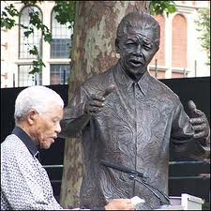
Mandela statue inaugurated in Parliament Square, London - 2007
“Though this statue is of one man, it should symbolise all those who have resisted oppression.”

Slide 13
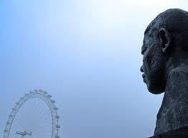
Mandela statue and the London Eye

Slide 14
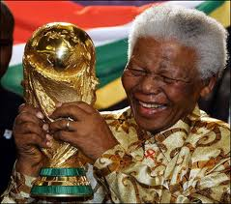
World Cup South Africa 2010

Slide 15
Video footage of
Nelson Mandela
Archive: Nelson Mandela freed from prison after 27 years
http://news.bbc.co.uk/2/hi/8509253.stm
Nelson Mandela: 'We never felt hopeless‘
http://news.bbc.co.uk/2/hi/africa/8509236.stm
www.ezakwantu.com/Gallery%20Nelson%20M...
A tribute to Nelson Mandela – Video Clips - Historic Nelson Mandela (Madiba) Movies and South African Township Music - Freedom - A New South Africa.

