Slide 1
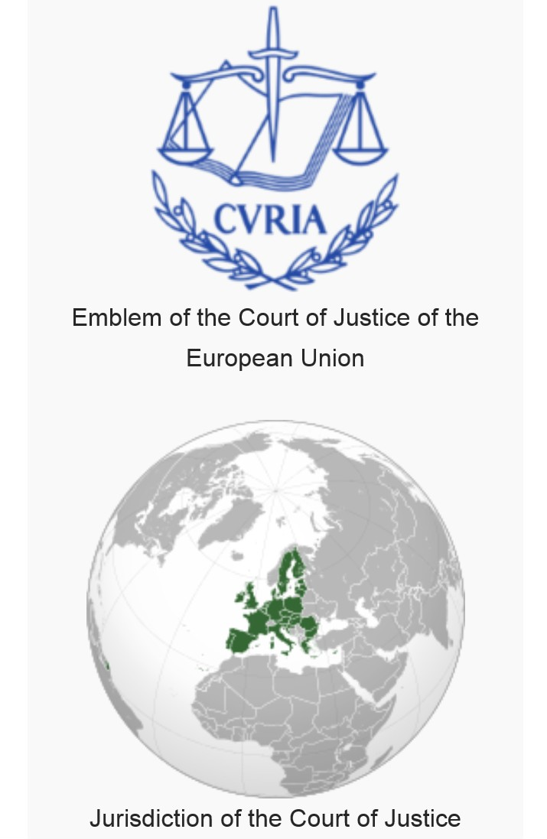
Case: 266/14
Professor: Silvia Borelli
Student: Claudia Rapisardi
Matricola: 118323 (Master in Economics Smes Unife)

Slide 2


Slide 3
I have studied the Judgement of the Court C266/14. This judgement had its origin from the request of Spanish workers of Tyco. According to these workers they wanted that their spent time during daily transferring could be recognized, considered “working time”. On daily travel between their homes and the premises of the first and last customers to be working time.
‘Working time’, within the meaning of point (1) of Article 2 of Directive 2003/88, is the time that the employees spend each day travelling from home to their first customer and from their last customer to their homes.

Slide 4
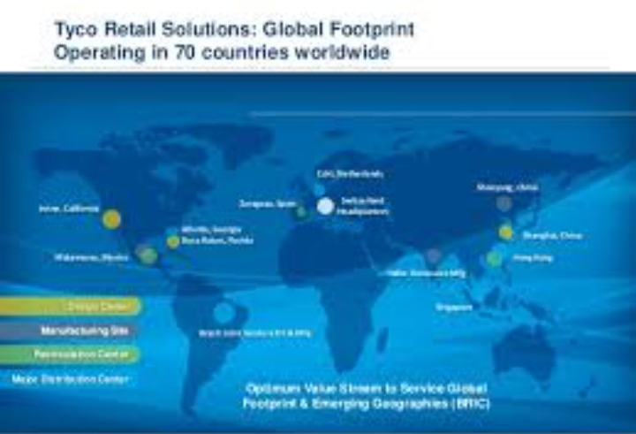

Tyco Integrated Fire & Security corporation carries out, in the majority of Spanish provinces, a business that involves installing and maintaining security systems which enable intrusions to be detected and burglaries to be prevented.
In 2011 Tyco closed its offices in the provinces (‘the regional offices’) and assigned all its employees to the central office in Madrid (Spain).

Slide 5
The technicians employed by Tyco install and maintain, in a functioning state, security equipment in private homes and on industrial and commercial premises located within the geographical area assigned to them. That area can be part of all the province, but sometimes they can work in more than one province. The distance between the worker’s home and the first client varies a great deal and is, sometimes, more than 100 kilometers. This means three hours to drive.

Slide 6
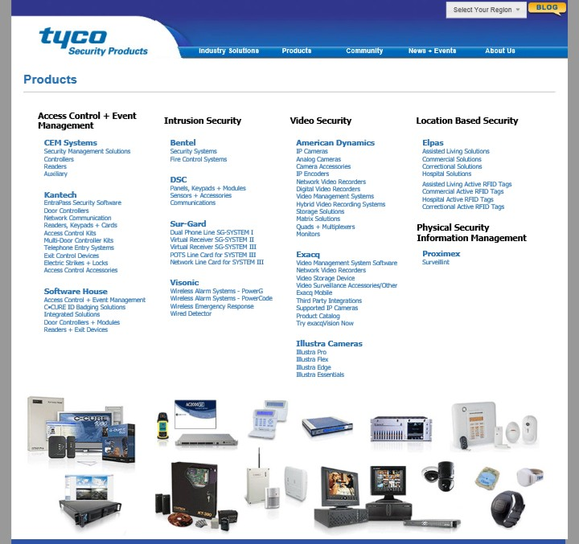
These workers have the use of a company vehicle in which they travel every day from their homes to the places where they install or maintain security systems.
They use the same vehicle to return home at the end of the day.

Slide 7
Once or more times per week, these workers must go to the nearby logistic transport offices in order to take what is necessary for them including available engines and needed spare parts in order to carry out, properly, their jobs.
Moreover, each worker has got his mobile phone which allows him to constantly communicate remotely with the central Office in Madrid.

Slide 8
An app. allows him:
first, to receive, daily, the list of clients living in a specific local area;
second, to know the exact appointment hour of each client;
third, as a consequence, the employee has to send Tyco a feedback which reports details of unexpected happenings during the intervention itself.

Slide 9
The Court notes that Tyco does not count the time spent travelling between home and customers as working time, because it is considered by Tyco as a rest period.
Therefore, the problem deals with the right “interpretation of working time”.
In order to find the right solution to this specific case, the Spanish Judge has observed that according to Article 34 of the Workers’ Statute the worker is free to choose his own domicile. Therefore, the longer or shorter distance between his house and working place depend on his own and personal choice.

Slide 10
In the specific case of mobile workers in the road transport sector, the Spanish legislator has clearly affirmed that their working place is the vehicle itself. Therefore, the transferring time is considered working time.
The time spent travelling between home and customers is not regarded as working time under Article 34 of the Workers’ Statute, in the version resulting from Royal Legislative Decree 1/1995. According to the same Court, the Spanish legislature opted for that approach on the basis that the worker is free to choose where to have his home. It is the worker alone who therefore decides, within the limits of his means, on the distance between his place of work and his home.

Slide 11
The referring Spanish Court observes that the case of mobile workers in the road transport sector for that category of workers, the national Spanish legislature would appear to have taken the view that their vehicle is the workplace and consequently the travelling time is considered to be working time. That court asks whether the situation of the Tyco’s workers might be considered to be the same as that of mobile workers in that sector. Indeed, according to the Spanish legislation working time of mobile workers in the road transport sector is considered working time.

Slide 12
In addition, the Spanish Judge points out the fact that, just a few hours before, the workers are already informed of the:
route to follow;
services that employees have to offer to Tyco’s clients
Thanks to a mobile phone given to them by Tyco itself.

Slide 13
In the Court’s view, the fact that the workers are informed of what route to follow and what particular work must be done for the customers, via mobile phone, a few hours before their appointment means that those workers are no longer able to choose and to adjust their private life and their place of residence in relation to its proximity to their place of work, since that place varies daily. The time spent travelling between home and customers cannot therefore be regarded as a rest period, bearing in mind in particular the safety and health objectives of Directive 2003/88.

Slide 14
According to that court, neither is it time during which the workers are, strictly speaking, at their employer’s disposal so that they can be assigned work nor than the travelling itself. Therefore, it is not sufficiently clear whether, pursuant to that directive, the time spent travelling between home and customers constitutes working time or a rest period.

Slide 15


Slide 16
“Must Article 2 of Directive 2003/88 be interpreted as meaning that the time spent travelling at the beginning and end of the day by a worker who is not assigned to a fixed place of work but is required to travel every day from home to the premises of a different customer of the employer and to return home from the premises of another, different, customer (following a route or list that is determined for the worker by the employer the previous day), at all times within a geographical area that is more or less extensive, in the conditions of the main proceedings as described in the background to this question, constitutes “working time” as that concept is defined in Article 2 of the directive or, conversely, must it be regarded as a “rest period”?”

Slide 17
The European Court of Justice, before answering to the specific preliminary issue explained by the Spanish Judge precises that:
The Directive 2003/88 points out the minima prescriptions to better both life and work conditions of all workers thanks to the binding effect of the national regulations to the European “Working Hour” Directives

Slide 18
Moreover, it is important, first of all, to point out that the aim of that latter directive is to lay down minimum requirements intended to improve the living and working conditions of workers through an approximation of the provisions of national law, in particular, those governing working time. That harmonization at EU level in relation to the organization of working time is intended to guarantee better protection of the safety and health of workers by ensuring that they are entitled to minimum rest periods — particularly daily and weekly — and adequate breaks and by setting the maximum average duration of the working week at 48 hours, which is expressly stated to encompass overtime.

Slide 19
In addition the Court has pointed out that this directive: regards the concept of ‘working time’, within the meaning of point (1) of Article 2 of Directive 2003/88. It is important to note that the Court has repeatedly held that directive which defines that concept as any period during which the worker is at work, at the employer’s disposal and he carries out his activity or duty, in accordance with national laws and/or practices, and that concept is placed in opposition to rest periods.

Slide 20

The conclusion in this context must be that the directive does not provide for any intermediate category between working time and rest periods.
The European Court has precised that the foundamental elements of the notion of working hour are three:

Slide 21
1st element of the concept of ‘working time the worker must be carrying out his activity or duty.
Before Tyco’s decision to abolish the regional offices, that employer regarded the travelling time of its workers between the regional offices and the premises of their first and last customers of the day as working time, but not their travelling time from their homes to the regional offices at the beginning and at the end of the day.
Moreover, before that decision, the working day of Tyco’s workers was travelling each day to those offices in order to pick up their vehicles which were provided to them by Tyco itself. Moreover, those workers completed their working day at those offices.

Slide 22
Tyco disputes the contention that the time spent by the workers travelling between home and customers may be regarded as working time, within the meaning of that provision, on the ground that, even if those workers have to undertake a journey to go to the premises of the customers it designates the activity and duties of those workers entail providing technical services, installing and maintaining security systems to their customers. Therefore, during the time spent travelling between home and customers, the same workers, their employees are not carrying out their activities or duties.

Slide 23

Tyco’s considerations cannot be shared and supported because the journeys of the workers to go to the customers designated by their employer, is a necessary means of providing those workers’ technical services to those customers. Not taking those journeys into account would distort that concept and jeopardise the objective of protecting the safety and health of workers.

Slide 24
The fact that the journeys of the workers in question, at the beginning and at the end of the day, to or from the customers, were regarded by Tyco as working time before the abolition of the regional offices also shows that the work, consisting in driving a vehicle from a regional office to the first customer and from the last customer to that regional office, was previously among the duties and activity of those workers. The nature of those journeys has not changed since the abolition of the regional offices. It is only the departure point of those journeys that has changed.

Slide 25
2nd (As regards the second)element of the concept of ‘travelling time’
“The worker must be at the employer’s disposal during that time.”
Being at the employer’s disposal, during that time, means that a worker must be placed in a situation in which he is legally obliged to obey the instructions of his employer and carry out his activity for that employer.

Slide 26
The details provided by Tyco which determines the list and order of the customers to be followed by the workers and the times at which they have appointments with its customers.
Despite the fact that a mobile phone was provided to each of the workers on which they receive their itinerary on the eve of the working day, Tyco’s workers are not required to keep that phone on during the time spent travelling between home and customers.

Slide 27
The itinerary for getting to those appointments is not determined by Tyco, the workers at issue remaining free to get there via the route they wish, with the result that they can manage their travelling time as they see fit.
In that regard, it should be stated that, during the time spent travelling between home and customers, workers have a certain freedom that they do not have during the time spent working on a customer’s premises, provided that they arrive at the designated customer at the time agreed upon by their employer.

Slide 28
During those journeys, the workers act on those instructions given by the employer, who may change the order of the customers or cancel or add an appointment. In any case, the necessary travelling time cannot be shortened, because these workers are not able to use their time freely and pursue their own interests. Therefore, they are at their employer’s disposal.
Nevertheless, it is apparent from the file provided to the Court that that freedom already existed before the abolition of the regional offices, the only thing that has changed is the departure point of the journey in order to get to that customer. Such a change does not affect the legal nature of the obligation of those workers to obey their employer’s instructions.

Slide 29
3rd the third element of the concept of ‘working time’:
“The worker must be working during the period in question.”
Indeed, the worker who has not a fixed working place is on duty even though during his way to work.

Slide 30
Travelling is an integral part of being a worker who is without a fixed or habitual place of work. The working place such employees cannot be reduced to the physical areas of their work on the premises of their employer’s customers.
That finding cannot be affected by the fact that workers begin and finish their journeys at their homes, as that fact, directly, depends on the decision of their employer to abolish regional offices and not from the desire of those workers.

Slide 31
This is due the fact that:
his moving depends on the employer’s decision to eliminate the local regional offices;
the employee’s will as well.
That employee cannot choose the distance between his domicile and to the first place and last client place. The worker cannot be bargained by the employer’s decision.

Slide 32
As a consequence, this fact goes against the health and safety of the worker according to the Directive 2003/88. Indeed this directive safeguards and guarantees a minimum rest to the worker that is legitimated if transferring are not considered as a period of rest any longer.
After having analyzed these considerations the European Court of Justice declares that these workers have to be considered at work during their travelling according to art.2.1 of the directive 2003/88.

Slide 33
This directive disciplinates some aspects of the organization of working time on one side, but on the other it does not disciplinate workers’wages. Wages are disciplinated by the Spanish Legislation. On the other side, the European Directive 2003/88 refers to working time in order to safeguard the worker.
Moreover, it is important, first of all, to point out that the aim of that latter directive is to lay down minimum requirements intended to improve the living and working conditions of workers through an approximation of the provisions of national law, in particular, those governing working time.

Slide 34
That harmonization at EU level in relation to the organization of working time is intended to guarantee better protection of the safety and health of workers by ensuring that they are entitled to minimum rest periods — particularly daily and weekly — and adequate breaks and by setting the maximum average duration of the working week at 48 hours, which is expressly stated to encompass overtime.

Slide 35
In Italy, according to the interpretation of the Directive 2003/88 that we have carefully seen in this Case C 266/14 we have D.Lgs. 66/2003 and D.Lgs. 213/2004.
Last but not least,
I think that concerning mobile workers potential abuses can be easily discovered thanks to crossed checks in the fuel pre-paid credit cards given by the employer himself.

