Slide 1
WTO Law Class 14: GATS
Ferrara 2018
Dr. Holger Hestermeyer
Shell Reader in International Dispute Resolution, King‘s College London

Slide 2
What is trade in services
Art. I:2 supply of services
From territory of one Member into territory of another (cross-border supply)
In the territory of one Member to consumer of another one (consumption abroad)
By service supplier of one Member through commercial presence in territory of another (supply through commercial presence)
By service supplier of one Member through presence of natural persons in territory of another (supply through presence of natural persons)
Mode 5?
Services includes any service in any sector except services supplied in the exercise of governmental authority (is that a definition?)
Supply of services includes production, distribution, marketing, sale and delivery of a service XXVIII b
Mode 3 implies: foreign investment by suppliers of services covered

Slide 3
Legal Principles (selection)
General Obligations
MFN (+ exemptions) Art II,
Transparency Art III,
Domestic regulation Art VI.4
Exceptions (Economic integration Art V; General exceptions Art XIV; Security Exception XIV bis)
Sectoral disciplines
Annex on Financial Services

Slide 4
Legal Principles (selection)
Specific Commitments
Market Access Art XVI
National Treatment Art XVII
Additional Commitments Art XVIII
Schedule of commitments
Hybrid scheduling approach (positive & negative list)
Horizontal and sector-specific
Relationship with GATT: Overlap: measures involving service relating to a particular good or a service supplied in conjunction with a particular good -> both agreements, but different specific aspects

Slide 5
MFN
General obligation
Art. II:1
Purpose: equality of opportunity to supply like services regardless of origin of services and service suppliers (other MFN like provisions in Art. VII, VIII, X, XII, XXI, XIV)
Applies to de jure and de facto discrimination (EC – Bananas III)
Test: three steps
Measure within scope of application of Art. II:1 (does GATS apply? Art. I, is measure exempted? Art. II:2 – over 400 measures listed)
Services and service suppliers like (considerations to both service and supplier are relevant for likeness (AB Argentina – Financial Services)
Whether like services and service suppliers are accorded treatment no less favourable
Note: LDC services waiver, obligations under Art. II:1 waived allowing SDT to services from LDC (reason: no enabling clause)
Note: Art. VII for recognition of eduction or experience obtained

Slide 6
NT
Specific commitment
Art. XVII GATS: ONLY applies to the extent that Member has explicitly committed itself to grant NT, set out in Schedule of Specific Commitments (i.e. Services Schedule)
Commitments to grant NT often made subject to conditions, qualifications and limitations, e.g. only specific modes of supply, typically: nationality, residence, assets in local currency, restrictions on purchase of land, subsidy or tax privileges only to domestic suppliers, differential capital requirements
De jure and de facto discrimination (indicated by treaty text)
Test
Has Member undertaken commitment in sector and mode of supply
Has Member adopted or applied measure affecting commitment in that sector and/or mode of supply
Foreign and domestic are like services and service suppliers
Treatment no less favourable

Slide 7
Schedules
Schedule of commitments
Hybrid scheduling approach (positive & negative list)
Horizontal and sector-specific

Slide 8
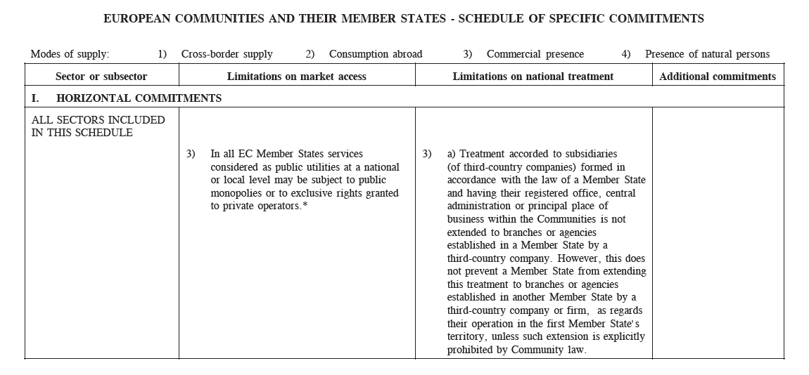
GATS Schedules (EU)

Slide 9
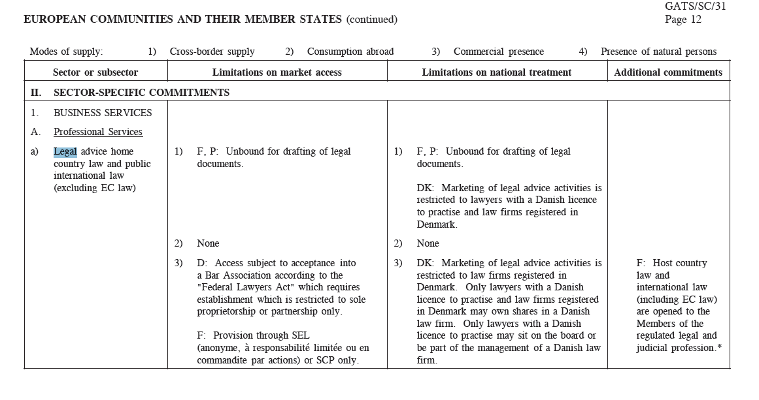
GATS Schedules (EU)

