Slide 1
WTO Law Class 10: SPS Agreement
Ferrara 2018
Dr. Holger Hestermeyer
Shell Reader in International Dispute Resolution, King‘s College London

Slide 2
What is the SPS Agreement?
SPS: measures to protect human, animal or plant life or health from specified risks (can be abused for protectionist purposes, e.g. hygiene standard to block agricultural imports from developing world)

Slide 3
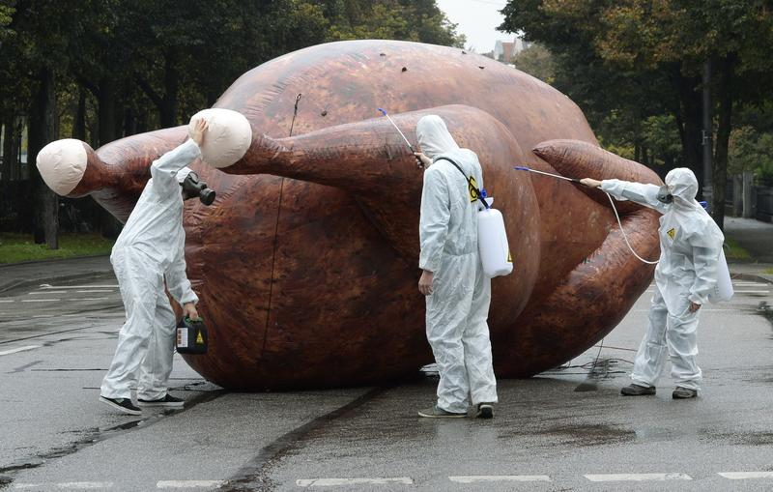
Why a separate agreement?
Why special regulation?
Health risks -> regulatory autonomy rules
Agriculture of particular interest
Balance health and liberalisation

Slide 4
Scope of Application
Art. 1.1 SPS Agreement (SPS measure / may affect trade)
SPS measure: Annex A
- Any measure applied:
(a) to protect animal or plant life or health within the territory of the Member from risks arising from the entry, establishment or spread of pests, diseases, disease-carrying organisms or disease-causing organisms;
(b) to protect human or animal life or health within the territory of the Member from risks arising from additives, contaminants, toxins or disease-causing organisms in foods, beverages or feedstuffs;
(c) to protect human life or health within the territory of the Member from risks arising from diseases carried by animals, plants or products thereof, or from the entry, establishment or spread of pests; or
(d) to prevent or limit other damage within the territory of the Member from the entry, establishment or spread of pests.
SPS measures include all relevant laws, decrees, regulations, requirements and procedures including, inter alia, end product criteria; processes and production methods; testing, inspection, certification and approval procedures; quarantine treatments […]; and packaging and labelling requirements directly related to food safety
-> Fundamental: purpose / intention determined objectively from text & structure and way it is applied (Australia – Apples) (how broad: other damage d e.g. to environment?), type of measure: broad

Slide 5
Scope of Application 2
What about private standards (e.g. supermarkets)?
Read Art. 13 , much-discussed problem in practice
Relationship with other Agreements
TBT: technical regulations, standards, conformity assessment Art. 1.5 TBT Agreement: SPS (if it has two purposes, one SPS one not, maybe both)
GATT: both apply, but: Art. 2.4 SPS Agreement

Slide 6
Main obligations
Art 2 general principles (compare e.g. To XX GATT)
2.2 Science as criterion – rational relationship between measure and scientific evidence, the more serious the risk, the less demanding requirement; proportionality between measure and risk? Measure under 5.7 excluded from 2.2
2.3 discrimination: 1) measure discriminates, includes different products 2) arbitrary / unjustifiable and 3) identical or similar conditions
Art 3 harmonization (international standards)
Art 4 equivalence (problems in implementation -> Decision on Equivalence with binding guidelines)
Art 5 risk assessment (RA) + appropriate level of protection (ALOP)

Slide 7
Harmonization - Art 3
‘Based on’ (Art 3.1) obligation
‘SPS measure may adopt some, not necessarily all, of the elements of the intl standard’ (Hormones, para. 171)
Presumption if SPS measure ‘conforms to’ international standards (Art 3.2)
‘conforms to’ = ‘embodies completely’ and ‘converts it into’ (Hormones, para. 170); rebuttably presumed to be consistent
If SPS measure ‘deviates from’ the relevant international standard in order to achieve higher level of protection: scientific justification or chosen in accordance with Art. 5 -> e.g. Risk assessment (Art 3.3)
Right to determine autonomous level of protection is ‘an important right’ (Hormones, para. 172)
What standards? Set by IOs, such as Codex Alimentarius, IPPC Standards for plant health, WOAH Standards for animal health
Burden of proof?

Slide 8
Risk assessment (RA) - 5.1-5.3
Definition of RA in Annex A, para 4
Objective/rational relationship between the RA and the SPS measure (Hormones, para. 189), RA reasonably supports the measure
No need for findings of RA to be fully reflected in the SPS measure (Hormones, para. 194)
RA must show proof of actual risk, not just uncertainty, but need not be quantified
RA does not have to be carried out by the regulating Member (Hormones, para. 190)
SPS measure may be based on minority scientific evidence (especially where life at risk)
“coming from qualified and respected sources” (Hormones, 194)
RA must be ‘sufficiently specific’ to the risk at issue (Hormones, para. 191)
“RA must review the carcinogenic potential, not of the relevant hormones in general, but of residues of those hormones found in meat derived from cattle to which the hormones had been administered for growth promotion purposes” (Hormones, 200)
Evolution of evidence after RA to be taken into account (Art. 2.2)

Slide 9
Consistency of ALOP - Art 5.4, 5.5
Para. 5 of Annex A
Three questions
1) Different levels of protection in different situations
situations must be ‘comparable’ (Horm., para. 217)
2) Arbitrary or unjustifiable differences in levels of protection
- reasons to justify difference (Horm., para. 235)
3) Resulting in discrimination or a disguised restriction on international trade
The panel’s finding that the difference in EC levels of protection result in discrimination or a disguised restriction on international trade is not supported either by the ‘architecture and structure’ of the EC measure or by the evidence submitted by the complaining parties (Horm., para. 246)

Slide 10
Choice of measure 5.3 AND 5.6
5.3: life and health of animals or plants
5.6:
“when establishing or maintaining SPS measures to achieve the appropriate level of SPS protection, Members shall ensure that such measures are not more trade-restrictive than required to achieve their appropriate level of SPS protection, taking into account technical and economic feasibility”
Footnote: “For purposes of paragraph 6 of Article 5, a measure is not more trade-restrictive than required unless there is another measure, reasonably available taking into account technical and economic feasibility, that achieves the appropriate level of SPS protection and is significantly less restrictive to trade.”

Slide 11
Test under 5.6
From Australia – Salmon
SPS measure more trade-restrictive than required if
There is reasonably available alternative SPS measure (technically and economically)
That measure achieves the appropriate level of protection
That measure is significantly less trade-restrictive

Slide 12
Insufficient scientific evidence – Art 5.7
Precautionary principle / precautionary approach, 4 requirements
‘relevant sufficient evidence is insufficient’
Insufficient, not uncertainty Japan – Apples,
insufficienty if it does not allow performance of adequate risk assessment
‘on the basis of available pertinent information’
Member needs to seek to obtain additional information
Member needs to review the measure within a reasonable period of time (ie., measure is provisional) (temporary safety valve)

Slide 13
Standard of review
Total deference v de novo review
Review under 5.1 does not involve a de novo reivew
Is the reasoning of the Member’s decision ‘coherent and objective’? (US-Continued Suspension (Hormones) AB)
Review under 5.6:
While caution not to conduct a de novo review is appropriate where panel reviews a risk assessment conducted by the Member, the situation is different in the context of Art 5.6.
“The legal question under Article 5.6 is not whether the authorities of the importing Member have, in conducting the risk assessment, acted in accordance with the obligations of the SPS Agreement. Rather, the legal question is whether the importing Member could have adopted a less trade-restrictive measure. This requires the panel itself to objectively assess, inter alia, whether the alternative measure proposed by the complainant would achieve the importing Member's appropriate level of protection.” (Australia Apples, AB para. 356)

