Slide 1
WTO Law Class 6: Regional Integration, National Security, Economic Emergency
Ferrara 2018
Dr. Holger Hestermeyer
Shell Reader in International Dispute Resolution, King‘s College London

Slide 2
Exceptions
Waivers
Derogation
General Exceptions
Regional Integration
Specific Exceptions
Security Exception
Economic Emergency Exceptions

Slide 3
Regional integration
Relevant legal provisions:
Article XXIV:(5) of GATT 1994; and
Article XXIV:(8) of GATT 1994
WTO case law on regional integration:
Panel and Appellate Body Reports, Turkey – Textiles:
What is meant by “shall not on the whole be higher or more restrictive than the general incidence of the duties and regulations of commerce applicable … prior to formation” in Article XXIV:5?
What is meant by “substantially all trade” in Article XXIV:8(b)?
Paragraph 4 of the Enabling clause, GATT 1994.

Slide 4
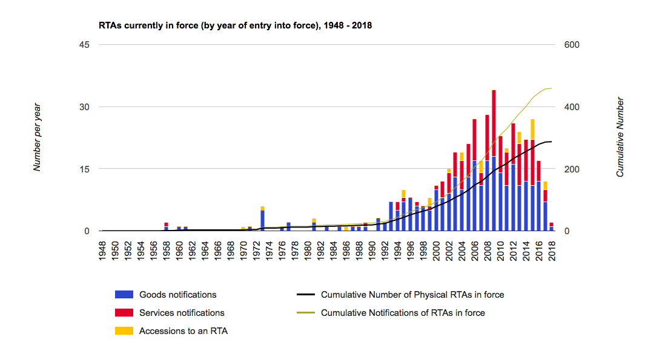
The Regional Trade Exception
“Regional” Trade Agreements or PTAs

Slide 5
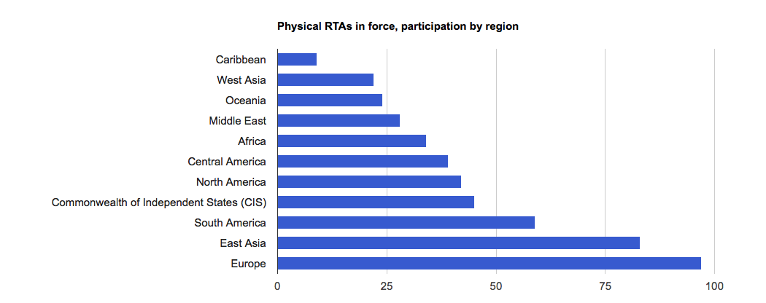
The Regional Trade Exception
“Regional” Trade Agreements or PTAs

Slide 6
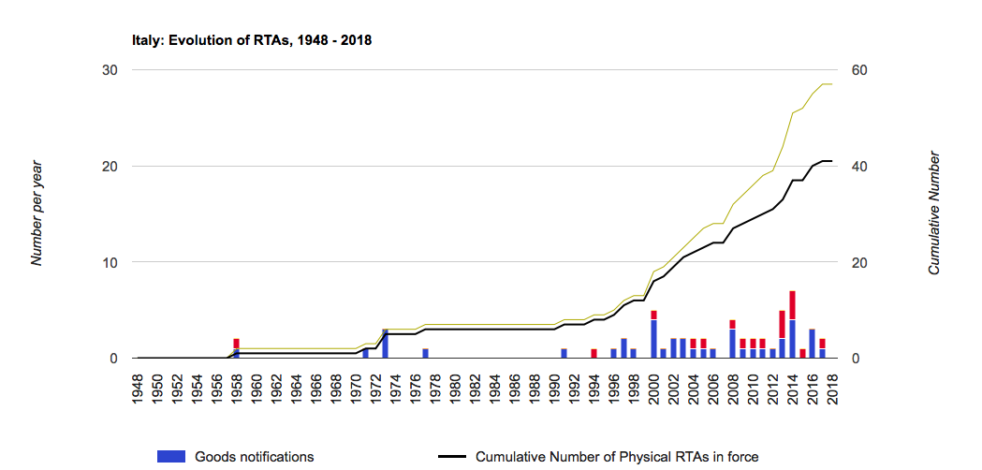
The Regional Trade Exception
“Regional” Trade Agreements or PTAs

Slide 7
The Regional Trade Exception
On everage: a WTO Member party to 13 RTAs
No WTO Member that is not party to at least one
GATT and GATS allow this breach of the MFN principle, see also Understanding on Art. XXIV of the GATT, principle (Art. XXIV:4 of the GATT): “The contracting parties recognize the desirability of increasing freedom of trade by the development, through voluntary agreements, of closer integration between the economies of the countries parties to such agreements. They also recognise that the purpose of a customs union or of a free trade area should be to facilitate trade between the constituent territories and not to raise barriers to the trade of other contracting parties with such territories.”
i.e.: further liberalisation, regional liberalisation as stepping stone for multilateral liberalisation / political reasons for regionalism
Criticism
Do RTAs divert or create trade?
Undermines multilateral approach rather than enhances it, inconsistencies

Slide 8
The Regional Trade Exception: Substance
Art. XXIV:5 (according to AB in Turkey-Textiles)
Measure introduced upon formation of CU/FTA meeting requirements of XXIV:8(a), 5(a)
Formation of CU/FTA would be prevented if it were not allowed to introduce the measure at issue (difficult)
What is a CU? -> Art. XXIV:8(a) (note: Argentine – Footwear: if safeguard investigation with respect to all sources, imposition on all sources, including members of FTA; note: Turkey – Textiles: not required that same duty and regulations as other constituent members with respect to trade with third countries, but substantially the same), note: applied rate is relevant (Understanding on Art. XXIV) Procedure: if bound rate rises in formation -> XXIV:6
What is an FTA? XXIV:8(b)

Slide 9
The Regional Trade Exception: Procedure
December 2006: RTA Transparency Mechanism (General Council, WT/L/671)
Early announcement of negotiations and newly signed RTAS
Notification requirements
Procedure to consider RTA in WTO Committee on RTAs or Committee on Trade and Development
WTO Secretariat has to maintain updated electronic database (WTO Website)

Slide 10
The Regional Trade Exception: SDT
Enabling Clause
Art. 2 (c)
PTAs between developing-country Members, less stringent requirements, no substantive requirements
Notified under enabling clause

Slide 11
The Regional Trade Exception
Art. XXIV defence not successfully used
No FTA successfully challenged under Art. XXIV

Slide 12
Art. XXIV to unliberalize trade? Peru - Agriculture
Peru maintained “Price Range Sytem” in addition to a 68% AV tariff: floor price and ceiling price; If reference price (average over past 2 weeks) drops below floor pice: additional duty
Guatemala: violation of Art. 4.2 AoA, violation of Art. II:1(b) GATT, X:1, X:3(a) GATT
Peru (amongst others): an FTA not yet in force explicitly allows the PRS
Inter se modification (VCLT)? Art. 41; systemic integration Art. 31 VCLT? But how can “shall not maintain” in 4.2 AoA be read as “may maintain”?

Slide 13
Art. XXIV to unliberalize trade? Peru - Agriculture
5.116. In setting out the above cited conditions for a GATT 1994-inconsistent measure to be justified as part of a customs union or FTA under paragraph 5 of Article XXIV of the GATT 1994, in Turkey – Textiles, the Appellate Body relied also on paragraph 4 of this provision, which states that the purpose of a customs union or FTA is "to facilitate trade" between the constituent members and "not to raise barriers to the trade" with third countries.307 We further note that paragraph 4 qualifies customs unions or FTAs as "agreements, of closer integration between the economies of the countries parties to such agreements“. In our view, the references in paragraph 4 to facilitating trade and closer integration are not consistent with an interpretation of Article XXIV as a broad defence for measures in FTAs that roll back on Members' rights and obligations under the WTO covered agreements.

Slide 14
Specific exceptions
Safeguard & Balance of payments exceptions:
Agreement on Safeguards -> surge in imports causes / threatens serious injury to domestic industry
Article XII:1 of GATT 1994, Understanding on BoP (safeguard external financial position, protect bop)
Enabling clause, GATT 1994:
Paragraphs 1 and 2 of the Enabling Clause.
Security exceptions:
Article XXI of GATT 1994;
No invocation of security exceptions in dispute settlement since the establishment of the WTO – until recently;
GATT panel, 1986 – panel established related to the invocation, by the United States, of Article XXI:(b)(iii) of GATT 1947 in defence of certain trade measures affecting Nicaragua (panel report not adopted by the parties).

Slide 15
Security Exception Cases
DS526: United Arab Emirates – Measures Relating to Trade in Goods and Services, and TRIPS (Panel established 22 Nov 2017)
Quatar requested consultation claiming violations of Arts. I:1, V:2; X:1, 2; XI:1 and XIII:1 GATT, various provisions of GATS and 3, 4 TRIPS
Background: attempts at economic isolation imposed by UAE against Qatar (prohibitions of imports / exports / transit etc.) (also: Bahrein DS527, Saudi-Arabia DS528)
DS525: Ukraine – Measures relating to Trade in Goods and Services
Russia requested consultations alleging a violation of numerous GATT, SPS, TBT, GATS and other articles
Background: Ukrainian measures taken in the context of the conflict in the Donbas – sanctions
DS544: US – Certain Measures on Steel and Aluminium Products
China requested consultation alleging that Trump’s Steel tariff violate the GATT
Background: Trump imposed tariffs on steel based on Section 232 of the Trade Expansion Act of 1962 (National Security)

