Slide 1
WTO Law Class 6: National Treatment 2; Waivers, Derogations
Ferrara 2018
Dr. Holger Hestermeyer
Shell Reader in International Dispute Resolution, King‘s College London

Slide 2
NT: Requirements (III:2)
Threshold issue: is it an internal tax or charge on products
(accrues due to internal event)
III:2 s. 1
Like products
Taxed in excess
III:2 s. 2
DCS products (ad Art.)
Not similarly taxed (ad Art.) > ad
minimis
So as to afford protection (III:1)

Slide 3
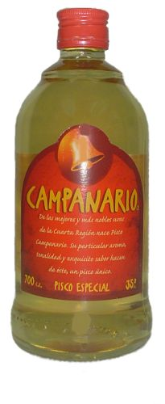
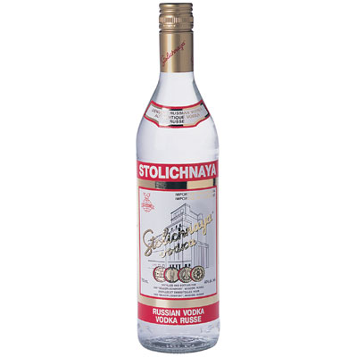
De Facto Discrimination

Slide 4
Facts Chile Alcohol
35° or less 27 %
36° 31 %
37° 35 %
38° 39 %
39° 43 %
more than 39° 47 %
75% of domestic products: 27%
95% of imported products: 47%

Slide 5
NT: Requirements (III:4)
Law, regulation or requirement
Affecting internal sale…
Imported product like domestic one
Less favorable treatment of imported product

Slide 6
Less favourable treatment
De iure and de facto discrimination
‘modify the conditions of competition to the detriment of imported products’
Purely effect-based? indirect discrimination? see para 100 of Asbestos
Dominican Cigarettes: no violation ‘if the detrimental effect is explained by factors unrelated to the foreign origin of the product (eg market share)’ > protectionist intent, causation?

Slide 7
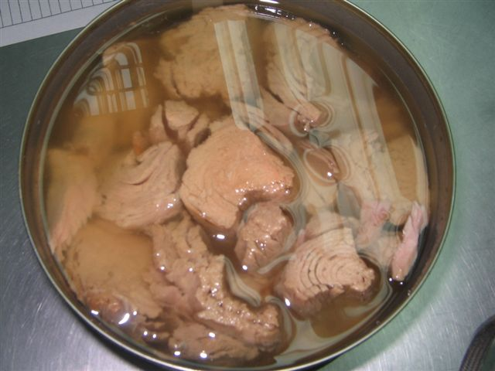
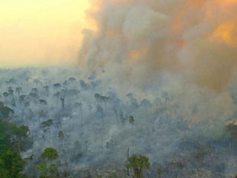
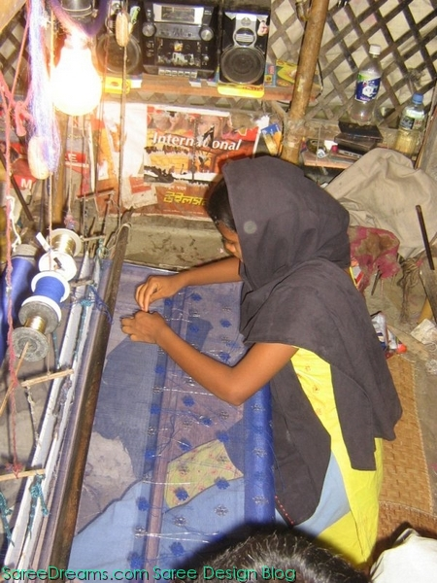
PPMs

Slide 8
Differences between III:2 and III:4
Two sentences (like and DCS products) versus one sentence (like products)
Two tests (“in excess of” and “not similarly taxed, so as to afford protection”) versus one test (“treatment no less favourable”)
Scope: taxation versus regulation
Relationship with III:1

Slide 9
Like products: general considerations
Dictionary meaning: undecided
Context: Art III:1 “informs” notion of like products
Informed by preventing protection? -> Aim and effects test, does it make sense to destinguish the measures for legitimate regulatory purposes that are not discriminatory
Two sentences in III:2 v one sentence in III:4
‘Accordion’ stretches differently
Fundamentally about ‘competitive relationship’ ?
Need for similar product scope III:2 and III:4

Slide 10
Like products in III:2
Likeness criteria (Working Party on Border Tax Adjustment):
characteristics, properties
end uses
consumers’ tastes and habits
tariff classification
Accordion, case by case
‘nature and extent of a competitive relationship between and among products’(Asbestos; Philippines Distilled Spirits)
‘taxed in excess of’ (no de minimis)

Slide 11
DCS products in III:2
Relationship with like products
DCS: market place, competition, elasticity of substitution, potential demand, other markets
Not similarly taxed: more than de minimis
So as to afford protection: not legislative intent but ‘protective application’ = ‘design, architecture, revealing structure’ (“objective” objectives)
Aims-and-effects?

Slide 12
Elements of aims-and-effects in the case-law?
1990s: aim and effects cases under III:4 (Malt Beverages, Auto Taxes): market effects need to be established
Art III:2, second sentence: “so as to afford protection”
Art III:2, first sentence, and Art III:4:
Like products
Discrimination (domestic and imported products)

Slide 13
Definition of like products
How do the criteria interrelate? How should they be examined?
Health risks and Art XX(b)
Competitive relationship: is that ultimately the test applied?

Slide 14
EXCEPTIONS

Slide 15
Preamble of the WTO Agreement
…
Recognizing that their relations in the field of trade and economic endeavour should be conducted with a view to raising standards of living, ensuring full employment and a large and steadily growing volume of real income and effective demand, and expanding the production of and trade in goods and services, while allowing for the optimal use of the world’s resources in accordance with the objective of sustainable development, seeking both to protect and preserve the environment and to enhance the means for doing so in a manner consistent with their respective needs and concerns at different levels of economic development,
…
(Emphasis added)

Slide 16
Friction between trade and other policy objectives
WTO OBLIGATION
EXCEPTIONS
General Exceptions
Specific Exceptions
Regional Integration
Waivers
Derogation
What do these instruments entail?
How do they operate?
What are the differences between them?
How do they interact?

Slide 17
Waivers
Relevant WTO legal provisions:
What are the prerequisites? - Article IX:3 of the WTO Agreement;
The Waiver Decision: Article IX:4 of the WTO Agreement;
Understanding in Respect of Waivers of Obligations under the GATT 1994.
WTO case law :
Appellate Body Report, EC – Bananas III:
Emphasis on “exceptional nature” of waivers;
Waivers subject to strict disciplines;
Should be interpreted “with great care”.
Appellate Body Report, EC — Bananas III (Article 21.5 — Ecuador II) / EC— Bananas III (Article 21.5 — US):
Purpose of waivers not to modify, amend or add to existing WTO obligations;
Waivers are not “subsequent agreements” within the meaning of Article 31(3)(a) of the Vienna Convention;
Waivers are limited in duration.

Slide 18
Waivers (continued)
Specific examples of waivers:
Kimberley Process Certification Scheme for Rough Diamonds;
TRIPS Agreement Waivers for Least Developed Country Members with respect to Pharmaceutical Products;
Waiver Relating to the Transitional Period for the Elimination of the Export Subsidy Program of Jordan;
WTO Waiver: Trade Preferences Granted by the United States of America to Nepal.

Slide 19
Derogations
National treatment derogation in respect of government procurement:
Article III:8(a) of GATT 1994:
The provisions of this Article shall not apply to laws, regulations or requirements governing the procurement by governmental agencies of products purchased for governmental purposes and not with a view to commercial resale or with a view to use in the production of goods for commercial sale.
Panel and Appellate Body Reports, Canada – Feed-In Tariff Program, India – Solar Cells.
Elimination of quantitative restrictions derogation in respect of “essential products”:
Article XI:2(a) of GATT 1994:
The provisions of paragraph 1 of this Article shall not extend to the following:
… Export prohibitions or restrictions temporarily applied to prevent or relieve critical shortages of foodstuffs or other products essential to the exporting contracting party.
Panel and Appellate Body Reports, China – Raw Materials.

