Slide 1


Slide 2


HOW TO FILL OUT A STUDY PLAN

Slide 3
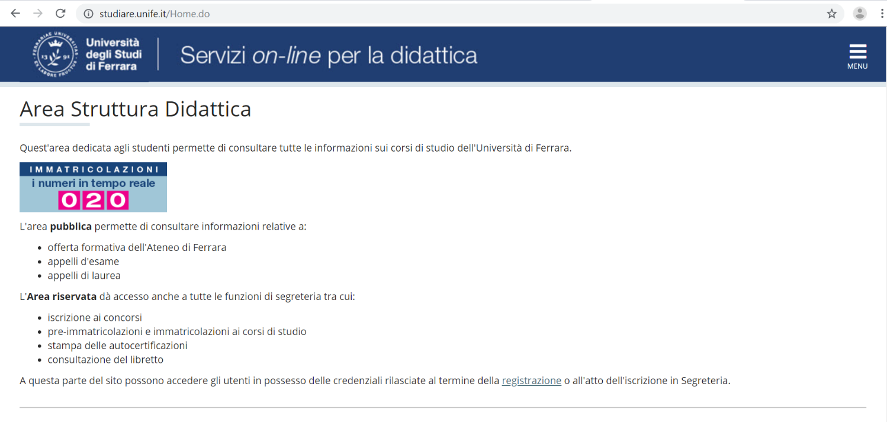
LOGIN TO YOUR PERSONAL UNIFE AREA
https://studiare.unife.it/

Slide 4
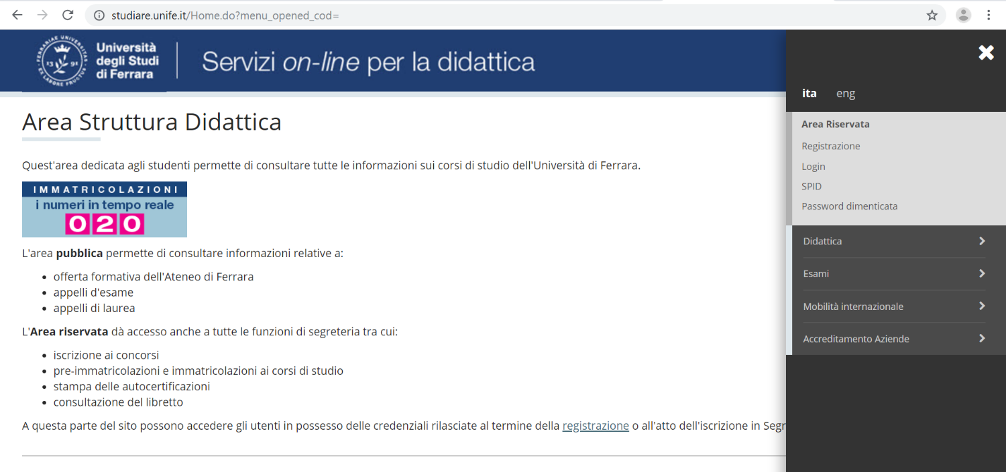

Slide 5
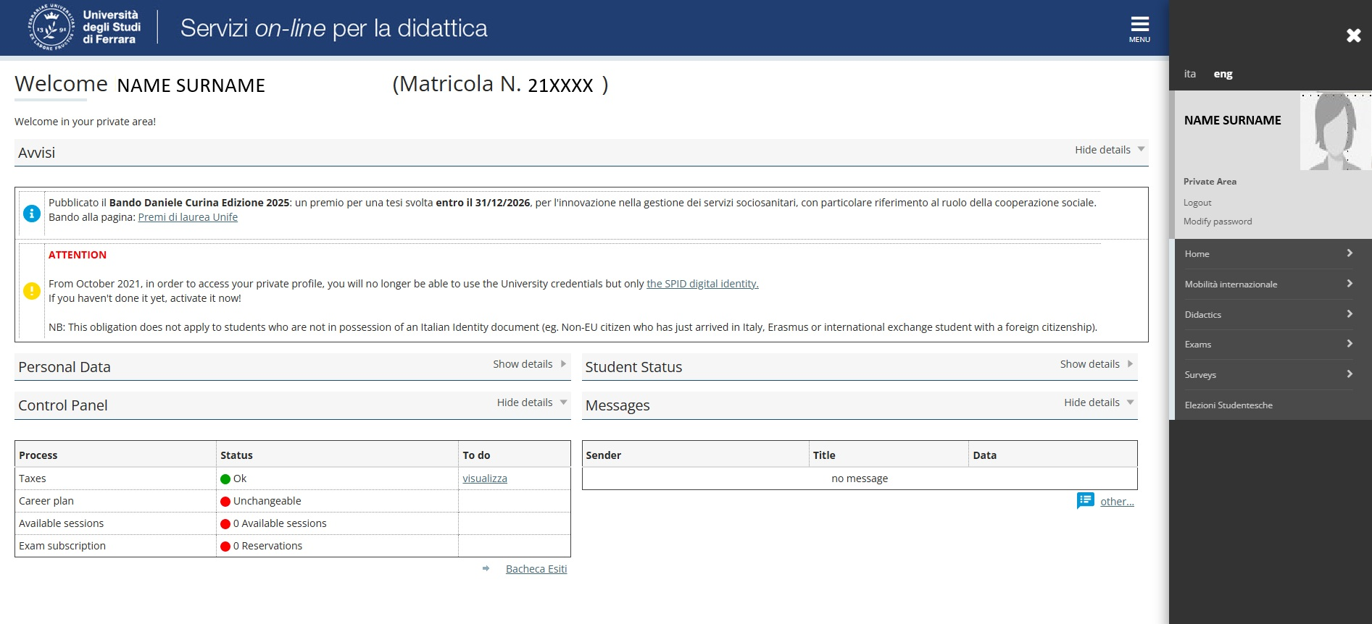
This is how your Personal Unife Area looks like:

Slide 7
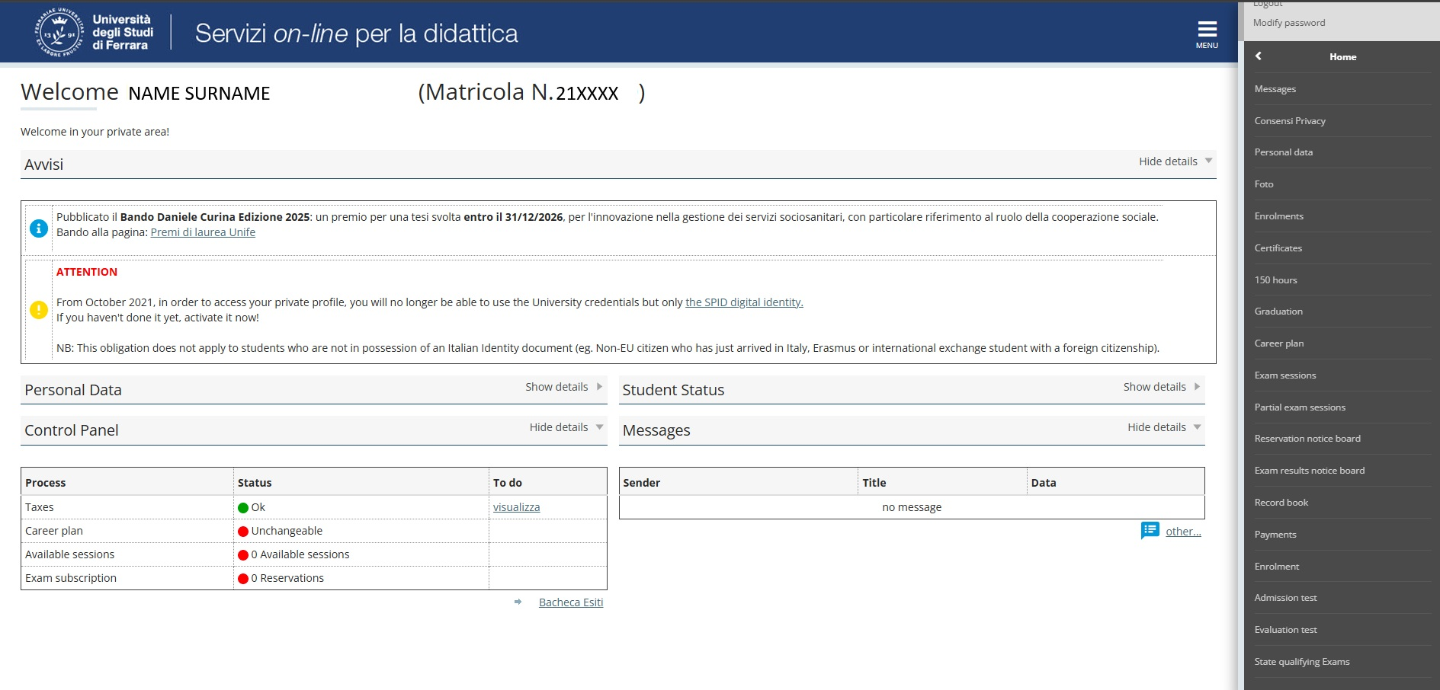

Slide 8
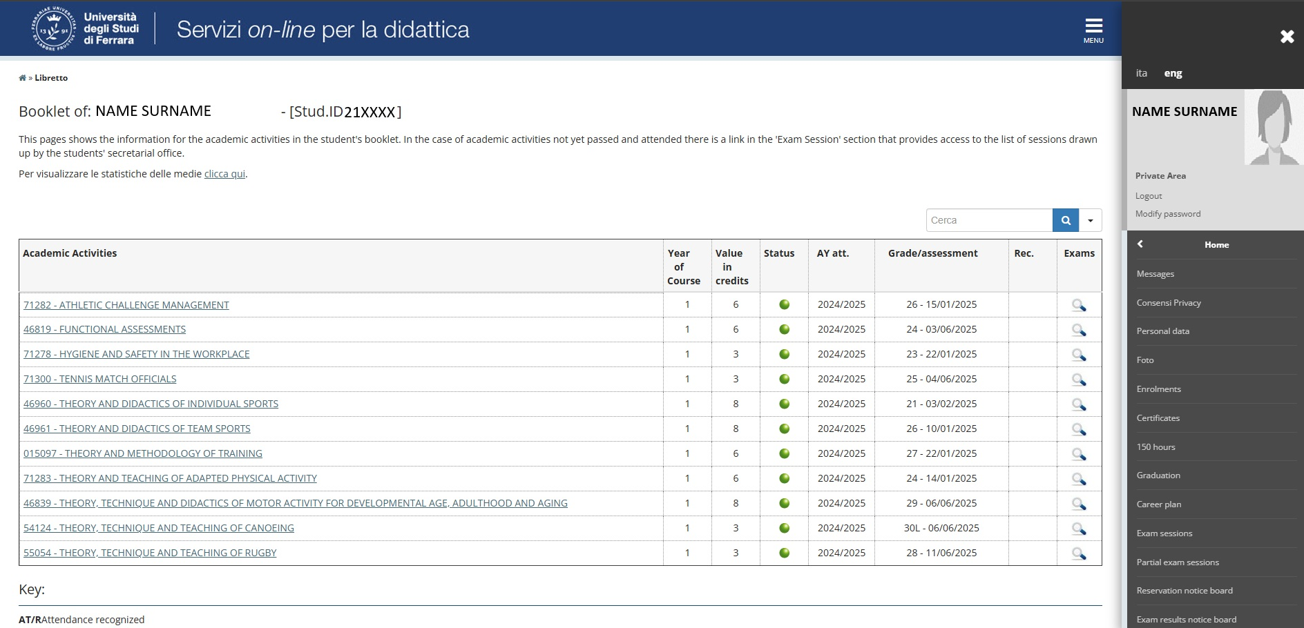


Slide 9
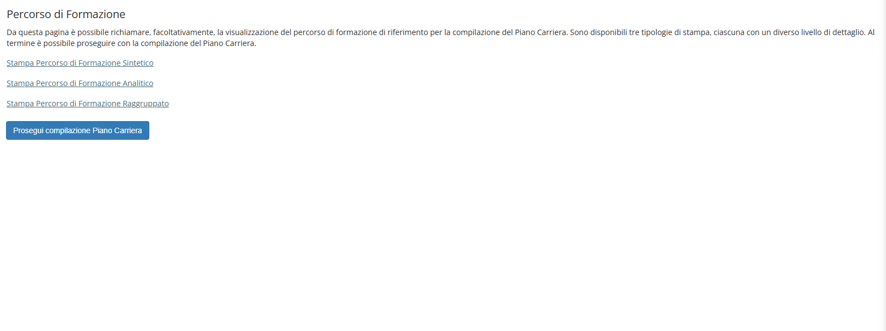

Slide 10
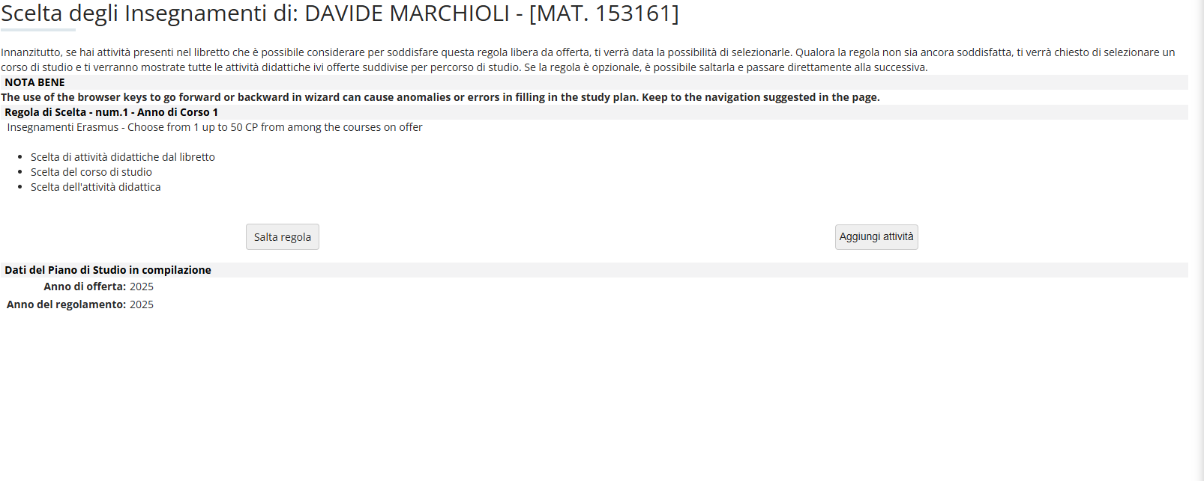
NAME SURNAME
21xxxx

Slide 11
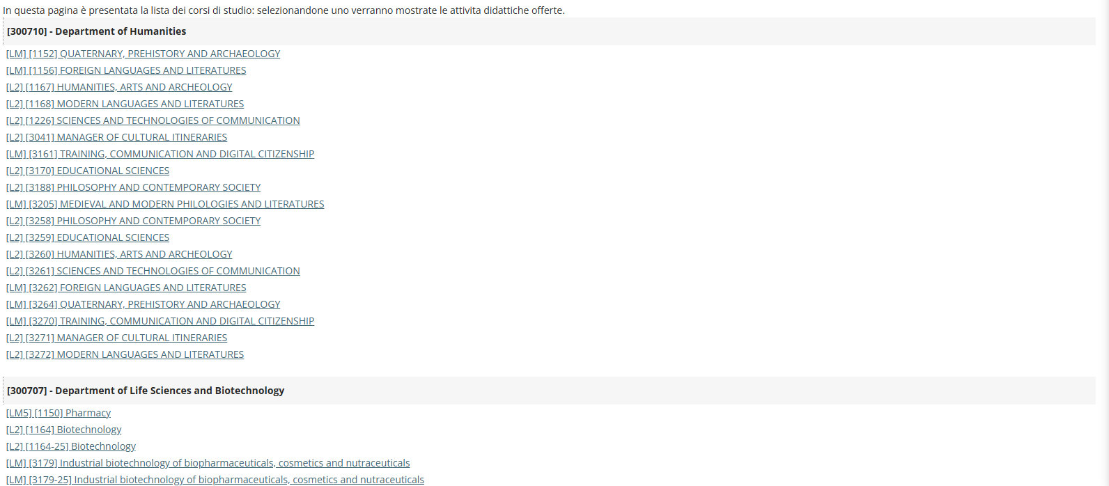
Choose the Degree course in which the course is taught

Slide 12
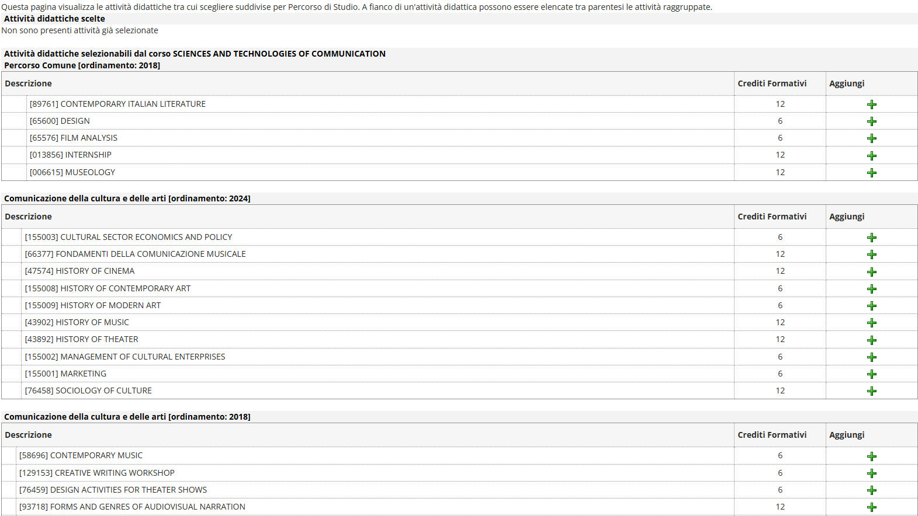
Click on + next to the course you wish to add

Slide 13
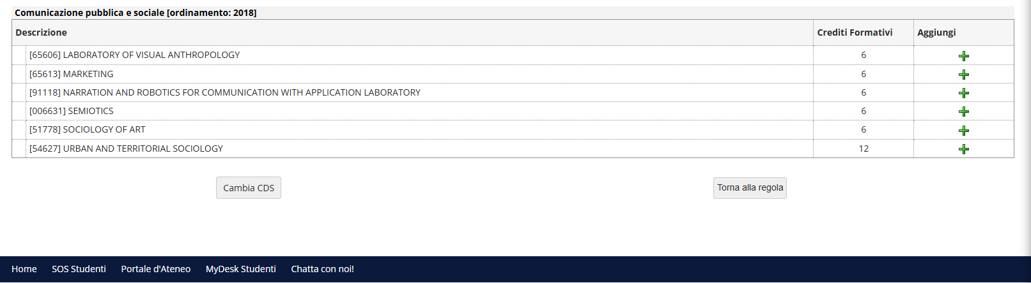
If you want to delete it, click on “trash” button
If you have entered all the courses and want to save it, click on “Torna alla regola” at the bottom of the page

Slide 14
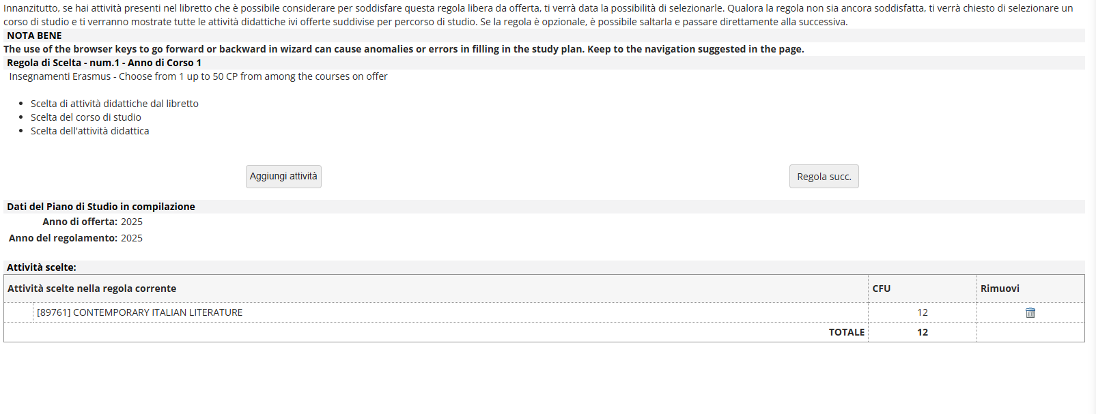

Slide 15
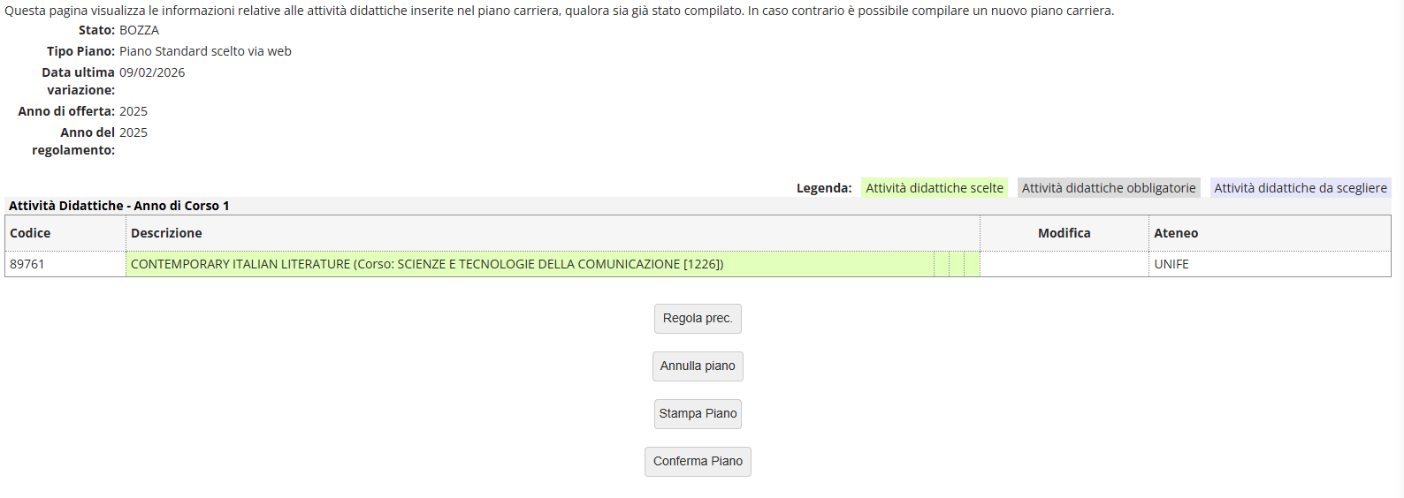

Slide 16
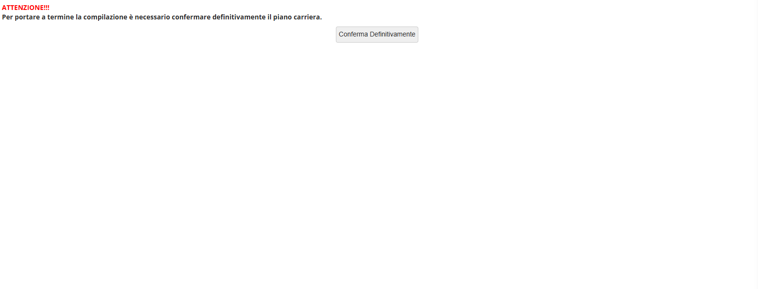
Your plan will be automatically uploaded and will be immediately visible.

Slide 17
DO YOU WANT TO CHANGE YOUR STUDY PLAN?
You have two possibilities:
Fill out the following form: https://modulistica.unife.it/studenti/carriere/modifica-piano-di-studi-incoming
This procedure is necessary if you want to choose a single part of an exam.
In your personal page, by accessing the following link: https://studiare.unife.it > HOME > CAREER PLAN

Slide 18
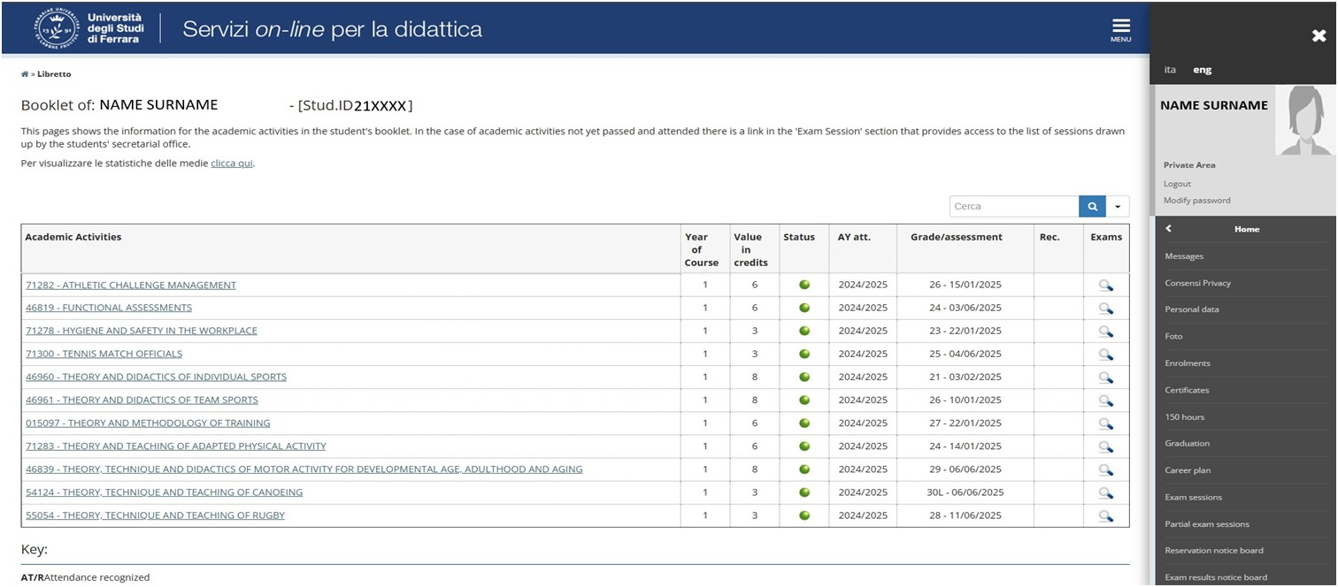
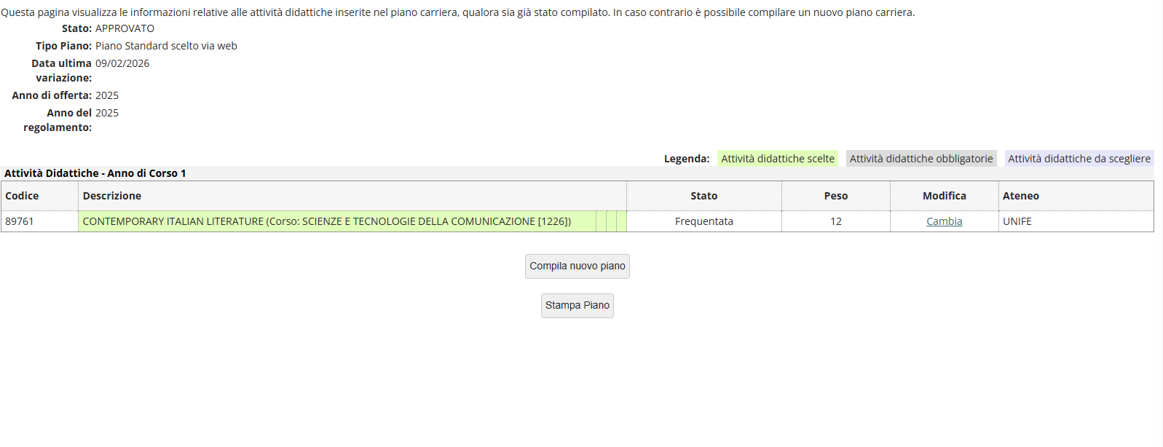
IMPORTANT: If you choose this option, you will have to fill out the ENTIRE study plan, repeating the procedure explained from page 9 to page 16.

Slide 19
For any further doubt or information contact us through sos.unife.it:
For issues related to your study plan or changes to it: Career Office
For any other matters: Incoming Students Office

