Slide 1
International Promotion
Prof. B. Orlando

Slide 2
Generic Thoughts on Situation Analysis and SWOT/PEST
Overall:
Good job. You really do understand the importance of placing your company into a larger market situation.
You seem to have a solid understanding of your business.
You took different approaches, but no one approach is correct.
Company:
Don’t spend too much time reciting the website about the company’s history. Use your own insights.
Customer:
Think more about the target. Is it a middle class old white male with a beard, a hipster millennial who owns a
puppy, a rich female with lots of leisure time or a Sophomore in college? A few groups were trying to be too
much to too many people.
Competitors:
Expand your thoughts. It can be more than just another store within a 10k range. For example, a record store
geek will drive to Denver to go record shopping.
Collaborators:
All in all, you really need to expand your thoughts on this. Collaborators include the companies that press vinyl or
manufacture CBD or beer, distributors, production factories in Vietnam or Romania, supply chain, POS and so on
and so on.

Slide 3
Generic Thoughts on Situation Analysis and SWOT/PEST
An Editor not only looks at punctuation and spelling, but also consistency and redundancy. Using the word “niche” 15 times in one document, may be 13 times too many.
Make sure your editor has time to do his or her job right.
And editor can also look at layout and graphics.
Have I ever told you about my hang up with ending a sentence with a preposition ((of, at, for, to…)
  I know, I need therapy.
PEST: Think larger. What are the global issues that effect your business.
Jlessenicals?
Record Store?
Cycling clothing?
Beer?

Slide 4
The single most important thing you will learn in this class
Not everyone is just like you.
(which happens to be a good theme for today’s lecture)

Slide 5

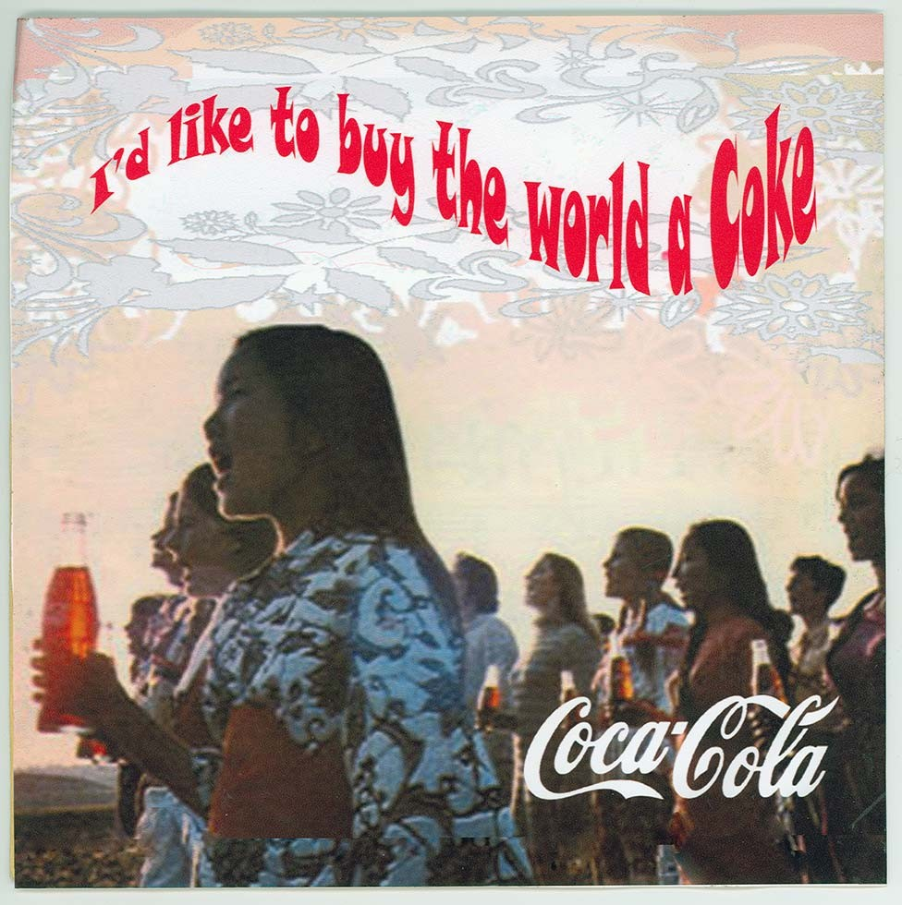
It’s a big, diverse world out there
There are 6500 different languages in the world.
The most prevalent language in the world is Mandarin Chinese, with 1,213,000,000 users.
Roughly 360,000,000 people speak English as their native language. But 1,500,000,000 identify as being able to speak English.
Spanish is spoken as a native language by 477,000,000. A total of 572,000,000
identify as being able to speak Spanish.

Slide 6

iClick, uClick, we all Click
Advantages of employing a global marketing strategy include:
A consistent image across all platforms
Centralized control of marketing and promotional programs
Lower marketing costs
Exploitation of good ideas from one source broadcast across multiple markets
All of the above

Slide 7
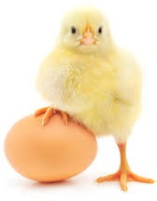
What the cluck? Another clucking question?
Disadvantages of a global marketing strategy
include:
a) Many products, High tech products in
particular, need to be tailored to the local
needs.
b) Legal restrictions from one country to the
next may prevent appropriate target
marketing.
c) Joy, sentiment, excitement and pleasure
are all uniquely different to different
cultures.
d) Advertising for luxury items like cars and
jewelry require local sensitivity.
e) All of the above

Slide 8
Global vs. Local
Global Benefits:
Efficiency
Economies of Scale
Reduced ad production/planning
Brand Consistency
Local Benefits:
Customers are Different
Culture
Benefits Sought
Markets are different:
Channels
Competition
Market Development

Slide 9
Global vs. Local
Or . . . Glocal
a global concept that addresses a universal human motivation (love, joy, fear)
a unified brand vision with creative delivery that respects local nuances and empowered consumers in each locale
an organizational architecture that facilitates collaboration between the global strategy and local strategists and implementers.

Slide 10
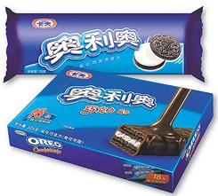
Global Marketing and Advertising
Global marketing: Using a common marketing plan for all countries
Global advertising: Way to implement global marketing strategy by using the same basic advertising approach in all markets
13

Slide 11
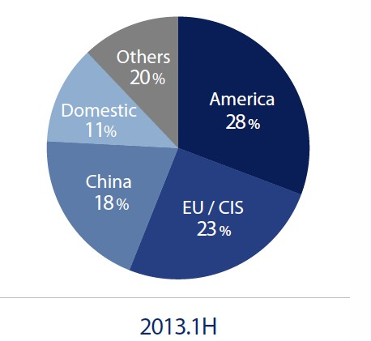
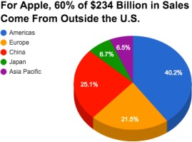
Marketing is Global
Samsung

Slide 12
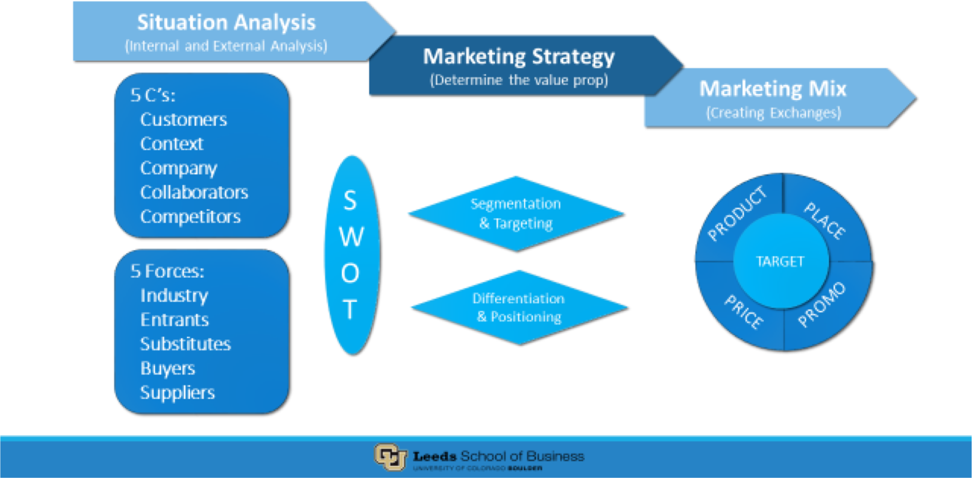
Marketing Principles are Universal

Slide 13
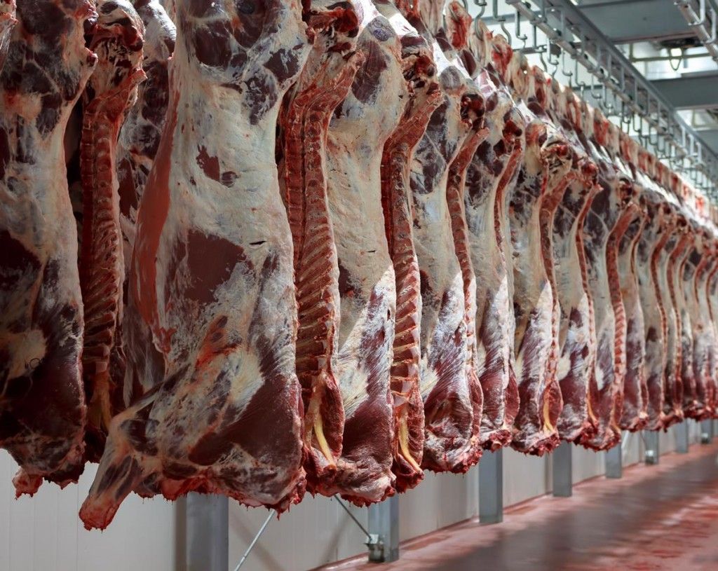
Think global. Market Local.
Four Reasons for having different
strategies for foreign markets
Unfamiliar marketing
environment
Difference in values, customs,
consumption patterns, and
habits of consumers
Language issues
Lack of availability of media
vehicles
16

Slide 14
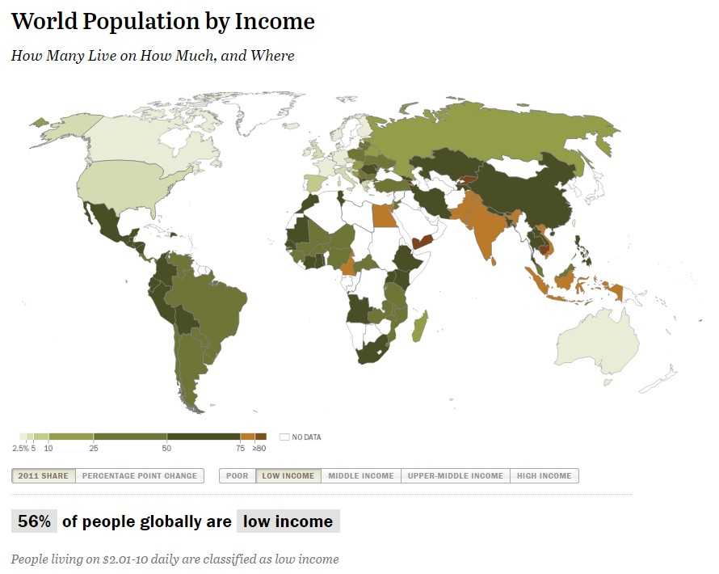
Economics – Purchasing Power

Slide 15
















Channel: Internet Users (in
millions)
746
699
245
123
117
75
Mexico
73
Germany
15
Australia
7 1
Switzerland Mongolia
China
India
United States
Brazil
Japan

Slide 16



















Channel: Daily TV Consumption (in minutes)
307
270
262
246
254
223
188
182
152
4
Germany Australia Switzerland Mongolia
China
India
United States
Brazil
Japan
Mexico

Slide 17


Chanel: Literacy Rate By Country
4
1
6
1
1
2
26
72
73
86
96
99
94
99
99
98
74
28
27
14
CHINA
INDIA
UNITED STATES
MEXICO
AUSTRALIA SWITZERLAND MONGOLIA AFGHANISTAN S. SUDAN
NIGER
Literate Illiterate

Slide 18

So sick of the click
Which marketing message is most persuasive to consumers in the developing world?
Easiest to use/simple
Best Economic Value
Most Reliable
Best for Productivity
Country of Manufacture

Slide 19
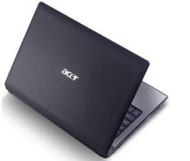
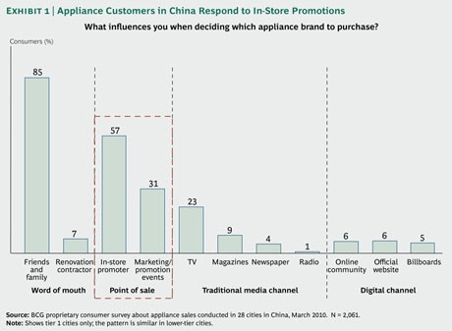
Global Consumers
Which message was most persuasive to consumers in the developing world?
Most Reliable

