Slide 1
COURSE OF ENVIRONMENTAL LAW and
INTELLECTUAL PROPERTY RIGHTS
2019/2020
16 March 2020 – Part 1
Prof. Alberto De Franceschi
alberto.defranceschi@unife.it
The Professor is available for any question
by email or Skype call

Slide 2
European Green Deal
Building and renovating in an energy and resource efficient way
Accelerating the shift to sustainable and smart mobility
From “Farm to Fork”: designing a fair, healthy and environmentally friendly food system
Preserving and restoring ecosystems and biodiversity

Slide 3
European Green Deal
Zero pollution ambition for toxic-free environment
Green Finance and investment
Greening national budgets
Mobilising research and fostering innovation
Activating education and training

Slide 4
COURSE OF ENVIRONMENTAL LAW and
INTELLECTUAL PROPERTY RIGHTS
2019/2020
16 March 2020 – Part 2
Prof. Alberto De Franceschi
alberto.defranceschi@unife.it
The Professor is available for any question
by email or Skype call

Slide 5
European Green Deal
Zero pollution ambition for toxic-free environment
Green Finance and Investment
Greening national budgets
Mobilising research and fostering innovation
Activating education and training

Slide 6
European Green Deal
The EU as a Global Leader
A European Climate Pact

Slide 7
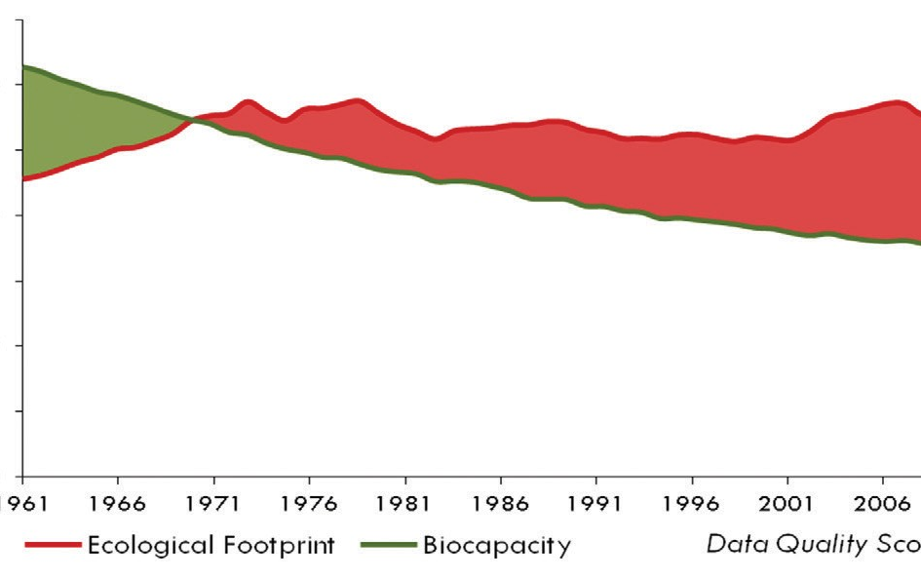
Ecological Footprint: urgency of change

Slide 8
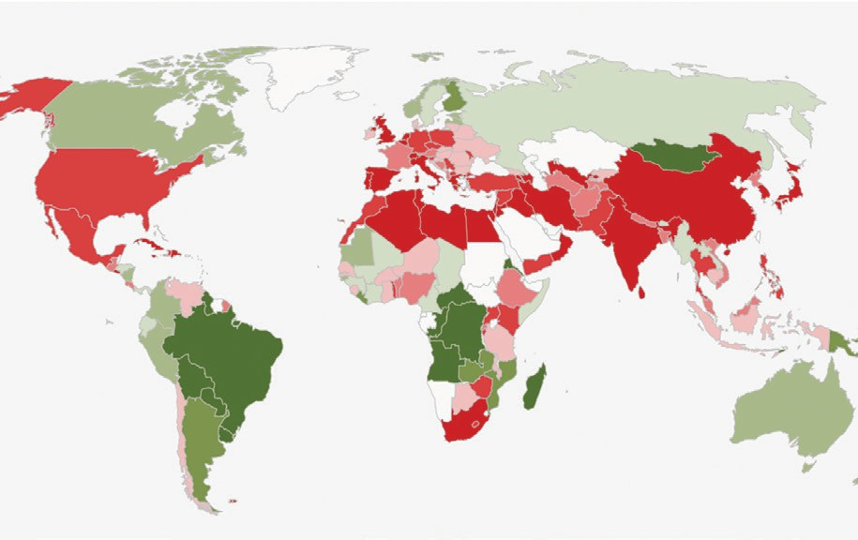
Ecological Footprint: urgency of change

Slide 9
COURSE OF ENVIRONMENTAL LAW and
INTELLECTUAL PROPERTY RIGHTS
2019/2020
16 March 2020 – Part 3
Prof. Alberto De Franceschi
alberto.defranceschi@unife.it
The Professor is available for any question
by email or Skype call

Slide 10
Agenda
Identify and critically assess “circular economy” legal instruments in various steps of the value chain.
1. Production, utilization, repair and remanufacturing
  Concerning movable, immovable goods
  High potential of the building sector for the reduction of the use of (raw) materials, energy, water and emissions
2. Legal challenges of the “servitization”: sharing economy
as a tool for the realisation of the circular economy

Slide 11
Transdisciplinary legal challenges
Should Waste Law be substituted by legal norms governing materials and products?
Is the Ecodesign Directive fit for fostering the transition to a circular economy or should it be broadened?
Supporting the utilization of Circular Building materials
Stimulating Green Public Procurement Law
Sharing Economy and Issues of Consumer Law

Slide 12
1. Refit of Waste Law
Waste Law is not yet declined in a circular perspective
Chance to substitute waste law by material and product regulation
  > towards a “zero-waste society”: from waste to secondary materials

Slide 13
1. Refit of Waste Law: three reasons
Waste has a negative image: several companies do not want to be associated with waste processors
Handling waste means extra administrative burdens (special permits, financial burdens, hinders innovation)
Waste law is an ‘unsafe area’: the interpretation of ‘waste’ and other crucial waste law terms is not clear

Slide 14
1. Refit of Waste Law
The function of waste law is twofold:
  Wants to prevent enviromental risks due to the fact that materials which are waste may be a burden for the holder
  By regulating waste, governments try to ensure a high level and high quality of recycle operations

Slide 15
1. Refit of Waste Law
Waste Law is redundant as soon as it assured that:
  Goods or materials are reused or recycled
  This reuse or recycling is in accordance with all legal requirements
  Goods or materials have still a positive value for the holder
  >> Possible reduction of the concept of “waste”: act on the factors, which impede that it comes to waste >> Encouraging market solutions for a high level of reuse

Slide 16
1. Refit of Waste Law
Plus: Waste Law: stimulates and guarantees a high level of circular use of materials
Minus: However, because of the applicability of waste law: markets do not develop the highest possible circular use of materials
Way forward: replacing waste law with ‘resources law’, which ensures the highest possible level of reuse

Slide 17
1. Refit of Waste Law
Whether the definition of Waste should be further clarified (Art. 3, par. 1 dir. 2008/98/EC - Waste Framework Directive: “any substance or object which the holder discards or intends to discard”)
Whether the exception for By-Products (Art. 5 Waste Framework Directive) is still adequate:

Slide 18
1. Refit of Waste Law
Article 5
By-products
1. A substance or object, resulting from a production process, the primary aim of which is not the production of that item, may be regarded as not being waste referred to in point (1) of Article 3 but as being a by-product only if the following conditions are met:
(a) further use of the substance or object is certain;
(b) the substance or object can be used directly without any further processing other than normal industrial practice;
(c) the substance or object is produced as an integral part of a production process; and
(d) further use is lawful, i.e. the substance or object fulfils all relevant product, environmental and health protection requirements for the specific use and will not lead to overall adverse environmental or human health impacts.
2. On the basis of the conditions laid down in paragraph 1, measures may be adopted to determine the criteria to be met for specific substances or objects to be regarded as a by-product and not as waste referred to in point (1) of Article 3. Those measures, designed to amend non-essential elements of this Directive by supplementing it, shall be adopted in accordance with the regulatory procedure with scrutiny referred to in Article 39(2).

Slide 19
1. Refit of Waste Law
In the later withdrawn proposal for a refit of the waste directive, the EU Commission did not change the definition of waste, but clarified, strengthened the definitions of the exceptions of the qualification as ‘waste’ in Art. 5 and 6, dir. 2008/98/EC (by broadening the concept of “by-product”).

Slide 20
1. Refit of Waste Law
Opening the possibility for the Commission to exclude, on a case by case basis, certain substances or goods from the waste regime if:
  (a) certain further use is certain
  (b) lawful
  (c) contributes to the highest level of efficient use of primary materials
  >> This may foster competition in the EU

Slide 21
COURSE OF ENVIRONMENTAL LAW and
INTELLECTUAL PROPERTY RIGHTS
2019/2020
16 March 2020 – Part 4
Prof. Alberto De Franceschi
alberto.defranceschi@unife.it
The Professor is available for any question
by email or Skype call

Slide 22
2. Regulation of Materials and Products: The Ecodesign Dir.
Directive 2009/125/EC of the European Parliament and of the Council of 21 October 2009 establishing a framework for the setting of ecodesign requirements for energy-related products
Regulation (EU) 2017/1369 of the European Parliament and of the Council of 4 July 2017 setting a framework for energy labelling and repealing Directive 2010/30/EU
REACH Regulation, Regulation 1907/2006/EC
Construction Products Regulation , Reg. 305/2011/EU
Waste Electrical and Electronical Equipment, Directive 2012/19/EU

Slide 23
2. Regulation of Materials and Products: The Ecodesign Dir.
The Ecodesign Directive has the highest potential for promoting circular economy issues
Goals:
  Prevent barriers to trade and unfair competition caused by disparities between the laws or administrative measures adopted by the member states in relation to the ecodesign of energy-related products
  Encourage improvement of the overall enviromental impact of energy-related products “in the interest of sustainable development”

Slide 24
2. Regulation of Materials and Products: The Ecodesign Dir.
Annex I of the Ecodesign Directive demonstrates two things:
The directive potentially addresses all aspects relevant with regards to a more circular design of products
Regulating products on the basis of this directive may become very complex and detailed
  General statement: the regulator has to make sure – if a holistic view of the enviromental aspects is aimed at, the rules do not prescribe certain techniques and processes, but only define results and outcomes to be reached. Otherwise, it will hinder innovation

Slide 25
COURSE OF ENVIRONMENTAL LAW and
INTELLECTUAL PROPERTY RIGHTS
2019/2020
17 March 2020 – Part 1
Prof. Alberto De Franceschi
alberto.defranceschi@unife.it
The Professor is available for any question
by email or Skype call

Slide 26
2. Regulation of Materials and Products: The Ecodesign Dir.
Criticism: the scope of the requirements based on the Ecodesign Directive is much limited to only energy efficiency targets
The Lawmaker could use the Ecodesign Directive to promote circular products and to encourage innovation:
Two ways forward:
  Concentrate on certain aspects of certain (groups of) products where regulation i urgent and promises to be very efficient (could concern the amount of secundary materials used or the ease to be disassembled and reused)
  Setting standards for certain products on the basis of holystic lifecycle

Slide 27
2. Regulation of Materials and Products: The Ecodesign Dir.
The scope of the Ecodesign Directive is limited to energy-related products (Art. 2: “ernergy related product is defined as a good that has an impact on energy consumption during use”) (e.g. televisions, consumer refrigerators, washing machines, dishwashers).
    The purpose is limited to lowering the use of energy
    None of the regulations at issue aim at encouraging the reuse of recycled or other secondary materials
    Not only goods which consume energy fall into the scope of application of this directive, but also products which have any effect on the use of energy, for example isolation material, wirings and windows.

Slide 28
2. Regulation of Materials and Products: The Ecodesign Dir.
Supporting the transformation to a circular economy > enlargement of the scope of application of the Directive >
  Originally: only energy efficiency
    Now: resource and raw materials efficiency has become
    an important topic of EU policy

Slide 29
2. Regulation of Materials and Products: The Ecodesign Dir.
To enlarge the scope of application of the Ecodesign Directive and to let it serve circular economy purposes:
  the possibility of establishing more product-specific and/or horizontal requirements in areas such as
      durability (against planned obsolescence)
      reparability (priority of repair over replacement?)
      upgradeability
      design for disassembly
      information
      ease of reuse and recycling (cf. Circular Economy Action Plan 2017: asked standardisation organisations to develop generic standards on reusab. and recycl.: but nothing is said about standards)

Slide 30
COURSE OF ENVIRONMENTAL LAW and
INTELLECTUAL PROPERTY RIGHTS
2019/2020
17 March 2020 – Part 2
Prof. Alberto De Franceschi
alberto.defranceschi@unife.it
The Professor is available for any question
by email or Skype call

Slide 31
3. Circular Building Materials
Construction and demolition are amongst the biggest sources of waste within Europe (25%-30% of all waste generated in the EU: CDW)
Two categories of CDW:
  Groundworks and road-construction sector: material maintain same or comparable level of quality
  Construction of buildings sector: materials from old buildings are usually not used again for the construction of new buildings, but often as filling materials in groundworks – thus for a lower purpose

Slide 32
3. Circular Building Materials
Art. 11 Waste Framework Directive (2008/98/EC – WFD) addresses CDW. Art. 11 (2) WFD: “Member States shall take the necessary measures designed to achieve that by 2020 a minimum of 20% (by weight) of non-hazardous construction and demolition waste … shall be prepared for reuse, recycled or undergo other material recovery”
But: focusing only on the percentages of reuse of materials is not sufficient
The challenge for the years to come it to extend the high quality reuse of CDW (savings of energy + prevent a surplus of CDW)

Slide 33
3. Circular Building Materials
Circular Buildings: are designed in a way that all materials are suitable for high quality reuse or recycling
“Circularity by design”:
  Know which materials were used in a building
  If these materials can be disassembled and separated easily
  Are suitable for high quality reuse

Slide 34
3. Circular Building Materials
The EU Commission Action Plan 2015 does not set concrete targets for the resource efficiency or circularity of constructions and buildings: this is an omission
  An example could be drawn from the Energy Efficiency Directive (dir. 2012/27/EU: cf. Art. 5: 3% of buildings owned and occupied by central governments have to be renovated each year to meet the minimum energy performance requirements laid down in at 4, dir. 2010/31/EU)

Slide 35
3. Circular Building Materials
    > the Energy Efficiency Directive could be broadened and should take into account all enviromental effects of buildings
    > the Construction Products Regulation (reg. 2011/305/ EU): chance to specify the criteria listed in Annex I, sub 7 (reuse and recyclability; durability; use of enviromentally compatible raw and secondary materials)
    > creation of a “building passport”)

Slide 36
4. Stimulating Green Public Procurement
Public Procurement accounts for a large proportion of European Consumption (nearly 20% of EU GDP)
PP can play an important role as an engine on the way of the transition to a circular economy
Relevant laws: directives 2014/23/EU, 2014/24/EU and 2014/25/EU

Slide 37
4. Stimulating Green Public Procurement
The most important piece of legislation is Directive 2014/24/EU on public procurement (PPD)
Art. 67, para 1 PPD: contracting authorities shall base the award of public contracts on the most economically advantageous tender
> This shall be identified on the basis of the price or cost, using a cost-effectiveness approach, such as lifecycle cost.

Slide 38
4. Stimulating Green Public Procurement
Art. 68 PPD, para 1, lett. B: end life costs belong to the ‘lifecycle costing’: comprises ‘such as pollution caused by extraction of the raw materials used in the product’
  > It is now possible to take all enviromental costs of products or services into account when awarding a contract, including (raw) material efficiency and use of secondary materials

Slide 39
X. Final Remarks
REFIT OF WASTE LAW: narrowing the category of waste and broadening the category of by-products
REFIT OF THE ECODESIGN DIRECTIVE (Avoiding programmed obsolescence; Priority of repair over replacement)

Slide 40
X. Final Remarks
REFIT OF THE BUILDING SECTOR LAW: The focus should change from the amount of materials which are reused and the level of that recycling and reuse to the very first phase of the cycle: the design of the construction of products and buildings
    > the Energy Efficiency Directive could be broadened and should take into account all enviromental effects of buildings
    > the Construction Products Regulation: chance to specify the criteria listed in Annex I, sub 7 (reuse and
    recyclability; durability; use of enviromentally compatible raw and secondary materials) > creation of a “building passport”)

Slide 41
X. Final Remarks
STIMULATING GREEN PUBLIC PROCUREMENT LAW: Art. 68 PPD, para 1, lett. B: end life costs belong to the ‘lifecycle costing’: comprises ‘such as pollution caused by extraction of the raw materials used in the product’
  > It is now possible to take all enviromental costs of products or services into account when awarding a contract, including (raw) material efficiency and use of secondary materials
  > possible to set the accent on circularity

