Slide 1
Lesson 9:
Funding & Financing (regulated) Investments in energy (regulated) industries
Roberto.Fazioli@unife.it
Dipartimento di Economia e Management,
Università di Ferrara

Slide 2
Energy supply investment needs to rise, whatever the scenario
Today’s capital allocation would need to shift rapidly towards cleaner sources and electricity networks in order to align with the Sustainable Development Scenario and the Paris Agreement. Under the New Policies Scenario, fuel supply and power each make up approximately 50% of average annual investment - in the Sustainable Development Scenario, power makes up 65%.
Global energy investment stabilised in 2018, ending three consecutive years of decline, as capital spending on oil, gas and coal supply bounced back while investment stalled for energy efficiency and renewables, according to the International Energy Agency’s latest annual review. The findings of the World Energy Investment 2019 report signal a growing mismatch between current trends and the paths to meeting the Paris Agreement and other sustainable development goals.
Global energy investment totalled more than USD 1.8 trillion in 2018, a level similar to 2017. For the third year in a row, the power sector attracted more investment than the oil and gas industry. The biggest jump in overall energy investment was in the United States, where it was boosted by higher spending in upstream supply, particularly shale, but also electricity networks. The increase narrowed the gap between the United States and China, which remained the world’s largest investment destination. Still, even as investments stabilized, approvals for new conventional oil and gas projects fell short of what would be needed to meet continued robust growth in global energy demand. At the same time, there are few signs of the substantial reallocation of capital towards energy efficiency and cleaner supply sources that is needed to bring investments in line with the Paris Agreement and other sustainable development goals.
“Energy investments now face unprecedented uncertainties, with shifts in markets, policies and technologies,” said Dr Fatih Birol, the IEA’s Executive Director. “But the bottom line is that the world is not investing enough in traditional elements of supply to maintain today’s consumption patterns, nor is it investing enough in cleaner energy technologies to change course. Whichever way you look, we are storing up risks for the future.”
The world is witnessing a shift in investments towards energy supply projects that have shorter lead times. In power generation and the upstream oil and gas sector, the industry is bringing capacity to market more than 20% faster than at the beginning of the decade. This reflects industry and investors seeking to better manage risks in a changing energy system, and also improved project management and lower costs for shorter-cycle assets such as solar PV, onshore wind and US shale.
Even though decisions to invest in coal-fired power plants declined to their lowest level this century and retirements rose, the global coal power fleet continued to expand, particularly in developing Asian countries.
The continuing investments in coal plants, which have a long lifecycle, appear to be aimed at filling a growing gap between soaring demand for power and a levelling off of expected generation from low-carbon investments (renewables and nuclear). Without carbon capture technology or incentives for earlier retirements, coal power and the high CO2 emissions it produces would remain part of the global energy system for many years to come. At the same time, to meet sustainability goals, investment in energy efficiency would need to accelerate while spending on renewable power doubles by 2030.
Among major countries and regions, India had the second largest jump in energy investment in 2018 after the United States. However, the poorest regions of the world, such as sub-Saharan Africa, face persistent financing risks. They only received around 15% of investment in 2018 even though they account for 40% of the global population. Far more capital needs to flow to the least developed countries in order to meet sustainable development goals.
The report also found that public spending on energy research, development and demonstration (RD&D) is far short of what is needed. While public energy RD&D spending rose modestly in 2018, led by the United States and China, its share of gross domestic product remained flat and most countries are not spending more of their economic output on energy research.
“Current investment trends show the need for bolder decisions required to make the energy system more sustainable,” Dr Birol said. “Government leadership is critical to reduce risks for investors in the emerging sectors that urgently need more capital to get the world on the right track.”
A better understanding the risks faced by investors requires timely and authoritative data and analysis, which the IEA is providing with this year’s World Energy Investment report. The report is being released in a new digital format to convey key findings more effectively

Slide 3
INVESTMENTS, COSTS AND SUBSIDIES
Meeting growing global energy demand over the coming decades will require significant increases in investment, regardless of the path the world takes. Cumulative investments in the energy system to 2050, including infrastructure and efficiency, will total almost USD 95 trillion in the Reference Case, and would increase to USD 110 trillion in the REmap Case. A pathway towards meeting the aims of the Paris Agreement will require a shift in investments away from fossil fuels towards renewable energy, electrification technologies and efficiency that would require an additional USD 15 trillion over the period to 2050.Renewable power technologies are increasingly the least-cost electricity supply options available. The renewable energy market would grow quickly as costs continue to decline, as technologies improve and as innovation brings additional applications. A huge market would emerge with almost USD 90 trillion of investments needed for renewable energy, electrification technologies and energy efficiency by 2050 in the REmap Case. In 2030 the renewable energy market would reach USD 730 billion annually, and in 2050 it would reach USD 680 billion annually. This compares to USD 332 billion invested in 2018 (including large hydropower). Annual investments therefore need to more than double by the end of the next decade. However, an energy system based heavily on renewables would be different than past systems and would require significant investments in power grids, complementary infrastructure and energy flexibility. In the Reference Case, investments for these would amount to USD 9 trillion. In the REmap Case, an additional USD 4 trillion would be required, for a total of USD 13 trillion.When accounting for these additional investment needs, operation and maintenance, and fuel savings, the incremental energy system costs in the REmap Case (compared to the Reference Case) would reach USD 1 trillion in the year 2050. Cumulative additional system costs over the period to 2050 add up to USD 21 trillion. These additional costs, however, are small compared to the benefits. The huge reduction in the use of fossil fuels would cut air pollution, improve health (and reduce healthcare costs) and reduce damage from the impacts of climate change. The resulting savings would add up to an average of USD 5.3 trillion annually by 2050, more than five times larger than the additional system costs of decarbonisation that year. Furthermore, the energy sector has for virtually all of the modern era of energy use operated under, and often actively sought, a range of fossil fuel subsidies that have distorted market functioning. In 2015 total subsidies to the energy sector were at least USD 605 billion, with fossil fuel subsidies accounting for around three-quarters (USD 450 billion) of this, while renewable power generation subsidies were around USD 110 billion and subsidies to liquid biofuels were USD 25 billion.7 Therefore, in recent years, fossil fuel subsidies have outweighed renewable subsidies by a factor of around four. Under current and planned policies of the Reference Case, and assuming similar subsidy policies, overall energy sector subsidies would increase to around USD 865 billion annually by 2050.In the REmap Case, annual energy sector subsidies will fall from at least USD 605 billion per year in 2015 to around USD 470 billion per year in 2050, a reduction of around USD 135 billion compared to 2050 (this is USD 396 billion per year lower than in the Reference Case). In the REmap Case, inefficient fossil fuel subsidies are largely eliminated by 2050, but subsidies remain for carbon capture and storage in industry given the difficulty of reducing process emissions.

Slide 4
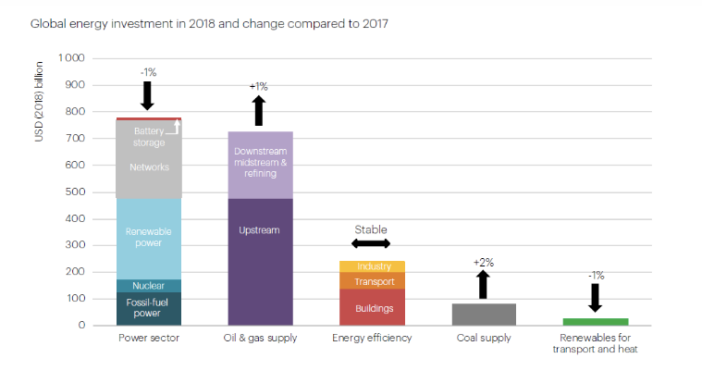
The REmap Case would see a rapid rebalancing of subsidy efforts towards energy efficiency and renewable energy (mostly for retrofitting buildings and using renewables in buildings and industry), although the subsidies would be used to support different types of technologies. Within renewables, a rebalancing is also required through time as subsidies for power generation technologies decline and are eliminated by 2050, while the subsidies to support the deployment of renewable and energy efficiency technologies needed to decarbonise the industry and transport sectors would grow. This rebalancing of subsidies from fossil fuels (which will also result in lower consumption, thereby helping to reduce their negative externalities) to renewables will improve the economic efficiency of the energy sector relative to the Reference Case by rebalancing investment away from fossil fuels with their large externality costs.
From now until 2050, the REmap Case would result in a cumulative reduction in fossil fuel subsidies of USD 15 trillion that will occur in the Reference Case (assuming similar subsidy policies). When the increased support for renewables in the REmap Case is included, the net reduction in energy sector subsidies for the period to 2050 would be USD 10 trillion. Therefore, the savings from reduced externalities and avoided subsidies outweigh the additional energy system costs by a factor of three to seven, resulting in cumulative savings of USD 65 trillion to USD 160 trillion. Or, viewed differently, for every USD 1 spent for the energy transition, there would be a payoff of between USD 3 and USD 7. Moreover, these savings do not take into account the additional benefits of renewable energy deployment and energy efficiency, which include lower water consumption, increased job creation and higher GDP, as well as the positive synergies with Sustainable Development Goals. The analysis also suggests that there would be a general improvement in welfare. These topics are discussed in more detail in the next section.

Slide 8
RATE OF RETURN REGULATION: general principles
Public Commissions aims: regulation.
Cost-of-Service Regulation has to recover admitted costs of regulated firms.
Network and/or Energy Industries are Capital Intensive.
To sustain investments Public Regulation has to assure Full Cost Recovery also for Fair Rate of Return on Investments.
Costs Recovery Regulation must establish rates that are just and reasonable.
Rates should be nondiscriminatory.
Rates should generate sufficient revenue for the utility to cover the cost of providing safe, adequate and reliable services to its customers plus the opportunity to earn a fair rate of return on its investment.
Rate of return regulation controls the profit (return) that a regulated firm can earn.
Rate of return regulation is implemented in two basic steps:
  " Determination of the utility’s revenue requirement
  " Design rates such that earned revenue does not exceed the revenue requirement
United States has utilized rate of return regulation since the regulation of public utilities began in the early 1900s.

Slide 9
REVENUE REQUIREMENT FORMULA
RR = OpEx + T + D + r(RB)
Where:
RR = revenue requirement
OpEx = operating costs – op. (admited) expenditures
T = taxes
D = depreciation allowance
r = fair rate of return RB = rate base
Components of Revenue Requirement
Operating Costs (OpEx) " Includes prudently incurred cost such as labor,
materials, equipment
Taxes = Generally income taxes, but may include other taxes paid by the utility (property)
Depreciation
RATE BASE
The valuation of all used and useful utility plant and intangible assets upon which a utility may earn a fair rate of return
Adjustments to rate base vary by Commissions
  " Customer Advances/Contributions-in-Aid of Construction (reduction)
  " Accumulated Deferred Income Taxes (reduction)
  " Customer Deposits (reduction)

Slide 10
No single established method of determining the rate of return for a regulated utility
Commissions have discretion in selecting the rate of return based on circumstances of each utility
US Supreme Court rulings establish guiding principals for setting the rate of return
" Bluefield Water Works and Improvement Co. v. Public Service Commission of West Virginia, 262 U.S. 679 (1923). In the Bluefield Water Works case, the US Supreme Court stated in its decision:
... A public utility is entitled to such rates as will permit it to earn a return on the value of the property which it employs for the convenience of the public equal to that generally being made at the same time and in the same general part of the country on investments in other business undertakings which are attended by corresponding risks and uncertainties; but it has no constitutional right to profits such as are realized or anticipated in highly profitable enterprises or speculative ventures. The return should be reasonably sufficient to assure confidence in the financial soundness of the utility, and should be adequate, under efficient and economical management, to maintain and support its credit and enable it to raise the money necessary for the proper discharge of its public duties...
" Federal Power Commission v. Hope Natural Gas Co., 320 U.S. 591 (1944). In the Hope decision, the US Supreme Court Stated:
" The rate-making process under the [Natural Gas] Act, i.e., the fixing of 32 'just and reasonable' rates, involves a balancing of the investor and consumer interests . . . . From the investor or company point of view it is Important that there be enough revenue not only for operating expenses but also for the capital costs of the business. These include service on the debt and dividends on the stock. By that standard the return to the equity owner should be commensurate with returns on investments in other enterprises having corresponding risks. That return, moreover, should be sufficient to assure confidence in the financial integrity of the enterprise, so as to maintain its credit and to attract capital.

Slide 11
WEIGHTED AVERAGE COST OF CAPITAL
The assets of a utility are financed through a combination of debt and equity.
The weighted average cost of capital looks at the relative structure of that financing (percentage of debt and percentage equity) and the relative cost of each.
 | Amount |  | Cost | weighted cost of capital
Debt | 400,000 | 40% | 6.0% | 2.4%
Equity | 600,000 | 60% | 10.0% | 6.0%
Total | 1,000,000 |  |  | 8.4%
COST OF DEBT
Effective rate paid by a utility on its debt
Includes traditional bank loans and bond issuances
Cost of debt is generally not difficult to determine
Some Commissions are beginning to include short term debt in cost of debt calculations
" Short term debt - due within 12-months and often used for bridge financing
" Long term debt - repayment schedule greater than one year
COST OF EQUITY
Return required by an shareholder to invest in and hold a utility’s stock
Several varying models used to determine cost of equity, but each uses a degree of judgment
" Discounted Cash Flow (DCF)
" Risk Premium Approach
" Comparable Earnings Model
" Capital Asset Pricing Model

Slide 12
Weighted average cost of capital (WACC) is the average after-tax cost of a company’s various capital sources, including common stock, preferred stock, bonds, and any other long-term debt.
A company has two primary sources of financing - debt and equity - and, in simple terms, WACC is the average cost of raising that money. WACC is calculated by multiplying the cost of each capital source (debt and equity) by its relevant weight, and then adding the products together to determine the WACC value:
WACC = (E/V) x Re + (D/V) x Rd x (1 – Tc)
Where:
Re = cost of equity
Rd = cost of debt
E = market value of the firm’s equity
D = market value of the firm’s debt
V = E + D
E/V = percentage of financing that is equity
D/V = percentage of financing that is debt
Tc = corporate tax rate
When calculating a firm's WACC, the first step is to determine what proportion of a firm is financed by equity and what proportion is financed by debt by entering the appropriate values into the (E/V) and (D/V) components of the equation. Next, the proportion of equity (E/V) is multiplied by the cost of equity (Re);
and the proportion of debt (D/V) is multiplied by the cost of debt (Rd).
The debt side of the equation (D/V * Rd) is then multiplied by (1 - Tc) to get the after-tax cost of debt (there is a tax shield associated with interest).
The final step is to add the equity side of the equation to the debt side of the equation to determine WACC.

Slide 13
DISCOUNTED CASH FLOW
Calculates the value of an asset today based on its value in the future
where
K = D/P + G
K = current cost of equity D = dividend rate
P = market price
G = growth rate
Estimating a company’s growth rate is difficult and subject to much dispute.
Commissions must project the growth rate anticipated by potential investors since they ultimately determine a future stock price.
RISK PREMIUM APPROACH
Presumes a higher return is required by the investor for a security having more risk than another
k = ka + RP where
k = required return on equity ka = long-term cost of debt RP = risk premium
Comparable Earnings Model
compares a utility’s earning to the earnings of a sampling of similar utilities
employs some form of benchmarking
difficulties lie in selecting comparable utilities
Capital Asset Pricing Model (CAPM)
presumes that an investor will require a higher return on a riskier investment than the return on a risk free investment (generally a Treasury Bond)
a variation of the Risk Premium Approach

Slide 14
Price Cap Regulation
Price is set at the rate of inflation (in the US, Consumer Price Index or “CPI”) less expected efficiencies of the utility (the “X-factor”) - expressed as CPI-X
“X-factor” acts as a substitute for competition; it considers the past performance of a utility and also looks at other firms in the industry
Some commissions allow adjustments for costs outside of the utility’s control (the “Z-factor”)
Revenue Cap Regulation
Attempts to achieve the same outcome as Price Cap Regulation but for revenue instead of prices

Slide 15
An important component of policies to promote effective competition in all segments ofnetwork industries such as electricity, telecoms or railways, is a regulatory environmentguaranteeing that competitors have access to the services of “potential bottleneck facilities”too costly to duplicate. Fair access rules to these facilities, including fair access prices, willgenerally improve economic efficiency by easing competition in markets both upstream anddownstream of the bottleneck. This is true whether the industries are verticallyunbundled/separated or not. More specifically, appropriate access pricing rules are neededwhenever a dominant firm controls the supply of one or more inputs that are vital for itscompetitors. Examples include: gas transportation, electricity transmission, localtelecommunications access or railway track. At a more general level, access pricing is partof the anti-trust concern of market foreclosure which is central in the so-called “essentialfacilities doctrine” covered by the US legislation.2 In a broader context, access pricing isrelated to a variety of competition policy issues that include quantity discounts, cross-subsidies, tie-ins, refuse to deal or to unbundle, exclusive dealing and predatory pricing.
A failure to design these access rules properly is one of the key reasons why thepotential gains from restructuring network utilities are not maximised and/or shared fairlybetween the users and the owners of these essential facilities. This is also why the accessproblem is at the top of the agenda of many regulators in developed countries.
Most restructuring of infrastructure activities results in some degree of vertical unbundlingof the sector aiming at freeing the potential competitive forces wherever possible.Previously vertically integrated electricity and gas public utilities have had their variousactivities dis-integrated vertically to allow competition in generation and in distribution forinstance. Vertical unbundling of infrastructure industries often results in the creation ofsome type of potential bottleneck activity. This could be an electricity transmissioncompany structurally separated from downstream competitive activities that require theessential service, i.e. the distribution companies who purchase electricity from thegenerators upstream from the transmission company. It could also be the owner of railtracks who sells access to various companies owning rolling stock. Because of theseparation, regulation is somehow simpler than the case of an integrated incumbent. Mostof the concerns arising from anti-competitive behaviour are now absent since, under manycircumstances, the upstream firm has no reason for favouring one particular downstreamfirm at the expenses of the others.
Consider an upstream firm, providing access to a downstream sector that in turn sells to thefinal users. The access price has to be regulated to induce firms to take efficient decisionsand to attain levels of production in the interest of consumers. The main difference betweenthe regulation of a standard monopolist (i.e. when final prices are regulated) and theregulation of access considered here, is that downstream firms have interrelated demandfor access. Imagine, for instance, two rail companies offering passenger services only.They both need access to tracks and stations. What “company 1” can get depends on theservices it sells but it also depends on what the other company sells. The access chargeenters both directly into the firm’s profit and indirectly since it influences the rival’s choices.The effect becomes particularly important if the downstream market is not perfectlycompetitive, so that strategic considerations affect the picture and add a twist to theanalysis. We address these points below in a slightly more rigorous way.

Slide 16
Consider an upstream firm, providing access to a downstream sector that in turn sells to thefinal users. The access price has to be regulated to induce firms to take efficient decisionsand to attain levels of production in the interest of consumers. The main difference betweenthe regulation of a standard monopolist (i.e. when final prices are regulated) and theregulation of access considered here, is that downstream firms have interrelated demandfor access. Imagine, for instance, two rail companies offering passenger services only.They both need access to tracks and stations. What “company 1” can get depends on theservices it sells but it also depends on what the other company sells. The access chargeenters both directly into the firm’s profit and indirectly since it influences the rival’s choices.The effect becomes particularly important if the downstream market is not perfectlycompetitive, so that strategic considerations affect the picture and add a twist to theanalysis. We address these points below in a slightly more rigorous way.a. What happens in the best theoretical situation (the first best)?In order to provide one unit of final good, downstream firms need one unit of the upstreaminput. This input is produced by the bottleneck owner at a unit cost c0. The bottleneck owneralso incurs a fixed cost F. This F can be interpreted as the set up cost of the network, orsome other costs deriving from social obligations that cause losses to the bottleneckprovider. . The users are charged a unit access charge denoted by a..If all firms in the competitive sector are similar (in terms of technology and thus ofcosts) and their products are identical, firms undercut each other until price competitiondrives to zero all extra profits in the final market. The price charged to final users ends upequal to the marginal cost of each firm. This amounts to the sum of the access charge andany other cost incurred in order to transform the intermediate good. If we denote by c all theother unit costs (besides the unit access charge), the final price would be p = a + c. Thelower the access charge, the lower the final prices and the higher the total quantityconsumed by the end-users.Without any other source of distortion in the functioning of the market, the best thatcould be done is to follow a marginal rule: the price to the final user should be set equal tothe marginal cost of production. The resulting allocation is said to achieve what is known a the first best.
The access price should be set equal to the marginal cost of production (a= c0) and since the downstream sector is perfectly competitive, the consumer price wouldbe p = c0 + c.
By setting the access charge equal to the marginal cost of producing the input, theincumbent would recover only the variable costs and would make a loss equal to the fixedcost F If this loss cannot be paid for by direct subsidies by the government, theorygenerally moves on to the next reference situation (second best). It seeks to set theefficient access price subject to a budget constraint (i.e. the need to avoid losses) faced bythe firms.
the incumbent monopoly can break even only if the access pricerecovers fixed costs on average: a = c0 + F/QS(a). This is an average pricing rule. Sincethe quantity supplied has to be equal by the quantity demanded by the users, denoted asQD(p), and that p = a + c, we finally get the following implicit formula for the access charge:
a = c0 + F/QD(a + c).

Slide 18
La spirale recessiva determina rischi per la stabilità finanziaria. Il legame di reciproca dipendenza dei bilanci di imprese e banche ha rivelato tuKa la sua fragilità durante la crisi:
• in seguito a shock macroeconomici di forte intensità l’onere del debito diventa insostenibile per un numero elevato di imprese
• aumentano le insolvenze e le perdite che innalzano il rischio di credito e riducono la capacità di autofinanziamento delle banche
• le banche riducono l’offerta di prestiti alle imprese
• la penuria di credito rinforza lo shock macroeconomico, ritarda la ripresa

Slide 20
Strategie e assetti societari del “veicolo del Finanziamento”
PPP
STU
MiniBond
Project financing
Project
Bond
Locazione finanziaria
Finanziamento
del Cash-Flow netto
Debt
Fund
Venture Capital
Esco
Equity&Debt Investors

Slide 21
CANALI ISTITUZIONALI di funding
Horizon 2020
Life+
Gestione diretta
Strumenti UE
Cosme
BEI
FSE
Gestione indiretta
FESR
Jessica
RSFF
Elena
Project Bond Initiative
Jeremie

Slide 23
Il finanziamento degli Investimenti Green in Impianti e Infrastrutture.
Strategie di
Funding
finanziario
Altissimi CapEx
(specie rispetto agli OpEx)
IRR di progetto
Problemi crescenti di remunerazione
del capitale finanziario investito
Problemi crescenti sono correlabili a:
Variabilità dell’assetto regolatorio (aumenta la variabilità del Cash-in e, quindi, dell’incertezza e, quindi, dei costi di copertura della varianza );
Rischio execution (aumento RRoR);
Rischio concessorio (incremento RRoR)
Rischio Funding (la mole del capitale finanziario richiesto induce una crescita del RRoR)
Elevati CapEx spiegano il tradizionale sviluppo degli investimenti infrastrutturali tramite:
Investimenti Pubblici (RRoR bassissimo e Return Period lungo);
Contributi Pubblici a Fondo perduto (abbattimento del RRoR);
Lunghi periodi concessori con alte tariffe (incremento dell’IRR)
IRR
RRoR
Required Rate of Return correlato a:
Tipologia di Progetto, timing, durata dell’investimento e del Periodo Concessorio, covenants, ecc…
Merito creditizio del Soggetto controparte
Risk Analysis sistemica, collaterals&mitigants sistemici
Risk Analysis specifica collaterals&mitigants specifici

Slide 26
La Green Finance: concetto “in divenire”
Dopo la Lezione sulla metodologia del Life Cycle Assessment, è ancor più difficile esprimersi chiaramente sui concetti di “green”. Se già è difficile affermare cosa sia esattamente la green economy, figuriamoci nei riguardi della cosiddetta “green finance”. Una riposta precisa, definitiva, da manuale, non c'è. In via del tutto preliminare, possiamo dire che la Green Finance può essere intesa come la declinazione "green" di una varietà di servizi di credito nel contesto della Green Economy. L'ipotesi si basa quindi su un'analogia: s'è vero che la finanza tradizionale è finalizzata al supporto dell'economia reale di tipo capitalistico, allora possiamo supporre che la Green Economy abbia a supporto una finanza declinata anche secondo la prospettiva "green". Come punto di partenza è accettabile ma non è del tutto soddisfacente.
Cosa sono i servizi di credito per l'economia? E cosa per l’economia green? In generale, i servizi di credito sono servizi offerti dagli operatori del mercato del credito: i datori di fondi (in surplus) offrono credito ai prenditori (in deficit) che ne fanno domanda; entrambe le tipologie di operatori hanno il fine di attuare i loro piani operativi. Quindi, mediante i servizi di credito avviene un trasferimento di fondi, differito nel tempo e veicolato dal contratto come prodotto materiale, dal datore al prenditore. Cioè, "oggi" il datore fornisce del credito e lo vedrà restituito dal prenditore ad una "scadenza" secondo certe modalità contrattuali che, in varia misura, vincoleranno questo alla restituzione del credito ottenuto ed al pagamento di un margine d'interessi. La cosa interessante è che, almeno per alcune fattispecie di prodotti finanziari, un contratto sottoscritto da un datore con un prenditore, che lo possiede, puo ̀ essere anche venduto trasformando così il prenditore in datore verso un soggetto terzo su cui si scarica ogni forma di rischio. Possiamo infine isolare almeno due modi con cui lo scambio di credito può avvenire. Il primo può essere il canale creditizio, cioè la fornitura di liquidità in forma di finanziamento (da parte del datore) di una somma domandata (dal prenditore). Il secondo può essere il canale finanziario nel senso che ricorre ai mercati finanziari e quindi a contratti di compra/vendita per strumenti di varia forma tecnica. Sul primo tema alla presente Lezione è associato un Documento della banca d’Italia al riguardo.
Le classi di attori del mercato del credito "green" sono le medesime che possiamo trovare nel mercato del credito "tradizionale": imprese, consumatori, intermediari, borse ed istituzioni. Ciò che fa la differenza è la causa della domanda di finanziamento. Nel canale creditizio la finanza si può intendere "green" quando fornisce servizi di credito finalizzati a sostenere la spesa per consumi e/o produzioni green-oriented o soddisfacimento di bisogni con criteri green-compliant.
Diverso, invece, è il caso del canale finanziario. In questo caso, infatti, esistono strumenti finanziari appositamente pensati in senso "green" e da impiegare a scopo di speculazione, diversificazione o copertura, e gli investitori possono essere sia consumatori sia imprese.
Ad esempio, esistono strumenti finanziari connessi al credito di emissioni (Emission Trading System), i derivati climatici (Weather Derivatives, Catastrophe Bonds) tipicamente impiegati per trasferire un rischio puro come quello climatico (alluvioni, grandinate, inondazioni, uragani, deviazioni della temperatura dalla norma) che può colpire le produzioni di particolari settori d'attività economica (ad esempio il settore agricolo, l'energetico, l'idroelettrico e le costruzioni, specie per quel che riguarda le infrastrutture ed il turismo). Dunque, alcuni strumenti non sono impiegati solo per aver cura dell'ambiente o per motivazione nella sostenibilità ambientale di produzioni e consumi, ma anche per curare gli interessi economici di quegli operatori le cui attività possono venire compromesse da eventi climatici oltremodo avversi.
Possiamo, infine,̀ pensare di comporre una tassonomia dei prodotti della Green Finance in quattro famiglie e quindi, per ciascuna, identificare le specie.

Slide 27
Green Asset managment
Green Retail Banking
Green Mortgages: sono muti per l'acquisto di abitazioni costruite secondo criteri di efficienza energetica o alimentate con fonti d'energia a basso impatto, l'incentivo per la sottoscrizione di questi mutui è dato dal fatto di applicare un tasso d'interesse
più conveniente di quello del mercato tradizionale.
Green Equity Loans: sono prestiti, a tassi agevolati o comunque più convenienti di
quelli del mercato tradizionale, finalizzati principalmente all'installazione di
apparecchi d'alimentazione energetica da fonti rinnovabili.
Green Commercial Building Loans: sono finanziamenti finalizzati a finanziare
l'installazione di impianti secondo i criteri del risparmio energetico, riduzione degli scarti e contenimento delle emissioni; si rivolgono al ramo commerciale e non residenziale.
Green Car Loans: sono prestiti a tassi inferiori di quelli di mercato per acquistare automobili di comprovata efficienza energetica.
Green Cards: sono carte di credito/debito legate ad attività ambientali, cioè provvedono una donazione o investimento green oriented da parte dell'emittente in base al valore dell'acquisto operato del possessore della carta
Green Deposit: sono depositi tecnicamente simili ai comuni depositi bancari ma la banca s'impegna ad investire una quota degli utili in attività green.
Green Fiscal Funds: investendo in una quota di un fondo green o investendo in una
green bank, gli investitori possono vedere i loro utili detassati; gli investitori possono così accettare tassi inferiori e le banche possono offrire fondi per finanziamenti ambientali a condizioni più vantaggiose.
Green Investment Funds: la composizione di questi fondi avviene operando una scelta delle migliori imprese in diversi settori d'attività tenendo però conto di criteri ambientali, cioè il soddisfacimento di alcuni criteri relativi a pratiche o politiche ambientali, indipendentemente dalla produzione purché non escludibili da criteri di carattere sociale.
Carbon Funds: sono fondi finalizzati all'investimento di progetti impegnati nella riduzione delle emissioni impiegando le quote degli investitori nell'acquisto di quote di emissioni.
Cat Bond Funds: poco sviluppati ma in via di espansione per l'interesse da parte del settore agricolo, turistico e delle costruzioni, questi fondi consentono copertura dal rischio fisico collegato ad eventi climatici, sono quindi delle assicurazioni che colmano il vuoto lasciato dalle assicurazioni tradizionali in questo ambito.

Slide 28
prodotti Green Insurance
Auto Insurance: una strategia che si sta diffondendo in Europa e nel Nord
America è la così detta formula assicurativa "Pay as you drive". Cioè, si vuole incentivare un uso più responsabile dell'auto, sia sotto il profilo della sicurezza sia sotto il profilo dell'inquinamento. In questa formula si lega il premio per il rischio sulla polizza auto direttamente all'uso del mezzo, ad esempio valutando il chilometraggio mediante moderni strumenti di monitoraggio che rilevino "quanto, quando e come" i clienti impiegano l'auto concedendo perfino degli sconti.
Home and Business: sono queste delle forme assicurative specializzate rispetto a quelle d'uso comune nel coprire i rischi connessi all'investimento nel green- building, spesso molto complesso in termini di regolamentazione e molto oneroso in termini di selezione dei materiali. Tra queste formule assicurative si hanno le Green Building Coverage, pensate per assicurare gli investimenti operati dai loro sottoscrittori in importanti rifacimenti, ammodernamenti o nuove installazioni di impianti eco-efficienti per l'alimentazione energetica, il riscaldamento, l'isolamento e l'illuminazione dei locali. L'assicurazione consente dunque di coprire eventuali perdite di guadagno conseguente alle opere di conversione degli impianti. Un'altra formula è la Carbon Neutral Home Insurance, che è un'assicurazione sulla casa collegata alla riduzione delle emissioni con l'obiettivo di giungere alla carbon netruality. Esiste anche una formula d'assicurazione delle sedi di piccole imprese locate presso zone a rischio ambientale, tipicamente allagamenti: sono le Covering Environmentally Vulmnerable SMEs.
Carbon Insurance: in questo ambito si trovano due formule assicurative. Le Covering Carbon Volatility e Kyoto Project Risk sono assicurazioni per coprire il rischio di volatilità del prezzo del carbone ma anche i rischi specifici e connessi al trattato di Kyoto nelle transazioni di Clean Development Mechanism e Joint Implementation. Non solo, esistono anche forme assicurative che coprono le perdite per l'installatore ed il possessore di impianti quando questi non riescono a corrispondere il risparmio energetico previsto.

Slide 29
Green Private Financing
Investimenti in “green economy” e progetti di energia da fonti rinnovabili in crescita in contro- tendenza nel contesto macro-economico globale recessivo. La crisi finanziaria ha innescato una spirale di deleveraging delle banche accompagnata da una politica monetaria fortemente espansiva. Malgrado questo scenario, gli investimenti nell’energia verde continuano ad attrarre capitali sia di debito che di rischio e l’Italia non è da meno grazie al favorevole contesto normativo. Oltre al capitale di rischio investito da fondi specializzati per la crescita di aziende green, la maggior parte della finanza è debito per la costruzione di impianti di energia pulita
Gli ingranaggi di distribuzione e allocazione del credito appaiono tuttavia ancora inceppati, per il combinato effetto di fenomeni afferenti sia l’offerta (politiche interne, costo del credito) che la domanda (bassa crescita, aspettative)
Soluzioni innovative e strumenti di debito alternativo sono disponibili sul mercato per far fronte a tali problematiche e finanziare i progetti d’investimento delle aziende, nella misura in cui questi siano validi e redditizi.
Sponsor financing
Credito bancario (project finance, leasing) prevede due approcci principali:
Approccio “corporate”, in base alla qualità creditizia dell’azienda-sponsor
Approccio “cash flow based” o “limited recourse”, senza ricorso all’azienda sponsor, bensì basato sui flussi di cassa del progetto e le garanzie del security package
Green bonds
Come per il resto del settore corporate, nel corso degli ultimi anni vi è stato un crescente interesse per i titoli di debito come strumenti per finanziare investimenti nell’economia verde:
Titoli di debito c.d. corporate
Emissioni obbligazionarie da parte di banche sopranazionali dedicate ad investimenti “verdi” - Emissioni derivanti da operazioni di finanza strutturata (project bonds, ABS, covered bonds)
Fondi d’Investimento
Vedi slides successive

Slide 30
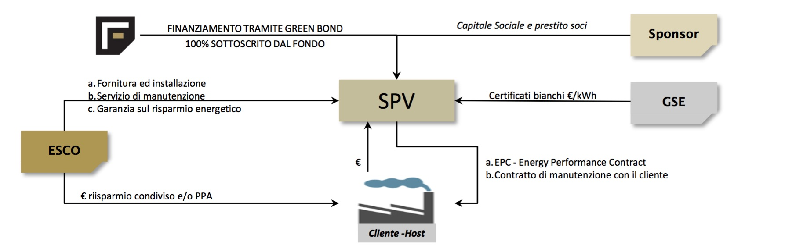
Bond
Project
Bond
Mini-Bond
Green
Bond
I project bond sono obbligazioni di scopo emesse da società che realizzano un progetto infrastrutturale o un servizio di pubblica utilità, per finanziarne la realizzazione e sono destinati ad investitori istituzionali. Il rimborso dei project bond dipende unicamente dai flussi finanziari che il progetto è in grado di assicurare1. Con il decreto legge n. 83 del 22 giugno 2012 è stata anche consentita l’emissione di project bond anche ai fini del rifinanziamento del debito precedentemente contratto per la realizzazione di un’infrastruttura o delle opere connesse al servizio di pubblica utilità di cui la predetta società sia titolare.
I project bond permettono di finanziare la realizzazione del progetto fin dalla fase di costruzione dell’opera, la più rischiosa per gli investitori stante l’assenza di flussi di cassa. Per evitare che il rischio della fase di costruzione possa costituire un ostacolo all’emissione di tali strumenti, il decreto 7 agosto 2012 (Modalità per la prestazione delle garanzie sulle obbligazioni e sui titoli di debito, di cui all’Articolo 157 del decreto legislativo 12 aprile 2006, n. 163, concernente emissione di obbligazioni e di titoli di debito da parte delle società di progetto – project bond)2, emanato in attuazione dell’Articolo 157, comma 3, decreto legislativo 12 aprile 2006, n. 163, ha previsto la prestazione di una garanzia (wrap) da parte del sistema finanziario, delle fondazioni (ivi incluse quelle a partecipazione pubblica) e dei fondi privati, di tal che il rischio di costruzione non sarà assunto interamente da parte dei sottoscrittori delle obbligazioni e dei titoli di debito e sia assicurata maggiore trasparenza alle operazioni e tutela ai sottoscrittori delle obbligazioni e dei titoli in considerazione della specificità degli stessi3
è un vero e proprio prestito obbligazionario
che può essere emesso da una azienda non quotata.

Slide 32
Canale di finanziamento complementare e alternativo al credito bancario
Art. 32 Decreto Legge n.83/2012 (c.d. Decreto Sviluppo) è possibile, anche per le società non quotate, accedere ai seguenti strumenti finanziari:
Obbligazioni
Cambiali finanziarie
Obbligazioni partecipative subordinate
Un MiniBond è un vero e proprio prestito obbligazionario
che può essere emesso da una azienda non quotata.
Uno dei principali vantaggi offerti dai mini-bond è rappresentato dall’opportunità di sostenere periodicamente, durante la vita del prestito, l’esborso dei soli interessi sul finanziamento ottenuto, evitando all’impresa ingenti uscite di cassa nel periodo in cui gli investimenti realizzati non hanno ancora generato adeguata liquidità. Si tratta di forme riconducibili al “Modello Bullet” (restituzione dell’ammontare del capitale alla fine del Periodo di riferimento, sovente anche quote significative di interessi passivi ….).
Le forme tradizionali di finanziamento di matrice bancaria non sono tipicamente riconducibili al modello bullet, solitamente prevedendo la restituzione di quote (variabili o fisse) di capitale di debito, già dalle fasi iniziali di vita del prestito stesso, ovvero il pagamento di rate comprensive sia di una quota interessi che di una quota capitale. Ciò, ovviamente, crea seri problemi di sostenibilità finanziaria del Prestito a quelle imprese che, pur investendo con adeguata remuneratività economica, vedono il cash-in spalmato nel tempo assai più a lungo del relativo cash-out iniziale finanziato a leva.
I mini-bond, inoltre, potendo essere emessi solamente con scadenza medio-lunga, consentono un allungamento della durata media delle fonti di finanziamento delle imprese. Tale allungamento può di conseguenza generare una maggiore coerenza tra la scadenza media dell’attivo patrimoniale e la durata media del passivo, con un generale miglioramento degli indici di bilancio che misurano la coerenza tra la liquidità degli investimenti e il grado di esigibilità delle fonti di finanziamento. Nel complesso, i mini-bond garantiscono all’impresa stabilità del credito per un periodo medio-lungo, senza il rischio di richieste anticipate di rientro dalle linee di fido.
recenti interventi legislativi (Decreto Crescita, Decreto Crescita bis e Decreto Destinazione Italia) hanno inoltre eliminato alcuni svantaggi, soprattutto di natura fiscale, che l’emissione di prestiti obbligazionari da parte di società non quotate presentava rispetto al ricorso ai tradizionali finanziamenti bancari.

Slide 33
La sottoscrizione di mini-bond è riservata a investitori professionali di diritto o su richiesta (in caso di obbligazioni), ovvero ad investitori professionali soggetti a vigilanza prudenziale (in caso di titoli di debito).
Per investitori professionali sia di diritto, su richiesta o soggetti a vigilanza prudenziale, si intendono coloro che posseggono l’esperienza, la conoscenza e la competenza necessaria per prendere le proprie decisioni in materia di investimenti e per valutare correttamente i rischi che in tal modo possono assumersi. Possono pertanto sottoscrivere le emissioni investitori quali Organismi di Investimento Collettivo del Risparmio OICR), Fondi (aperti o chiusi, di natura immobiliare, speculativi, pensione), banche, S.I.M.(Società Investimenti Mobiliari), Società Finanziarie regionali e Fondazioni. La scelta di riservare la sottoscrizione di mini-bond ai soli investitori professionali deriva dalla sostanziale illiquidità che, almeno in questa fase, caratterizza il mercato.
Le società che emettono mini-bond possono decidere di collocare i propri titoli presso il segmento professionale del Mercato di Borsa Italiana, dedicato alla negoziazione di obbligazioni e altri titoli di debito (quali ad esempio cambiali finanziarie e project bonds) emessi dalle società di capitali.

Slide 34
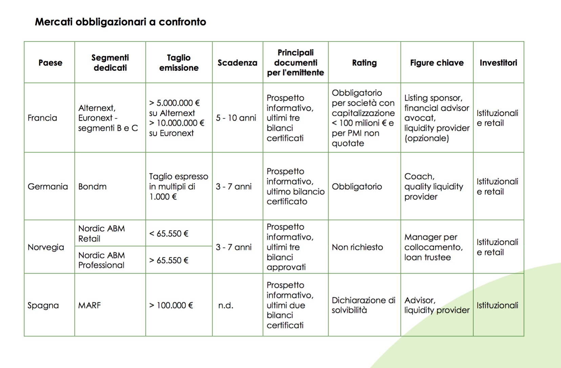

Slide 36
Negli ultimi anni la cosiddetta finanza verde sta diventando finalmente parte attiva nella lotta contro i cambiamenti climatici. In particolare, in seguito agli accordi climatici di Parigi, la domanda di strumenti finanziari che garantiscano una ricaduta positiva, o nulla, sull’ambiente è aumentata notevolmente, diventando una priorità su scala globale sia per gli investitori che per i decisori politici e le istituzioni governative. Per sostenere una simile esigenza, nel settembre del 2016, la Borsa del Lussemburgo, Luxembourg Stock Exchange, ha lanciato il Luxembourg Green Exchange (LGX), una piattaforma esclusivamente riservata a titoli obbligazionari che finanziano progetti ambientalmente sostenibili. Il successo è stato tale che nel maggio del 2017 l’accesso è stato esteso alle obbligazioni che sostengono progetti sociali o sostenibili. L’intenzione di LGX è quella di garantire a chi investe una borsa in grado di evidenziare l’impegno ambientale e/o sociale dei titoli sottoscritti attraverso un’informazione di qualità pre e post emissione. L’accesso alla piattaforma è infatti riservato agli emittenti che possono fornire piena trasparenza, congiuntamente ad una reportistica adeguata sia al momento dell’emissione che durante l’intera vita del prodotto finanziario. I risultati ottenuti fino ad oggi sono molto incoraggianti. Al 31 dicembre 2017, la somma dei green, social e sustainable bond presenti sul LGX ammontava a 72,9 miliardi di euro. Inoltre, abbiamo quotato il primo green bond sovrano, emesso dalla Polonia, e il più importante green bond cinese emesso nell’Eurozona. Vi sono ammessi la maggior parte dei green bond italiani quotati: Enel, Intesa Sanpaolo, Cassa Prestiti e Depositi, Hera. In totale, LGX annovera 125 bond emessi da 35 emittenti in 17 valute diverse.

Slide 37
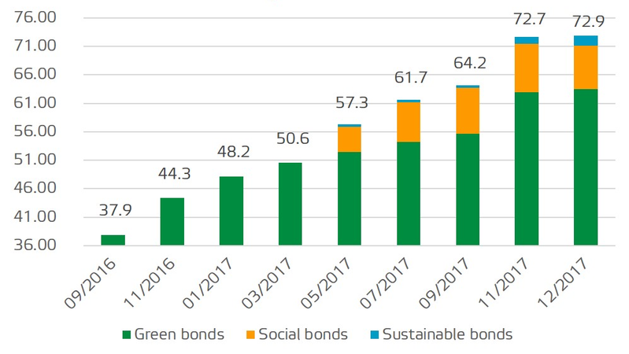
Con la firma degli Accordi di Parigi, nel dicembre 2015, più di 180 paesi, responsabili dell’88% delle emissioni globali, si sono impegnati a mantenere l’innalzamento della temperatura media mondiale al di sotto dei 2°C rispetto ai livelli pre-industriali. Presentando i Sustainable Development Goals (SDGs), i governi hanno assunto una responsabilità ambientale senza precedenti. L’effetto domino si è esteso, infine, al settore privato, che ha iniziato a valutare la sostenibilità delle proprie attività. In questa cornice è evidente che la domanda di investimenti green è attesa aumentare (il World Economic Forum stima che entro il 2020 circa 5.700 miliardi di dollari verranno investiti annualmente in infrastrutture “verdi”).
In un contesto che vede le obbligazioni tradizionali presentare rendimenti bassi o addirittura negativi, non è difficile immaginare come la caratteristica green rappresenti una forte attrattività agli occhi degli investitori e di chi si affaccia per la prima volta sul mercato obbligazionario. Basti considerare che il mercato dei green bond ha raddoppiato i suoi volumi di anno in anno dal 2007 ad oggi fino ad arrivare a 155 miliardi di dollari nel 2017. Nonostante ciò stiamo parlando di una piccola goccia nell’oceano: l’OCSE stima che ad oggi solo poco più dell’1% dei titoli emessi possano essere etichettati come green. È quindi chiaro che c’è ancora tanto lavoro da fare, sia per quanto riguarda il coinvolgimento di nuovi capitali che per quanto riguarda la consapevolezza degli investitori.

Slide 38
La partita più importante nel mercato dei green bond si gioca sulla credibilità&trasparenza, ovvero sulla possibilità di valutare correttamente gli impatti reali di ogni singolo titolo. A più di dieci anni dal lancio del primo green bond europeo emesso dalla Banca Europea per gli Investimenti (BEI) nel 2007, il principale ostacolo allo sviluppo del settore rimane la mancanza di un quadro normativo, di standard e criteri di misura (metrics) universalmente accettati. Questo non permette agli investitori di accedere all’informazione più importante: la destinazione dei fondi ed il loro impatto non-finanziario. Spesso, dietro ad un’obbligazione, magari coperta da un’ottima campagna di comunicazione, si nascondono centinaia di progetti finanziati, il che rende il tracking di ogni singolo finanziamento arduo. A tal proposito, è fondamentale che l’investitore possa prendere visione di tutte le informazioni riguardanti la natura e l’impatto non finanziario atteso e realizzato nella maniera più granulare possibile. Ad oggi, chi emette titoli utilizza standard diversi nel riportare simili informazioni, rendendo difficile la comprensione per i “non addetti ai lavori”. Per semplificare il monitoraggio da parte degli investitori e il confronto tra diversi prodotti, andrebbe quindi definita in maniera più univoca e comparabile una serie di indicatori (KPI) di facile lettura, che riporti, ad esempio, la CO₂ risparmiata per ogni migliaio o milione di euro investito. Solo armonizzando le metodologie, gli indicatori di performance (KPI) e la relativa reportistica permetteremo agli investitori “comuni” di valutare tra due bond quale si confà maggiormente al proprio profilo etico, economico, ambientale e sociale. La problematica del controllo dell’impatto è particolarmente sentita sia presso gli investitori istituzionali come fondi pensione ed assicurativi che sempre più sono tenuti a rendere conto dell’impatto non finanziario del loro portafoglio sia, in maniera crescente, presso i retail.
Tutti i bond ammessi su LGX – ma in generale tutti i green bond che rispettano gli standard internazionali (ad esempio i GBP delineati dall’International Capital Market Association, ICMA) – sono obbligati a fornire una qualche forma di aggiornamento anche dopo l’emissione del titolo. Osserviamo però che lo stile dei report, la loro qualità e le informazioni contenute differiscono notevolmente.
La politica regolatoria sull’LGX è molto severa, oltre alla valutazione iniziale da parte di esperti imparziali sulla sostenibilità degli strumenti finanziari emessi, la reportistica costante è considerata un requisito per l’accesso e la permanenza: chi non può garantirla viene escluso dalla piattaforma green. Problema che fino ad oggi non si è presentato poiché tutti gli emittenti che hanno emesso titoli verdi hanno rispettato questa prerogativa, sebbene alcuni di essi – spesso si tratta di grandi società che devono misurarsi con processi burocratici più complessi - abbiano talvolta presentato dei ritardi. Ma finché non verranno standardizzate le informazioni contenute nei report sarà difficile per gli investitori comparare le diverse obbligazioni e di conseguenza avere piena fiducia nel potenziale di un mercato che può invece dare un grande impulso agli investimenti sostenibili e a una diversa concezione della finanza.

Slide 39
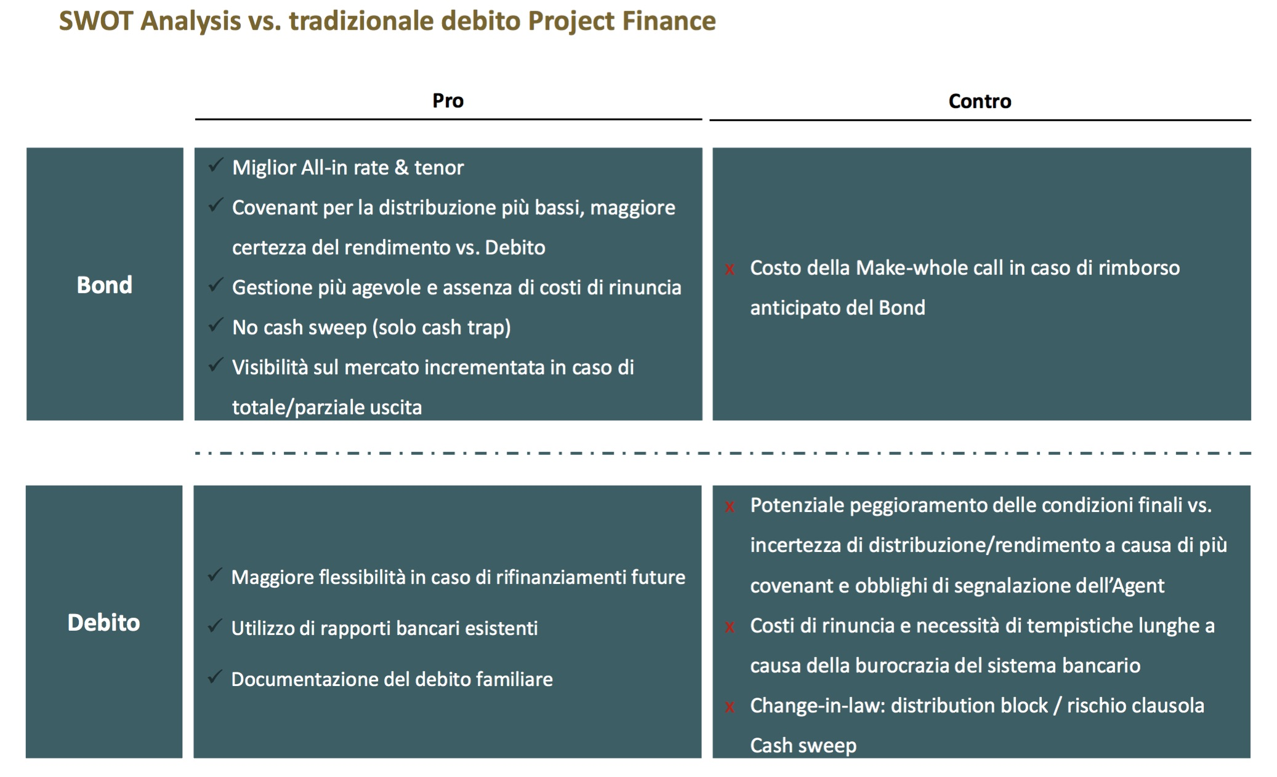

Slide 40
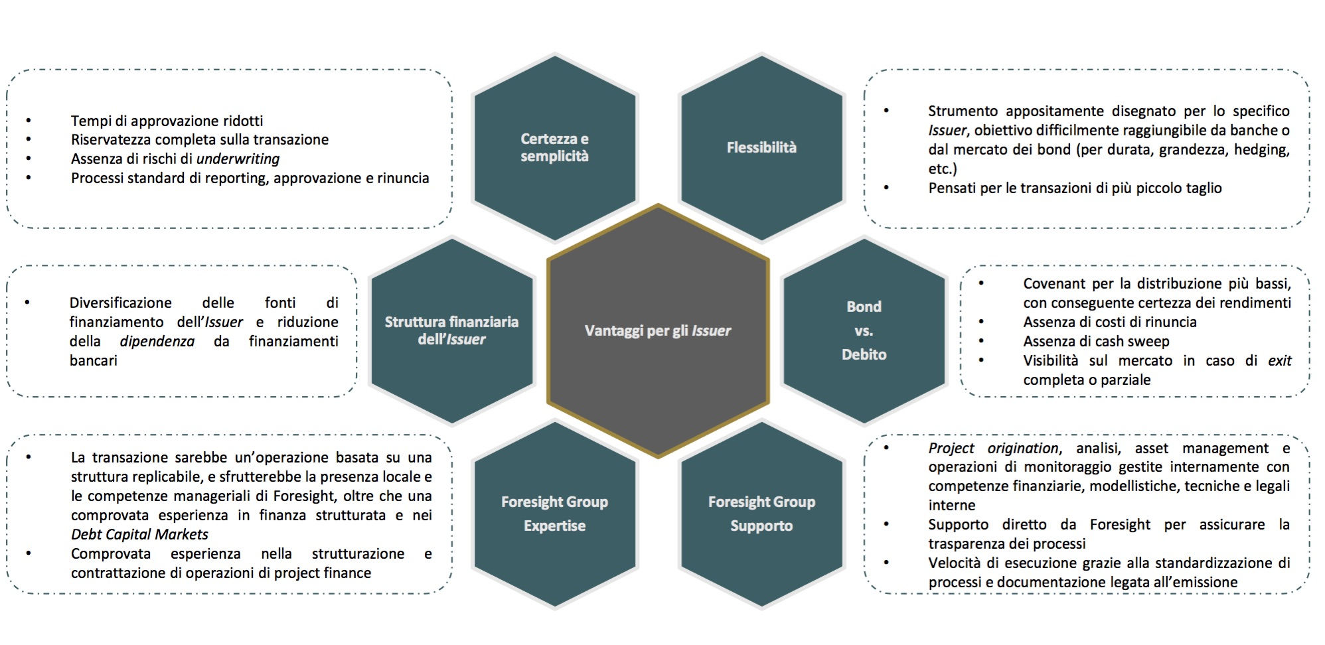

Slide 41
IL RICORSO AL “RISPARMIO GESTITO”
Organizzato e gestito in FONDI D’INVESTIMENTO
Per risparmio gestito si intendono le attività delegate relative alle scelte finanziarie dei risparmiatori.
Il T.U.F. (1°luglio 1998), (D.Lgs. N 58 del 24 feb. 1998) distingue tra:
Gestione individuale: svolta da Banche e Sim.
Gestione collettiva: riservata a società specializzate ed SGR
ISTITUZIONE DI UN FONDO
Art. 4 D.M. n. 228/1999
Le S.G.R. possono istituire fondi di investimento il cui patrimonio è investito in una o più categorie di beni: strumenti finanziari, depositi bancari, beni immobili, diritti reali immobiliari e partecipazioni in società immobiliari.
Le SGR possono:
Istituire e gestire Fondi
Svolgere attività connesse e strumentali stabilite dalla Banca d’Italia, sentita la Consob.
(Attività connessa: attività che consente di promuovere e sviluppare l’attività principale esercitata; Attività strumentale: attività che ha carattere ausiliarie rispetto all’attività svolta. Es. studio, ricerca, analisi economico finanziarie; elaborazione, comunicazione e trasmissione di informazioni economico finanziarie; amministrazione di immobili ad uso funzionale; servizi di natura amministrativo contabile)
Prestare servizio accessorio di custodia e amministrazione di strumenti finanziari, limitatamente alle quote di OICR di propria istituzione
Prestare il servizio accessorio di consulenza in materia di investimenti in strumenti finanziari
Per gestione collettiva del risparmio si intende:
La promozione, l’istituzione e l’organizzazione di Fondi Comuni d‘Investimento e l’amministrazione dei rapporti con i partecipanti
Gestione del patrimonio di organismi di investimento collettivo O.I.C.R. e SICAV (fondi comuni d’investimento e società d’investimento a capitale variabile), di propria o altrui istituzione, mediante l’investimento avente a oggetto strumenti finanziari crediti o altri beni o immobili.

Slide 43
I Fondi comuni di investimento
Sono patrimoni autonomi, gestiti in monte, indivisibili, suddivisi in quote uguali di pertinenza di una pluralità di soggetti. Le principali tipologie di fondo, per modalità di funzionamento, sono:
il fondo aperto, nel quale l’ingresso e l’uscita degli investitori è libero. Il patrimonio risulta variabile in funzione:
  dell’andamento delle quotazioni di mercato delle poste dell’attivo,
  del saldo tra nuova raccolta e riscatti;
il fondo chiuso, invece, dopo la costituzione prevede luscita dei soci solo in determinate scadenze o dopo un certo periodo.
Si possono ancora classificare per tipo di oggetto in :
Fondi mobiliari, se investiti in strumenti finanziari, che a loro volta si classificano in:
  azionari, se prevalentemente investiti in azioni, obbligazioni convertibili e simili;
  bilanciati con il portafoglio distribuito tra titoli a reddito e titoli a contenuto patrimoniale;
  obbligazionari, se prevalentemente investiti in obbligazioni;
  di liquidità, se investiti in obbligazioni con scadenza inferiore ai sei mesi;
  flessibili, se la struttura del portafoglio varia a discrezione del gestore.
Fondi immobiliari, se investiti in immobili e limitatamente ai fondi chiusi.

Slide 44
Fondi comuni d’investimento: caratteristiche
Ogni macro categoria si distingue per la percentuale minima e massima di investimento azionario.
Fondi obbligazionari
I fondi obbligazionari investono il loro portafogli in obbligazioni, possono detenere azioni che risultano dalla conversione dei titoli obbligazionari in misura non superiore al 10% del valore del portafoglio.
Valuta di denominazione e duration del portafoglio. Durata finanziaria espressione del rischio di tasso dinteresse a cui è sottoposto un titolo o un portafogli obbligazionario. La Duration è la media ponderata delle scadenze dei pagamenti per interessi e capitale associati al titolo obbligazionario.
Categorie specializzate: l’investimento principale deve essere pari almeno al 70% del portafoglio, 30% residuale. Per i fondi governativi linvestimento principale deve essere pari almeno all’80% del portafoglio ed il 20% residuale.
Tipologia dell’emittente: categorie governative, corporate investment grade con rating non inferiore a BBB (S&P)
Merito creditore: i fondi specializzati in high yield si caratterizzano per investimenti in strumenti finanziari senza rating o con rating inferiore a BBB (S&P)
Investimento residuale: i fondi appartenenti a categorie specializzate investono in strumenti finanziari con rating non inferiore a BBB (S&P)
Fondi azionari
Investono almeno il 70% del portafoglio in azioni
Investimento principale - almeno il 70% del portafogli deve essere investito in azioni
Investimento residuale - (non più del 30% del portafogli può essere investito in obbligazioni
Specificazioni
    Azionari Italia, area euro, Europa, America, Pacifico, Paesi emergenti, investimento principale in azione con emittente appartenete all’area geografica di riferimento
    Fondi azionari paese: investimento principale in emittenti appartenenti al paese definito nel regolamento
    Fondi appartenenti ad una delle 9 categorie settoriali: emittente qualunque ma appartenete ad uno o più settori definiti dal Global Industry Classification Standard.

Slide 49
Le Sicav
Si definiscono SICAV “le società per azioni a capitale variabile con sede legale e direzione generale in Italia, avente ad oggetto esclusivo l’investimento collettivo del patrimonio raccolto attraverso un’offerta al pubblico delle proprie azioni.”
L’autorizzazione è concessa dalla Banca d’Italia, sentita la CONSOB, la SICAV è iscritta presso un apposito albo tenuto dalla Banca d’Italia.
Caratteristica della Sicav è che l’investitore diventa azionista della società e quindi, attraverso l’esercizio del diritto di voto, partecipa alla vita della stessa intervenendo sulla sua politica degli investimenti.
Una SICAV può gestire direttamente il proprio patrimonio o delegarne la gestione ad una società di gestione del risparmio.
Le SICAV sono organismi di tipo “aperto” con capitale sociale variabile e coincidente con il patrimonio netto.
Le SICAF, invece, definiscono il loro operare a partire da un Capitale iniziale Fisso.

Slide 51
Fondi comuni d’investimento
Rendimento del fondo e rendimento dell’investitore:
Il rendimento del fondo è dato dalla variazione di valore della quota di partecipazione in un certo arco temporale.
R= VCQ ^{1/t} -1 *100
VQI
R = valore percentuale del rendimento
VCQ = valore della quota al momento del calcolo
VQI = valore della quota al momento iniziale
T = tempo espresso in anni, mesi, giorni
Il controvalore iniziale deve tener conto delle commissioni di sottoscrizione mentre quello finale delle commissioni di rimborso.

