Slide 1
Lesson 6. Others (renewable) sources of Energy
" Energy and Natural Resources Economics.”
a.a. 2019/20

Slide 2
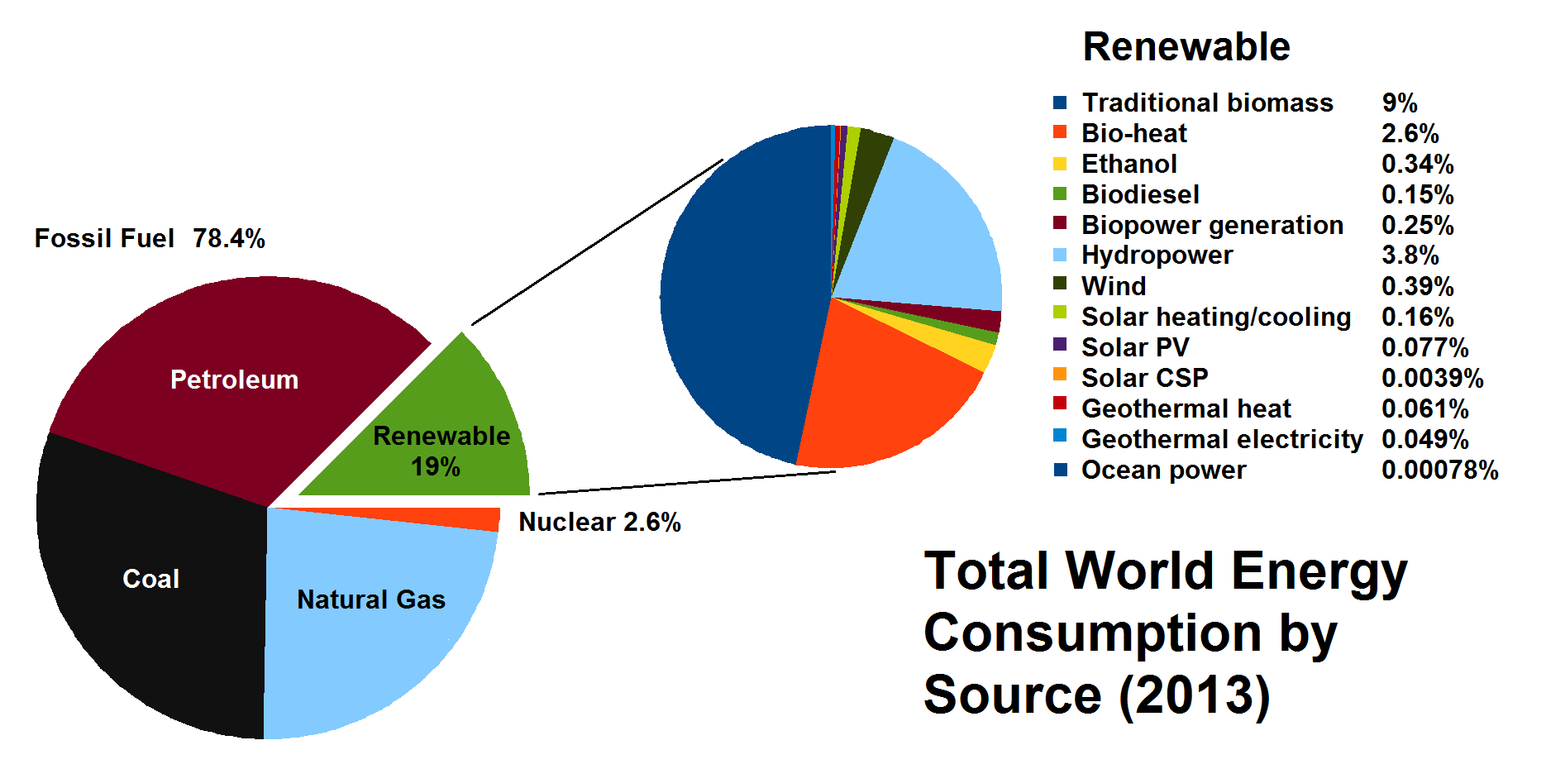

Slide 3
IEA: 2003
Usa: 8 TEP/anno a persona
Italia: 3 TEP/anno a persona
Africa: 0,5 TEP/anno a persona

Slide 4
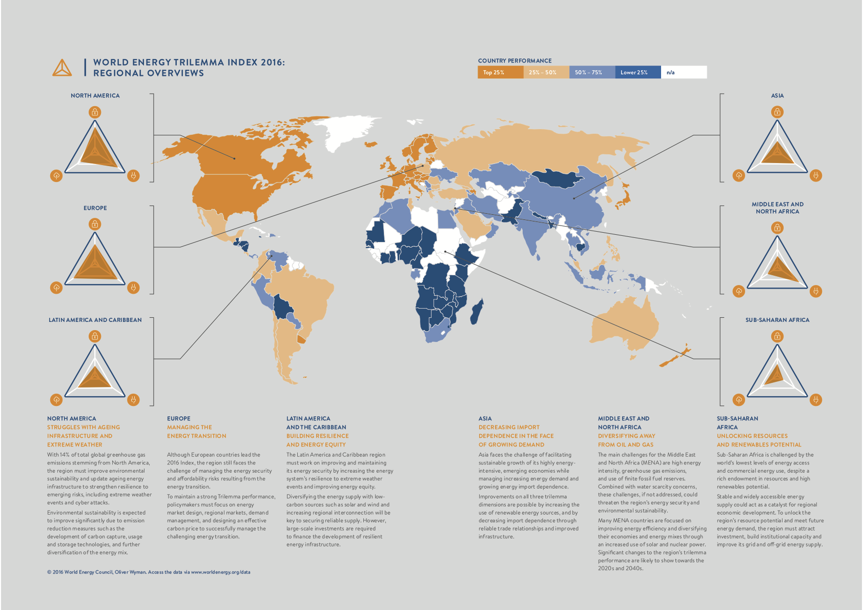

Slide 5
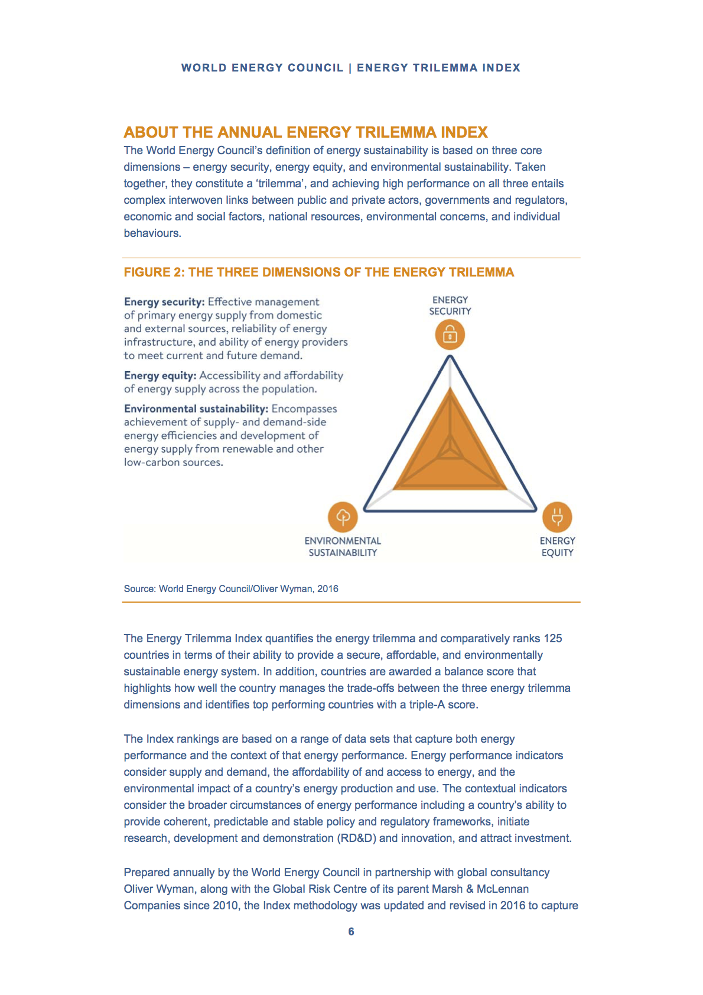

Slide 6
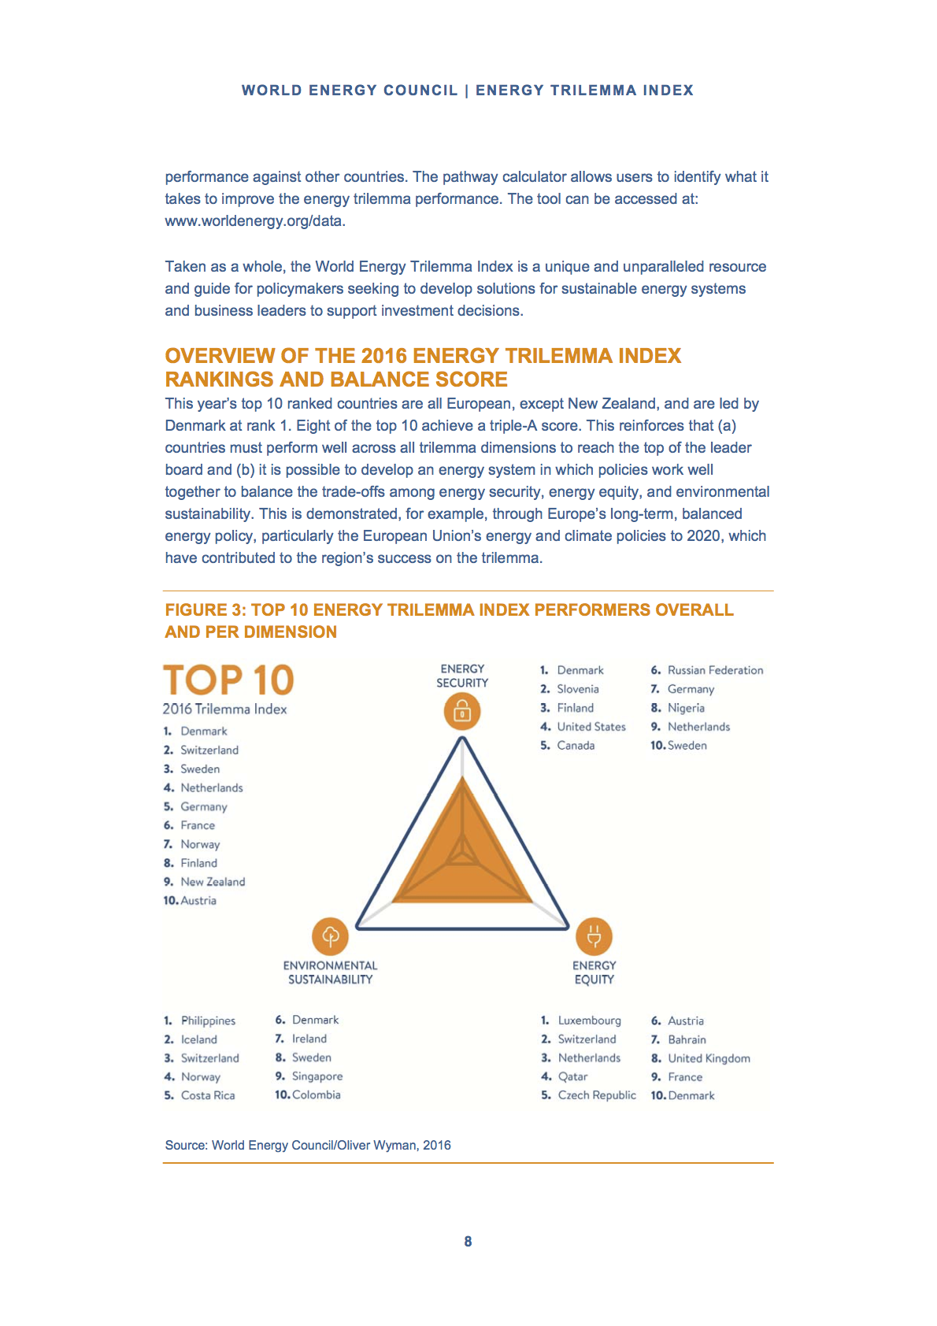

Slide 7
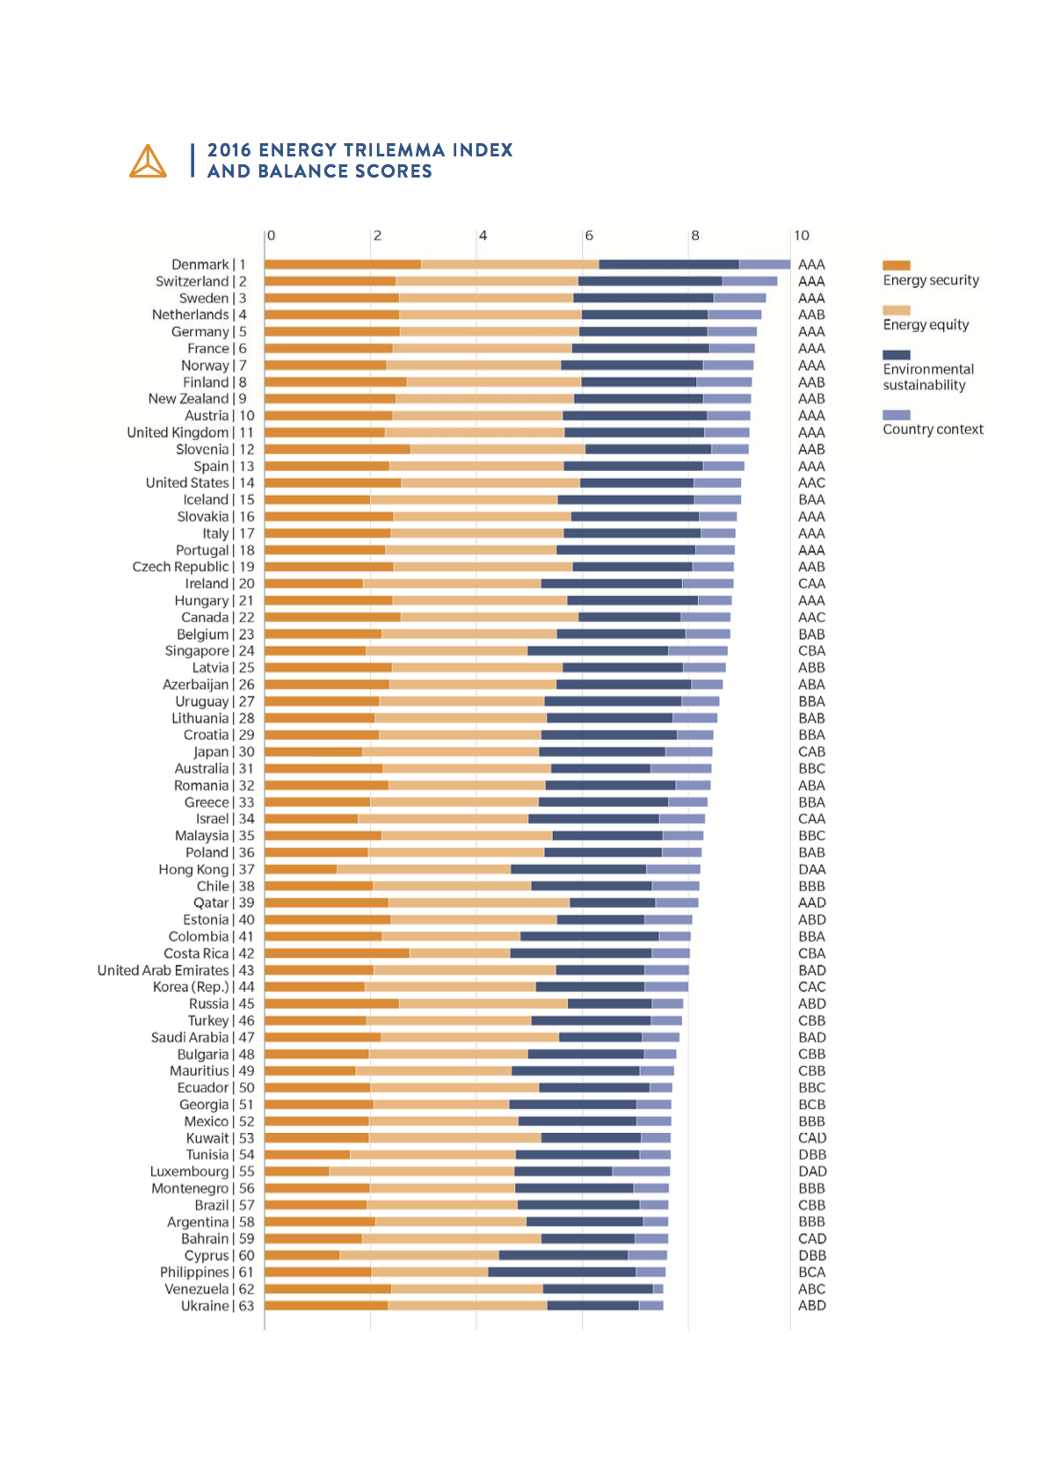
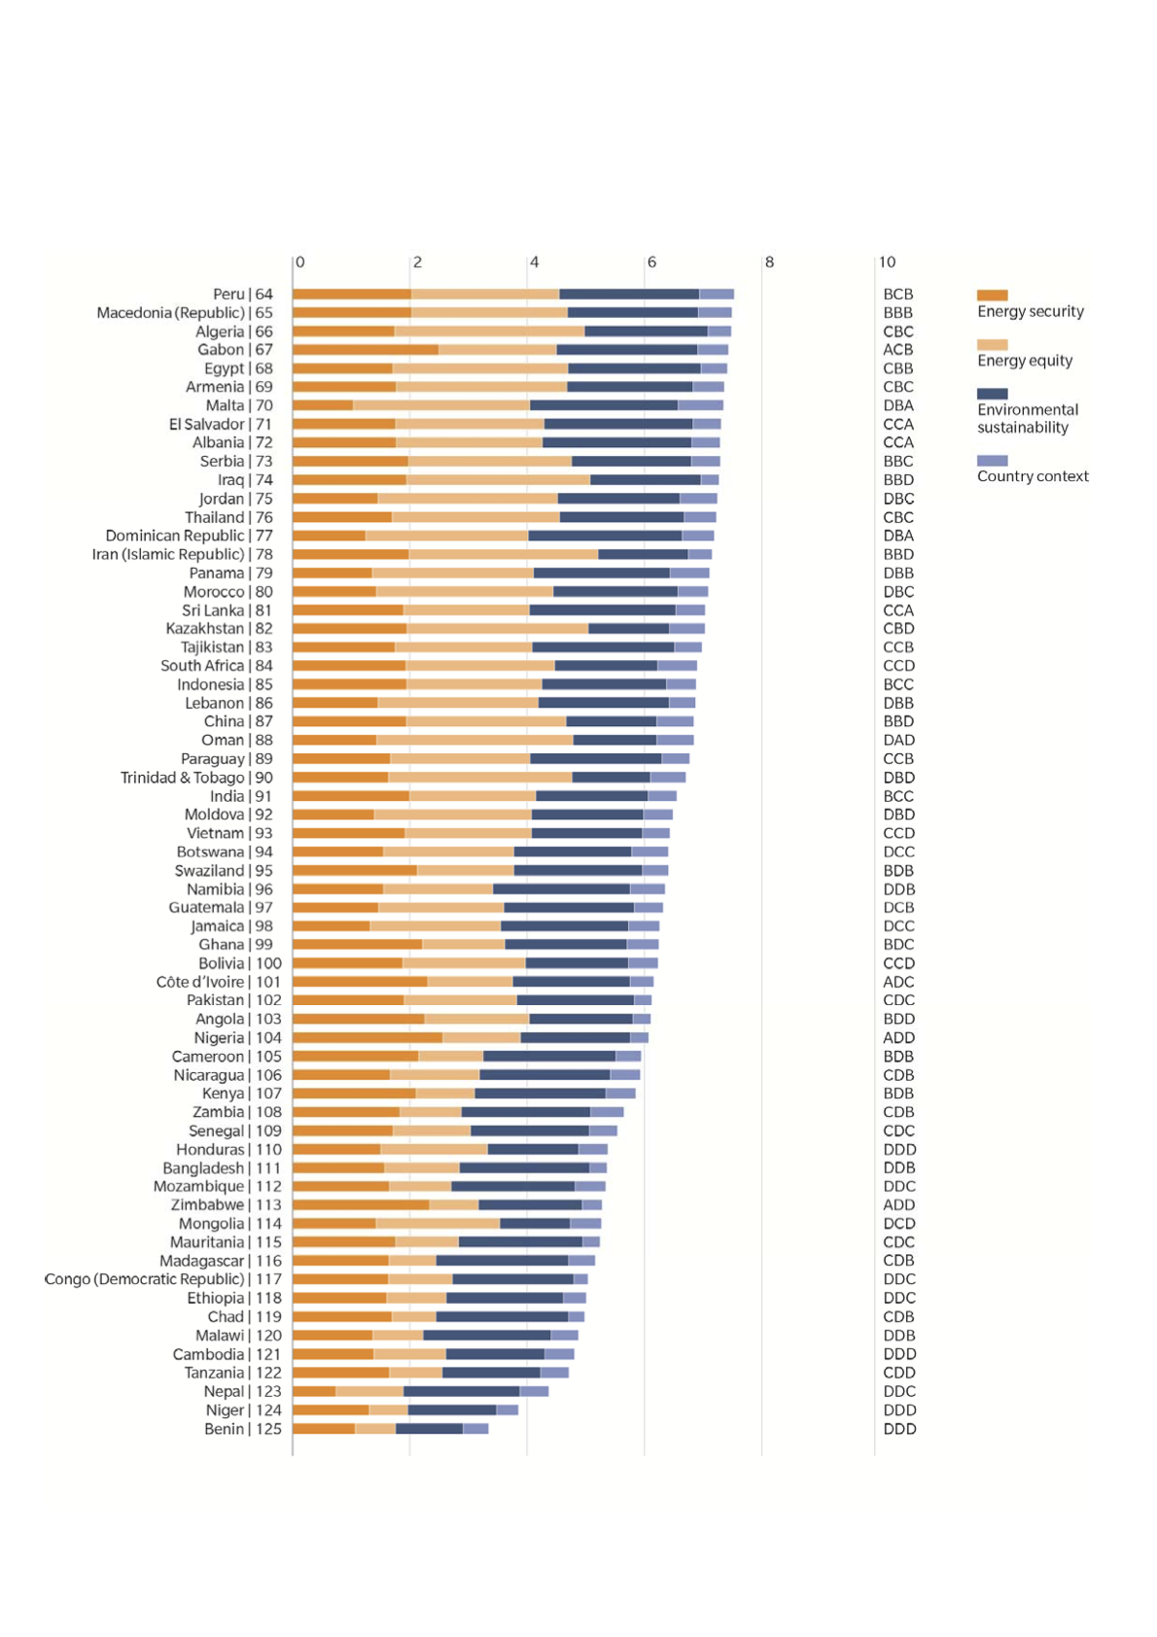

Slide 8
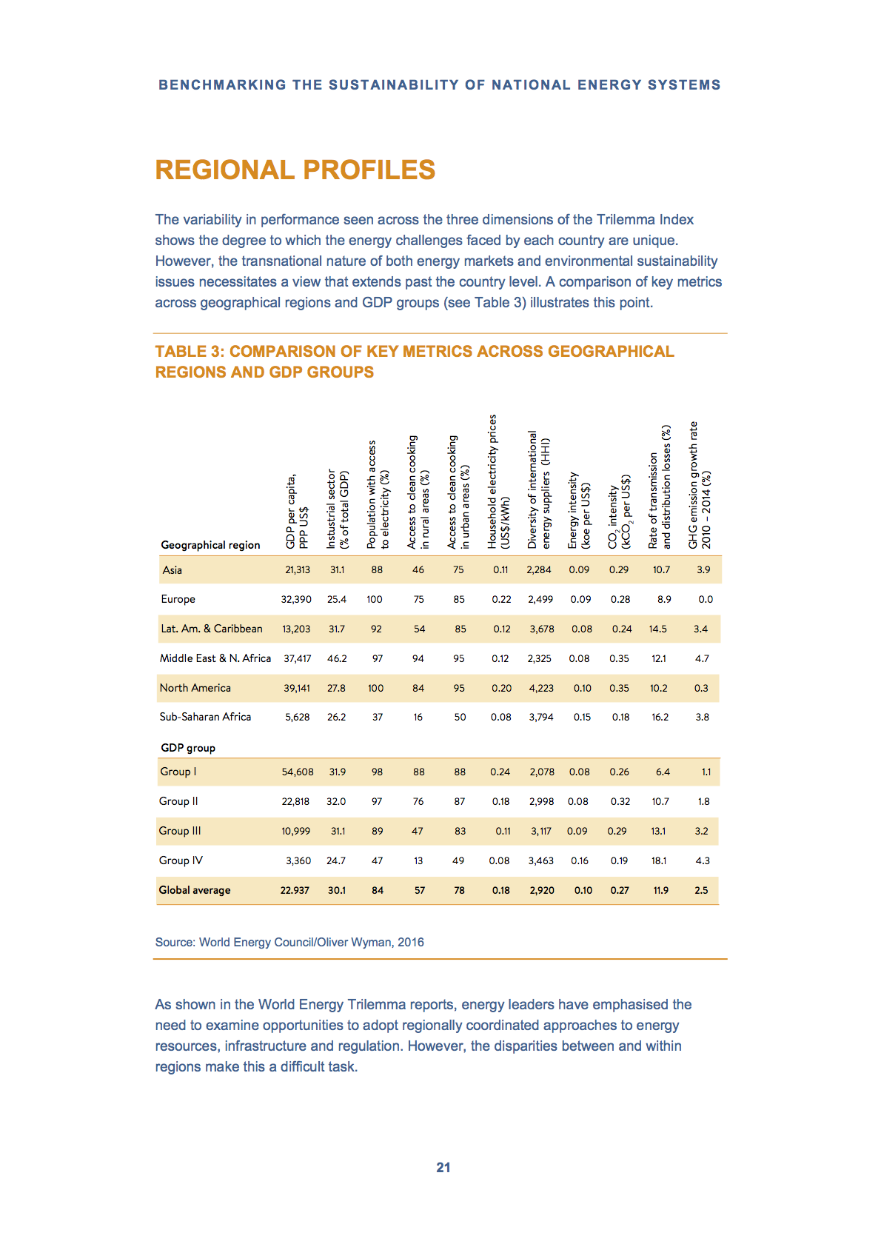

Slide 9
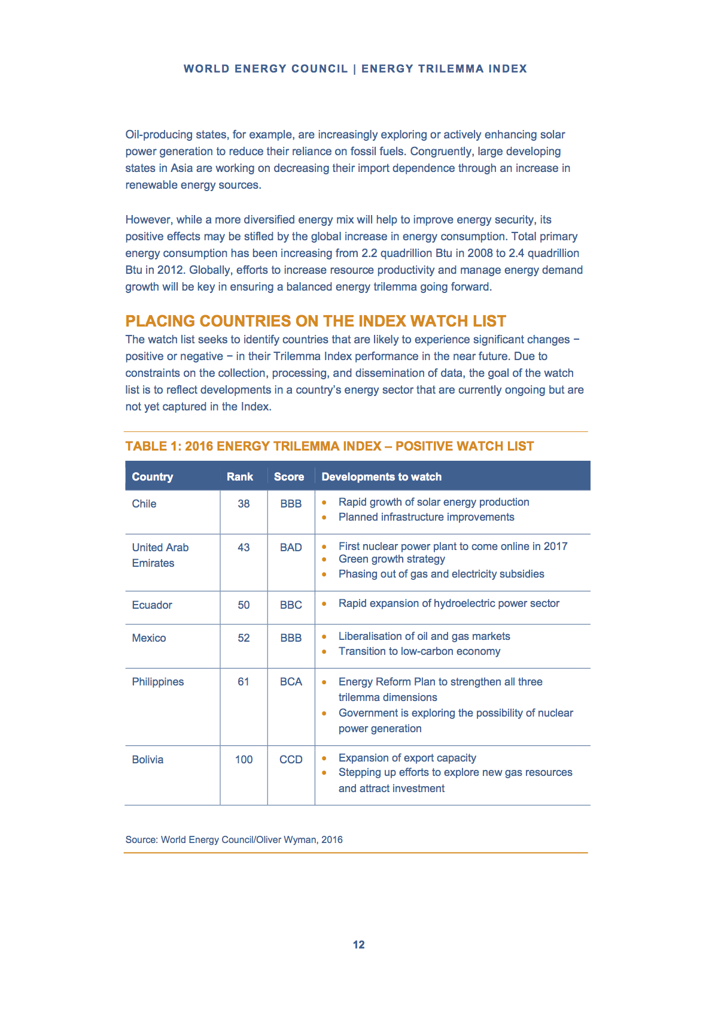

Slide 10
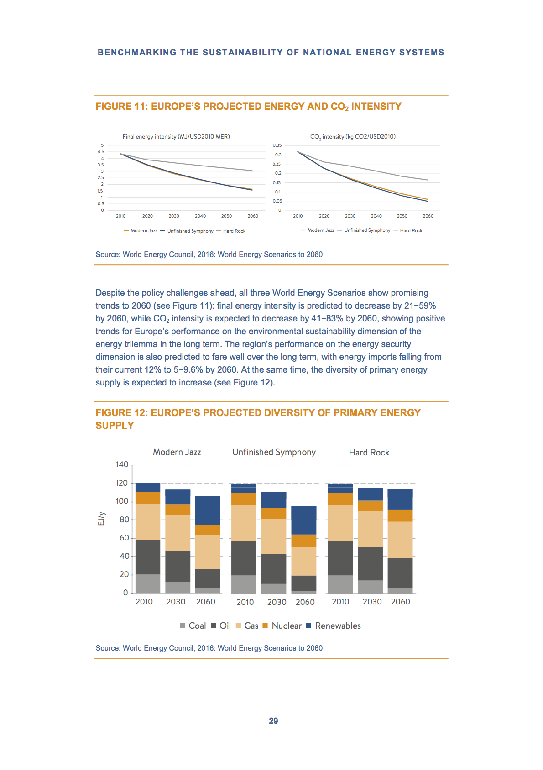

Slide 11
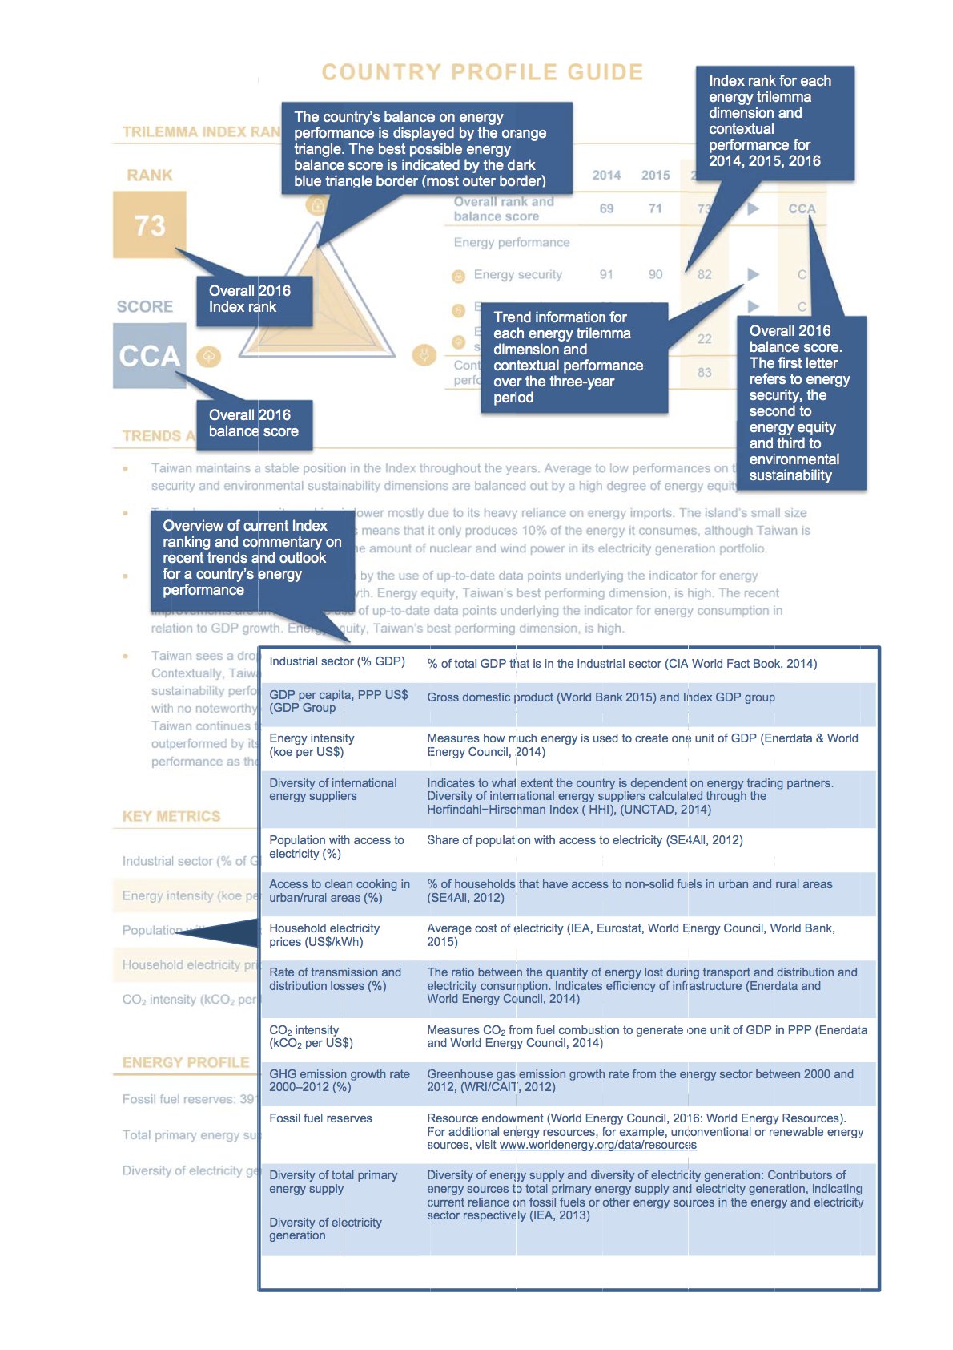

Slide 12
Obiettivi delle Politiche Energetiche
Ottimizzazione delle variabili macroeconomiche nazionali (ad esempio, La Bilancia del Commercio con l’Estero → minimizzazione delle importazioni);
Minimizzazione della Dipendenza dall’Estero;
Minimizzazione del Rischio Paese Fornitore di essential facilities;
Massimizzazione della Sostenibilità → nelle varie sfaccettature di cui si compone la Sostenibilità Generale → Trilemma Index

Slide 14
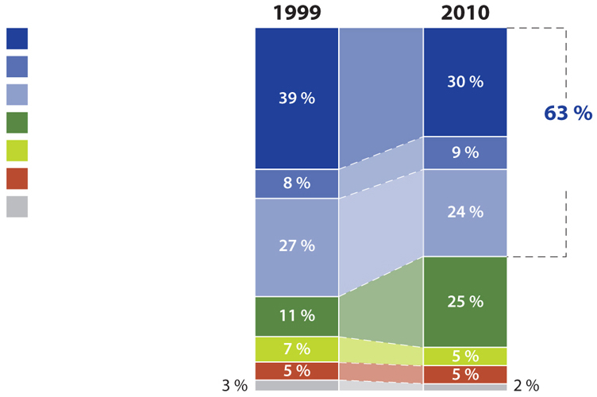
Le importazioni di energia dell'UE sono in aumento
La persistente “dipendenza da terzi” dei paesi europei
Importazioni extra-UE, per gruppo di prodotto
%
il 63 % delle importazioni nell'UE riguarda prodotti manifatturieri (macchinari e veicoli, sostanze chimiche e altri prodotti manifatturieri)
Sono però in crescita le importazioni di prodotti primari
Nel 2010, le importazioni di prodotti energetici sono state quattro volte superiori a quelle del 1999
Macchinari e veicoli
Sostanze chimiche
Altri prodotti manifatturieri
Energia
delle importazioni riguarda prodotti manifatturieri
Prodotti alimentari e bevande
Materie prime
Prodotti n.c.a.
Fonte: Eurostat (codice dei dati online: ext_lt_intratrd)

Slide 15
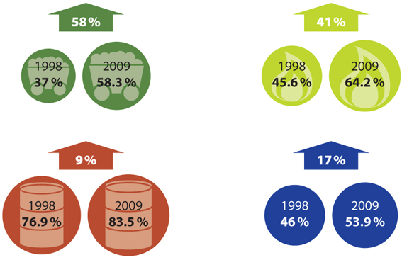
La dipendenza energetica
UE-27 da altri paesi
La dipendenza dell'UE dall'energia importata è cresciuta costantemente nel corso dello scorso decennio
Dal 2004, più del 50 % dell'energia impiegata nell'UE è stata importata
La dipendenza è superiore per i prodotti del petrolio, come il petrolio greggio
Circa un terzo delle importazioni di petrolio greggio e gas naturale proviene dalla Russia
Derivati del carbon fossile
Gas naturale
Tutti i prodotti del petrolio
Totale
Nota: il "totale" non corrisponde alla media delle tre categorie di combustibili; comprende anche altre fonti energetiche, come le rinnovabile e il nucleare, che sono trattate come fonti domestiche
Fonte: Eurostat (codice dei dati online: tsdcc310)

Slide 16
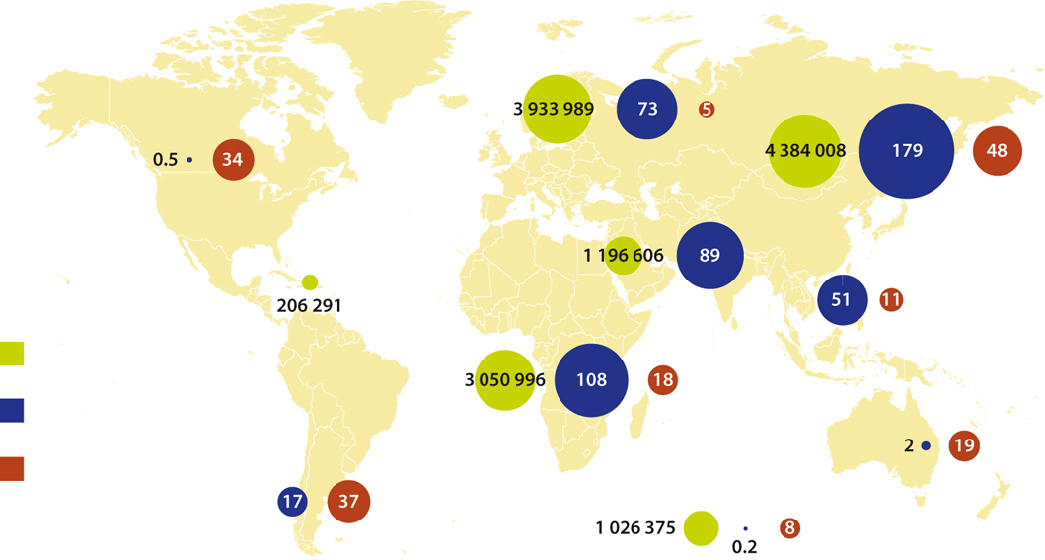
Provenienza delle importazioni di energia nell'UE
Importazioni di energia nell'UE-27, 2010
Resto dell'Europa non-UE
Russia
Nord America
Medio Oriente
Caraibi
Asia
Africa
Gas
Terajoule
Oceania
Petrolio
Milioni di tonnellate
America
centrale e meridionale
Combustibili solidi
Milioni di tonnellate
Non specificato
Fonte: Eurostat (codice dei dati online: nrg_122a, nrg_123a, nrg_124a)

Slide 17
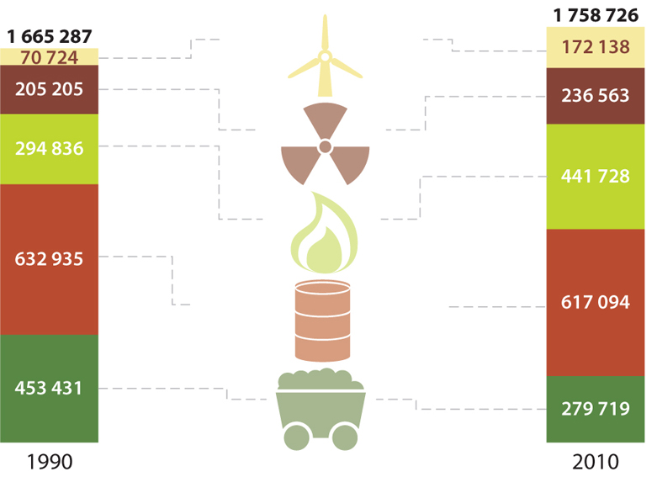
Aumento del consumo di energia e revisione del “Mix Energetico”
La revisione del MIX ENERGETICO
Consumo interno lordo di energia, per combustibile, UE-27
1 000 tonnellate, equivalente petrolio
Il consumo di energia nell'UE è cresciuto del 6 % dal 1990
Il "mix energetico" dell'UE è cambiato dal 1990
L'impiego di combustibili solidi si è ridotto, mentre l'uso di gas naturale è cresciuto di quasi il 50 %
Energia rinnovabile
+143.4 %
Calore nucleare
+15.3 %
Gas naturale
+49.8 %
Tutti i prodotti del petrolio
-2.5 %
Combustibili solidi
-38.3 %
Fonte: Eurostat (codice dei dati online: tsdcc320)

Slide 18
La produzione di energia per Fonti
Fonti fossili e nucleare
Carbone
Energia fossile
Gas naturale
Fonti rinnovabili
Petrolio
Impianti termici
Scissione
nucleare
Energia solare
Impianti fotovoltaici
Energia nucleare
Fusione
Importanti problemi sorgono da:
analisi dell’impatto energetico-ambientale dell’intera filiera della tecnologia di riferimento e non della sola “applicazione finale” (es. il pannello fotovoltaico);
Problemi di gestione del Sistema Energetico complessivo a fronte della non programmabilità delle fonti di produzione d’energia.
Energia eolica
On shore/Off shore
Pale eoliche
Mulini a vento
Energia idrica
Impianti idroelettrici
Mulini sui
fiumi
Energia da biomasse e rifiuti
Biogas
Biocarburanti
Energia geotermica
Riscaldamento
Elettricità

Slide 19
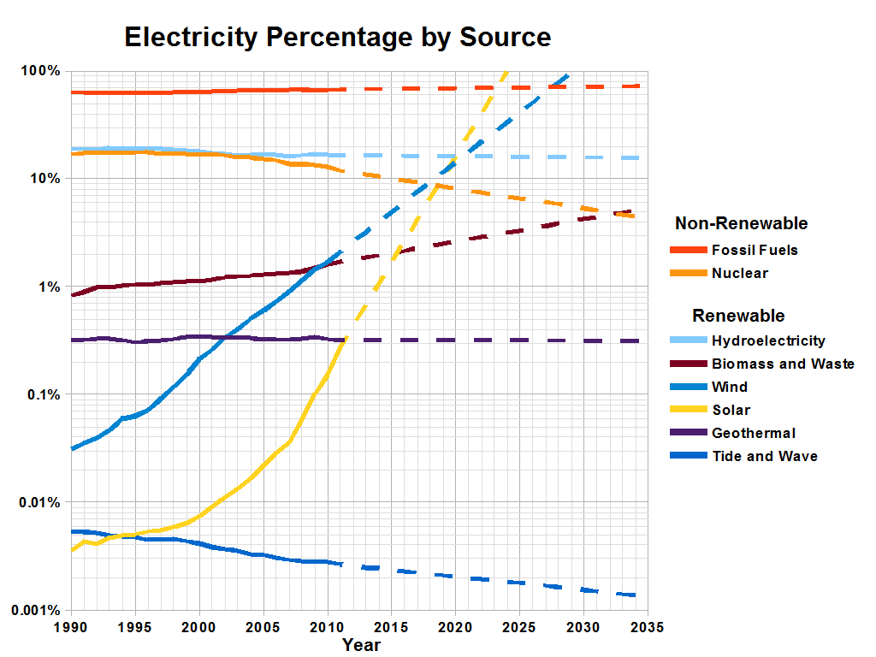

Slide 21
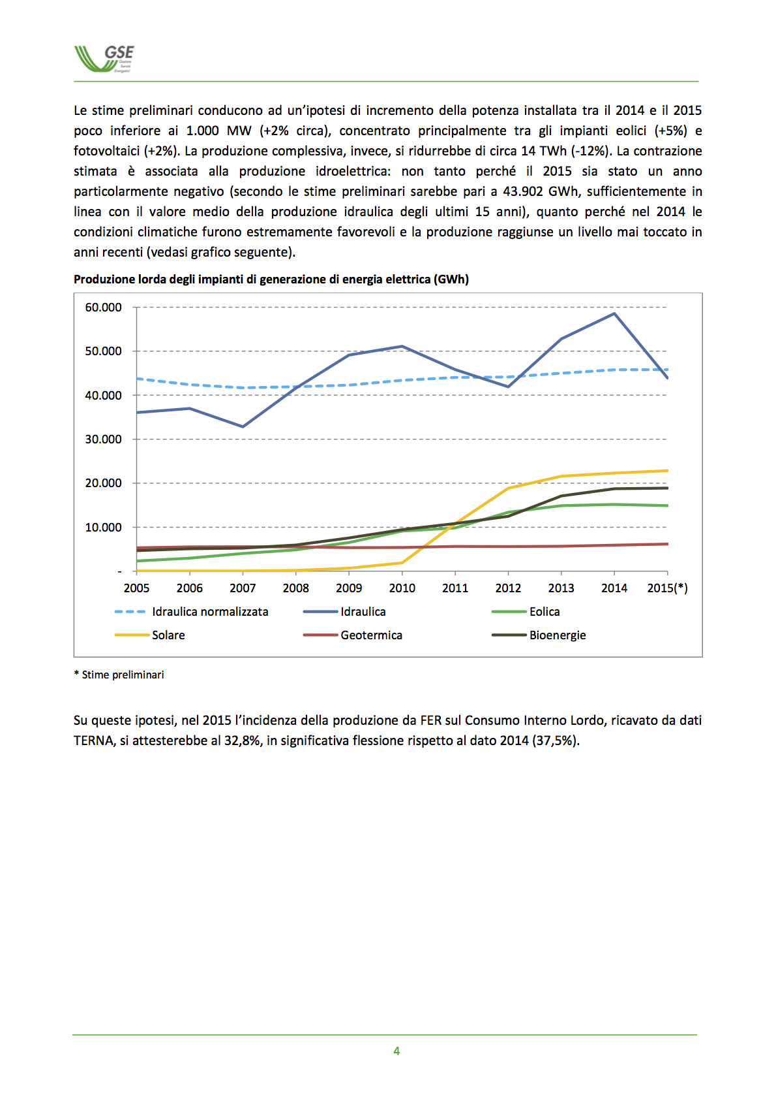

Slide 24
Renewable Energy Sources
  Renewable Energy Sources
    Radiant solar energy
      Solar heating (passive and active), solar power plants, photovoltaic cells
    Biomass energy
      Direct: combustion of biomass
      Indirect: chemical conversion to biofuel
    Wind energy
    Hydro energy
    Geothermal energy
      Power plants, direct use, heat pumps
    Ocean energy
      Tidal; salinity-driven

Slide 25
PASSIVE SOLAR HEATING
Passive solar heating – captures sunlight directly with a structure and converts it to low-temperature heat for space heating.
Advantages Disadvantages
1. save money 1. expensive for initial costs
2. create 2-5 more jobs/unit of electricity 2. aesthetically not pleasing
3. eliminate/reduce fossil fuels 3. latitude
4. less pollution
5. less environmental damage

Slide 26
ACTIVE SOLAR HEATING
Active solar heating – specially designed collectors absorb solar energy and fan/pump distributes energy to parts of a building to meet space/water heating needs.
Advantages Disadvantages
1. save money 1. expensive for initial costs
2. create 2-5 more jobs/unit of electricity 2. aesthetically not pleasing
3. eliminate/reduce fossil fuels 3. latitude
4. less pollution
5. less environmental damage

Slide 27
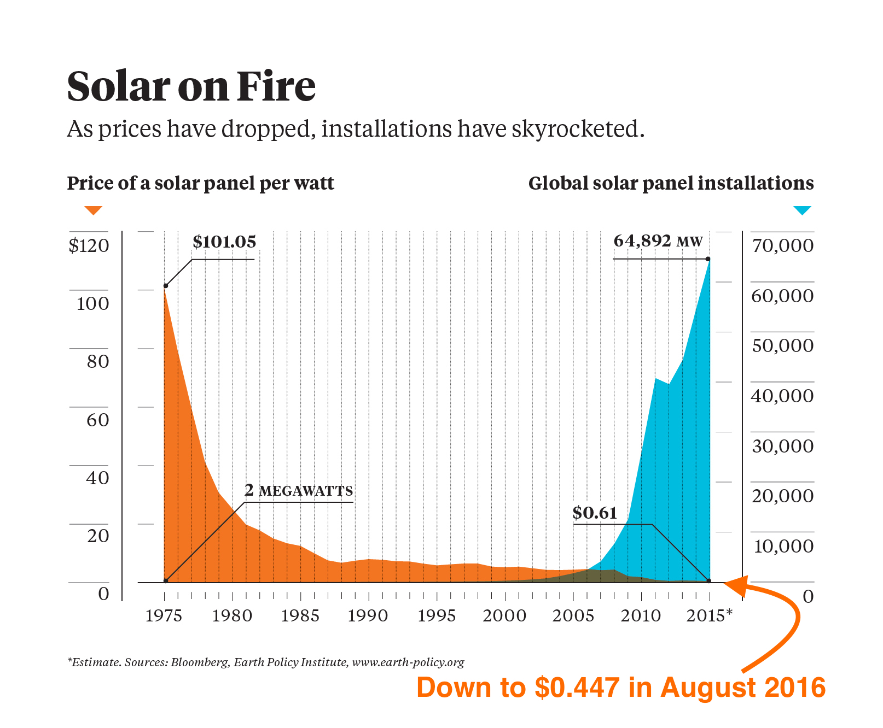

Slide 28
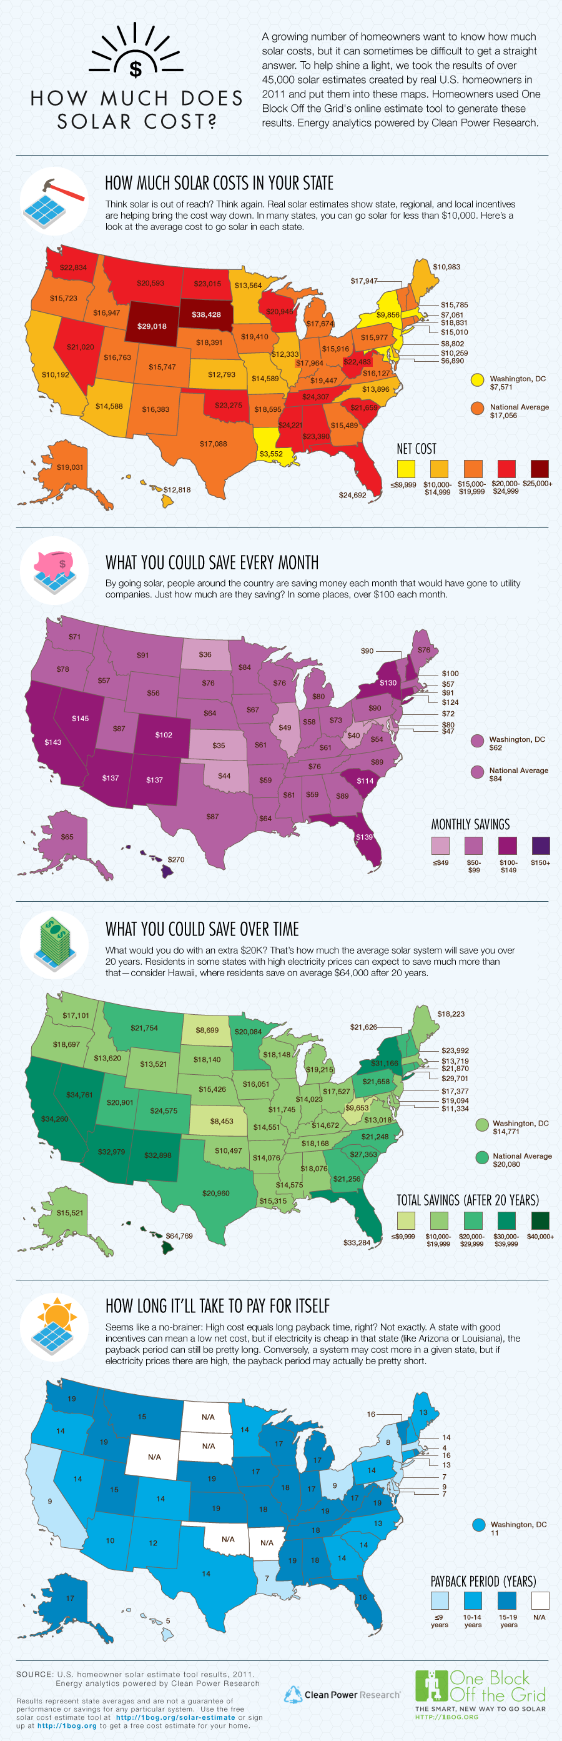

Slide 29
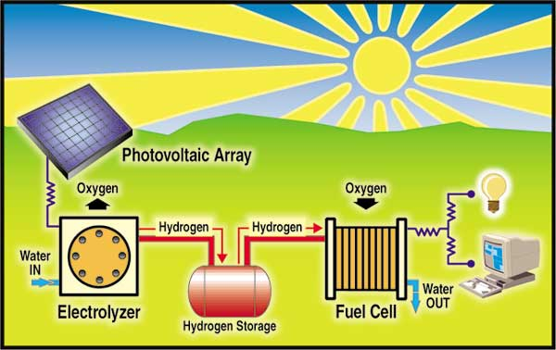
SOLAR HYDROGEN
Solar-Hydrogen – Water can be split into gaseous hydrogen and oxygen.
It is in its infancy. So far… we can create fuel cells where hydrogen and oxygen combine to produce an electrical current, but it is difficult to store enough hydrogen gas in a fuel tank for very long.
Politics and economics are “holding up” this technology.
R&D from government needed.
must convince energy companies and investors to $ into this type of power and phase out fossil fuels.
must convince public to change over.
But …Not Yet!

Slide 30
GEOTHERMAL
Geothermal Energy - Heat contained in underground rocks and fluid that can be tapped for energy.
Extract dry steam, wet steam or hot water and can be used to heat space or water.
“Potentially renewable resource”
22 countries currently use geothermal, it supplies 1% of world energy. In the USA (44% geothermal energy produced worldwide) geothermal electricity is produced mostly in Hawaii, California, Nevada, and Utah.

Slide 31
Hydropower
Nature
  Generation of electricity using the flow of water as the energy source.
  Gravity as source.
  Requires a large reservoir of water.
  Considered cleaner, less polluting than fossil fuels.
Tidal power
  Take advantage of the variations between high and low tides.
  Hydroelectric power plants – A dam is built across a large river to create a reservoir. The higher the head, the greater the amount of power that can be generated. Water is stored in a reservoir during low electricity production. Water is released and flows are controlled as electricity demands peak. Water spins the turbines in the “powerhouse”. Electricity is distributed to end user.

Slide 32
Hydro Energy
Advantages
  Cheap to operate
    Long life and lower operating costs than all other power plants
  Renewable
  High yield
    Lower energy cost than any other method
  Pretty plentiful
    Some countries depend almost entirely on it
  Not intermittent (if reservoir is large enough)
  Reservoirs have multiple uses
    Flood control, drinking water, aquaculture, recreation
  Less air pollution than fossil fuel combustion

Slide 33
Hydro Energy
Disadvantages:
  Human population displacement
  More significant breeding ground for disease
  Reduces availability of water downstream
  Ecosystem impacts
    Barriers to migrating fish
    Loss of biodiversity both upstream and downstream
    Coastal erosion
    Reduces nutrient flow (dissolved and particulate)
  Water pollution problems
    Low dissolved oxygen (DO)
    Increased H₂S toxicity; other DO-related problems
    Siltation a big problem (also shortens dam life)
  Air pollution
    Actually may be a significant source of GHGs (CH₄, N₂O, CO₂)
  Decommissioning is a big problem
The Size Issue
  Many (most) of the above problems are significantly worse for larger dams
  However, small dams have shorter lifetimes, less capacity, and are more intermittent

Slide 34
Hydropower
Sun
Evaporation
Water
Sufficient and regular precipitations
Precipitation
Rivers
Flow
Reservoirs
Suitable local site
Accumulation
Dam
Gravity
Turbine
Power loss due to distance
Electricity

Slide 35
Hydropower
Controversy
  Require the development of vast amounts of infrastructures:
    Dams.
    Reservoirs.
    Power plants and power lines.
    Very expensive and consume financial resources or aid resources that could be utilized for other things.
  Environmental problems:
    The dams themselves often alter the environment in the areas where they are located.
    Changing the nature of rivers, creating lakes that fill former valleys and canyons, etc.

Slide 36
World Hydroelectric Generating Capacity, 1950-98 (in megawatts)
Notes:
Source: Worldwatch Institute.

Slide 37
BIOMASS
Biomass – organic matter in plants produced through photosynthesis and can be burned directly as a solid fuel or converted into a gas or liquid fuel.
1. Burning wood
2. Agricultural Waste
a. Bagasse (sugar cane residue)
b. Straw
3. Urban Waste (WTE)
a. burning garbage
4. Biofuels
a. Biogas – a mixture of 60% methane and 40% carbon dioxide.
b. Liquid ethanol- (grain alcohol) – sugar + grain; mix gasoline + ethanol = gasohol which can burned in conventional gasoline engines (super-unleaded)
c. Liquid methanol – wood alcohol

Slide 38
BIOMASS
Advantages Disadvantages
1. potentially renewable resource 1. removal of trees depletes
soil nutrients
2. less air pollutants released 2. soil erosion (turbidity)
3. decrease in use of fossil fuels 3. flooding
moderate-high net energy yield 4. loss of wildlife habitats
large land areas needed
heavy pesticide/fertilizer use 5. reduces biodiversity 6. reduces ecological integrity

Slide 39
BIOMASS
Advantages Disadvantages
1. potentially renewable resource 1. removal of trees depletes
soil nutrients
2. less air pollutants released 2. soil erosion (turbidity)
3. decrease in use of fossil fuels 3. flooding
4. moderate-high net energy yield 4. loss of wildlife habitats
5. large land areas needed
6. heavy pesticide/fertilizer use 7. reduces biodiversity 8. reduces ecological integrity

Slide 40
BIOMASS
Advantages Disadvantages
1. potentially renewable resource 1. removal of trees depletes
soil nutrients
2. less air pollutants released 2. soil erosion (turbidity)
3. decrease in use of fossil fuels 3. flooding
moderate-high net energy yield 4. loss of wildlife habitats
large land areas needed
heavy pesticide/fertilizer use 8. reduces ecological integrity

Slide 41
Nuclear Power
Nature
  Fission of uranium to produce energy.
  The fission of 1 kg (2.2 lb) of uranium-235 releases 18.7 million kilowatt-hours as heat.
  Heat is used to boil water and activate steam turbines.
  Uranium is fairly abundant.
  Requires massive amounts of water for cooling the reactor.

Slide 42
Nuclear Power
Production and storage
Suitable site (NIMBY)
Large quantities
Uranium
Reactor
Water
Fission
Waste storage and disposal
Steam
Turbine
Electricity

Slide 43
Nuclear Power Plants, 1960-2002 (in gigawatts)
Notes:
Source: Worldwatch Institute.

Slide 44
Nuclear Power
Nuclear power plants
  430 operating nuclear power plants (civilian) worldwide.
  Very few new plants coming on line:
    Public resistance (NIMBY syndrome).
    High costs.
    Nuclear waste disposal.
  30 countries generate nuclear electricity:
    About 17% of all electricity generated worldwide.
  United States:
    109 licensed nuclear power plants; about 20% of the electricity.
    Licenses are usually given for a 40 year period.
    Many US plants will be coming up for license extensions by 2006.
    No new nuclear power plant built since 1979 (Three Mile Island incident).
  China:
    Plans to had 2 new nuclear reactor per year until 2020.

Slide 45
Global Nuclear Energy Generation, 2003

Slide 46
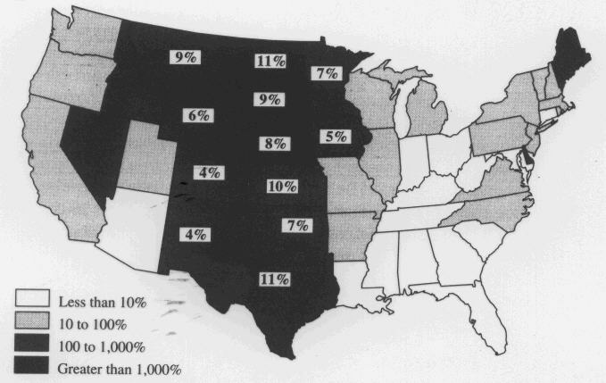
Wind Energy
How it works
  Wind turbines directly generate electricity
  Quite efficient (not a heat engine)
Wind Energy Potential
shading gives potential for in-state electrical needs
numbers give total potential for total US needs

Slide 47
Wind Energy
Advantages
  High net energy yield
  Renewable and free
  Very clean source of energy
    No pollution (air or water) during operation
  Long operating life
  Low operating/maintenance costs
  Can be quickly built; not too expensive
  Now almost competitive with hydro and fossil fuels
  Land can be used for other purposes
    Can combine wind and agricultural farms

Slide 48
Wind Energy
Disadvantages
  Energy storage issues
    An intermittent source of energy; need backup (eg stored energy) for low-wind days
    Or must be connected to the electrical grid
  Only practical in areas that are windy enough
  Visual pollution
  Danger to birds
    New (slow turning) designs largely eliminate this problem
  Low energy density of wind
    Must use large areas of land

Slide 49
Biomass Energy
What is it?
  Biomass energy is the use of living and recently dead biological material as an energy source
  Ultimately dependent on the capture of solar energy and conversion to a chemical (carbohydrate) fuel
  Theoretically it is a carbon neutral and renewable source of energy
How it works?
  Traditional: forest management, using wood as fuel
  Use of biodegradable waste
    Examples: manure, crop residue, sewage, municipal solid waste
  Recent interest in agricultural production of energy crops
    Should be high yield and low maintenance
    Examples: corn, sugarcane, switchgrass, hemp, willow, palm oil, rapeseed, and many others
    Does not have to be a food crop
    Recent interest in bioengineered (GM) plants as fuel sources
  Production of a liquid or gaseous biofuel
    Biogas due to the breakdown of biomass in the absence of O₂
      Includes capture of landfill methane
    Bioethanol from fermentation, often from corn. Cellulosic bioethanol is usually from a grass (switchgrass)
    Biodiesel from rapeseed and other sources

Slide 50
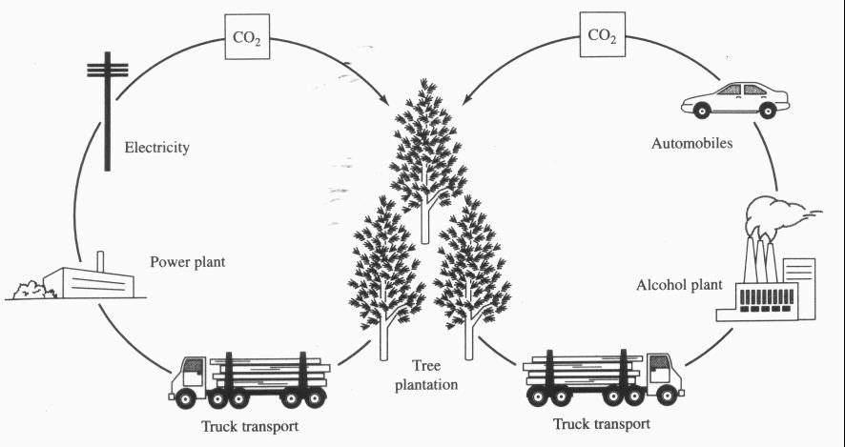
Biomass Energy
Carbon neutral
  CO₂ ultimately released in energy generation is recently captured and so ideally does not change total atmospheric levels
  Carbon leaks can result in a net increase in CO₂ levels
  Sequestration in soil can result in a net decrease in CO₂ levels

Slide 51
Biomass Energy
Advantages
  Versatile
  Renewable
  No net CO₂ emissions (ideally)
  Emits less SO₂ and NO_{x} than fossil fuels
Disadvantages
  Low energy density/yield
    In some cases (eg, corn-derived bioethanol) may yield no net energy
  Land conversion
    Biodiversity loss
    Possible decrease in agricultural food productivity
  Usual problems associated with intensive agriculture
    Nutrient pollution
    Soil depletion
    Soil erosion
    Other water pollution problems

Slide 52
Geothermal Energy
How it works
  Geothermal power plants
    Use earth’s heat to power steam turbines
  Geothermal direct use
    Use hot springs (etc) as heat source
  Geothermal heat pumps
Advantages
  Renewable
  Easy to exploit in some cases
  CO₂ production less than with fossil fuels
  High net energy yield
Disadvantages
  Not available everywhere
  H₂S pollution
  Produces some water pollution (somewhat similar to mining)

Slide 53
Radiant Solar Energy
How it works
  Solar power plants
    Steam produced to turn turbine
  Solar heating
    Active and passive systems
  Photovoltaic cells
    “Solar batteries” use special semiconductors
Advantages
  Renewable and free
  High energy yield
  A very clean source of energy
    No air/water pollution during operation
  Low operating costs
    Will pay for themselves over time
Disadvantages
  Intermittent source
    Energy storage issues
  Low energy density
    Requires pretty much land

Slide 54
The Hydrogen Economy
Lecture Questions
  What is the hydrogen economy?
  Explain how the hydrogen economy could potentially serve as the basis for a renewable energy system that emits little or no air pollution
Definition
  The Hydrogen Economy is a hypothetical large-scale system in which elemental hydrogen (H₂) is the primary form of energy storage
    Fuel cells would be the primary method of conversion of hydrogen to electrical energy.
      Efficient and clean; scalable
    In particular, hydrogen (usually) plays a central role in transportation.
Potential Advantages
  Clean, renewable
  Potentially more reliable (using distributed generation)
BUT many roadblocks including potential showstoppers
  Poses great technological challenges for efficient hydrogen production, storage, and transport

Slide 55
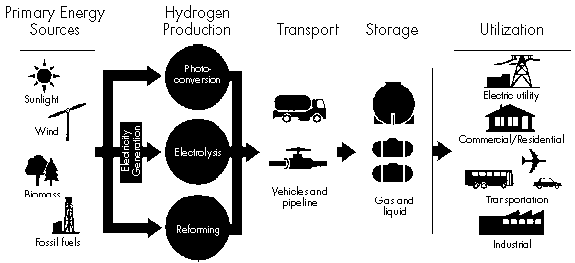
Components of the Hydrogen Economy
Infrastructure needs
  Production
  Storage
  Delivery
  End use

Slide 56
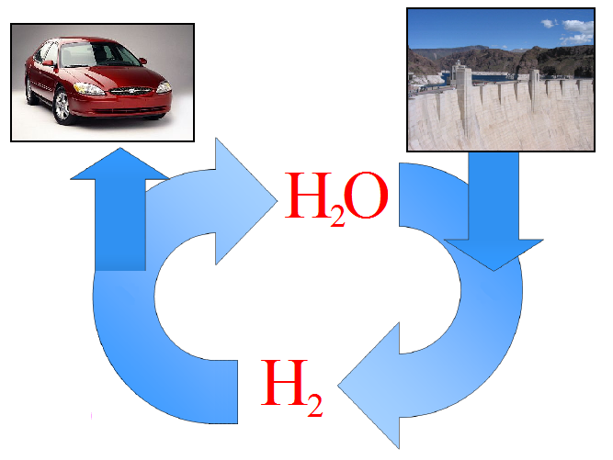
Hydrogen as a Transportation Fuel

Slide 57
Hydrogen Production
Fossil Fuels
  Steam Reforming of Natural Gas
    Combination of methane and steam produces hydrogen gas
      Carbon monoxide is also produced
      The “water gas shift” reaction can produce further hydrogen from the carbon monoxide. Carbon dioxide is produced too.
    Most economical; main current method
      Carbon sequestration one method to reduce CO₂ emission
  Partial Oxidation (POX) of Hydrocarbons
    HC partially oxidized to produce hydrogen and carbon monoxide
  Coal Gasification
    Gasified at high temps, then processed
    Can also be used to get hydrogen from biomass

Slide 58
Hydrogen Production
Electrolysis
  Efficiencies 70-85%
  Produces highest purity of hydrogen
  Currently, the electricity consumed is usually worth more than the hydrogen produced
Experimental methods
  Biological hydrogen production
  Direct photolysis
  Thermolysis

Slide 59
Renewable Solar Paths to Hydrogen

Slide 60
Hydrogen Storage
Large-Scale Stationary Storage
  Underground in depleted oil/gas fields, aquifers, caverns
Intermediate- and Small-Scale Stationary/Mobile Storage
  The focus of most current research
  As a liquid
    Advantage: higher energy density, cheaper transport
    Disadvantage: economic/energy cost of liquefaction is significant
  As a compressed gas
    Probably best short-term method, particularly with advanced materials to decrease weight
    Advantages
      Rapid charging/discharging
      Lower costs than liquid storage
    Disadvantages:
      Low energy density, Probably still acceptable for motor vehicles
      Safety (esp public perception)
  Metal hydrides
    Hydrogen is absorbed under pressure, released when heated
    Less filling pressure needed
    Low energy density, long recharge time, expensive
Experimental Methods
  Improved hydrides; carbon nanotubes; many other materials (eg conversion to ammonia)

Slide 61
Chemical Batteries
Lecture Questions
  What are batteries and how do they work?
  What’s the difference between a “regular” and a “rechargeable” battery? Why are rechargeable batteries sometimes referred to as “storage” batteries?
  Chemical batteries are based on reduction-oxidation (redox) reactions, which are reactions where electron transfer occurs.
    The oxidation half-reaction occurs at the anode
    Electrons flow from the anode, through an external circuit, and to the cathode, where the reduction half-reaction occurs
  Chemical batteries are a very efficient method of generating electricity
    Efficiencies of 80% are regularly achieved
    Significantly (2-3 times) more efficient than heat engines
  Rechargeable batteries can be hooked up to an external source of electricity to regenerate the redox reactants through electrolysis.
    Rechargeable batteries thus provide a means of storing electricity in chemical form. They are thus sometimes called storage batteries.

Slide 62
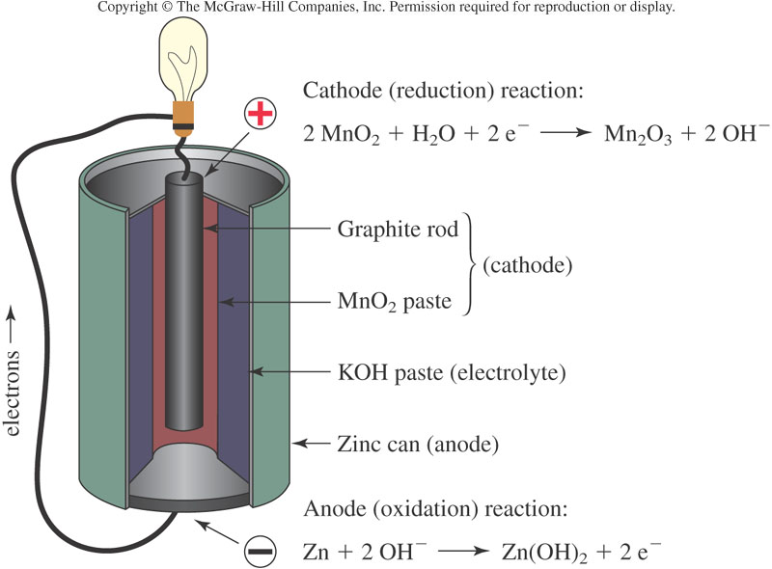
The Alkaline Battery

Slide 63
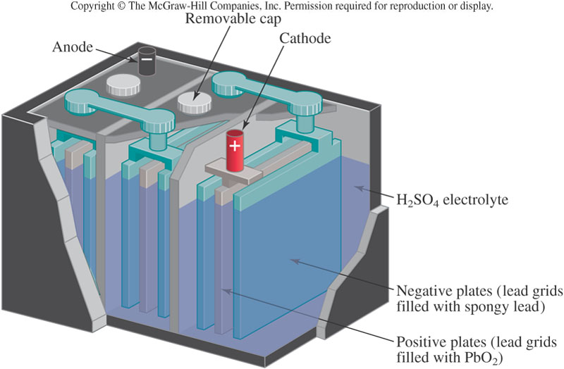
The Lead Storage Battery

Slide 64
Fuel Cells
Lecture Questions
  What is a fuel cell and how does it work?
  What is distributed generation?
  A fuel cell is basically a battery in which the reactants are continually supplied to the electrodes, and the products are continually removed.
    Much more efficient (2-3 times) than heat engines at generating electricity
    Most common type of fuel cells based on hydrogen (there are others)
  Fuel cells are scaleable
    Large ones can power homes or neighborhoods
    Small ones can be used in appliances
    Distributed generation is a decentralized power system consisting of hydrogen generators and fuel cells

Slide 65
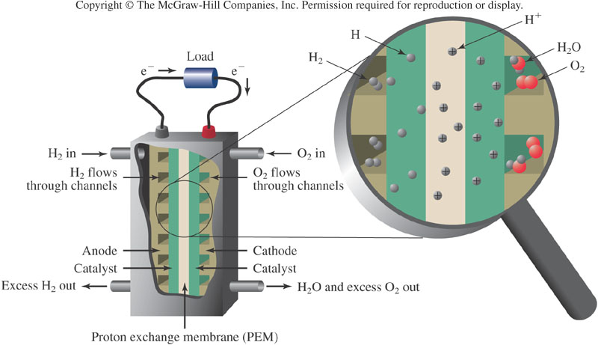
A Hydrogen Fuel Cell

Slide 66

Hydrogen Fuel Cells: Scalable

Slide 67
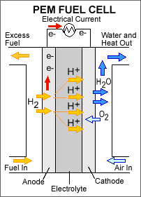
Polymer Electrolyte Fuel Cell

Slide 68
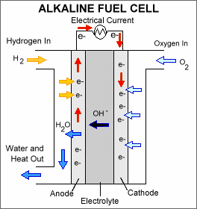
Alkaline Fuel Cell (AFC)

