Slide 1
Ethnic-Based Federal Finance: The Ethiopian Case

Slide 2
Outline of the Presentation
Brief profile about Ethiopia
Features of the Federal Finance Structure
Expenditure Assignment
Tax Assignment
Inter-governmental transfer
Borrowing
Conclusion

Slide 3
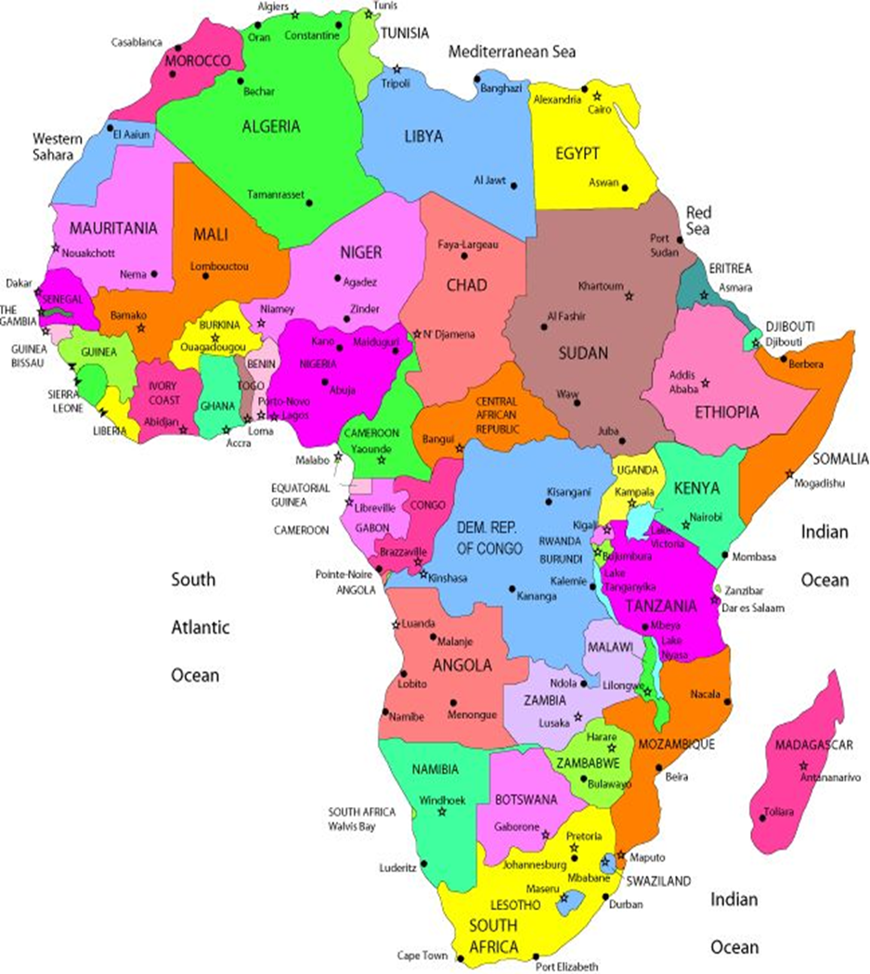
Ethiopia on the African map

Slide 4
The second-most populous country in Africa ( pop. 99.4 million)
One of the world’s oldest civilizations
One of the world’s poorest countries
The second fast-growing economy in the world (World Bank: 10.8% per year in 2003/04 - 2014/15)
Area: 1,104,300 km² (3.7x larger than Italy)
Pop. Density: 101.9 per sq km (203.3 for Italy)

Slide 5
Ethiopian Government Structure
Parliamentarian Federal Country (since 1995)
Two-Tier Government : Federal and States

Slide 6
FG
SG2
SG3
SG4
SG5
SG8
SG1
SG7
SG6
SG9

Slide 7
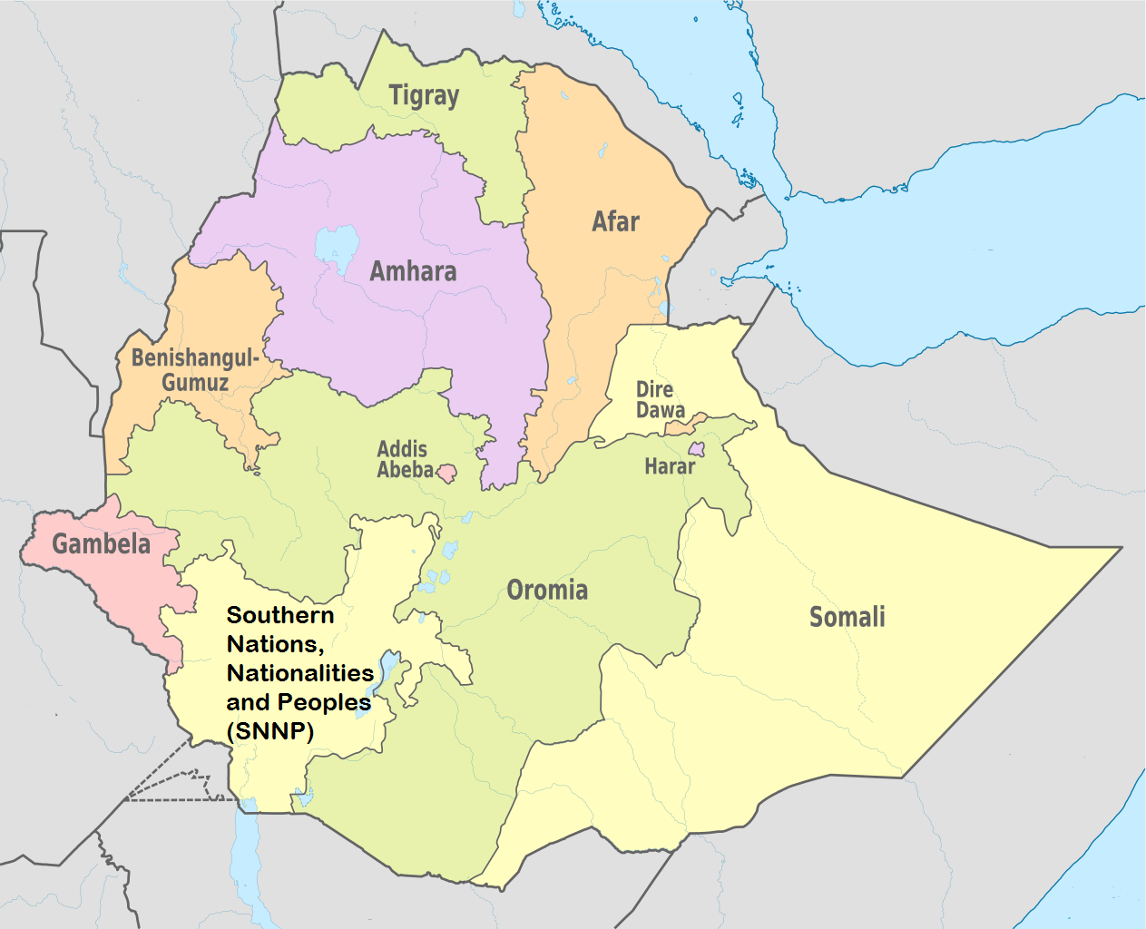
State Governments Map

Slide 8
States | Population | Population Share (%) | Land Area Share (%)
Afar | 1,678,000 | 1.9 | 7.07
Amhara | 20,018,988 | 22.8 | 17.34
Benishangul-Gumuz | 975,998 | 1.1 | 4.3
Gambella | 396,000 | 0.5 | 2.4
Harari | 226,000 | 0.3 | 0.03
Oromia | 32,815,995 | 37.3 | 33.05
SNNP | 17,837,005 | 20.3 | 10.28
Somali | 5,307,002 | 6.0 | 19.82
Tigray | 4,960,003 | 5.6 | 5.53
Addis Ababa | 3,194,999 | 3.6 | 0.04
Dire Dawa | 427,000 | 0.5 | 0.15

Slide 9
State Government’s Decentralized Structure
State
Zone
Woreda (District)
Kebele (County)
Central Government

Slide 10

The 3 Branches of Government

Slide 11
Central Government
Legislative (Parliament)
Executive (Prime minister)
Judiciary
State Governments
Legislative (State council)
Executive (President)
Judiciary

Slide 12
Federal Government Houses

Slide 13
Federal Government House
It has two houses :
House of Peoples Representative (HPR), and
House of Federation (HF)
But it is unicameral legislative structure (than bicameral)
HPR (Parliament)
The highest legislative branch of the FG
547 seats
MPs are directly elected by the people
Have a term of five years

Slide 14
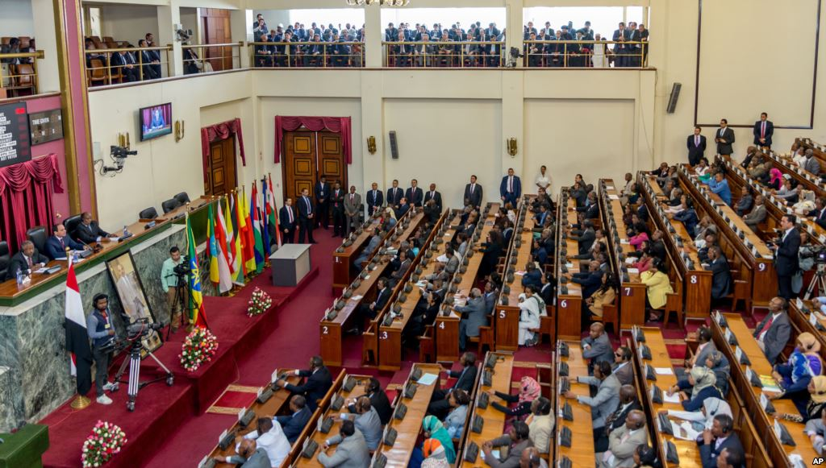

Slide 15
House of Federation
Doesn’t have legislative role
Tasked mainly with interpretation of the constitution
Approves formula for FG budget transfer to states
Members are representatives of each ethnic group, and elected by the State Councils
Each ethnic group is represented by at least one member,
Each ethnic group is represented by one additional representative for each one million of its population.

Slide 16
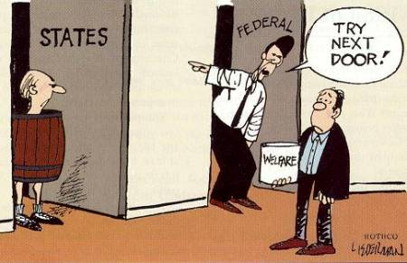
Division of Power and Responsibility

Slide 17
Expenditure Assignment
Federal government responsibilities (to mention few):
Formulating overall economic, social and development policies
Administering the National Bank
Printing money and regulating money in circulation,
Regulating foreign exchange
Negotiating and ratifying international agreements
Administering national defense
administering all matters relating to immigration, the granting of passports, and matters relating to nationality.
Administering universities

Slide 18
State government responsibilities
The Residual Principle is followed
Administering a state police force
Executing economic, social and development policies of the State
Runs schools up to colleges (not universities)
Regulate local businesses

Slide 19

Tax Assignment

Slide 20
Tax Assignment
Federal
State
Joint

Slide 21
Employment income tax
FG employees…………………………………………….…….Federal
Employees of Int’l Org’n…………………………………. Federal
Employees in joint enterprises………………………..…. Joint
Other employees…………………………………………….... State
Business income tax
Companies……………………………………………………….…. Joint
Other private businesses…………………………….…….. State
Federal enterprises……………………………………….... Federal
State enterprises…………………………………………….….. State
Small-scale mining operations ……………………….….. State
Large-scale mining ………………………………………………… Joint
Petroleum and gas operations …………………………….. Joint

Slide 22
Income on game of chance………………. Federal
Property Rental income tax
Federal-owned…………………………….. Federal
State-owned………………………………… State
Privately-owned………………………….. State
Dividend income tax………………………… Joint
Interest income tax ………………………… Federal

Slide 23
Value-added tax (VAT)/ Turnover tax
Companies…………………………………. Joint
Other Businesses………………………… State
State-owned Enterprises.…………… State
Federal-owned Enterprises.………… Federal
Joint Enterprises…………………………. Joint
Custom duties……………………………… Federal

Slide 24
Division of Joint Taxes

Slide 25
 | Federal Government | Regional Government
Jointly Established Enterprises
Profit Tax | Based on capital contribution
Employment Income Tax | 50% | 50%
Consumption Taxes (VAT) | 70% | 30%
Companies
Profit Tax | 50% | 50%
Dividend Income Tax | 50% | 50%
Consumption Taxes (VAT) | 70% | 30%
Mineral & Petroleum Operation
Profit Tax | 50% | 50%
Royalty | 60% | 40%

Slide 26

There are vertical and horizontal Fiscal Imbalances

Slide 27
Vertical Fiscal Imbalance
Vertical fiscal imbalance (VFI) is measured using the following formula:
VFI= 1-[(R_{S}/R)/(E_{S}/E)]
where R_{S} is combined revenue of all states,
R is the total revenue of the government (federal plus state governments),
E_{S} is the amount of combined expenditure States
E is the total expenditure (federal plus States governments)
The coefficient of the vertical fiscal imbalance ranges between zero and one.
Coefficient of zero indicate states have fiscal autonomy.
Coefficient of one indicates the federal government has absolute control over States.

Slide 28
Vertical Fiscal Imbalance

Slide 29
Horizontal Fiscal Imbalance

Slide 30
How are the Imbalances Addressed?

Slide 31

Through Transfer of Money from FG to SGs

Slide 32
How?
There is:
Unconditional annual transfer
Part of FG budget

Slide 33

How is it shared?

Slide 34
It is formula-based
The allocation formula is developed and approved by House of Federation
The total sum to be transferred to SGs is suggested by MoFEC
The actual amount is approved by Parliament as part of the FG budget

Slide 35
The allocation formula considers
Population
Level of development
Revenue raising capacity
Expenditure needs

Slide 36
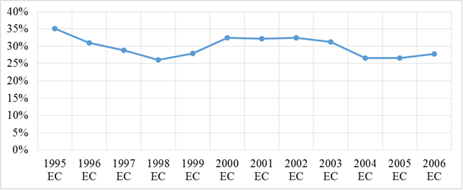
Share of FG Grant in its Total Annual Budget (Eth. Calendar)

Slide 37
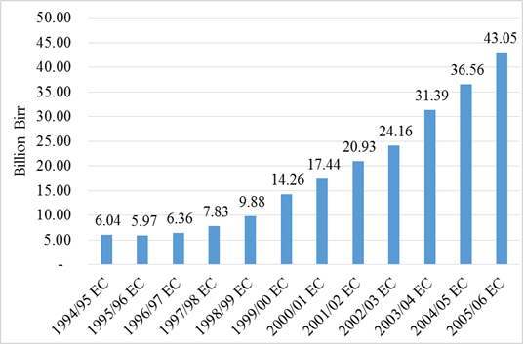
Total Amount Transferred to SG (Eth. Currency)

Slide 38

Borrowing Authority

Slide 39

For SGs?

Slide 40
SGs are not allowed to borrow locally as well as from abroad
SGs have to “balance the budget”
Prepare their own state budget after knowing their share of FG transfer amount
But can borrow from state-owned bank (CBE) to address annual cash flow mismatch.
It requires approval by MOFEC (FG)

Slide 41
The budget subsidy to SGs by FG is financed from:
FG’s own and joint revenue
FG Loan
Foreign grants
The two chartered cities can borrow but up on approval by FG

Slide 42
FG loans
Domestic
Treasury-bills
Bonds (rare)
Direct advance from NBE
Foreign
Bilateral (Italy government, etc.)
Multilateral (IMF, World Bank)
Not from international financial market

Slide 43

Final Point

Slide 44
No political challenge up to now because of same party ruling the country both at state and federal government level since 1995
BUT
Time will tell what will happen if different political parties hold majority at some SGs councils or at FG Parliament

Slide 45
Grazie!!!

