Slide 1
DECENTRALIZATION
AND FUEL SUBSIDIES
Ferraresi, Kostsogiannis and Rizzo (2016)

Slide 2
Introduction - 1
Fuel price-subsidies are causing significant inefficiencies, international organizations (IMF, World Bank and OECD) have recently called for their phasing out
Strong reason for removing them:
  in perfectly competitive markets, generating economic efficiency losses;
  any desired redistribution can be achieved with more efficient instruments (distributional perspective)
  benefit, perversely, the rich (significant users of energy);
  spillover effects and many externalities, as a consequence of excessive use of fuel;
  significant strain on public finances;
  encourage socially wasteful activities;

Slide 3
Introduction - 2
Despite all these inefficiencies, subsidies are significant:
  $5.3 trillion in 2015 (6.5% of global GDP) (Coady et al., 2016);
  in terms of revenues, the IMF (2013) estimates that consumption of petroleum, electricity, natural gas and coal were subsidised by about 2% of total government revenue in 2011.

Slide 4
Introduction - 3
Why are they so popular with policy-makers? Why is reforming them so hard?
  subsidies are salient for households and as such they are preferred by policymakers since households (voters) assign a larger weight on the popularity of the policymakers if the price of fuel is low;
  It is a very visible instrument;
  For low-income countries sudden rises in energy costs have an immediate impact on households' budgets and they spill very quickly into public unrest, with example of such episodes taking place in Nigeria (2012)

Slide 5
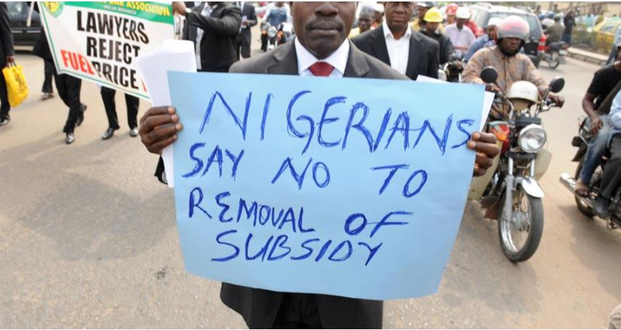
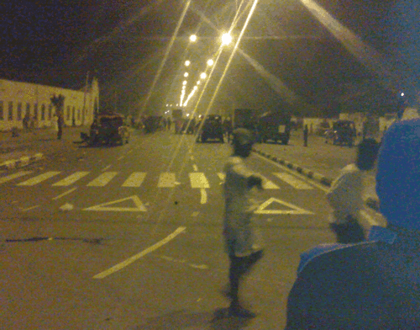
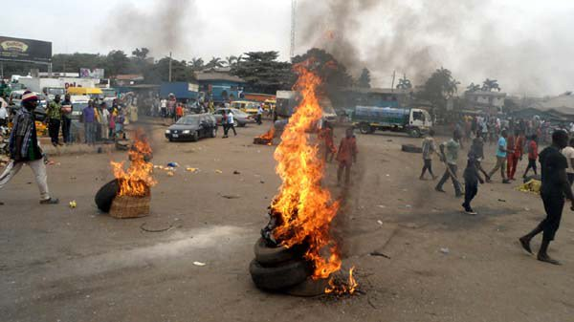
#occupynigeria

Slide 6
Introduction - 4
There are complex political economy incentives behind fuel subsidies but intuition would suggest that the visibility of the policy is a key determinant.
As the setting of subsidies is a central government responsibility, it is conceivable that the government architecture of a country is an important determinant of their level.
The point here being that any incentive for political gain can be weakened by a multi-leveled political architecture of governance.

Slide 7
Introduction - 5
How does the existence of a multi-leveled government structure affect fuel pricing, in particular for developing countries, where accountability of government is in general lower than in developed countries?

Slide 8
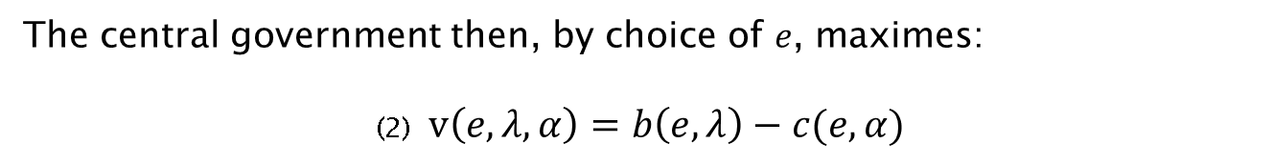
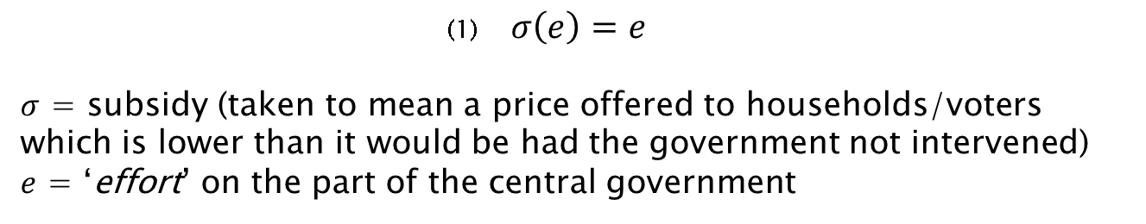
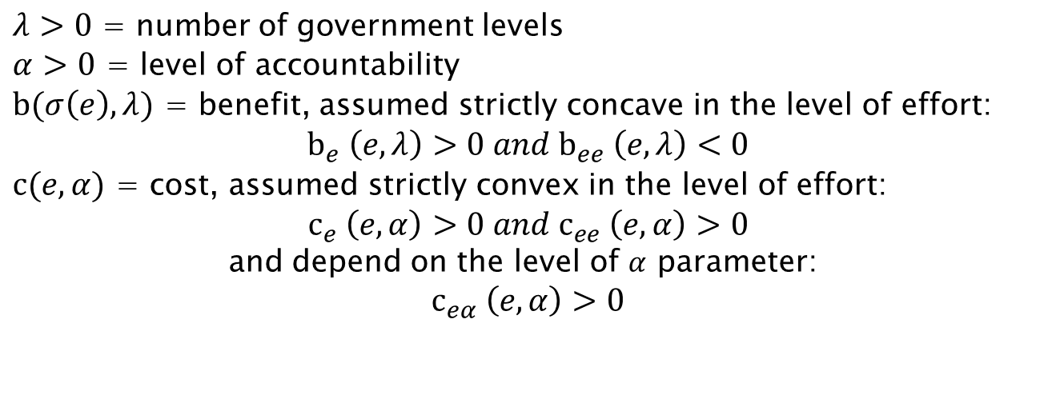
Fixing ideas and stating the hypotheses - 1
(1) $σ\left(e\right)=e$
$σ$ = subsidy (taken to mean a price offered to households/voters which is lower than it would be had the government not intervened)
𝑒 = ‘effort’ on the part of the central government
The central government then, by choice of 𝑒, maximes:
(2) $v\left(e,λ,α\right)=b\left(e,λ\right)−c(e,α)$
$λ>0$ = number of government levels
$α>0$ = level of accountability
$b(σ\left(e\right),λ)$ = benefit, assumed strictly concave in the level of effort:
$$b_{e} \left(e,λ\right)>0 and b_{ee} \left(e,λ\right)<0$$
$c(e,α)$ = cost, assumed strictly convex in the level of effort:
$$c_{e} \left(e,α\right)>0 and c_{ee} \left(e,α\right)>0$$
and depend on the level of $α$ parameter:
$$c_{eα} \left(e,α\right)>0$$

Slide 9
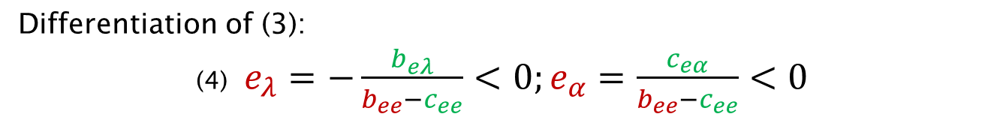

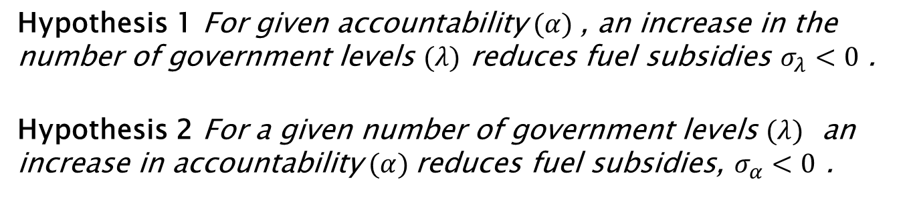
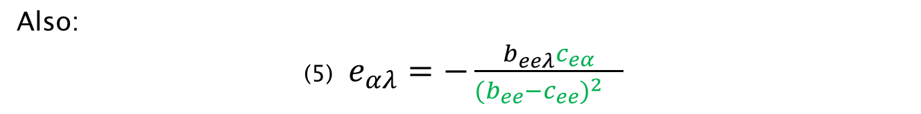
Fixing ideas and stating the hypotheses - 2
Necessary condition:
(3) $v_{e}\left(e,λ,α\right)=b_{e}\left(e,λ\right)−c_{e}\left(e,α\right)=0$
Differentiation of (3):
(4) $e_{λ}=−\frac{b_{eλ}}{b_{ee}−c_{ee}}<0;e_{α}=\frac{c_{eα}}{b_{ee}−c_{ee}}<0$
Also:
(5) $e_{αλ}=−\frac{b_{eeλ}c_{eα}}{{{(b_{ee}−c_{ee})}^{2}}_{}}$
Hypothesis 1 For given accountability $(α)$, an increase in the number of government levels $(λ)$ reduces fuel subsidies $σ_{λ}<0$ .
Hypothesis 2 For a given number of government levels $(λ)$ an increase in accountability $(α)$reduces fuel subsidies, $σ_{α}<0$ .

Slide 10

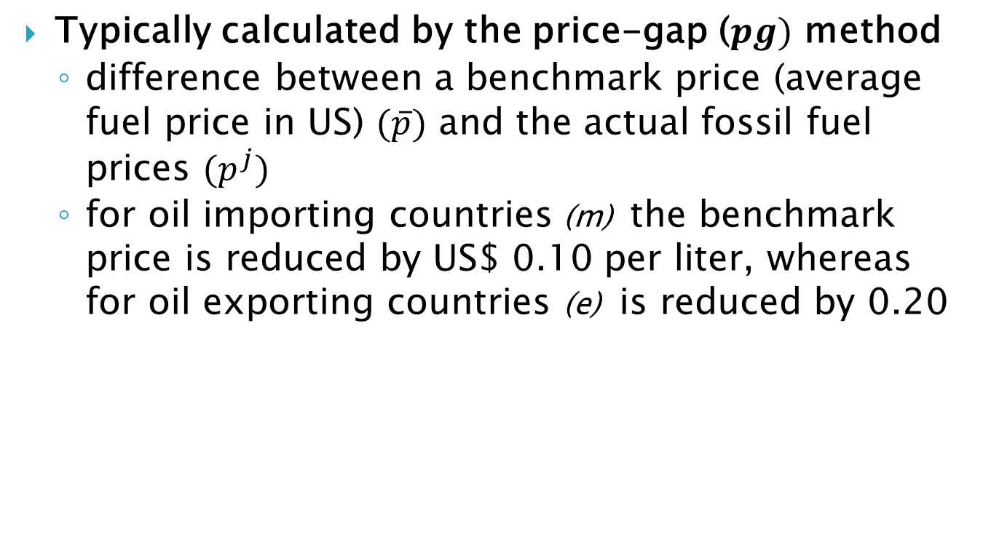
Subsidies
Typically calculated by the price-gap ($pg)$ method
  difference between a benchmark price (average fuel price in US) $(\overline{p})$ and the actual fossil fuel prices $(p^{j})$
  for oil importing countries (m) the benchmark price is reduced by US$ 0.10 per liter, whereas for oil exporting countries (e) is reduced by 0.20

Slide 11
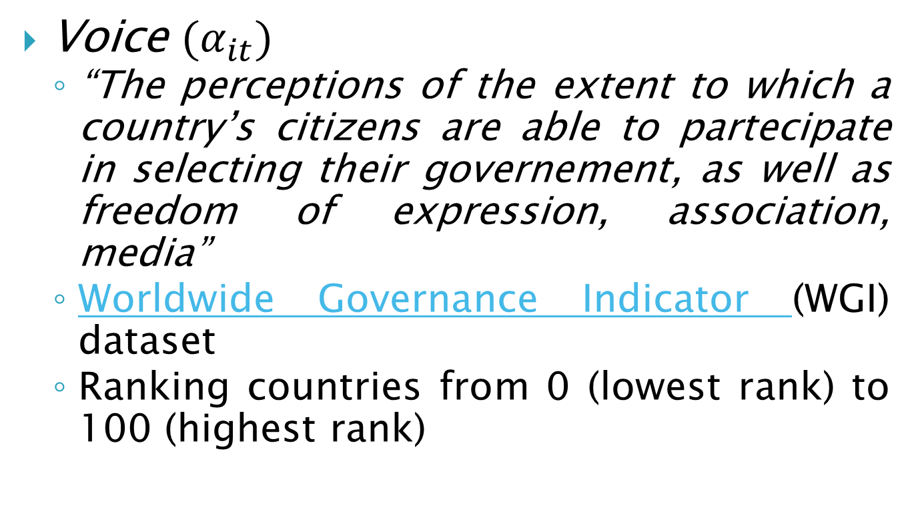
Accountability
Voice $(α_{it})$
  “The perceptions of the extent to which a country’s citizens are able to partecipate in selecting their governement, as well as freedom of expression, association, media”
  Worldwide Governance Indicator (WGI) dataset
  Ranking countries from 0 (lowest rank) to 100 (highest rank)
Notes:
http://info.worldbank.org/governance/wgi/#home

Slide 12

Decentralization
Tiers $(λ_{j})$
  Measures the number of administrative layers, ${Tiers}_{i}$ $(i=1,2,3,4,5,6)$
Notes:
http://info.worldbank.org/governance/wgi/#home

Slide 13
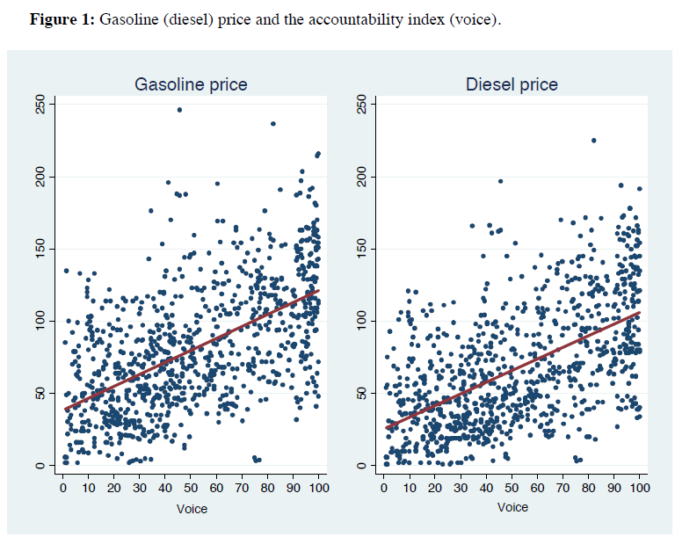
As accountability increases gasoline (diesel) price increases
Increase in accountability(more trasparency), make an inefficient policy more costly for the policy maker

Slide 14
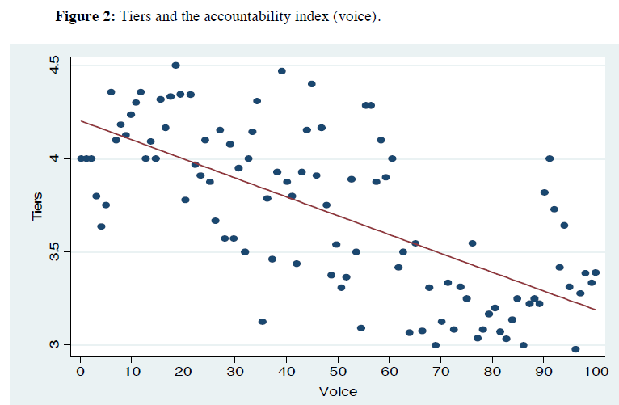
Accountability and number of governements levels negatively related
Accountability increases when decentralization decreseas
(Boffa et al., 2016)

Slide 15
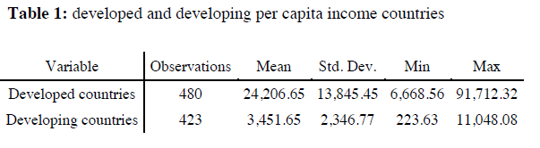
Developed and developing countries
From the World Bank Classification:
  Using the per capita income level of a country:
World Bank Classification | Paper Classification
Low-income | Developing countries
Lower middle-income
Upper middle-income | Developed countries
High income

Slide 16
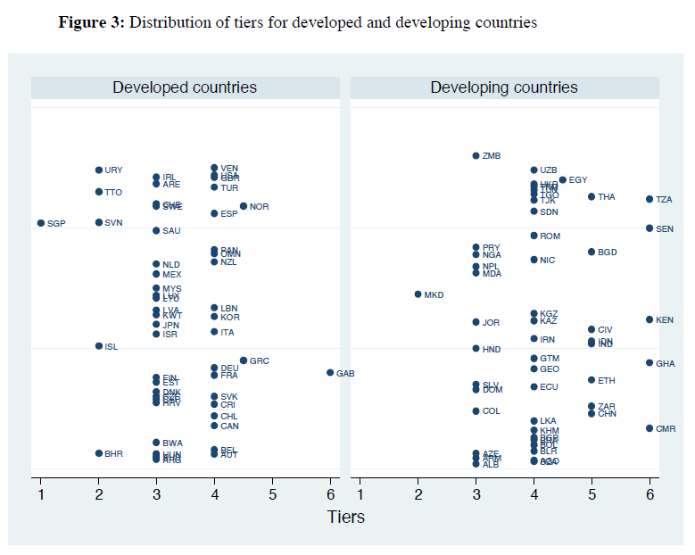
Developed and developing countries differ in their median and also the mean is statistically different
Median
Median

Slide 17
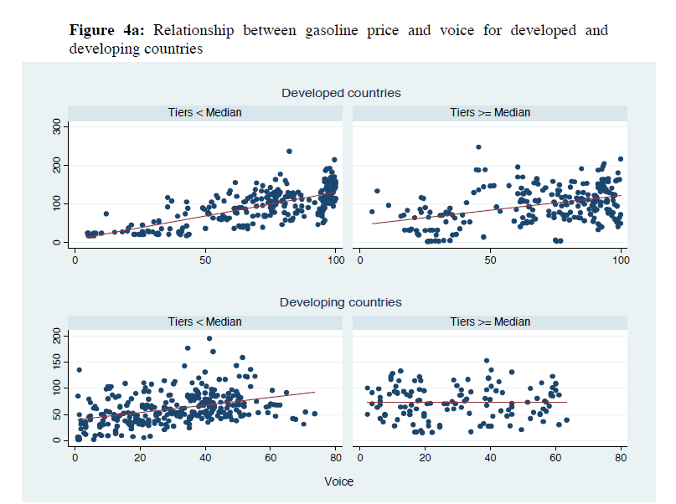
For developed countries relationship beetween gasoline price and accountability always positive
For developing countries the relationship is positive only for the low governement levels sub-sample

Slide 18
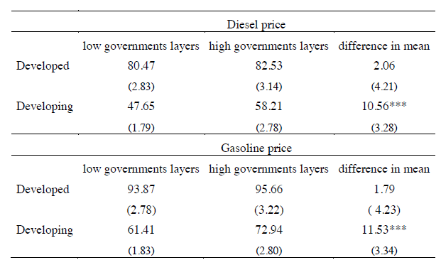
Preliminary evidence
The difference in mean of gasoline (diesel) price between low and high government levels sub-samples is not statistically significant for developed countries, but is positive and statistically significant for developing countries
Preliminary evidence suggest that for developing countries (where the accountability level is, on average, lower), decentralization negatively affect the gasoline (diesel) subsidies

Slide 19
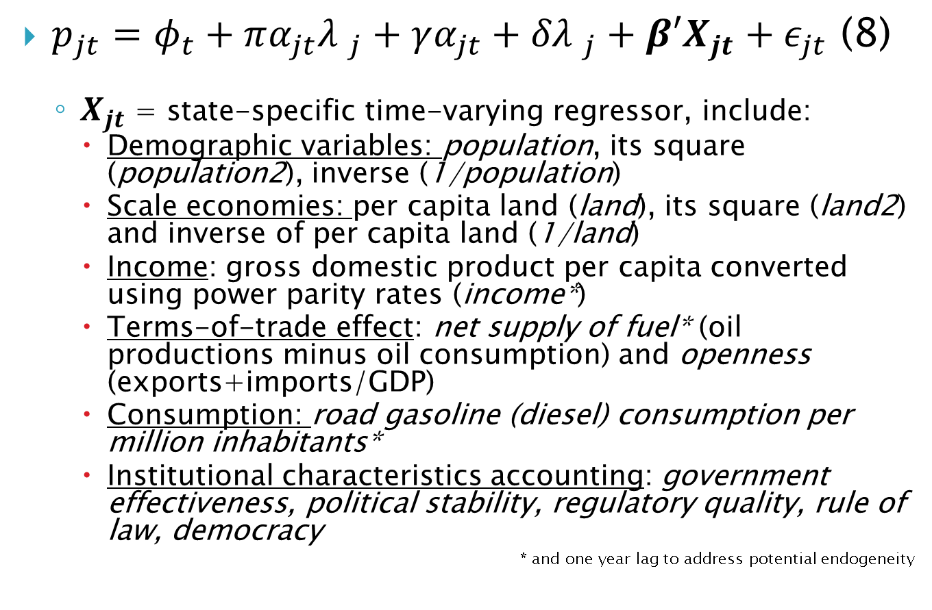
Empirical analysis 1
$p_{jt}=φ_{t}+πα_{jt}{λ }_{j}+γα_{jt}+{δλ }_{j}+β′X_{jt}+ε_{jt}$ (8)
  $X_{jt}$ = state-specific time-varying regressor, include:
    Demographic variables: population, its square (population2), inverse (1/population)
    Scale economies: per capita land (land), its square (land2) and inverse of per capita land (1/land)
    Income: gross domestic product per capita converted using power parity rates (income*)
    Terms-of-trade effect: net supply of fuel* (oil productions minus oil consumption) and openness (exports+imports/GDP)
    Consumption: road gasoline (diesel) consumption per million inhabitants*
    Institutional characteristics accounting: government effectiveness, political stability, regulatory quality, rule of law, democracy
    * and one year lag to address potential endogeneity

Slide 20
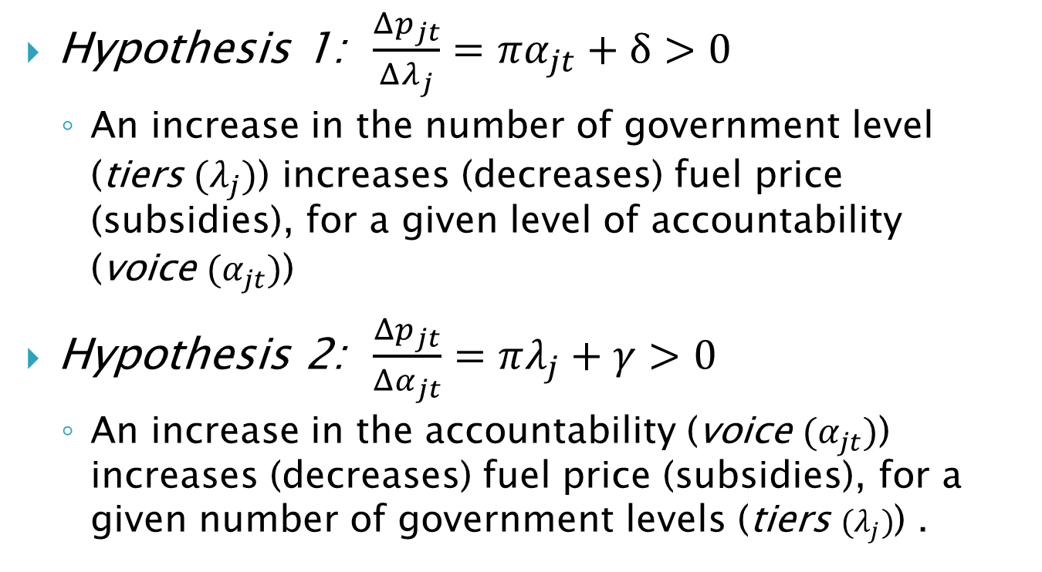
Empirical analysis 1
Hypothesis 1: $\frac{Δp_{jt}}{Δλ_{j}}=πα_{jt}+δ>0$
  An increase in the number of government level (tiers $(λ_{j})$) increases (decreases) fuel price (subsidies), for a given level of accountability (voice $(α_{jt})$)
Hypothesis 2: $\frac{Δp_{jt}}{Δα_{jt}}=πλ_{j}+γ>0$
  An increase in the accountability (voice $(α_{jt})$) increases (decreases) fuel price (subsidies), for a given number of government levels (tiers $(λ_{j})$) .

Slide 21
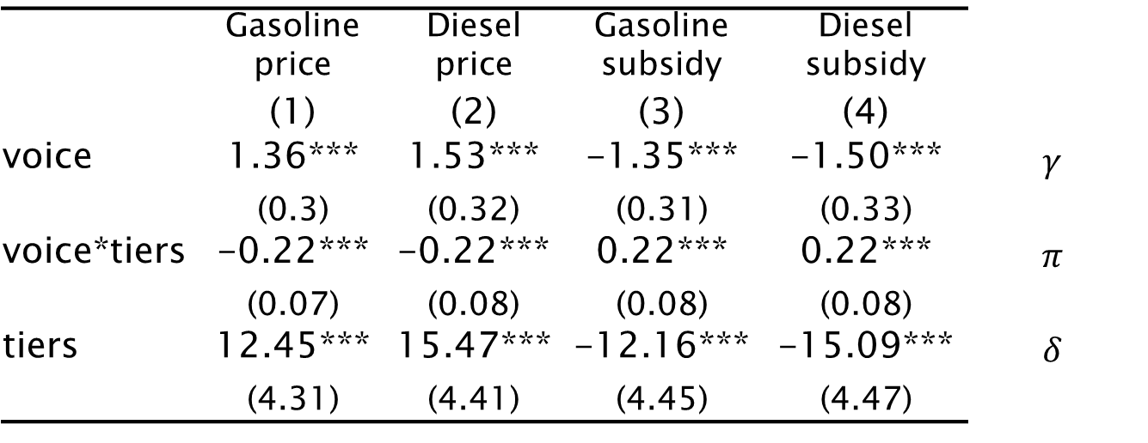
Results 1
Estimate (8) using random effect regressions, control for year effects
  Table 3: Impact of decentralization on gasoline and diesel price (and subsidy).
 | Gasoline price | Diesel price | Gasoline subsidy | Diesel subsidy
 | (1) | (2) | (3) | (4)
voice | 1.36*** | 1.53*** | -1.35*** | -1.50*** | $$γ$$
 | (0.3) | (0.32) | (0.31) | (0.33)
voice*tiers | -0.22*** | -0.22*** | 0.22*** | 0.22*** | $$π$$
 | (0.07) | (0.08) | (0.08) | (0.08)
tiers | 12.45*** | 15.47*** | -12.16*** | -15.09*** | $$δ$$
 | (4.31) | (4.41) | (4.45) | (4.47)

Slide 22
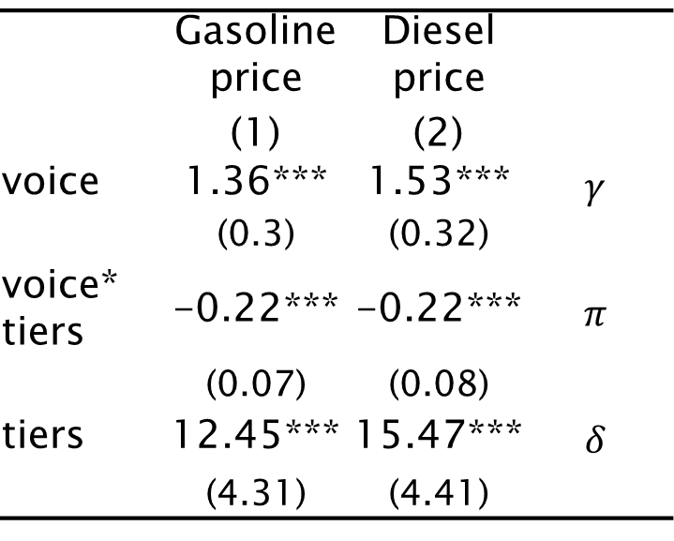
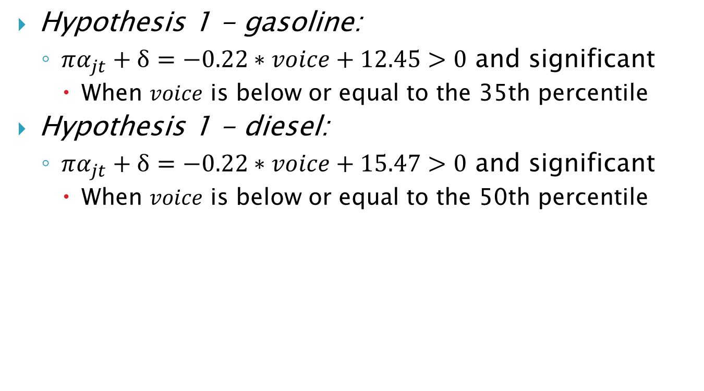
 | Gasoline price | Diesel price
 | (1) | (2)
voice | 1.36*** | 1.53*** | $$γ$$
 | (0.3) | (0.32)
voice* tiers | -0.22*** | -0.22*** | $$π$$
 | (0.07) | (0.08)
tiers | 12.45*** | 15.47*** | $$δ$$
 | (4.31) | (4.41)
Hypothesis 1 - gasoline:
  $πα_{jt}+δ=−0.22∗voice+12.45>0$ and significant
    When $voice$ is below or equal to the 35th percentile
Hypothesis 1 - diesel:
  $πα_{jt}+δ=−0.22∗voice+15.47>0$ and significant
    When $voice$ is below or equal to the 50th percentile

Slide 23
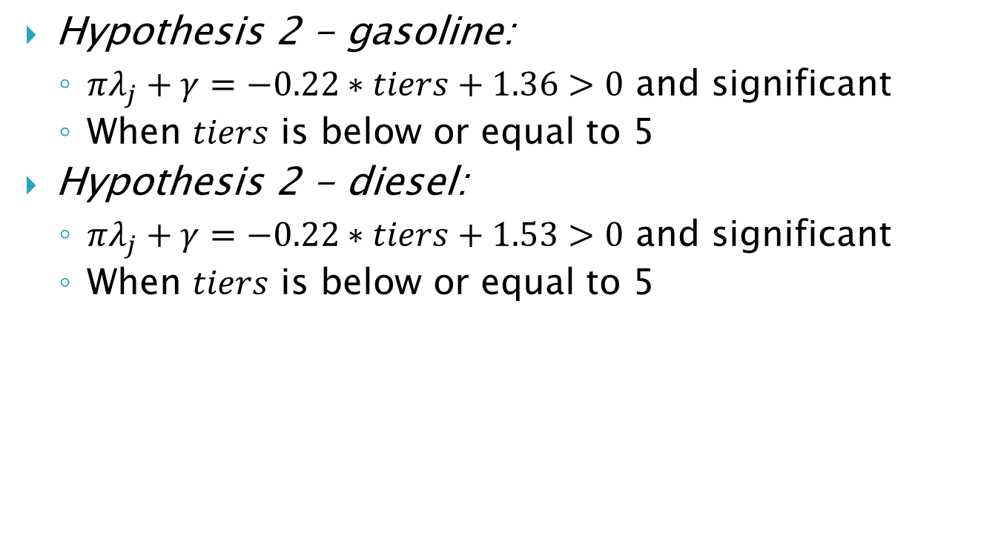
 | Gasoline price | Diesel price
 | (1) | (2)
voice | 1.36*** | 1.53*** | $$γ$$
 | (0.3) | (0.32)
voice* tiers | -0.22*** | -0.22*** | $$π$$
 | (0.07) | (0.08)
tiers | 12.45*** | 15.47*** | $$δ$$
 | (4.31) | (4.41)
Hypothesis 2 - gasoline:
  $πλ_{j}+γ=−0.22∗tiers+1.36>0$ and significant
  When $tiers$ is below or equal to 5
Hypothesis 2 - diesel:
  $πλ_{j}+γ=−0.22∗tiers+1.53>0$ and significant
  When $tiers$ is below or equal to 5

Slide 24
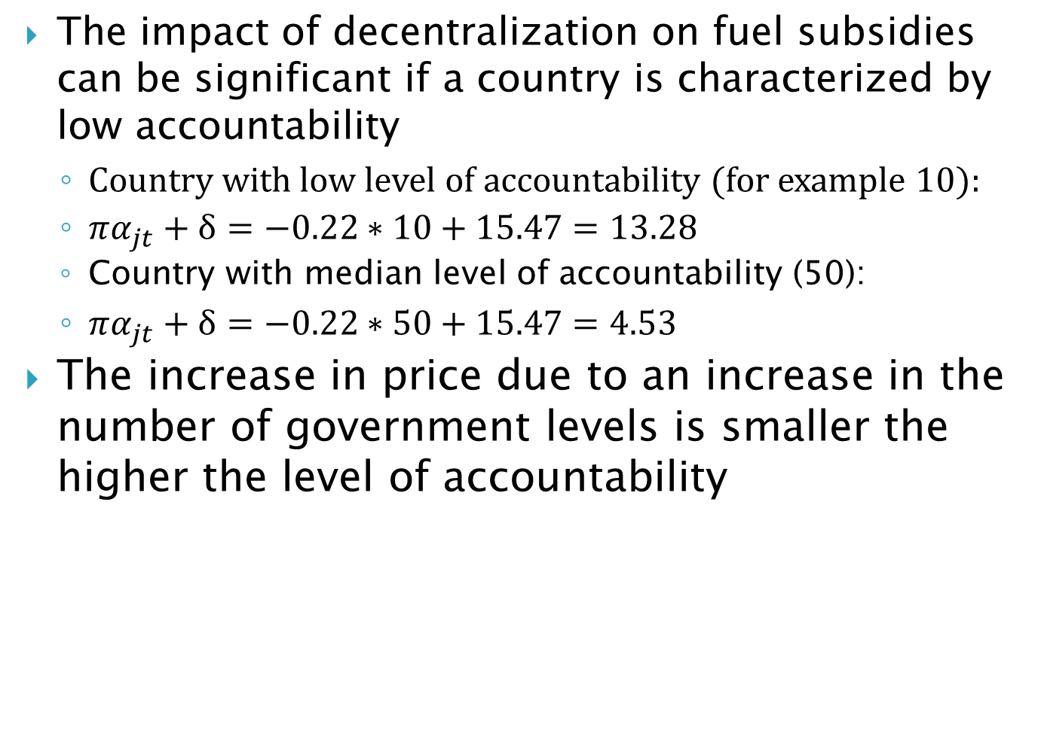
The impact of decentralization on fuel subsidies can be significant if a country is characterized by low accountability
  Country with low level of accountability (for example 10):
  $πα_{jt}+δ=−0.22∗10+15.47=13.28$
  Country with median level of accountability (50):
  $πα_{jt}+δ=−0.22∗50+15.47=4.53$
The increase in price due to an increase in the number of government levels is smaller the higher the level of accountability

Slide 25
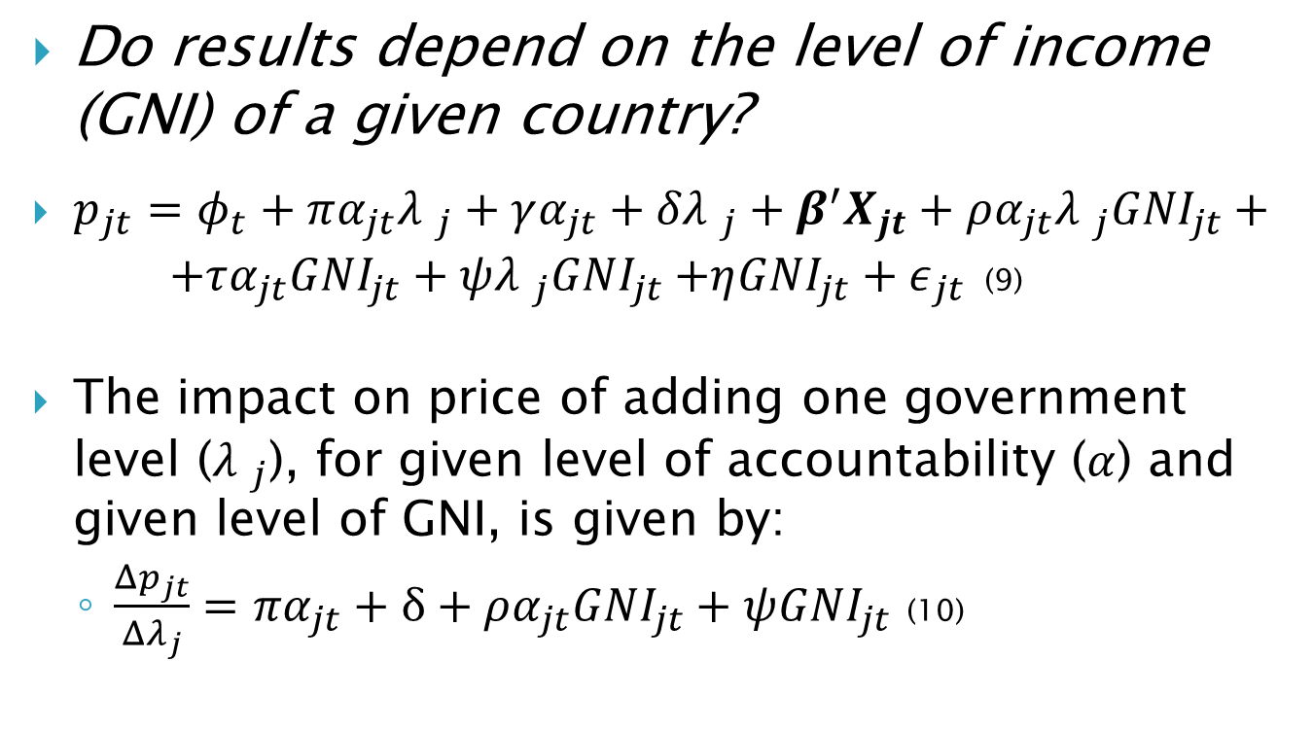
Empirical analysis 2
Do results depend on the level of income (GNI) of a given country?
  $p_{jt}=φ_{t}+πα_{jt}{λ }_{j}+γα_{jt}+{δλ }_{j}+β^{′}X_{jt}+ρα_{jt}{λ }_{j}{GNI}_{jt}+ +τα_{jt}{GNI}_{jt}+ψ{λ }_{j}{GNI}_{jt}{+η{GNI}_{jt}+ε}_{jt}$ (9)
The impact on price of adding one government level (${λ }_{j}$), for given level of accountability ($α$) and given level of GNI, is given by:
  $\frac{Δp_{jt}}{Δλ_{j}}=πα_{jt}+δ+ρα_{jt}{GNI}_{jt}+ψ{GNI}_{jt}$ (10)

Slide 26
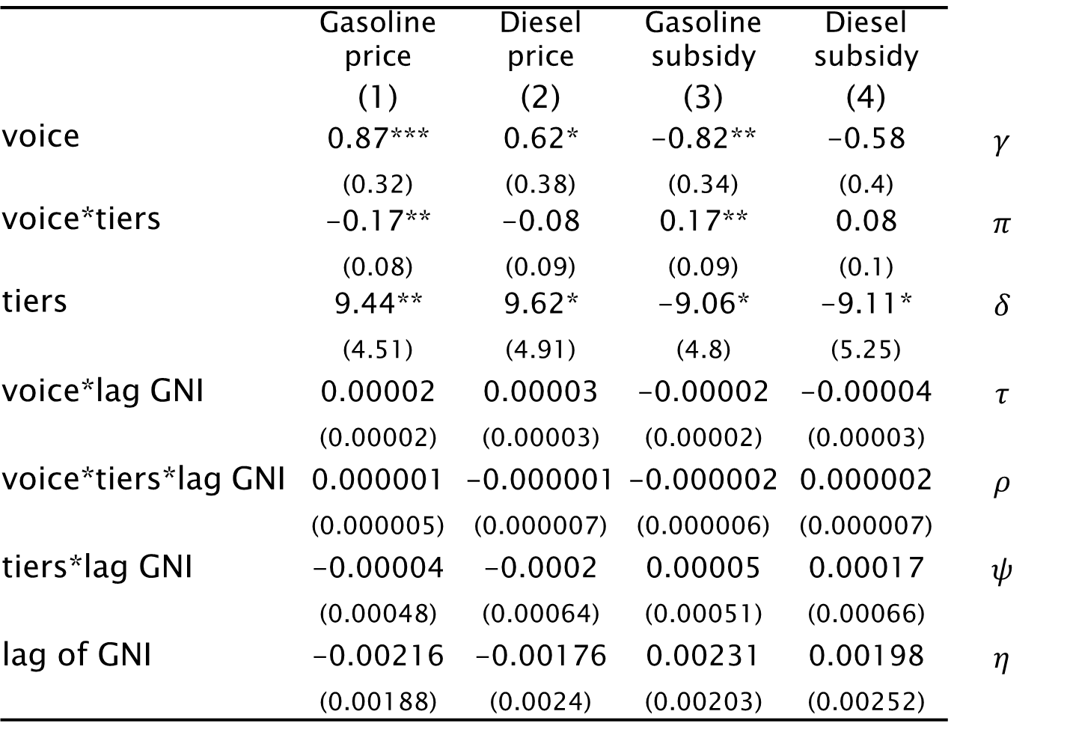
  Table 4: Impact of decentralization on gasoline and diesel price (and subsidy) for developed and developing countries.
 | Gasoline price | Diesel price | Gasoline subsidy | Diesel subsidy
 | (1) | (2) | (3) | (4)
voice | 0.87*** | 0.62* | -0.82** | -0.58 | $$γ$$
 | (0.32) | (0.38) | (0.34) | (0.4)
voice*tiers | -0.17** | -0.08 | 0.17** | 0.08 | $$π$$
 | (0.08) | (0.09) | (0.09) | (0.1)
tiers | 9.44** | 9.62* | -9.06* | -9.11* | $$δ$$
 | (4.51) | (4.91) | (4.8) | (5.25)
voice*lag GNI | 0.00002 | 0.00003 | -0.00002 | -0.00004 | $$τ$$
 | (0.00002) | (0.00003) | (0.00002) | (0.00003)
voice*tiers*lag GNI | 0.000001 | -0.000001 | -0.000002 | 0.000002 | $$ρ$$
 | (0.000005) | (0.000007) | (0.000006) | (0.000007)
tiers*lag GNI | -0.00004 | -0.0002 | 0.00005 | 0.00017 | $$ψ$$
 | (0.00048) | (0.00064) | (0.00051) | (0.00066)
lag of GNI | -0.00216 | -0.00176 | 0.00231 | 0.00198 | $$η$$
 | (0.00188) | (0.0024) | (0.00203) | (0.00252)

Slide 27
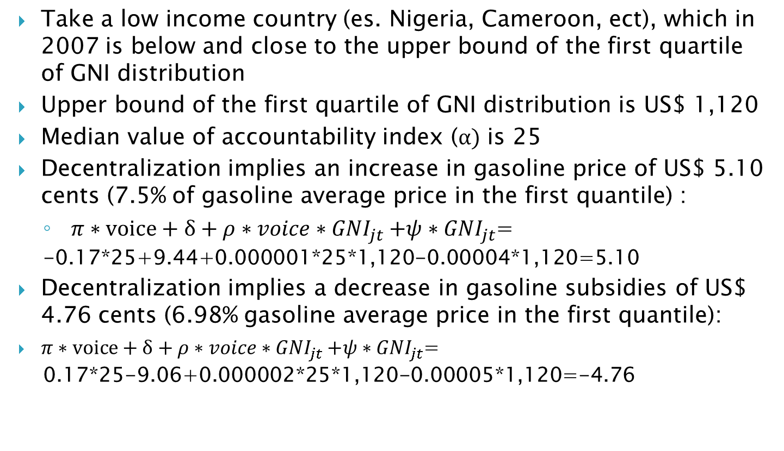
Impact of decentralization on gasoline price: developing countries
Take a low income country (es. Nigeria, Cameroon, ect), which in 2007 is below and close to the upper bound of the first quartile of GNI distribution
Upper bound of the first quartile of GNI distribution is US$ 1,120
Median value of accountability index ($α)$ is 25
Decentralization implies an increase in gasoline price of US$ 5.10 cents (7.5% of gasoline average price in the first quantile) :
  $π∗voice+δ+ρ{∗voice∗GNI}_{jt}+ψ∗{GNI}_{jt}$=
  -0.17*25+9.44+0.000001*25*1,120-0.00004*1,120=5.10
Decentralization implies a decrease in gasoline subsidies of US$ 4.76 cents (6.98% gasoline average price in the first quantile):
$π∗voice+δ+ρ{∗voice∗GNI}_{jt}+ψ∗{GNI}_{jt}$=
  0.17*25-9.06+0.000002*25*1,120-0.00005*1,120=-4.76

Slide 28
Impact of decentralization on gasoline price: developed countries
Take a rich country (es. Austalia, UK, France, ect), which in 2007 is below and close to the lower bound of the last quartile of the GNI distribution
Decentralization has no effect on gasoline price and gasoline subsidies (with the coefficient being not statistically significant)
The impact of adding a government level on the gasoline subsidy for developing countries is statistically different (p-value=0.0473) from the same impact for developed countries.
Same results with diesel price and diesel subsidies

Slide 29
Robustness check
Random effect specification can bias the estimation since the unobserved country characteristic can be correlated with the term error
Mundlak approach (1978) allows to incorporate the unobserved effect into the random model specification by including the time averages of the covariates as additional explanatory variables
Regressions in Table 5 and 6 show very similar results to those obtained with the random effect specification

Slide 30
Conclusion
When the architecture is a decentralized one, for given level of accountability of the government, the use of subsidy for political gain become less effective.
The increase in the level of accountability of the government mitigates the former effect: the more accountable is the government the more difficult the political benefit of a distortive subsidy is.

Slide 31
Conclusion
Find that adding one government level leads to a statistically significant increase in gasoline and diesel price (and so a decrease in the subsidy) for developing countries, while it has no effect for developed countries.
Possibility that in developing economies where voters are poorly informed, and the assignment of functions and policy instruments to the various government levels are imperfect, fuel subsides will be an inefficient policy but it will be more so in the absence of multi-leveled governance.

