Slide 1

Ordinary Least Square estimator using STATA
Evaluation of Public Policy

Slide 2
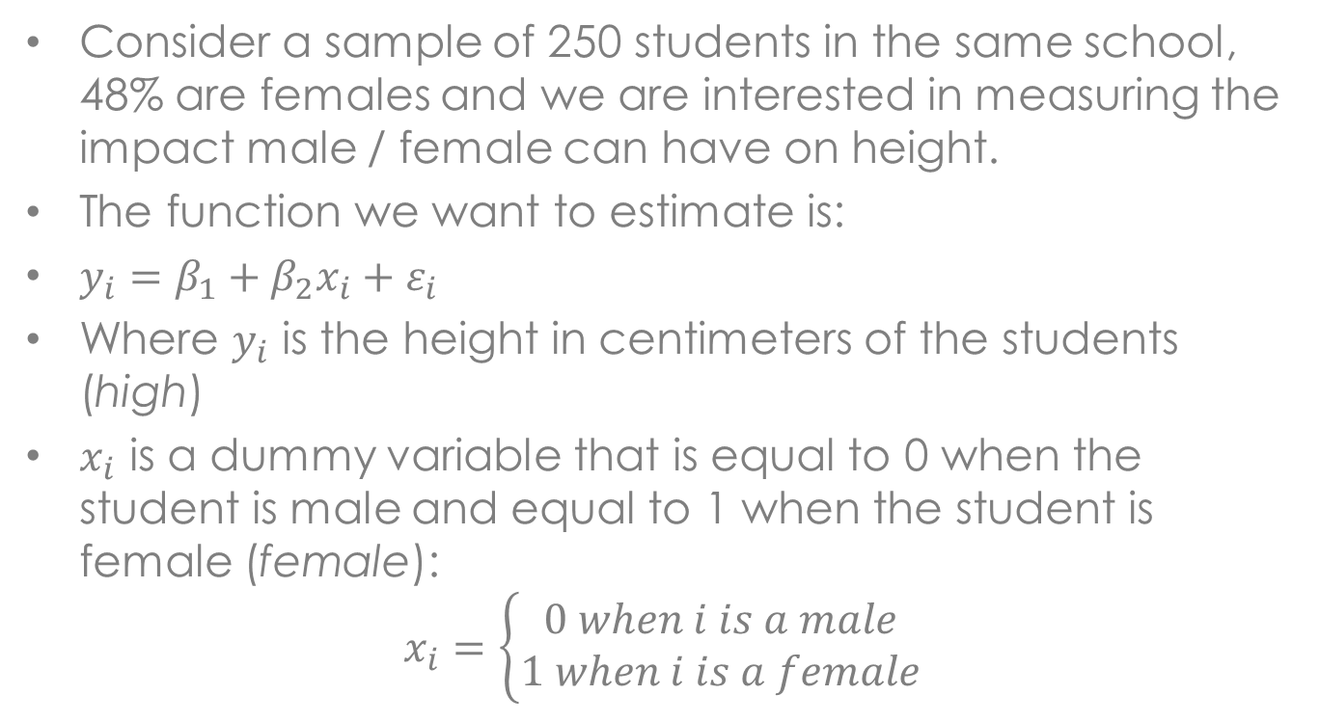
OLS using STATA
Consider a sample of 250 students in the same school, 48% are females and we are interested in measuring the impact male / female can have on height.
The function we want to estimate is:
$y_{i}=β_{1}+β_{2}x_{i}+ε_{i}$
Where $y_{i}$ is the height in centimeters of the students (high)
$x_{i}$ is a dummy variable that is equal to 0 when the student is male and equal to 1 when the student is female (female):
$$x_{i}=\left\{\begin{aligned}0 when i is a male \\ 1 when i is a female\end{aligned}\right.$$

Slide 3
Command regress [reg]
In STATA the command that makes estimates with the OLS model is regress [reg] command.
We open first the dataset with the command use.
And next use the command reg to start the regression:
the first variable after the command is the dependent variable , the others are the explenatory variables:
reg y x1 x2
Excercise:
open the dataset
high_school.dta
Replicate the regression previously specificate with the OLS model
Notes:
The first Help that Stata provides is online, for more details you can consult the PDF manual

Slide 4
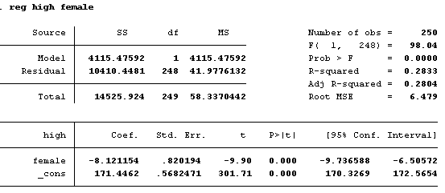

STATA results 01
The p-value of the $β_{2}$ is statistically significant at 1% level because the p-value is lower than 0.01

Slide 5
Command regress – options
Notice that Stata automatically adds a constant.
If you wanted to exclude it, you would have to enter nocons as option:
reg y x1 x2, nocons
As any other command in Stata, "regress" can be applied to a subset of the observations.
Suppose you want to run two separate regressions, one for students under 18 and the other for student over 18:
reg y x1 x2 if x3<18
reg y x1 x2 if x3==18
Excercise:
using the dataset
high_school.dta
Replicate the regression previously specificate only for students without illness

Slide 6
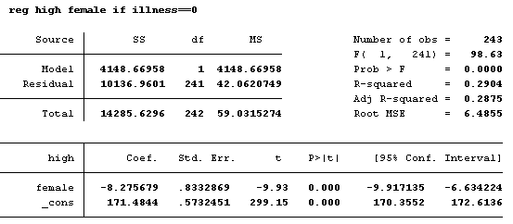

STATA results 02
The p-value of the $β_{2}$ is still statistically significant at 1% level because the p-value is lower than 0.01

Slide 7
Command global
You will sometimes find very tedious to copy and paste the list of control variables in each regression you run.
An easy and elegant way to save some time and space is to define at the beginning of the code the list of control variables with the command global
global controls x1 x2 x3
And then simply enter “$controls” each time that you need the list of control variables:
reg y $controls
Excercise:
open the dataset
high_school.dta,
generate the variable olympus equal to one If the district is Mount Olympus,
replicate the regression with also the variables age and Olympus as explanatory variables using the command global

Slide 8
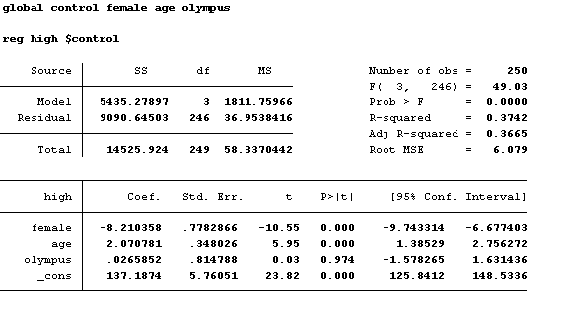
STATA results 03
Also the variable age explains the height of the students, the variable olympus is not statistical significant

Slide 9
Predict 01
After every estimation command (e.g. reg, logit, probit) some "predicted" values (fitted values, residuals, etc.) can be stored in a new variable using the command predict.
In our example:
reg y x1 x2 x3
predict fit
Enter "browse y fit" to appreciate the fit of the model.
Excercise:
open the dataset
high_school.dta,
Using the last regression show the predict values of the regression

Slide 10
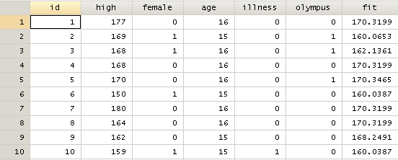
STATA results 04

Slide 11
Predict 02
Alternately, the residual can be obtained with the option ,residual:
predict res, residual
Notice that generate the residual is simply:
gen res_alternative = y - fit
The residuals can be shown in a histogram plot:
histogram residual
Excercise:
open the dataset
high_school.dta,
Using the last regression show a graph with the distribution of the residual

Slide 12
STATA results 05

Slide 13
Fixed Effect Estimator in STATA
before regression, we need to specify that we are using a panel data with the xtset command:
xtset panelvar timevar
Fixed-effects (FE) model in Stata using the option fe of the xtreg command :
xtreg y x1 x2, fe
to create n dummies variables that control for fixed time effects:
xi: xtreg y x1 x2 i.timevar

Slide 14
Fixed Effect Estimator in STATA
Open the dataset panel_wb.dta
Set a simple regression in Stata in which the dependent variable is the gdp per capita
Replicate the previous regression with country fixed effects
Replicate the first regression with year fixed effects

Slide 15
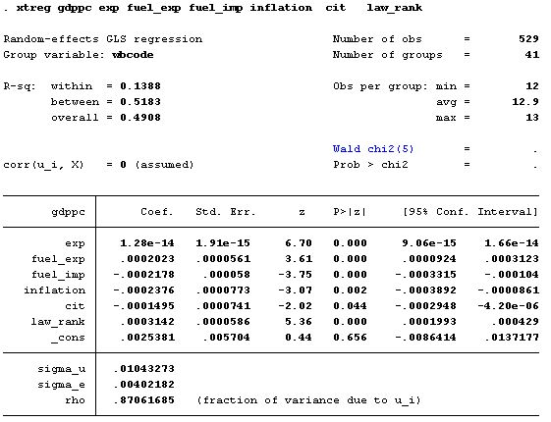
STATA results 06

Slide 16
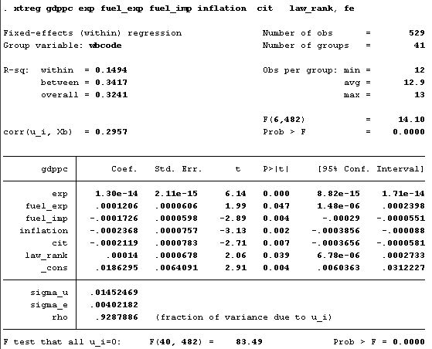
STATA results 07

Slide 17
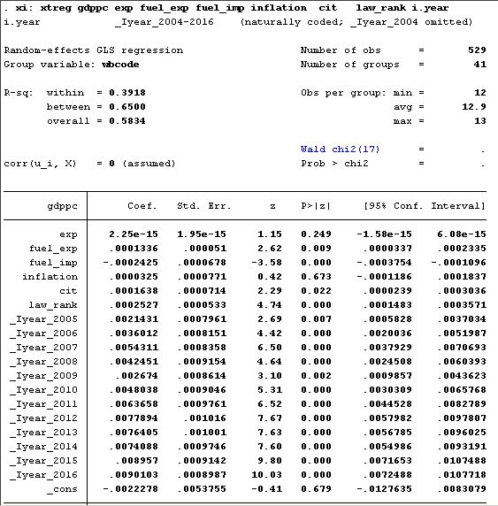
STATA results 08

