Slide 1


Introduction to Stata
Evaluation of Public Policy

Slide 2
What is Stata?
Stata is a statistical software, widely used in academic research and in private companies, able to perform a variety of functions:
  database management;
  statistical-econometric analysis;
  graphic analysis.
Stata is able to respond to the most different statistical-econometric problems, thanks to already available commands and its own programming language that allows advanced users to create customized routines.
A useful Stata User’s guide is available at: https://www.stata.com/manuals13/u.pdf
Notes:
All analyses can be reproduced and documented for publication and review

Slide 3
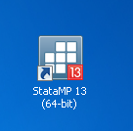
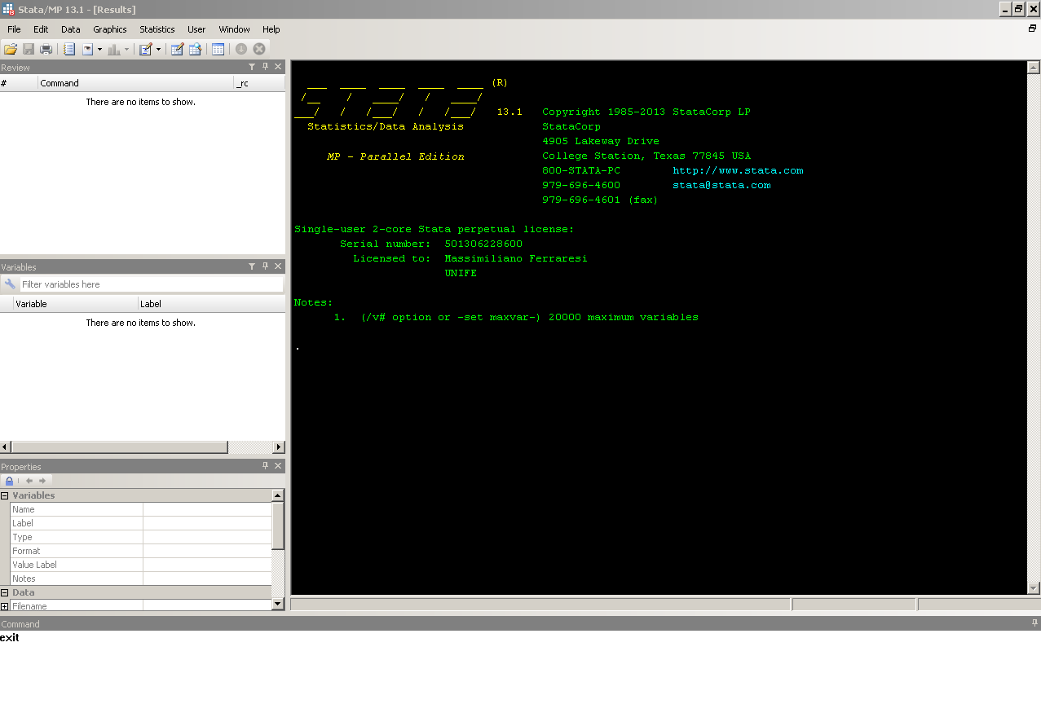

Start and shut down STATA
To start simply click on the Stata icon
or select the program from the Windows menu
To exit, type exit in the command bar
Exercise:
start and stop STATA on your PC
exit

Slide 4
The layout of the windows
The first screen that Stata offers consists of several windows:
  1. Stata Results
  2. Review
  3. Variables
  4. Stata Command
Notes:
Stata Results: window in which Stata presents the results of the commands given
Review: records the history of the commands given by the Stata Command. By clicking on one of them, the mouse is returned to the Stata Command
Variables: when a dataset is loaded here is a list of the variables that compose it
Stata Command: window in which the commands Stata must execute are written

Slide 5
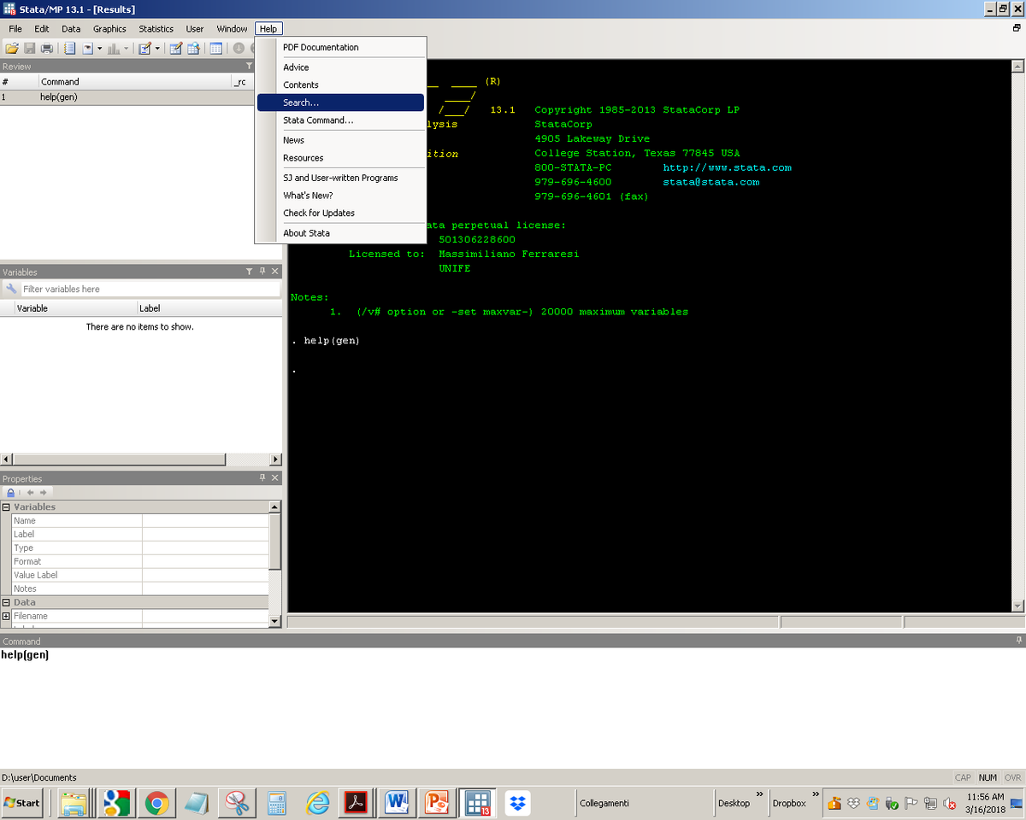

Help !!!
To see what the commands in Stata indicate, their options or in general all the features in Stata, there is the Help!
To access to the Help, select from the top bar or type help ### in the command bar
Attention !!! The controls are Case Sensitive!
Exercise:
Open STATA on the PC and find the meaning of tab and sort commands
help
Notes:
The first Help that Stata provides is online, for more details you can consult the PDF manual

Slide 6
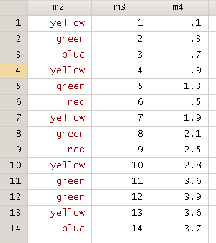
Upload data 01
Stata needs data, these come from datasets
Stata expects the dataset to be rectangular with the variables in the columns (m) and the observations / statistic units in the rows (n).
Datasets can have different origins, we focus on those formats: .dta and excel origin.
Notes:
M2 is a string variable
M3 is a integer variable (int)
M4 is a float variable

Slide 7
Upload data 02
To load data in .dta format you need:
  tell Stata where the dataset is located with the command cd “path directory ###"
  Open the dataset with the command use file.dta
  Put the command ,clear after the use command to delete the dataset previously memorized by Stata
For example to open the dataset today.dta in the directory Lecture1 the command are:
cd “C:\Users\user\Dropbox\Lecture1”
use today.dta, clear
Attention !!! Only one dataset at time is stored by Stata

Slide 8
Upload data 03
To view the dataset click on the data editor or type the command br
To save a dataset type save file.dta, replace
The command , replace allows to rewriting over the previous dataset
Exercise:
Put the file ethiopian_regions.dta into a PC folder,
upload the dataset in STATA,
see what is the capital of the region Afar,
save the previous dataset with the name new_dataset.dta

Slide 9
Upload data 04
To upload data from an Excel file, the shortest way is to:
  Open the Excel file and copy only the data of interest;
  Open the data editor in Stata;
  Paste the dataset, if dataset has the columns with the name of the variables press the option "Treat first row as variable names”
To see the imported dataset click on data editor or br
Or directly with the import excel command:
import excel
“path folder\excel.file.name.xls", firstrow
Create a dataset in Excel with 2 or more variables,
upload this dataset on Stata
Notes:
datetime translation — String to numeric date translation functions
gen date_hire=date(date, "YMD")
format date_hire %tdMonth dd, CCYY

Slide 10
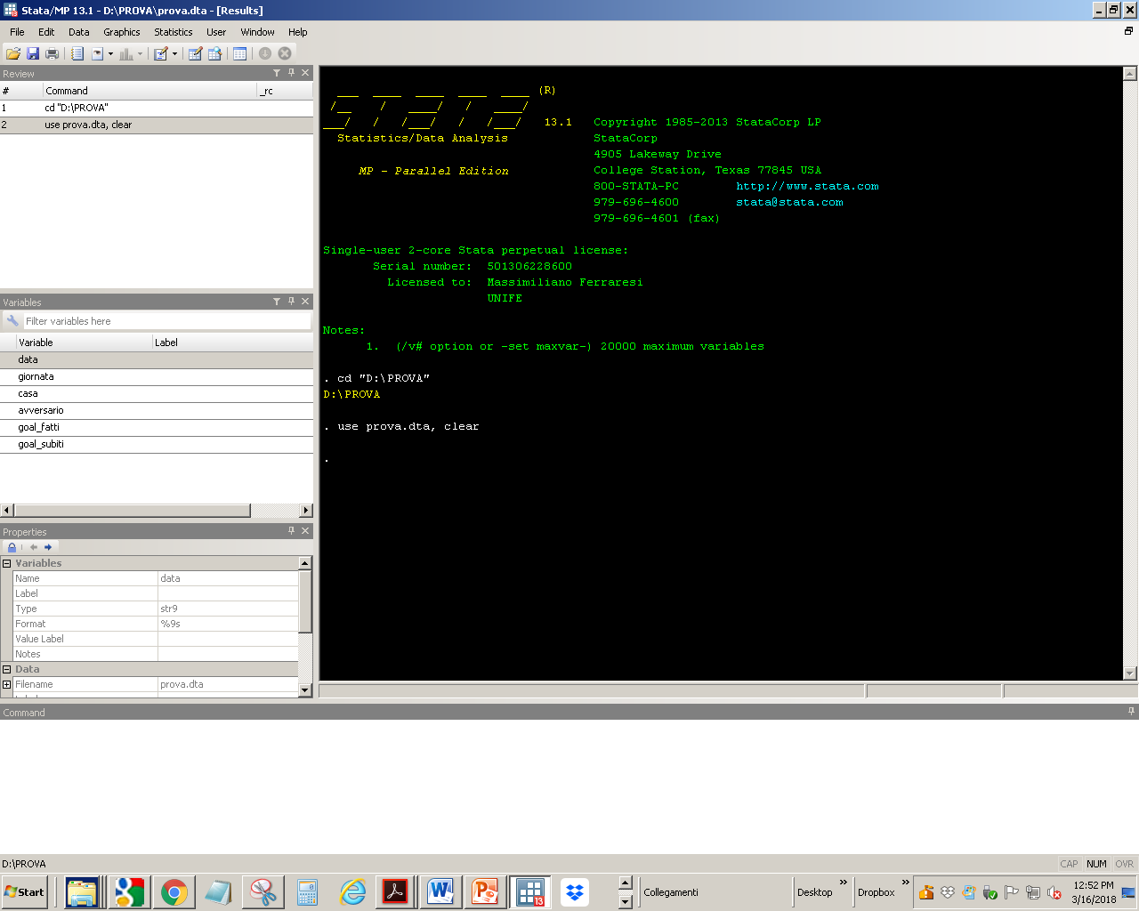
Data editor
Data editor

Slide 11
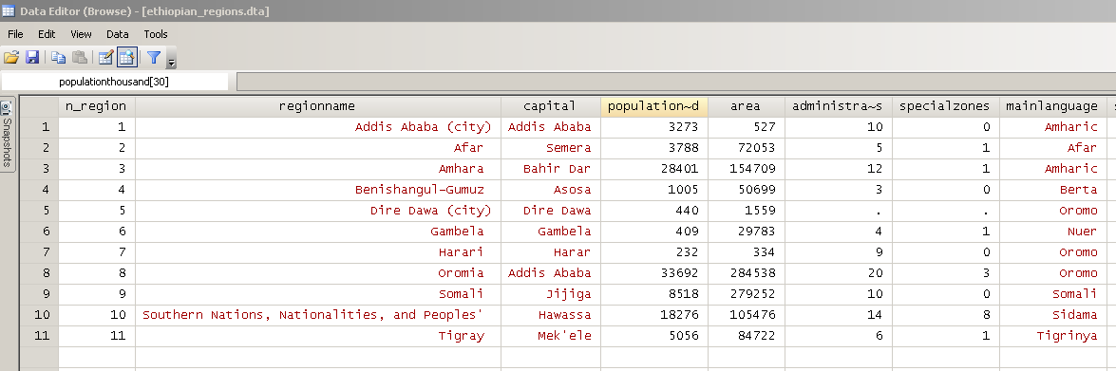
Data editor (browse)

Slide 12
A first look at the data
The command sum var1 var2 allows to display the number of observations and some descriptive statistics
For some variables it is also convenient to use the command tab var1 to analyze the frequency distribution of a single variable
To rename a variable: rename oldvar newvar
To enter a description of a variable label var var “description”
To delete a variable from the dataset: drop var1
Excercise:
from the dataset ethiopian_regions.dta
report the summary statistics of the variables population and area,
see the frequency of the variable administrativezones,
rename the variable accesstosafedrinkingwater in water,
insert a description for the variable water
drop the variable n_region

Slide 13
Use the do files 01
STATA has an editor that allows you to create do files
The do files are simple text files with the extension .do which contain a series of commands to be passed to the program for execution
Each line only one command
Anticipated by * the line is not read as a command but only a comment – not processed by the software
Use the run command to start the command
Notes:
ASTERISK (*)

Slide 14

Apertura do file
Do file

Slide 15
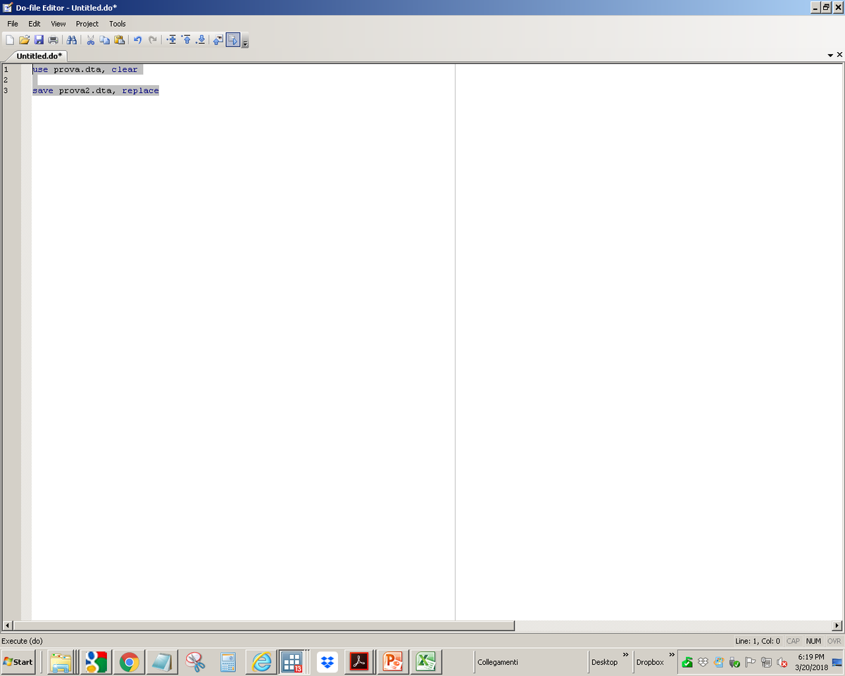
Do file2
Run

Slide 16
Use the do files 02
Why use do files and not direct iteration with «Stata Command»:
  All the steps that are made in data processing are documented
  The reproducibility of the results is obtained
  Possible to repair mistakes
To open a do file select from the top bar, then its management is like that of a text file .txt
Exercise:
Open a new do file,
repeat the operations of slide 6,
save the do file in a folder

Slide 17
Order and count on STATA
You can sort the observations in ascending order for a variable with the command sort var1
You can count the observations of a variable given certain conditions with the command count if var1 ? x1
from the dataset ethiopian_regions.dta,
sort the region by area,
count the number of regions with area greater than 100,000;
count the number of regions without information on the special zones
? Syntax to remember:
> greater than
< less than
>= greater or equal
<= less or equal
== equal to
! = different from
& is the boolean operators "and"
| is the boolean operators "or"
Notes:
AMPERSAND (&)
BROKEN BAR (|)

Slide 18
Manipulate data on STATA 1
With the command gen it’s possible to create new variables through an expression, for example:
  Create a new variable as a sum:
  gen newvar = var1 + var2
  Create a difference variable:
  gen newvar = var1 - var2
  Create a product variable:
  gen newvar = var1 * var2
  Create a ratio variable:
  gen newvar = var1 / var2
  Create the square of a variable:
  gen newvar = var1 ^ 2

Slide 19
Manipulate data on STATA 2
With the command replace, you can replace values ​​according to a certain function
For example, to replace a variable with the value zero when it becomes 10, the command is
replace oldvar = 0 if oldvar == 10
From the dataset ethiopian_regions.dta
create the new variable pop1000 as a product between population and 1.000,
create the density variable as a ratio between pop1000 and area,
create the dummy variable high_density equal to 1 when the variable density assumes values greater than 500

Slide 20
Manipulate data on STATA 3
The generate command provides an enhanced version (egen) that should be used only in conjunction with a series of functions specifically provided for.
To see which functions are combined: help egen
For example:
  to create an average variable of var1:
  egen newvar1= mean(var1)
  To create an average variable of var1 for different groups of observations, classified by var2:
  bysort var2: egen newvar1=mean(var1)
Exercise:
from the dataset ethiopian_regions.dta,
create a variable with the population average,
create a variable with the population average divided by regions with a high/low population density

Slide 21
Merge dataset
Often data has different origins and sometimes it’s necessary to use at the same time information coming from two different datasets, that we call dataset master.dta and dataset slave.dta.
A necessary condition for adding to a dataset (master) variables coming from another dataset (slave) is that in both are present one or more variables that allow to establish a relationship between the observations of the first and second dataset (key_var).
The command merge allows us to add new variables to the master dataset coming from the slave dataset using one or more key variables
use master.dta, clear
merge key_var using slave.dta
Attention !!! The datasets used in the merge must be sorted according to the key variable
Exercise:
Merge the dataset ethiopian_region
with the dataset ethiopia_agri.dta

Slide 22
A graph on STATA
It’s possible to make several graphs in STATA, most "ready-to-use" packages are in the bar at the top under graphics
The most used graphs are (where var1is on y-axis and is on var2 x-axis):
  Scatter, with the command twoway(scatter var1 var2)
  Line, with the command twoway(line var1 var2)
from the dataset ethiopian_regions.dta,
sort data for the population, create a graph that relates the population to the number of administrative zones

Slide 23
Graph population - administrative zones

Slide 24
Ripasso finale
exit
twoway
sort
rename
count if
cd
by sort
tab
help
sum
.do file
egen
!=
drop
clear
"D:\
use
and
scatter
|
gen
br
save
replace
label

Slide 25
Some useful websites
Stata’s own resources for learning STATA:
Stata website, Stata library, Statalist archive
www.stata.com/links/resources1.html
Stata YouTube Channel
http://www.youtube.com/user/statacorp
University of North Carolina:
www.cpc.unc.edu/research/tools/data_analysis/statatutorial
Princeton:
www.princeton.edu/~otorres/Stata

