Slide 1
Innovation, Ecoinnovation and policy

Slide 2
Key issues
Innovation in economic theory
Innovation drivers
Innovation effects
  The Porter hypothesis
  The Pollution haven hypothesis
Data issues

Slide 3
Innovation in economic theory
In mainstream economics, innovation is somewhat treated as a black box
Y= f(K, L)

Slide 4
Efficiency increase
y
k

Slide 5
Highlight of growth theory: sources of growth
Capital accumulation drives income increases (transition)
When the economy is mature (high level of capital, advanced economy)
  Population growth drives the increase of long run income growth
  ONLY technology may explain income per capita growth in the long run

Slide 6
Producing more with the same input level
k
Production frontier
L

Slide 7
From EEA (2014) report
Invention and innovation adoption and diffusion are crucial factor to achieve a sustainable and competitive economic development. Technological progress has been long recognised the only exogenous driver of long run growth in income per capita.
Economic growth theory has emphasised the role of R&D and human capital as main forces behind countries performances. Evolutionary theory poses innovation in a broad techno-organisational meaning at the heart of economic systems development.
In studies of environmental and economic performances, innovations – of technological, organisational, behavioural kind – have gained increasing relevance as a key factor to obtain sustainable transitions (Costantini and Mazzanti, 2013; Mazzanti and Montini, 2010; van den Bergh, 2007) and more specifically to decarbonize the economy (Edenhofer, Carraro and Hourcade, 2012).
It is among the main factors – as long as energy mix changes and structural change - that – as outlined by IPAT models (Kaya identity) – can compensate the increasing scale of the economy.

Slide 8
From EEA (2014) report
The Stern review itself acknowledges the role of technological change for climate change mitigation, as one of the three pillars (policy and behavioral change the others).
Eco or environmentally friendly innovations are defined as ‘The production, assimilation or exploitation of a product, production process, service or management or business method that is novel to the organisation (developing or adopting it) and which results, throughout its life-cycle, in a reduction of environmental risks, pollution and other negative impacts of resources use (including energy use) compared to relevant alternatives’ (Kemp, 2010). The definition comes from the EU FP7 Measuring Eco innovation project. The definition of EI is not limited to specific technologies; it also includes new organisational methods, products, services and knowledge-oriented innovations.
http://www.unep.org/ecoinnovationproject/. UNEP states that Eco-innovation is the development and application of a business model, inspired by a new business strategy, that will lead to a company’s enhanced sustainability performance through a combination of a significantly improved or new product (good/service), processes, market approach and organizational structure. Eco-innovation operates at the level of a company strategy, mainstreaming a holistic life-cycle approach throughout all the company’s operations (including associated activities that take place beyond company gates and influence / involve its supply chain) and is centred on enhancing its positive sustainability impacts, gaining reputational benefits and access to new markets. In sum, eco-innovation provides a win-win solution to improving economic competitiveness and sustainability.

Slide 9
Dynamic efficiency
A route through which long-run effects may transmit is via induced impacts on the rate of technological innovation.
There are two aspects to this.
One route concerns what are sometimes called dynamic efficiency effects. These arise from the pattern of innovation incentives generated by a pollution control instrument. A common argument in this regard is that command and control instruments have poor long-run properties because they generate weak incentives for innovation.
The binary nature of many such instruments (you reach the target or you do not reach it) creates a discrete switch in behaviour: once a required target has been obtained there is no longer any incentive to go further.
An emissions tax (or abatement subsidy) is likely to generate a dynamically efficient pattern of incentives on corporate (and consumer) behaviour.
The incentive structure operates to continually reward successful environmentally friendly innovation.
In a market-based scheme, every unit of emissions reduction is rewarded by a tax saving. The key issue here is what incentives firms face in developing pollution-saving technology or developing new, environmentally cleaner products. Under a emissions tax scheme, these incentives may be strong.
EU ETS as well…

Slide 10
Dynamic incentives under emissions tax controls: tax savings
£
Two benefits
MC₁
MC₂
μ
Λ
Lower tax – increased costs
Ω
0
Z₁*
Z₂*
Emissions abatement, Z

Slide 11
Area Ω is the saving that would result if marginal costs were lowered from MC1 to MC2 and the emissions level was unchanged. But if marginal cost were lowered in this way, the firm’s profit-maximising emissions abatement level would rise from Z1* to Z2*, and so an additional saving of ∧ would accrue to the firm. The firm has an incentive to develop new technology to abate emission if the total costs of developing and applying the technology are less than the present value of the savings Ω + ∧ accumulated over the life of the firm.
In contrast, in a command and control (CAC) regulatory system, dynamic incentives are weaker or non-existent. As we said above, if a target is set in (non-marketable) quantitative terms, then once that target has been met there is little or no further incentive on the polluter to reduce emissions.
But there is a second aspect that weakens the force of these arguments. Some researchers believe that technological change can be driven from above. Suppose that the EPA identifies best-practice environmentally friendly technology, and imposes this as a requirement on firms through minimum acceptable technology regulations. Not only will this have a direct effect on spreading technology diffusion, but the indirect effects may be powerful too. Barriers due to frictions, lack of information, and other market imperfections that may lead firms to be over-cautious or unable to act voluntarily no longer bite in the face of imposed requirements. Moreover, these changes have catalytic effects which set in motion spurts of innovation as learning effects occur. These kinds of arguments are likely to have most relevance for technological innovation and diffusion in developing economies.

Slide 12
Dynamic incentives under emissions tax controls: tax savings
£
Two benefits
MC₁
MC₂
μ
Λ
Lower tax – increased costs
Ω
0
Z₁*
Z₂*
Emissions abatement, Z

Slide 13
Green taxes, MAC and technology
A tax stimulates reduction of MAC through investments
This generates an increase of abatement
The firm saves net MAC and pays lower taxes
This links to ‘dynamic efficiency’ properties
  Porter Paradigm (Costantini & Mazzanti, 2012, Research Policy)
  Hahn and STavins, 1991
  Renè Kemp and Pablo Del Rio Gonzalez works

Slide 14
What is innovation?
Innovation is a new idea, device or process which can be viewed as the application of better solutions that meet new requirements, inarticulated needs, or existing market needs.
This is accomplished through more effective products, processes, services, technologies, or ideas that are readily available to markets, governments and society.
The term innovation can be defined as something original and, as a consequence, new, that "breaks into" the market or society.

Slide 15
Environmental Innovation
Eco-innovation is the production, assimilation or exploitation of a product, production process, service or management or business method that is novel to the organisation (developing or adopting it) and which results, throughout its life cycle, in a reduction of environmental risk, pollution and other negative impacts of resources use (including energy use) compared to relevant alternatives. (Kemp & Pearson, 2007)

Slide 16
Environmental innovation [ctd.]
Relevant criterion to determine if an innovation is an eco-innovation is that its use is less environmentally harmful than the use of relevant alternatives
The definition is based on environmental performance rather than environmental aim (i.e., an innovation can be “eco” even if it has not been specifically designed to reduce environmental impact but it does)

Slide 17
Eco innovations
Product / process
  Material/energy sources
  Emissions
  GHG
EMS / ISO schemes
(presence of) Environmental R&D
CSR oriented motivations
  Demand
  Policy

Slide 18

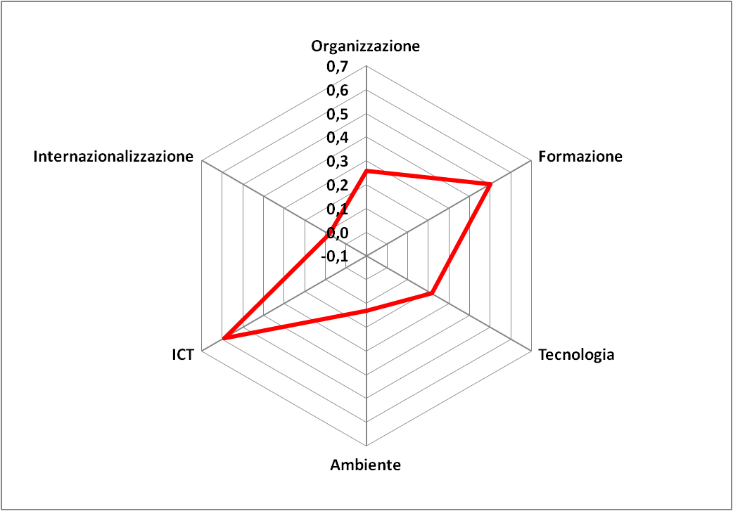
We need to understand the weight of eco innovations
Environmental innovations adoption in industrial firms
Organisational change
HighPerfWorkPract
Internationalisation
training
Techn. innovation
Still lagging behind
need to understand the joint role of policies, firm internal and external resources, industrial relations, cooperation
Envir. Innov.
Notes:
18

Slide 19



Eco-innovation
Products, processes and systems that are more environmentally benign than relevant alternatives (on a life cycle basis)
The environmental benefit may be the primary goal or an unintended side-effect

Slide 20
Categories of eco-innovation
A. Environmental technologies
  Pollution control technologies including waste water treatment technologies
  Cleaning technologies that treat pollution released into the environment
  Cleaner process technologies: new manufacturing processes that are less polluting and/or more resource efficient than relevant alternatives
  Waste management equipment
  Environmental monitoring and instrumentation
  Green energy technologies
  Water supply
  Noise and vibration control
B. Green energy technologies
C. Organizational innovation for the environment:
  Pollution prevention schemes
  Environmental management and auditing systems
  Chain management: cooperation between companies so as to close material loops and to avoid environmental damage across the value chain (from cradle to grave)
D. Product and service innovation offering environmental benefits:
  New or environmentally improved products (goods) including eco-houses and buildings
  Green financial products (such as eco-lease or climate mortgages)
  Environmental services
  Services that are less pollution and resource intensive (car sharing is an example)
E. Green system innovations
F. General puropose technologies offering green benefits

Slide 21
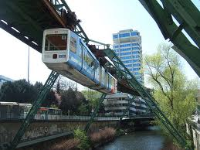

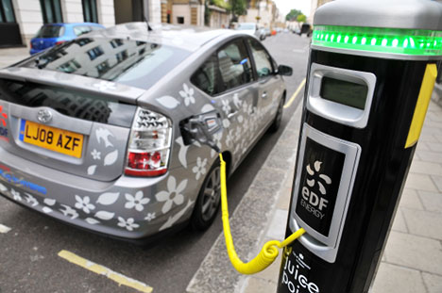
Eco-innovation for a better Quality of Life

Slide 22
Environmental technologies
End of pipe technologies (e.g., scrubbers for smokestacks or catalytic converters for automobile): adopted at the end of the pipe to contain emissions (exhaust gases, wastewater, noise), pollutants and other polluting substances which have already occurred or arisen, or to render them controllable or disposable.
Clean technolgies (e.g., recycling, renewable energies):new products or processes which lead to a reduced environmental impact
Notes:
End of pipe: rimuovono i contaminanti già formatisi da un flusso di aria, acqua, rifiuti. Sono implementati come ultimo stage prima dello smaltimento del flusso
Clean tec (tecnologie pulite): sono prodotti o processi produttivi del tutto nuovi (ad esempio un minor utilizzo di energia) che portano ad un ridotto impatto ambientale

Slide 23
Determinants of ecoinnovation

Slide 24
Market failures for knowledge
Knowledge is a public good (non-excludable, non-rivalrous)
i.e., a firm which invests or implement a new technology, creates benefits for the others while incurring in all the costs
Lack of the incentive in investing in new technology
Even if policies correct the environmental externality, the level of environmental R&D can still be suboptimal, because environmental policies ignores the positive spillovers created by R&D

Slide 25
The role of policy
Corrects the environmental externality
Policy
Corrects knowledge market failures
and/or
e.g., patent protection, R&D tax credit, funding for basic research

Slide 26
Induced Innovation
Hicks (1932): a change in the relative prices of inputs is itself a spur to invention particularly that directed to economising the use of the factor that has become relatively espensive.
Different policy instruments works differentely in this sense…

Slide 27
Which policy instrument?
Market based:
Encourage behaviour through mkt signals rather than through explicit directive on pollution control level or methods
Policy
Command and Control:
Forces firm to take on similar magnitude of the pollution burden regardless of the cost.
Technology standard: specify the method and the actual quipment that firm must use to comply with a particular regulation
For example: taxes, subsidies, emission trading, property rights
Performance standard: set uniform control target for firms while allowing some decision on how the target is met
Can be:
Allows to choose the least cost solution to improve the environmental performace (flexibility)
It always pay for firms to clean up a bit more if a sufficiently low-cost method of doing so can be identified and adopted
Or:
Both of these instruments works because their nature is to require/induce firms to do things that they would not otherwise do
Notes:
Con i mkt based instruments le imprese possono scegliere tecnologie che si possono permettere in termini di costo.
Gli strumenti CAC, in particolare i tecnology std, non incentivano le imprese ad innovare.

Slide 28
Which policy instrument? [ctd.]
Following induced innovation approach market based instruments will induce more environmentally friendly innovation than a command and control policy
Empirical results:
  Jaffe and Palmer (1997): significant correlation over time between the rate of expenditure on pollution abatement and the level of R&D spending but no effect on overall patenting
Notes:
C’è quindi secondo Jaffe e Palmer un’influ della policy sulla ricerca e sviluppo (le imprese almeno intraprendono un processo di generazione di nuova conoscenza) anche se questo sforzo non si traduce sempre e immediatamente in innovazione

Slide 29
Eco-innovation effects
Less pollution …. CO2-
Less pollution and waste management costs
Less resource costs… efficiency
Increased sales … VA+
Quality of life benefits
  Worker’s benefits, higher productivity
  Higher wages, higher productivity (efficiency wage theory.. Ford)
CO2/VA

Slide 30
Evolutionary teory or Schumpeterian theory
Firms are not rational but uses only “rules of thumb” and “routines” to determine how much to invest in R&D
In practice they can neglect profitable opportunities, like the increase in efficiency (i.e., reduction in marginal cost of production) that a clean technology may bring to the firm
Policy is important in this sense because while trying to achieve a better environment also signals frms abut new and profitable opportunities to reduce cost
This leads to the Porter hypothesis: stricter and well designed environmental policies can spur economic performances!

Slide 31
The Porter hypotheses
Esty and Porter, 1998
Jaffe and Palmer (1997) Jaffe et al. (1995) Ambec et al., 2010
Porter special issue on ‘Greening the economy’ of March 2010 on the Harvard Business Review

Slide 32
Weak and strong Porter hypotheses
Ambec et al
Costantini and Mazzanti
Jaffe et al.
In the Porter idea, well designed policies should take into account multiple objectives and types of behaviour, not just maximisation and short run efficiency.

Slide 33
weak
The weak version predicts that additional innovations induced by regulations present opportunity costs on the one hand, but their gross benefits may be higher.
Agents will be induced by new constraints to reengineering and reorganise technology and organization, to improve the coordination of activities, and to align incentives for the purpose of meeting the constraints at a lower cost, resulting in more efficiency and increasing productivity. T
his version of the PH cannot say which kinds of innovation are stimulated by regulation, notwithstanding that “ since addition of constraints to a maximization problem cannot improve the outcome, the weak version implies that the additional innovation must come at an opportunity cost that exceeds its benefits (ignoring the social value of reduced pollution)” (Jaffe and Palmer, 1997)

Slide 34
strong
the so called narrowly strong PH envisages that a more stringent regulatory framework might positively impact only on the green side of the economy, since through the inducement of early innovation in environmental fields the domestic environmental industry can gain competitiveness
The strong version starts from a rejection of the profit maximizing behaviour assuming a dynamic evolutionary setting, and it claims that environmental regulation enhances economic performance at least in the medium run for compliant firms, the sector to which they belong and, eventually, the economy as a whole

Slide 35
CSR issues and Porter
Corporate social responsibility firms..
  Different definitions and approach to CSR
  CSR firms may be defined as those firms which cope with pollution by moving beyond policy targets (over abating emissions)
  Why should they abate beyond targets?
  Taking a long run view, anticipating future targets, anticipating market demand, entering niche markets with higher value added, etc..
  Creating internal and external conditions to enhance economic value. Innovation is crucial
You may read Reinhardt et al 2008 FEEM nota di lavoro

Slide 36
The Pollution haven hypothesis

Slide 37
The issue links policy effects with development issues
Environmental policies increase the costs of production
Argument: env policy driven Incentives to delocate in poorer more industrialised countries with lax policies ( on labor, environment)..
You may read Levinson (2009) on the drivers of US reduced pollution: trade, technology, composition of the economy

Slide 38
Empirical issue, sector by sector country by country
Environmental costs are one cost among others…often not the most relevant..
.. Then economic theory highlights two motivations behind ‘trade’
Ricardian issue
  A country produces and specialises in goods where it is relatively more efficient (800’: England textile, Portugal wine)
Asset issue (Heckscher-Ohlin theorem)
  A country specialises in goods depending on relative abundance (China labor, Sweden Forests, etc..)
  R&D might be an ‘asset’

Slide 39
Innovation: Community Innovation Survey data (CIS)
Data sources

Slide 40
Borghesi et al 2015, Research Policy
  EU ETS effects on eco innovation
  EEA (2014) Report

Slide 41
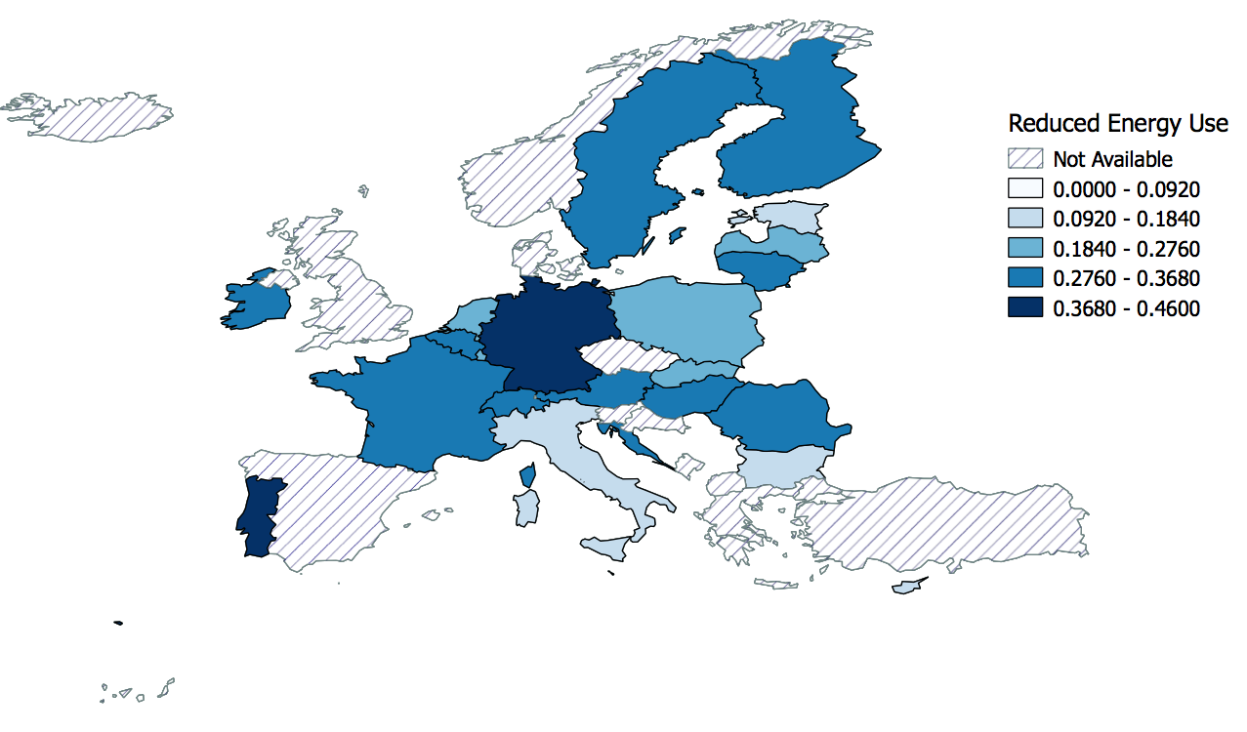
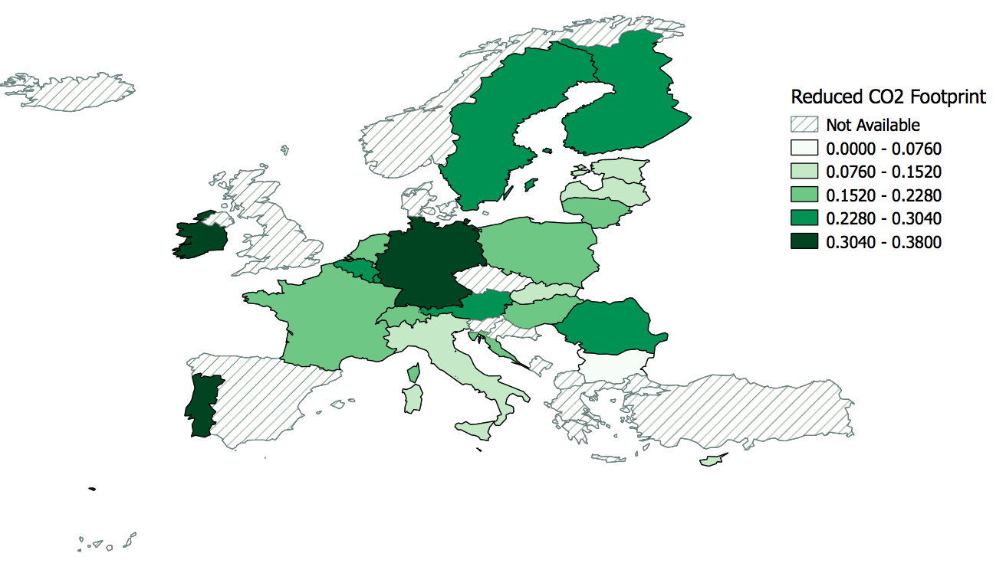
EEA 2014

Slide 44
Invention: patent data

Slide 45
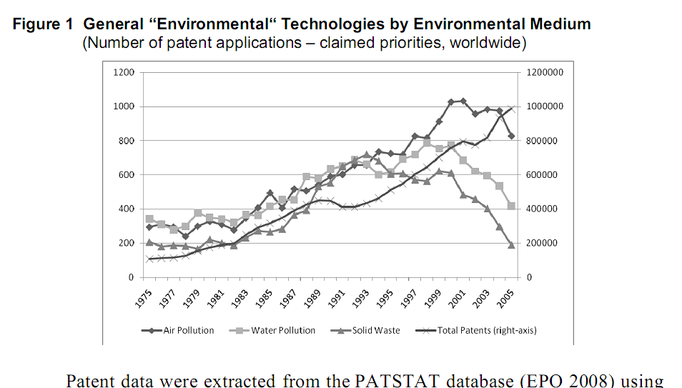
Grafico waste da oecd

Slide 46
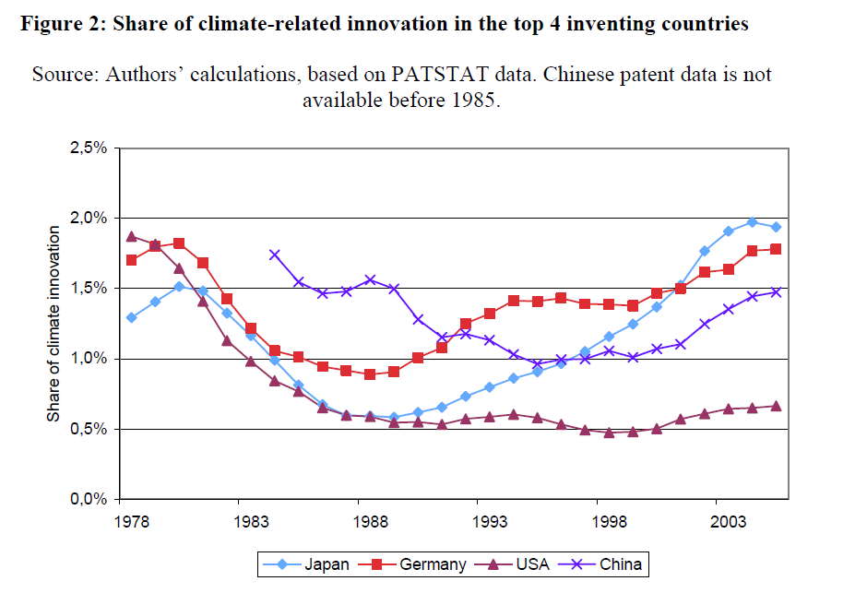

Slide 47
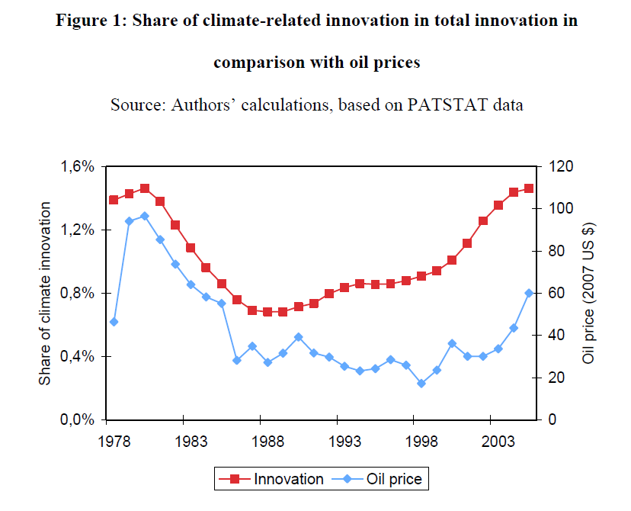
Kyoto?

Slide 48
Innovation studies stress methodological variety

Slide 49

A plea for methodological pluriformity and knowledge integration

Slide 50
Methodological constraints influence findings
Theoretical models of incentives:
limited to incentives for innovation in pollution control and end-of pipe solutions (no other forms of eco-innovation)
factors related to techno-economic context and policy-design issues are not considered
Econometric analysis:
very difficult to incorporate policy design aspects of policies
the majority consider only innovations in pollution control
the majority use inventive activity indicators (patents and environmental R&D) and not innovation output measures
Case studies:
Not possible to determine causal links in a rigorous way
Findings difficult to compare
Findings are highly case-specific
Surveys:
Sensitive to respondees’ knowledge
Sample bias may be an issue
Kemp and Pontoglio, 2011

Slide 51
Creation robust knowledge by combining different methods and types of expertise
Ideally one should employ different research methods. Any analysis is as good as the data or its assumptions. In limiting oneself to one method there is a danger of coming up with partial truths, and make unjustified generalizations.
Before embarking on econometric study it is advisable to speak to industry experts and suppliers about the most important factors behind certain innovations.
Too often scientists seek universal knowledge, whereas in reality the specifics of the situation are all-important for outcomes. Policy impacts depend on the design of the policies and context in which they are used. Working with experts and policymakers helps to learn about relevant contextual factors.
Research should be more concerned to the generation of robust knowledge than it presently is.
Kemp and Pontoglio, 2011 in Ecological Economics

