Slide 1
Command and Control vs taxes
∆

Slide 2
Table 6.2 Classification of pollution control instruments
Instrument category
Institutional approaches to facilitate internalisation of externalities
Command and control instruments
Economic incentive (market-based) instruments

Slide 3
Instrument category | Description
Institutional approaches to facilitate internalisation of externalities
Facilitation of bargaining | Cost of, or impediments to, bargaining are reduced
Specification of liability | Codification of liability for environmental damage
Development of social responsibility | Education and socialisation programmes promoting ‘citizenship’

Slide 4
Instrument category | Description
Command and control instruments
Input controls over quantity and/or mix of inputs | Requirements to use particular inputs, or prohibitions/restrictions on use of others
Technology controls | Requirements to use particular methods or standards
Output quotas or prohibitions | Non-transferable ceilings on product outputs
Emissions licences | Non-transferable ceilings on emission quantities
Location controls (zoning, planning controls, relocation) | Regulations relating to admissible location of activities

Slide 5
Instrument category | Description
Economic incentive (market-based) instruments
Emissions charges/taxes | Direct charges based on quantity and/or quality of a pollutant
User charges/fees/natural resource taxes | Payment for cost of collective services (charges), or for use of a natural resource (fees or resource taxes)
Product charges/taxes | Applied to polluting products
Emissions abatement and resource management subsidies | Financial payments designed to reduce damaging emissions or conserve scarce resources
Marketable (transferable, marketable) emissions permits | Two systems: those based on emissions reduction credits (ERCs) or cap-and-trade
Deposit-refund systems | A fully or partially reimbursable payment incurred at purchase of a product
Non-compliance fees | Payments made by polluters or resource users for non-compliance, usually proportional to damage or to profit gains
Performance bonds | A deposit paid, repayable on achieving compliance
Liability payments | Payments in compensation for damage

Slide 6
Command and Control
Set limit on emission or specify technology
MAX
SMC
PMC
demand
Q ^{M}
Q

Slide 7
Drawback of C+C:
If marginal abatement costs are different for different pollutors, then
C+C will lead to an
inefficient allocation of clean up burden among different producers.

Slide 8
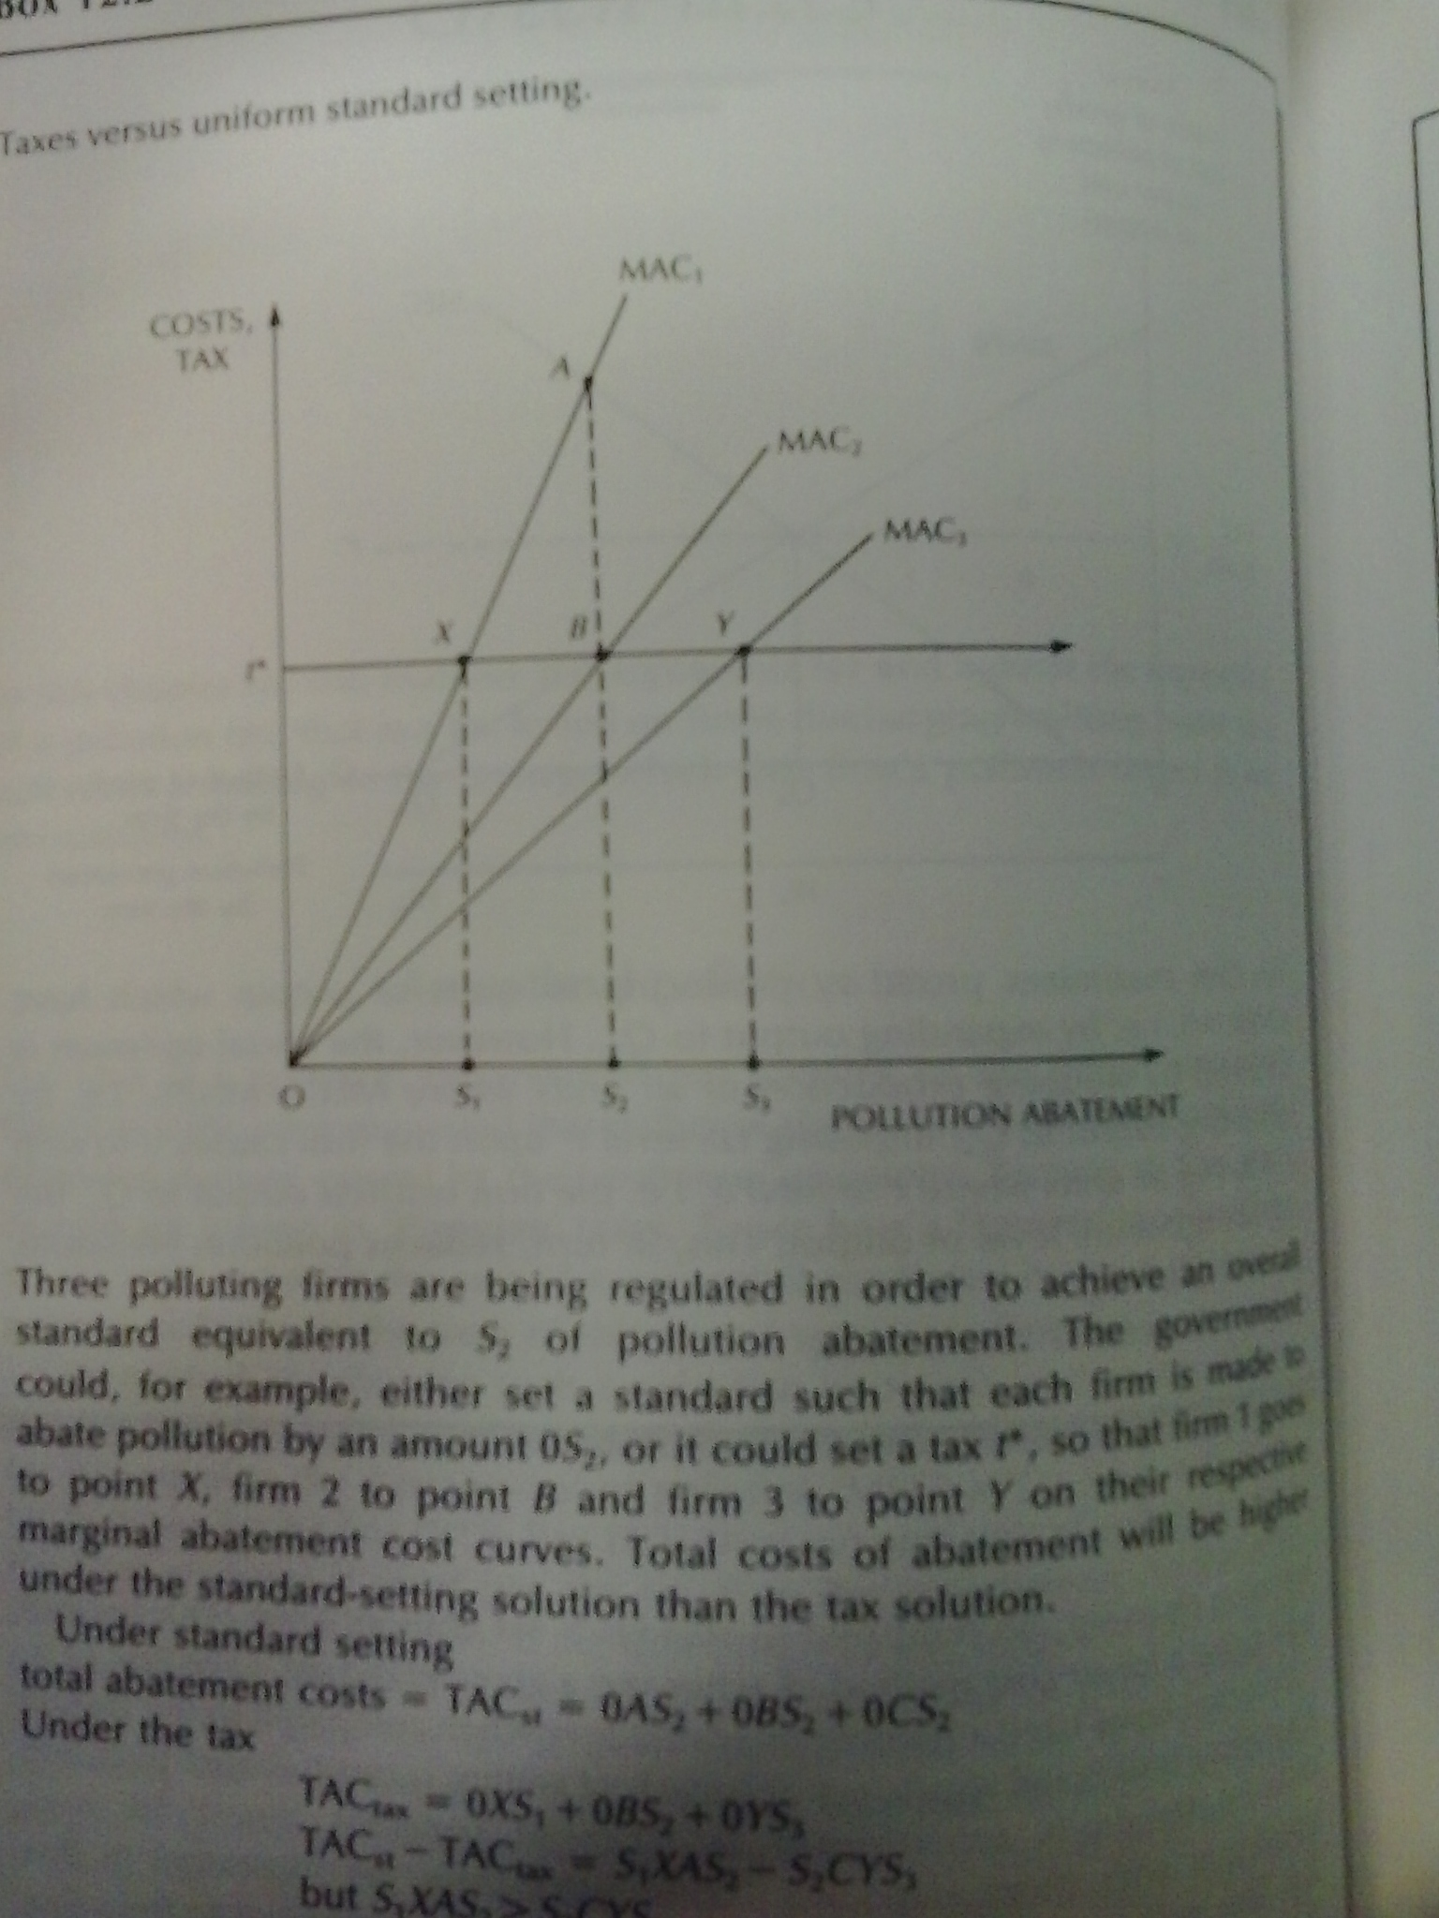

Slide 9
MAC1
Cost, tax
MAC2
a
MAC3
x
b
Option 1 – set a standard such that each firm abate 0S2
Option 2 – apply a tax t
Firms equate t=marginal cost of abatement
t
y
c
0
s1
s2
s3
abatement

Slide 10
MAC1
Cost, tax
MAC2
a
MAC3
x
b
Under standard
Total cost= 0as2+0bs2+0cs2
Under tax
TAC=0xs1+0bs2+0ys3
Difference is
s1Xas2 (saving firm1) – s2cys3 (cost firm3)
t
y
c
0
s1
s2
s3
abatement

Slide 11
MAC1
Cost, tax
MAC2
a
MAC3
x
b
s1Xas2
(saving firm1) > s2cys3
(cost firm3)
t
y
c
0
s1
s2
s3
abatement

Slide 12
Economic instruments are efficient IF agents are heterogeneous regarding marginal cost of abatement

Slide 13
Least-cost theorem of pollution control.
A necessary condition for abatement at least cost is that the marginal cost of abatement be equalised over all abaters.
This result is known as the least-cost theorem of pollution control.

Slide 14
Some important conclusions
A least-cost control regime implies that the marginal cost of abatement is equalised over all firms undertaking pollution control.
A least-cost solution will in general not involve equal abatement effort by all polluters.
Where abatement costs differ, cost efficiency implies that relatively low-cost abaters will undertake most of the total abatement effort, but not usually all of it.

Slide 15
a firm with two establishments
Another example:
Take a firm with two establishments
Is this efficient to set the same target within a firm?
Lets minimise overall costs, we save money for other purposes..

Slide 16
Marg abatement costs
Never equal abatement if firms differ in MAC!
MACa=MACb
A
B
Abatement to be produced

Slide 17
drawback
In some locations/areas we could create Environmental hot spots

Slide 18
.. In the next lecture we will show that CAC can be efficient when the policy maker faces uncertainty on MargAbatCosts….

Slide 19
Optimality conundrum

Slide 20
Nevertheless, we believe that it is possible to design policies for the control of externalities that are reasonably efficient. The approach that we will propose in this and the next chapter consists of the use of a set of standards that serve as targets for environmental quality coupled with fiscal measures and other complementary instruments used as means to attain these standards.
The standards, while admittedly somewhat arbitrary, are, in principle, not unlike the growth or employment goals that have guided governmental macroeconomic policies. In both cases, employment and environmental policy, the approach is, in practice, basically of the “satisficing” variety, with acceptability standards based on individual judgments and, often, compromise. Yet, in both cases, the choice of effectivemeans to achieve the established goals has been facilitated by a substantial body of economic theory. This theory suggests that fiscal measures can contribute to the efficiency of a program to control externalities.

Slide 21
Efficiency without optimality: the charges and standard approach
«The charges or prices would be selected so as to achieve specific acceptability standards rather than attempting to base them on the unknown value of marginal net damages»
«In marked contrast to an attempt of optimisation, should iterative adjustments in tax rates prove desirable in a charges and standard approach… They require no data on costs and damage, only figures on current pollution»
«least cost method for the achievement of these targets»

Slide 22
CH 11 Baumol & Oates – A theory of environmental policy
The validity of the least cost theorem does not require profit maximizer or perfect competition, all that is necessary is that firms minimise cosst or whatever ouput they select
  Invariance wrt market structure
The approach approximate a pigovian outcome
It leads to Political economy issues

Slide 23
Where the charges and standard approach is appropriate
«where there is reason to believe that the existing situation imposes a high level of social costs and that these costs can be significantly reduced by feasible decreases in the level of a certain externality»
Where marginal net damage is decreasing and steep

Slide 24
Acceptability region
Social welfare
Net social benefit
Externality activity

Slide 25
Heterogeneity across firms and least cost theorem
When we face a given Q reduction of pollution, we can rely on cost minimization strategy to efficiently allocate abatement (unequal)
When we dont have knowledge on damages and costs (but only pollution) we can apply the iterative ‘charges and standard approach (efficiency without optimality)

Slide 26
Pearce DW (2005), Energy Economics: The Political economy of an energy tax
Textbook recommendations dont consider the political context
However, great care is needed
  «explaining differences between optimal and actual design of policy measures does not justify them. Normative political economy then has the role of asking whether the various institutional and political constraints really are as limiting as the political economy model might suggest»
  «what is becomes what should be» « This Panglossian analysis needs to be avoided»

