Slide 1
Marketable emissions permits
Marketable permit systems are based on the principle than any increase in emissions must be offset by an equivalent decrease elsewhere.
There is a limit set on the total quantity of emissions allowed, but the regulator does not attempt to determine how that total allowed quantity is allocated among individual sources.

Slide 2
TRADABLE PERMITS
OBJECT: create an artificial price for the use and/or pollution of public environmental goods that can be used for free and have no market
HOW: the regulatory authority initially allocates permits among the polluters (users) of the natural resource on the basis of an ecological indicator (e.g. carrying capacity) of the ecosystem taken into account
Polluters (users) then trade permits among themselves, leading to a market price for the pollution (exploitation) of the natural resource
Market price signals scarcity of the resource and creates incentive to adopt a more environmental friendly technology (in order to avoid the cost of purchasing the permits)

Slide 3
Cap and trade permit systems (for UMP)
A cap-and-trade emission permits scheme for a uniformly mixing pollutant involves:
A total quantity of emissions of some particular type (the ‘cap’) that is to be allowed by a specified class of actual and potential emitters over some period of time.
The creation of a quantity of emissions permits that in sum equal, in units of permitted emissions, the emissions cap (the target level of emissions).
A mechanism by which the total quantity of emission permits is initially allocated between potential polluters.
A rule which states that no firm is allowed to emit pollution (of the designated type) beyond the quantity of emission permits it possesses.
A system whereby actual emissions are monitored and penalties – of sufficient deterrent power – are applied to sources which emit in excess of the quantity of permits they hold.
A guarantee that emission permits can be freely traded between firms at whichever price is agreed for that trade.

Slide 4
The initial allocation of permits and the determination of the equilibrium market price of permits
Two general methods of initial allocation:
Case 1: all permits by auction
Case 2all permits at no charge (grandfathering)

Slide 5
Permit trade
Two firms
Initial pollution is 10 tonnes
8 are allocated (permits) 4 to A 4 to B
MCb
Competitive market price
Permit price
MCa
Though A only needs to cut 1 tonne, it is efficient to cut two and sell one permit

Slide 6
‘Coasian’ kind of bargaining based upon willingness to accept and pay for licences….

Slide 7
Marginal abatement cost (aggregate)
A firm will bid to purchase an additional emissions permit whenever the marginal cost of abating emissions exceeds the permit price. The market equilibrium permit price is determined by the value of the aggregate marginal abatement cost at the level of abatement implied by the total number of issued permits.
Fixed supply of permits
μ*
0
M*
Emissions, M
The determination of the market price of emissions permits
Auctioned permits case
Notes:
Case 1: Auctioned permits
Suppose that the permits are initially allocated through a competitive auction market.
Individual firms submit bids to the EPA. When the received bids are ranked in descending order of bid price, the resulting schedule can be interpreted as a market demand curve for permits.
Assuming that no strategic behaviour takes place in the bidding process, this market demand curve will be identical to the aggregate marginal benefits of emissions. However, as we showed earlier, the marginal benefit of emissions (MB_{M}) function is also interpretable as the mirror image of the marginal cost of abatement (MC_{Z}) function.
Hence, we can also say that the market demand curve will be identical to (a suitably redrawn) aggregate marginal cost of emissions abatement cost curve.

Slide 8
Marketable permit systems and the distribution of income and wealth
In a perfectly functioning marketable permit system the method of initial allocation of permits has no effect on the short-run distribution of emissions between firms.
But it does have significant effects on the distribution of income and wealth between firms.
If the permits are sold by competitive auction, each permit purchased will involve a payment by the acquiring firm to the EPA equal to the equilibrium permit price.
Note that the transfer of income from the business sector to the government when successful bids are paid for is not a real resource cost to the economy.
If the EPA distributes permits at no charge, there is no transfer of income from businesses to government. However, there will be transfers between firms.

Slide 9
Tradable Permits: advantages
Creation of an artificial market
Pricing pollution/consumption natural resources → incentive to technological progress
Minimize abatement costs (incentive to reduce pollution/consumption is higher for the most efficient firms)

Slide 10
Tradable Permits: disadvantages
Price volatility due to scientific uncertainty → market instability and disincentive to invest in new technologies
Low number of agents → low market competition
Entry Barriers: auctions improve it
Allocation criteria

Slide 11
Existing ETS
AIR
  EU ETS – biggest CO2 market
  California
  RGGI (Regional Greenhouse Gas Initiative)
  Australia
  China
  Others (New Zealand, Japan, Taiwan, South Korea, India, Switzerland….)
WATER
  TWPR: Tradable Water Pollution Rights (US, Australia)
  TWAR: Tradable Water Abstraction Rights (US, Australia, Chile, Mexico)

Slide 12
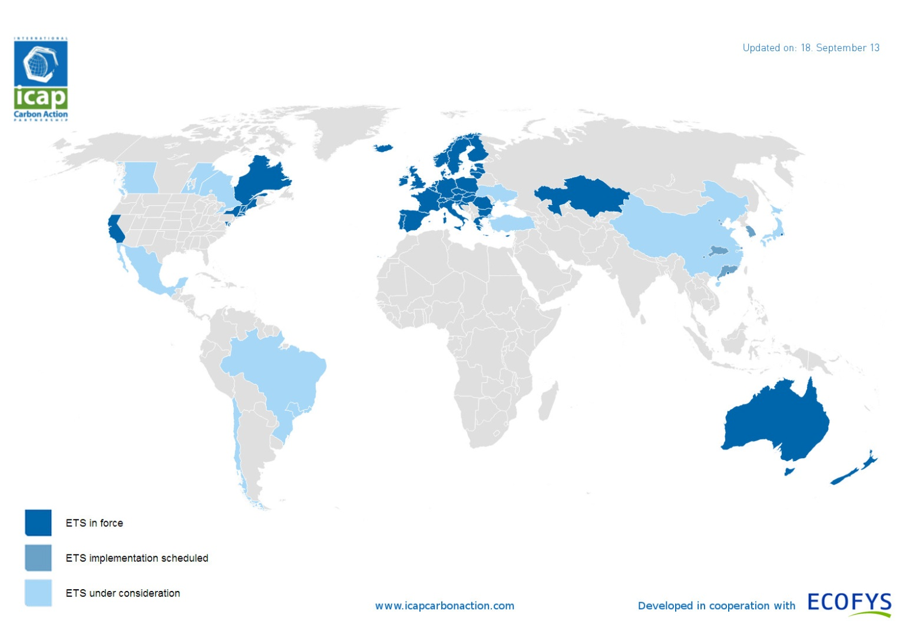
Air Emissions Trading Schemes around the world

Slide 13
The EU-ETS
World’s largest carbon market and first transboundary cap-and-trade system
EU Directives: 2003/87 & 2009/29
Each member estabilishes a national emission scheme to determine the allocation criteria of emission permits (mainly for free) and the share allocated to selected sectors in three trading phases: 2005-’07, 2008-’12, 2013-’20.
Sectors: energy activites (e.g. oil refineries); production and processing of ferrous metals; mineral industry; pulp and paper industry. Extension to further industries (petrochemical, aluminium and ammonia sectors) and gases (nitrous oxide and perfluorocarbons)
Trading of emission permits within the EU.
Penalties (art.16): 40€ (2005-2007) and 100€ (2008-2012) per tonne of CO₂ emitted in excess of allowances at disposal

Slide 14
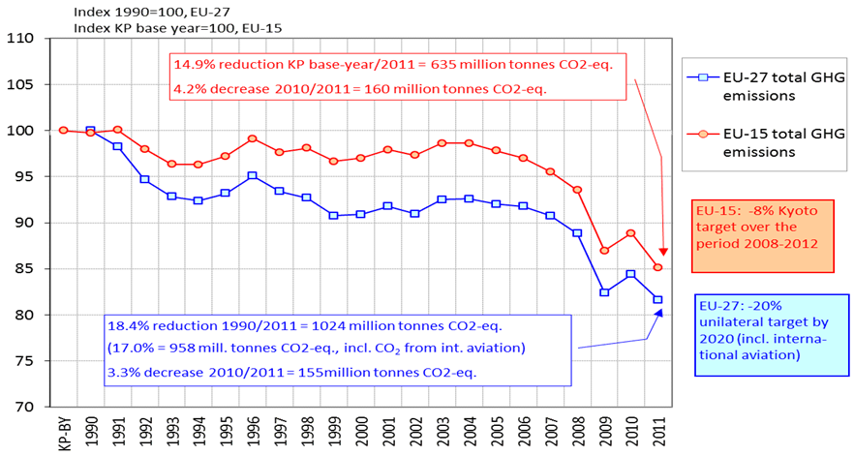
CO2-e emissions trend
during the 1990-2011 period
in EU ETS zone
European Environment Agency, 05/29/2013.

Slide 15
EU-ETS: open issues
Overallocation (recession not anticipated)
Allocation criteria: grandfathering vs auctioning
Monitoring problems: fraudes
Price volatility on the EU-ETS market

Slide 16
1. The “overallocation” issue
Most national allocation plans (NAP) allocated a number of emission permits well above the upper bound for each member state by the Kyoto Protocol during both 1st phase (2005-’07) and 2nd phase (2008-’12) (Gilbert et al., 2004; Sijm, 2005)
Causes:
  political pressures from interest groups
  strong uncertainty on the actual emissions level
Effect: sharp fall in the spot price of the emissions permits during 1st period
→ revision proposal: unique EU emission permits ceiling (rather than 27 national ceilings) that decreases every year during the third trading phase (2013-2020)

Slide 17
2. Allocation criteria: grandfathering vs. auctioning
Tradable permits generally allocated according to historical emission levels (grandfathering)
Grandfathering tends to preserve status quo (reduces incentive to technological progress)
Grandfathering may create potential disparities in the permits market between large firms (that receive many initial permits to maintain their activity level) and small-medium enterprises
PROPOSAL: Higher share of emissions allocated through auctions rather than grandfathering; harmonization of allocation rules when permits given for free.
ADVANTAGES: increase authority’s financial entries that can be used for environmental purposes (double dividend)

Slide 18
3. Monitoring capacity of the ETS
On January 19, 2011 a market participant, Blackstone Global Ventures, said 475,000 carbon permits (about 7 million euros) had vanished from its account in the Czech Republic.
1.6 million carbon permits went missing from the Romanian registry account of cement-maker Holcim in November 2010.
On January 19, the European Commission suspended spot trades (75% of the ETS market) until January 26, following the suspected theft from the Czech Republic's carbon registry. The Czech Republic, Greece, Estonia, Poland and Austria closed their carbon trading registries.
This theft and a hacking attack on the Austrian registry on 10 January follows a raft of scandals in the market in the past two years e.g. the Value-Added Tax (VAT) fraud: permits imported into a country VAT-free and sold on in that country with VAT charged. Afterwards the importer disappears instead of paying VAT to the governent (Euractive, 2011)
→ new anti-fraud measures, approved by the European Council's climate change committee on February 17, 2011

Slide 19
4. EU-ETS: market price volatility
Price of carbon permits tripled in the period January-July 2005, then more than halved in April 2006 (cf. The Economist, 2006)
  EU ETS: carbon price more than halved in a few months (from above 27 €/tonne in June 2008 to 13.25 €/tonne as of 15 January 2009);
  extreme volatility in December 2009 (+3% ahead of COP-15, then -8.7% immediately after Copenhagen)
  → crucial role of expectations and credibility
Effects: uncertainty discourage investments in environmental friendly technologies

Slide 20
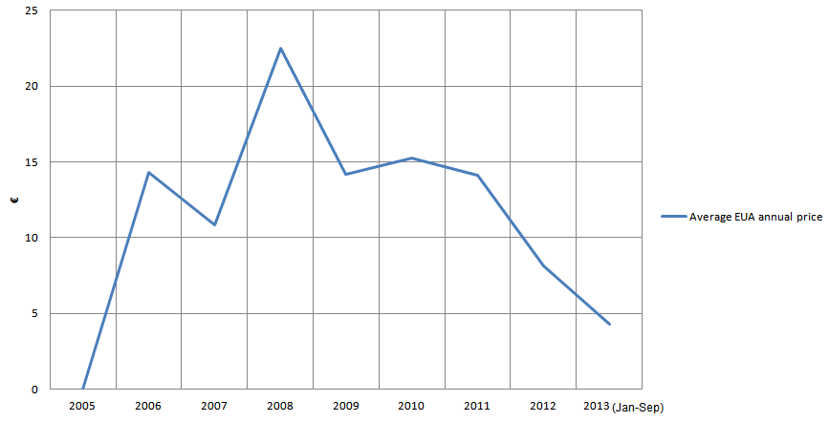
EU ETS allowance (EUA) price trend
during the 2005-2013 period:
roller coaster or collapse?
Notes:
Latest EUA price (09 30 2013) 4,47 € (European Energy Exchanges
https://www.eex.com/en/Download/Market-Data/EU%20Emission%20Allowances%20-%20EEX
Latest EUA Point Carbon 01/10/2013 5.12€/tCO2

Slide 21
EU vs Rest of the World: price volatility at a glimpse

Slide 22
Rescuing the EU-ETS: recent reform proposals
Carbon price has collapsed due to overallocation of free permits, recession
“Backloading” proposal by the European parliament environment committee: to restrict over-supply of permits and raise carbon price, some allocations of permits by member states would be held back from auction and auctions postponed for several years.

Slide 23
5. EU-ETS: the penalty system
Art.16: if an operator emits more than allowed by the permits at disposal, it will be liable to pay the penalty
Fees: F=40€ (1st phase: 2005-2007) and F=100€ (2nd phase: 2008-2012) per tonne of CO2 emitted in excess of the allowances at disposal.
In addition the operator has to purchase the excess emissions “when surrendering allowances in relation to the following calendar year”.
→ the price that the non-compliant firm has to pay for its excess emissions is given by the market price when the purchase is made.
market price volatility + possible limitations in the monitoring system → moral hazard behaviours among the operators.

Slide 24
Policies to tackle externalities
comparison
 |  | effectiveness | Economic efficiency | Dynamic efficiency
Non-mkt | standard | + | – | –
Mkt (tax) | Pigou tax | ? | + | ?
 | subsidy | – | Yes, but… | ?
Mkt | trading | + | + | ?
Key (empirical) issue

Slide 25
Water tradable pollution rights: applications

Slide 26
Water tradable abstraction rights: applications
Water Basin or State | Application period | Principal Purchasers | Economic/environmental results
California, Idaho, Montana, Oregon, Washington, Arizona, Nevada, New Mexico, Colorado | Various start dates | Federal agents, private firms, environmental groups | Increase of flow in the main rivers Wide variability in the water price across States Numerous transfers, particularly in California
Upper Snake River (Idaho) | 1980- | Federal agencies Idaho Electric Company | Increased river flow Ambiguous results on the protection of salmon in the rivers
The Murray-Darling Basin (Australia) | 1989- | Main city representatives Single farmers | Significant success in the number of transfers (2 computerized centers created). Temporary transfers, mainly limited to the agricultural sector
Chile | 1979- | Single farmers | Contradictory opinions in the literature: economic growth but less transactions than expected
Mexico | 1992- | Single farmers and water management associations | Limited number of transactions High variability between the districts for the quantity of water used and transferred
Southern Asia (Pakistan, India, Yemen, Jordan, Palestinian territory) | Informal or illegal markets | Small farmers Private Water companies | Depletion of the water resource High prices due to the monopolistic character of the market

Slide 27
References
Ellerman, A. Denny. 2010. “The EU's Emissions Trading Scheme: A Proto-type Global System?” In Post-Kyoto International Climate Policy, edited by Joe Aldy and Robert N. Stavins, 88-118. Cambridge: Cambridge University Press.
  http://globalchange.mit.edu/files/document/MITJPSPGC_Rpt170.pdf
Borghesi S. (2011) “The European emission trading scheme and renewable energy policies: credible targets for incredible results?”, International Journal Sustainable Economy, vol.3, n.3, pp.312-327. http://www.feem.it/userfiles/attach/201010291656484NDL2010-141.pdf
Borghesi S., (2013), “Water tradable permits: a review of theoretical and case studies”, Journal of Environmental Planning and Management, pp.1-28, forthcoming. http://www.tandfonline.com/doi/full/10.1080/09640568.2013.820175#.UlLAAetH4W4
Jotzo F., de Boer D., Kater H.. 2013. “China Carbon Pricing Survey 2013” China Carbon Forum.

