Slide 1
Sustainability perspectives: technology, trade and policy
Lecture 1 and L4

Slide 2
Issues
Sustainability perspectives
  Capital based view
  Efficiency view
  Sustainable consumption and production
Ecological tax reforms
Prof. Mazzanti – mzzmsm@unife.it

Slide 3
Sustainability
Development and capital accumulation
Decoupling from economic growth and resource efficiency
(dynamic) Resilience
Sustainable consumption and production
Economics, Ethics, Technology, Policy…

Slide 4
Social and environmental Policy targets
EU 2030 targets for climate change: 40% cut in CO₂ emissions with respect to 1990.
  EU 2050 targets: 90% cut with respect to 1990
Waste framework Directive
  Waste reduction. Not only recycling!
R&D 3% of GDP
… + Unemployment (by gender, age..)!
Those are some key sustainability socio Economic targets

Slide 5
Sustainable society is an ‘investing society’
Capital based economic view

Slide 6
Capital shares at different income levels
human
natural
Man made

Slide 7

The key role of Human capital for development
Intrinsic trade off to manage
  How to invest the income we get out of Natural resources to create human capital and knowledge

Slide 8
Holland vs Kenya capital stocks shares of wealth
Holland
  78% Human capital + institutions
    Of which 36% schooling; 57% institutions, property rights
  3% natural capital (of which 57% land)
  19% produced man made capital
Kenya
  46% natural capital (1/2 crops)
  13% man made
  42% intangible including human capital

Slide 9
Ghana – decomposition of genuine saving (2000)
SD → What matters is to accumulate an increasing stock of total capital forms

Slide 10
At the end of the day, we are sustainable if we transfer to the next generation a unit more of tangible and intangible capital
Capital derives from investments
GDP = Consumption + Investments

Slide 11
Savings and accumulation
Y = C + I
I = S = ∆K saving and accumulation (both Keynesian Harrod Domar and Solow Model)
∆Kt = K_{t} – K_{t-1}
Sustainability rule
Total capital t+1 ≥ Total capital T, thus
∆K >0 for any t
Given that K is associated with an intrinsic depreciation rate α
∆K >0 if I=S > α

Slide 12
α
Constrains and defined whether an economy is sustainable
α
Makes necessary a given flow of I, which defines the maximum C generation T can experience
Weak Sustainability – the rule is applied on TOTAL CAPITAL
Strong Sustainability – Rule eventually applied to critical NATURAL capital (no substitution after a threshold e.g. Amazon forest, species stock….)

Slide 13
Sustainable society is an ‘investing society’
Investments moves societies into the future….often difficult given social myopia (Tiranny of the present)

Slide 14
World Bank (data)
http://www.worldbank.org/en/news/feature/2013/06/05/accurate-pulse-sustainability

Slide 15
Efficiency view (efficient growth)

Slide 16
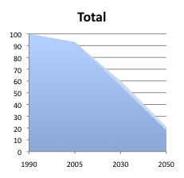
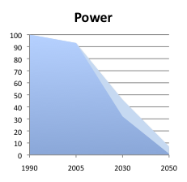
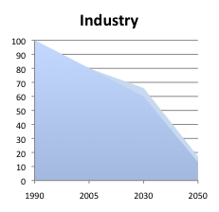
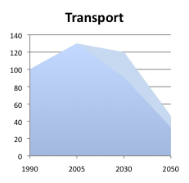
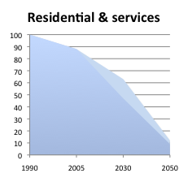
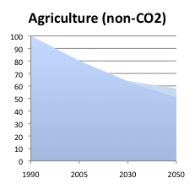
low-carbon economy requires a radical transformation…2050 EU targets…
- 78-82%
- 93-99%
83-87%
- 42-49%
- 54-67%
- 88-91%
Source: Roadmap Impact Assessment SEC(2011) 288

Slide 17
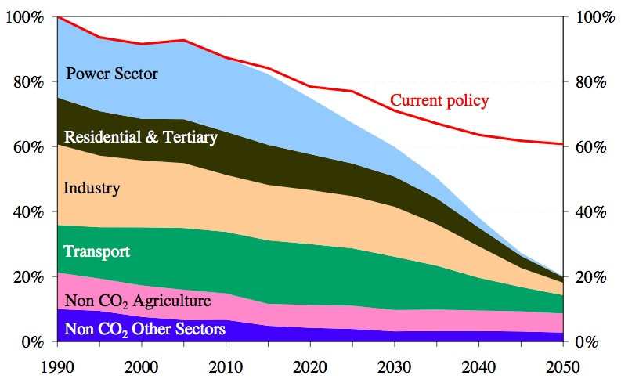
… but current policies are not equipped to deliver this transformation
Source: “A Roadmap for moving to a competitive low carbon economy in 2050” COM(2011)112

Slide 18
MSW generation and landfilling in the EU-27
Note: Figures from 1980-2004 are data from Eurostat.
Figures from 2005-2020 are projections. BMW = biodegradable municipal waste.
Source: EEA (2007).

Slide 19
We do need strong tech and behavioral driven efficiency to reduce waste and Co2

Slide 20
Efficiency was not enough.. CO2 still increasing worldwide…
More efficient… but Growth scale effect dominates

Slide 21
IPAT framework
In the IPAT Identity, technological progress T is the factor, which compensates for population P and affluence A (scale) effects on I (environmental impact).
I= POP*A/POP*I/A=I
I/A =Tech

Slide 22
STIRPAT
Stochastic IPAT to be econometrically estimated
Marin, G. & Mazzanti, M., 2013. The evolution of environmental and labor productivity dynamics. Journal of Evolutionary Economics, 23(2), pp.357–399.
Martinez-Zarzoso, I., Bengochea-Morancho, A. & Morales Lage, R., 2007. The Impact of Population on CO2 Emissions: Evidence from European Countries. Environmental and Resource Economics, 38, pp.497–512.

Slide 23
Italian industry emissions

Slide 24
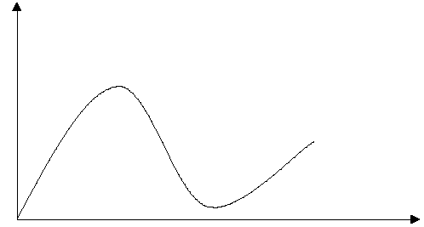
Delinking and Kuznets curves
(specific lecture 13!)
Turning point
Policy effect?
Environmental pressure
Absolute delinking
Re-coupling (not relevant for waste)
Relative delinking
(if any)
Economic drivers

Slide 25
North America and Oceania, CO2 trends
Notes:
25

Slide 26
EU south – CO2 trends
Mazzanti & Musolesi 2014, Studies in non linear dynamic and econometrics
Notes:
26

Slide 27
EU North - CO2 trends
Oil shocks? Policies?
Growth period
Notes:
27

Slide 28
Figure 1 – CO₂ emissions by income level (World Bank categories)
Figure 2 - CO₂ emissions by technology classes (UNIDO categories)
Mazzanti et al. UNIDO Report, forth.

Slide 29
Figure 5 – Environmental productivity (VA/CO2) by technology classes (UNIDO categories)
Figure 6 - Environmental productivity (VA/CO2) by income level (World Bank categories)

Slide 30
Technology and policy
Policy → (green) technological development

Slide 31
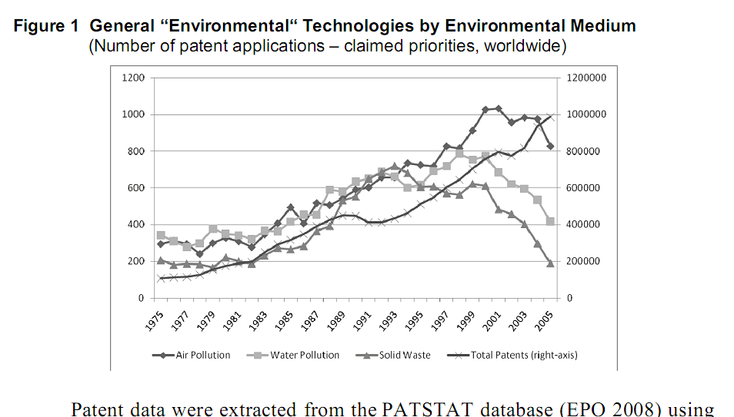
Grafico waste da oecd

Slide 32
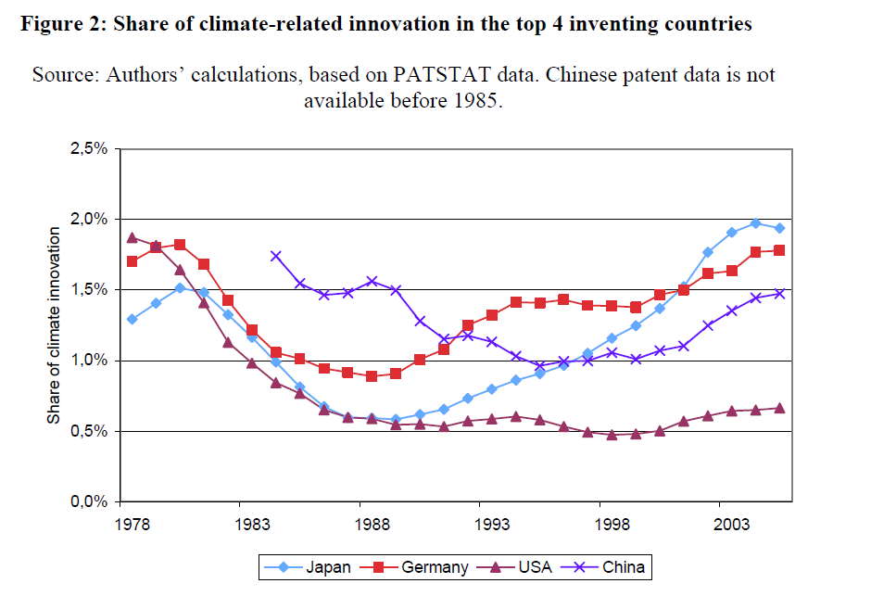

Slide 33
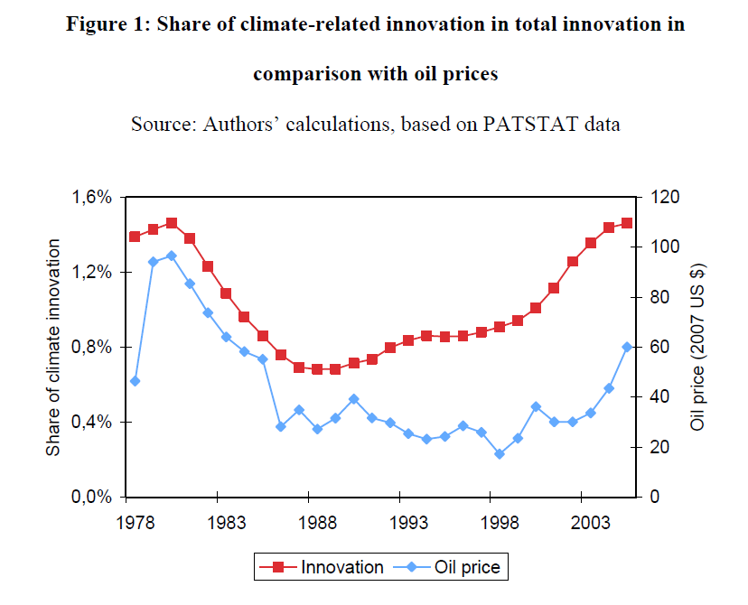
Kyoto?

Slide 34
A key Policy: environmental taxes (Polluter pays principle)
Carbon taxes, landfill and emission taxes, resource taxes..
! 0.1% of GDP!
1992 Delors white Book (chapter on Ecological tax reforms)!
25-30B€ potential revenue to be used to fund public goods, cut labor taxes, etc..

Slide 35
EU North - CO2 trends
Growth period
Notes:
35

Slide 36
But…
Some emissions of the EU might be ‘exported’
Delocalisation of production
‘natural’ fact of economic development

Slide 37

Economic, ethics and policy meets
Who’s responsible for the emissions?
Sustainable Consumption and Production Issue

Slide 38
Marin, G., Mazzanti, M. & Montini, A., 2012. Linking NAMEA and Input output for “consumption vs. production perspective” analyses. Evidence on emission efficiency and aggregation biases using the Italian and Spanish environmental accounts. Ecological Economics, 74, pp.71–84.

Slide 39
A North ‘versus’ South approach does not help
Sharing responsibility
Sharing knowledge (autarchy is not a solution)
Taking into account that countries are on different development stages

Slide 40
Resilience

Slide 41
The green economy targets are shocks..
… additional to the 2009 economic downturn…
Firms and institutions may proactively react..leader and laggards.. One risk along the eventual sustainable transition is to increase gaps
  Across sectors, regions, states….
  Economic, innovation and environmental differences
  We ve to manage the transition and tackle divergences, ‘natural’ but problematic if irreversible and not temporary

Slide 42
Are EU countries diverging?

Slide 43
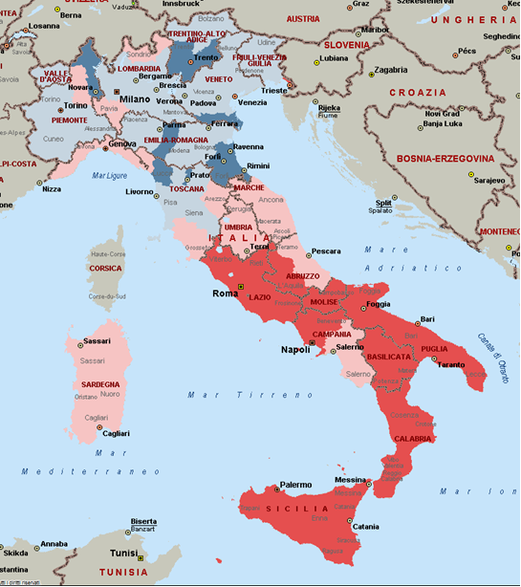
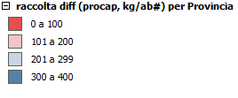
Recycling per capita (kg, 2008)
(Irreversible) divergences?
Hot spots…

Slide 44
Ecological tax reforms as policy shocks to spur Sustainability and growth by innovation
Ecological tax reforms

Slide 45
Co2 trends and TIME RELATED EVENTS EU south

Slide 46
North america and Oceania
Mazzanti & Musolesi FEEM paper 2010

Slide 47
Co2 trends, EU North
ETR? In Scandinavia, UK, Holland..
After 1995, env policy in the EU did not hamper exports, often there is a + correlation… Costantini & Mazzanti, 2011, Research Policy

Slide 48
Ecological tax reforms ETR
Shift fiscal burden from labour to ‘things’ and assets
Carbon tax and other taxes may generate 2-3% GDP in revenue
  Andersen et al. (EEA) Estimate overall 35 billions in Italy (event on ETR next week at the Treasury!)
(false) problems
  Inflationary?
  Regressive? (VAT..)
  Reduce competitiveness….

Slide 49
Energy intensity
GHG

Slide 50
GERD total

Slide 51
Two options
Labour oriented reycling
  Increase labor demand of unskilled and young through cuts.
  Not a long run growth fact
Innovation oriented reycling.
  Energy efficiency stimulus
  Through creation of trusts and funds that finance innovation
    General technological innovation (recyling on the basis of energy use..) or ex ante defining the type (tender on specific issues)?

Slide 52
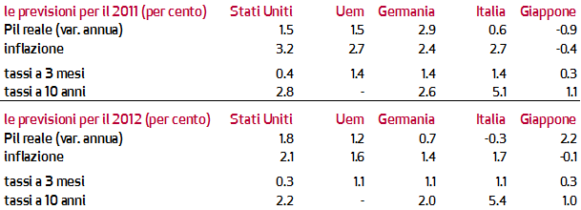
Very Low inflation , stagnation, high unemployement
A paradise for ETR implementation !
Fiscal stimulus is needed!!
!!!!!

Slide 53
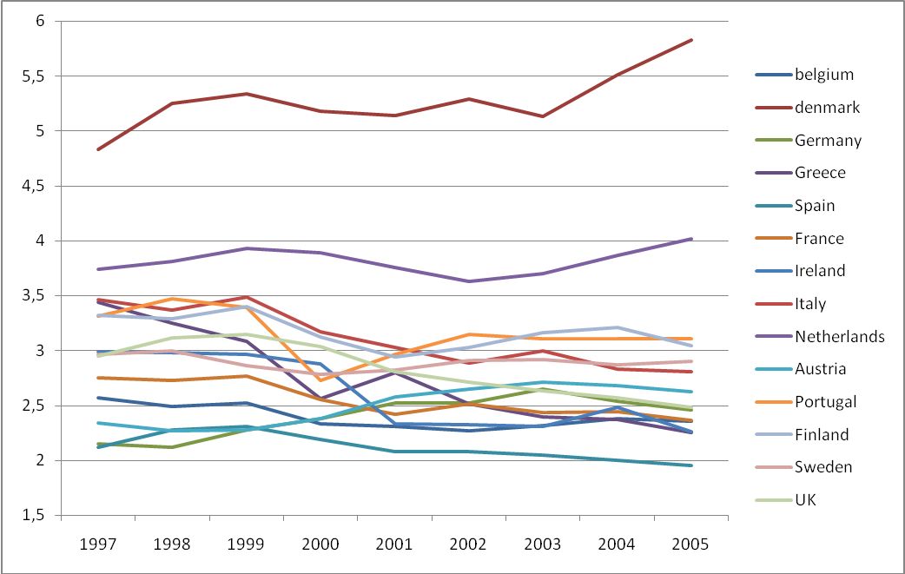
Total environmental and energy taxes (% GDP); source: Eurostat

Slide 54
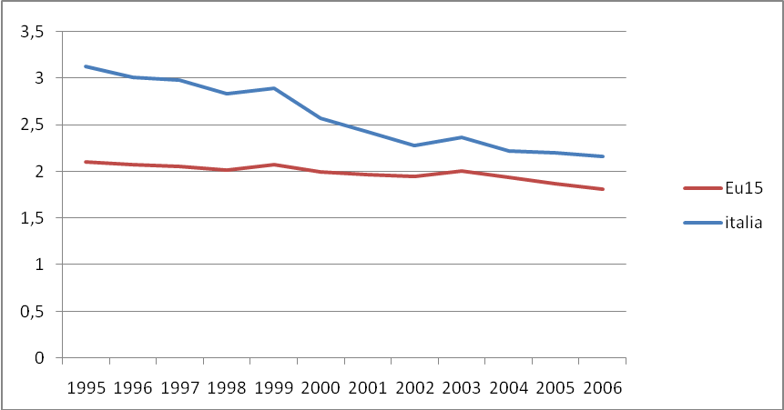
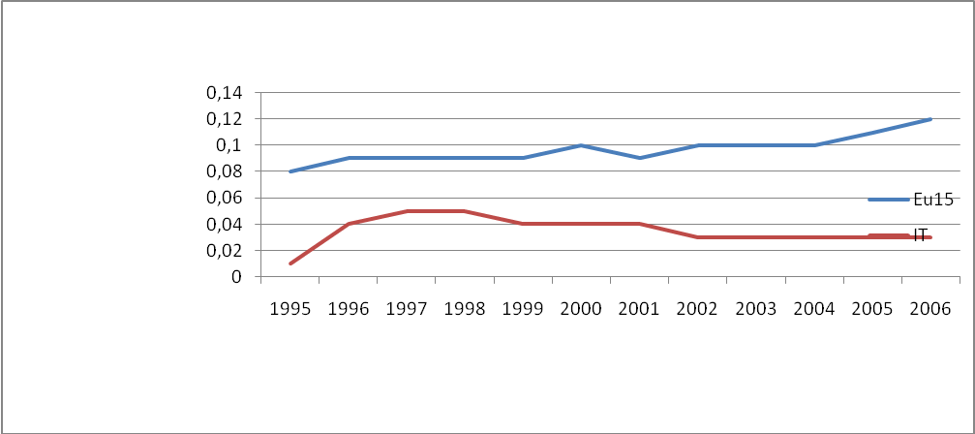
Share of GDP, total Energy taxes
Share of GDP, environmental & resource taxes

Slide 55
ETR: national and decentralised levels
  National levels of taxation (Sox, Co2 taxes on non ETS sectors, ETS auctioning)
  Regional and local levels
    Landfill taxes, PM taxes, water resource taxes, other resource taxes on minerals, aggregates…
    They could abate IRAP, the ‘hated’ regional tax on economic activity, around 30 billions
    Issue of ‘Resource taxation reform’ RTR

Slide 56
Environmental externalities still at the heart of ETR rationale
Muller, Mendelshon, Nordhaus (2011), Environmental Accounting for Pollution in the US economy, AER, 1649-75.
Definition of gross and net external damages
Gross external damage of US economy 182 billions $
Net external damage (GED – regulation costs, tax payments)
Transport, energy, agriculture, much more pollution intensive than manufacturing (very low in E/VA: 0.01 vs 0.1 transport)
Transport and manufacturing both account 10% of total
Intuitive figure for Italy: 20-25 Billions €.

Slide 57
EEA report 2011 on air pollution costs in the EU
‘Revealing the costs of air pollution from industrial facilities in Europe’
10000 facilities generate between 102-169 billions € of damages (health and environment)
50% caused by 191 sites out of 10000 (easier policy making)
www.eea.europa.eu

